Slide 1

Paper Reading
CS 2001: Research Topics in Computer Science
Fall 2019
School of Computing and Information
Department of Computer Science

Slide 2
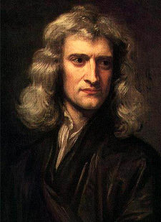
Research papers are the lifeblood of science
If I have seen further it is by standing on the shoulders of giants.
—Isaac Newton, 1676
Notes:
Note to Robert Hooke

Slide 3
Today, we’ll cover
Typical paper structure
How to read
  Structuring your reading session
  What to look for
  Comprehension strategies
Filling in gaps in your knowledge

Slide 4
Papers in computer science often follow a somewhat predictable format
Abstract
Introduction
Related work*
Proposed design/system/method
Evaluation
Discussion
Related work*
Conclusions & Future work
References
Content:
  Very short (~250 words)
  Brief description of purpose
  Highlight main results
Purpose:
  “Hook” the reader
    Why is this paper interesting?
    Why should I spend my time reading this?
    What do you claim to do?
  Set the stage for the paper
Purpose:
  “Hook” the reader
    Why is this paper interesting?
    Why should I spend my time reading this?
    What do you claim to do?
  Set the stage for the paper

Slide 5
Papers in computer science often follow a somewhat predictable format
Content:
  Usually 1-1.5 pages
  Main elements
    What is the problem?
    Why is the state of the art insufficient?
    Overview of the solution
    Novel contributions of the work?
    How is impact evaluated?
  Balance content and conciseness!
Purpose:
  Motivate the work
  Inform the reader of what is to come
  Many reviewers will make their initial decisions after reading only the intro!
Abstract
Introduction
Related work*
Proposed design/system/method
Evaluation
Discussion
Related work*
Conclusions & Future work
References

Slide 6
Papers in computer science often follow a somewhat predictable format
Content:
  Overview of past research/results
  Comparison to claimed contributions
  Not a book report!
Purpose:
  Motivate the work (How?)
  Inform the reader that you are aware of prior results
  Clearly demonstrate the novelty in your approach
Abstract
Introduction
Related work*
Proposed design/system/method
Evaluation
Discussion
Related work*
Conclusions & Future work
References
Note: Related work may occur at the beginning or end of a paper
  Beginning: Prior work is necessary for understanding this paper
  End: Prior work is only tangentially related

Slide 7
Papers in computer science often follow a somewhat predictable format
Content:
  Maybe more than one section…
    Requirements, Design
    Syntax, Semantics, Enforcement
    Design, Implementation
    …
  This is the novel content of a paper
Purpose:
  Proposal of original idea(s)
  This is the authors’ contribution!
  Should be detailed enough for others to replicate the work (in theory)
Abstract
Introduction
Related work*
Proposed design/system/method
Evaluation
Discussion
Related work*
Conclusions & Future work
References

Slide 8
Papers in computer science often follow a somewhat predictable format
Content:
  Could be any number of things
    Performance measurements
    Simulation results
    Analysis of user study data
    Formal proofs
    …
Purpose: “Prove” that the stated contributions are meaningful
Abstract
Introduction
Related work*
Proposed design/system/method
Evaluation
Discussion
Related work*
Conclusions & Future work
References
Note: A incomplete/incorrect evaluation can kill an otherwise good paper!

Slide 9
Papers in computer science often follow a somewhat predictable format
Content:
  Not all papers have this
  If included, typically contains
    An interpretation of results/evaluation
    Discussion of open problems
    Description of limitations
Purpose:
  Papers do not often “close” a topic
  This is where you reflect on what has been done, and what is still open
Abstract
Introduction
Related work*
Proposed design/system/method
Evaluation
Discussion
Related work*
Conclusions & Future work
References

Slide 10
Papers in computer science often follow a somewhat predictable format
Abstract
Introduction
Related work*
Proposed design/system/method
Evaluation
Discussion
Related work*
Conclusions & Future work
References
Content:
  Far too often: Rehash of the paper
  Ideally: Reflection on contributions
Purpose:
  One last summary of contributions given the whole context of the work
  Identification of promising future research directions

Slide 11

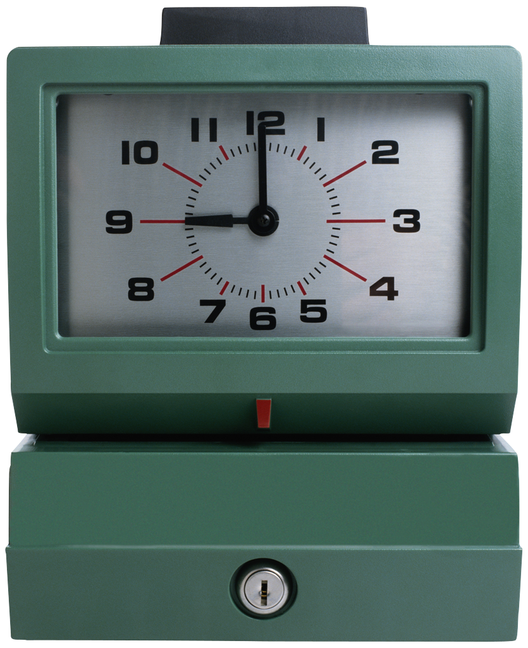

Preparing to read
Reading a research paper is different than other reading!
  10 pages of news: < 10 minutes
  10 pages of fiction: < 20 minutes
  10 pages in a textbook: < 30 minutes
  10 page research paper: 20 minutes – several hours!
Prior to reading, make sure you gather the appropriate supplies
Quiet Environment
Appropriate Time
(How much?)
Note-Taking Supplies (?!)

Slide 12
Why are you planning to read that paper?
There are many legitimate reasons for reading a paper
  I heard someone talking about this result
  The conference talk interested me
  It’s related to a problem I am working on
  My advisor told me to
  This provides context for another problem
  I think that I might want to explore this area
  …
Take-away point: Why you plan to read a paper will—to some degree—dictate how you should go about reading it
Curiosity
Depth
Breadth

Slide 13
A multi-pass approach to reading is generally good
Keshav* has a nice paper on a three-pass reading approach
Pass 1: Basic comprehension
  What is the main topic of the paper?
  What are the authors’ claimed contributions?
  What do they cite?
Pass 2: First look at real details
  Focus on details: evaluation, figures, methods
  Ignore proofs
Pass 3: Depth!
  Fully understand all details
Curiosity
Depth
Breadth
* S. Keshav, “How to Read a Paper,” ACM SIGCOMM Computer Communication Review 37(3) : 83-84, July 2007.

Slide 14
Your first pass over the paper should help you decide how much time you need to invest in it
Focus your attention on:
  Title and Abstract
  Full details of the Introduction
  Section and Sub-Section headings in the body
  Full details in the Conclusion
  Skim references, note what you’ve read
After this, you should know about the “5 Cs”
  Category: Experimental paper? Theory? Measurement?
  Context: What does this paper cite?
  Correctness: Do any assumptions seem reasonable?
  Contributions: What do the authors (claim) to contribute?
  Clarity: Can you follow the paper?
You can probably accomplish this for most papers in ~10 minutes

Slide 15
Audience Participation!
  John Kubiatowicz, David Bindel, Yan Chen, Steven E. Czerwinski, Patrick R. Eaton, Dennis Geels, Ramakrishna Gummadi, Sean C. Rhea, Hakim Weatherspoon, Westley Weimer, Chris Wells, Ben Y. Zhao: OceanStore: An Architecture for Global-Scale Persistent Storage. ASPLOS 2000: 190-201
Let’s talk a little bit…
  Category: Experimental paper? Theory? Measurement?
  Context: What does this paper cite?
  Correctness: Do any assumptions seem reasonable?
  Contributions: What do the authors (claim) to contribute?
  Clarity: Can you follow the paper?
Notes:
Take 10-15 minutes, read paper. Answer 5 Cs.

Slide 16
The second pass over a paper is all about breadth of knowledge
General idea: Read the whole paper, but skip super-intricate details like proofs.
Focus on:
  Understanding methodology, evaluation, figures, etc.
  Mark relevant references for later reading (more breadth!)
  Being able to explain the main ideas of the paper to someone else
This process can take up to an hour for a standard 10-page paper
Why so long?
  Perhaps you’re new to the subject area
  Authors use methodologies or techniques that are unfamiliar
  Paper is just badly written…

Slide 17
After breadth reading, you should be able to answer many questions about a paper
Important questions include:
  What are the motivations for this work?
  What is the proposed solution? Is it novel?
  How is this solution evaluated?
  What do you think about the problem, solution, and evaluation?
  What are the contributions of this work?
  What does this paper close an area of research? Open a new one? Lead to interesting future work?
  What questions do you still have?
Griswold has a nice template for answering these questions. I’ve linked to it on the course page.

Slide 18
Audience Participation!
Adi Shamir, “How to Share a Secret,” Communications of the ACM 22(11) : 612-613, November 1979.
Let’s talk a little bit…
  What are the motivations for this work?
  What is the proposed solution? Is it novel?
  How is this solution evaluated?
  What do you think about the problem, solution, and evaluation?
  What are the contributions of this work?
  Does this paper close an area of research? Open a new one? Lead to interesting future work?
  What questions do you still have?
Notes:
Take 10-15 minutes, read paper. Answer 5 Cs.

Slide 19
Your third pass over a paper should focus on developing an intricate understanding of the subject matter
Main focus: Everything you’ve glossed over so far
  Thorough scrutiny of assumptions
  What alternative solutions might have been possible?
  Does the evaluation cover enough meaningful cases?
  Detailed examination of proofs and proof techniques
After a thorough pass, you should (ideally) be able to replicate the results presented in the paper
This is a time-intensive process
  4-5 hours for beginners
  Around an hour for more experienced readers

Slide 20
Note-taking can help build your understanding of a paper and manage the many papers that you’ll eventually read
Note taking while you read helps capture the context of your reading session for later reference
Use a highlighter to mark major points, definitions, and theorems for quick reference later
Make notes in the margin
  Write down questions as they pop into your head
  Answer previous questions as you find answers
  Summarize tables, graphs, etc.
  Add details to incomplete/unclear examples

Slide 21
Note-taking can help build your understanding of a paper and manage the many papers that you’ll eventually read
Note taking after you read can help
  Ensure complete understanding of relevant papers
  Manage large collections of papers as your progress in your studies
Consider making a document per research area
For each paper, write up:
  A technical summary of the work
  A brief description of the paper’s relation to other works
  Relationships to your ongoing/planned research
  Any cool ideas for future work that come to mind
A few examples…
Notes:
Examples: Exposure reading list, my PhD stuff
https://docs.google.com/document/d/1ANuDUX3t9cXInv8wSK_LNfQz0FIOMDB5Tu1VO_OIGVg/edit?hl=en_US

Slide 22
Filling in the gaps…
Initially, you will have an incomplete knowledge of a research area. How can you fix this problem?
Step 1: Read up on prior work!
Step 2: Understand how this paper fits into more recent research
There are research tools to help aid these processes
  ACM portal: http://portal.acm.org
  IEEEXplore: http://ieeexplore.ieee.org/Xplore
  Google scholar: http://scholar.google.com
  Citeseer: http://citeseerx.ist.psu.edu/

Slide 23
Let’s do a little tracing…
Notes:
Trace oceanstore paper

Slide 24
Conclusions
Paper reading is an essential skill for PhD students (and researchers in general!)
At first, this is a slow process, but gets easier with practice
Multi-pass reading can help aid comprehension
  Pass 1: Overview
  Pass 2: General understanding, expand breadth of knowledge
  Pass 3: Details, details, details
Next time: Writing paper reviews

