Slide 1
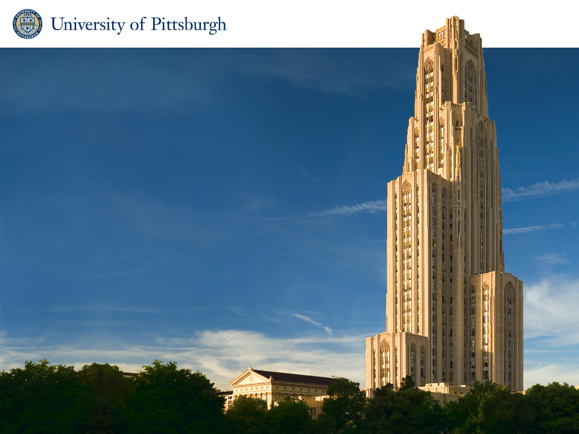
Introduction
CS 2001: Research Topics in Computer Science
Fall 2019
Dietrich School of Arts of and Sciences
Department of Computer Science

Slide 2
Administrivia
Research Topics in Computer Science
CS 2001
Monday/Tuesday 1:00 – 2:15PM, F ? - ? (rarely)
6516 Sennott Square
Instructor
Professor Taieb Znati
znati@cs.pitt.edu
6137 Sennott Square
Office Hours: If my door is open
Email me your Friday schedules so that we can pick a reserved make-up time
http://www.cs.pitt.edu/~znati/courses/cs2001
Notes:
Introduce self, research, informal/discussion nature of course

Slide 3



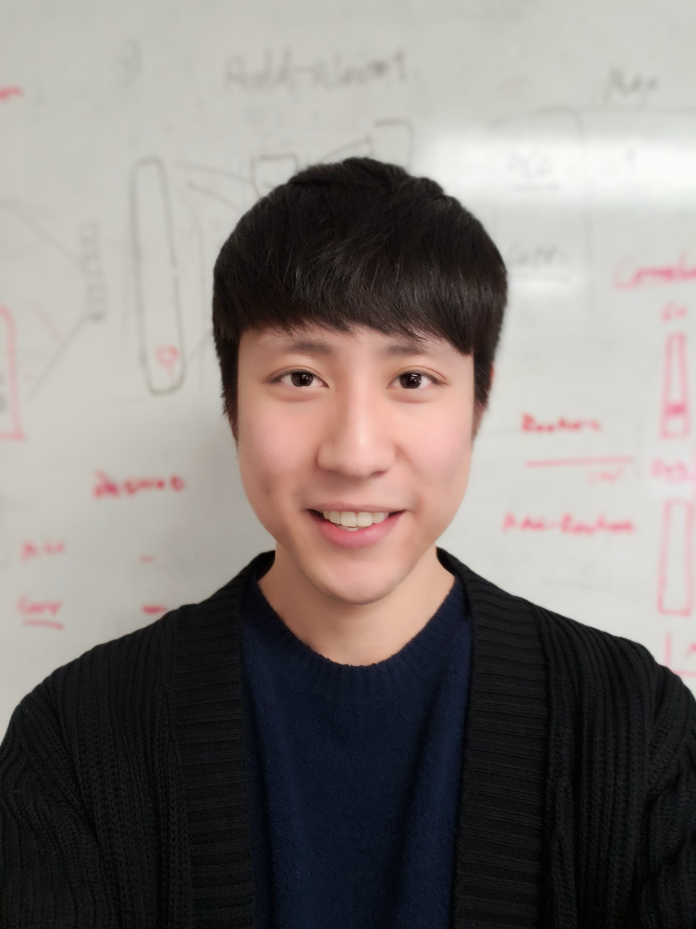








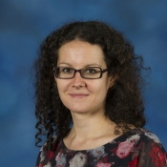
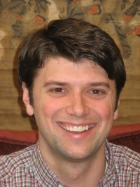
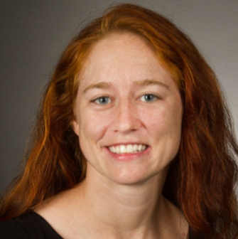
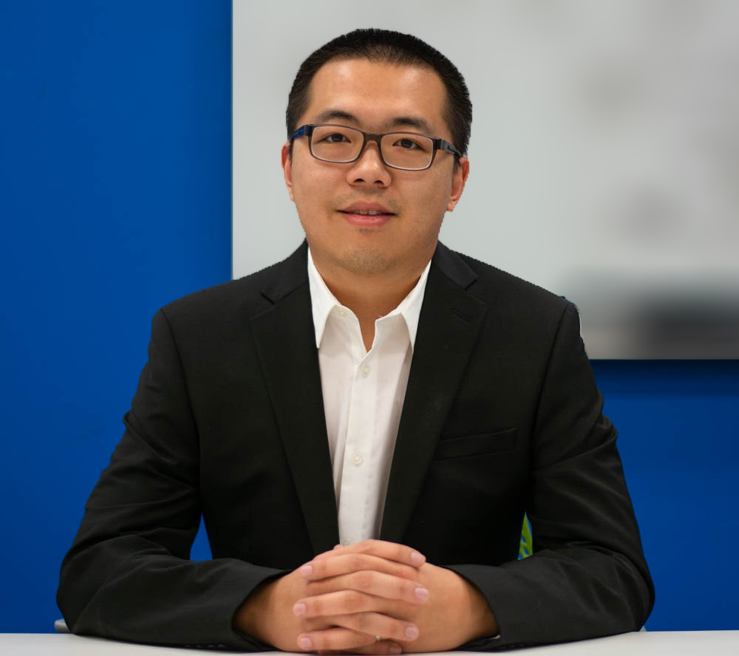
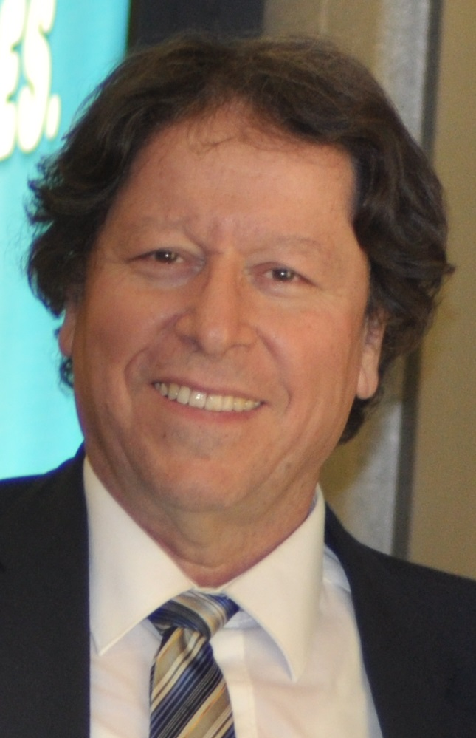
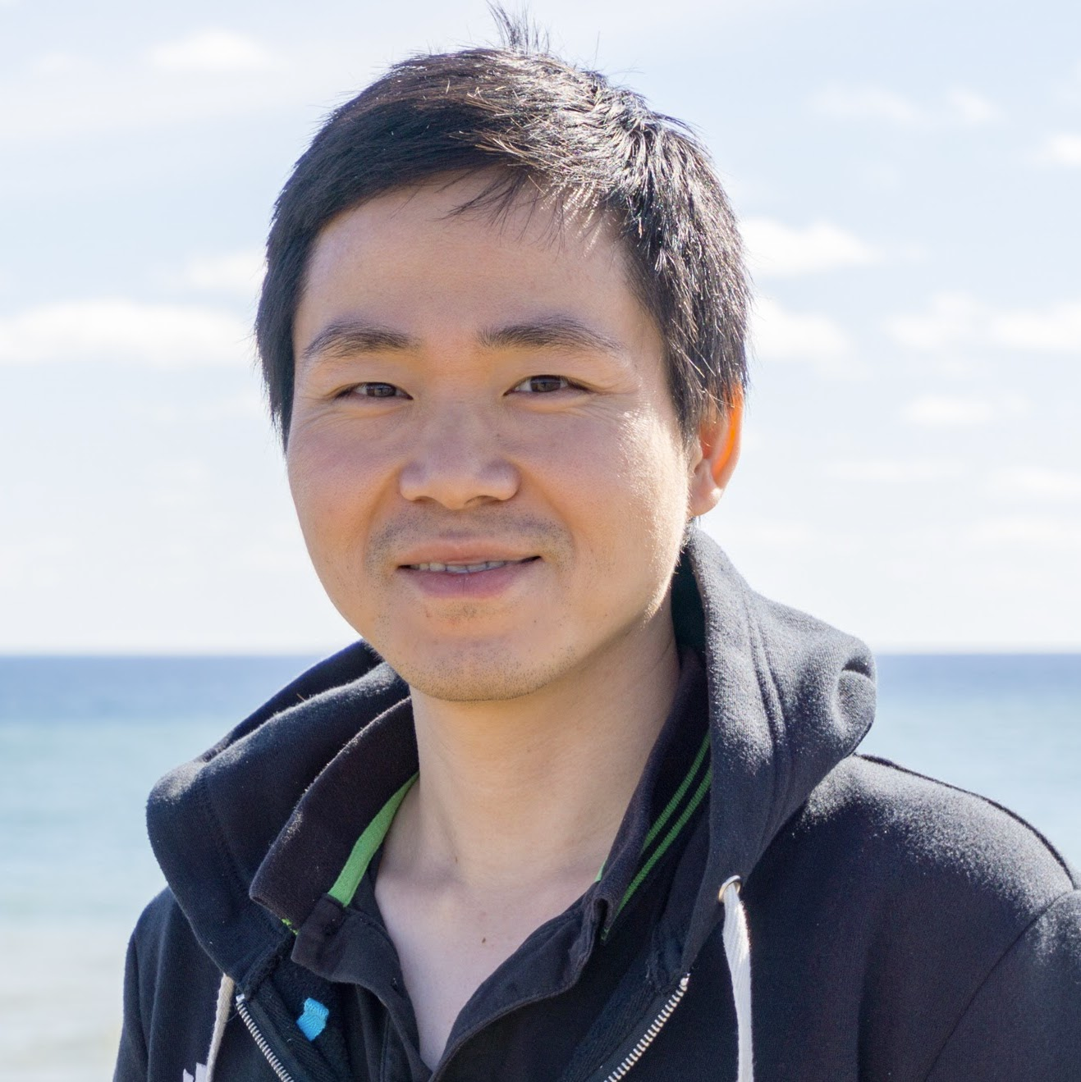
So how is this course scheduled anyway?
Two distinct sections…
Part I:
What is research?
How do I understand reseach?
How do I evaluate the research of others?
How do I do my own research?
How can I communicate my exciting new results to others?
The goal here is to prepare you for success in our program
Part II:

Slide 4


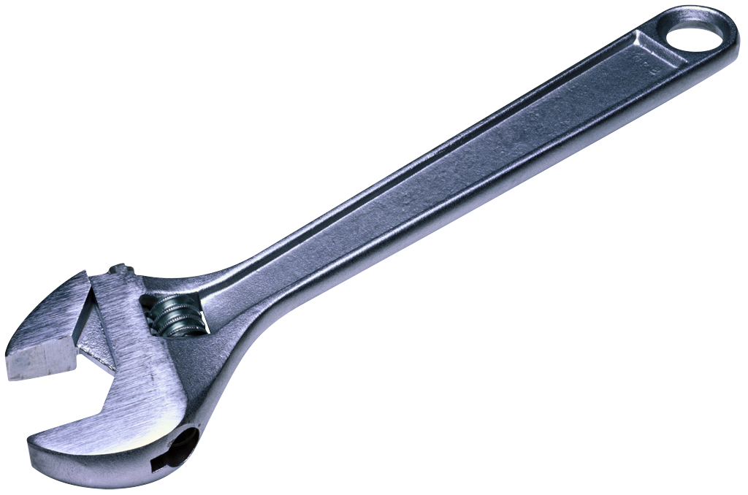
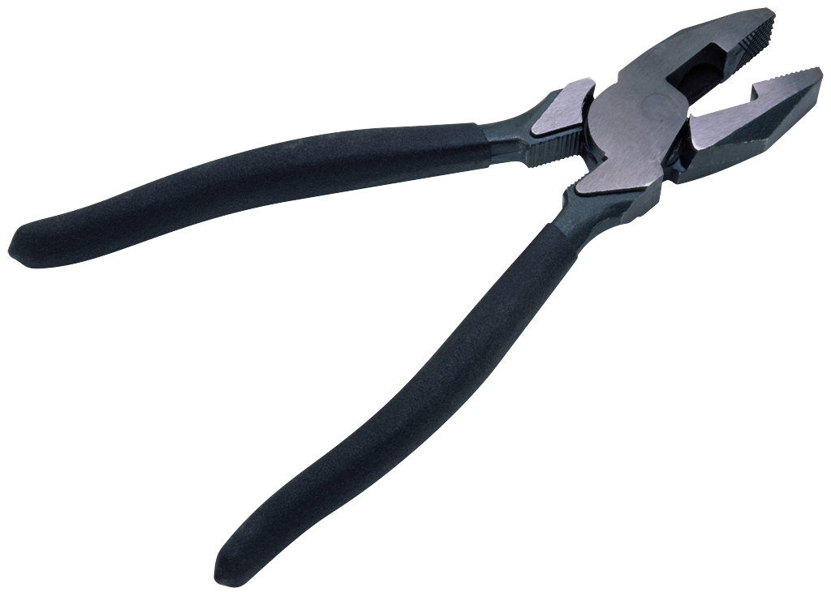

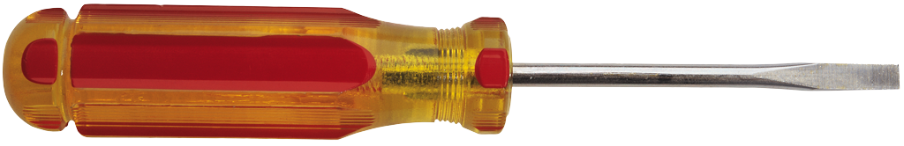
The goal of the first part of the course is to prepare you to do research
Research papers
How to read and understand
How to critique
How to write*
Communication
What makes a good talk?
What makes a bad talk?
Advertisements vs. book reports
Tools of the trade…
University computing environment
Statistical processing
Scripting and plotting
Paper writing
Notes:
Papers, tools (env, script/plot, writing, r), presenting results

Slide 5
Goals for today…
Quick introductions to one another
What is a PhD?
Why do a PhD?
Getting a PhD at Pitt

Slide 6
Who are you guys?
Let’s get to know one another…
Your name
Why Pitt?
Research interests
Anything else?
“I have no idea…” is a perfectly fine answer!

Slide 7
What is a PhD?
Borrowed from http://matt.might.net
Notes:
Imagine a circle that contains all human knowledge

Slide 8
What is a PhD?
Borrowed from http://matt.might.net
Notes:
By the time you finish elementary school, you know a little

Slide 9
What is a PhD?
Borrowed from http://matt.might.net
Notes:
By the time you finish high school, you know a bit more

Slide 10
What is a PhD?
Borrowed from http://matt.might.net
Notes:
With a BS, you begin to develop a specialty

Slide 11
What is a PhD?
Borrowed from http://matt.might.net
Notes:
An MS deepens that specialty

Slide 12
What is a PhD?
Borrowed from http://matt.might.net
Notes:
Reading research papers takes you to the edge of human knowledge

Slide 13
What is a PhD?
Borrowed from http://matt.might.net
Notes:
Once you’re at the boundary, you focus

Slide 14
What is a PhD?
Borrowed from http://matt.might.net
Notes:
You push at the boundary for a few years…

Slide 15
What is a PhD?
Borrowed from http://matt.might.net
Notes:
Until one day, the boundary gives way

Slide 16
What is a PhD?
Borrowed from http://matt.might.net
Notes:
And that dent you’ve made is called a PhD

Slide 17
What is a PhD?
Borrowed from http://matt.might.net
Notes:
Of course, the world looks different to you now…

Slide 18
What is a PhD?
Keep Pushing.
Borrowed from http://matt.might.net
Notes:
So don’t forget the bigger picture

Slide 19
So… What is a PhD?
A PhD is a process!
A demoralizing process at times…
So much has been done already, how do I keep up?
What new problem should I be solving?
Solving this problem is way harder than I thought it would be…
Why doesn’t my code (or code that I’ve borrowed) work?!
Why do my papers keep getting rejected?
But a process that will educate you greatly
Problem identification and solving
Persistence and hard work
Clear (written and spoken) communication skills
Team work, management, and mentoring
Notes:
Smarts is not enough. Persistence, hard work, are key

Slide 20

So why would anyone do a PhD?
Notes:
Ask students, write on board

Slide 21
The (Abridged) PhD Timeline at Pitt
Coursework only
4 Classes, A- or better
CS 2100 – 2899 only
Can count towards core reqs
Demonstrate depth of knowledge
Very basic gist of PhD topic area
Committee: 3 CS faculty
Ideally done by end of year 3
The big show…
At least 8 months after proposal
CS 2001
Pass Prelims
Comprehensive Exam
Defense
CS 2002
Find an advisor!
1
2
3
4
5
6
RESIDENCY REQUIREMENT
All PhD students must engage in a minimum of one term of full-time graduate study by the end of the term in which the comprehensive examination is taken.
Pass core requirements
One course from each of
Artificial Intelligence / Database
Operating Systems / Networks
Architecture / Compilers
Theory / Algorithms
At least a B in each
Dissertation Proposal
“Contract” for PhD
Committee: 3 CS + 1 external
https://cs.pitt.edu/degrees/phd/requirements/

Slide 22
Tips for Success
Work hard to finish course requirements
Identify research areas/professors of interest
Begin reading papers & discussing area
1
2
3
4
5
6
Notes:
Time management: Balance work, life. Success is not hours, it’s results.

Slide 23



Tips for making the most of meetings…
When reading/experimenting:
Take notes on the papers
Write down questions and interesting problems
Write up preliminary results
During the meeting:
Take notes!
Ask questions: It’s OK to be confused
Agree on next steps, desirable outcomes
After a meeting:
Reflect on meeting “minutes”
Develop a plan for meeting expectations
Pop-in or exchange email to address small problems between meetings

Slide 24
Tips for Success
Work hard to finish course requirements
Identify research areas/professors of interest
Begin reading papers & discussing area
1
2
3
4
5
6
Attend group meetings
Read several papers per week
Research! Develop your niche.
Work on time management skills
Notes:
Time management: Balance work, life. Success is not hours, it’s results.

Slide 25
How do I choose an advisor?!
Key points: research interest and fit
You are unlikely to finish a PhD that you aren’t interested in…
Use CS2001 to get to know faculty whose work seems interesting
Take courses and seminars in these areas
Read papers, make sure you’re interested in recent developments
You will be working very closely with your advisor
Do you prefer “hands on” or “hands off” advising?
Can you take direction/criticism from this person?
Use CS2002 and course projects to test fit!
Choosing an advisor is a big decision…

Slide 26
Tips for Success
More than smarts: Persistence!
Time management should become an art…
Identify larger open problem, not just many small “neat” problems
writing, Writing, WRITING
Work hard to finish course requirements
Identify research areas/professors of interest
Begin reading papers & discussing area
1
2
3
4
5
6
Attend group meetings
Read several papers per week
Research! Develop your niche.
Work on time management skills
Good thesis or great thesis?
To defend, you must be an expert. Are you?
Resist the temptation to take a job before you defend. This is a recipe for disaster.
Notes:
Time management: Balance work, life. Success is not hours, it’s results.

Slide 27
Welcome to the program!

