Slide 1
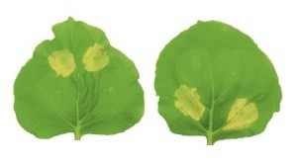


Everything you wanted to know about research integrity but never dared to ask
Sophien Kamoun
http:KamounLab.net
@KamounLab

Slide 2

We have a duty to our profession, to our funders, to our colleagues to conduct research according to the best scientific practice and highest professional standards

Slide 3
We have a duty to our profession, to our funders, to our colleagues to conduct research according to the best scientific practice and highest professional standards

Slide 4
We have a duty to our profession, to our funders, to our colleagues to conduct research according to the best scientific practice and highest professional standards
NOT

Slide 5
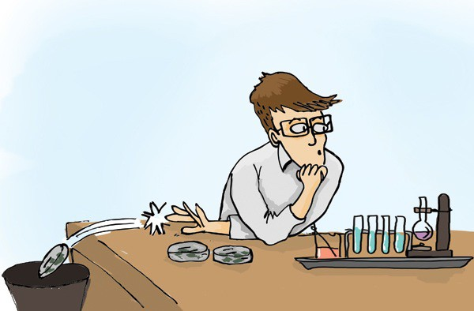
What is research misconduct?
Mis‐representation, falsification or fabrication of data
Appropriation of other’s work
Conduct that deviates from accepted standards
Failure to follow accepted procedures
Mismanagement or inadequate preservation of data and materials
Inappropriate conduct in peer review
Misrepresentation of involvement or authorship

Slide 6
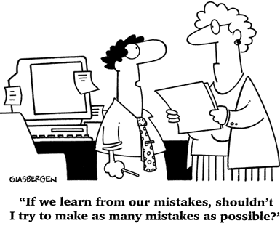
Research misconduct is not…
…honest error
…honest differences in the interpretation or assessment of data
However, failure to address an error and fix the record in a timely fashion could be construed as research misconduct

Slide 7
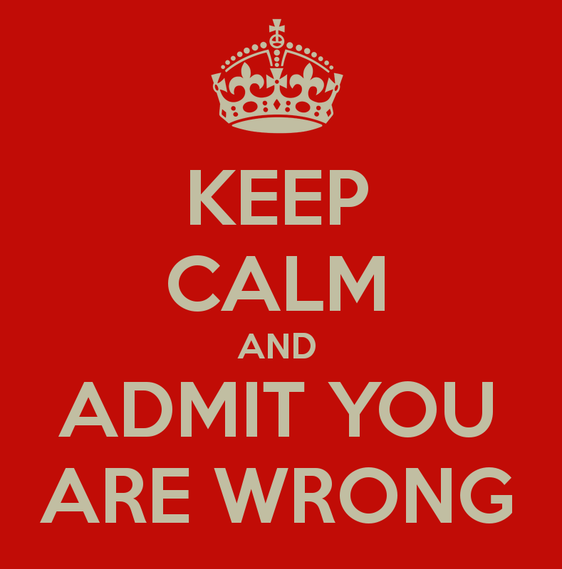
The importance of wrong
•
Our goal is to generate robust knowledge to advance science
•
“I was wrong” should not be taboo
•
Respond quickly, admit error, make correction

Slide 8

Research misconduct is less likely to arise in an environment with…
•
…high professional standards
•
…good practices
•
…appropriate managerial systems
•
…a culture of open discussion and sharing

Slide 9
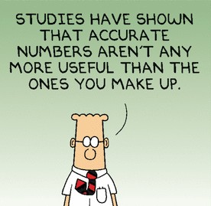
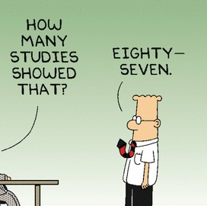
Standards of professional conduct
Honesty and fairness
Accuracy and rigour
Accountability
Openness and transparency
Independence
Respect
Co‐operation and collegiality

Slide 10
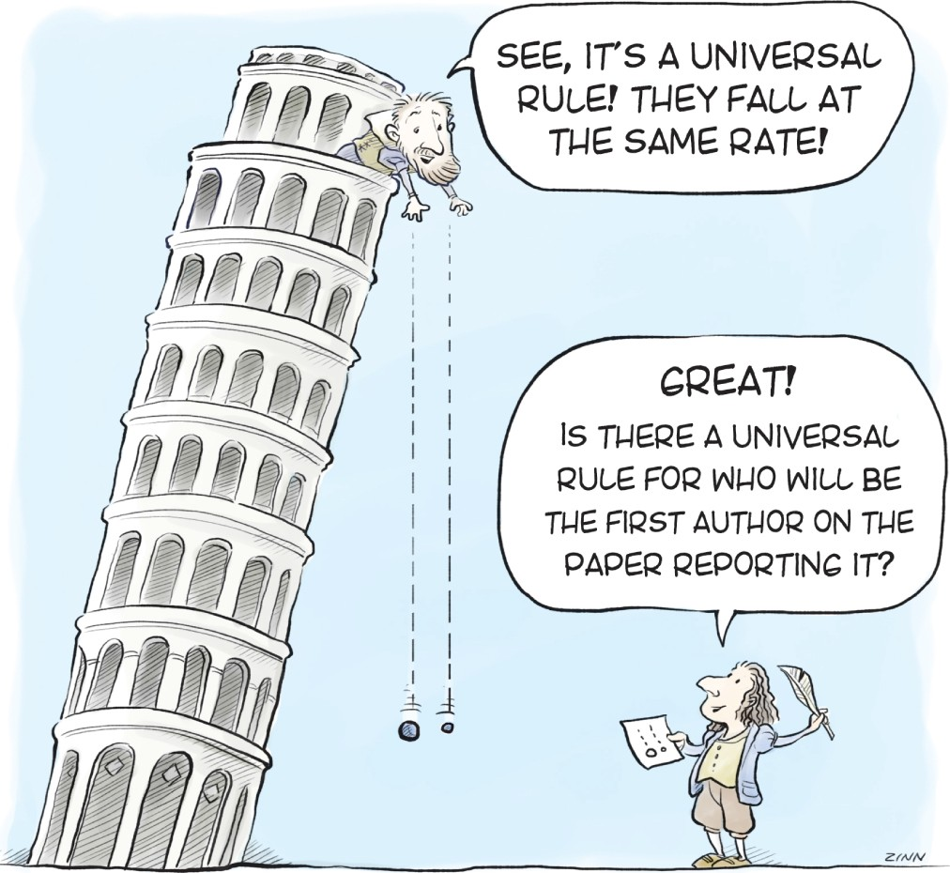
Principles of good research practice
A Critical Approach
Documenting Results
Storage and Disposal of Data
Authorship and Publication
Collaborators and Partners
Exploitation and Protection of Intellectual Assets

Slide 11

Support and oversight
Training on research integrity
UEA research integrity portal http:// www.uea.ac.uk/research/ our-research-integrity
Procedure for reporting allegations (whistleblowing)
Procedure for dealing with allegations

Slide 12
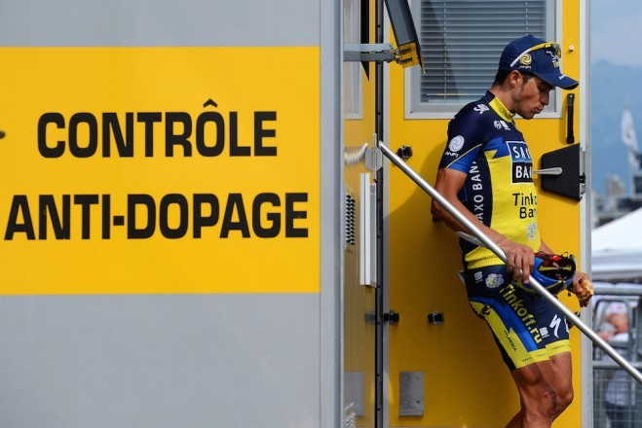
The Sainsbury Laboratory 3:3:3 system
http://www.tsl.ac.uk/about-tsl/scientific-integrity/

Slide 13

confirmation
impact

