Slide 1
An introduction to version control systems with Git

Slide 2
Version control systems
Version control systems record changes to a file or set of files over time so that you can recall specific versions later
Many systems have risen to popularity over the years
  RCS
  CVS
  Subversion
We will focus on Git

Slide 3
Why use version control?
These systems help with:
  Tracking changes
  Short and long term undo
  Backup and restore
  Synchronization
  Collaboration

Slide 4
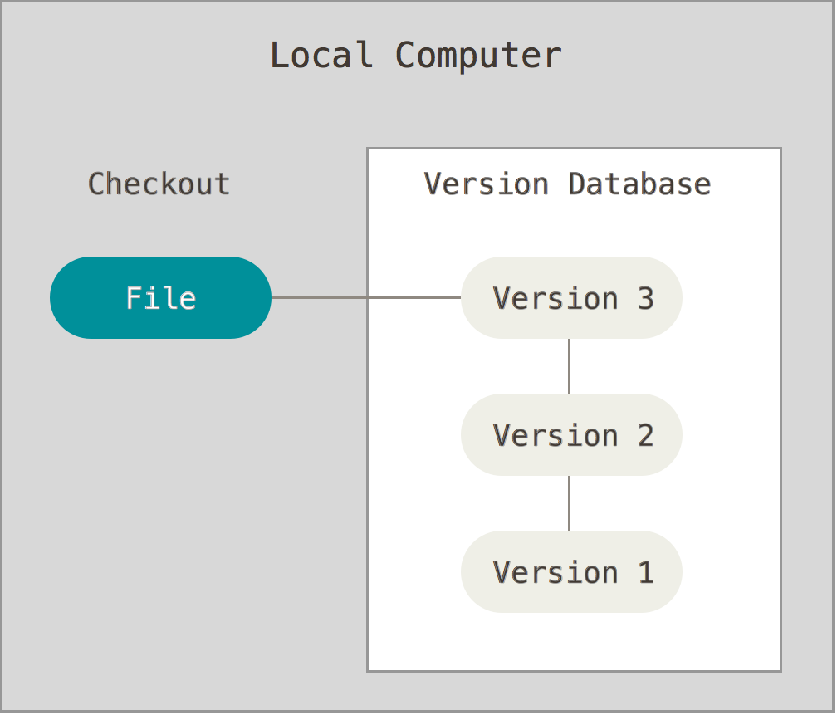
Local version control systems
Notes:
log changes made to the file, any version can be restored at any time

Slide 5
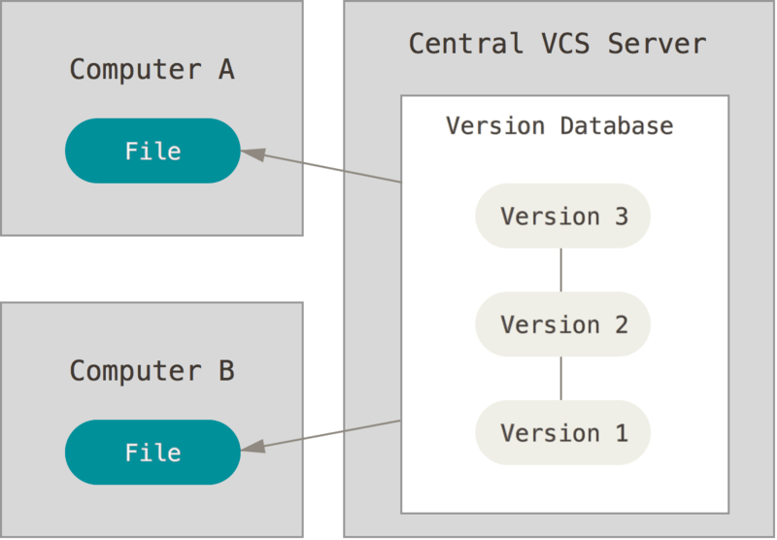
Centralized version control systems
Notes:
now added features to help with synchronization (computers A and B owned by the same user) and collaboration (computers A and B owned by different users)
also introduces problems: single point of failure, can't work offline

Slide 6
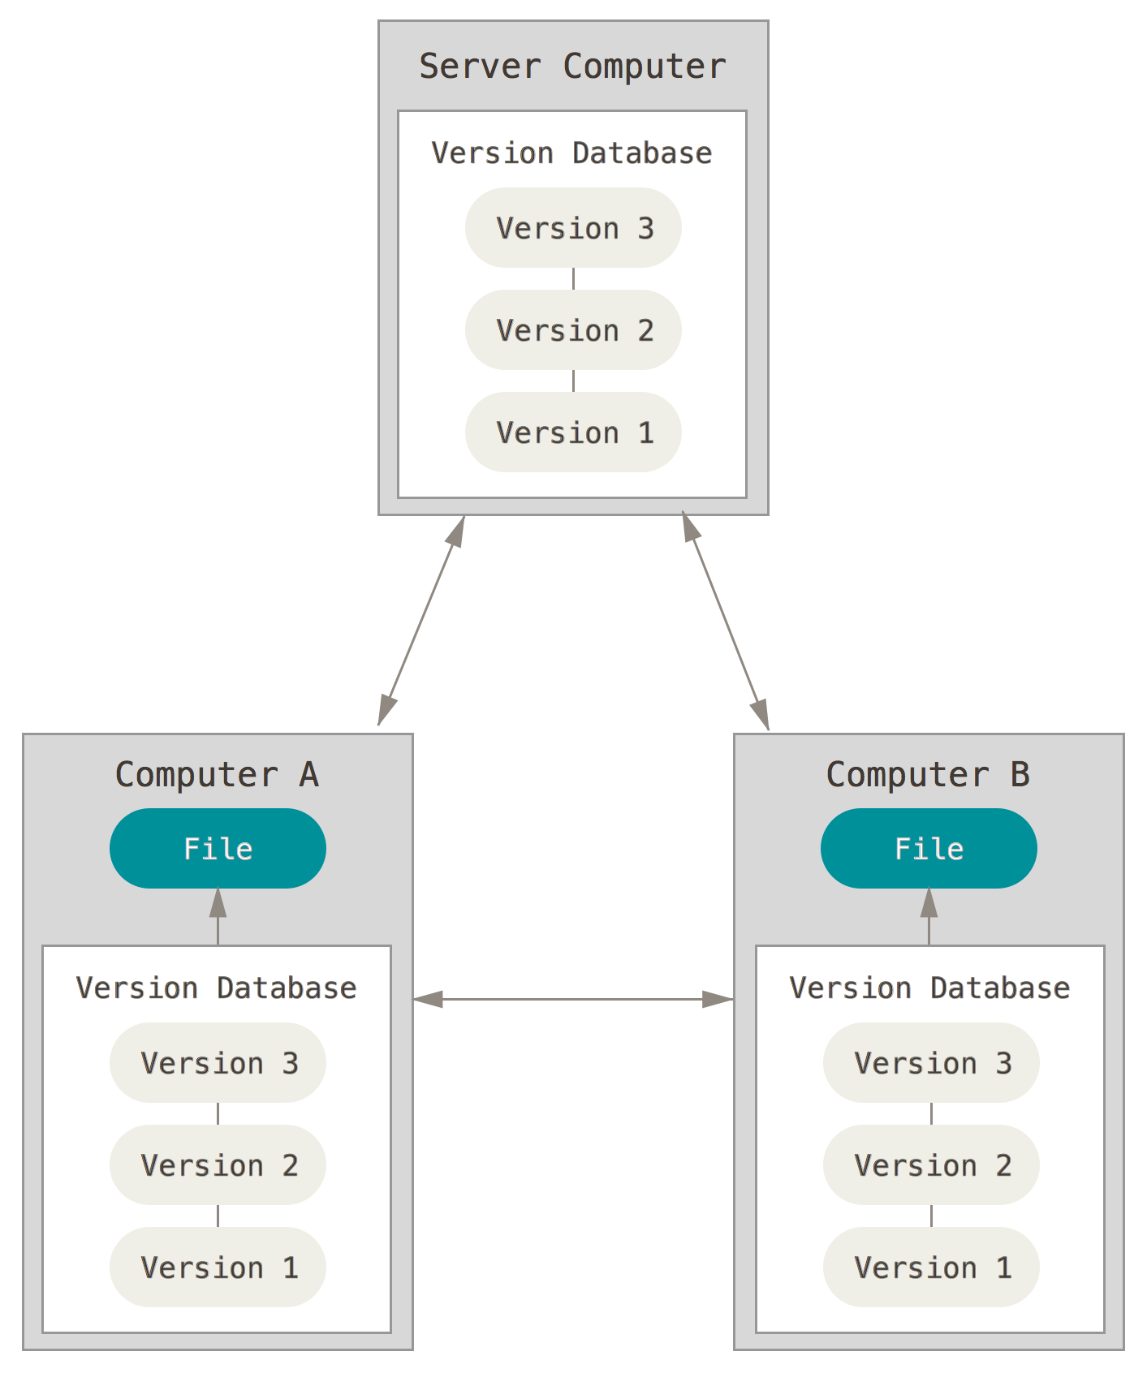
Distributed version control systems
Notes:
Copy of the version database in every working directory

Slide 7
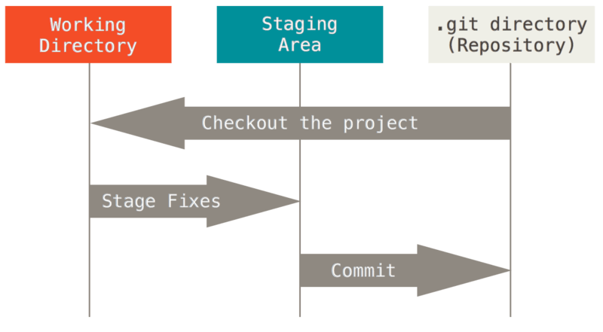
The basic Git workflow
Modify files in your working directory
Stage the files, adding snapshots to your staging area
Commit your changes to your local copy of the repository

Slide 8
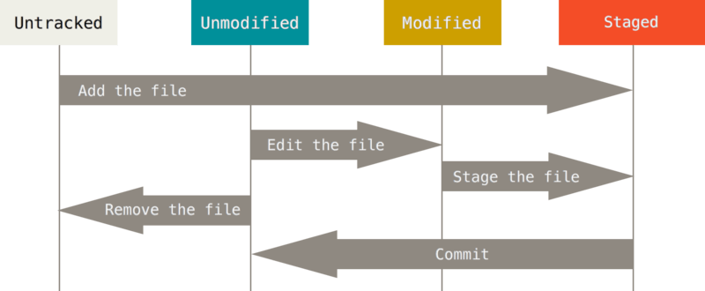
The lifecycle of a file in Git
Git does not necessary keep track of all files in your working directory

Slide 9
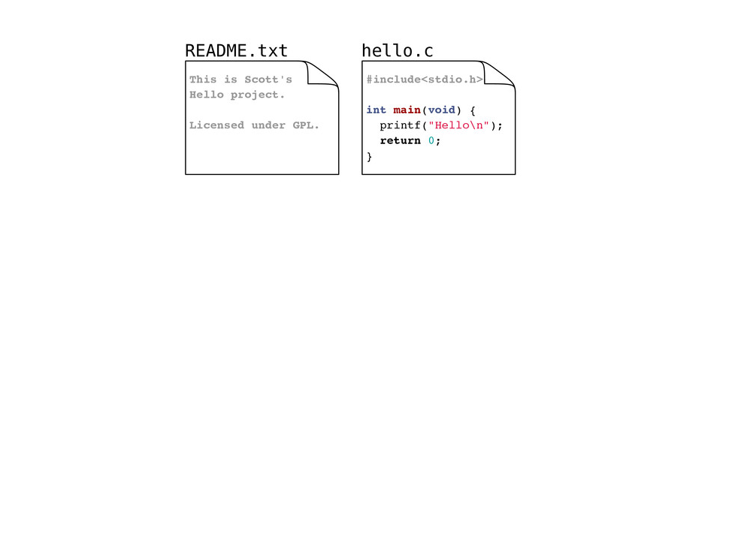
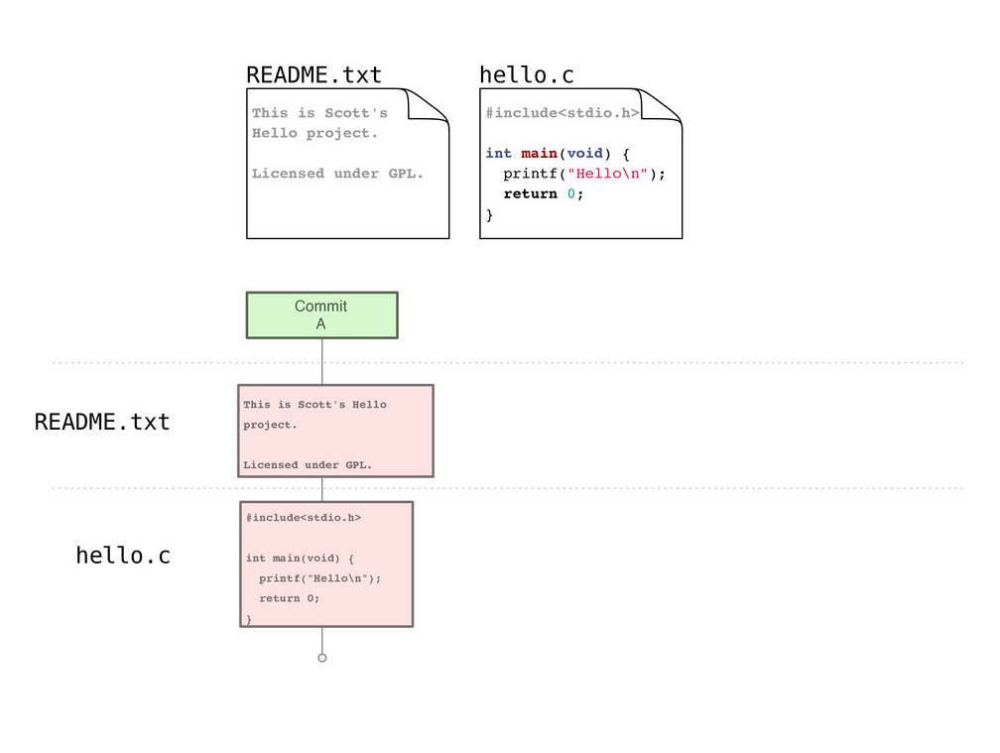
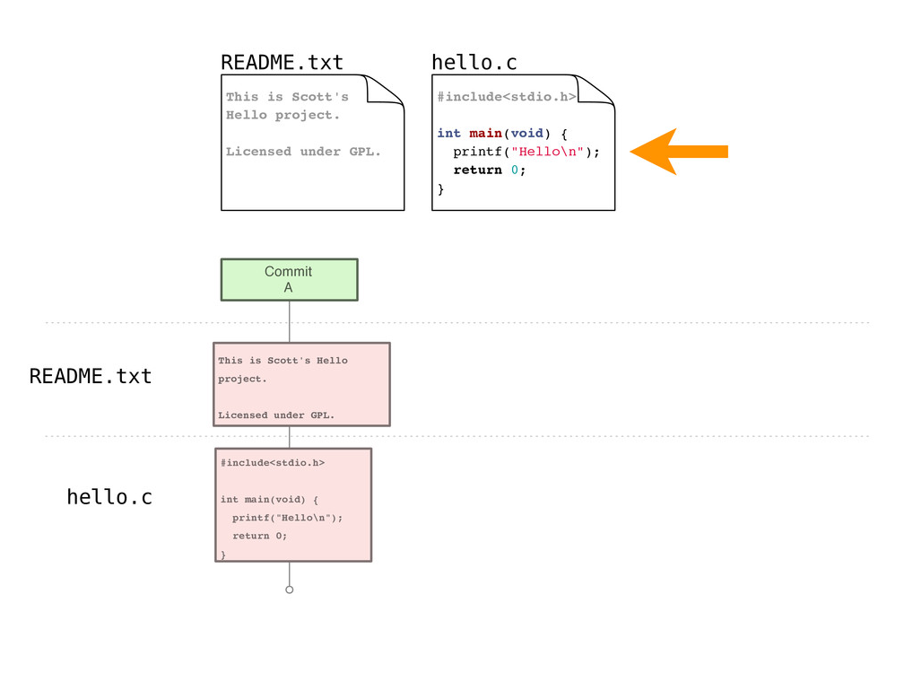

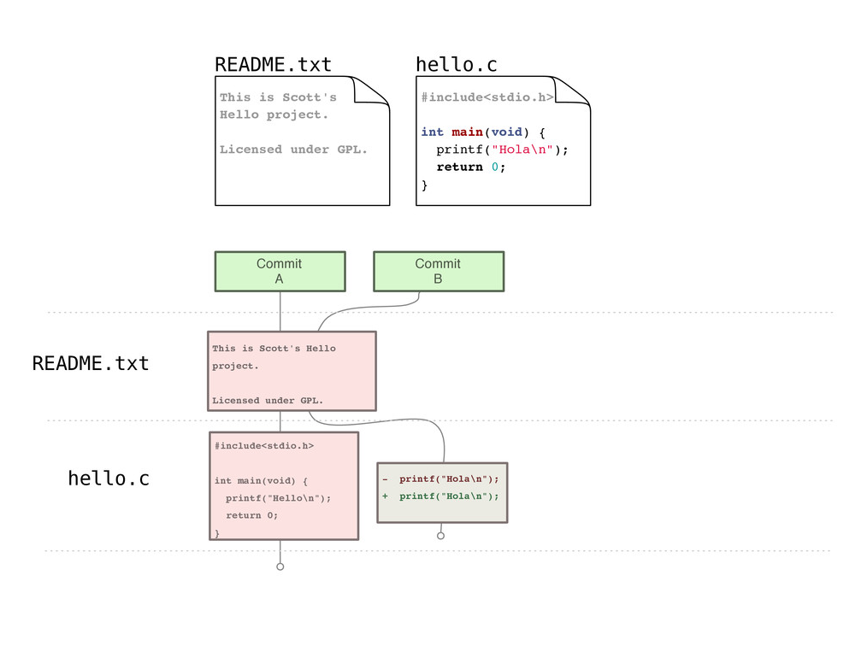
Example repository

Slide 10
Gitting started
Set your identity
  $ git config --global user.name "John Doe"
  $ git config --global user.email jdoe@example.com
Set other configuration options
  $ git config --global color.ui true
Get help
  $ git help <verb>
Notes:
Already installed on most Mac systems
Can install Git shell on Windows or use PowerShell Git application

Slide 11
Creating a new repository
$ git init
Creates a new (empty) repository in the current directory

Slide 12
Copying a repository
For this class, your instructor will create a repository for you, you will just need to copy it from GitHub to your computer using the following command:
$ git clone <repository>
  Creates a copy of <repository> in the current directory

Slide 13
Staging files
As you work, you will create new files and modify existing files, when you are satisfied with your changes, you can stage them for commit with:
$ git add <file_pattern>
Notes:
Note this is not just for new files, but also for edited files

Slide 14
Committing changes
Commits create a new version in the repository
Include a commit message describing the new version
$ git commit -m <msg>
Notes:
Note that this is a local operation

Slide 15
Checking working directory status
$ git status
Reports:
  Files in the working directory that are not tracked
  File modifications not yet staged for commit
  File additions and modifications staged for commit

Slide 16
Overviewing commit history
$ git log
Lists commits made to the current repository

Slide 17
Git example (cloning via GitHub)
Notes:
Go through example demonstrating the following commands:
git clone https://github.com/PittCS1501/PITTID-project0.git
ls
cd PITTID-project0
ls
nano P0.txt
Or, use another text editor, use of nano doesn't matter
git status
git diff
nano Status.txt
git status
git diff
git add P0.txt
git status
git add Status.txt
git status
git commit -m "finished project0"
git push
To end, view the repository on github.com, showing that the stuff you pushed appears there

Slide 18
Handy command - comparing versions
It may be handy to see exactly how files changed
$ git diff
  Shows modifications not yet staged for commit
$ git diff <commit_id>
  Show changes since the commit specified
$ git diff <commit_id1> <commit_id2>
  Show changes between two commits

Slide 19
What we've covered here...
… presents only a brief overview of Git
  Further topics:
    branching
    rebasing
    tagging
    …
Further resources:
  https://git-scm.com/book/en/v2
  http://gitref.org/
  http://gitimmersion.com/

