Slide 1

CS 1550
Week 14
–
Lab 5
Teaching Assistant
Xiaoyu (Veronica) Liang

Slide 2
Lab 5 – Bigger Files for xv6
Reuse xv6 qemu
Changing how xv6 organizes file blocks in the inode
Notes:
myproc()->sz is only the heap size where the heap ends

Slide 3
Lab 5 – Bigger Files for xv6
Current implementation limit files to 72 KB
xv6 Can only map 140 sectors
Disk Sectors
0
1
2
…
140
512 bytes
We want it to be able to map more then 140 sectors/data blocks.
71 680 bytes
Notes:
myproc()->sz is only the heap size where the heap ends

Slide 4
Lab 5 – Bigger Files for xv6
This limit is based on the current implementation of direct and indirect references you can use in the inode.
We can modify xv6 to be able to map bigger files by adding a double indirect reference in its inode.
xv6 also uses the Unix Fast File System (FFS) or (UFS)
Notes:
myproc()->sz is only the heap size where the heap ends

Slide 5
Lab 5 – xv6 Unix Fast File System
inode
Every file have an inode that holds its metadata
metadata
It also maps where to find in disk the blocks of data that compose that file
Notes:
myproc()->sz is only the heap size where the heap ends

Slide 6
Lab 5 – xv6 Unix Fast File System
inode
data
metadata
data
…
address 1
address 2
data
Direct Pointers
.
.
.
address 12
Notes:
myproc()->sz is only the heap size where the heap ends

Slide 7
Lab 5 – xv6 Unix Fast File System
inode
Saved as data blocks of 512 bytes. (each data block is a disk sector)
data
metadata
data
…
Referred in the lab 5 description as the disk sectors
address 1
address 2
data
Direct Pointers
.
.
.
data
address 12
address 1
data
single indirect
address 2
data
…
address 128
In xv6 this holds 128 blocks
Notes:
myproc()->sz is only the heap size where the heap ends

Slide 8
Lab 5 – xv6 Unix Fast File System
inode
The lab task is to increase it to add a double indirect block
metadata
address 1
address 2
.
.
.
address 12
single indirect
Notes:
myproc()->sz is only the heap size where the heap ends

Slide 9
Lab 5 – xv6 Unix Fast File System
inode
The lab task is to increase is to add a double indirect block
metadata
data
data
address 1
…
address 2
address 1
data
. . .
address 2
address 11
…
single indirect
address 128
single indirect
single indirect
doubly indirect
…
And each pointer from this table points to actual physical blocks
single indirect
Each pointer will point to a table of single indirect pointers
It will allow us to map files up to 8.5 MB
Notes:
myproc()->sz is only the heap size where the heap ends

Slide 10
Lab 5 – Bigger Files for xv6 – preliminaries
qemu optimizations
  Modify the xv6 makefile
    CPUS := 1
    QEMUESTRA = -snapshot (right before QEMUOPTS)
param.h
  FSSIZE = 20000
Copy big.c (course web lab description)
  Add it to the UPROGS list (in your makefile)
  Will attempt to create a big file xv6 will allow, and reports how many sectors it could use to create it.
  It should say “wrote 140 sectors”
Notes:
myproc()->sz is only the heap size where the heap ends

Slide 11
Lab 5 – Bigger Files for xv6
Important xv6 files for this lab are:
  fs.h – defines the number of direct blocks
  fs.c – bmap()
  file.h – inode struct
Notes:
myproc()->sz is only the heap size where the heap ends

Slide 12
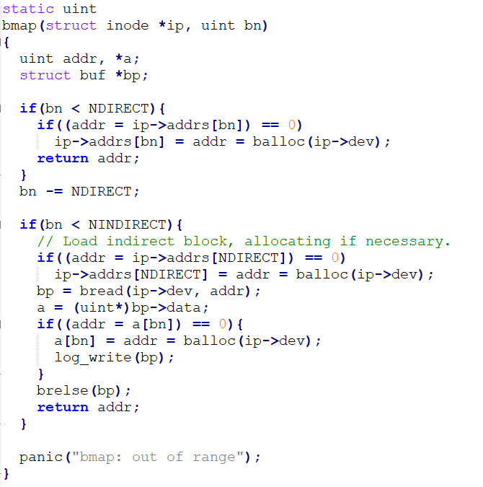
Lab 5 – Bigger Files for xv6 – bmap()
Bmap returns the disk block number of the bn’th data block for the inode ip.
If ip does not have such a block yet, bmap allocates one.
Notes:
myproc()->sz is only the heap size where the heap ends

Slide 13
Lab 5 – Bigger Files for xv6 – bmap()
  static unit
  bmap(struct inode *ip, uint bn)
  {
  uint addr, *a;
  struct buf *bp;
  if(bn < NDIRECT){
  if((addr = ip->addrs[bn]) == 0)
  ip->addrs[bn] = addr = balloc(ip->dev);
  return addr;
  …
  }
picking off the easy case:
the first NDIRECT blocks are listed in the inode itself
Notes:
myproc()->sz is only the heap size where the heap ends

Slide 14
Lab 5 – Bigger Files for xv6 – bmap()
  static unit
  bmap(struct inode *ip, uint bn)
  {
  uint addr, *a;
  struct buf *bp;
  if(bn < NDIRECT){
  if((addr = ip->addrs[bn]) == 0)
  ip->addrs[bn] = addr = balloc(ip->dev);
  return addr;
  …
  }
Is the pointer empty?
picking off the easy case:
the first NDIRECT blocks are listed in the inode itself
Notes:
myproc()->sz is only the heap size where the heap ends

Slide 15
Lab 5 – Bigger Files for xv6 – bmap()
  static unit
  bmap(struct inode *ip, uint bn)
  {
  uint addr, *a;
  struct buf *bp;
  if(bn < NDIRECT){
  if((addr = ip->addrs[bn]) == 0)
  ip->addrs[bn] = addr = balloc(ip->dev);
  return addr;
  …
  }
If it is empty
creates a new block
picking off the easy case:
the first NDIRECT blocks are listed in the inode itself
Notes:
myproc()->sz is only the heap size where the heap ends

Slide 16
Lab 5 – Bigger Files for xv6 – bmap()
  static unit
  bmap(struct inode *ip, uint bn)
  {
  uint addr, *a;
  struct buf *bp;
  …
  bn -= NDIRECT;
  if(bn < NINDIRECT){
  if((addr = ip->addrs[NDIRECT]) == 0)
  ip->addrs[NDIRECT] = addr = balloc(ip->dev);
  bp = bread(ip->dev, addr);
  a = (uint*)bp->data;
  if((addr = a[bn]) == 0){
  a[bn] = addr = balloc(ip->dev);
  log_write(bp);
  }
  brelse(bp);
  return addr;
  }
  panic("bmap: out of range");
  }
Load indirect block, allocating if necessary
Notes:
myproc()->sz is only the heap size where the heap ends

Slide 17
Lab 5 – Bigger Files for xv6 – bmap()
  static unit
  bmap(struct inode *ip, uint bn)
  {
  uint addr, *a;
  struct buf *bp;
  …
  bn -= NDIRECT;
  if(bn < NINDIRECT){
  if((addr = ip->addrs[NDIRECT]) == 0)
  ip->addrs[NDIRECT] = addr = balloc(ip->dev);
  bp = bread(ip->dev, addr);
  a = (uint*)bp->data;
  if((addr = a[bn]) == 0){
  a[bn] = addr = balloc(ip->dev);
  log_write(bp);
  }
  brelse(bp);
  return addr;
  }
  panic("bmap: out of range");
  }
We are checking if the block from the table we just read is empty
Notes:
myproc()->sz is only the heap size where the heap ends

Slide 18
Lab 5 – Bigger Files for xv6 – bmap()
  static unit
  bmap(struct inode *ip, uint bn)
  {
  uint addr, *a;
  struct buf *bp;
  …
  bn -= NDIRECT;
  if(bn < NINDIRECT){
  if((addr = ip->addrs[NDIRECT]) == 0)
  ip->addrs[NDIRECT] = addr = balloc(ip->dev);
  bp = bread(ip->dev, addr);
  a = (uint*)bp->data;
  if((addr = a[bn]) == 0){
  a[bn] = addr = balloc(ip->dev);
  log_write(bp);
  }
  brelse(bp);
  return addr;
  }
  panic("bmap: out of range");
  }
Blocks are not immediately written to disk
Writes to disk are delayed and will be written in batch once disk operations are done
Notes:
myproc()->sz is only the heap size where the heap ends

Slide 19
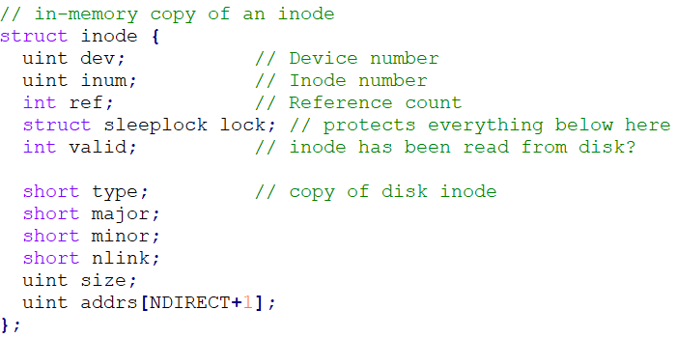
Lab 5 – Bigger Files for xv6 – hints
If you change the definition of NDIRECT, you'll probably have to change the size of addrs[] in struct inode in file.h. Make sure that struct inode and struct dinode have the same number of elements in their addrs[] arrays.

Slide 20
Lab 5 – Bigger Files for xv6 – hints
If you change the definition of NDIRECT, make sure to create a new fs.img, since mkfs uses NDIRECT too to build the initial file systems. If you delete fs.img, make on Unix (not xv6) will build a new one for you.
If your file system gets into a bad state, perhaps by crashing, delete fs.img (do this from Unix, not xv6). make will build a new clean file system image for you.
Don't forget to brelse() each block that you bread(). brelse() releases the buffer cache for the block (check bio.c).

Slide 21
Lab 5 – Bigger Files for xv6 – bmap()
If all goes well, big will now report that it can write 16523 sectors. It will take big a few dozen seconds to finish.
  11 + 128 + 128*128

