Slide 1
Kitties
Presented by CS 0131

Slide 2
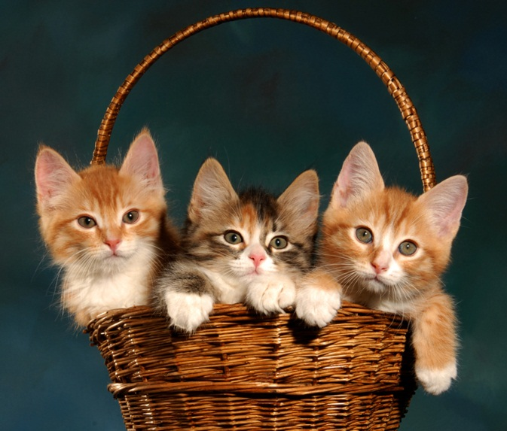
Kitties are adorable!
Kitties are little cats
Cats are cute, too
But kitties are really adorable!

Slide 3
Let’s compare…
Tigers
Kitties
Big
Scary
Tiny
Cute

Slide 4
But tigers are cats, too!

