Slide 1
The Heilmeier Catechism
What are you trying to do? Articulate your objectives using absolutely no jargon.
How is it done today, and what are the limits of current practice?
What is new in your approach and why do you think it will be successful?
Who cares? If you succeed, what difference will it make?
What are the risks?
How much will it cost?
How long will it take?
What are the mid-term and final “exams” to check for success?

Slide 2
Allen Newell’s Research Style
Good science responds to real problems
Good science is in the details
Good science makes a difference

Slide 3
Good science responds to real problems
Good scientific problems are those that reflect real phenomena in the world.
Real problems that need to be solved.
Clear statement of the real phenomena or application it addresses.

Slide 4
Good science makes a difference
Measures of contribution:
How it solves a real problem
How it shapes the work of other
Solves a real problem
The problem sets the crucial context for the work
A million ideas to pursue, but which ones are worth doing?
Shapes the work of others
Highest goal: change other people’s thinking
Paradigm changes are the most impactful [Kuhn]

Slide 5
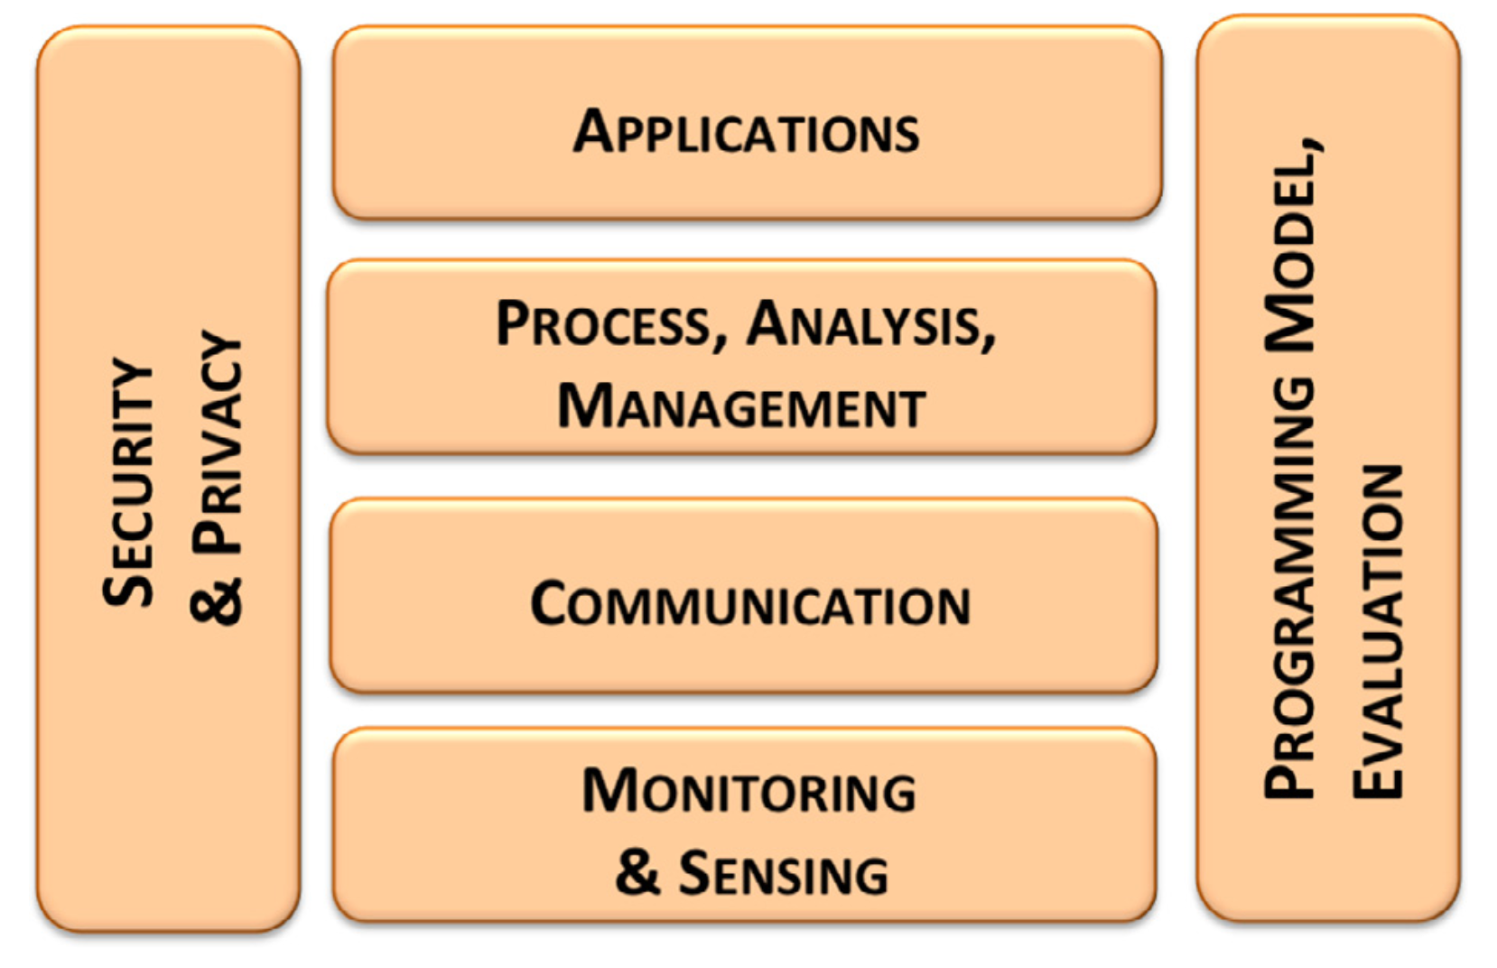
The research issues of the Internet of Things

Slide 6
What issues are still issues today?
Need for energy-efficient hardware and sensors
Wireless radio technologies
Privacy preserving techniques for user data
Human interaction patterns

Slide 7
What new issues characterize the IoT?
Issues of heterogeneity
Communication
Management and discovery
Secure systems
Programming models
Distributed or cloud based

Slide 8
Real time monitoring?

Slide 9
Sensor lifetime?
“50-62 days”
But, 2 mA sleep current at the time

Slide 10
ALPS: A Bluetooth and Ultrasound Platform for Mapping and Localization
Patrick Lazik, Niranjini Rajagopal, Oliver Shih, Bruno Sinopoli, Anthony Rowe
SenSys 2015

Slide 11
Indoor Localization
Multiple categories
Inertial sensors based
Fingerprinting based
Lidar based
Custom infrastructure
Dedicated tags
Existing devices

Slide 12
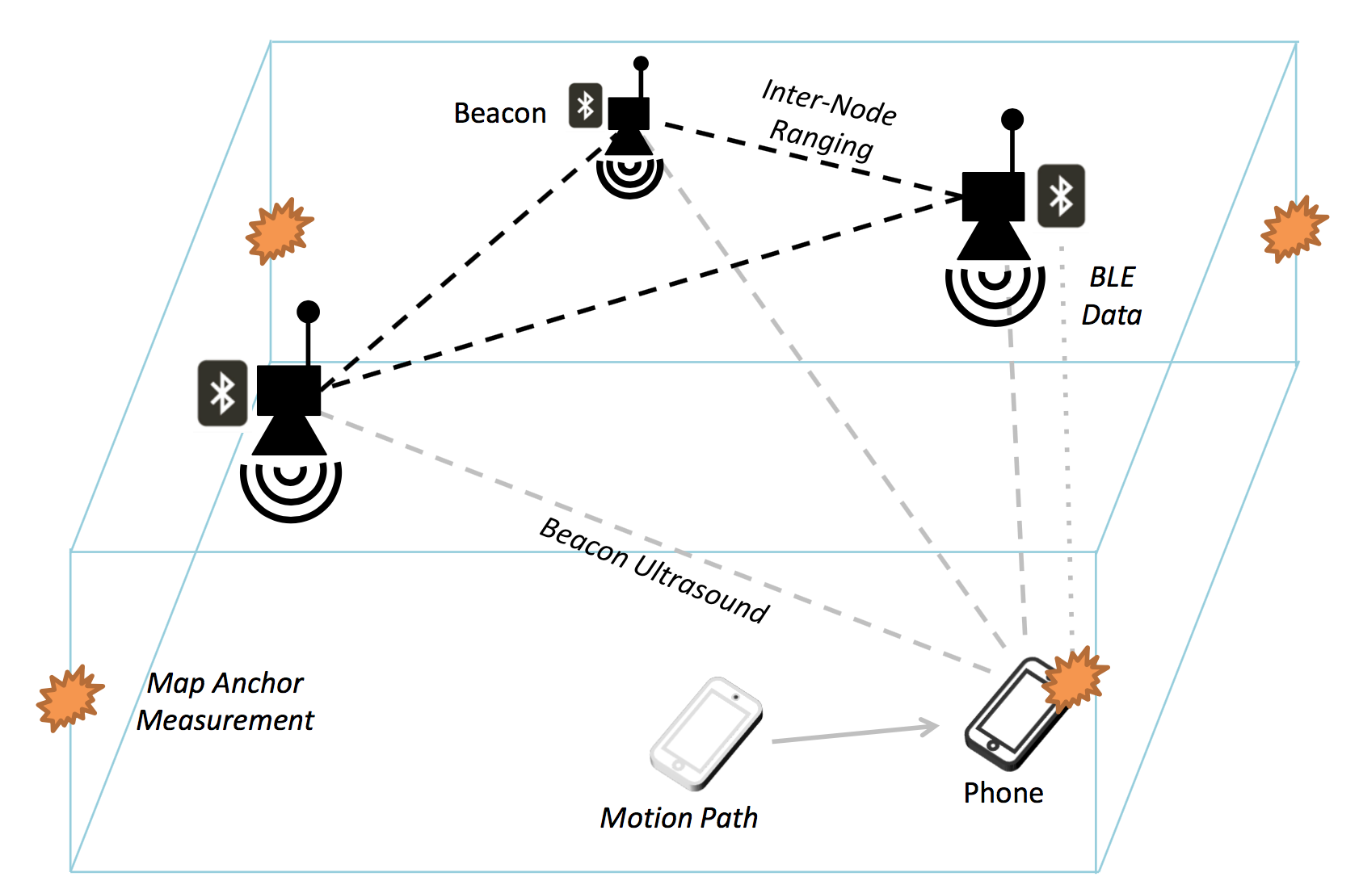

Slide 13
2015 Microsoft Indoor Localization Competition

Slide 14
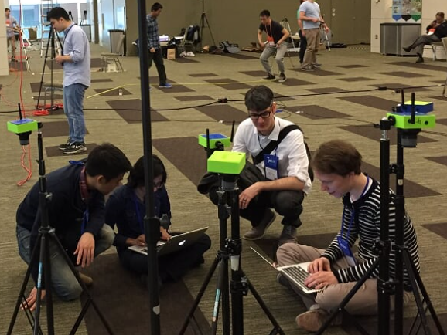
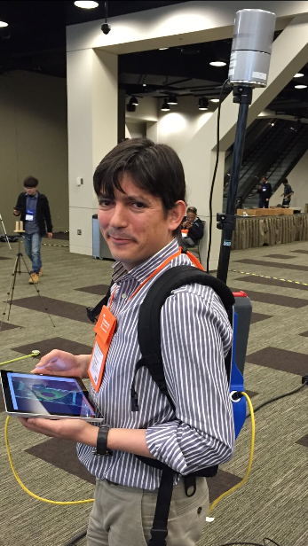

Slide 15
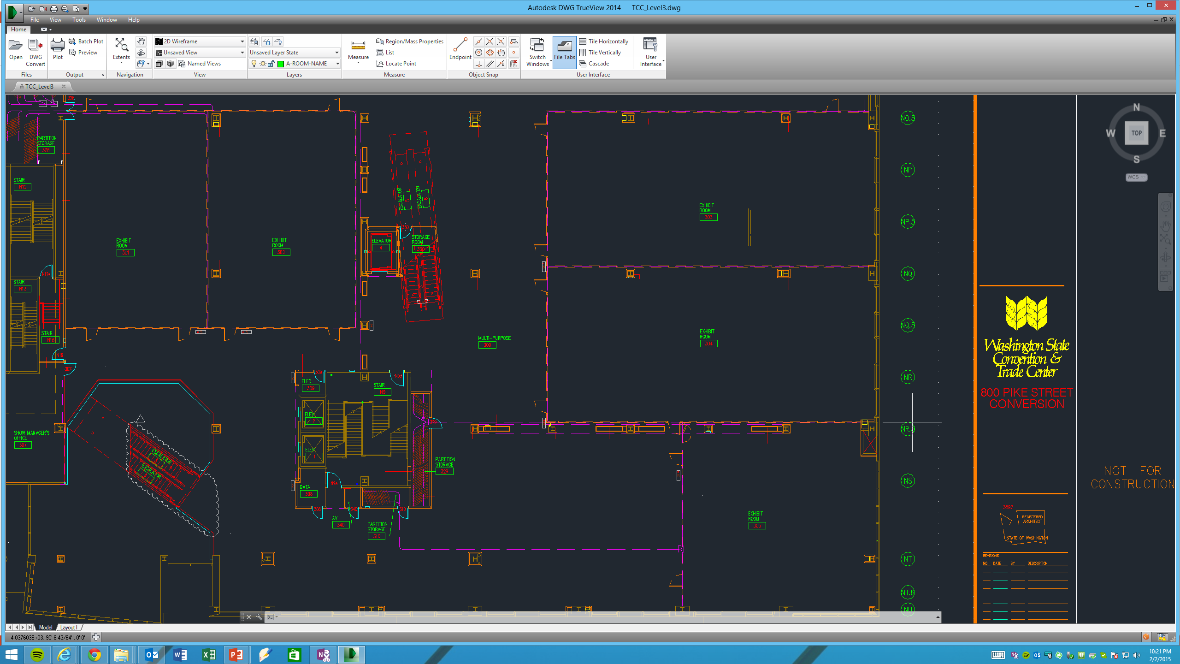
Goal: be accurate at each measurement point
Y Axis
Origin Point
(0,0)
X Axis

Slide 16
Three key challenges
Accurate localization
Easy setup
Handle non line-of-sight cases well

Slide 17
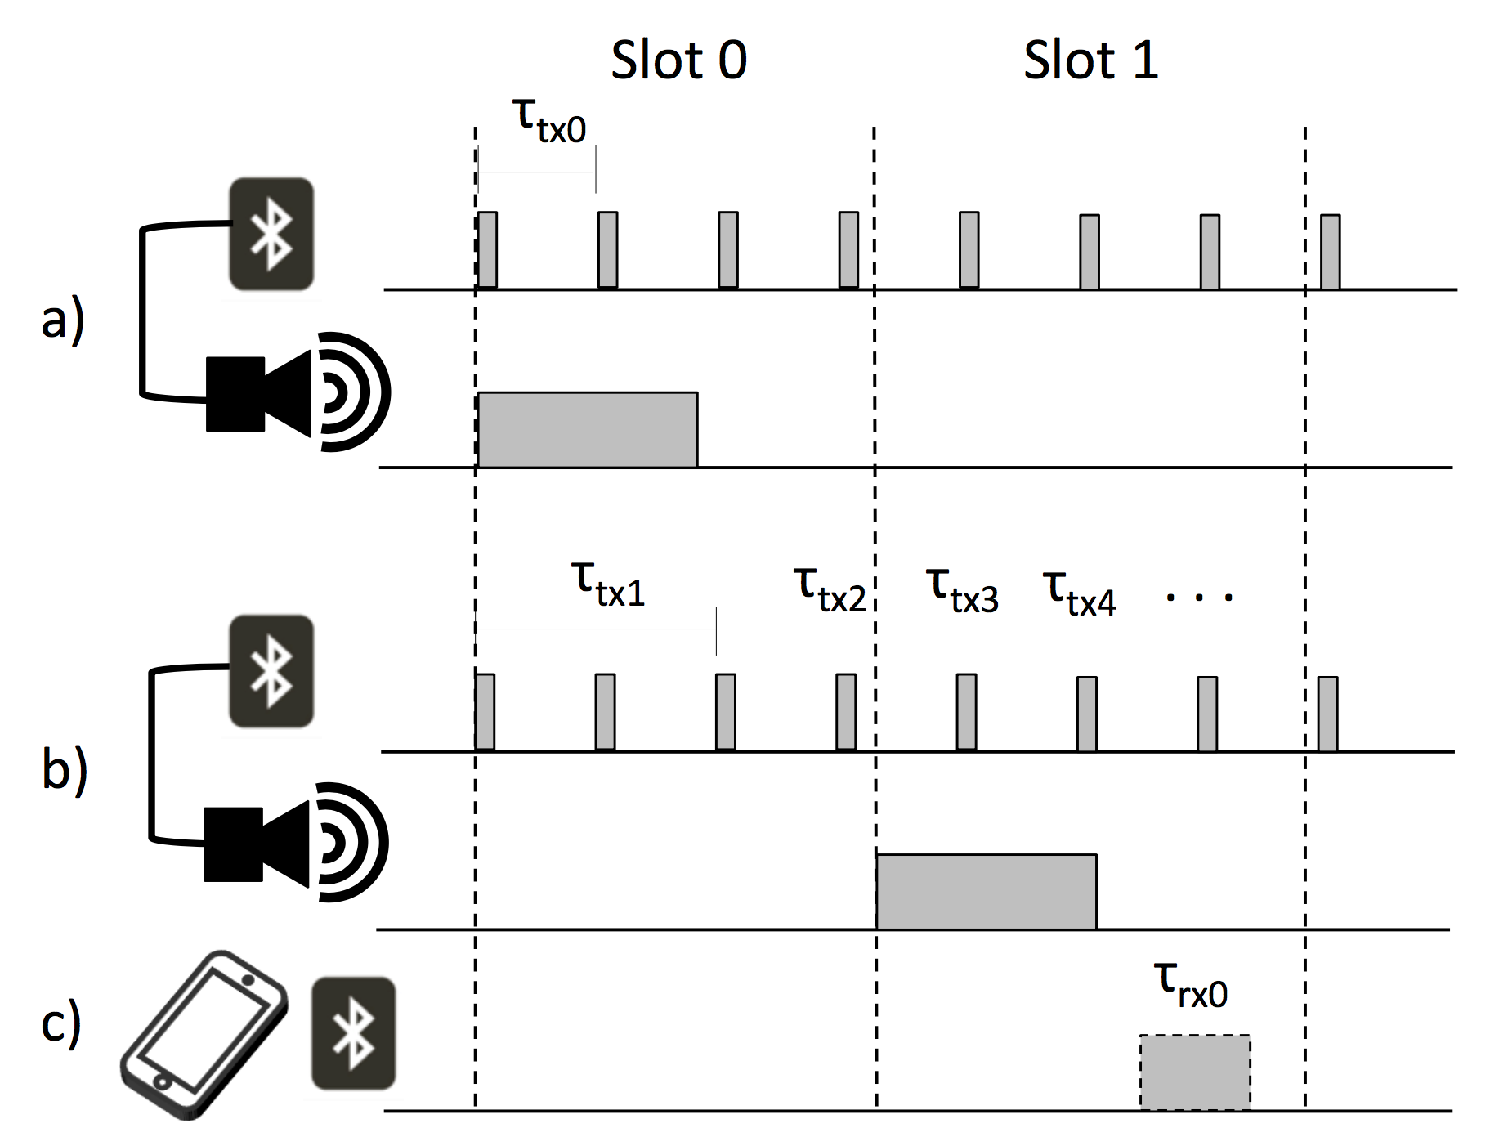

Slide 18
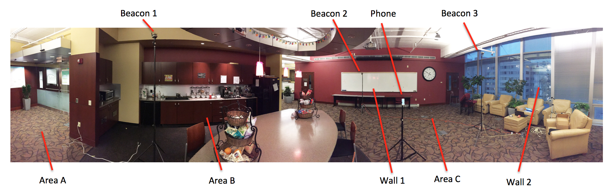
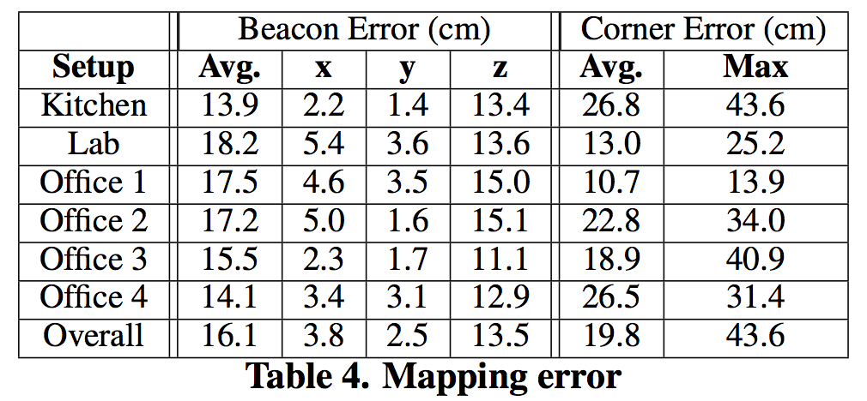

Slide 19
How good is good enough?

Slide 20
Tradeoff between usability, deployment, accuracy, cost, reliability

Slide 21
Project proposal
~2 pages, due Feb 6
Should convey:
What is your idea? Why is it important? Who will care if it succeeds?
What is your hypothesis?
What other approaches exist? Why are they insufficient?
Some related work.
What might the design for a solution look like?
Any format

