Slide 1
Power Management
Daniel Mosse

Slide 2
Power management
Device duty cycle (i.e., turning the device on/off)
Periodicity of collecting or transmitting data
Data compression, packing, …
Data transformations:
  how aggressive
  Location (sensor, Gateway, edge)
  energy impact

Slide 3
Challenges
Battery capacity increase: 2-3% per year (not following Moore’s law)
  CPUs 2x, SSDs 2x, memory 1.2x, …
IoT has unique challenges, due to its SWEPT characteristics
  Size (small everything)
  Weight (typically in movable devices, eg airborne)
  Energy (batteries or renewable sources)
  Power (peaks are usually limited)
  Time (real-time constraints)
Reliability and fault tolerance (Devices run unattended for long time)
What platform to select?
  Note (in next slide) power consumed in each state (on, off, etc)

Slide 4
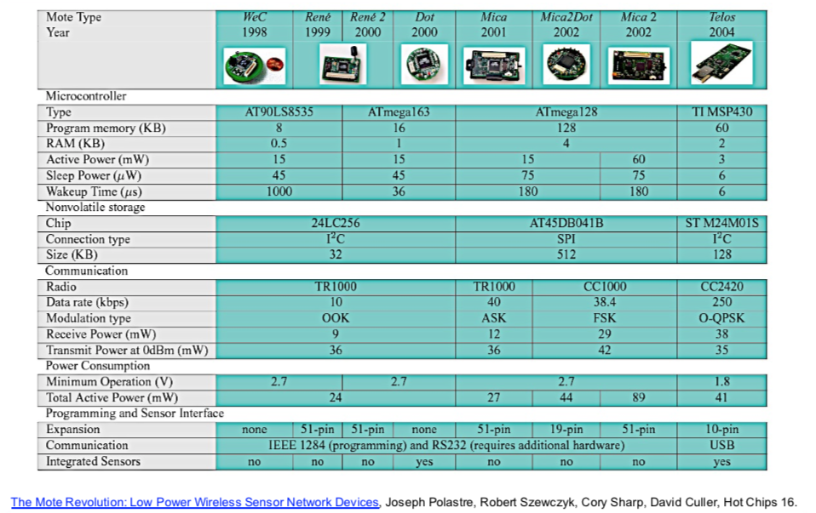

Slide 5
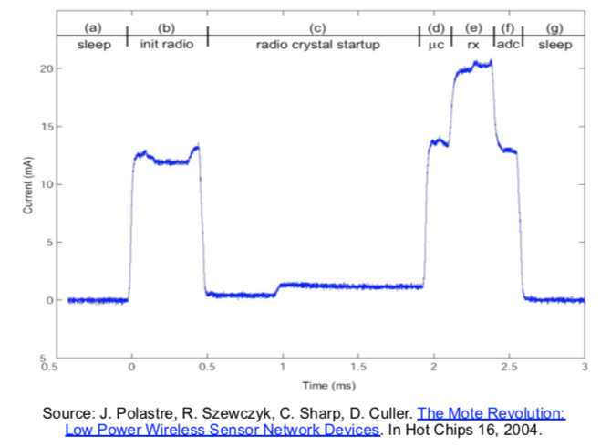
Challenges
Battery capacity increase: 2-3% per year (not following Moore’s law)
  CPUs 2x, SSDs 2x, memory 1.2x, …
What platform to select?
  Note power consume in each state
  (on, off, etc)
  Platforms have different states
  Components have different states
Power consumed in transitioning
from one state to another state
  Also time to stabilize state

Slide 7
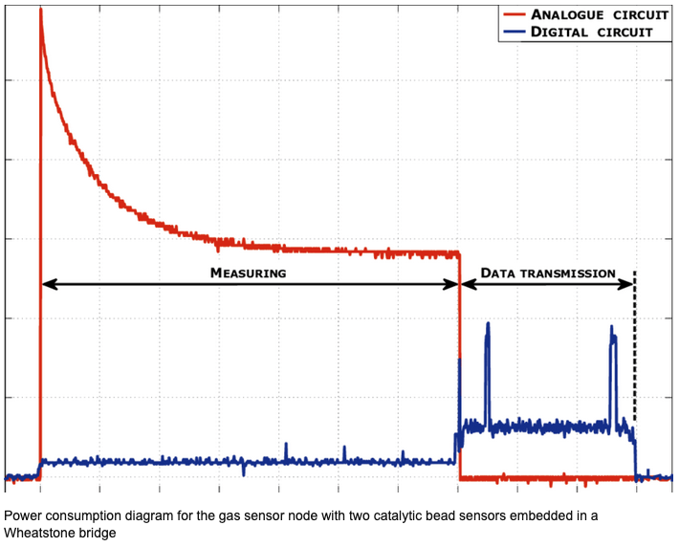

Slide 8
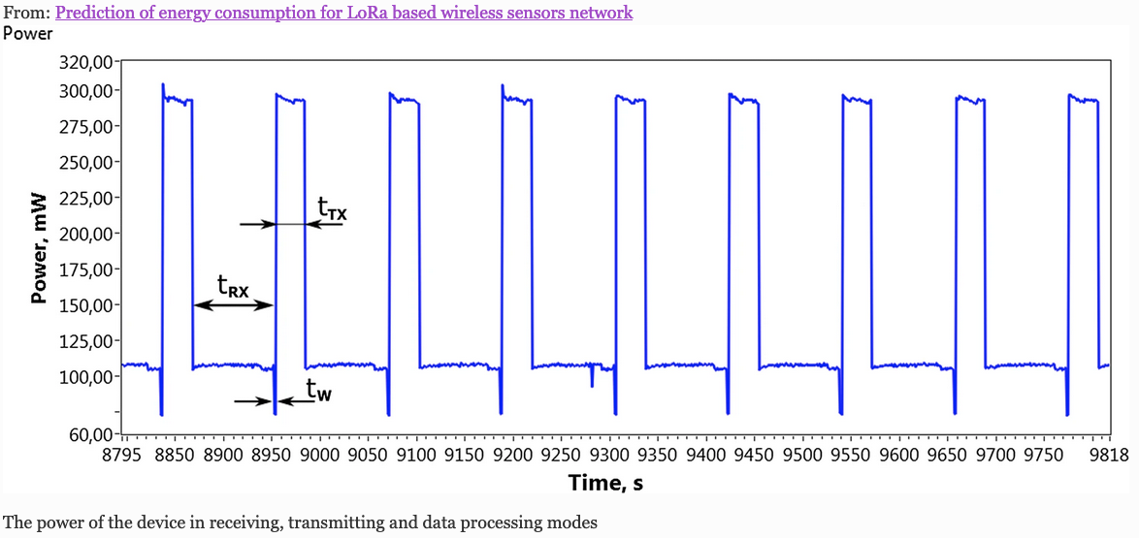

Slide 9
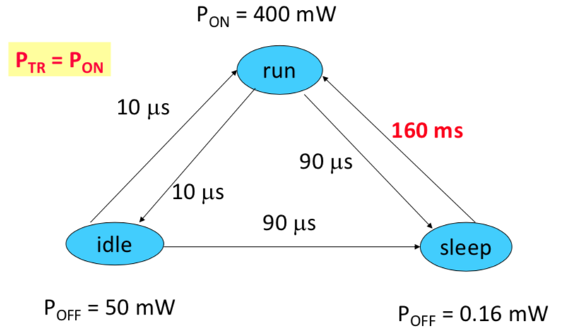

Slide 10
Solutions to power challenges
Where to do power management?
  Hardware: most efficient, fastest, more localized
  IoT OS: coordinates devices, coordinate requests from applications
  Application: knows (does not need to predict) which resources will be used and when: can plan.
  Integrated (cross layer optimization)
Add the power consumed by a task as part of the characterization of the task. Or should it be energy? Or neither?
Can we use virtualization? At the hardware or hypervisor/software level?

