Slide 1
Data Dissemination Models
Network-Level Multicasting

Slide 2

IP Multicast Architecture
Service Model
Hosts
Host-to-Router Protocol
(IGMP)
Routers
Multicast Routing Protocols
(various)

Slide 3
Logical Naming
Single name/address maps to logically related set of destinations
  Destination Set is referred to as the Multicast Group
Scalability is a key challenge
  Single name/address independent of group growth or changes

Slide 4
Multicast Router Responsibilities
Learn of the existence of multicast groups
  Typically done through advertisement
Identify links with group members
Establish state to route packets
  Replicate packets on appropriate interfaces
  Routing entry in the routing table
Src, incoming interface
List of outgoing interfaces

Slide 5
IP Multicast Service Model
Each group identified by a single IP address
Groups may be of any size
Members of groups may be located anywhere in the Internet
Members of groups can join and leave at will
Senders need not be members
Group membership not known explicitly
Analogy:
  Each multicast address is like a radio frequency, on which anyone can transmit, and to which anyone can tune-in.

Slide 6
IP Multicast API
Sending – Send packets to a multicast group
Receiving – Two new operations
  Join-IP-Multicast-Group – (Group-address, Interface)
  Leave-IP-Multicast-Group – (Group-address, Interface)
    Receive multicast packets for joined groups via normal IP-Receive operation
    Implemented using socket options

Slide 7
IP Multicast Addresses
Class D IP addresses
  224.0.0.0 – 239.255.255.255
How to allocated these addresses?
  Well-known multicast addresses, assigned by IANA
  Transient multicast addresses, assigned and reclaimed dynamically, e.g., by “sdr” program
1
1
1
0
Group ID

Slide 8
Multicast Scope Control – Small TTLs
TTL expanding-ring search to reach or find a nearby subset of a group
s
1
2
3

Slide 9
Multicast Scope Control – Large TTLs
Administrative TTL Boundaries to keep multicast traffic within an administrative domain, e.g., for privacy or resource reasons
The rest of the Internet
TTL threshold set on
interfaces to these links,
greater than the diameter
of the administrative domain
An Administrative Domain

Slide 10
Routing Techniques
The main objective is to build distribution tree for multicast packets
  Flood and prune – DVMRP, PIM-DM
  Begin by flooding traffic to entire network
  Prune branches with no receivers
  Examples: Unwanted state where there are no receivers
Link-state multicast protocols – MOSPF
  Routers advertise groups for which they have receivers to entire network
  Compute trees on demand
  Unwanted state where there are no senders

Slide 11
IP Multicast Challenges
IP-Level Multicasting presents various challenges that turned out to be very hard to address in a large-scale, heterogeneous networks
  Scalability of routing protocols
  Hard to manage
  Hard to implement TCP equivalent
  Hard to get applications to use IP Multicast without existing wide deployment
  Hard to get router vendors to support functionality and hard to get ISPs to configure routers to enable

Slide 12
Data Dissemination Models
Application-Level Multicasting

Slide 13
Application-Level Multicasting
IP multicasting gives rise to several challenges
  Often difficult to configure
  Requires complex administrative support
  Involves mutual agreements among different parties
Application-level seeks to address those issues.
  Structured overlay management
  No need to set up explicit communication paths
  Use gossiping for information dissemination
Notes:
Suppose a sender S wants to send a message to N receivers, R₁ to R_{N}. How?
Can try to send across long distance first, then split out.

Slide 14
Application-Level Multicasting
The basic idea is to organize nodes of a distributed system into an overlay network and use the resulting overlay network to disseminate data.
Overlay multicasting over a structured chord-based peer-to-peer network – Example
  1. Initiator generates a multicast identifier (MiD)
  2. Lookup succ(MiD), the node responsible for MiD.
  3. Request is routed to succ(MiD), which will become the root.
  4. If P wants to join, it sends a join request to the root.
  5. When request arrives at Q:
    If Q has not seen a join request before, then it becomes forwarder
      P becomes child of Q.
      Join request continues to be forwarded.
    If Q knows about tree, then P becomes child of Q.
      No need to forward join request anymore.
Notes:
More generally, can organize into a tree, or a mesh.
Pros/cons?

Slide 15
Overlay Construction
Overlays may be very inefficient.
  Multicasting from A will traverse <B, R_{b}>, <R_{a}, R_{b} >, < R_{c}, R_{d}>, and <D, R_{d}> twice.
  It would have been better to make an overlay link between A and C instead of B and D.
Notes:
It should be clear that although building a tree by itself is not that difficult once we have organized the nodes into an overlay, building an efficient tree may be a different story. Note that in our description so far, the selection of nodes that participate in the tree does not take into account any performance metrics: it is purely based on the (logical) routing of messages through the overlay.

Slide 16
Overlay Network – Quality Metrics
Several metrics can be used to indicate the quality of an overlay network.
  Link stress – How often a packet crosses a link?
    Message from A to D needs to cross < R_{a}, R_{b} > twice.
  Stretch or Relative Delay Penalty – Ratio between the delay in the overlay network, and delay in the underlying network.
    Messages B to C follow path of length 59 using Application Level Multicasting, but 47 at network level multicasting → Stretch = 59/47.
  Tree cost – Minimizing some metric of a tree, such as delays.
    Minimal delay spanning tree.

Slide 17
Overlay Networks – Operations
Joining a multicast overlay network
  Joining node contacts a well-known node
  Typically referred to as a rendezvous node
  Rendezvous node returns a list of possible parents.
  What parent should the joining node select?
    There are many alternatives and different proposals often follow different solutions.

Slide 18
Switch Trees
One specific family of solutions to parent selection uses
  It assumes that periodically, a node will seek to switch parents.
Node periodically check other nodes, to determine if any of them have a shorter path.
Whenever a node notices that its parent has failed, it simply attaches itself to the root.

Slide 19
MESSAGE ORIENTED COMMUNICATION
MESSAGE PASSING INTERFACE

Slide 20
What is MPI?
A message-passing library specifications for parallel computers, clusters, and heterogeneous networks
  Extended message-passing model
Communication modes
  Standard, synchronous, buffered, and ready.
Designed for parallel applications and tailored to transient communications
Provides access to advanced parallel hardware
  It assumes that serious failures are fatal and do not require automatic recovery
    For example, process crashes or network disconnect

Slide 21
Group and Context
MPI assumes communication takes place with a group of processes – (groupID, procID)
  Use in lieu of a transport-level address
MPI ties the concepts of process group and communication context into a communicator
Communicator
Group
Context

Slide 22
MPI Abstractions
A process group is high-level abstraction, visible to users
A context is a system-defined object that uniquely identifies a communicator – Mechanism to isolate messages in distinct libraries and the user programs from one another
  A message sent in one context can't be received in other contexts.
  The communication context is low-level abstraction, not visible to users
A communicator is a data object that specializes the scope of a communication.
  MPI_COMM_WORLD is an initial communicator, which is predefined and consists of all the processes running when program execution begins

Slide 23
MPI Communication Semantics
Point-to-point communication is the basic concept of MPI standard and fundamental for send and receive operations for typed data with associated message tag.
  Using the point-to point communication, messages can be passed to another process with explicit message tag and implicit communication context.
  Each process can carry out its own code in MIMD style, sequential or multi-threaded.
  MPI is made thread-safe by not using global state.

Slide 24
MPI Communication Primitives
Primitive | Meaning
MPI_bsend | Append outgoing message to a local send buffer
MPI_send | Send a message and wait until copied to local or remote buffer
MPI_ssend | Send a message and wait until receipt starts
MPI_sendrecv | Send a message and wait for reply
MPI_isend | Pass reference to outgoing message, and continue
MPI_issend | Pass reference to outgoing message, and wait until receipt starts
MPI_recv | Receive a message; block if there are none
MPI_irecv | Check if there is an incoming message, but do not block

Slide 25
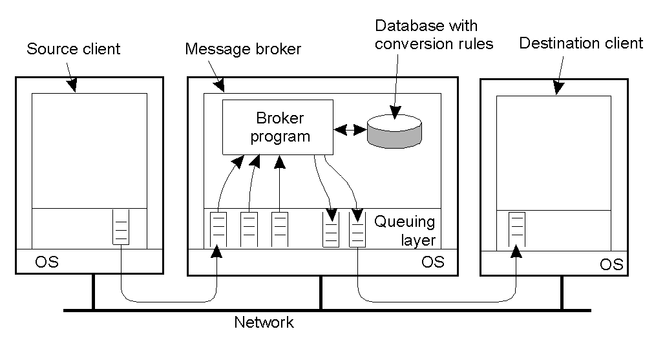
Message Brokers
Common message format, typically used in traditional networks, does not generally work for MQM systems
  Mostly due to the diversity of applications, which reduces the best common format to a sequence of bytes
Brokers – Message broker in a message-queuing system.

Slide 26
MQM Brokers Functionalities
Message brokers act as an application-level gateway
  Their main purpose is to convert incoming messages to a format that can be understood by the recipient
  Properly match end-of-record delimiters between database applications
  More advanced broker are designed to handle conversations between two different database applications
    Difficult task, as information and semantic “mapping” between two different applications may not always be possible
Brokers are commonly used in Enterprise Application Integration for mediation
  Publish/Subscribe is the typical communication model
  Brokers “matches” messages to applications’ interests

