Slide 1
PETAL (Pitt EducaTional And Language Technology) Lab
Professor Diane Litman
http://people.cs.pitt.edu/~litman/

Slide 2
Natural Language Processing (NLP)
Getting computers to perform useful and interesting tasks involving human languages
  languages such as English, Spanish, Chinese, etc.
  as opposed to computer languages such as Python

Slide 3
Why is NLP needed?
  An enormous amount of machine readable text, audio, and video is now available
  Conversational agents such as Siri and Alexa are becoming an important form of human-computer communication

Slide 4
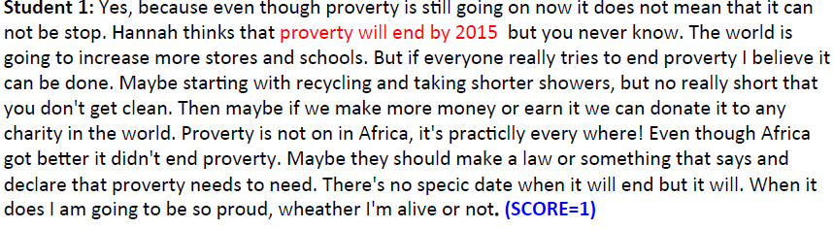
Roles for Language Processing in Education
Learning Language
(e.g., reading, writing, speaking)
Automatic Essay Grading

Slide 5
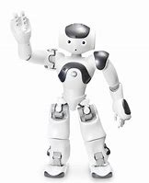

Roles for Language Processing in Education
Using Language
(e.g., teaching in the disciplines)
Dialogue Systems for Students

Slide 6
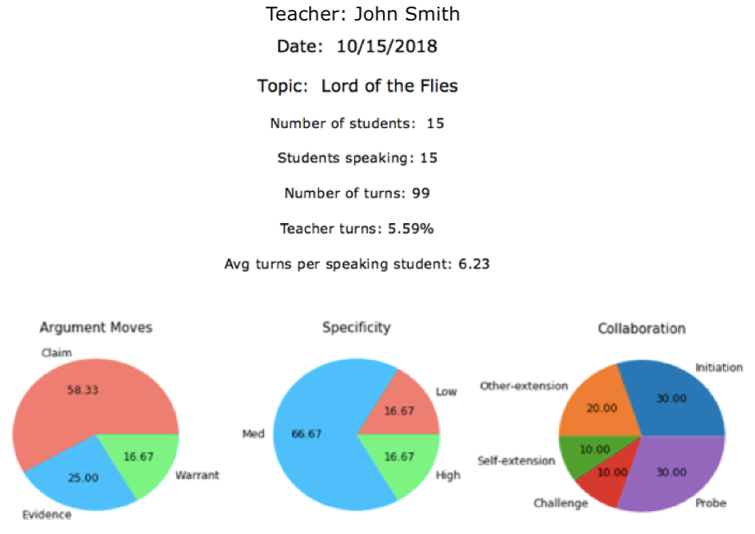
Roles for Language Processing in Education
Using Language
(e.g., teaching in the disciplines)
Classroom Discussion Dashboard for Teachers

Slide 7
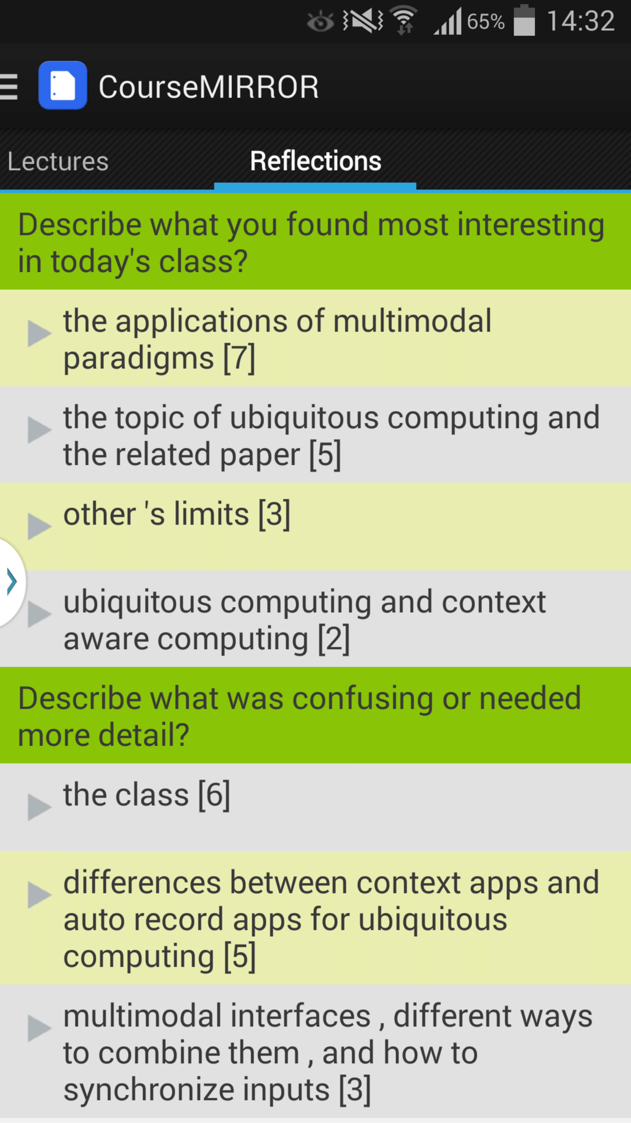
Roles for Language Processing in Education
Processing Language
Student Reflections

Slide 8
PETAL Lab Undergraduate Research
Connecting
  I recruit (class performance, email to colleagues)
  Students initiate contact
    Provide transcript/resume
    Ideal prerequisites: one or more of Artificial Intelligence, Natural Language Processing (via CS or linguistics), Machine Learning, Vision
Implementing
  Employment or Credit
    Often over multiple years with increasing autonomy
  Individual and/or group meetings
  Interaction with graduate students

Slide 9
Current Opportunities
(CourseMIRROR, through 2022) Enhancing Undergraduate STEM Education by Integrating Mobile Learning Technologies with Natural Language Processing
  Web/android
  NLP/ML

Slide 10
Current Opportunities
(Discussion Tracker, through 2022) Development of Human Language Technologies to Improve the Teaching of Collaborative Argumentation in High School English Classrooms
  Data annotation
  NLP/ML
  Interface/web

Slide 11
Current Opportunities
Studying Collaborative Dialogue with a Teachable Robot in a Mathematics Domain (through 2020, with Prof. Walker)
  Dialogue scripting

Slide 12
Selected Prior Projects / Outcomes
  First-authored publications
  CS Day Award for Best Undergraduate Student Poster
  Honorable Mention in the Computing Research Association's Outstanding Undergraduate Award
  National Science Foundation Graduate Research Fellowship
  Accepted for PhD programs in Computer Science

