Slide 1
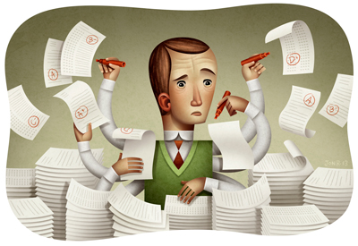
RoboGrading
Professor Diane Litman

Slide 2
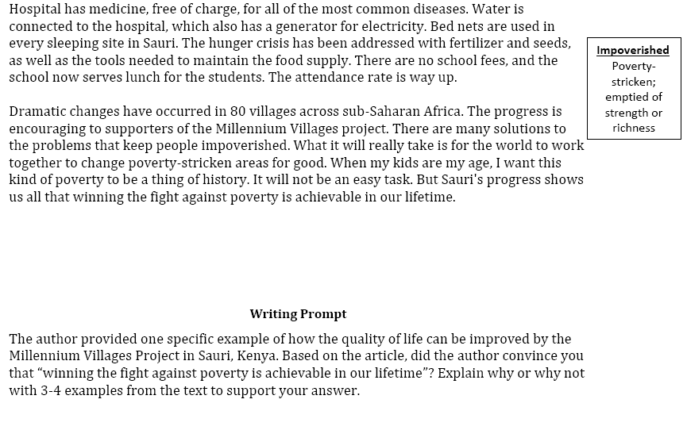
An Example Writing Task
Time for Kids

Slide 3
Rubric for Grading Use of Evidence
1 | 2 | 3 | 4
Features one or no pieces of evidence | Features at least 2 pieces of evidence | Features at least 3 pieces of evidence | Features at least 3 pieces of evidence
Selects inappropriate or little evidence from the text; may have serious factual errors and omissions | Selects some appropriate but general evidence from the text; may contain a factual error or omission | Selects appropriate and concrete, specific evidence from the text | Selects detailed, precise, and significant evidence from the text
Demonstrates little or no development or use of selected evidence | Demonstrates limited development or use of selected evidence | Demonstrates use of selected details from the text to support key idea | Demonstrates integral use of selected details from the text to support and extend key idea
Summarize entire text or copies heavily from text | Evidence provided may be listed in a sentence, not expanded upon | Attempts to elaborate upon Evidence | Evidence must be used to support key idea / inference(s)

Slide 4
Audience Participation: Evidence Scoring (1 or 4?)
Student 1: Yes, because even though proverty is still going on now it does not mean that it can not be stop. Hannah thinks that proverty will end by 2015 but you never know. The world is going to increase more stores and schools. But if everyone really tries to end proverty I believe it can be done. Maybe starting with recycling and taking shorter showers, but no really short that you don't get clean. Then maybe if we make more money or earn it we can donate it to any charity in the world. Proverty is not on in Africa, it's practiclly every where! Even though Africa got better it didn't end proverty. Maybe they should make a law or something that says and declare that proverty needs to need. There's no specic date when it will end but it will. When it does I am going to be so proud, wheather I'm alive or not.

Slide 5
Audience Participation: Evidence Scoring (1 or 4?)
Student 2: I was convinced that winning the fight of poverty is achievable in our lifetime. Many people couldn't afford medicine or bed nets to be treated for malaria . Many children had died from this dieseuse even though it could be treated easily. But now, bed nets are used in every sleeping site . And the medicine is free of charge. Another example is that the farmers' crops are dying because they could not afford the nessacary fertilizer and irrigation . But they are now, making progess. Farmers now have fertilizer and water to give to the crops. Also with seeds and the proper tools . Third, kids in Sauri were not well educated. Many families couldn't afford school . Even at school there was no lunch . Students were exhausted from each day of school. Now, school is free . Children excited to learn now can and they do have midday meals . Finally, Sauri is making great progress. If they keep it up that city will no longer be in poverty. Then the Millennium Village project can move on to help other countries in need.

Slide 6
RoboGrading
Student 1: Yes, because even though proverty is still going on now it does not mean that it can not be stop. Hannah thinks that proverty will end by 2015 but you never know. The world is going to increase more stores and schools. But if everyone really tries to end proverty I believe it can be done. Maybe starting with recycling and taking shorter showers, but no really short that you don't get clean. Then maybe if we make more money or earn it we can donate it to any charity in the world. Proverty is not on in Africa, it's practiclly every where! Even though Africa got better it didn't end proverty. Maybe they should make a law or something that says and declare that proverty needs to need. There's no specic date when it will end but it will. When it does I am going to be so proud, wheather I'm alive or not. (SCORE=1)

Slide 7
RoboGrading
Student 2: I was convinced that winning the fight of poverty is achievable in our lifetime. Many people couldn't afford medicine or bed nets to be treated for malaria . Many children had died from this dieseuse even though it could be treated easily. But now, bed nets are used in every sleeping site . And the medicine is free of charge. Another example is that the farmers' crops are dying because they could not afford the nessacary fertilizer and irrigation . But they are now, making progess. Farmers now have fertilizer and water to give to the crops. Also with seeds and the proper tools . Third, kids in Sauri were not well educated. Many families couldn't afford school . Even at school there was no lunch . Students were exhausted from each day of school. Now, school is free . Children excited to learn now can and they do have midday meals . Finally, Sauri is making great progress. If they keep it up that city will no longer be in poverty. Then the Millennium Village project can move on to help other countries in need. (SCORE=4)

Slide 8
Automatic Scoring Approach
Natural language processing on the essays
Machine learning using the NLP output
Experts derive a decision tree from the rubric
Define some features based on the tree and extract them from the essays
Perform supervised machine learning using extracted features

Slide 9
Natural Language Processing (NLP)
Getting computers to perform useful and interesting tasks involving human languages
  languages such as English, Spanish, Chinese, etc.
  as opposed to computer languages such as Python

Slide 10
Why is NLP needed?
  An enormous amount of machine readable text, audio, and video is now available
  Conversational agents such as Siri and Alexa are becoming an important form of human-computer communication

Slide 11
Litman Lab Undergraduate Research
Connecting
  I recruit (class performance, email to colleagues)
  I advertise (Pitt’s First Experiences in Research Program)
    RoboGrader is a listed project, deadline soon!
    Another project is also available
  Students initiate contact
    Ideal prerequisites: one or more of Artificial Intelligence, Natural Language Processing (via CS or linguistics), Machine Learning, Vision
Implementing
  Employment or Credit
  Individual and/or group meetings
  Interaction with graduate students

Slide 12
Selected Prior Projects / Outcomes
  First-authored publications
  CS Day Award for Best Undergraduate Student Poster
  Honorable Mention in the Computing Research Association's Outstanding Undergraduate Award
  National Science Foundation Graduate Research Fellowship
  Accepted for PhD programs in Computer Science

Slide 13
Teams Project
Process conversations using NLP
Applications
  Conversational agents
  Browsers for (un)successful teams

Slide 14
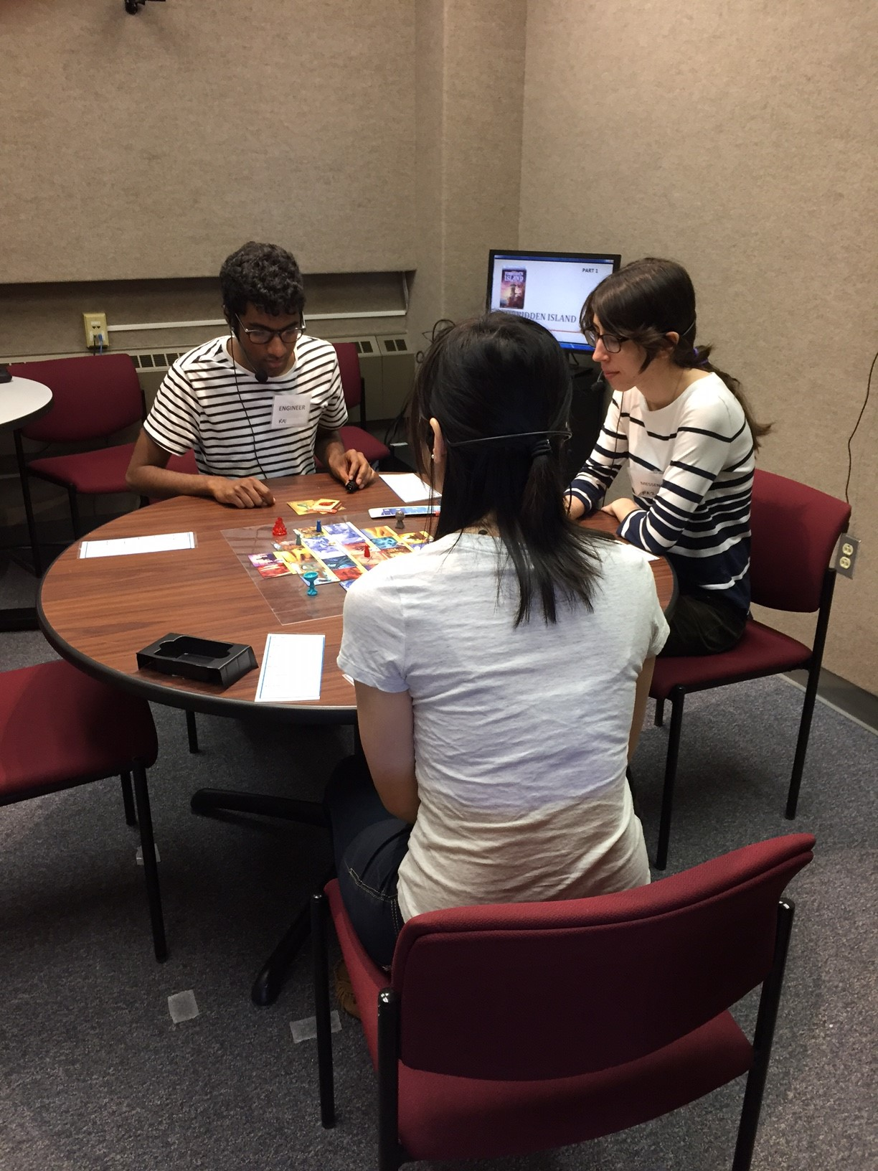
Data
Experimental Design
Audio-Video
  47 hours
  63 teams
Questionnaires
  216 individuals

