Slide 1
Experiences with Undergraduate Research
(Computationally Analyzing Audio, Video, and Transcriptions of Team Conversations)
Professor Diane Litman

Slide 2
Natural Language Processing (NLP)
Getting computers to perform useful and interesting tasks involving human languages
  languages such as English, Spanish, Chinese, etc.
  as opposed to computer languages such as Python

Slide 3
Why is NLP needed?
  An enormous amount of machine readable text, audio, and video is now available
  Conversational agents such as Siri and Alexa are becoming an important form of human-computer communication

Slide 4
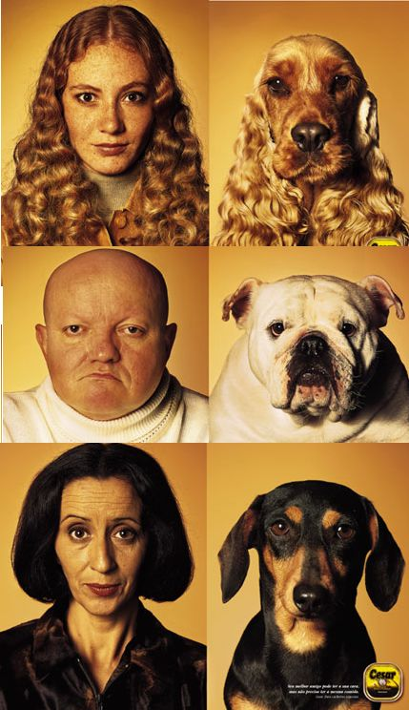
Teams Project: Entrainment and Task Success in Team Conversations

Slide 5
Teams Project: Entrainment and Task Success in Team Conversations
Multi-party entrainment measures that are computable using NLP
Applications
  Conversational agents
  Browsers for (un)successful teams

Slide 6
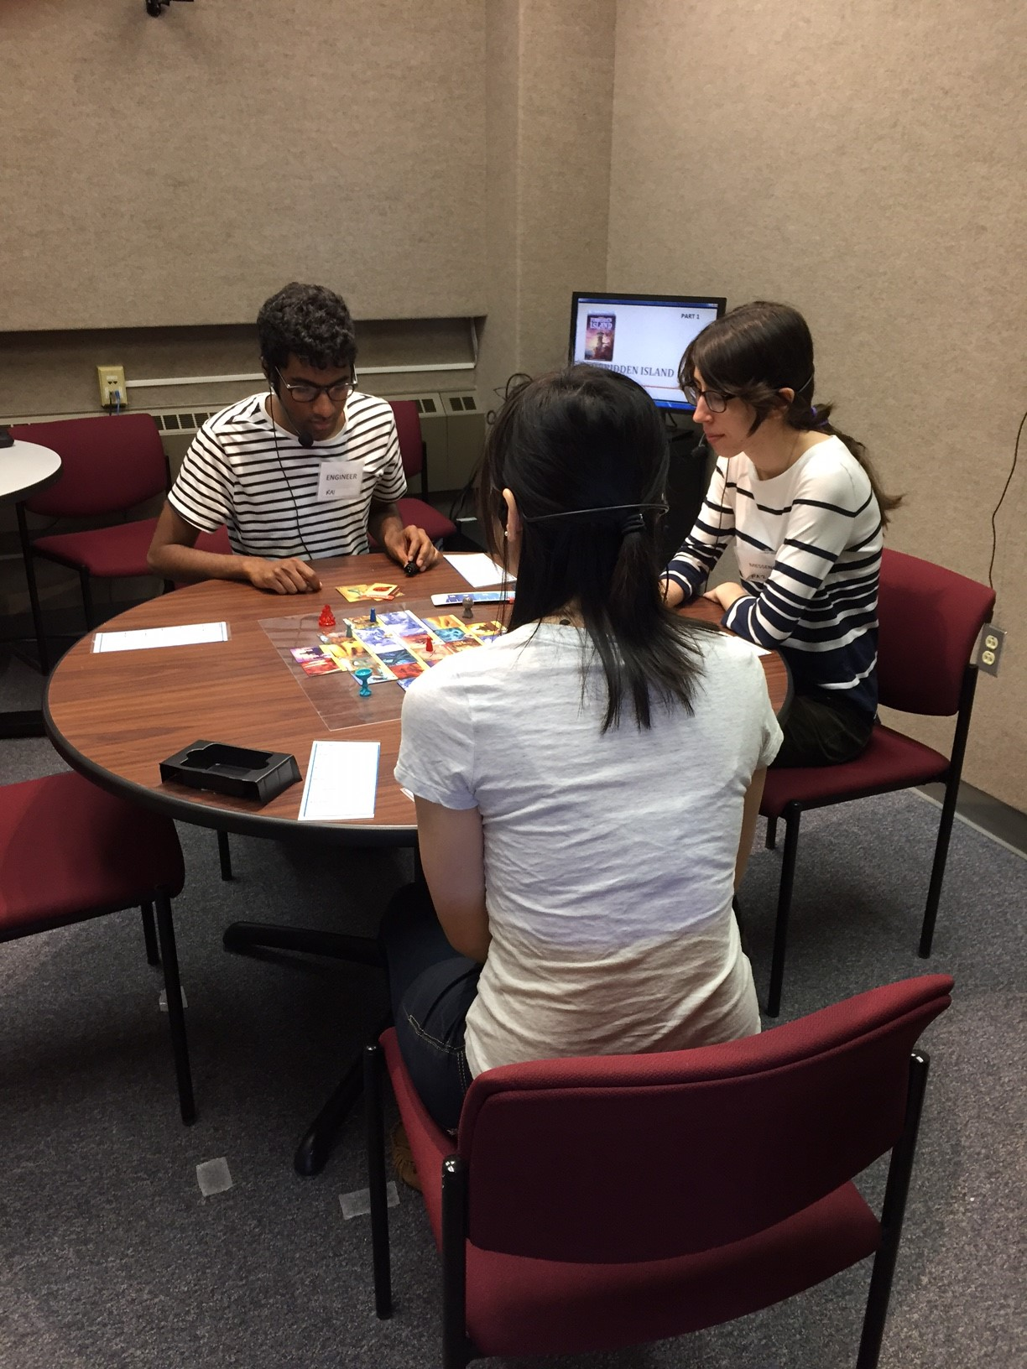
Experimentally Collected Data
Experimental Design
  Team Training or Not
  First vs. Second Games
Audio-Video
  47 hours
  63 teams
Questionnaires
  216 individuals

Slide 7
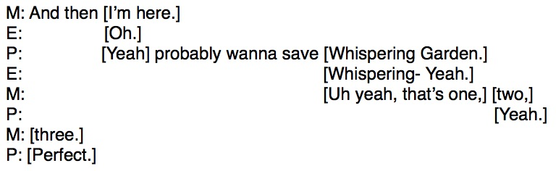
What teams say (transcriptions)

Slide 8
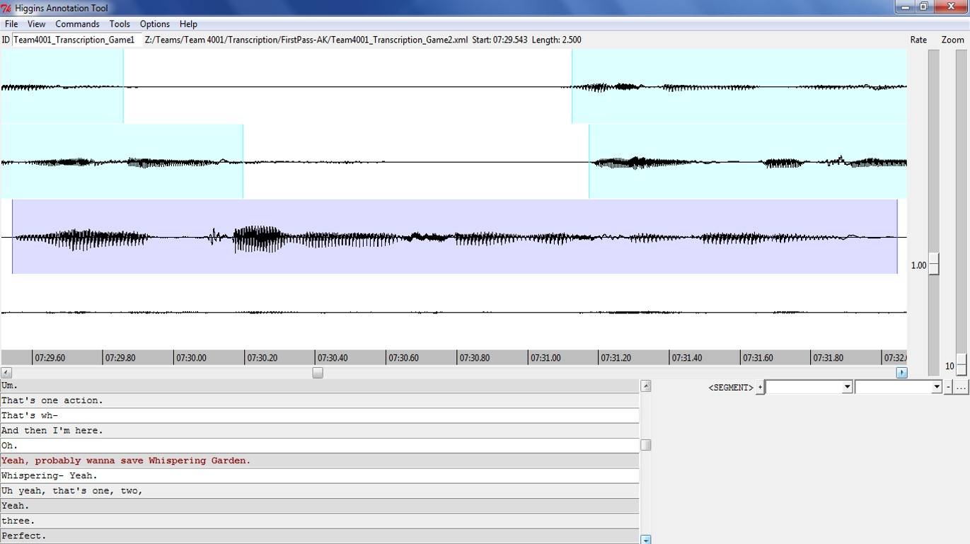
How teams say it (audio)

Slide 9
How teams say it (video)
Non-verbal communication
  Gaze
  Gesture
  Facial expressions
  Etc.

Slide 10
Litman Lab Undergraduate Research
Connecting
  I recruit (class performance, email to colleagues)
  I advertise (Pitt’s First Experiences in Research Program)
  Students initiate contact
    Ideal prerequisites: one or more of AI, NLP, ML
Implementing
  Employment: REU funds from the National Science Foundation
  Credit: CS Capstone project
    lab or office space
    Individual and group meetings

Slide 11
Selected Prior Projects / Outcomes
Exploiting Word-level Features for Emotion Prediction
  First-authored publications
  CS Day Award for Best Undergraduate Student Poster
  Honorable Mention in the Computing Research Association's Outstanding Undergraduate Award
  MS from Brown University
In the Zone: Towards Detecting Student Zoning Out using Supervised Machine Learning
Examining the Impacts of Dialogue Content and System Automation on Affect Models in a Spoken Tutorial Dialogue System
  First-authored publications
  CS Day Award for Best Undergraduate Student Poster
  National Science Foundation Graduate Research Fellowship
  now at U of Toronto
Differences in User Responses to a Wizard-of-Oz versus Automated System
  First-authored publications
  Honorable Mention in Computing Research Association's Outstanding Undergraduate Researcher Award
  now at U of Texas

