Slide 1
Experiences with
Undergraduate Research
(Natural Language Processing for Educational Applications)
Professor Diane Litman
University of Pittsburgh

Slide 2
Natural Language Processing
(NLP)
Getting computers to perform useful and interesting tasks involving human languages
  languages such as English, Spanish, Chinese, etc.
  as opposed to computer languages such as Python, etc.

Slide 3
Why is NLP needed?
  An enormous amount of knowledge is now available in machine readable form as natural language text
    the web
  Conversational agents are becoming an important form of human-computer communication
    Siri
  Much of human-human communication is now mediated by computers
    facebook

Slide 4
Spoken Dialogue Systems
Systems that interact with users via speech
Speech
Recognition
user
Spoken Dialog
System
Cloud,
DB, web,
smartphone
TTS or
recording

Slide 5

My Interests: Computer Tutors

Slide 6
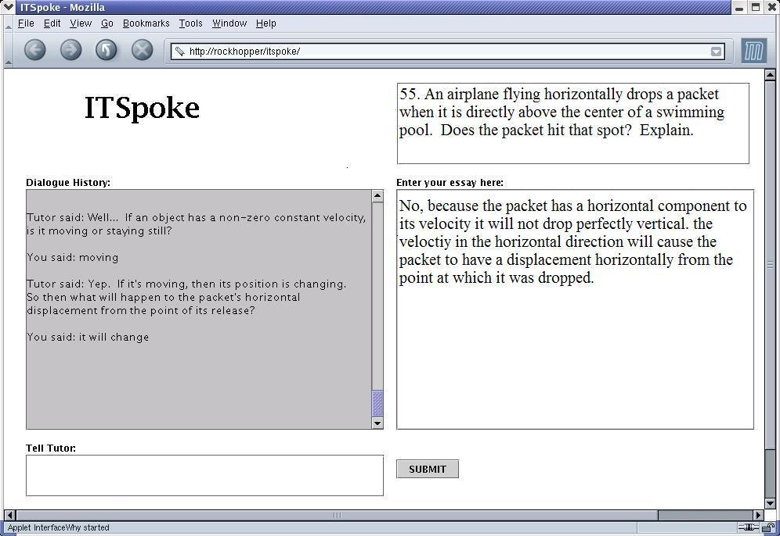

Slide 7
My Experiences with Undergraduate Research
Connecting
  I recruit students (often based on class performance), even as freshman
  Students contact Prof. Ramirez or contact me directly
    I typically follow-up with a transcript/CV request, and (for suitable candidates) an interview
Implementing
  Employment: REU (research experience for undergraduates) program of the National Science Foundation
  Credit: CS Capstone project
  Either way, students join my research group
    have an office
    Individual and group meetings
    work with me and/or my graduate students

Slide 8
Selected Prior Projects / Outcomes
Exploiting Word-level Features for Emotion Prediction
  First-authored publications
  CS Day Award for Best Undergraduate Student Poster
  Honorable Mention in the Computing Research Association's Outstanding Undergraduate Award
  MS from Brown University
In the Zone: Towards Detecting Student Zoning Out using Supervised Machine Learning
Examining the Impacts of Dialogue Content and System Automation on Affect Models in a Spoken Tutorial Dialogue System
  First-authored publications
  CS Day Award for Best Undergraduate Student Poster
  National Science Foundation Graduate Research Fellowship
  now at U of Toronto
Differences in User Responses to a Wizard-of-Oz versus Automated System
  First-authored publications
  Honorable Mention in the Computing Research Association's Outstanding Undergraduate Researcher Award
  now at U of Texas

Slide 9
Current Interests
Web-enabled peer review of homework
Fully-automated writing assessment
Deployed Educational Technology (SWoRD)
Ideal prerequisites: one or more of CS1571, 1573, 1671, 1675

