Slide 1
Automatically Predicting
Peer-Review Helpfulness
  Diane Litman
  Professor, Computer Science Department
  Senior Scientist, Learning Research & Development Center
  Co-Director, Intelligent Systems Program
  University of Pittsburgh
  Pittsburgh, PA

Slide 2
Context
Speech and Language Processing for Education
Learning Language
(reading, writing,
speaking)
Tutors
Scoring

Slide 3
Context
Speech and Language Processing for Education
Learning Language
(reading, writing,
speaking)
Using Language
(teaching in the disciplines)
Tutors
Tutorial Dialogue
Systems / Peers
Scoring

Slide 4
Context
Speech and Language Processing for Education
Learning Language
(reading, writing,
speaking)
Using Language
(teaching in the disciplines)
Processing
Language
Readability
Tutors
Tutorial Dialogue
Systems / Peers
Peer Review
Questioning
& Answering
Scoring
Discourse
Coding
Lecture
Retrieval

Slide 5
Outline
SWoRD
  Improving Review Quality
  Identifying Helpful Reviews
  Recent Directions
Tutorial Dialogue; Student Team Conversations
Summary and Current Directions

Slide 6
SWoRD: A web-based peer review system
[Cho & Schunn, 2007]
Authors submit papers

Slide 7
SWoRD: A web-based peer review system
[Cho & Schunn, 2007]
Authors submit papers
Peers submit (anonymous) reviews
  Instructor designed rubrics

Slide 8
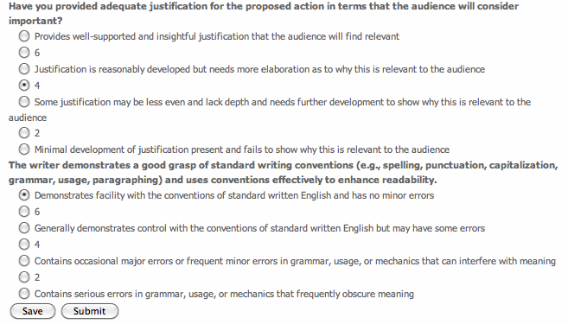

Slide 9
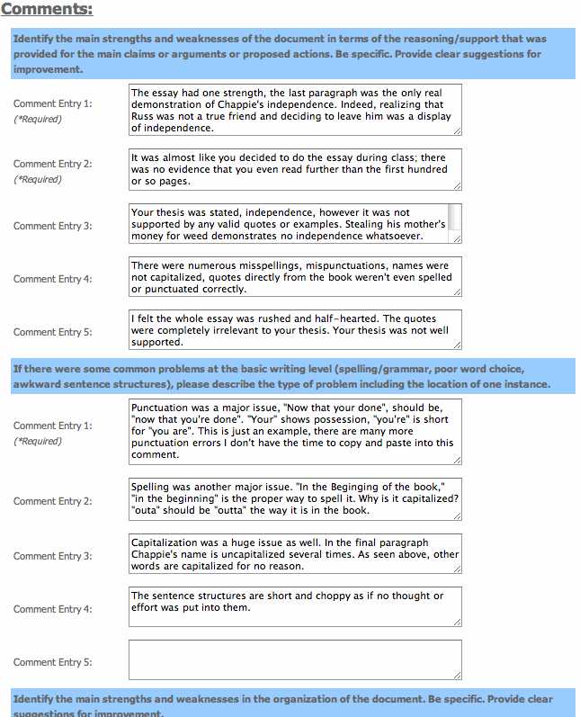

Slide 10
SWoRD: A web-based peer review system
[Cho & Schunn, 2007]
Authors submit papers
Peers submit (anonymous) reviews
Authors resubmit revised papers

Slide 11
SWoRD: A web-based peer review system
[Cho & Schunn, 2007]
Authors submit papers
Peers submit (anonymous) reviews
Authors resubmit revised papers
Authors provide back-reviews to peers regarding review helpfulness

Slide 13
Pros and Cons of Peer Review
  Pros
  Quantity and diversity of review feedback
  Students learn by reviewing
  Cons
Reviews are often not stated in effective ways
Reviews and papers do not focus on core aspects
Students (and teachers) are often overwhelmed by the quantity and diversity of the text comments

Slide 14
Related Research
Natural Language Processing
Helpfulness prediction for other types of reviews
  e.g., products, movies, books
  [Kim et al., 2006; Ghose & Ipeirotis, 2010; Liu et al., 2008;
  Tsur & Rappoport, 2009; Danescu-Niculescu-Mizil et al., 2009]
Other prediction tasks for peer reviews
    Key sentence in papers [Sandor & Vorndran, 2009]
    Important review features [Cho, 2008]
    Peer review assignment [Garcia, 2010]
Cognitive Science
Review implementation correlates with certain review features (e.g. problem localization) [Nelson & Schunn, 2008]
Difference between student and expert reviews [Patchan et al., 2009]
Notes:
One sentence or two?

Slide 15
Outline
SWoRD
  Improving Review Quality
  Identifying Helpful Reviews
  Recent Directions
Tutorial Dialogue; Student Team Conversations
Summary and Current Directions

Slide 16
Review Features and Positive Writing Performance [Nelson & Schunn, 2008]
Solutions
Summarization
Understanding
of the Problem
Implementation
Localization

Slide 17
Our Approach: Detect and Scaffold
Detect and direct reviewer attention to key review features such as solutions and localization
  [Xiong & Litman 2010; Xiong, Litman & Schunn, 2010, 2012]
Detect and direct reviewer and author attention to thesis statements in reviews and papers

Slide 18
Detecting Key Features of Text Reviews
Natural Language Processing to extract attributes from text, e.g.
  Regular expressions (e.g. “the section about”)
  Domain lexicons (e.g. “federal”, “American”)
  Syntax (e.g. demonstrative determiners)
  Overlapping lexical windows (quotation identification)
Machine Learning to predict whether reviews contain localization and solutions

Slide 19
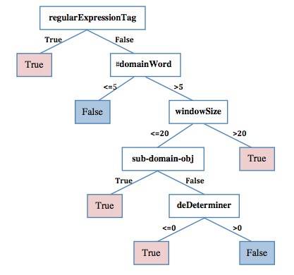
Learned Localization Model
[Xiong, Litman & Schunn, 2010]

Slide 20
Quantitative Model Evaluation
(10 fold cross-validation)
Review Feature | Classroom Corpus | N | Baseline Accuracy | Model Accuracy | Model Kappa | Human Kappa
Localization | History | 875 | 53% | 78% | .55 | .69
 | Psychology | 3111 | 75% | 85% | .58 | .63
Solution | History | 1405 | 61% | 79% | .55 | .79
 | CogSci | 5831 | 67% | 85% | .65 | .86

Slide 21
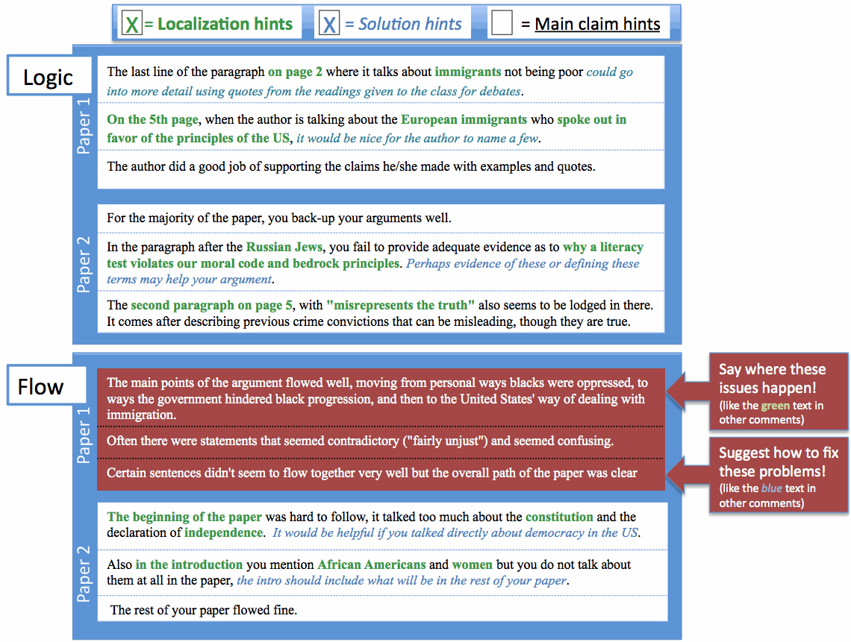

Slide 22
Outline
SWoRD
  Improving Review Quality
  Identifying Helpful Reviews
  Recent Directions
Tutorial Dialogue; Student Team Conversations
Summary and Current Directions

Slide 23
Review Helpfulness
Recall that SWoRD supports numerical back ratings of review helpfulness
  The support and explanation of the ideas could use some work. broading the explanations to include all groups could be useful. My concerns come from some of the claims that are put forth. Page 2 says that the 13th amendment ended the war. Is this true? Was there no more fighting or problems once this amendment was added? … The arguments were sorted up into paragraphs, keeping the area of interest clera, but be careful about bringing up new things at the end and then simply leaving them there without elaboration (ie black sterilization at the end of the paragraph). (rating 5)
  Your paper and its main points are easy to find and to follow. (rating 1)

Slide 24
Our Interests
Can helpfulness ratings be predicted from text? [Xiong & Litman, 2011a]
  Can prior product review techniques be generalized/adapted for peer reviews?
  Can peer-review specific features further improve performance?
Impact of predicting student versus expert helpfulness ratings
[Xiong & Litman, 2011b]

Slide 25
Baseline Method: Assessing (Product) Review Helpfulness
[Kim et al., 2006]
Data
  Product reviews on Amazon.com
  Review helpfulness is derived from binary votes (helpful versus unhelpful):
Approach
  Estimate helpfulness using SVM regression based on linguistic features
  Evaluate ranking performance with Spearman correlation
Conclusions
  Most useful features: review length, review unigrams, product rating
  Helpfulness ranking is easier to learn compared to helpfulness ratings: Pearson correlation < Spearman correlation
Notes:
Explain their features

Slide 26
Peer Review Corpus
Peer reviews collected by SWoRD system
  Introductory college history class
  267 reviews (20 – 200 words)
  16 papers (about 6 pages)
Gold standard of peer-review helpfulness
  Average ratings given by two experts.
    Domain expert & writing expert.
    1-5 discrete values
    Pearson correlation r = .4, p < .01
Prior annotations
  Review comment types -- praise, summary, criticism. (kappa = .92)
  Problem localization (kappa = .69), solution (kappa = .79), …

Slide 27
Peer versus Product Reviews
Helpfulness is directly rated on a scale (rather than a function of binary votes)
Peer reviews frequently refer to the related papers
Helpfulness has a writing-specific semantics
Classroom corpora are typically small

Slide 28

Generic Linguistic Features
(from reviews and papers)
Features motivated by Kim’s work
type | Label | Features (#)
Structural | STR | revLength, sentNum, question%, exclamationNum
Lexical | UGR, BGR | tf-idf statistics of review unigrams (#= 2992) and bigrams (#= 23209)
Syntactic | SYN | Noun%, Verb%, Adj/Adv%, 1stPVerb%, openClass%
Semantic (adapted) | TOP | counts of topic words (# = 288) ¹;
 | posW, negW | counts of positive (#= 1319) and negative sentiment words (#= 1752) ²
Meta-data (adapted) | META | paperRating, paperRatingDiff
Topic words are automatically extracted from students’ essays using topic signature software (by Annie Louis)
Sentiment words are extracted from General Inquirer Dictionary
* Syntactic analysis via MSTParser

Slide 29
Specialized Features
Features that are specific to peer reviews
    Lexical categories are learned in a semi-supervised way (next slide)
Type | Label | Features (#)
Cognitive Science | cogS | praise%, summary%, criticism%, plocalization%, solution%
Lexical Categories | LEX2 | Counts of 10 categories of words
Localization | LOC | Features developed for identifying problem localization

Slide 30
Lexical Categories
  Extracted from:
    Coding Manuals
    Decision trees trained with Bag-of-Words
Tag | Meaning | Word list
SUG | suggestion | should, must, might, could, need, needs, maybe, try, revision, want
LOC | location | page, paragraph, sentence
ERR | problem | error, mistakes, typo, problem, difficulties, conclusion
IDE | idea verb | consider, mention
LNK | transition | however, but
NEG | negative | fail, hard, difficult, bad, short, little, bit, poor, few, unclear, only, more
POS | positive | great, good, well, clearly, easily, effective, effectively, helpful, very
SUM | summarization | main, overall, also, how, job
NOT | negation | not, doesn't, don't
SOL | solution | revision, specify, correction

Slide 31
Experiments
Algorithm
  SVM Regression (SVM^{light})
Evaluation:
  10-fold cross validation
    Pearson correlation coefficient r (ratings)
    Spearman correlation coefficient r_{s} (ranking)
Experiments
  Compare the predictive power of each type of feature for predicting peer-review helpfulness
  Find the most useful feature combination
  Investigate the impact of introducing additional specialized features

Slide 32
Results: Generic Features
Feature Type | r | r_{s}
STR | 0.604+/-0.103 | 0.593+/-0.104
UGR | 0.528+/-0.091 | 0.543+/-0.089
BGR | 0.576+/-0.072 | 0.574+/-0.097
SYN | 0.356+/-0.119 | 0.352+/-0.105
TOP | 0.548+/-0.098 | 0.544+/-0.093
posW | 0.569+/-0.125 | 0.532+/-0.124
negW | 0.485+/-0.114 | 0.461+/-0.097
MET | 0.223+/-0.153 | 0.227+/-0.122
All classes except syntactic and meta-data are significantly correlated
Most helpful features:
  STR (, BGR, posW…)
Best feature combination: STR+UGR+MET
, which means helpfulness ranking is not easier to predict compared to helpfulness rating (suing SVM regressison).

Slide 33
Results: Generic Features
Feature Type | r | r_{s}
STR | 0.604+/-0.103 | 0.593+/-0.104
UGR | 0.528+/-0.091 | 0.543+/-0.089
BGR | 0.576+/-0.072 | 0.574+/-0.097
SYN | 0.356+/-0.119 | 0.352+/-0.105
TOP | 0.548+/-0.098 | 0.544+/-0.093
posW | 0.569+/-0.125 | 0.532+/-0.124
negW | 0.485+/-0.114 | 0.461+/-0.097
MET | 0.223+/-0.153 | 0.227+/-0.122
All-combined | 0.561+/-0.073 | 0.580+/-0.088
STR+UGR+MET | 0.615+/-0.073 | 0.609+/-0.098
Most helpful features:
  STR (, BGR, posW…)
Best feature combination: STR+UGR+MET
, which means helpfulness ranking is not easier to predict compared to helpfulness rating (suing SVM regression).

Slide 34
Results: Generic Features
Feature Type | r | r_{s}
STR | 0.604+/-0.103 | 0.593+/-0.104
UGR | 0.528+/-0.091 | 0.543+/-0.089
BGR | 0.576+/-0.072 | 0.574+/-0.097
SYN | 0.356+/-0.119 | 0.352+/-0.105
TOP | 0.548+/-0.098 | 0.544+/-0.093
posW | 0.569+/-0.125 | 0.532+/-0.124
negW | 0.485+/-0.114 | 0.461+/-0.097
MET | 0.223+/-0.153 | 0.227+/-0.122
All-combined | 0.561+/-0.073 | 0.580+/-0.088
STR+UGR+MET | 0.615+/-0.073 | 0.609+/-0.098
Most helpful features:
  STR (, BGR, posW…)
Best feature combination: STR+UGR+MET
, which means helpfulness ranking is not easier to predict compared to helpfulness rating (using SVM regression).

Slide 35
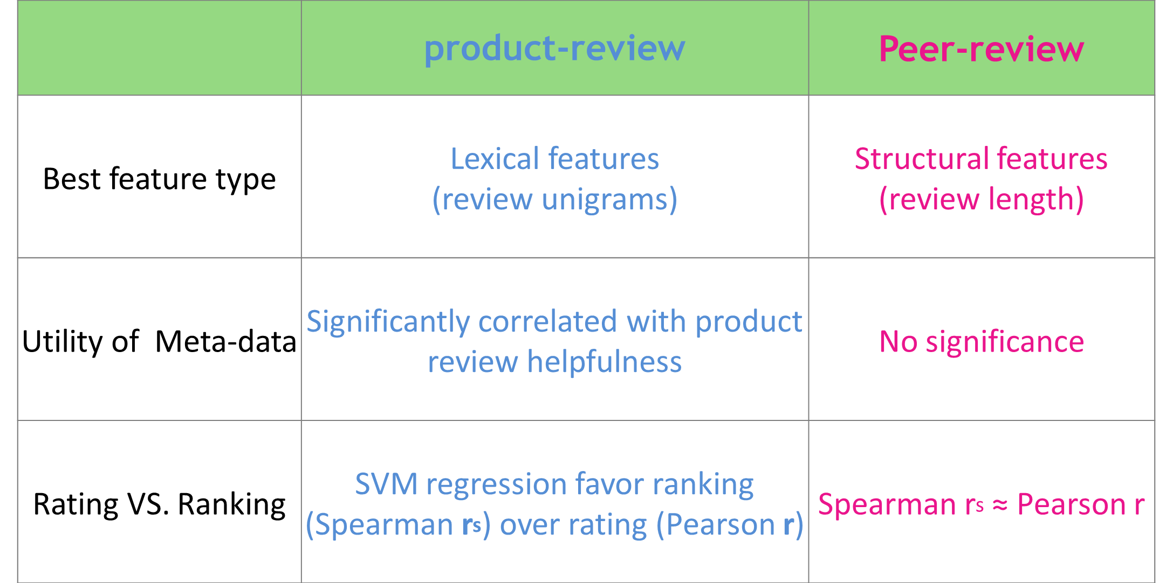
Discussion (1)
Effectiveness of generic features across domains
Same best generic feature combination (STR+UGR+MET)
But…

Slide 36
Results: Specialized Features
Feature Type | r | r_{s}
cogS | 0.425+/-0.094 | 0.461+/-0.072
LEX2 | 0.512+/-0.013 | 0.495+/-0.102
LOC | 0.446+/-0.133 | 0.472+/-0.113
STR+MET+UGR (Baseline) | 0.615+/-0.101 | 0.609+/-0.098
STR+MET+LEX2 | 0.621+/-0.096 | 0.611+/-0.088
STR+MET+LEX2+TOP | 0.648+/-0.097 | 0.655+/-0.081
STR+MET+LEX2+TOP+cogS | 0.660+/-0.093 | 0.655+/-0.081
STR+MET+LEX2+TOP+cogS+LOC | 0.665+/-0.089 | 0.671+/-0.076
All features are significantly correlated with helpfulness rating/ranking
  Weaker than generic features (but not significantly)
  Based on meaningful dimensions of writing (useful for validity and acceptance)

Slide 37
Results: Specialized Features
Feature Type | r | r_{s}
cogS | 0.425+/-0.094 | 0.461+/-0.072
LEX2 | 0.512+/-0.013 | 0.495+/-0.102
LOC | 0.446+/-0.133 | 0.472+/-0.113
STR+MET+UGR (Baseline) | 0.615+/-0.101 | 0.609+/-0.098
STR+MET+LEX2 | 0.621+/-0.096 | 0.611+/-0.088
STR+MET+LEX2+TOP | 0.648+/-0.097 | 0.655+/-0.081
STR+MET+LEX2+TOP+cogS | 0.660+/-0.093 | 0.655+/-0.081
STR+MET+LEX2+TOP+cogS+LOC | 0.665+/-0.089 | 0.671+/-0.076
Introducing high level features does enhance the model’s performance.
    Best model: Spearman correlation of 0.671 and Pearson correlation of 0.665.

Slide 38
Discussion (2)
  Techniques used in ranking product review helpfulness can be effectively adapted to the peer-review domain
    However, the utility of generic features varies across domains
  Incorporating features specific to peer-review appears promising
    provides a theory-motivated alternative to generic features
    captures linguistic information at an abstracted level better for small corpora (267 vs. > 10000)
    in conjunction with generic features, can further improve performance

Slide 39
What if we change the meaning of “helpfulness”?
  Helpfulness may be perceived differently by different types of people
Experiment: feature selection using different helpfulness ratings
      Student peers (avg.)
      Experts (avg.)
      Writing expert
      Content expert
Notes:
What gold-standard to use for the machine learning task??
Investigating differences in perceived peer-review helpfulness
between students and experts
between different types of expert

Slide 40
Example 1
Difference between students and experts
  Student rating = 7
  Expert-average = 2
  Student rating = 3
  Expert-average rating = 5
The author also has great logic in this paper. How can we consider the United States a great democracy when everyone is not treated equal. All of the main points were indeed supported in this piece.
I thought there were some good opportunities to provide further data to strengthen your argument. For example the statement “These methods of intimidation, and the lack of military force offered by the government to stop the KKK, led to the rescinding of African American democracy.” Maybe here include data about how …
(omit 126 words)
Note: Student rating scale is from 1 to 7, while expert rating scale is from 1 to 5
Notes:
Explain the difference:
Less helpful thought by the expert may because
Only praise no critiques not constructive
The comment is not supported with enough paper content.

Slide 41
Example 1
Difference between students and experts
  Student rating = 7
  Expert-average rating = 2
  Student rating = 3
  Expert-average rating = 5
The author also has great logic in this paper. How can we consider the United States a great democracy when everyone is not treated equal. All of the main points were indeed supported in this piece.
I thought there were some good opportunities to provide further data to strengthen your argument. For example the statement “These methods of intimidation, and the lack of military force offered by the government to stop the KKK, led to the rescinding of African American democracy.” Maybe here include data about how …
(omit 126 words)
Paper content
Note: Student rating scale is from 1 to 7, while expert rating scale is from 1 to 5
Notes:
Explain the difference:
Less helpful thought by the expert may because
Only praise no critiques not constructive
The comment is not supported with enough paper content.

Slide 42
Example 1
Difference between students and experts
  Student rating = 7
  Expert-average rating = 2
  Student rating = 3
  Expert-average rating = 5
Critique
The author also has great logic in this paper. How can we consider the United States a great democracy when everyone is not treated equal. All of the main points were indeed supported in this piece.
I thought there were some good opportunities to provide further data to strengthen your argument. For example the statement “These methods of intimidation, and the lack of military force offered by the government to stop the KKK, led to the rescinding of African American democracy.” Maybe here include data about how …
(omit 126 words)
praise
Note: Student rating scale is from 1 to 7, while expert rating scale is from 1 to 5
Notes:
Explain the difference:
Less helpful thought by the expert may because
Only praise no critiques not constructive
The comment is not supported with enough paper content.

Slide 43
Example 2
Difference between content expert and writing expert
  Writing-expert rating = 2
  Content-expert rating = 5
  Writing-expert rating = 5
  Content-expert rating = 2
Your over all arguements were organized in some order but was unclear due to the lack of thesis in the paper. Inside each arguement, there was no order to the ideas presented, they went back and forth between ideas. There was good support to the arguements but yet some of it didnt not fit your arguement.
First off, it seems that you have difficulty writing transitions between paragraphs. It seems that you end your paragraphs with the main idea of each paragraph. That being said, … (omit 173 words) As a final comment, try to continually move your paper, that is, have in your mind a logical flow with every paragraph having a purpose.

Slide 44
Example 2
Difference between content expert and writing expert
  Writing-expert rating = 2
  Content-expert rating = 5
  Writing-expert rating = 5
  Content-expert rating = 2
Your over all arguements were organized in some order but was unclear due to the lack of thesis in the paper. Inside each arguement, there was no order to the ideas presented, they went back and forth between ideas. There was good support to the arguements but yet some of it didnt not fit your arguement.
First off, it seems that you have difficulty writing transitions between paragraphs. It seems that you end your paragraphs with the main idea of each paragraph. That being said, … (omit 173 words) As a final comment, try to continually move your paper, that is, have in your mind a logical flow with every paragraph having a purpose.
Argumentation issue
Transition issue

Slide 45
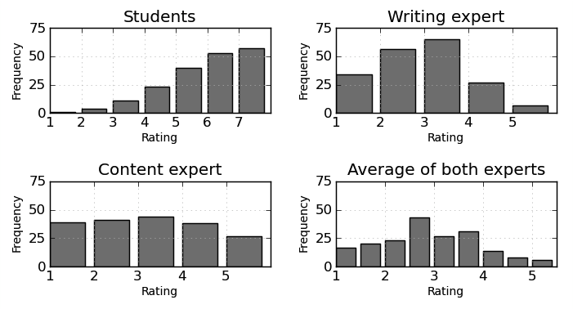
Difference in helpfulness rating distribution

Slide 46
Corpus
Previous annotated peer-review corpus
  Introductory college history class
  16 papers
  189 reviews
  Helpfulness ratings
  Expert ratings from 1 to 5
          Content expert and writing expert
          Average of the two expert ratings
  Student ratings from 1 to 7
Notes:
Paper topics
Descriptive information about the review
#words
#sentences

Slide 47
Experiment
Two feature selection algorithms
    Linear Regression with Greedy Stepwise search (stepwise LR)
      selected (useful) feature set
    Relief Feature Evaluation with Ranker (Relief)
      Feature ranks
Ten-fold cross validation

Slide 48
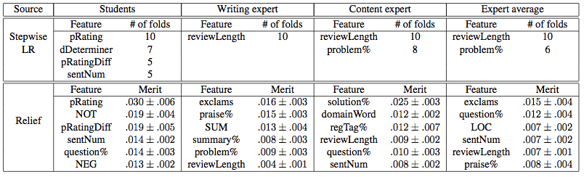
Sample Result: All Features
Feature selection of all features
    Students are more influenced by meta features, demonstrative determiners, number of sentences, and negation words
    Experts are more influenced by review length and critiques
    Content expert values solutions, domain words, problem localization
    Writing expert values praise and summary
Notes:
Though localization is more important than problem within the non-linguistic feautre set, when combined all features together, problem is more useful than lcoalization, due to the interaction among features. (regTag, LOC implies localization information)

Slide 49
Sample Result: All Features
Feature selection of all features
    Students are more influenced by meta features, demonstrative determiners, number of sentences, and negation words
    Experts are more influenced by review length and critiques
    Content expert values solutions, domain words, problem localization
    Writing expert values praise and summary
Notes:
Though localization is more important than problem within the non-linguistic feautre set, when combined all features together, problem is more useful than lcoalization, due to the interaction among features. (regTag, LOC implies localization information)

Slide 50
Sample Result: All Features
Feature selection of all features
    Students are more influenced by social-science features, demonstrative determiners, number of sentences, and negation words
    Experts are more influenced by review length and critiques
    Content expert values solutions, domain words, problem localization
    Writing expert values praise and summary
Notes:
Though localization is more important than problem within the non-linguistic feautre set, when combined all features together, problem is more useful than lcoalization, due to the interaction among features. (regTag, LOC implies localization information)

Slide 51
Sample Result: All Features
Feature selection of all features
    Students are more influenced by meta features, demonstrative determiners, number of sentences, and negation words
    Experts are more influenced by review length and critiques
    Content expert values solutions, domain words, problem localization
    Writing expert values praise and summary
Notes:
Though localization is more important than problem within the non-linguistic feautre set, when combined all features together, problem is more useful than lcoalization, due to the interaction among features. (regTag, LOC implies localization information)

Slide 52
Sample Result: All Features
Feature selection of all features
    Students are more influenced by meta features, demonstrative determiners, number of sentences, and negation words
    Experts are more influenced by review length and critiques
    Content expert values solutions, domain words, problem localization
    Writing expert values praise and summary
Notes:
Though localization is more important than problem within the non-linguistic feautre set, when combined all features together, problem is more useful than lcoalization, due to the interaction among features. (regTag, LOC implies localization information)

Slide 53
Other Findings
  Lexical features: transition cues, negation, and suggestion words are useful for modeling student perceived helpfulness
  Cognitive-science features: solution is effective in all helpfulness models; the writing expert prefers praise while the content expert prefers critiques and localization
  Meta features: paper rating is very effective for predicting student helpfulness ratings

Slide 54
Outline
SWoRD
  Improving Review Quality
  Identifying Helpful Reviews
  Recent Directions
Tutorial Dialogue; Student Team Conversations
Summary and Current Directions

Slide 55
1. High School Implementation
Fall 2012 – Spring 2013
  3 English teachers
  1 History teacher
  1 Science teacher
  1 Math teacher
All teachers (except science) in low SES, urban schools
Classroom contexts
  9 – 12 grade
  Little writing instruction
  Major writing assignments given 1-2 times per semester
  Variable access to technology
Notes:
College = history
High-school = TCCL (has higher ratio of praise% and critique% compared to the other one (TACL))
Localized% and solution% are computed within identified critiques

Slide 56
Challenges of High School Data
Different characteristics of feedback comments
More low-level content (language/grammar)
  High School: 32%; College: 9%
More vague comments
  Your essay is short. It has little information and needs work.
  You need to improve your thesis.
Comments often contain multiple ideas
  First, it's too short, doesn't complete the requirements. It's all just straight facts, there is no flow and finally, fix your spelling/typos, spell check's there for a reason. However, you provide evidence, but for what argument? There is absolutely no idea or thought, you are trying to convince the reader that your idea is correct.
Domain | Praise% | Critique% | Localized% | Solution%
College | 28% | 62% | 53% | 63%
High School | 15% | 52% | 36% | 40%
Notes:
College = history
High-school = TCCL (has higher ratio of praise% and critique% compared to the other one (TACL))
Localized% and solution% are computed within identified critiques

Slide 57
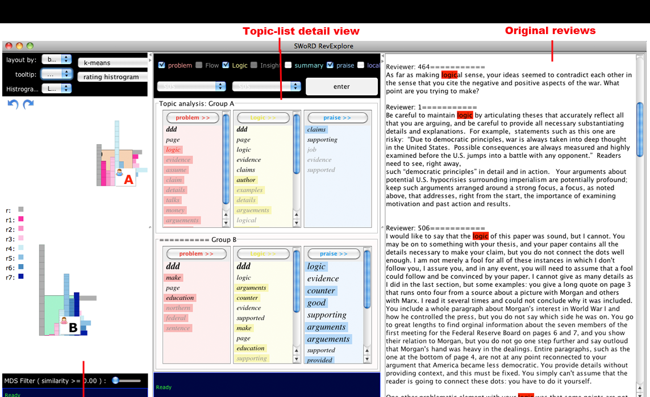
2) RevExplore:An Analytic Tool for Teachers
[Xiong, Litman, Wang & Schunn, 2012]

Slide 58
Topic-Word Evaluation
[Xiong and Litman, submitted]
Method | Reviews by helpful students | Reviews by less helpful students
Topic Signatures | Arguments, immigrants, paper, wrong, theories, disprove, theory | Democratically, injustice, page, facts
LDA | Arguments, evidence, could , sentence, argument, statement, use, paper | Page, think, essay, facts
Frequency | Paper, arguments, evidence, make, also, could, argument paragraph | Page, think, argument, essay

Slide 59
Topic-Word Evaluation
[Xiong and Litman, submitted]
Method | Reviews by helpful students | Reviews by less helpful students
Topic Signatures | Arguments, immigrants, paper, wrong, theories, disprove, theory | Democratically, injustice, page, facts
LDA | Arguments, evidence, could , sentence, argument, statement, use, paper | Page, think, essay, facts
Frequency | Paper, arguments, evidence, make, also, could, argument paragraph | Page, think, argument, essay
Topic words of reviews reveal writing & reviewing patterns
  Classification study
  User study

Slide 60
Topic-Word Evaluation
[Xiong and Litman, submitted]
Method | Reviews by helpful students | Reviews by less helpful students
Topic Signatures | Arguments, immigrants, paper, wrong, theories, disprove, theory | Democratically, injustice, page, facts
LDA | Arguments, evidence, could , sentence, argument, statement, use, paper | Page, think, essay, facts
Frequency | Paper, arguments, evidence, make, also, could, argument paragraph | Page, think, argument, essay
Topic words of reviews reveal writing & reviewing patterns
  Classification study
  User study
Topic signature method outperforms standard alternatives

Slide 61
Outline
SWoRD
  Improving Review Quality
  Identifying Helpful Reviews
  Recent Directions
Tutorial Dialogue; Student Team Conversations
Summary and Current Directions

Slide 62
1) ITSPOKE: Intelligent Tutoring SPOKEn Dialogue System
Speech and language processing to detect and respond to student uncertainty and disengagement (over and above correctness)
  Problem-solving dialogues for qualitative physics
Collaborators: Kate Forbes-Riley
National Science Foundation, 2003-present

Slide 63
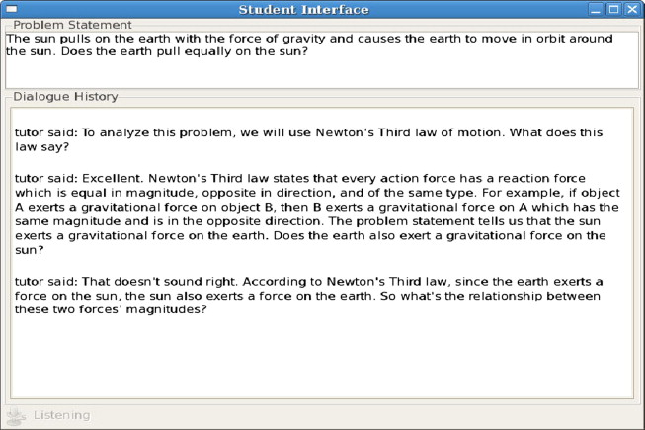

Slide 64
Example Experimental Treatment
TUTOR: Now let’s talk about the net force exerted on the truck. By the same reasoning that we used for the car, what’s the overall net force on the truck equal to?
STUDENT: The force of the car hitting it? [uncertain+correct]
TUTOR (Control System): Good [Feedback] … [moves on]
versus
TUTOR (Experimental System A): Fine. [Feedback] We can derive the net force on the truck by summing the individual forces on it, just like we did for the car. First, what horizontal force is exerted on the truck during the collision? [Remediation Subdialogue]
Notes:
1st Overview study...
And the coding done on the student turns
Parameters extracted from corpora, used to build models
Then I’ll discuss our results – our predictive models

Slide 65
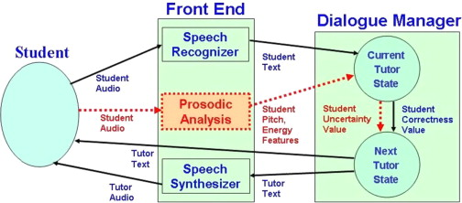
ITSPOKE Architecture

Slide 66
Recent Contributions
Experimental Evaluations
  Detecting and responding to student uncertainty (over and above correctness) increases learning [Forbes-Riley & Litman, 2011a,b]
  Responding to student disengagement (over and above uncertainty) further improves performance [Forbes-Riley & Litman, 2012; Forbes-Riley et al., 2012]
Enabling Technologies
  Reinforcement learning to automate the authoring / optimization of (tutorial) dialogue systems [Tetreault & Litman, 2008; Chi et al., 2011a,b]
  Statistical methods to design / evaluate user simulations [Ai & Litman, 2011a,b]
  Affect detection from text and speech [Drummond & Litman, 2011; Litman et al., 2012]

Slide 67
Outline
SWoRD
  Improving Review Quality
  Identifying Helpful Reviews
  Recent Directions
Tutorial Dialogue; Student Team Conversations
Summary and Current Directions

Slide 68
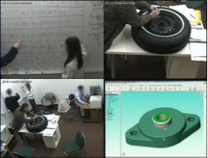
Student Engineering Teams
(Chan, Paletz & Schunn, LRDC )
Pitt student teams working on engineering projects
  Variety of group sizes and projects
  “In vivo” dialogues
    Semester meetings were recorded in a specially prepared room in exchange for payment
10 high and 10 low-performing teams
Sampled ~1 hour of dialogue / team (~43000 turns)

Slide 69
Lexical Entrainment and Task Success
[Friedberg, Litman & Paletz, 2012]
Corpus-based measures of (multi-party) dialogue cohesion and entrainment
Cohesion, Entrainment and…
  Learning gains in one-on-one human and computer tutoring dialogues [Ward dissertation, 2010]
  Team success in multi-party student dialogues
Towards teacher data mining and tutorial dialogue system manipulation

Slide 70
Outline
SWoRD
  Improving Review Quality
  Identifying Helpful Reviews
  Recent Directions
Tutorial Dialogue; Student Team Conversations
Summary and Current Directions

Slide 71
Peer Review
Scaffolded peer review to improve student writing as well as reviewing
  Natural language processing to detect and scaffold useful feedback features
  Techniques used in predicting product review helpfulness can be effectively adapted to the peer-review domain
  The type of helpfulness to be predicted influences feature utility for automatic prediction
Currently generalizing from students to teachers, and college to high school

Slide 72
Conversational Systems and Data
Computer dialogue tutors can serve as a valuable aid for studying and improving student learning
  ITSPOKE
Intelligent tutoring in turn provides opportunities and challenges for dialogue research
  Evaluation, affective reasoning, statistical learning, user simulation, lexical entrainment, prosody, and more!
Currently extending research from tutorial dialogue to multi-party educational conversations

Slide 73




Acknowledgements
SWoRD: K. Ashley, A. Godley, C. Schunn, J. Wang, J. Lippman, M. Falaksmir, C. Lynch, H. Nguyen, W. Xiong, S. DeMartino
ITSPOKE: K. Forbes-Riley, S. Silliman, J. Tetreault, H. Ai, M. Rotaru, A. Ward, J. Drummond, H. Friedberg, J. Thomason
NLP, Tutoring, & Engineering Design Groups @Pitt: M. Chi, R. Hwa, K. VanLehn, J. Wiebe, S. Paletz

Slide 74
Thank You!
Questions?
Further Information
  http://www.cs.pitt.edu/~litman/itspoke.html

Slide 75
The Problem
Students unable to synthesize what the sources say…
Psychology Research Methods
Assignment
Read these 5 sources: ….
Articulate a research question.
Identify 3 research hypotheses (2 main effects and 1 interaction effect).
Write an introductory text for a research paper that:
  addresses the research question,
  supports these hypotheses based on and citing the 5 sources, and
  proposes a method to test the hypotheses empirically.
… or to apply them in solving the problem.

Slide 76
LASAD analyzes diagrams
With even small set of types of argument nodes and relations and of constraint-defining rules…
Even simple argument diagrams provide pedagogical information that can be automatically analyzed. E.g., has student:
  Addressed all sources and hypotheses? (No)
  Indicated that citations support claims/hypotheses? (Not vice versa as here)
  Related all sources and hypotheses under single claim? (No)
  Related some citations to more than one hypothesis? (No interactions here)
  Included oppositional relations as well as supports? (No)
  Avoided isolated citations? (Yes)
  Avoided disjoint sub-arguments? (No)

Slide 77
Prototype SWoRD Interface for feedback to reviewer pre-review submission
= Localization hints
= Solution hints
Say where these issues happen!
(like the green text in other comments)
X
X
Claims or reasons are unconnected to the research question or hypothesis.
Lippman, 2010 is not organized around a hypothesis.
Siler 2009 is more focused on the response to the task not focused on the actual type of task which is what the hypothesis for the effect of IV2. Doesn’t support the research question.
Diagram 1
Suggest how to fix these problems!
(like the blue text in other comments)
H2 needs reasoning to connect prior research with the hypothesis, e.g. “because multi-step algebra problems are perceived as more difficult, people are more likely to fail in solving them.”
Support 2 is weak because it’s basically citing a study as the reason itself. Instead, it should be a general claim, that uses Jones, 2007 to back it up.
Lippman, 2010 is free floating and needs to be linked to either the research question or a hypothesis.
Diagram 2

Slide 78
Prototype tool to translate student argument diagrams into text
A Translation of Your Argument Diagram (click to edit)
Next Steps
The first hypothesis is, “If participants are assigned to the active condition, then they will be better at correctly identifying stimuli than participants in the passive condition.” This hypothesis is supported by (Craig 2001) where it was found that “Active touch participants were able to more accurately identify objects because they had the use of sensitive fingertips in exploring the objects.” The hypothesis is also supported by (Gibson 1962) where …
1
2
The second hypothesis is, …
Possible things to improve your argument:
Add a missing citation
Add third hypothesis
Indicate which hypothesis is an interaction hypothesis and specifying an interaction variable(s)
Relate one or more hypotheses along with their supporting sources under a single sub claim
Include any oppositional relations between citations and a hypothesis
Relate the disjointed subarguments concerning the hypotheses under one overall argument
Save progress
Export text
Quit

Slide 79

Disengagement is also of interest
User sings answer indicating lack of interest in its purpose
ITSPOKE: What vertical force is always exerted on an object near the surface of the earth?
USER: Gravity
(disengaged, certain)

Slide 80
ITSPOKE Experimental Procedure
College students without physics
  Read a small background document
  Take a multiple-choice Pretest
  Work 5 problems (dialogues) with ITSPOKE
  Take an isomorphic Posttest
Goal is to optimize Learning Gain
  e.g., Posttest – Pretest

Slide 81
Reflective Dialogue Excerpt
Problem: Calculate the speed at which a hailstone, falling from 9000 meters out of a cumulonimbus cloud, would strike the ground, presuming that air friction is negligible.
    Solved on paper (or within another computer tutoring system)
Reflection Question: How do we know that we have an acceleration in this problem?
  Student: b/c the final velocity is larger than the starting velocity, 0.
  Tutor: Right, a change of velocity implies acceleration …

Slide 82
Example Student States
ITSPOKE: What else do you need to know to find the box‘s acceleration?
Student: the direction [UNCERTAIN]
ITSPOKE : If you see a body accelerate, what caused that acceleration?
Student: force [CERTAIN]
ITSPOKE : Good job. Say there is only one force acting on the box. How is this force, the box's mass, and its acceleration related?

