Slide 1



Natural Language Processing for
Enhancing Teaching and Learning at Scale:
Three Case Studies
Diane Litman
  Professor, Computer Science Department
  Co-Director, Intelligent Systems Program
  Senior Scientist, Learning Research & Development Center
University of Pittsburgh
Pittsburgh, PA USA
Shaw Visiting Professor (Semester 1): NUS
Notes:
Online reviews is an important information resources for our everyday life.
Reviews play an important role in consumer purchase decisions, and thus has an economic impact on product sales
Stats:
-71% of consumers read online reviews. -55% of consumers trust a local business more after reading positive online reviews. -50% of consumers are more likely to use a local business having read positive reviews. -67% of consumers trust online reviews as much as personal recommendations.

Slide 2
Roles for Language Processing in Education
Learning Language
(e.g., reading, writing, speaking)

Slide 3
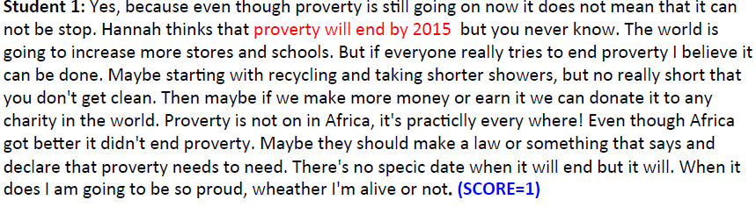
Roles for Language Processing in Education
Learning Language
(e.g., reading, writing, speaking)
1. Automatic Essay Grading

Slide 4

Roles for Language Processing in Education
Using Language
(e.g., teaching in the disciplines)
Tutorial Dialogue Systems for STEM

Slide 5
Roles for Language Processing in Education
Processing Language
(e.g,. from MOOCs)

Slide 6
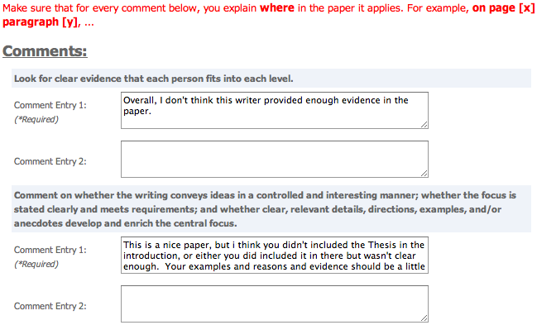
Roles for Language Processing in Education
Processing Language
(e.g.. from MOOCs)
2. Peer Feedback

Slide 7

Roles for Language Processing in Education
Processing Language
(e.g., from MOOCs)
3. Student Reflections

Slide 8
NLP for Education Research Lifecycle
Systems and Evaluations
Real-World
Problems
Learning and Teaching
Higher Level Learning Processes
NLP-Based Educational Technology
Challenges!
User-generated content
Meaningful constructs
Real-time performance
Theoretical and Empirical Foundations

Slide 9
Three Case Studies
Automatic Writing Assessment
  Co-PIs: Rip Correnti, Lindsay Clare Matsumara
Peer Review of Writing
  Co-PIs: Kevin Ashley, Amanda Godley, Chris Schunn
Summarizing Student Generated Reflections
  Co-PIs: Muhsin Meneske, Jingtao Wang

Slide 10

Why Automatic Writing Assessment?
Essential for Massive Open Online Courses (MOOCs)
Even in traditional classes, frequent assignments can limit the amount of teacher feedback
Notes:
The first question is that you may ask is why Automatic Essay Assessment is important.
Well, in order to Score and provide feedback on written assignments in Tutoring systems and MOOCs, it is essential to have reliable AES systems. Even in class rooms with large number of students and frequent writing assignments, Providing individual feedback to students is a burden and a very time consuming task for teatures.
Consider the capitalization

Slide 11
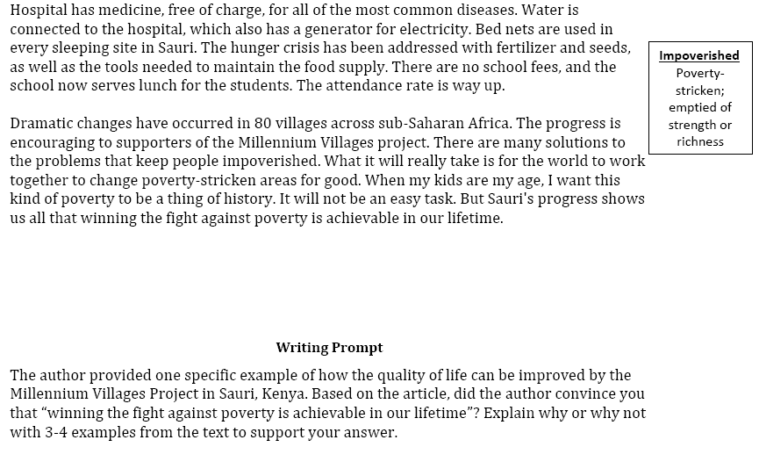
An Example Writing Assessment Task: Response to Text (RTA)
MVP, Time for Kids – informational text

Slide 12
RTA Rubric for the Evidence dimension
1 | 2 | 3 | 4
Features one or no pieces of evidence | Features at least 2 pieces of evidence | Features at least 3 pieces of evidence | Features at least 3 pieces of evidence
Selects inappropriate or little evidence from the text; may have serious factual errors and omissions | Selects some appropriate but general evidence from the text; may contain a factual error or omission | Selects appropriate and concrete, specific evidence from the text | Selects detailed, precise, and significant evidence from the text
Demonstrates little or no development or use of selected evidence | Demonstrates limited development or use of selected evidence | Demonstrates use of selected details from the text to support key idea | Demonstrates integral use of selected details from the text to support and extend key idea
Summarize entire text or copies heavily from text | Evidence provided may be listed in a sentence, not expanded upon | Attempts to elaborate upon evidence | Evidence must be used to support key idea / inference(s)

Slide 13
Gold-Standard Scores (& NLP-based evidence)
Student 1: Yes, because even though proverty is still going on now it does not mean that it can not be stop. Hannah thinks that proverty will end by 2015 but you never know. The world is going to increase more stores and schools. But if everyone really tries to end proverty I believe it can be done. Maybe starting with recycling and taking shorter showers, but no really short that you don't get clean. Then maybe if we make more money or earn it we can donate it to any charity in the world. Proverty is not on in Africa, it's practiclly every where! Even though Africa got better it didn't end proverty. Maybe they should make a law or something that says and declare that proverty needs to need. There's no specic date when it will end but it will. When it does I am going to be so proud, wheather I'm alive or not. (SCORE=1)
Student 2: I was convinced that winning the fight of poverty is achievable in our lifetime. Many people couldn't afford medicine or bed nets to be treated for malaria . Many children had died from this dieseuse even though it could be treated easily. But now, bed nets are used in every sleeping site . And the medicine is free of charge. Another example is that the farmers' crops are dying because they could not afford the nessacary fertilizer and irrigation . But they are now, making progess. Farmers now have fertilizer and water to give to the crops. Also with seeds and the proper tools . Third, kids in Sauri were not well educated. Many families couldn't afford school . Even at school there was no lunch . Students were exhausted from each day of school. Now, school is free . Children excited to learn now can and they do have midday meals . Finally, Sauri is making great progress. If they keep it up that city will no longer be in poverty. Then the Millennium Village project can move on to help other countries in need. (SCORE=4)

Slide 14
Automatic Scoring of an Analytical
Response-To-Text Assessment (RTA)
Summative writing assessment for argument-related RTA scoring rubrics
  Evidence [Rahimi, Litman, Correnti, Matsumura, Wang & Kisa, 2014]
  Organization [Rahimi, Litman, Wang & Correnti, 2015]
Pedagogically meaningful scoring features
  Validity as well as reliability

Slide 15
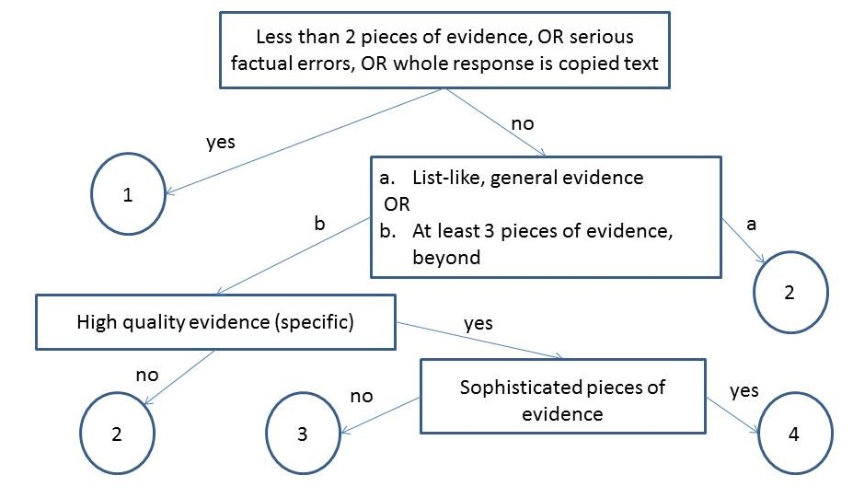
Extract Essay Features using NLP
Notes:
What is evidence topic subtopic,
Copping how much copy is copying

Slide 16
Extract Essay Features using NLP
Number of Pieces of Evidence (NPE)
  Topics and words based on the text and experts
Notes:
What is evidence topic subtopic,
Copping how much copy is copying

Slide 17
Extract Essay Features using NLP
Notes:
What is evidence topic subtopic,
Copping how much copy is copying

Slide 18
Extract Essay Features using NLP
Concentration (CON)
High concentration essays have fewer than 3 sentences with topic words (i.e., evidence is not elaborated)
Notes:
What is evidence topic subtopic,
Copping how much copy is copying

Slide 19
Extract Essay Features using NLP
Notes:
What is evidence topic subtopic,
Copping how much copy is copying

Slide 20
Extract Essay Features using NLP
Specificity (SPC)
Specific examples from different parts of the text
Notes:
What is evidence topic subtopic,
Copping how much copy is copying

Slide 21
Extract Essay Features using NLP
Word Count (WOC)
Potentially helpful fallback feature (temporarily )
Notes:
What is evidence topic subtopic,
Copping how much copy is copying

Slide 22
Supervised Machine Learning
Data [Correnti et al., 2013]
  1560 essays written by students in grades 4-6
    Short, many spelling and grammatical errors

Slide 23
Experimental Evaluation
Baseline1 [Mayfield 13]: one of the best methods from the Hewlett Foundation competition [Shermis and Hamner, 2012]
  Features: primarily bag of words (top 500)
Baseline2: Latent Semantic Analysis
  Based on the scores of the 10 most similar essays, weighted by semantic similarity [Miller 03]
Notes:
Make shorter

Slide 24
Results: Can we Automate?
Proposed features outperform both baselines

Slide 25
Other Results
Evidence Rubric
  Wordcount is only useful for discriminating score 4 (where no rubric features were defined)
  Features also outperform baselines for grades 6-8 essays
Organization Rubric
  New coherence of evidence features outperform baselines for both student essay corpora

Slide 26
Three Case Studies
Automatic Writing Assessment
  Co-PIs: Rip Correnti, Lindsay Clare Matsumara
Peer Review of Writing
  Co-PIs: Kevin Ashley, Amanda Godley, Chris Schunn
Summarizing Student Generated Reflections
  Co-PIs: Muhsin Meneske, Jingtao Wang

Slide 27
Why Peer Review?
An alternative for grading writing at scale in MOOCs
Also used in traditional classes
  Quantity and diversity of review feedback
  Students learn by reviewing

Slide 28
SWoRD: A web-based peer review system
[Cho & Schunn, 2007]
Authors submit papers
Peers submit (anonymous) reviews
  Students provide numerical ratings and text comments
  Problem: text comments are often not stated effectively

Slide 29
One Aspect of Review Quality
Localization: Does the comment pinpoint where in the paper the feedback applies? [Nelson & Schunn 2008]
  There was a part in the results section where the author stated “The participants then went on to choose who they thought the owner of the third and final I.D. to be…” the ‘to be’ is used wrong in this sentence. (localized)
  The biggest problem was grammar and punctuation. All the writer has to do is change certain tenses and add commas and colons here and there. (not localized)

Slide 30
Our Approach for Improving Reviews
Detect reviews that lack localization and solutions
  [Xiong & Litman 2010; Xiong, Litman & Schunn 2010, 2012; Nguyen & Litman 2013, 2014]
Scaffold reviewers in adding these features
  [Nguyen, Xiong & Litman 2014]

Slide 31
Detecting Key Features of Text Reviews
Natural Language Processing to extract attributes from text, e.g.
  Regular expressions (e.g. “the section about”)
  Domain lexicons (e.g. “federal”, “American”)
  Syntax (e.g. demonstrative determiners)
  Overlapping lexical windows (quotation identification)
Supervised Machine Learning to predict whether reviews contain localization and solutions

Slide 32
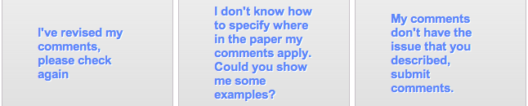
Localization Scaffolding
System scaffolds (if needed)
Localization model applied
Localization model applied
Reviewer makes decision (e.g. DISAGREE)

Slide 33
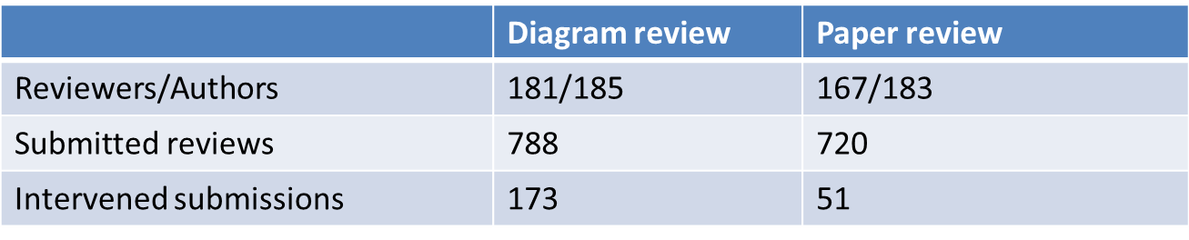
A First Classroom Evaluation
[Nguyen, Xiong & Litman, 2014]
NLP extracts attributes from reviews in real-time
Prediction models use attributes to detect localization
Scaffolding if < 50% of comments predicted as localized
Deployment in undergraduate Research Methods
  Diagrams → Diagram reviews → Papers → Paper reviews

Slide 34
Results: Can we Automate?
Comment Level (System Performance)
  Detection models significantly outperform baselines
  Results illustrate model robustness during classroom deployment
    testing data is from different classes than training data
Close to with reported results (in experimental setting) of previous studies (Xiong & Litman 2010, Nguyen & Litman 2013)
  Prediction models are robust even in not-identical training-testing
 | Diagram review |  | Paper review
 | Accuracy | Kappa | Accuracy | Kappa
Majority baseline | 61.5% (not localized) | 0 | 50.8% (localized) | 0
Our models | 81.7% | 0.62 | 72.8% | 0.46

Slide 35
Results: Can we Automate?
Review Level (student perspective of system)
  Students do not know the localization threshold
  Scaffolding is thus incorrect only if all comments are already localized

Slide 36
Results: Can we Automate?
Review Level (student perspective of system)
  Students do not know the localization threshold
  Scaffolding is thus incorrect only if all comments are already localized
Only 1 incorrect intervention at review level!
 | Diagram review | Paper review
Total scaffoldings | 173 | 51
Incorrectly triggered | 1 | 0

Slide 37
Results: New Educational Technology
Student Response to Scaffolding
Why are reviewers disagreeing?
  No correlation with true localization ratio
Reviewer response | REVISE | DISAGREE
Diagram review | 54 (48%) | 59 (52%)
Paper review | 13 (30%) | 30 (70%)

Slide 38
A Deeper Look: Student Learning
 | # and % of comments (diagram reviews)
NOT Localized → Localized | 26 | 30.2%
Localized → Localized | 26 | 30.2%
NOT Localized → NOT Localized | 33 | 38.4%
Localized → NOT Localized | 1 | 1.2%
Comment localization is either improved or remains the same after scaffolding
  Localization revision continues after scaffolding is removed
  Replication in college psychology and 2 high school math corpora

Slide 39
Three Case Studies
Automatic Writing Assessment
  Co-PIs: Rip Correnti, Lindsay Clare Matsumara
Peer Review of Writing
  Co-PIs: Kevin Ashley, Amanda Godley, Chris Schunn
Summarizing Student Generated Reflections
  Co-PIs: Muhsin Meneske, Jingtao Wang

Slide 40
Why (Summarize) Student Reflections?
Student reflections have been shown to improve both learning and teaching
In large lecture classes (e.g. undergraduate STEM), it is hard for teachers to read all the reflections
  Same problem for MOOCs
Notes:
The first question is that you may ask is why Automatic Essay Assessment is important.
Well, in order to Score and provide feedback on written assignments in Tutoring systems and MOOCs, it is essential to have reliable AES systems. Even in class rooms with large number of students and frequent writing assignments, Providing individual feedback to students is a burden and a very time consuming task for teatures.
Consider the capitalization

Slide 41
Student Reflections and a TA’s Summary
Reflection Prompt: Describe what was confusing or needed more detail.
Student Responses
S1: Graphs of attraction/repulsive & interatomic separation
S2: Property related to bond strength
S3: The activity was difficult to comprehend as the text fuzzing and difficult to
read.
S4: Equations with bond strength and Hooke's law
S5: I didn't fully understand the concept of thermal expansion
S6: The activity ( Part III)
S7: Energy vs. distance between atoms graph and what it tells us
S8: The graphs of attraction and repulsion were confusing to me
… (rest omitted, 53 student responses in total)

Slide 42
Student Reflections and a TA’s Summary
Reflection Prompt: Describe what was confusing or needed more detail.
Student Responses
S1: Graphs of attraction/repulsive & interatomic separation
S2: Property related to bond strength
S3: The activity was difficult to comprehend as the text fuzzing and difficult to
read.
S4: Equations with bond strength and Hooke's law
S5: I didn't fully understand the concept of thermal expansion
S6: The activity ( Part III)
S7: Energy vs. distance between atoms graph and what it tells us
S8: The graphs of attraction and repulsion were confusing to me
… (rest omitted, 53 student responses in total)
Summary created by the Teaching Assistant
1) Graphs of attraction/repulsive & atomic separation [10*]
2) Properties and equations with bond strength [7]
3) Coefficient of thermal expansion [6]
4) Activity part III [4]
* Numbers in brackets indicate the number of students who semantically mention each phrase (i.e., student coverage)

Slide 43
Enhancing Large Classroom Instructor-Student Interactions via Summarization
CourseMIRROR: A mobile app for collecting and browsing student reflections
  [Fan, Luo, Menekse, Litman, & Wang, 2015]
  [Luo, Fan, Menekse, Wang, & Litman, 2015]
A phrase-based approach to extractive summarization of student-generated content
  [Luo & Litman, 2015]

Slide 44
Challenges for (Extractive) Summarization
  Student reflections range from single words to multiple sentences
  Concepts (represented as phrases in the reflections) that are semantically mentioned by more students are more important to summarize
  Deployment on mobile app

Slide 45
Phrase-Based Summarization
Stage 1: Candidate Phrase Extraction
  Noun phrases (with filtering)
Stage 2: Phrase Clustering
  Estimate student coverage with semantic similarity
Stage 3: Phrase Ranking
  Rank clusters by student coverage
  Select one phrase per cluster

Slide 46
Data
An Introduction to Materials Science and Engineering Class
53 undergraduates generated reflections via paper
3 reflection prompts
  Describe what you found most interesting in today's class.
  Describe what was confusing or needed more detail.
  Describe what you learned about how you learn.
12 (out of 25) lectures have TA-generated summaries for each of the 3 prompts

Slide 47
Quantitative Evaluation
Summarization baseline algorithms
  Keyphrase extraction
  Sentence extraction
  Sentence extraction methods using NPs
Performance in terms of human-computer overlap
  R-1, R-2, R-SU4 (Rouge scores)
Results
  Our method outperforms all baselines for F-measure

Slide 48
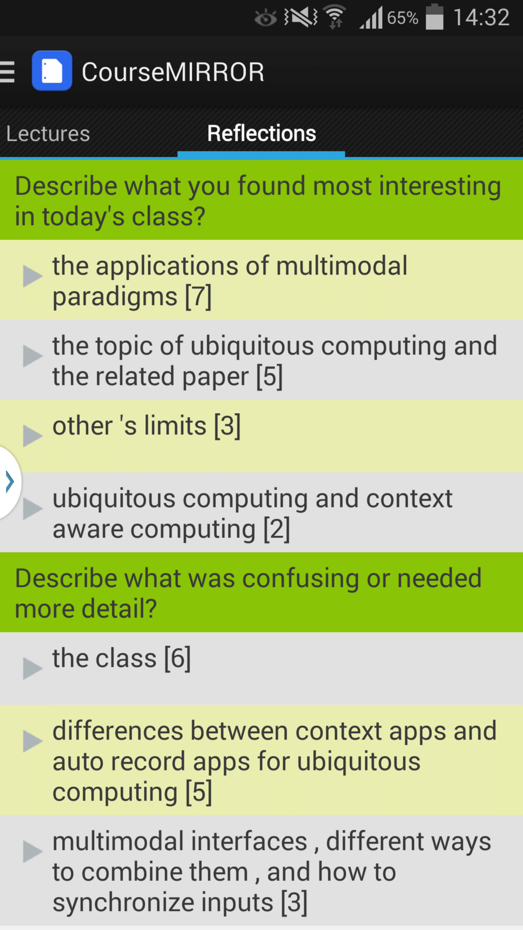
From Paper to Mobile App
[Luo et al., 2015]
Two semester long pilot deployments during Fall 2014
Average ratings of 3.7 (5 Likert-scale) on survey questions
  I often read reflection summaries
  I benefited from reading the reflection summaries
Qualitative feedback
  “It's interesting to see what other people say and that can teach me something that I didn't pay attention to.”
  “Just curious about whether my points are accepted or not.”

Slide 49
Summing Up: Common Themes
NLP can support teaching and learning at scale
  RTA: From manual to automated writing assessment
  SWoRD: Enhancing peer review with intelligent scaffolding
  CourseMIRROR: A mobile app with automatic summarization
Many opportunities and challenges
  Characteristics of student generated content
  Model desiderata (e.g., beyond accuracy)
  Interactions between (noisy) NLP & Educational Technology

Slide 50
Current Directions
RTA
  Formative feedback (for students)
  Analytics (for instruction and policy)
SWoRD
  Solution scaffolding (for students as reviewers)
  From reviews to papers (for students as authors)
  Analytics (for teachers)
CourseMIRROR
  Improving reflection quality (for students)
  Beyond ROUGE evaluation (for teachers)

Slide 51
Use our Technology and Data!
Peer Review
  SWoRD
    NLP-enhanced system is free with research agreement
  Peerceptiv (by Panther Learning)
    Commercial (non-enhanced) system has a small fee
CourseMirror
  App (both Android and iOS)
  Reflection dataset

Slide 52



Thank You!
Questions?
Further Information
  http://www.cs.pitt.edu/~litman

Slide 53
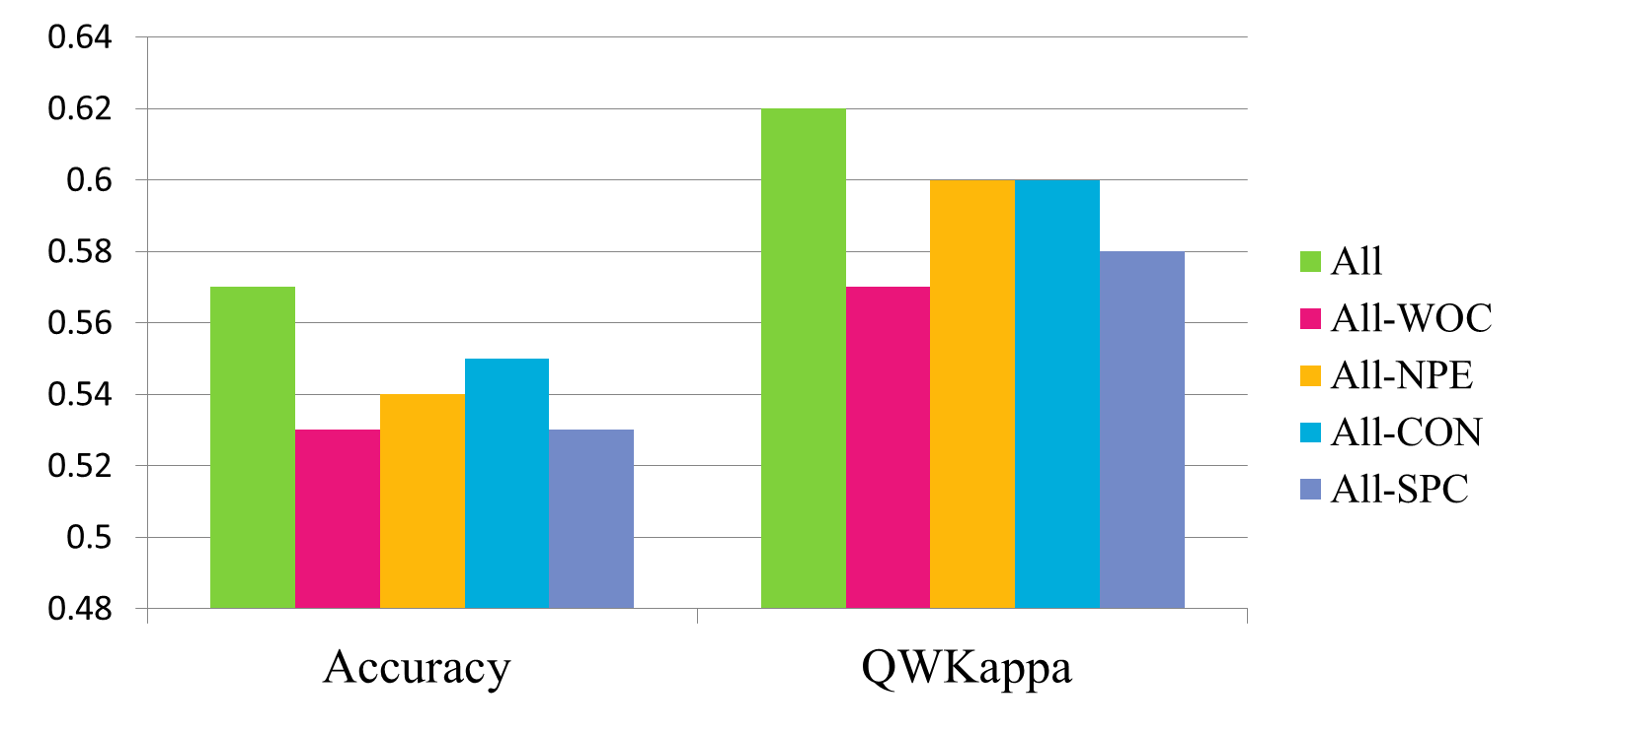

Slide 54
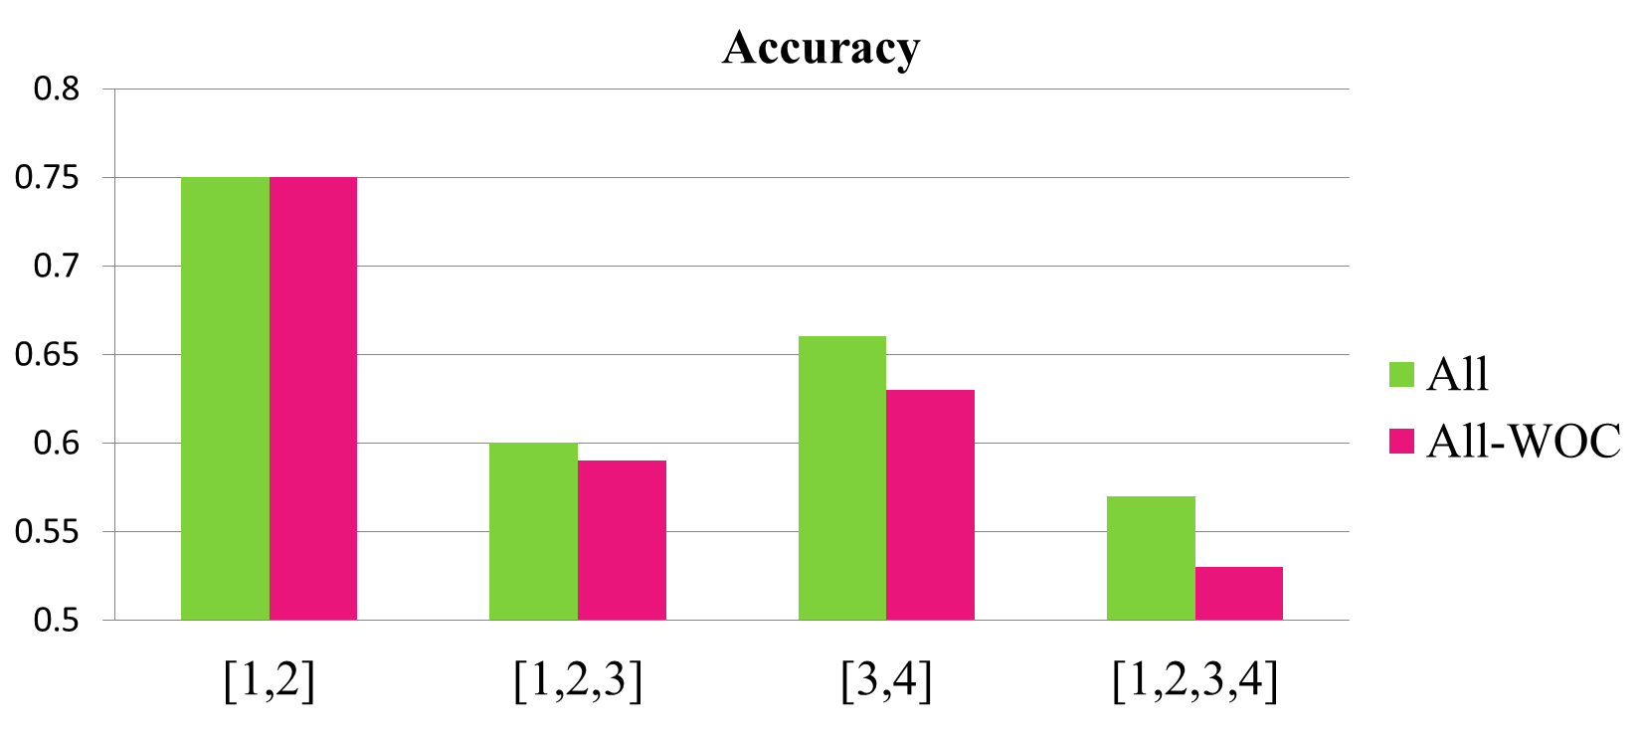

Slide 55
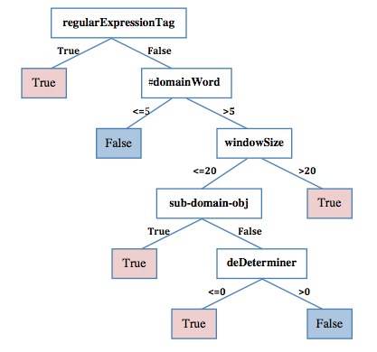
Paper Review Localization Model
[Xiong, Litman & Schunn, 2010]

Slide 56
Student response analysis
Students’ disagreement is not related to how well the original review were localized

Slide 57
Results: Revision Performance
 | Number (pct.) of comments of diagram reviews
 | Scope=In |  | Scope=Out |  | Scope=No
NOT Loc. → Loc. | 26 | 30.2% | 7 | 87.5% | 3 | 12.5%
Loc. → Loc. | 26 | 30.2% | 1 | 12.5% | 16 | 66.7%
NOT Loc. → NOT Loc. | 33 | 38.4% | 0 | 0% | 5 | 20.8%
Loc. → NOT Loc. | 1 | 1.2% | 0 | 0% | 0 | 0%
Comment localization is either improved or remains the same after scaffolding]
Localization revision continues after scaffolding is removed
Are reviewers improving localization quality, or performing other types of revisions?
Interface issues, or rubric non-applicability?

Slide 58
Example Feature Vectors
Essay with Score=1 (from earlier example)
Essay with Score=4 (from earlier example)
NPE | CON | WOC | SPC
1 | 1 | 166 | 0 | 0 | 0 | 0 | 0 | 1 | 1 | 0
NPE | CON | WOC | SPC
4 | 0 | 187 | 0 | 0 | 1 | 4 | 3 | 3 | 5 | 1
Notes:
Highlite potential feadbacks

Slide 59
A Deeper Look: Student Learning
 | # and % of comments (diagram reviews)
NOT Localized → Localized | 26 | 30.2%
Localized → Localized | 26 | 30.2%
NOT Localized → NOT Localized | 33 | 38.4%
Localized → NOT Localized | 1 | 1.2%
Open questions
  Are reviewers improving localization quality?
  Interface issues, or rubric non-applicability?

