Slide 1



Natural Language Processing for
Enhancing Teaching and Learning
Diane Litman
  Professor, Computer Science Department
  Co-Director, Intelligent Systems Program
  Senior Scientist, Learning Research & Development Center
University of Pittsburgh
Pittsburgh, PA USA
AAAI 2016
Notes:
Advances in NLP and educational technology, as well as the availability of unprecedented amounts of text and speech data, have led to an increasing interest in using NLP to address the needs of teachers, students, and researchers.
But educational applications differ in many ways from the types of applications for which NLP systems are typically developed.
This talk will organize and give an overview of research opportunities and challenges.

Slide 2
Roles for Language Processing in Education
Learning Language
(e.g., reading, writing, speaking)

Slide 3
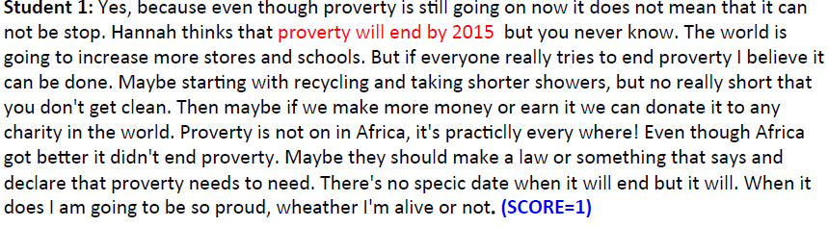
Roles for Language Processing in Education
Learning Language
(e.g., reading, writing, speaking)
Automatic Essay Grading

Slide 4
Roles for Language Processing in Education
Using Language
(e.g., teaching in the disciplines)

Slide 5

Roles for Language Processing in Education
Using Language
(e.g., teaching in the disciplines)
Tutorial Dialogue Systems for STEM

Slide 6
Roles for Language Processing in Education
Processing Language
(e.g. MOOCs, textbooks)

Slide 7
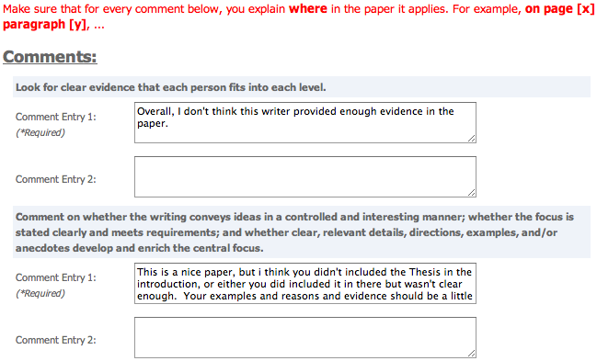
Roles for Language Processing in Education
Processing Language
(e.g. MOOCs, textbooks)
Peer Feedback

Slide 8
NLP for Education Research Lifecycle
Systems and Evaluations
Real-World
Problems
Learning and Teaching
Higher Level Learning Processes
NLP-Based Educational Technology
Challenges!
User-generated content
Meaningful constructs
Real-time performance
Theoretical and Empirical Foundations

Slide 9

A Case Study:
Automatic Writing Assessment
Essential for Massive Open Online Courses (MOOCs)
Even in traditional classes, frequent assignments can limit the amount of teacher feedback

Slide 10
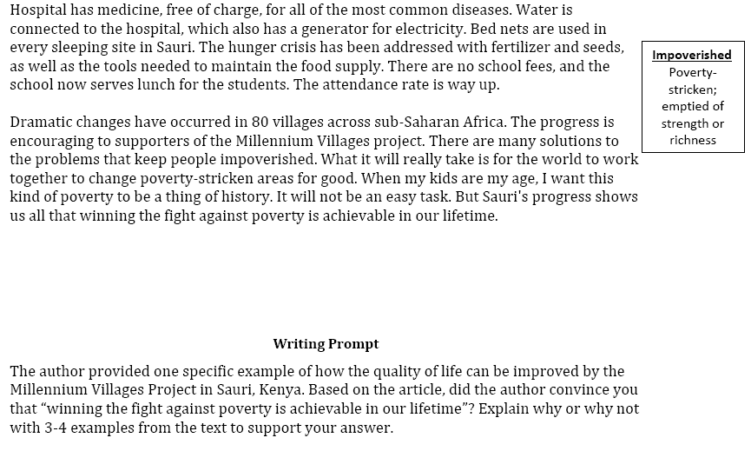
An Example Writing Assessment Task: Response to Text (RTA)
MVP, Time for Kids – informational text

Slide 11
RTA Rubric for the Evidence dimension
1 | 2 | 3 | 4
Features one or no pieces of evidence | Features at least 2 pieces of evidence | Features at least 3 pieces of evidence | Features at least 3 pieces of evidence
Selects inappropriate or little evidence from the text; may have serious factual errors and omissions | Selects some appropriate but general evidence from the text; may contain a factual error or omission | Selects appropriate and concrete, specific evidence from the text | Selects detailed, precise, and significant evidence from the text
Demonstrates little or no development or use of selected evidence | Demonstrates limited development or use of selected evidence | Demonstrates use of selected details from the text to support key idea | Demonstrates integral use of selected details from the text to support and extend key idea
Summarize entire text or copies heavily from text | Evidence provided may be listed in a sentence, not expanded upon | Attempts to elaborate upon evidence | Evidence must be used to support key idea / inference(s)

Slide 12
Gold-Standard Scores (& NLP-based evidence)
Student 1: Yes, because even though proverty is still going on now it does not mean that it can not be stop. Hannah thinks that proverty will end by 2015 but you never know. The world is going to increase more stores and schools. But if everyone really tries to end proverty I believe it can be done. Maybe starting with recycling and taking shorter showers, but no really short that you don't get clean. Then maybe if we make more money or earn it we can donate it to any charity in the world. Proverty is not on in Africa, it's practiclly every where! Even though Africa got better it didn't end proverty. Maybe they should make a law or something that says and declare that proverty needs to need. There's no specic date when it will end but it will. When it does I am going to be so proud, wheather I'm alive or not. (SCORE=1)
Student 2: I was convinced that winning the fight of poverty is achievable in our lifetime. Many people couldn't afford medicine or bed nets to be treated for malaria . Many children had died from this dieseuse even though it could be treated easily. But now, bed nets are used in every sleeping site . And the medicine is free of charge. Another example is that the farmers' crops are dying because they could not afford the nessacary fertilizer and irrigation . But they are now, making progess. Farmers now have fertilizer and water to give to the crops. Also with seeds and the proper tools . Third, kids in Sauri were not well educated. Many families couldn't afford school . Even at school there was no lunch . Students were exhausted from each day of school. Now, school is free . Children excited to learn now can and they do have midday meals . Finally, Sauri is making great progress. If they keep it up that city will no longer be in poverty. Then the Millennium Village project can move on to help other countries in need. (SCORE=4)

Slide 13
Automatic Scoring of an Analytical
Response-To-Text Assessment (RTA)
Summative writing assessment for argument-related RTA scoring rubrics
  Evidence [Rahimi, Litman, Correnti, Matsumura, Wang & Kisa, 2014]
  Organization [Rahimi, Litman, Wang & Correnti, 2015]
Pedagogically meaningful scoring features
  Validity as well as reliability

Slide 14
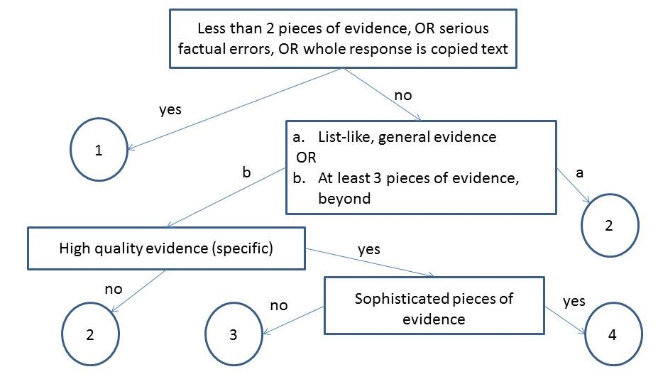
Extract Essay Features using NLP
Notes:
What is evidence topic subtopic,
Copping how much copy is copying

Slide 15
Extract Essay Features using NLP
Number of Pieces of Evidence
  Topics and words based on the text and experts
Notes:
What is evidence topic subtopic,
Copping how much copy is copying

Slide 16
Extract Essay Features using NLP
Notes:
What is evidence topic subtopic,
Copping how much copy is copying

Slide 17
Extract Essay Features using NLP
Concentration
High concentration essays have fewer than 3 sentences with topic words (i.e., evidence is not elaborated)
Notes:
What is evidence topic subtopic,
Copping how much copy is copying

Slide 18
Extract Essay Features using NLP
Notes:
What is evidence topic subtopic,
Copping how much copy is copying

Slide 19
Extract Essay Features using NLP
Specificity
Specific examples from different parts of the text
Notes:
What is evidence topic subtopic,
Copping how much copy is copying

Slide 20
Extract Essay Features using NLP
Notes:
What is evidence topic subtopic,
Copping how much copy is copying

Slide 21
Extract Essay Features using NLP
Argument Mining
Link to thesis
Notes:
What is evidence topic subtopic,
Copping how much copy is copying

Slide 22
Evaluation
Evidence and Organization Rubrics
Data
  Essays written by students in grades 4-6 and 6-8
Results
  Features outperform competitive baselines in cross-evaluation
  Features more robust in cross-corpus evaluation

Slide 23
AI Research Opportunities/Challenges
Argumentation Mining
Ontology Extraction
Unsupervised Topic Modeling
Transfer Learning
… and of course, Language & Speech!

Slide 24
Current Instructional & Assessment Needs
Assessments
  Grading vs. coaching
Environments
  Automated vs. human in the loop
Linguistic dimensions
  Phonetics to discourse

Slide 25
The Issue of Evaluation
Intrinsic evaluation is the norm
Extrinsic evaluation is less common
In vivo evaluation is even rarer

Slide 26
Summing Up
NLP roles for teaching and learning at scale
  Assessing language
  Using language
  Processing language
Many opportunities and challenges
  Characteristics of student generated content
  Model desiderata (e.g., beyond accuracy)
  Interactions between (noisy) NLP & Educational Technology

Slide 27
Learn More!
Innovative Use of NLP for Building Educational Applications
  NAACL workshop series
  11th meeting (June 16, 2016, San Diego)
Speech and Language Technology in Education
  ISCA special interest group
  7th meeting (2017, Stockholm)
Shared Tasks
  Grammatical error detection
  Student response analysis
  MOOC attrition prediction
Hewlett Foundation / Kaggle Competitions
  essay and short-answer scoring

Slide 28



Thank You!
Questions?
Further Information
  http://www.cs.pitt.edu/~litman

Slide 29
Language Processing in Education
Over a 50 year history
Exciting new research opportunities
  MOOCs, mobile technologies, social media, ASR
Commercial interest as well
  E.g., ETS, Pearson, Turnitin, Carnegie Speech

Slide 30

Roles for Language Processing in Education
Processing Language
(e.g., MOOCs, textbooks)
Student Reflections

Slide 31
A Case Study: Teaching about Language
(joint work with School of Education)
Automatic Writing Assessment at Scale (today)
Tutors, Analytics, Data Science (longer term)
  For students, teachers, researchers, policy makers

Slide 32
Supervised Machine Learning
Data [Correnti et al., 2013]
  1560 essays written by students in grades 4-6
    Short, many spelling and grammatical errors

Slide 33
Experimental Evaluation
Baseline1 [Mayfield 13]: one of the best methods from the Hewlett Foundation competition [Shermis and Hamner, 2012]
  Features: primarily bag of words (top 500)
  Baseline2: Latent Semantic Analysis [Miller 03]
Notes:
Make shorter

Slide 34
Results: Can we Automate?
Proposed features outperform both baselines

Slide 35
Current Directions
RTA
  Formative feedback (for students)
  Analytics (for instruction and policy)
SWoRD
  Solution scaffolding (for students as reviewers)
  From reviews to papers (for students as authors)
  Analytics (for teachers)
CourseMIRROR
  Improving reflection quality (for students)
  Beyond ROUGE evaluation (for teachers)

Slide 36
Use our Technology and Data!
Peer Review
  SWoRD
    NLP-enhanced system is free with research agreement
  Peerceptiv (by Panther Learning)
    Commercial (non-enhanced) system has a small fee
CourseMirror
  App (both Android and iOS)
  Reflection dataset

Slide 37
Three Case Studies
Automatic Writing Assessment
  Co-PIs: Rip Correnti, Lindsay Clare Matsumara
Peer Review of Writing
  Co-PIs: Kevin Ashley, Amanda Godley, Chris Schunn
Summarizing Student Generated Reflections
  Co-PIs: Muhsin Meneske, Jingtao Wang

Slide 38
Why Peer Review?
An alternative for grading writing at scale in MOOCs
Also used in traditional classes
  Quantity and diversity of review feedback
  Students learn by reviewing

Slide 39
SWoRD: A web-based peer review system
[Cho & Schunn, 2007]
Authors submit papers
Peers submit (anonymous) reviews
  Students provide numerical ratings and text comments
  Problem: text comments are often not stated effectively

Slide 40
One Aspect of Review Quality
Localization: Does the comment pinpoint where in the paper the feedback applies? [Nelson & Schunn 2008]
  There was a part in the results section where the author stated “The participants then went on to choose who they thought the owner of the third and final I.D. to be…” the ‘to be’ is used wrong in this sentence. (localized)
  The biggest problem was grammar and punctuation. All the writer has to do is change certain tenses and add commas and colons here and there. (not localized)

Slide 41
Our Approach for Improving Reviews
Detect reviews that lack localization and solutions
  [Xiong & Litman 2010; Xiong, Litman & Schunn 2010, 2012; Nguyen & Litman 2013, 2014]
Scaffold reviewers in adding these features
  [Nguyen, Xiong & Litman 2014]

Slide 42
Detecting Key Features of Text Reviews
Natural Language Processing to extract attributes from text, e.g.
  Regular expressions (e.g. “the section about”)
  Domain lexicons (e.g. “federal”, “American”)
  Syntax (e.g. demonstrative determiners)
  Overlapping lexical windows (quotation identification)
Supervised Machine Learning to predict whether reviews contain localization and solutions

Slide 43
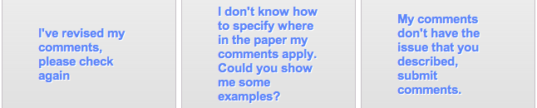
Localization Scaffolding
System scaffolds (if needed)
Localization model applied
Localization model applied
Reviewer makes decision (e.g. DISAGREE)

Slide 44
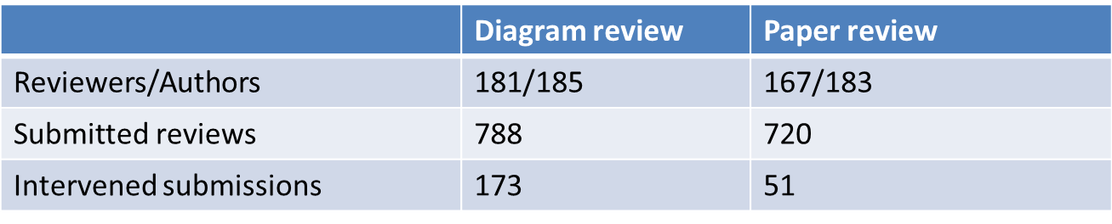
A First Classroom Evaluation
[Nguyen, Xiong & Litman, 2014]
NLP extracts attributes from reviews in real-time
Prediction models use attributes to detect localization
Scaffolding if < 50% of comments predicted as localized
Deployment in undergraduate Research Methods
  Diagrams → Diagram reviews → Papers → Paper reviews

Slide 45
Results: Can we Automate?
Comment Level (System Performance)
  Detection models significantly outperform baselines
  Results illustrate model robustness during classroom deployment
    testing data is from different classes than training data
Close to with reported results (in experimental setting) of previous studies (Xiong & Litman 2010, Nguyen & Litman 2013)
  Prediction models are robust even in not-identical training-testing
 | Diagram review |  | Paper review
 | Accuracy | Kappa | Accuracy | Kappa
Majority baseline | 61.5% (not localized) | 0 | 50.8% (localized) | 0
Our models | 81.7% | 0.62 | 72.8% | 0.46

Slide 46
Results: Can we Automate?
Review Level (student perspective of system)
  Students do not know the localization threshold
  Scaffolding is thus incorrect only if all comments are already localized

Slide 47
Results: Can we Automate?
Review Level (student perspective of system)
  Students do not know the localization threshold
  Scaffolding is thus incorrect only if all comments are already localized
Only 1 incorrect intervention at review level!
 | Diagram review | Paper review
Total scaffoldings | 173 | 51
Incorrectly triggered | 1 | 0

Slide 48
Results: New Educational Technology
Student Response to Scaffolding
Why are reviewers disagreeing?
  No correlation with true localization ratio
Reviewer response | REVISE | DISAGREE
Diagram review | 54 (48%) | 59 (52%)
Paper review | 13 (30%) | 30 (70%)

Slide 49
A Deeper Look: Student Learning
 | # and % of comments (diagram reviews)
NOT Localized → Localized | 26 | 30.2%
Localized → Localized | 26 | 30.2%
NOT Localized → NOT Localized | 33 | 38.4%
Localized → NOT Localized | 1 | 1.2%
Comment localization is either improved or remains the same after scaffolding
  Localization revision continues after scaffolding is removed
  Replication in college psychology and 2 high school math corpora

Slide 50
Three Case Studies
Automatic Writing Assessment
  Co-PIs: Rip Correnti, Lindsay Clare Matsumara
Peer Review of Writing
  Co-PIs: Kevin Ashley, Amanda Godley, Chris Schunn
Summarizing Student Generated Reflections
  Co-PIs: Muhsin Meneske, Jingtao Wang

Slide 51
Why (Summarize) Student Reflections?
Student reflections have been shown to improve both learning and teaching
In large lecture classes (e.g. undergraduate STEM), it is hard for teachers to read all the reflections
  Same problem for MOOCs
Notes:
The first question is that you may ask is why Automatic Essay Assessment is important.
Well, in order to Score and provide feedback on written assignments in Tutoring systems and MOOCs, it is essential to have reliable AES systems. Even in class rooms with large number of students and frequent writing assignments, Providing individual feedback to students is a burden and a very time consuming task for teatures.
Consider the capitalization

Slide 52
Student Reflections and a TA’s Summary
Reflection Prompt: Describe what was confusing or needed more detail.
Student Responses
S1: Graphs of attraction/repulsive & interatomic separation
S2: Property related to bond strength
S3: The activity was difficult to comprehend as the text fuzzing and difficult to
read.
S4: Equations with bond strength and Hooke's law
S5: I didn't fully understand the concept of thermal expansion
S6: The activity ( Part III)
S7: Energy vs. distance between atoms graph and what it tells us
S8: The graphs of attraction and repulsion were confusing to me
… (rest omitted, 53 student responses in total)

Slide 53
Student Reflections and a TA’s Summary
Reflection Prompt: Describe what was confusing or needed more detail.
Student Responses
S1: Graphs of attraction/repulsive & interatomic separation
S2: Property related to bond strength
S3: The activity was difficult to comprehend as the text fuzzing and difficult to
read.
S4: Equations with bond strength and Hooke's law
S5: I didn't fully understand the concept of thermal expansion
S6: The activity ( Part III)
S7: Energy vs. distance between atoms graph and what it tells us
S8: The graphs of attraction and repulsion were confusing to me
… (rest omitted, 53 student responses in total)
Summary created by the Teaching Assistant
1) Graphs of attraction/repulsive & atomic separation [10*]
2) Properties and equations with bond strength [7]
3) Coefficient of thermal expansion [6]
4) Activity part III [4]
* Numbers in brackets indicate the number of students who semantically mention each phrase (i.e., student coverage)

Slide 54
Enhancing Large Classroom Instructor-Student Interactions via Summarization
CourseMIRROR: A mobile app for collecting and browsing student reflections
  [Fan, Luo, Menekse, Litman, & Wang, 2015]
  [Luo, Fan, Menekse, Wang, & Litman, 2015]
A phrase-based approach to extractive summarization of student-generated content
  [Luo & Litman, 2015]

Slide 55
Challenges for (Extractive) Summarization
  Student reflections range from single words to multiple sentences
  Concepts (represented as phrases in the reflections) that are semantically mentioned by more students are more important to summarize
  Deployment on mobile app

Slide 56
Phrase-Based Summarization
Stage 1: Candidate Phrase Extraction
  Noun phrases (with filtering)
Stage 2: Phrase Clustering
  Estimate student coverage with semantic similarity
Stage 3: Phrase Ranking
  Rank clusters by student coverage
  Select one phrase per cluster

Slide 57
Data
An Introduction to Materials Science and Engineering Class
53 undergraduates generated reflections via paper
3 reflection prompts
  Describe what you found most interesting in today's class.
  Describe what was confusing or needed more detail.
  Describe what you learned about how you learn.
12 (out of 25) lectures have TA-generated summaries for each of the 3 prompts

Slide 58
Quantitative Evaluation
Summarization baseline algorithms
  Keyphrase extraction
  Sentence extraction
  Sentence extraction methods using NPs
Performance in terms of human-computer overlap
  R-1, R-2, R-SU4 (Rouge scores)
Results
  Our method outperforms all baselines for F-measure

Slide 59
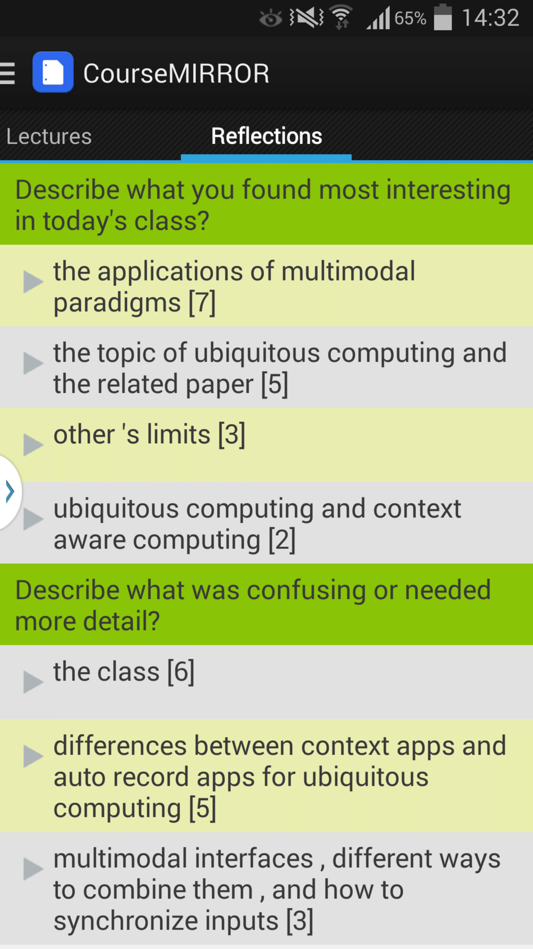
From Paper to Mobile App
[Luo et al., 2015]
Two semester long pilot deployments during Fall 2014
Average ratings of 3.7 (5 Likert-scale) on survey questions
  I often read reflection summaries
  I benefited from reading the reflection summaries
Qualitative feedback
  “It's interesting to see what other people say and that can teach me something that I didn't pay attention to.”
  “Just curious about whether my points are accepted or not.”

Slide 60
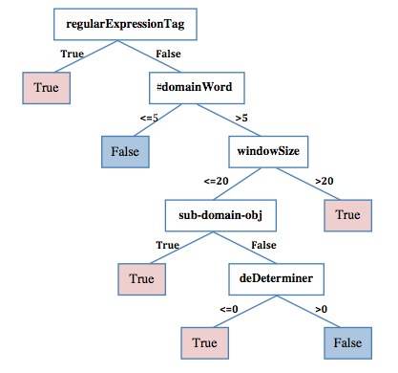
Paper Review Localization Model
[Xiong, Litman & Schunn, 2010]

Slide 61
Results: Revision Performance
 | Number (pct.) of comments of diagram reviews
 | Scope=In |  | Scope=Out |  | Scope=No
NOT Loc. → Loc. | 26 | 30.2% | 7 | 87.5% | 3 | 12.5%
Loc. → Loc. | 26 | 30.2% | 1 | 12.5% | 16 | 66.7%
NOT Loc. → NOT Loc. | 33 | 38.4% | 0 | 0% | 5 | 20.8%
Loc. → NOT Loc. | 1 | 1.2% | 0 | 0% | 0 | 0%
Comment localization is either improved or remains the same after scaffolding]
Localization revision continues after scaffolding is removed
Are reviewers improving localization quality, or performing other types of revisions?
Interface issues, or rubric non-applicability?

Slide 62
Example Feature Vectors
Essay with Score=1 (from earlier example)
Essay with Score=4 (from earlier example)
NPE | CON | WOC | SPC
1 | 1 | 166 | 0 | 0 | 0 | 0 | 0 | 1 | 1 | 0
NPE | CON | WOC | SPC
4 | 0 | 187 | 0 | 0 | 1 | 4 | 3 | 3 | 5 | 1
Notes:
Highlite potential feadbacks

Slide 63
A Deeper Look: Student Learning
 | # and % of comments (diagram reviews)
NOT Localized → Localized | 26 | 30.2%
Localized → Localized | 26 | 30.2%
NOT Localized → NOT Localized | 33 | 38.4%
Localized → NOT Localized | 1 | 1.2%
Open questions
  Are reviewers improving localization quality?
  Interface issues, or rubric non-applicability?

