Slide 1
Using Computational Linguistics to Support Students and Teachers during Peer Review of Writing
  Diane Litman
  Professor, Computer Science Department
  Senior Scientist, Learning Research & Development Center
  Director, Intelligent Systems Program
  University of Pittsburgh
  Pittsburgh, PA 15217 USA
  Joint work with Professors K. Ashley, A. Godley & C. Schunn

Slide 2
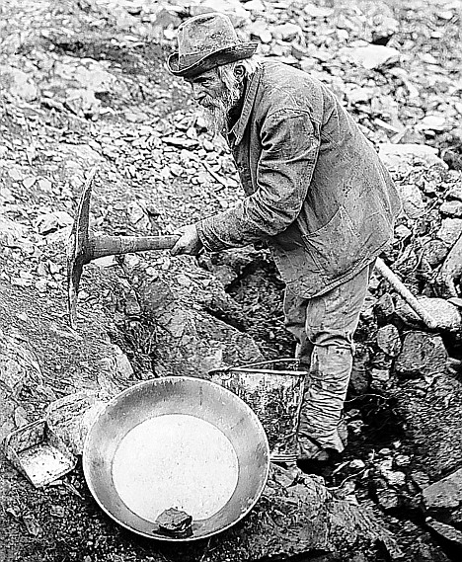

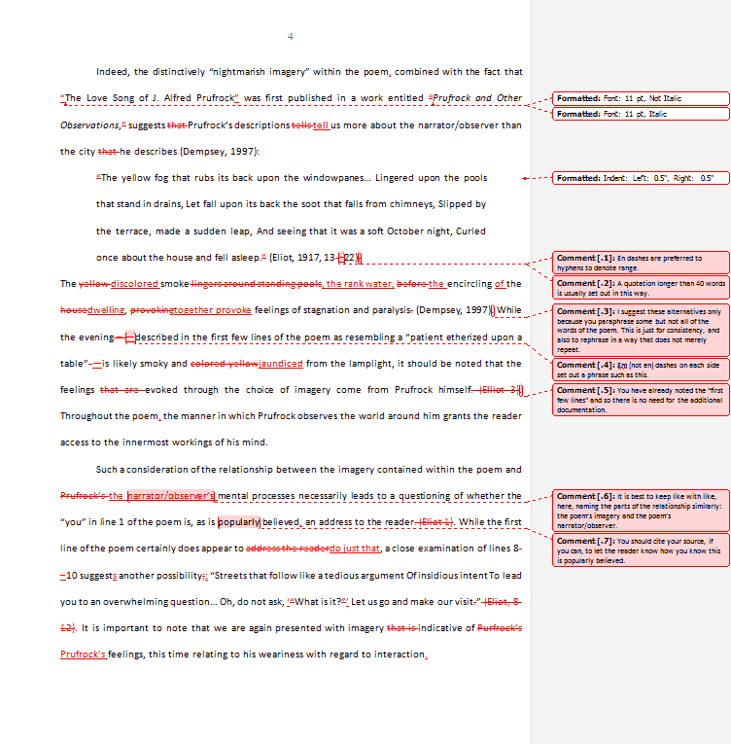
Peer Review Research is a Goldmine for Computational Linguistics
Can we automate human coding?
New Educational Technology!
Learning Science at Scale!

Slide 3
Outline
SWoRD (Computer-Supported Peer Review)
Supporting Students with Review Scaffolding
Keeping Teachers Well-informed
Summary and Current Directions

Slide 4
SWoRD: A web-based peer review system
[Cho & Schunn, 2007]
Authors submit papers (or diagrams)
Peers submit reviews
Authors provide back-reviews to peers

Slide 5
Pros and Cons of Peer Review
  Pros
  Quantity and diversity of review feedback
  Students learn by reviewing
  Useful for MOOCs
  Cons
Reviews are often not stated in effective ways
Reviews and papers do not focus on core aspects
Information overload for students and teachers

Slide 6
Outline
SWoRD (Computer-Supported Peer Review)
Supporting Students with Review Scaffolding
Keeping Teachers Well-informed
Summary and Current Directions

Slide 7
The Problem
Reviews are often not stated effectively
Example: no localization
  Justification is sufficient but unclear in some parts.
Our Approach: detect and scaffold
  Justification is sufficient but unclear in the section on African Americans.

Slide 8
Detecting Key Properties of Text Reviews
Computational Linguistics to extract attributes from text, e.g.
  Regular expressions (e.g. “the section about”)
  Domain lexicons (e.g. “federal”, “American”)
  Syntax (e.g. demonstrative determiners)
  Overlapping lexical windows (quotation identification)
Machine Learning to predict whether reviews contain properties correlating with feedback implementation
  Localization
  Solutions
  Thesis statements

Slide 9
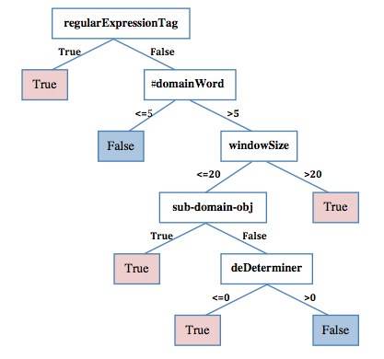
Paper Review Localization Model
[Xiong, Litman & Schunn, 2010]

Slide 10
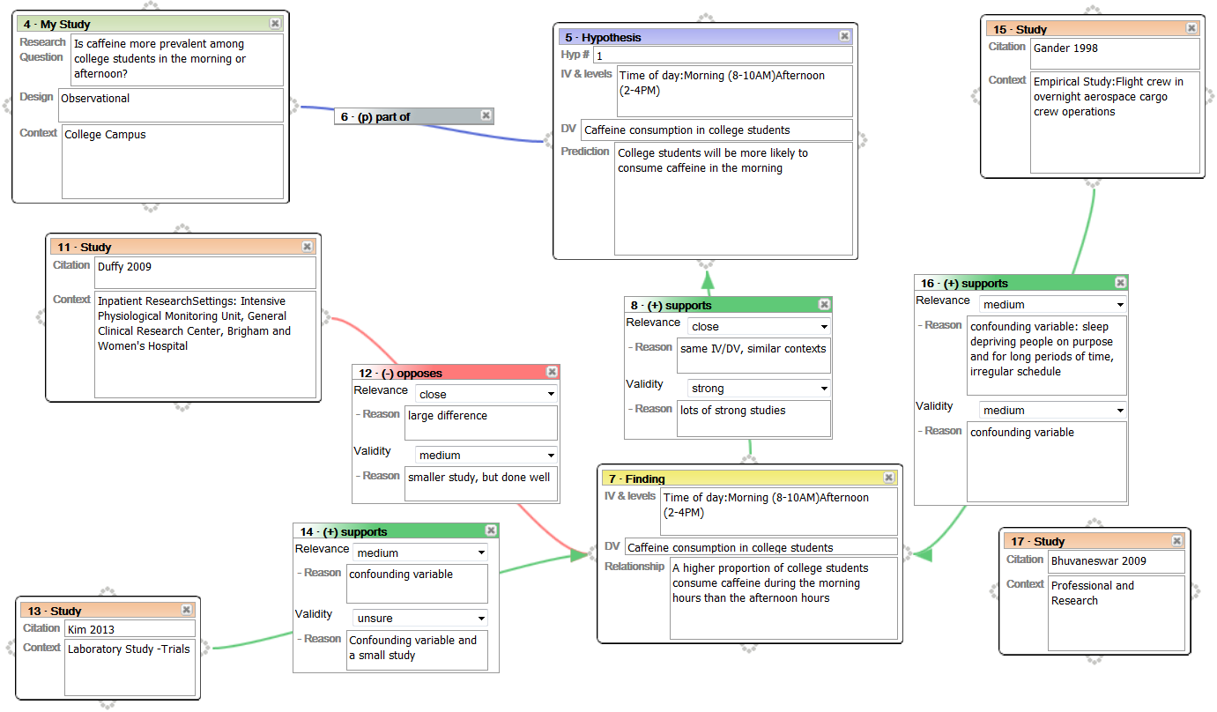
Localization in Diagram Reviews
Study 17 doesn’t have a connection to anything, which makes it unclear about it’s purpose.
Although the text is minimal, what is written is fairly clear.

Slide 11
Diagram Review Localization Model
[Nguyen & Litman, 2013]
Pattern-based detection algorithm
  Numbered ontology type, e.g. citation 15
  Textual component content, e.g. time of day hypothesis
  Unique component, e.g. the con-argument
  Connected component, e.g. support of 2nd hypothesis
  Numerical regular expression, e.g. H1, #10

Slide 12
Learned Localization Model
Localized?
Pattern
Algorithm = yes
Pattern Algorithm = no
yes
#domainWord> 2
#domainWord ≤ 2
windowSize
≤ 16
windowSize
> 16
windowSize
≤ 12
windowSize
> 12
yes
no
no
#domainWord
≤ 0
#domainWord
> 0
no
yes

Slide 13
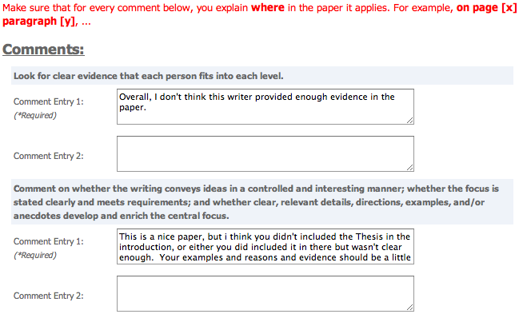
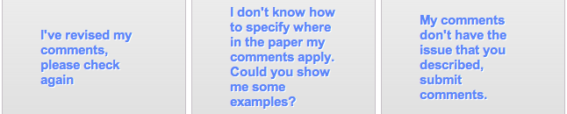
Localization Scaffolding
System scaffolds (if needed)
Localization model applied
Localization model applied
Reviewer makes decision

Slide 14
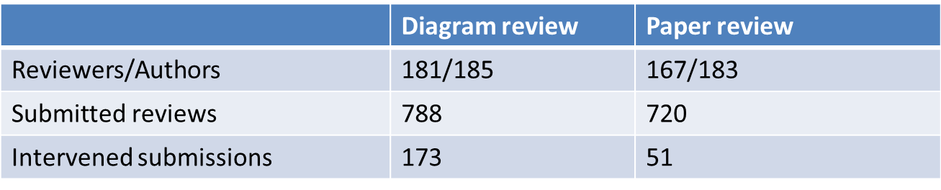
A First Classroom Evaluation
[Nguyen, Xiong & Litman, 2014]
Computational linguistics extracts attributes in real-time
Prediction models use attributes to detect localization
Scaffolding if < 50% of comments predicted as localized
Deployment in undergraduate Research Methods

Slide 15
Results: Can we Automate?
Comment Level
Review Level
 | Diagram review |  | Paper review
 | Accuracy | Kappa | Accuracy | Kappa
Majority baseline | 61.5% (not localized) | 0 | 50.8% (localized) | 0
Our models | 81.7% | 0.62 | 72.8% | 0.46
 | Diagram review | Paper review
Total scaffoldings | 173 | 51
Incorrectly triggered | 1 | 0

Slide 16
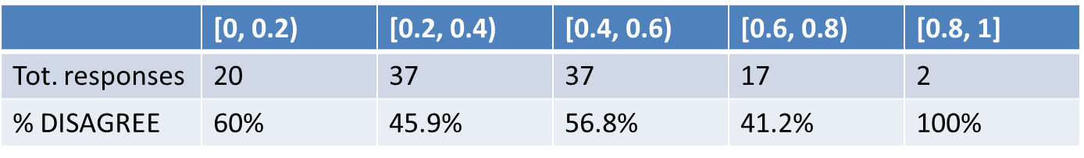
Results: New Educational Technology
Response to Scaffolding
Why are reviewers disagreeing?
  No correlation with true localization ratio (diagrams)
Reviewer response | REVISE | DISAGREE
Diagram review | 54 (48%) | 59 (52%)
Paper review | 13 (30%) | 30 (70%)

Slide 17
A Deeper Look: Revision Performance
 | # and % of comments (diagram reviews)
NOT Localized → Localized | 26 | 30.2%
Localized → Localized | 26 | 30.2%
NOT Localized → NOT Localized | 33 | 38.4%
Localized → NOT Localized | 1 | 1.2%
Comment localization is either improved or remains the same after scaffolding

Slide 18
A Deeper Look: Revision Performance
 | # and % of comments (diagram reviews)
NOT Localized → Localized | 26 | 30.2%
Localized → Localized | 26 | 30.2%
NOT Localized → NOT Localized | 33 | 38.4%
Localized → NOT Localized | 1 | 1.2%
Open questions
  Are reviewers improving localization quality?
  Interface issues, or rubric non-applicability?

Slide 19
Other Results: Non-Scaffolded Revision
 | Number (pct.) of comments of diagram reviews
 | Scope=In |  | Scope=Out |  | Scope=No
NOT Loc. → Loc. | 26 | 30.2% | 7 | 87.5% | 3 | 12.5%
Loc. → Loc. | 26 | 30.2% | 1 | 12.5% | 16 | 66.7%
NOT Loc. → NOT Loc. | 33 | 38.4% | 0 | 0% | 5 | 20.8%
Loc. → NOT Loc. | 1 | 1.2% | 0 | 0% | 0 | 0%
Localization continues after scaffolding is removed

Slide 20
Outline
SWoRD (Computer-Supported Peer Review)
Supporting Students with Review Scaffolding
Keeping Teachers Well-informed
Summary and Current Directions

Slide 21
Observation:
Teachers rarely read peer reviews
Challenges faced by teachers
  Reading all reviews (scalability issues)
  Simultaneously remembering reviews across students to compare and contrast (cognitive overload)
  Knowing where to start (cold start)

Slide 22
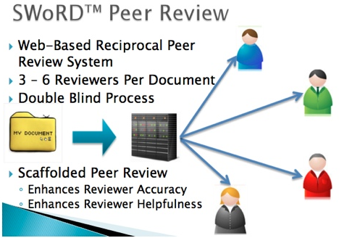
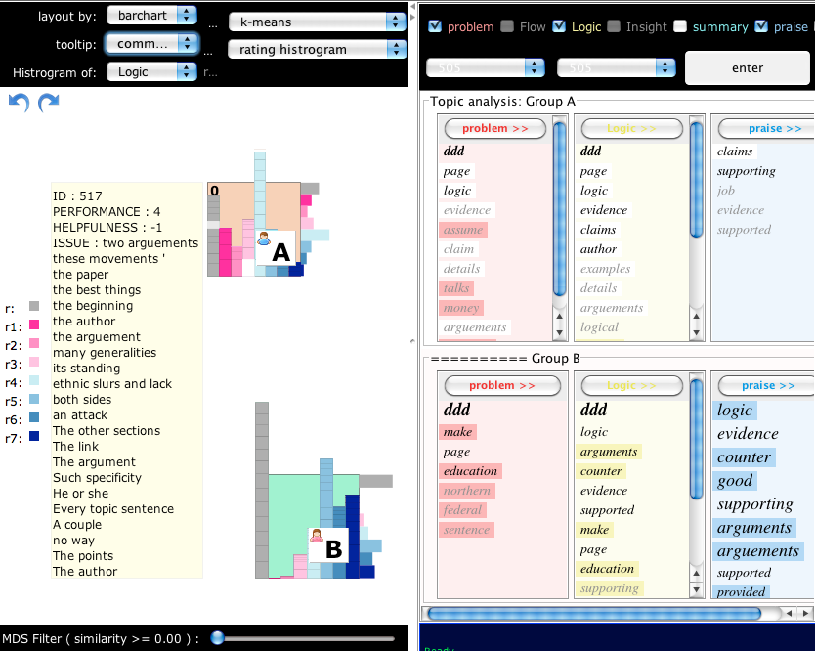
Solution: RevExplore
SWoRD
RevExplore: An Interactive Analytic Tool for Peer-Review Exploration for Teachers
[Xiong, Litman, Wang & Schunn, 2012]
Peer-review content
Notes:
To address the challenge, proposed revExplore, on top of SWoRD,
SWoRD is a web-based pr reciprocal
a interactive analytic tool for peer review exploration designed for SWorD

Slide 23
RevExplore Example
Writing assignment:
  “Whether the United States become more democratic, stayed the same, or become less democratic between 1865 and 1924.”
  Reviewing dimensions:
  Flow, logic, insight
Goal
  Discover student group difference in writing issues
Notes:
How instructor can use revExplore to make sense of peer reviews

Slide 24
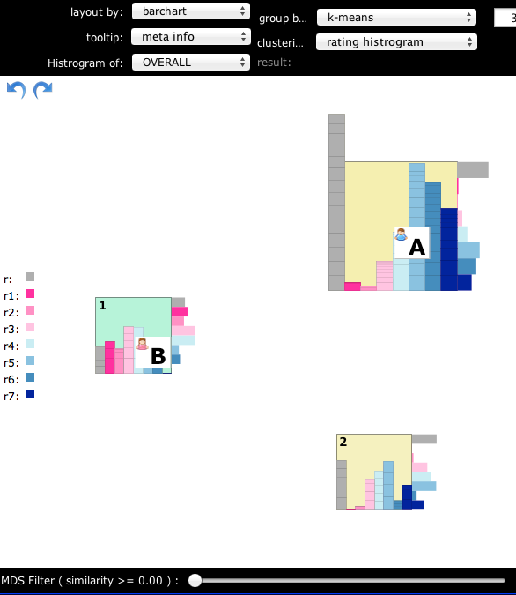
  RevExplore Example
Step 1 -- Interactive student grouping
K-means clustering
Peer rating distribution
Target groups: A & B

Slide 25
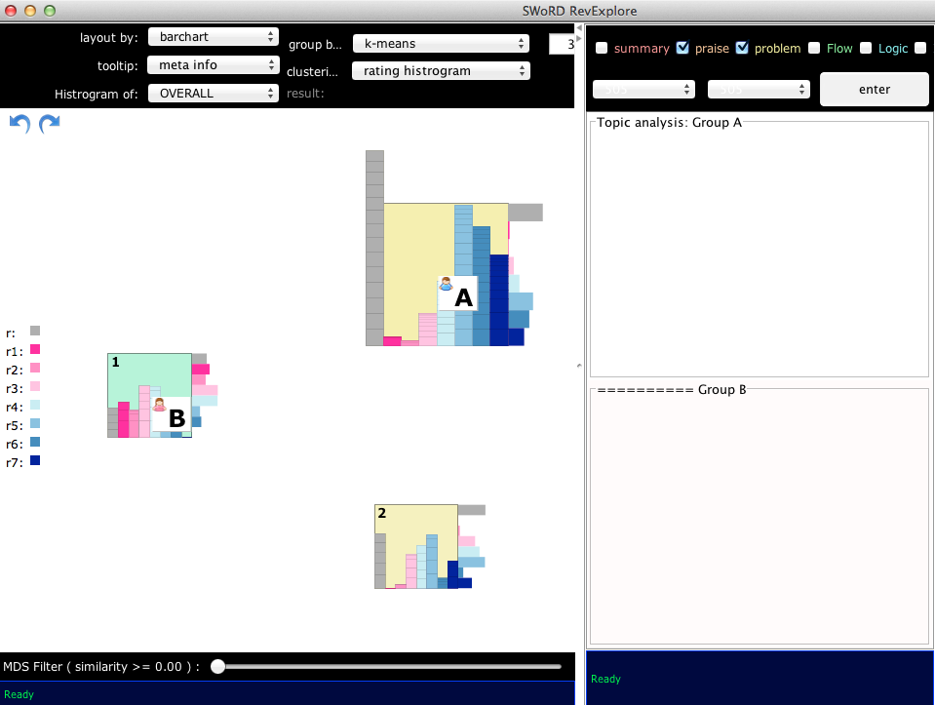
  RevExplore Example
Step 2 – Automated topic-word extraction
Click “Enter”

Slide 26
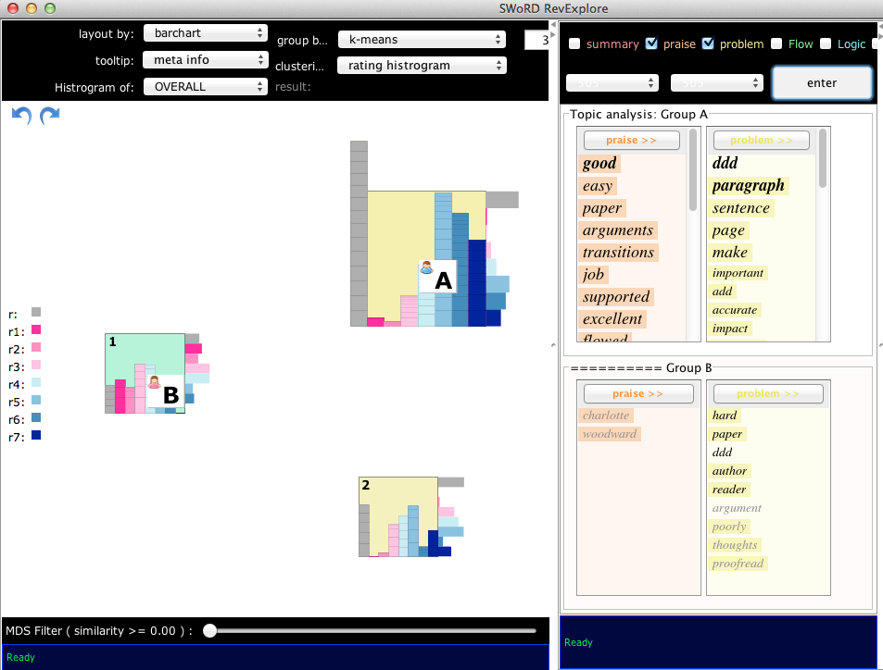
  RevExplore Example
Step 2 – Automated topic-word extraction

Slide 27
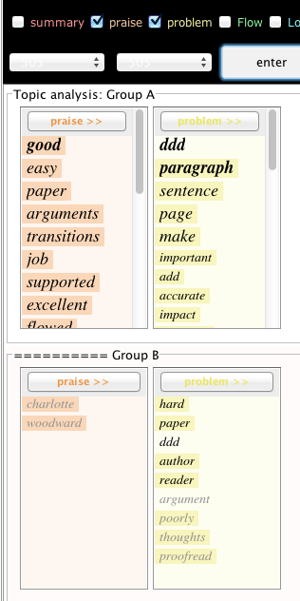
  RevExplore Example
Step 3 – Group comparison by topic words
Group A receives more praise than group B
Group A’s writing issues are location-specific
  Paragraph, sentence, page, add, …
Group B’s are general
  Hard, paper, proofread, …

Slide 28
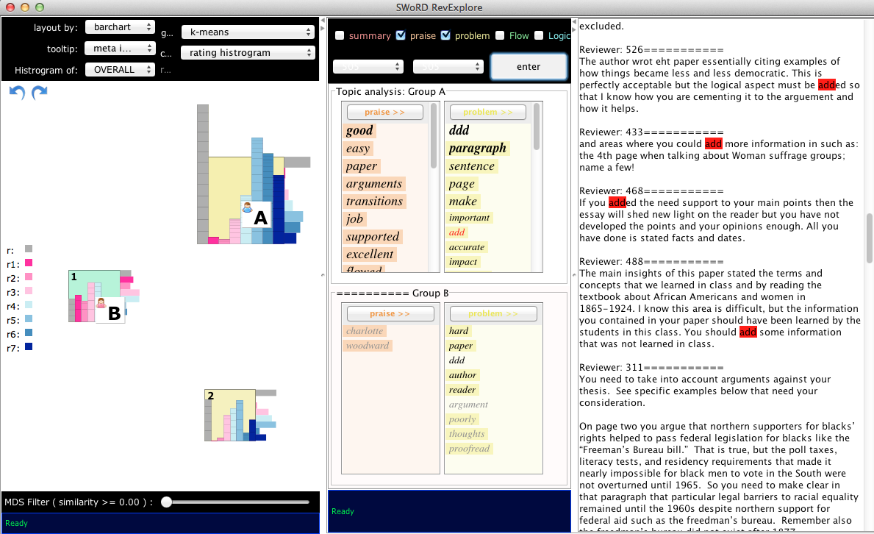
  RevExplore Example
Step 3 – Group comparison by topic words
Double click

Slide 29
Evaluating Topic-Word Analytics
[Xiong & Litman, 2013]
User study (extrinsic evaluation)
  1405 free-text reviews of 24 history papers
  46 recruited subjects
Research questions
  Are topic words useful for peer-review analytics?
  Does the topic-word extraction method matter?
  Do results interact with analytic goal, grading rubric, and user demographics?

Slide 30
Topic Signatures in RevExplore
Domain word masking via topic signatures [Lin & Hovy, 2000; Nenkova & Louis, 2008]
  Target corpus: Student papers
  Background corpus: English Gigaword
  Topic words: Words likely to be in target corpus (chi-square)
Comparison-oriented topic signatures
  User reviews are divided into groups
    High versus low writers (SWoRD paper ratings)
    High versus low reviewers (SWoRD helpfulness ratings)
  Target corpus: Reviews of user group
  Background corpus: Reviews of all users

Slide 31
Comparing Student Reviewers
Method | Reviews by helpful students | Reviews by less helpful students
Topic Signatures | Arguments, immigrants, paper, wrong, theories, disprove, theory | Democratically, injustice, page, facts

Slide 32
Comparing Student Reviewers
Method | Reviews by helpful students | Reviews by less helpful students
Topic Signatures | Arguments, immigrants, paper, wrong, theories, disprove, theory | Democratically, injustice, page, facts
Frequency | Paper, arguments, evidence, make, also, could, argument paragraph | Page, think, argument, essay

Slide 33
Experimental Results
Topic words are effective for peer-review analytics
  Objective metrics (e.g. correct identification of high vs. low student groups)
  Subjective ratings (e.g. “how often did you refer to the original reviews?”)
Topic signature method outperforms frequency
Interactions with:
  Analytic goal (i.e. reviewing vs. writing groupings)
  Reviewing dimensions (i.e. grading rubric)
  User demographics (e.g. prior teaching experience)

Slide 34
Outline
SWoRD (Computer-Supported Peer Review)
Supporting Students with Review Scaffolding
Keeping Teachers Well-informed
Summary and Current Directions

Slide 35
Summary
Computational linguistics for peer review to improve both student reviewing and writing
Scaffolding useful feedback properties
  reviews are often not stated in effective ways
Incorporation of argument diagramming
  reviews and papers do not focus on core aspects
Topic-word analytics for teachers
  teacher information overload
Deployments in university and high school classes

Slide 36
Current Directions
Additional measures of review quality
  Solutions to problems [Nguyen & Litman, 2014]
  Argumentation [Falakmasir et al., 2014; Ong et al., 2014]
  Impact on paper revision [Zhang & Litman, 2014]
New scaffolding interventions
Teacher dashboard
  Review and paper revision quality
  Topic-word analytics
  Helpfulness guided review summarization
    Talk at 2pm at Oxford tomorrow [Xiong & Litman, submitted]

Slide 37



Thank You!
Questions?
Further Information
  http://www.cs.pitt.edu/~litman
  http://www.pantherlearning.com

Slide 38
Computational Linguistics & Educational Research
Learning Language
(reading, writing,
speaking)
Automatic Essay
Grading

Slide 39
Computational Linguistics & Educational Research
Learning Language
(reading, writing,
speaking)
Using Language
(teaching in the disciplines)
Tutorial Dialogue
Systems
(e.g. for STEM)
Automatic Essay
Grading

Slide 40
Computational Linguistics & Educational Research
Learning Language
(reading, writing,
speaking)
Using Language
(teaching in the disciplines)
Processing
Language
(e.g. from MOOCs)
Tutorial Dialogue
Systems
(e.g. for STEM)
Automatic Essay
Grading
Peer
Review

Slide 41
ArgumentPeer Project
Phase I: Argument
Diagramming
Author creates Argument Diagram
AI: Guides preparing diagram & using it in writing
Peers review Argument Diagrams
Author revises Argument Diagram
Author writes paper
AI: Guides reviewing
Peers review papers
Author revises paper
Phase II: Writing

Slide 42
Current Directions: SWoRD in High School
Fall 2012 – Spring 2013
  English, History, Science, Math
  low SES, urban schools
  9 to 12 grade
Classroom contexts
  Little writing instruction
  Variable access to technology
Challenge: different review characteristics
Joint work with Kevin Ashley, Amanda Godley, Chris Schunn
Domain | Praise% | Critique% | Localized% | Solution%
College | 28% | 62% | 53% | 63%
High School | 15% | 52% | 36% | 40%
Notes:
College = history
High-school = TCCL (has higher ratio of praise% and critique% compared to the other one (TACL))
Localized% and solution% are computed within identified critiques

Slide 43
Common Themes
NLP for supporting writing research at scale
  Educational technology
  Learning science
Many opportunities and challenges
  Characteristics of student writing
    Prior NLP software often trained on newspaper texts
  Model desiderata
    Beyond accuracy
  Interactions between NLP and Educational Technologies
    Robustness to noisy predictions
    Implicit feedback for lifelong computer learning

