Slide 1
Modeling and Exploiting Review Helpfulness for Summarization
Diane Litman
  Professor, Computer Science Department
  Senior Scientist, Learning Research & Development Center
  Director, Intelligent Systems Program
University of Pittsburgh
Pittsburgh, PA 15260 USA
Joint work with Wenting Xiong, Computer Science
(PhD Dissertation)
Notes:
Online reviews is an important information resources for our everyday life.
Reviews play an important role in consumer purchase decisions, and thus has an economic impact on product sales
Stats:
-71% of consumers read online reviews. -55% of consumers trust a local business more after reading positive online reviews. -50% of consumers are more likely to use a local business having read positive reviews. -67% of consumers trust online reviews as much as personal recommendations.

Slide 2
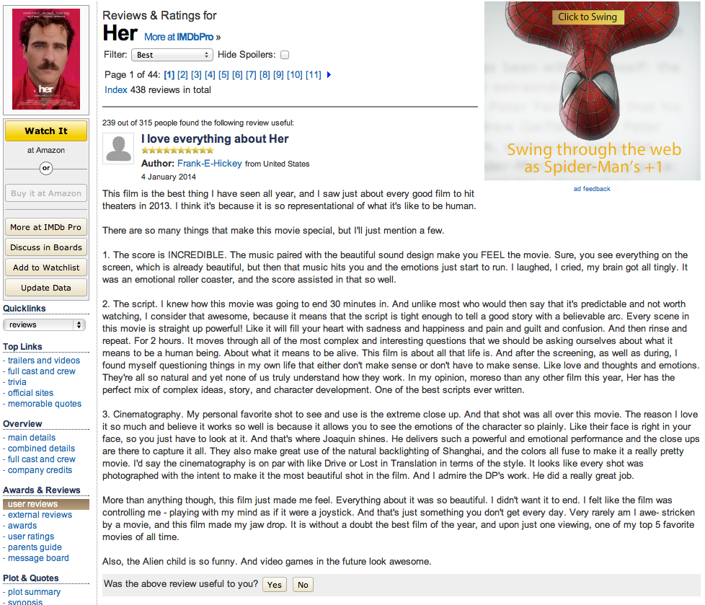

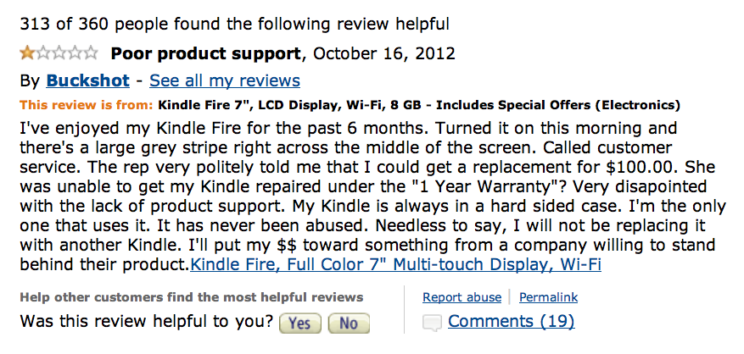

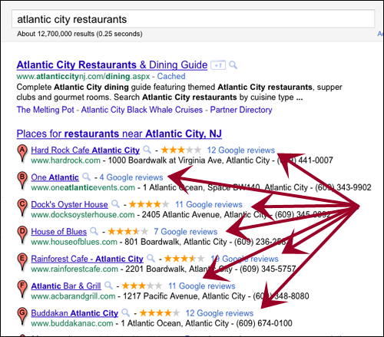



Online reviews
Online reviews are influential in customer decision-making
Notes:
Online reviews are important info resource for our everyday life, which has great influence on product sales and customers' decision making.

Slide 3

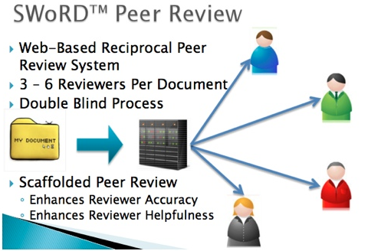
Online peer reviews
Student peer reviews have been used for grading assignments in Massive Open Online Courses (MOOCs)
Online peer-review software
  E.g. SWoRD
Developed at the University of Pittsburgh

Slide 4
While reviews thrive on the internet…
Overwhelming!
Notes:
To many reviews
Reviews are not equally helpful

Slide 5
While reviews thrive on the internet…
Overwhelming!
Mixed quality!
Notes:
To many reviews
Reviews are not equally helpful

Slide 6
Review metadata includes user-provided quality assessments (e.g., helpfulness votes)

Slide 7
Review metadata includes user-provided quality assessments (e.g., helpfulness votes)
Research Problem 1: What if helpfulness metadata is not available?

Slide 8
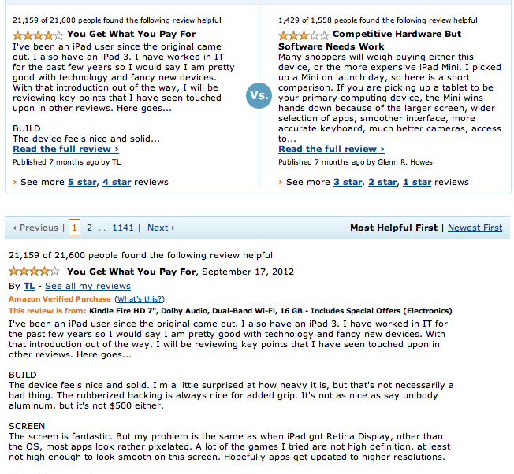
Helpfulness metadata, in turn, has been used to facilitate review exploration
Notes:
Need to automatically predicting review helpfulness

Slide 9
Helpfulness metadata has been used to facilitate review exploration
Research Problem 2: What about helpfulness for summarization?
Notes:
Need to automatically predicting review helpfulness

Slide 10
Outline
  Introduction
  Challenges for NLP
  Review content analysis for helpfulness prediction
  From customer reviews to peer reviews
  A general helpfulness model based on review text
  Helpfulness-guided review summarization
  Human summary analysis
  A user study
  Conclusions

Slide 11
Challenges for NLP
The definition of review helpfulness varies
  E.g. Educational aspects of peer reviews

Slide 12
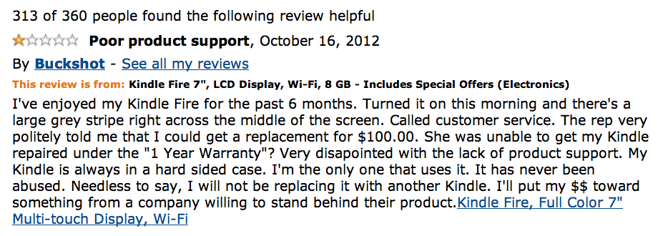
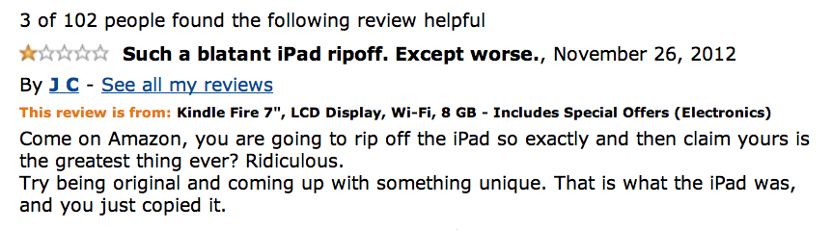
Product review examples
More helpful review
Personal experience
Product support
Less helpful review
Comparison with iPad
Notes:
Same star ratings, of different helpfulness
Language style, imperative sentences

Slide 13
Peer review examples
Criticism
Expert-rated helpfulness = 5
I thought there were some good opportunities to provide further data to strengthen your argument. For example the statement “These methods of intimidation, and the lack of military force offered by the government to stop the KKK, led to the rescinding of African American democracy.” Maybe here include data about how …
(omit 126 words)
Solution
Problem localization
Expert-rated helpfulness = 2
The author also has great logic in this paper. How can we consider the United States a great democracy when everyone is not treated equal. All of the main points were indeed supported in this piece.
Praise
    Problem localization and solutions are significantly correlated with the likelihood of feedback implementation <Nelson and Schunn 2009>

Slide 14
Challenges for NLP
The definition of review helpfulness varies
  E.g. Educational aspects of peer reviews
Review content may have multiple sources
  E.g. A description of movie plot

Slide 15
Review content from multiple sources
  The external content is highlighted in green
Product reviews
The Nikon D3100 is a very good entry-level digital SLR. Clearly targeted toward the beginner, its combination of Guide Modes, assist images, and help screens easily makes it the most accessible of any D-SLR out there.
Notes:
Plot a graph showing the occurring frequency of each aspect, and the average helpfulness of the corresponding reviews, and the frequency * helpfulness
Consider it as vague sentences

Slide 16
Review content from multiple sources
  The external content is highlighted in green
Movie reviews
Peer reviews
…Schultz tells Django to pick out whatever he likes. Django looks at the smiling white man in disbelief. You’re gonna let me pick out my own clothes? Django can’t believe it. The following shot delivered one of the biggest laughs from the audience I watched the film with. …
The paragraph about Abraham Lincoln's actions towards the former slaves is not clear. Which social and political reforms were not made quickly by Lincoln? It may well be true that Lincoln did not accomplish everything he intended before his assassination, but this sentence is too vague to know whether the writer is historically accurate.
Notes:
For more difficult domains, the external content are diverse and more complex

Slide 17
Challenges for NLP
The definition of review helpfulness varies
  E.g. Educational aspects of peer reviews
Review content may have multiple sources
  E.g. A description of movie plot
  User helpfulness ratings are not at a fine-granularity
  E.g. At the paragraph rather than the sentence level

Slide 18
Identifying review helpfulness in fine-granularity
An example
I really like this camera. It has 10x optical, image stabilization, a 3.0inch lcd with 230,000 pixels, and more.
The size is great for a 10x zoom camera. Image stabilization and is great for getting shots that would come out blurry with my Canon Powershot A620. My other favorite feature besides the zoom and image stabilization, is the wide angle. It is great to finally get cityscapes and have the whole skyline in one shot!! And with the camera set to 16X9, I can get a 24mm shot!

Slide 19
Identifying review helpfulness in fine-granularity
Sentence-level review helpfulness prediction
Index | Review sentence | Estimated helpfulness
1 | I really like this camera. | 1.5
2 | It has 10x optical, image stabilization, a 3.0inch lcd with 230,000 pixels, and more. | 2.0
3 | The size is great for a 10x zoom camera. | 1.8
4 | Image stabilization and is great for getting shots that would come out blurry with my Canon Powershot A620. | 1.4
5 | My other favorite feature besides the zoom and image stabilization, is the wide angle. | 1.8
6 | It is great to finally get cityscapes and have the whole skyline in one shot!! | 1.6
7 | And with the camera set to 16X9, I can get a 24mm shot! | 1.8

Slide 20
Identifying review helpfulness in fine-granularity
Highlight the most helpful sentences
Index | Review sentence | Estimated helpfulness
1 | I really like this camera. | 1.5
2 | It has 10x optical, image stabilization, a 3.0inch lcd with 230,000 pixels, and more. | 2.0
3 | The size is great for a 10x zoom camera. | 1.8
4 | Image stabilization and is great for getting shots that would come out blurry with my Canon Powershot A620. | 1.4
5 | My other favorite feature besides the zoom and image stabilization, is the wide angle. | 1.8
6 | It is great to finally get cityscapes and have the whole skyline in one shot!! | 1.6
7 | And with the camera set to 16X9, I can get a 24mm shot! | 1.8

Slide 21
Research questions
Can we model review helpfulness based on review textual content automatically?
Can we improve summarization performance by introducing review helpfulness?

Slide 22
Outline
  Introduction
  Challenges to NLP
  Review content analysis for helpfulness prediction
  From customer reviews to peer reviews
  A general helpfulness model based on review text
  Helpfulness-guided review summarization
  Human summary analysis
  A user study
  Conclusions

Slide 23
  Automatically assessing peer-review helpfulness
Our approach – Adaptation
  From product reviews <Kim et al 2006> to peer reviews
  Introduce peer-review domain knowledge

Slide 24
Annotated peer-review corpus
Collected from a college level history introductory class
  22 papers and 267 reviews
  Paper ratings
  Review helpfulness ratings provided by experts
Prior annotations <Nelson and Schunn 2009>
  Feedback types -- praise, summary, criticism
    Kappa = .92
  For criticisms
    Localization information of the problem
      pLocalization, Kappa = .69
    Concrete solution to problems
      Solution, Kappa = .87
Annotation
feedbackType = criticism
pLocalization = True
Solution = True
I thought there were some good opportunities to provide further data to strengthen your argument. For example the statement “These methods of intimidation, and the lack of military force offered by the government to stop the KKK, led to the rescinding of African American democracy.” Maybe here include data about how … (omit 126 words)
Notes:
Point out the differences between product review and peer reviews

Slide 25
Adaptation from product reviews to peer reviews
Generic features motivated by prior work on product reviews <Kim et al 2006>
type | Label | Features (#)
Structural | STR | revLength, sentNum, sentLengthAve, question%, excerlatmationNum
Lexical | UGR, BGR | Review unigrams (#= 2992) and bigrams (#= 23209)
Syntactic | SYN | Noun%, Adj/Adv%, 1stPVerb%, openClass%
Semantic* | TOP | counts of topic words (# = 288) ¹
 | GIW (negW, posW) | counts of positive (#= 1319) and negative sentiment words (#= 1752) ²
Metadata | META | product/paper rating, ratingDiff
Topic words are automatically extracted from students’ papers using publicly available software (by Annie Louis 2008)
Sentiment words are extracted from General Inquirer Dictionary

Slide 26
Introducing domain knowledge
Peer-review specialized features
Type | Label | Features (#)
Cognitive Science | cogS | praise%, summary%, criticism%, plocalization%, solution%
Lexical Categories | LEX | Counts of 10 categories of words
Localization | LOC | Features developed for identifying problem localization (# =3)

Slide 27
Experiment 1
Comparison
  Generic features vs. peer-review specialized features
Algorithm
  SVM Regression (SVM^{light})
Evaluation
  10-fold cross validation
    Pearson correlation coefficient r

Slide 28
Results – Analysis of the generic features
Feature Type | r
STR | .60+/-.10
UGR | .53+/-.09
BGR | .58+/-.07
SYN | .36+/-.12
TOP | .55+/-.10
posW | .57+/-.13
negW | .49+/-.11
META | .22+/-.15
All-combined | .56+/-.07
STR+UGR+META | .62+/-.07
Most helpful features: STR
Best feature combination: STR+UGR+META
Notes:
Analyze these features in isolation and combined

Slide 29
Results – Analysis of the generic features
Feature Type | r
STR | .60+/-.10
UGR | .53+/-.09
BGR | .58+/-.07
SYN | .36+/-.12
TOP | .55+/-.10
posW | .57+/-.13
negW | .49+/-.11
META | .22+/-.15
All-combined | .56+/-.07
STR+UGR+META | .62+/-.07
Most helpful features: STR
Best feature combination: STR+UGR+META
Feature redundancy effect
Combining all features together does not add up their predictive power
Notes:
Analyze these features in isolation and combined

Slide 30
Results – Analysis of the peer-review specialized features
Feature Type | r
Cognitive Science (cogS) | .43+/-.09
Lexical Categories (LEX) | .51+/-.11
Localization (LOC) | .45+/-.13
STR+META+UGR (Baseline) | .62+/-.10
STR+META+LEX | .62+/-.10
STR+META+LEX+TOP | .65+/-.10
STR+META+LEX+TOP+cogS | .66+/-.09
STR+META+LEX2+TOP+cogS+LOC | 0.67+/-0.09
Introducing peer-review specific features enhances performance
Feature redundancy effect is reduced after replacing UGR with Lexical Categories

Slide 31
Outline
  Introduction
  Challenges to NLP
  Review content analysis for helpfulness prediction
  From customer reviews to peer reviews
  A general helpfulness model based on review text
  Helpfulness-guided review summarization
  Human summary analysis
  A user study
  Conclusions

Slide 32
Modeling review helpfulness based on content patterns of multiple sources
High-level representation of review content patterns
Differentiating review content sources
type | Label | Features (#)
Language usage | LU | LIWC statistics (#=82)
Content diversity | CD | Language entropy and language perplexity (#=2)
Helpfulness-related review topics | hRT | Topic distribution inferred by sLDA (#=20)

Slide 33
Content patterns – LU
  Linguistic Inquiry Word Count <Pennebaker, et al. 2007>
  To examine review language usage patterns
Category | Representative words
Dictionary words
Words>6 letters
Function words: total pronouns | I, them, itself, …
Function words: Past tense | Went, ran, had, …
Affective processes: Positive emotions | Love, nice, sweet, …
Cognitive processes: Discrepancy | should, would, could, …
…

Slide 34
Content patterns – CD
  Language entropy over word distribution <Stark, et al. 2012>

Slide 35
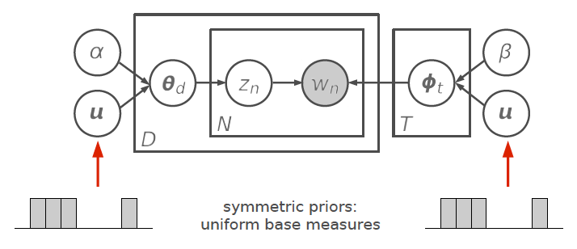


Content patterns -- rRT
Statistical topic modeling — sLDA <Blei et al 2007>
Introduce document information as supervision
Helpfulness rating

Slide 36
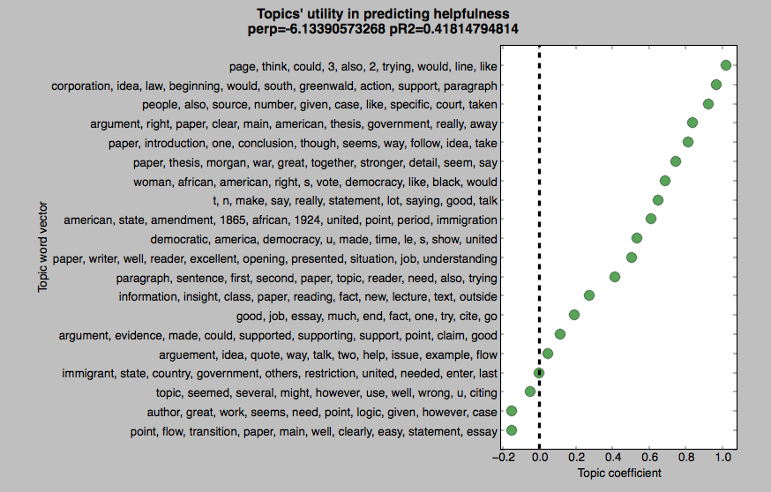
Content patterns – rRT
Topic words learned from peer reviews

Slide 37
Differentiating review content sources
Feature extraction with respect to different content sources
  Internal content: reviewers’ judgments
  External content: reviewers’ references to the review item
Consider review external content as external topic words
  Topic signature acquisition algorithm <Lin and Hovy, 2000>
  Software: TopicS <Nenkova and Louis, 2008>
…Schultz tells Django to pick out whatever he likes. Django looks at the smiling white man in disbelief. You’re gonna let me pick out my own clothes? Django can’t believe it. The following shot delivered one of the biggest laughs from the audience I watched the film with. …
Domain | Input corpus | External topic words
Movie | Plot keywords, Actor/actress names, Synopses | merry, goondor, treebeard, helm, gandalf, wormtongue, allies, fangorn, grma, aragorn, rohan, omer, frodo, war, rohirrim, uruk, pippin, ents, gimli, saruman, gollum, army, …
Peer | Student papers | war, african, americans, women, democracy, rights, states, vote, united, amendment, …

Slide 38
Data
Three domains
  Camera reviews
    From Amazon.com <Jindal and Liu 2008>
    Each camera/movie review is voted by more than 3 people
  Movie reviews
    Collected from IMDB.com
  Educational peer reviews
    <Xiong and Litman 2011>
Helpfulness gold standard
  Camera/Movie reviews
    <Kim et al. 2006>
  Peer reviews
    5-point expert ratings <Nelson and Schunn 2009>
Measurement | Camera | Movie | Peer
Vocabulary size | 14541 | 9492 | 2699
# of reviews | 4050 | 280 | 267
# of words/review | 144 | 447 | 101
Ave. helpfulness | .80 | .71 | .43
Notes:
Talk about the differences
For camera and movie reviews, the helpfulness is alittle bit sckewed to high helpfulness ratings
Gold standard, rescale to 0-1

Slide 39
Experiment 2
Comparison
  Content patterns (LU, CD, hRT) vs. unigram
  Content patterns + others vs. unigram + others
  Content sources: F, I, E, I+E
Algorithm
  SVM Regression (SVM^{light})
Evaluation
  10-fold cross validation
    Pearson correlation coefficient r
Notes:
Check the resutl!!!!

Slide 40
Experiment 2 – Feature Results
Feature set | Camera | Movie | Peer
Language Usage (LU) | .469(.089) - | .197(.417) - | .599(.274) +
Content Diversity (CD) | .418(.087) - | -.033(.451) - | .612(.239) +
Review Topics (hRT) | .351(.082) - | .440(.305) + | .523(.241)
LU+CD+hRT (Content) | .490(.068) - | .444(.394) + | .599(.273)+
Unigram (Baseline) | .620(.043) | .218(.533) | .518(.266)
The proposed features work better than unigrams for movie reviews and peer reviews
Unigrams work best for camera reviews
  Same pattern when performed down-sampling
Domain difficulty: movie > peer > camera (?)
Notes:
Check the resutl!!!!

Slide 41
Experiment 2 – Feature Results
  Content patterns + others vs. unigram + others
  Same pattern holds
Feature set | Camera | Movie | Peer
Content + STR+META | .574 | .470 | .626
Unigram+ STR+META (baseline) | .635 | .234 | .584
Feature set | Camera | Movie | Peer
Content + STR+META+SYN+DW+SENT | .615 | .435 | .630
Unigram+ STR+META+SYN+DW+SENT | .656 | .202 | .550
Notes:
Check the resutl!!!!

Slide 42
Experiment 2 – Content Source Results
The best content source is in bold for each feature type
Significant improvement over F is in purple
  Movie reviews
  Peer reviews
  For movie review: external > internal
  For both: internal + external yields most predictive models (LU+CD+hRT)
Features | F | I | E | I+E
LU | .197(.417) | .301(.627) | .414(.283)+ | .392(.412)+
CD | -.033(.451) | .047(.462) | .115(.374) | .094(.405)
hRT | .440(.305) | .418(.284) | .511(.280) | .518(.268)+
LU+CD+hRT | .444(.394) | .417(.397) | .523(.491) | .523(.311)+
Features | F | I | E | I+E
LU | .599(.274) | .620(.262) | .454(.141)- | .632(.243)+
CD | .612(.239) | .607(.220) | .284(.503)- | .586(.223)-
hRT | .523(.241) | .529(.167) | .275(.381)- | .521(.193)
LU+CD+hRT | .599(.273) | .631(.255) | .447(.145)- | .640(.251)+

Slide 43
Lessons learned
Techniques used in predicting product review helpfulness can be effectively adapted to the new peer-review domain
Prediction performance can be further improved by incorporating features that capture helpfulness information specific to peer-reviews
Content features which capture review content patterns at a high-level work better than unigrams for predicting review helpfulness
Review content source also matters to modeling review helpfulness, differentiating which yields better performance

Slide 44
Outline
  Introduction
  Challenges to NLP
  Review content analysis for helpfulness prediction
  From customer reviews to peer reviews
  A general helpfulness model based on review text
  Helpfulness-guided review summarization
  Human summary analysis
  A user study
  Conclusions

Slide 45
Problem formalization
Problem: multi-document summarization
Genre: user-generated online reviews
Approach: extraction
  Key: content selection
  Goal: capture the essence while reduce redundancy
  Tasks: sentence scoring + sentence re-ranking
Motivation: limitations of traditional summarization heuristics

Slide 46
Human summary analysis.1
Average number of words and sentences in agreed human summaries
  It is difficult for humans to agree on the informativeness of review sentences
# of shared words (Log₁₀)
# of shared sentences (Log₁₀)
Used by
# users

Slide 47
Human summary analysis.2
Human judges tend to select high-frequency word (in the input) during manual summarization <Nenkova and Vanderwende, 2005>
Average probability of words used in human summaries
  Word frequency alone is not enough for capturing review salient information
Used by
# users

Slide 48
Human summary analysis.3
With respect to effective heuristics proposed for news articles
Minimum KL-Divergence <Lin et al 2006>
    Do agreed sentences exhibit similar word distribution with the input text?
  Does not apply when x in [0, 8]
Average KLD scores
Used by
# users

Slide 49
Human summary analysis.4
With respect to effective heuristics proposed for news articles
  Maximum sum of bigram coverage <Nenkova and Vanderwende 2005, Gillick and Favre 2009>
    Do agreed sentences have greater bigram coverage in the input?
  Does not apply
Average BigramSum
Used by
# users

Slide 50
A helpfulness-guided review summarization framework
Traditional review summarizer
Traditional review summarizer
Review helpfulness models
Review helpfulness metadata
  Directly reflects user preferences
  Largely available
  Can be predicted automatically

Slide 51

Introducing review helpfulness
Filtering
  Review preprocessing <Liu et. Al., 2007>
  By review helpfulness gold-standard
Content scoring
  Identify helpfulness-related review topics
    Supervised LDA <Blei et al, 2003>
    D – review, Y_{d} – helpfulness rating
    Trained on the full corpus
      20 topics, α = 0.5, β =0.1, 10000 iterations
      Infer topic assignment based on the final 10 iterations
  Construct sentence-level helpfulness features
Helpfulness rating
Given and , we can infer review helpfulness for a review sentence S

Slide 52
Data
Domains
  Camera reviews
    From Amazon.com <Jindal and Liu 2008>
    Each camera/movie review is voted on by more than 3 people
  Movie reviews
    Collected from IMDB.com
  Peer reviews
    <Xiong and Litman 2011>
Helpfulness gold standard
  Camera/Movie review
    <Kim et al. 2006>
Measurement | Camera | Movie
Vocabulary size | 14541 | 9492
# of reviews | 4050 | 280
hRating ave. | .80 | .71

Slide 53
Experimental design
An extractive multi-document summarization framework – MEAD <Radev 2003>
Content scoring (unsupervised)
  At the sentence level
  Features (provided by MEAD):
    MEAD-default: position, centroid, length (filtering)
    LexRank: <Radev 2004>
  Sentence reranking
  Word-based MMR (maximal marginal relevance) reranker
  lambda = 0.5
MEAD + LexRank (baseline)
vs. Helpfulness features

Slide 54
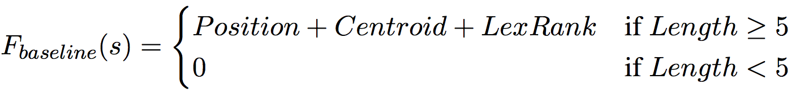
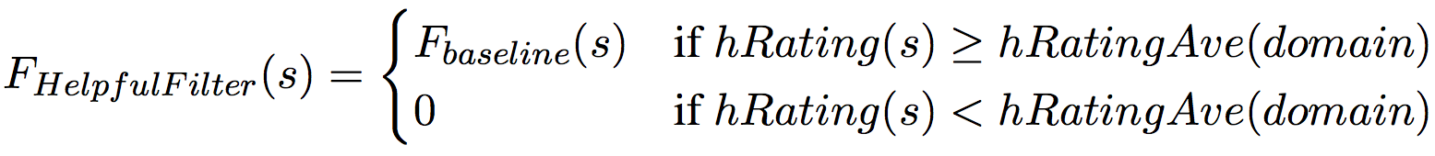
Experimental design
Three summarizers
  Baseline (MEAD + LexRank)
  HelpfulFilter
  HelpfulSum
    Compression constraint = 200 words

Slide 55
User study
6 summarization test sets
  2 domains between-subject factor
  3 review items per domain (e.g. a camera/movie)
  18 reviews per item
36 subjects
  18 for camera reviews, 18 for movie reviews
Experimental procedures
  Introduction with a real-world scenario
  Manual summarization (10 sentences)
  Pairwise comparison (5 point rating)
  Content evaluation (5 point rating)
  Time:60~90 minutes
  within-subject factor
Measurement | Camera | Movie
# of sentence/review | 9 | 18
# words/sentence | 25 | 27

Slide 56
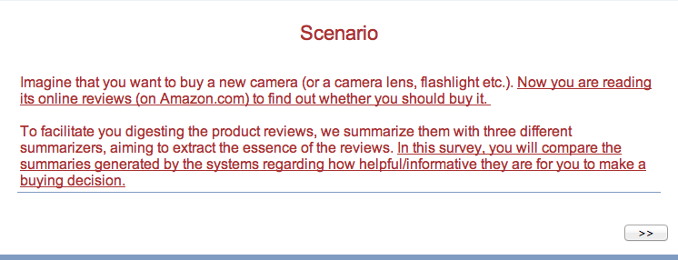
Introduction scenario -- Camera reviews

Slide 57
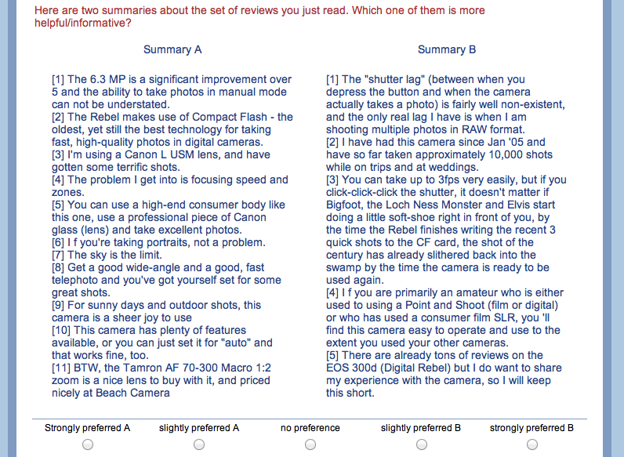
Example -- Pairwise comparison

Slide 58
Human evaluation – Pairwise comparison
A mixed linear model analysis
  Summarizer: between-subject factor
  Review item: repeated factor
  Subject: random
Preference rating of “B over A” (B is better than A if score >0)
  HelpfulSum > baseline for both review domains
  HelpfulFilter > baseline on movie reviews, vice versa on camera reviews
  HelpfulSum > HelpfulFilter on Camera reviews
Pair | Domain | Est. Mean | Sig.
HelpfulFilter over baseline | Camera | -.602 | .001
 | Movie | .621 | .000
HelpfulSum over baseline | Camera | .424 | .011
 | Movie | .601 | .000
HelpfulSum over HelpfulFilter | Camera | 1.18 | .000
 | Movie | .160 | .310

Slide 59
Compression rate of the three systems across domains
  HelpfulFilter generates shorter summaries on Camera reviews
    Smaller compression rate (3.25%)
  Higher compression rate tends to give better summaries <Napoles et al., 2011>
Summarizer | Camera | Movie
MEAD+LexRank | 6.07% | 2.64%
HelpfulFilter | 3.25% | 2.39%
HelpfulSum | 5.94% | 2.69%
Human (average) | 6.11% | 2.94%

Slide 60
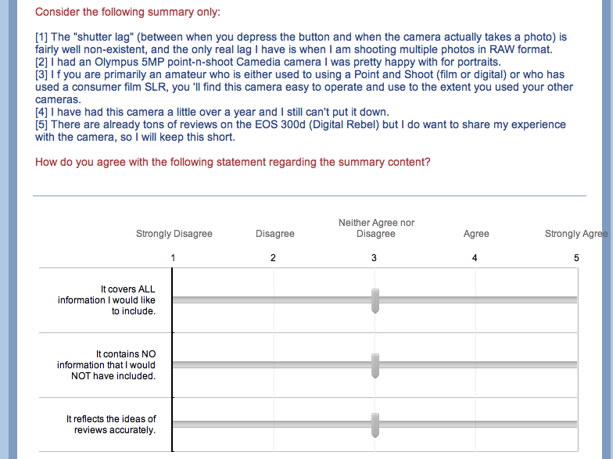
Example – Content evaluation
Recall
Precision
Accuracy

Slide 61
Human evaluation – content evaluation
Average quality rating received by each summarizer
  Across 3 review items
  1-5 points
Paired T-test for each summarizer pair on each content aspect
  Movie reviews: no significant difference
  Camera review:
    HelpfulSum > HelpfulFilter on precision (p=.034) and accuracy (p=.008)
    Baseline > HelpfulFilter on precision (p=.005) and accuracy (p=.005)
Summarizer | Camera |  |  | Movie
Metric | Precision | Recall | Acc. | Precision | Recall | Acc.
Baseline | 3.24 | 2.63 | 3.57 | 2.59 | 2.50 | 2.93
HelpfulFilter | 2.74 | 2.78 | 3.11 | 2.61 | 2.44 | 2.96
HelpfulSum | 3.19 | 2.41 | 3.69 | 2.67 | 2.52 | 3.02
Pairwise comparison is more suitable than content evaluation for human evaluation

Slide 62
Automated evaluation – ROUGE scores
18 human summaries
leave-1-out: 17 set of references
Summary length = 100 words
  Helpfulness-guided summarizers > baseline on Camera reviews
  HelpfulSum works best on Movie reviews
    Consistent with the pairwise comparison result
Camera reviews
Movie reviews
summarizer | R-1 | R-2 | R-SU4
baseline | .333 | .117 | .110
HelpfulFilter | .346 | .121 | .111
HelpfulSum | .350 | .110 | .101
Human | .360 | .138 | .126
summarizer | R-1 | R-2 | R-SU4
baseline | .281 | .044 | .047
HelpfulFilter | .278 | .040 | .041
HelpfulSum | .325 | .095 | .090
Human | .339 | .093 | .093

Slide 63
Highlights
Analysis on human review summaries reveals the limitations of traditional summarization heuristics
Proposed a novel unsupervised extractive approach for summarizing online reviews by exploiting review helpfulness ratings
  Requires no annotation
  Generalizable to multiple review domains
Both human and automated evaluation results show that helpfulness-guided summarizers outperform a strong MEAD baseline

Slide 64
Ongoing & future work
For educational peer reviews, generate review summaries for each student separately, using student-provided helpfulness ratings
Use predicted review helpfulness ratings when review helpfulness meta data is not available
Take into account review content sources in content selection for review summarization
Deployment in SWoRD system

Slide 65
Outline
  Introduction
  Challenges to NLP
  Review content analysis for helpfulness prediction
  From customer reviews to peer reviews
  A general helpfulness model based on review text
  Helpfulness-guided review summarization
  Human summary analysis
  A user study
  Conclusions

Slide 66
Conclusions
Contributions to peer review, review mining & summarization
  A specialized review helpfulness model tailored to peer reviews
  A general review helpfulness model based on review content patterns with respect to different content sources
  Applying supervised topic modeling for differentiating review helpfulness at the sentence level
  A user-centric review summarization framework which leverages user-provided review helpfulness assessment to select salient information
Applicable to a wide range of review domains
The proposed ideas can be generalized to other related tasks
  Text mining of other types of user-generated content

Slide 67
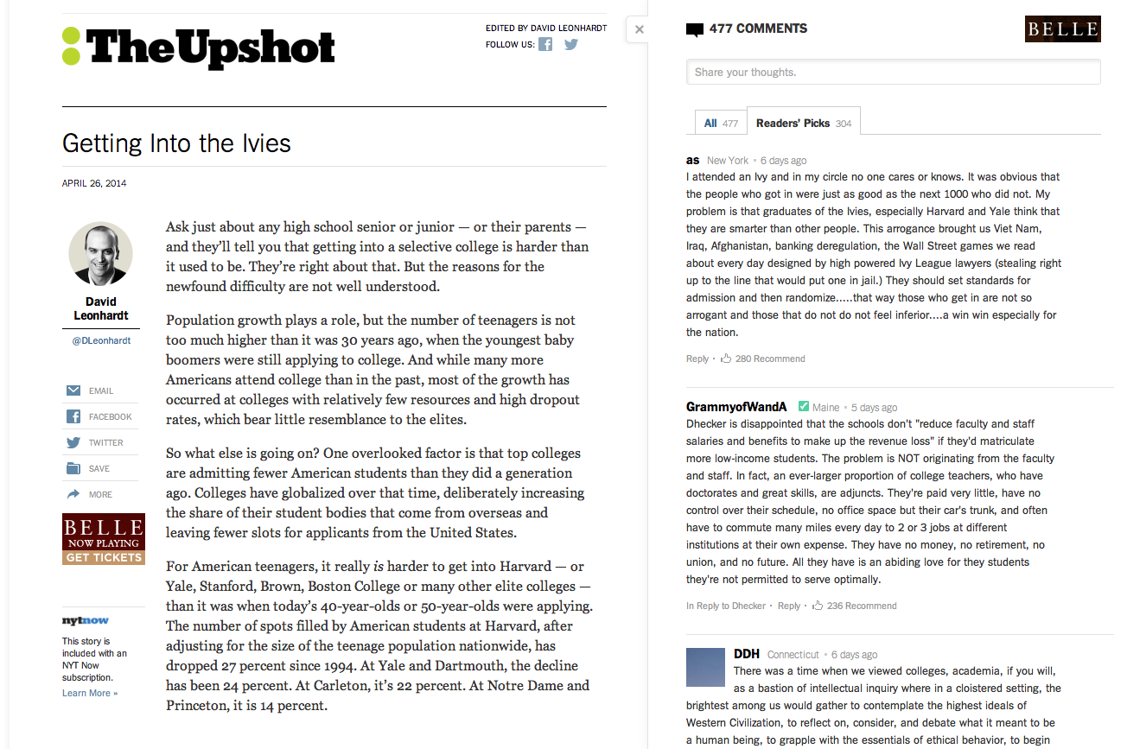
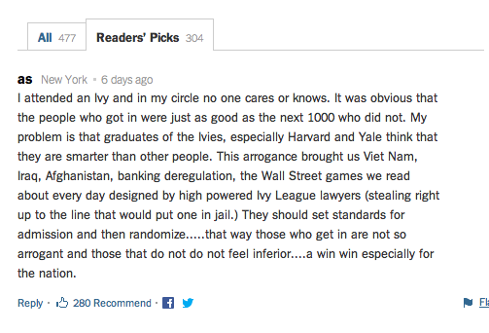
User preferences of user-generated content

Slide 68

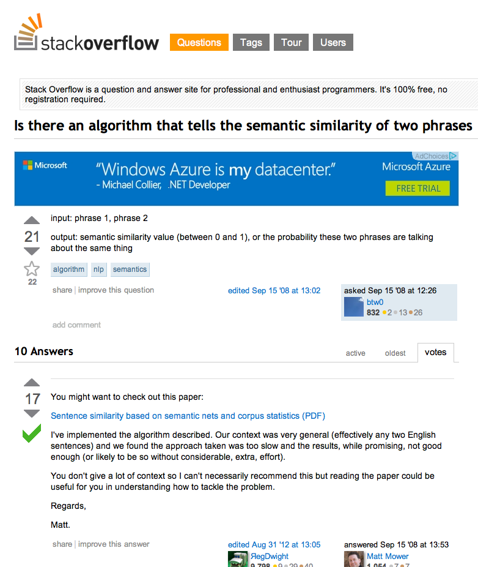
User preferences of user-generated content
Social Question Answering service

Slide 69
New Summarization Applications
Improving Undergraduate STEM Education by Integrating Natural Language Processing with Mobile Technologies
Peer Review Search & Analytics in MOOCs via Natural Language Processing

Slide 70



Acknowledgements
Dr. Melissa Nelson and Professor Chris Schunn for the annotated peer-review corpus
SWoRD research team
ITSPOKE group members

Slide 71
Thank You!
Questions?
Further Information
  http://www.cs.pitt.edu/~litman
  https://sites.google.com/site/swordlrdc/

Slide 72
Questions & Answers

Slide 73
Related research projects
on educational peer reviews

Slide 74
Assessing students’ reviewing performance
Reviewer
reviews
Segmentation
Predictions at feedback-level
Predictions at reviewer-level
Feedback
A
B
Criticism Identifier
pLocalization Identifier
Aggregation
Assessment
essays
Domain vocabulary
Domain resources generated automatically
Domain knowledge extraction

Slide 75
Observation:
Teachers rarely read peer reviews
Challenges faced by teachers
  Read all reviews (Scalability issues)
  Simultaneously remember all reviewers’ comments for different students to compare and contrast between students
  Do not know where to start first (cold start)

Slide 76
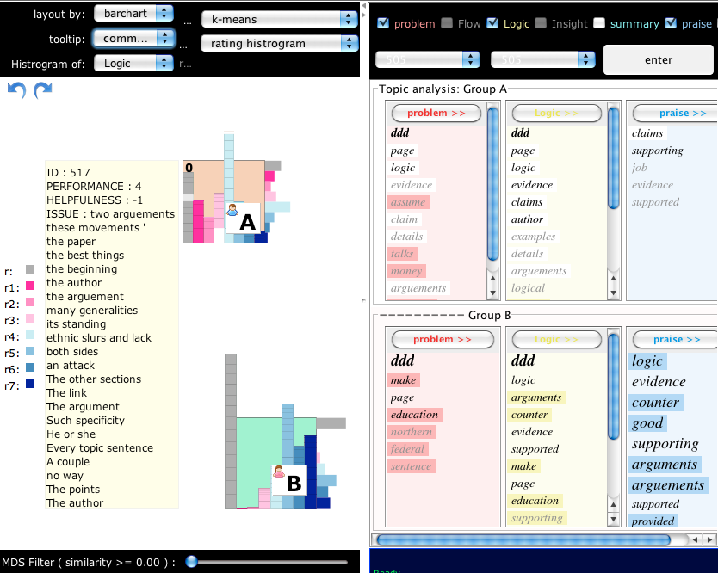
Solution: RevExplore
SWoRD <Cho and Shunn, 2007>
RevExplore <Xiong et al, 2012>
Peer-review content
http://www.pantherlearning.com/blog/sword/
  -- An interactive analytic tool for peer-review exploration
Notes:
To address the challenge, proposed revExplore, on top of SWoRD,
SWoRD is a web-based pr reciprocal
a interactive analytic tool for peer review exploration designed for SWorD

Slide 77
RevExplore example
Writing assignment:
  “Whether the United States become more democratic, stayed the same, or become less democratic between 1865 and 1924.”
  Reviewing dimensions:
  Flow, logic, insight
Goal
  Discover student group difference in writing issues
Notes:
How instructor can use revExplore to make sense of peer reviews

Slide 78
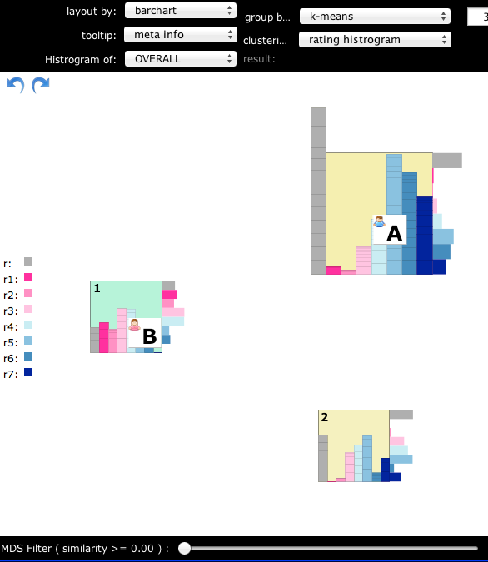
  RevExplore example
Step 1 -- Interactive student grouping
K-means clustering
Peer rating distribution
Target groups: A & B

Slide 79
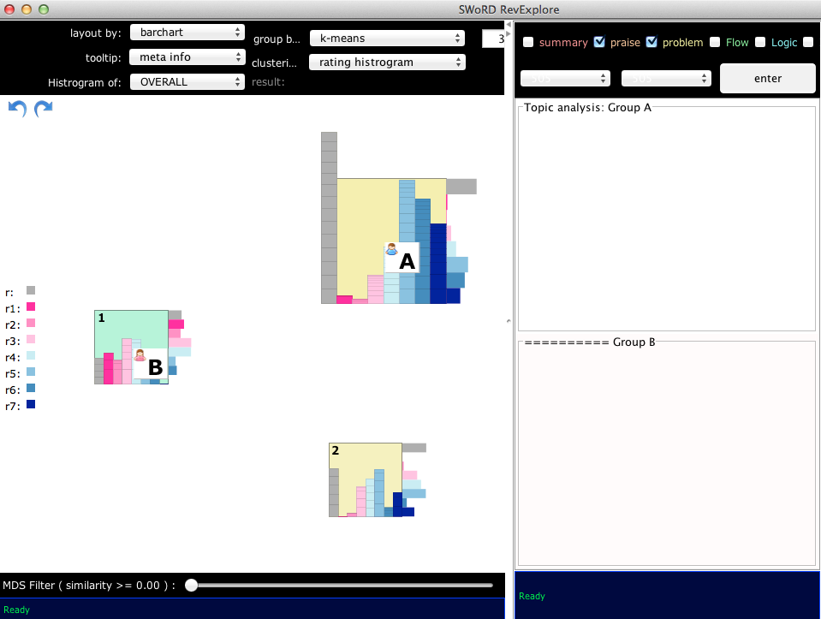
  RevExplore example
Step 2 – Automated topic-word extraction
Click “Enter”

Slide 80
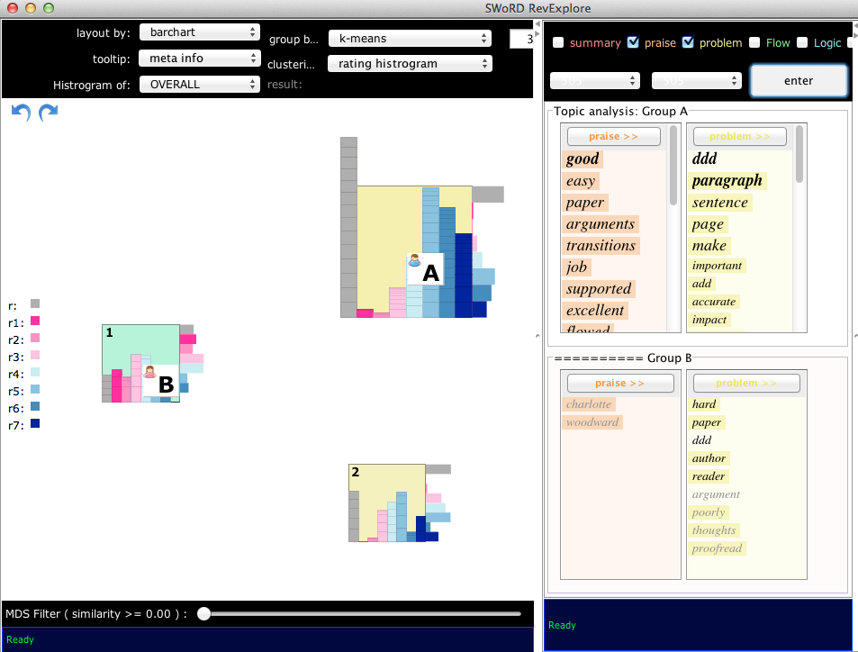
  RevExplore example
Step 2 – Automated topic-word extraction

Slide 81
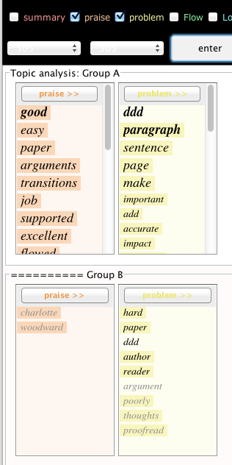
  RevExplore example
Step 3 – Group comparison by topic words
Group A receive more praises than group B
Group A’s writing issues are location-specific
  Paragraph, sentence, page, add, …
Group B’s are general
  Hard, paper, proofread, …

Slide 82
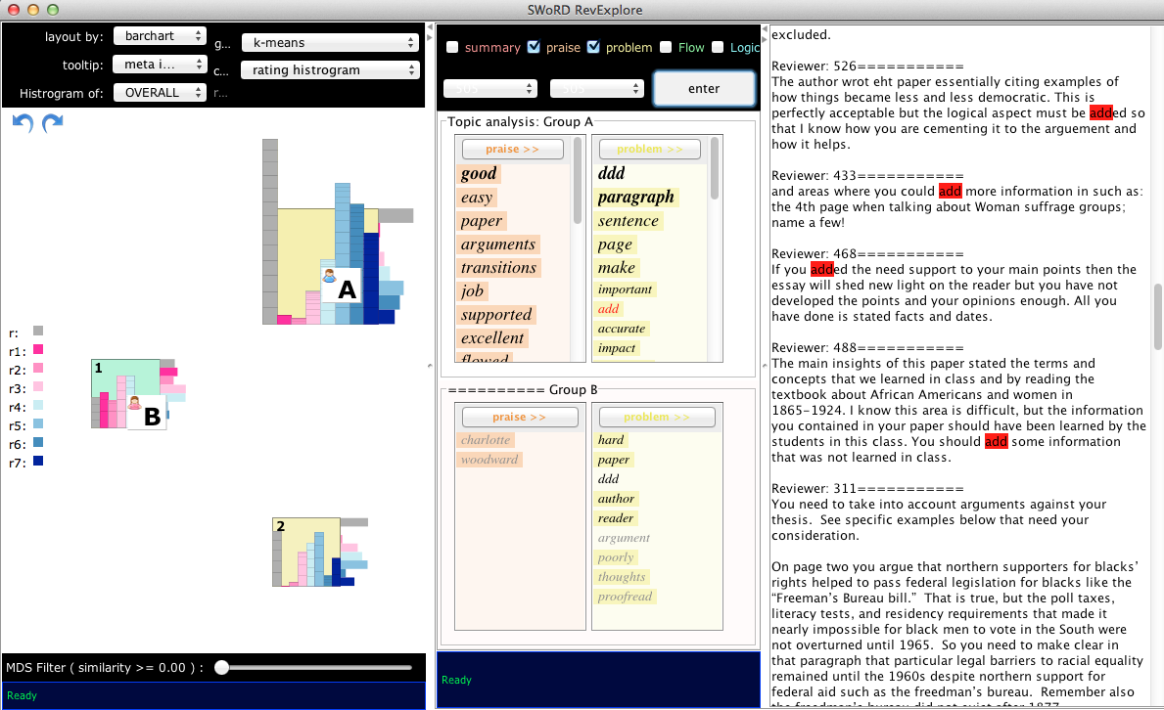
  RevExplore example
Step 3 – Group comparison by topic words
Double click

Slide 83
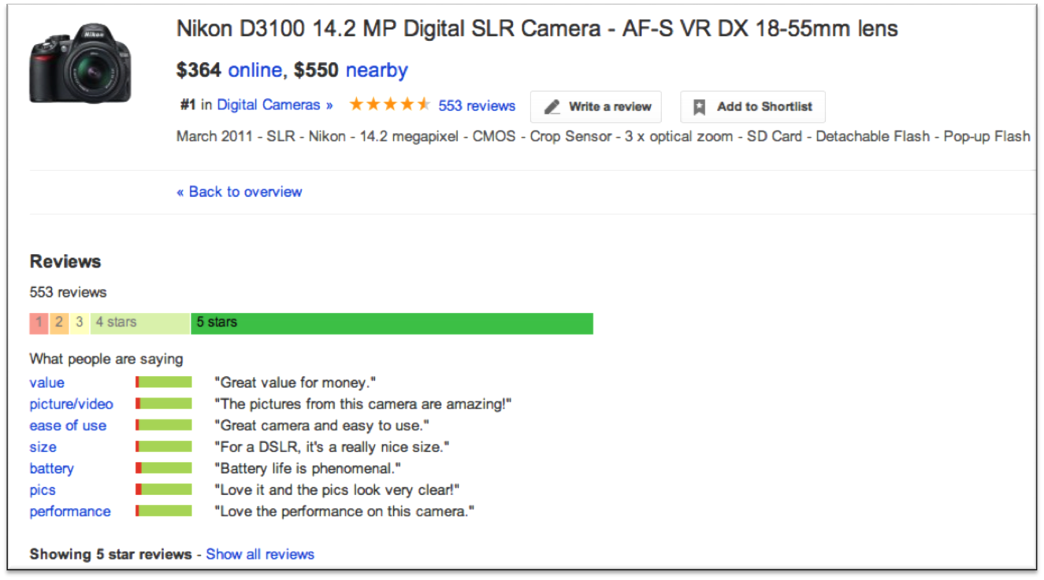
  Automatic review summarization
Current approach: mining opinions based on star ratings
Notes:
Example from google shopping
For a particular product, there are reviews collected from e-ecommerce websites.
Review summarization based on Aspect-specific sentiment analysis

Slide 84
Automatic review summarization
There are generally two paradigms
  Mining opinions based on star ratings
    Focus: reviewers’ opinions on specific aspects
  Text summarization for reviews
    Formulated as text summarization problem
    Focus: salient information (e.g. sentences) in text
Designed for customer reviews
Does not reflect user preferences
What’s salient is domain-specific

Slide 85
Review content from multiple sources
Beyond the scope of prior work in subjectivity
  In addition to evaluations <Carenini et al 2006>, a review may contain descriptions of personal experience.
  External content objective content <Pang and Lee 2004>
I am merely a birthday holiday type picture taker.
The enslavement of African Americans, the fight for women's suffrage and the immigration laws that were passed greatly effected the U.S. democratically.
Notes:
Personal experience matters (directly from/about the reviewer), but could be objective
Paraphrase of the review target (student paper) can be subjective

Slide 86
Data preparation for machine-learning experiment
Text preprocessing
  Tokenization, lowercase, no-stemming
Syntactic analysis
  MSTParser <McDonald et al. 2005>
Feature extraction
Normalization and transformation
  Transform each feature f using , and rescaling it into [0, 1]
  Gold standard is rescaled to [0, 1]

Slide 87
To capture and leverage user preferences regarding reviews, we propose a helpfulness-guided summarization framework:
Traditional review summarizer
Review helpfulness models
Traditional review summarizer
  No need for manual annotation of important review content
  Can be generalized to multiple review domains
  E.g. Product reviews, movie reviews, educational peer reviews
Notes:
While a lot of effort has been devoted to customer reviews, hotel reviews, little attention has been given to educational peer reviews
However, when we attempt to summarize educational peer review with existing techniques, it doesn’t wok well.
We expect a helpfulness-guided summarization framework would help us out

Slide 88
  Lexical Categories (LEX) : Counts of 9 categories of words
Learned in a semi-supervised way based on their syntactic and semantic functions in opinion expression
  Coding Manuals
Decision trees trained with Bag-of-Words
Tag | Meaning | Word list
SUG | suggestion | should, must, might, could, need, needs, maybe, try, revision, want
LOC | location | page, paragraph, sentence
ERR | problem | error, mistakes, typo, problem, difficulties, conclusion
IDE | idea verb | consider, mention
LNK | transition | however, but
NEG | negative | fail, hard, difficult, bad, short, little, bit, poor, few, unclear, only, more, stronger, careful, sure, full
POS | positive | great, good, well, clearly, easily, effective, effectively, helpful, very
SUM | summarization | main, overall, also, how, job
NOT | negation | not, doesn't, don't
Notes:
Keywords are defined in the manually created keyword list, in which all key words are categorized into 9 groups according to its functionally semantics or syntax.

Slide 89
  Localization (LOC)
  Developed for automatically predicting problem localization (Xiong and Litman, 2010)
    windowSize
      For each review sentence, we search for the most likely referred window of words in the related paper, and windowSize is the average number of words of all windows
Feature | Example/Description
regTag% | “On page five, …”
dDeterminer | “To support this argument, you should provide more ….”
windowSize | The amount of context information regarding the related paper

Slide 90
Human evaluation – content evaluation
Average quality rating received by each summarizer
  Across 3 review items
  1-5 points
Paired T-test for each summarizer pair on each content aspect
  Movie reviews: no significant difference
  Camera review:
    HelpfulSum > HelpfulFilter on precision (p=.034) and accuracy (p=.008)
    Baseline > HelpfulFilter on precision (p=.005) and accuracy (p=.005)
Summarizer | Camera |  |  | Movie
Metric | Precision | Recall | Acc. | Precision | Recall | Acc.
Baseline | 3.24 | 2.63 | 3.57 | 2.59 | 2.50 | 2.93
HelpfulFilter | 2.74 | 2.78 | 3.11 | 2.61 | 2.44 | 2.96
HelpfulSum | 3.19 | 2.41 | 3.69 | 2.67 | 2.52 | 3.02

Slide 91
Introducing review helpfulness
Filtering
  Review preprocessing <Liu et. al. 2007>
  By review helpfulness gold-standard
Content scoring
  Identify helpfulness-related review topics
    Supervised LDA <Blei et al, 2003>
    D – review, Y_{d} – helpfulness rating
    Trained on the full corpus
      20 topics, α = 0.5, β =0.1, 10000 iterations
      Infer topic assignment based on the final 10 iterations
  Construct sentence-level helpfulness features
Helpfulness rating

Slide 92
Introducing review helpfulness
Filtering
  Review preprocessing <Liu et. Al., 2007>
  By review helpfulness gold-standard
Content scoring
  Identify helpfulness-related review topics
    Supervised LDA <Blei et al, 2003>
    D – review, Y_{d} – helpfulness rating
    Trained on the full corpus
      20 topics, α = 0.5, β =0.1, 10000 iterations
      Infer topic assignment based on the final 10 iterations
  Construct sentence-level helpfulness features
Helpfulness rating

