Slide 1



Natural Language Processing for
Enhancing Teaching and Learning
Diane Litman
  Senior Scientist, Learning Research & Development Center
  Professor, Computer Science Department
  Director, Intelligent Systems Program
University of Pittsburgh
Pittsburgh, PA USA
Notes:
Advances in NLP and educational technology, as well as the availability of unprecedented amounts of text and speech data, have led to an increasing interest in using NLP to address the needs of teachers, students, and researchers.
But educational applications differ in many ways from the types of applications for which NLP systems are typically developed.
This talk will organize and give an overview of research opportunities and challenges.

Slide 2
Natural Language Processing (NLP)
Getting computers to perform useful and interesting tasks involving human languages
  Online text and audio
  Intelligent personal assistants

Slide 3
Language Processing in Education
Over a 50 year history
Exciting new research opportunities
  E.g., MOOCs, mobile technologies, social media
Commercial interest as well
  E.g., ETS, Pearson, Turnitin, Grammerly, Coursera

Slide 4
Roles for Language Processing in Education
Learning Language
(e.g., writing)

Slide 5
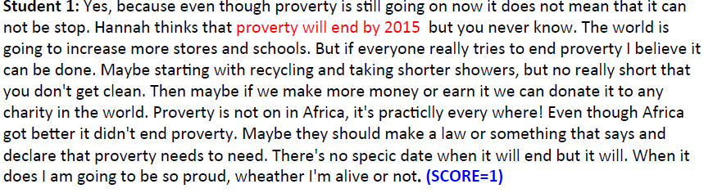
Roles for Language Processing in Education
Learning Language
(e.g., writing)
Automatic Essay Grading

Slide 6
Roles for Language Processing in Education
Learning Language
(e.g., writing)
Revision Writing Assistant

Slide 7
Roles for Language Processing in Education
Using Language
(e.g., teaching in the disciplines)

Slide 8

Roles for Language Processing in Education
Using Language
(e.g., teaching in the disciplines)
Tutorial Dialogue Systems for STEM

Slide 9
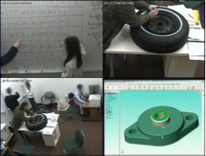
Roles for Language Processing in Education
Using Language
(e.g., teaching in the disciplines)
Identifying Successful Student Teamwork

Slide 10
Roles for Language Processing in Education
Processing Language
(e.g. MOOCs)

Slide 11
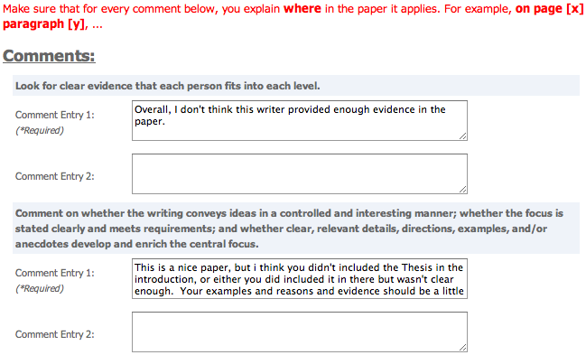
Roles for Language Processing in Education
Processing Language
(e.g., MOOCs)
Peer Feedback

Slide 12
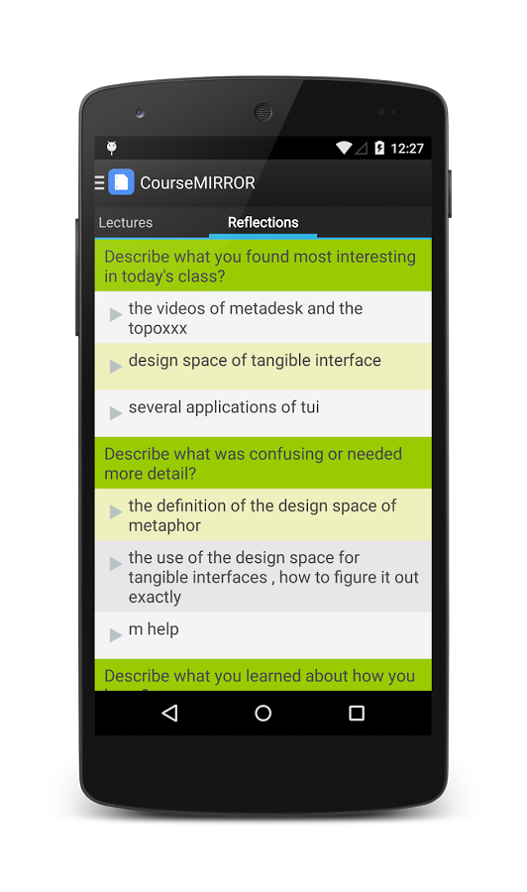
Roles for Language Processing in Education
Processing Language
(e.g., MOOCs)
Student Reflections

Slide 13
Three Case Studies
Writing Assessment and Tutoring
Spoken Tutorial Dialogue
Summarizing Student Reflections

Slide 14

Why Automatic Writing Assessment?
Essential for Massive Open Online Courses (MOOCs)
Even in traditional classes, frequent assignments can limit the amount of teacher feedback

Slide 15
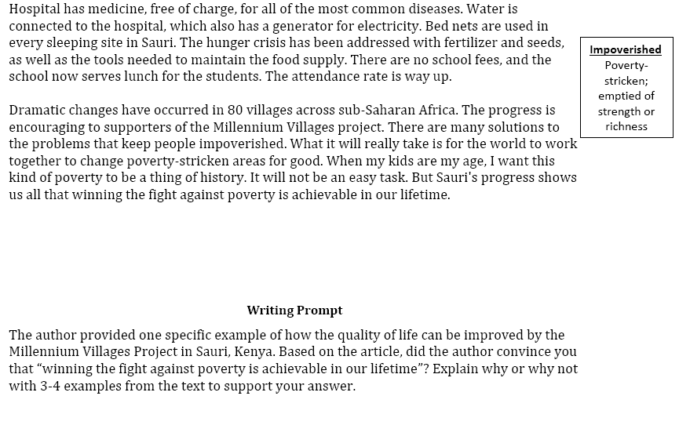
An Example Writing Assessment Task: Response to Text (RTA)
MVP, Time for Kids – informational text

Slide 16
RTA Rubric for the Evidence dimension
1 | 2 | 3 | 4
Features one or no pieces of evidence | Features at least 2 pieces of evidence | Features at least 3 pieces of evidence | Features at least 3 pieces of evidence
Selects inappropriate or little evidence from the text; may have serious factual errors and omissions | Selects some appropriate but general evidence from the text; may contain a factual error or omission | Selects appropriate and concrete, specific evidence from the text | Selects detailed, precise, and significant evidence from the text
Demonstrates little or no development or use of selected evidence | Demonstrates limited development or use of selected evidence | Demonstrates use of selected details from the text to support key idea | Demonstrates integral use of selected details from the text to support and extend key idea
Summarize entire text or copies heavily from text | Evidence provided may be listed in a sentence, not expanded upon | Attempts to elaborate upon evidence | Evidence must be used to support key idea / inference(s)

Slide 17
Gold-Standard Scores (& NLP-based evidence)
Student 1: Yes, because even though proverty is still going on now it does not mean that it can not be stop. Hannah thinks that proverty will end by 2015 but you never know. The world is going to increase more stores and schools. But if everyone really tries to end proverty I believe it can be done. Maybe starting with recycling and taking shorter showers, but no really short that you don't get clean. Then maybe if we make more money or earn it we can donate it to any charity in the world. Proverty is not on in Africa, it's practiclly every where! Even though Africa got better it didn't end proverty. Maybe they should make a law or something that says and declare that proverty needs to need. There's no specic date when it will end but it will. When it does I am going to be so proud, wheather I'm alive or not. (SCORE=1)
Student 2: I was convinced that winning the fight of poverty is achievable in our lifetime. Many people couldn't afford medicine or bed nets to be treated for malaria . Many children had died from this dieseuse even though it could be treated easily. But now, bed nets are used in every sleeping site . And the medicine is free of charge. Another example is that the farmers' crops are dying because they could not afford the nessacary fertilizer and irrigation . But they are now, making progess. Farmers now have fertilizer and water to give to the crops. Also with seeds and the proper tools . Third, kids in Sauri were not well educated. Many families couldn't afford school . Even at school there was no lunch . Students were exhausted from each day of school. Now, school is free . Children excited to learn now can and they do have midday meals . Finally, Sauri is making great progress. If they keep it up that city will no longer be in poverty. Then the Millennium Village project can move on to help other countries in need. (SCORE=4)

Slide 18
Automatic Scoring of an Analytical
Response-To-Text Assessment (RTA)
Summative writing assessment for argument-related RTA scoring rubrics
  Evidence [Rahimi, Litman, Correnti, Matsumura, Wang & Kisa, 2014]
  Organization [Rahimi, Litman, Wang & Correnti, 2015]
Pedagogically meaningful scoring features
  Validity as well as reliability

Slide 19
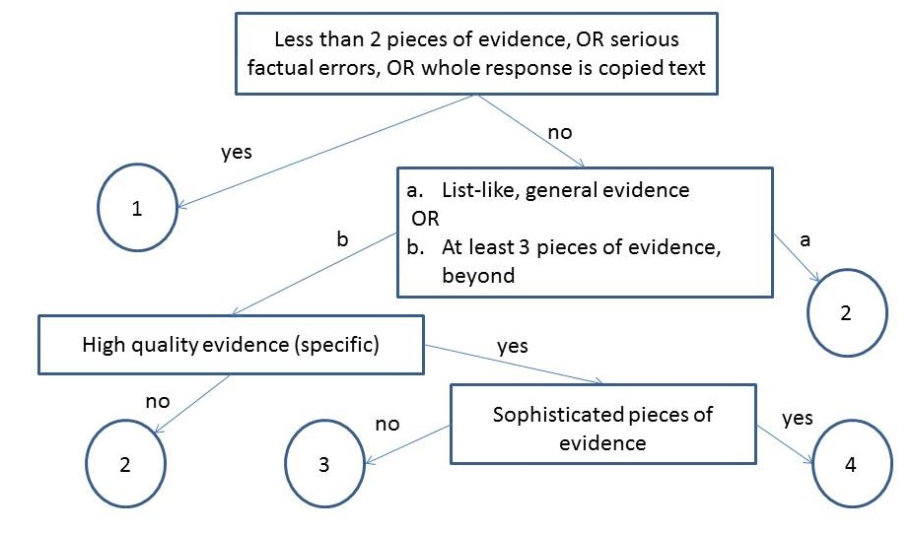
Extract Essay Features using NLP
Notes:
What is evidence topic subtopic,
Copping how much copy is copying

Slide 20
Extract Essay Features using NLP
Number of Pieces of Evidence
  Topics and words based on the text and experts
Notes:
What is evidence topic subtopic,
Copping how much copy is copying

Slide 21
Extract Essay Features using NLP
Notes:
What is evidence topic subtopic,
Copping how much copy is copying

Slide 22
Extract Essay Features using NLP
Concentration
High concentration essays have fewer than 3 sentences with topic words (i.e., evidence is not elaborated)
Notes:
What is evidence topic subtopic,
Copping how much copy is copying

Slide 23
Extract Essay Features using NLP
Notes:
What is evidence topic subtopic,
Copping how much copy is copying

Slide 24
Extract Essay Features using NLP
Specificity
Specific examples from different parts of the text
Notes:
What is evidence topic subtopic,
Copping how much copy is copying

Slide 25
Extract Essay Features using NLP
Notes:
What is evidence topic subtopic,
Copping how much copy is copying

Slide 26
Extract Essay Features using NLP
Argument Mining
Link to thesis
Notes:
What is evidence topic subtopic,
Copping how much copy is copying

Slide 27
Example Feature Vectors
Essay with Score=1
Essay with Score=4
NPE | CON | WOC | SPC
1 | 1 | 166 | 0 | 0 | 0 | 0 | 0 | 1 | 1 | 0
NPE | CON | WOC | SPC
4 | 0 | 187 | 0 | 0 | 1 | 4 | 3 | 3 | 5 | 1
Notes:
Highlite potential feadbacks

Slide 28
Evaluation
Data
  Essays written by students in grades 4-6 and 6-8
Results
  Features outperform competitive baselines
  Features more robust in cross-corpus evaluation

Slide 29
Three Case Studies
Writing Assessment and Tutoring
Spoken Tutorial Dialogue
Summarizing Student Reflections

Slide 30
Why Tutorial Dialogue?
One-on-one tutoring is a powerful technique for helping students learn
Spoken dialogue is a typical human tutoring method
Using NLP, can computer tutors similarly improve student learning?

Slide 31
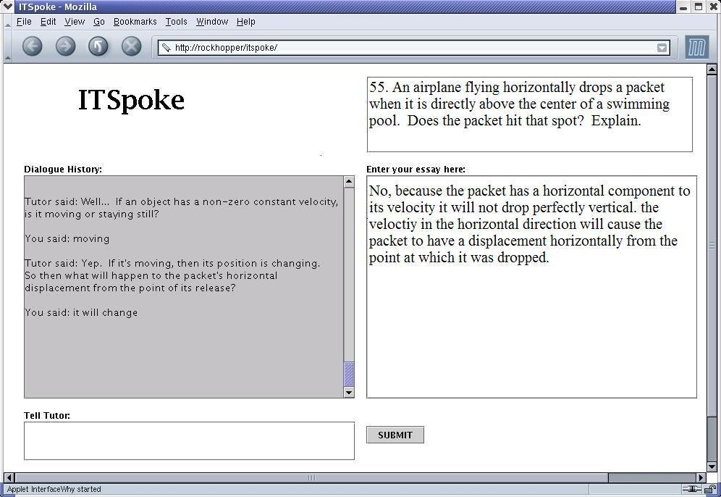
Back-end is Why2-Atlas system [VanLehn et al. 2002]
Sphinx2 speech recognition and Cepstral text-to-speech

Slide 32
Back-end is Why2-Atlas system [VanLehn et al. 2002]
Sphinx2 speech recognition and Cepstral text-to-speech

Slide 33
Back-end is Why2-Atlas system [VanLehn et al. 2002]
Sphinx2 speech recognition and Cepstral text-to-speech

Slide 34
Adaptive ITSPOKE
System detects and adapts to student states
  uncertainty and disengagement
NLP is used to analyze student utterances
  what students say
  how they say it

Slide 35
Challenges
What student “emotions” to detect?
How should a computer tutor respond?
  Data-driven methods for designing dialogue systems adaptive to student states

Slide 36
Results
Dynamically detecting and adapting to student uncertainty and disengagement can significantly improve student learning
  [Litman & Forbes-Riley 2014]
  [Forbes-Riley & Litman, 2011]

Slide 37
Three Case Studies
Writing Assessment and Tutoring
Spoken Tutorial Dialogue
Summarizing Student Reflections

Slide 38
Why (Summarize) Student Reflections?
Student reflections have been shown to improve both learning and teaching
In large lecture classes, it is hard for teachers to read all the reflections

Slide 39
Student Reflections and a TA’s Summary
Reflection Prompt: Describe what was confusing or needed more detail.
Student Responses
S1: Graphs of attraction/repulsive & interatomic separation
S2: Property related to bond strength
S3: The activity was difficult to comprehend as the text fuzzing and difficult to
read.
S4: Equations with bond strength and Hooke's law
S5: I didn't fully understand the concept of thermal expansion
S6: The activity ( Part III)
S7: Energy vs. distance between atoms graph and what it tells us
S8: The graphs of attraction and repulsion were confusing to me
… (rest omitted, 53 student responses in total)

Slide 40
Student Reflections and a TA’s Summary
Reflection Prompt: Describe what was confusing or needed more detail.
Student Responses
S1: Graphs of attraction/repulsive & interatomic separation
S2: Property related to bond strength
S3: The activity was difficult to comprehend as the text fuzzing and difficult to
read.
S4: Equations with bond strength and Hooke's law
S5: I didn't fully understand the concept of thermal expansion
S6: The activity ( Part III)
S7: Energy vs. distance between atoms graph and what it tells us
S8: The graphs of attraction and repulsion were confusing to me
… (rest omitted, 53 student responses in total)
Summary created by the Teaching Assistant
1) Graphs of attraction/repulsive & atomic separation
2) Properties and equations with bond strength
3) Coefficient of thermal expansion
4) Activity part III

Slide 41
Enhancing Large Classroom Instructor-Student Interactions via Summarization
CourseMIRROR: A mobile app for collecting and browsing student reflections
  [Fan, Luo, Menekse, Litman, & Wang, 2015]
  [Luo, Fan, Menekse, Wang, & Litman, 2015]
A phrase-based approach to extractive summarization of student-generated content
  [Luo & Litman, 2015]
  [Luo, Liu & Litman, 2016]

Slide 42
Challenges for (Extractive) Summarization
  Reflections range from single words to sentences
  Concepts that are semantically mentioned by more students are more important to summarize
  Deployment on mobile app

Slide 43
Phrase-Based Summarization
Stage 1: Candidate Phrase Extraction
  Noun phrases
Stage 2: Phrase Clustering
  Estimate student coverage with semantic similarity
Stage 3: Phrase Ranking
  Rank clusters by student coverage
  Select one phrase per cluster

Slide 44
Quantitative Evaluation
Summarization baseline algorithms
Performance in terms of human-computer overlap
Multiple corpora of reflections/summaries
Our method outperforms all baselines

Slide 45
Summing Up
NLP roles for teaching and learning at scale
  Assessing language
  Using language
  Processing language
Many opportunities and challenges

Slide 46
Current Directions
Writing Assessment
  From summative to formative
  Automated as well as human in the loop
Tutorial Dialogue
  From STEM to ESL
Reflection Summarization
  Beyond English

Slide 47



Thank You!
Questions?
Further Information
  http://www.cs.pitt.edu/~litman

Slide 48
NLP for Education Research Lifecycle
Systems and Evaluations
Real-World
Problems
Learning and Teaching
Higher Level Learning Processes
NLP-Based Educational Technology
Challenges!
User-generated content
Meaningful constructs
Real-time performance
Theoretical and Empirical Foundations

