Slide 1



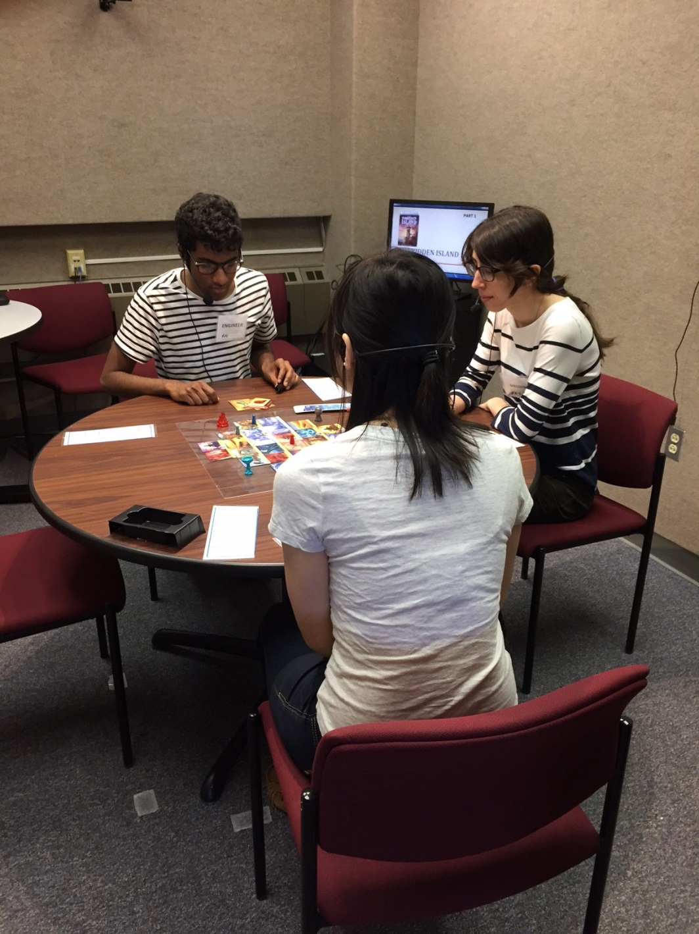

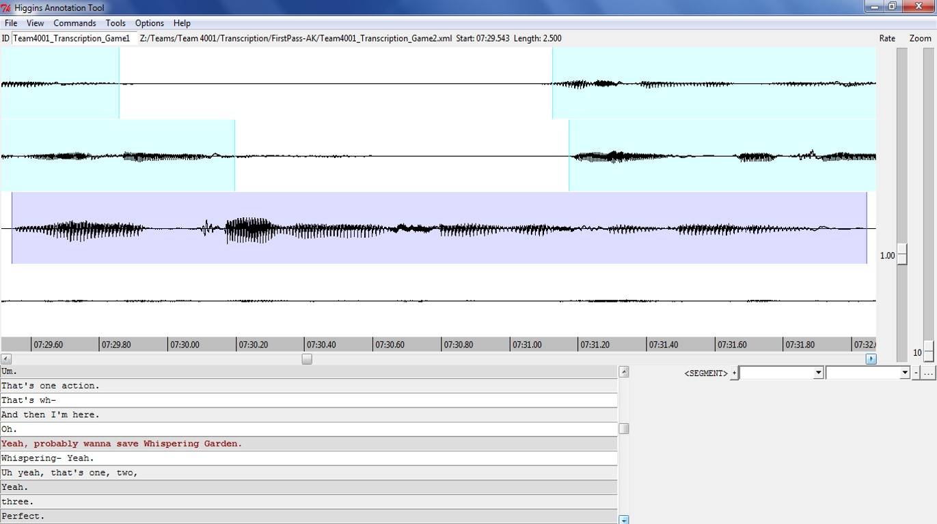
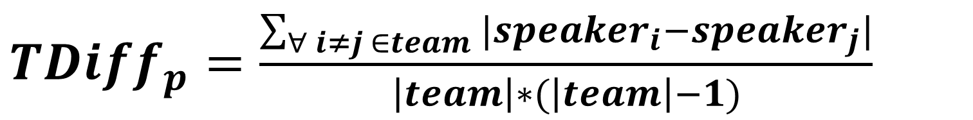
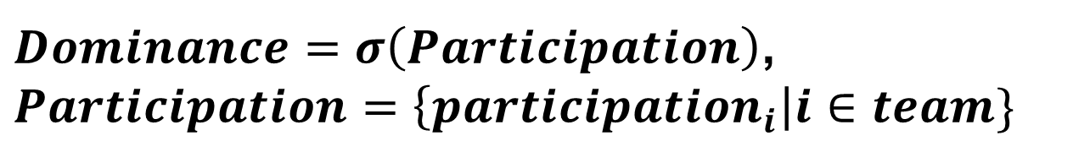
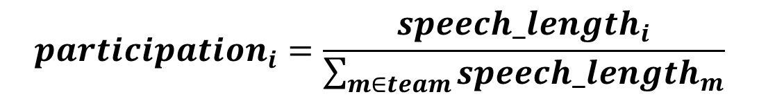
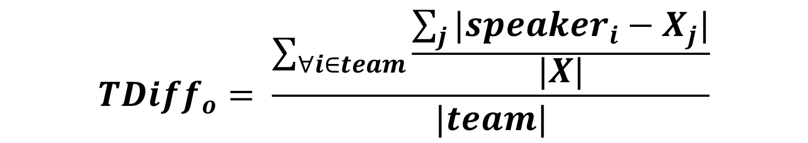
The Teams Corpus and Entrainment in Multi-Party Spoken Dialogues
Diane Litman, Susannah Paletz, Zahra Rahimi, Stefani Allegretti & Caitlin Rice
Background
Contributions
Entrainment: the convergence of (para)linguistic features across speakers
  Speakers entrain to both humans and computers
  Entrainment often correlates with task and dialogue success
Prior work has focused on dyads rather than multiparty team conversations
The Teams Corpus: large-scale community resource
High quality audio, transcriptions, and video
Team process and success measures
Use cases: Acoustic-prosodic team entrainment; relation to participation equality/dominance
Experimental Study
Design
High vs. low entrainment manipulation via independent variables (IV)
Task & Subjects
3 or 4 person teams playing a cooperative board game requiring conversation
Adults from university and surrounding community
Procedure (2-3 hours)
Questionnaire (individual-level)
Game tutorial
(Team training: intervention condition only)
Game 1
Questionnaire (team-level)
(Team reflection: intervention condition only)
Game 2 (isomorphic to Game 1)
Questionnaire (team-level)
Data Capture
Video: Four wall-mounted Zoom cameras
Audio: Individual close-talk Sennheiser microphones
Surveys: Qualtrics
 | (IV) Condition
(IV) Game | Control (low) | Intervention (high)
First (low) | No Training | Team Training
Second (high) | No Training | Team Training
Descriptive Statistics
63 teams (47 hours audio)
Within team effect for game time in minutes (p < .001)
216 individuals
Diverse gender, age, education, occupation, race
The Teams Corpus
https://sites.google.com/site/teamentrainmentstudy/corpus
Release v1
124 game-level WAV files
216 demographic responses
Audio Segmentation and Transcription
Inter-pausal segments
Time-aligned transcriptions
Higgins Annotation Tool
 | Control |  | Intervention
 | 3-per | 4-per | 3-per | 4-per
# teams | 20 | 11 | 16 | 16
G1 time | 26.6 | 28.0 | 26.4 | 27.3
G2 time | 18.0 | 17.7 | 18.2 | 19.7
Acoustic-Prosodic Team Entrainment Does Participation Predict Entrainment? Summary
Theoretical Background: Two Types of Entrainment
Proximity: feature similarity over a conversation (across teams)
Convergence: an increase in feature proximity over time (within teams)
Measuring Entrainment (from dyads to teams)
Proximity: TDiff_{p} (difference with team partners) < TDiff_{o} (difference with other speakers)
Convergence: TDiff_{p} (later in conversation) < TDiff_{p} (earlier in conversation)
Extracting Acoustic-Prosodic Features
Pitch, intensity, voice quality (jitter, shimmer): extracted for each speaker / game
Significant Entrainment Results
Proximity: intensity (mean, min, max) & shimmer (both games) ; jitter (game 2)
Convergence: pitch (min, max), shimmer, jitter (game 1, various temporal intervals)
Theoretical Background: Participation Equality/Dominance
Equality of participation is associated with team success
Measuring Participation Equality/Dominance
Standard deviation of individuals’ participation (lower is more equal)
Hierarchical Regression Analysis
Independent variables: participation (of speaking time), covariates from team literature (team size, session length)
Dependent variable: pitch-max convergence in Game 1
Result: Convergence increases with participation equality (p < .05)
Novel Large-Scale Corpus
Experimental manipulations
High-quality audio/video
Time-aligned transcriptions
Team process self-report data
New Entrainment Directions
Teams rather than dyads
Team literature constructs (e.g., participation)
Broader Impacts
Corpus for studying other aspects of teamwork
Data mining applications
Dialogue agent interventions
${TDiff}_{p}=\frac{\sum_{∀ i≠j ∈team}{|{speaker}_{i}−{speaker}_{j}|}}{\left|team\right|∗(\left|team\right|−1)}$
$${TDiff}_{o}= \frac{\sum_{∀i∈team}{\frac{\sum_{j}{{|speaker}_{i}−X_{j}|}}{|X|}}}{|team|}$$
$Dominance=σ\left(Participation\right)$,
$$Participation=\left\{{participation}_{i}\right|i∈team\}$$
$${participation}_{i}=\frac{{speech_length}_{i}}{\sum_{m∈team}{{speech_length}_{m}}}$$

