Slide 1
Text-based Reasoning & Argumentation
Chair: Diane Litman
Diane Litman – “Argument Mining from Text for Formative and Summative Assessment”
Kevin Ashley – “Annotating Texts for Legal Pedagogy and Machine Learning”
Byeong-Young Cho – “Can Metacognition Facilitate Digital Literacy? An Intervention Study of High School Learners”
Question & Answer Period

Slide 2



Argument Mining from Text for Formative and Summative Assessment
Diane Litman
Professor, Computer Science Department
Co-Director, Intelligent Systems Program
Senior Scientist, Learning Research & Development Center
University of Pittsburgh
Pittsburgh, PA USA
Notes:
Based on JHU16

Slide 3
Research Question
Can argument mining be used to better teach, assess, and understand student argumentation?
Approach: Technology design and evaluation
  System enhancements that improve student learning
  Argument analytics for teachers
  Experimental platforms to test research predictions

Slide 4
Outline
Argument Mining
Analyzing Student Essays & Classroom Discussions
  eRevise: Providing Formative Feedback on Students’ Use of Evidence in Response to Text Writing
Summary and Current Directions

Slide 5
Argument Mining
“… exploits the techniques and methods of natural language processing … for semi-automatic and automatic recognition and extraction of structured argument data from unstructured … texts.” [SICSA Workshop on Argument Mining, July 2014]

Slide 6
Argument Mining Subtasks
[Peldszus and Stede, 2013]
Scope of today’s talk
Even partial argument mining can support useful applications

Slide 7
Argument Mining for Education
Challenges
  Noisy data (e.g., adult learners, children)
  Limited quantity of data
  Real-time algorithms
  Meaningful predictive features

Slide 8
Outline
Argument Mining
Analyzing Student Essays & Classroom Discussions
  eRevise: Providing Formative Feedback on Students’ Use of Evidence in Response to Text Writing
Summary and Current Directions

Slide 9
Mining a Grade School Text-Based Essay for Evidence
I was convinced that winning the fight of poverty is achievable in our lifetime. Many people couldn't afford medicine or bed nets to be treated for malaria . Many children had died from this dieseuse even though it could be treated easily. But now, bed nets are used in every sleeping site . And the medicine is free of charge. Another example is that the farmers' crops are dying because they could not afford the nessacary fertilizer and irrigation . But they are now, making progess. Farmers now have fertilizer and water to give to the crops. Also with seeds and the proper tools . Third, kids in Sauri were not well educated. Many families couldn't afford school . Even at school there was no lunch . Students were exhausted from each day of school. Now, school is free . Children excited to learn now can and they do have midday meals . Finally, Sauri is making great progress. If they keep it up that city will no longer be in poverty. Then the Millennium Village project can move on to help other countries in need.

Slide 10
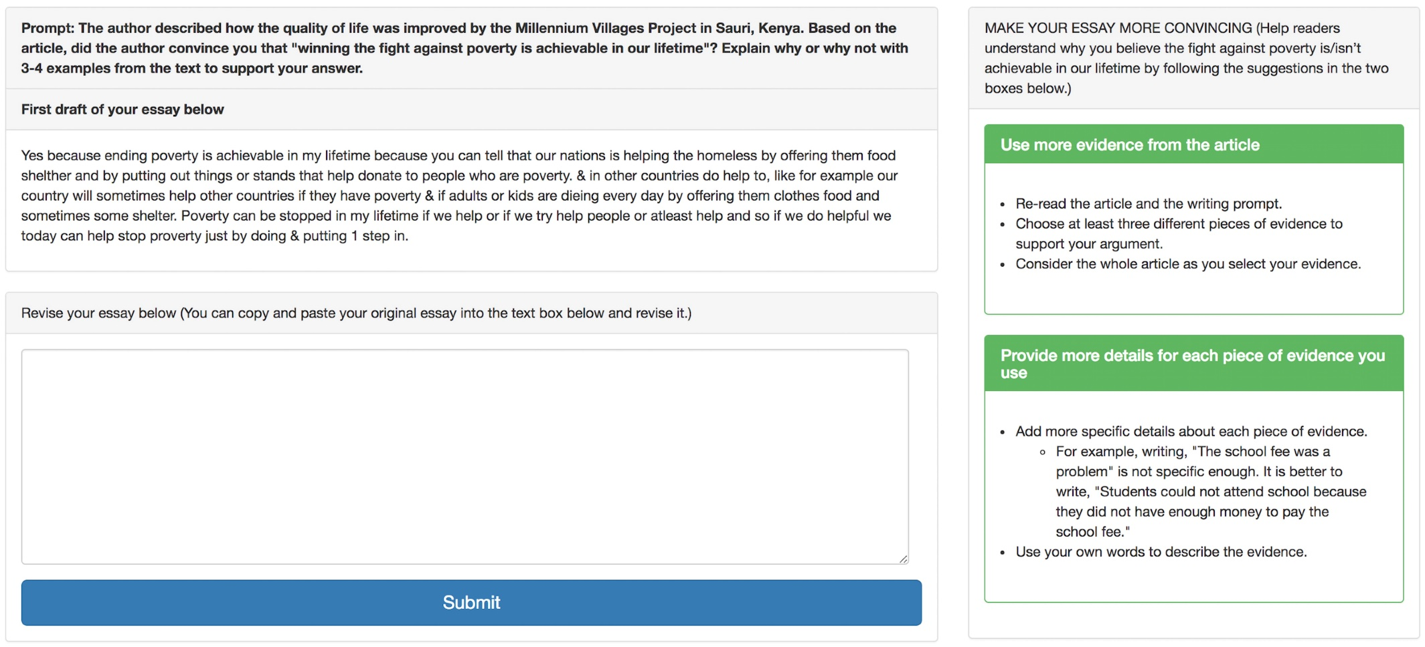
Application: Formative Assessment
(Automatic Writing Evaluation System)

Slide 11
Mining a High School Text-Based Classroom Discussion for Claim, Evidence, Warrants
Student | Transcript | Component
S1 | She’s like really just protecting Willy from everything | claim
 | Like at the end of the book remember how she was telling the kids to leave and never come back | evidence
 | Like she’s not even caring about them, she’s carying about Willy. | warrant
S2 | It’s like she’s concerned with him trying to … | claim

Slide 12
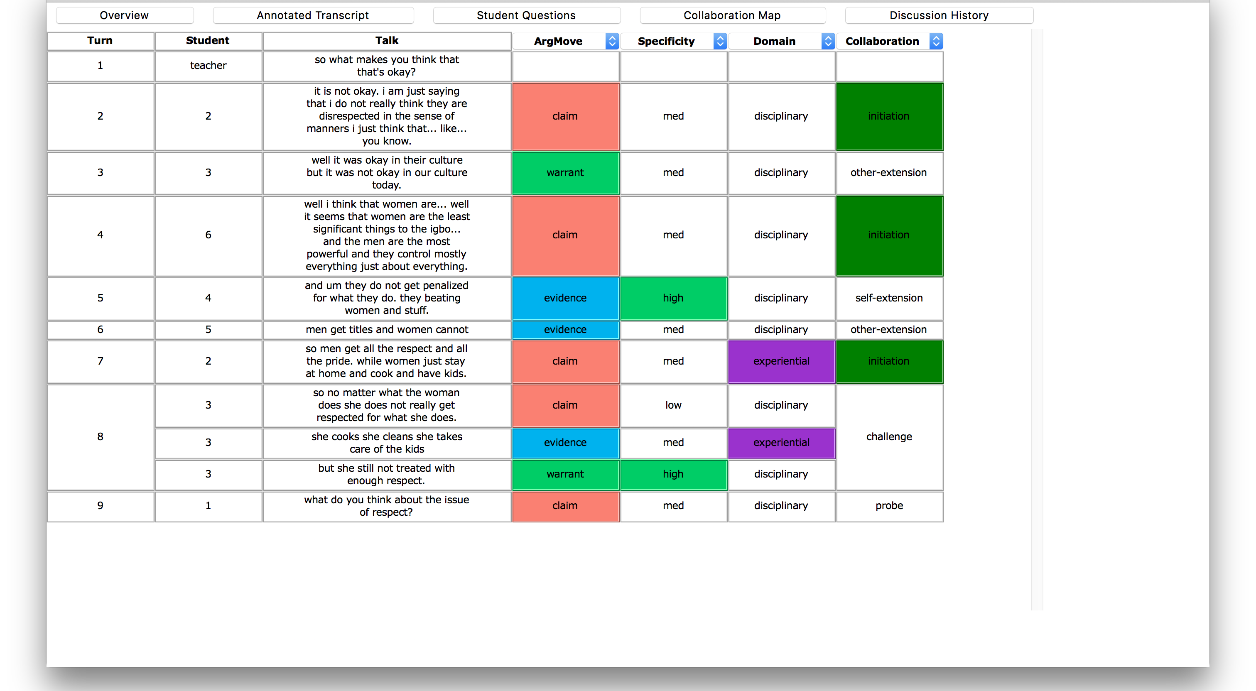
Application: Teacher Dashboard
(joint NSF grant with Prof. Amanda Godley)

Slide 13
Mining a College Essay for Claims, Premises and their Support/Attack Relations
(Huy Nguyen CS dissertation)
C
⁽¹⁾[Taking care of thousands of citizens who suffer from disease or illiteracy is more urgent and pragmatic than building theaters or sports stadiums]_{Claim}.
⁽²⁾As a matter of fact, [an uneducated person may barely appreciate musicals]_{Premise}, whereas [a physical damaged person, resulting from the lack of medical treatment, may no longer participate in any sports games]_{Premise}. ⁽³⁾Therefore, [providing education and medical care is more essential and prioritized to the government]_{Claim}.
Claim(1)
Premise(2.1) supports Claim(1)
Premise(2.1) supports Claim(3)
Premise(2.2) supports Claim(1)
Premise(2.2) supports Claim(3)
Claim(3) supports Claim(1)
Claim(3)
Premise (2.1)
Premise (2.2)

Slide 14
Application: Summative Assessment
(Automated Essay Scoring System)
 | Argument Component Features (AC)
1, 2 3, 4 5 6 7 | Number and fraction of argument components over total number of sentences in essay Number and fraction of argumentative sentences Total number of words in argument components Number of paragraphs containing argument components Whether the essay has paragraph without any argument component
 | Argument Component Label Features (CL)
8 9, 10 11, 12 13 | Number of Major Claims Number and fraction of Claims over total number of sentences Number and fraction of Premises Average number of Premises per Claim
 | Argument Flow Features (AF)
14 15 16 17 – 24 | Number of paragraphs that contain Major Claims and Claims Number of paragraphs that contain Major Claims and Premises Number of paragraphs that contain Claims and Premises Frequency of 8 typed bigrams of argument components
 | Argumentative Relation Features (RL)
25 26 27 28 | Number of supported Claims Number of dangling Claims Number of supporting Premises Number of paragraphs that have support relations
 | Argumentation Structure Typology Features (TS)
29 30 31 32 33 | Number of Chain-structures Number of Tree-structures Number of Tree-structures with height = 1 Number of paragraphs that contain Chain-structures Number of paragraphs that contain Tree-structures

Slide 15
Outline
Argument Mining
Analyzing Student Essays & Classroom Discussions
  eRevise: Providing Formative Feedback on Students’ Use of Evidence in Response to Text Writing
Summary and Current Directions

Slide 16
eRevise
Response-to-Text Tasks to Assess Students' Use of Evidence and Organization in Writing: Using Natural Language Processing for Scoring Writing and Providing Feedback At-Scale
  IES Education Technology/Measurement Grant
  Co-PIs: Rip Correnti and Lindsay Clare Matsumara
Argument mining subtasks
  segmentation: spans of text
  segment classification: evidence from text (or not)
Supports both summative and formative assessment

Slide 17
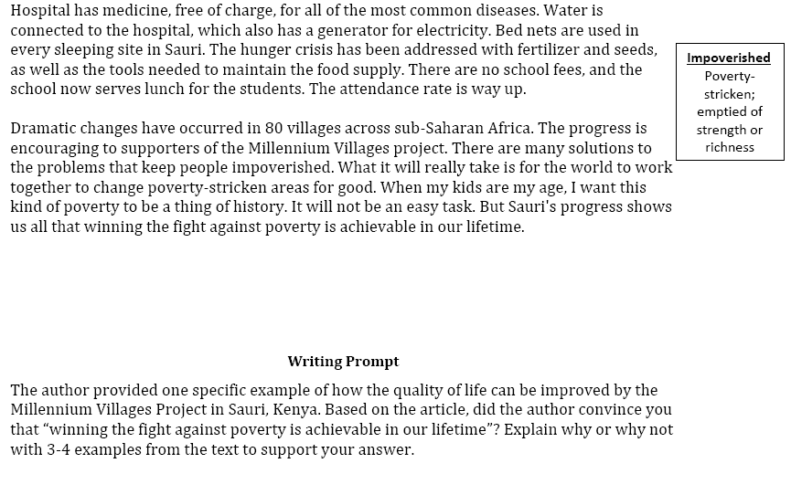
An Example Writing Assessment Task: Response to Text (RTA)
MVP, Time for Kids – informational text

Slide 18
Evidence Scoring via Argument Mining
Student 1: Yes, because even though proverty is still going on now it does not mean that it can not be stop. Hannah thinks that proverty will end by 2015 but you never know. The world is going to increase more stores and schools. But if everyone really tries to end proverty I believe it can be done. Maybe starting with recycling and taking shorter showers, but no really short that you don't get clean. Then maybe if we make more money or earn it we can donate it to any charity in the world. Proverty is not on in Africa, it's practiclly every where! Even though Africa got better it didn't end proverty. Maybe they should make a law or something that says and declare that proverty needs to need. There's no specic date when it will end but it will. When it does I am going to be so proud, wheather I'm alive or not. (SCORE=1)
Student 2: I was convinced that winning the fight of poverty is achievable in our lifetime. Many people couldn't afford medicine or bed nets to be treated for malaria . Many children had died from this dieseuse even though it could be treated easily. But now, bed nets are used in every sleeping site . And the medicine is free of charge. Another example is that the farmers' crops are dying because they could not afford the nessacary fertilizer and irrigation . But they are now, making progess. Farmers now have fertilizer and water to give to the crops. Also with seeds and the proper tools . Third, kids in Sauri were not well educated. Many families couldn't afford school . Even at school there was no lunch . Students were exhausted from each day of school. Now, school is free . Children excited to learn now can and they do have midday meals . Finally, Sauri is making great progress. If they keep it up that city will no longer be in poverty. Then the Millennium Village project can move on to help other countries in need. (SCORE=4)

Slide 19
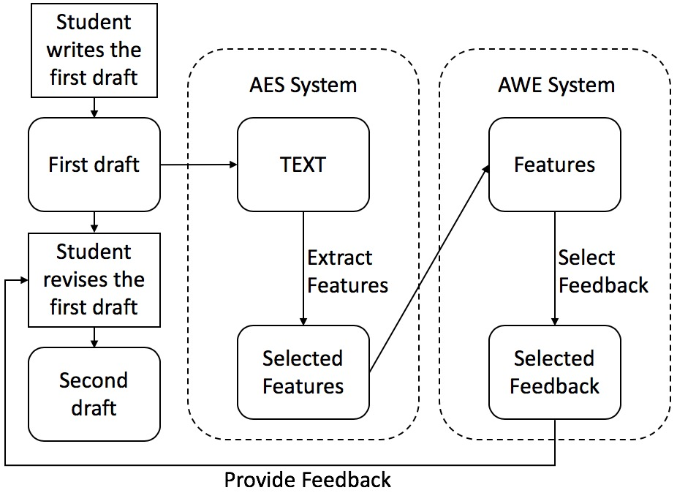
eRevise: System Usage & Architecture

Slide 20
eRevise: System Usage & Architecture

Slide 21
eRevise: System Usage & ArchitectUre

Slide 22
eRevise: System Usage & Architecture

Slide 23
eRevise: System Usage & Architecture

Slide 24
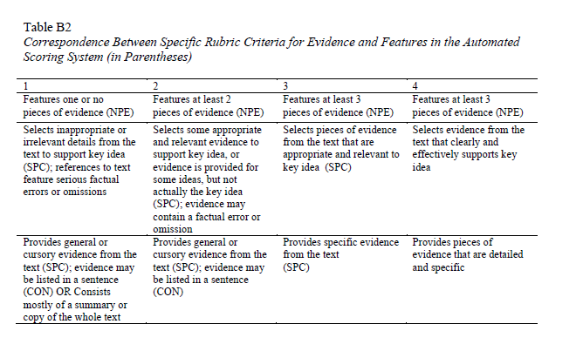
Automated Essay Scoring (AES):
Feature Extraction

Slide 25
Automatic Writing Evaluation (AWE): Feedback Selection
NPE indicates the breadth of unique topics
SPC (after further processing) indicates the number of unique pieces of evidence
A matrix of these two matches each essay to appropriate feedback

Slide 26
Theory of Effective Formative Feedback
Puts forth a coherent vision of an effective practice
Feedback is understandable and actionable
Information is specific enough to improve the piece of work
Also generalizable to other contexts/similar tasks
Notes:
(Switch to Elaine & Lindsay)
Another aspect of our system that we want to highlight is that the features used in scoring (AES) are the same as the ones used for AWE system (for selecting feedback)

Slide 27
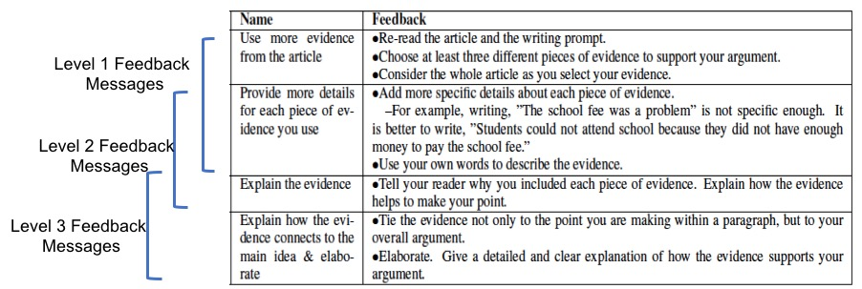
Formative Feedback Messages
Notes:
(Elaine & Lindsay)

Slide 28
Revision and Formative Feedback Screenshot

Slide 29
Spring 2018 Pilot Deployment
Seven 5th and 6th grade teachers in two public rural parishes in LA
  Students wrote/revised an essay using eRevise for RTA_{mvp}
  143 students completed all tasks
Mean RTA Evidence scores improved from first to second draft
  Human graders (p ≤ 0.08)
  AES in eRevise (p = 0.001)
AES feature values increased from first to second draft
  NPE (p ≤ 0.003)
  SPC_TOTAL_MERGED (p ≤ 0.001)
Notes:
MAKE YOUR ESSAY MORE CONVINCING
Help readers understand why you believe the fight against poverty is/isn’t achievable in our lifetime by following the suggestions highlighted in green.
…
Provide more details for each piece of evidence you use
Go back to the article to find the evidence you chose and add specific details to your response
Check that you give enough details about the examples you use. People reading your essay who may not have read the article should be able to understand what the example is about
For example, writing, “The school fee was a problem” is not specific enough. It is better to write, “Students could not attend school because they did not have enough money to pay the school fee.”
Try using your own words when using evidence from the articles
Explain the evidence
If you quoted evidence from the article, say again clearly in your own words what the evidence means
Tell your reader why you included each piece of evidence. Explain how the evidence helps to make your point
Connect the evidence to your argument
Tie the evidence not only to the point you are making within a paragraph, but to your overall argument in response to the writing prompt
Elaborate. Give a detailed and clear explanation of how the evidence supports your argument

Slide 30
2018-2019 Deployment
Beginning a new study with almost 50 teachers in Louisiana
eRevise will now be used for both RTA_{mvp} and RTA_{space}
More teacher support as well as a control-condition

Slide 31
Outline
Argument Mining
Analyzing Student Essays & Classroom Discussions
  eRevise: Providing Formative Feedback on Students’ Use of Evidence in Response to Text Writing
Summary and Current Directions

Slide 32
Summary
AI for Technology Development
  Natural Language Processing & Machine Learning
  Technically Challenging
  Experimental Student & Teacher Evaluations
  Even non-structural argument mining can support useful assessments
Current Directions

Slide 33



Thank You!
Questions?
Further information, data, and software
  http://www.cs.pitt.edu/~litman

Slide 34
AES: An Alternative Approach
Although eRevise uses this rubric-based AES system
  Requires education experts to pre-encode knowledge of the source article
  Requires computer science experts to handcraft predictive features for AES
This year we have also developed a co-attention-based neural network for source-dependent AES
  Increases reliability (not sure about validity)
  Eliminates human source encoding and feature engineering
  Zhang & Litman, Proceedings Thirteenth Workshop on Innovative Use of NLP for Building Educational Applications, 2018

Slide 35
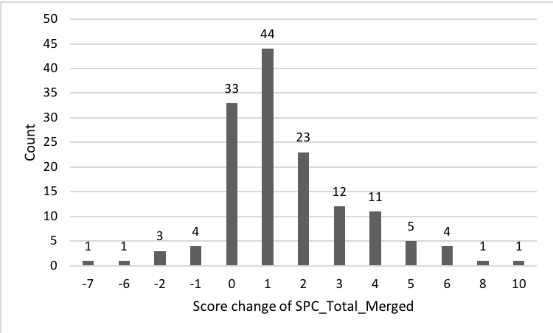
AES Feature Change (Automated)

