Slide 1



Argument Mining from Text for Teaching and Assessing Writing
Diane Litman
Professor, Computer Science Department
Co-Director, Intelligent Systems Program
Senior Scientist, Learning Research & Development Center
University of Pittsburgh
Pittsburgh, PA USA

Slide 2
Outline
Argumentative Writing / Argument Mining
Algorithms and Applications
Summary and Current Directions

Slide 3
Why teach argumentative writing?
Studies show students:
  lack competence in argument writing (Oostdam, et al., 1994; Oostdam & Emmelot, 1991).
  do not integrate their arguments into a high-level structure or coherent position (Keith, Weiner, & Lesgold, 1991).
  Even if compose-aloud protocols show students mentally connect position statement & supporting details, connections not evident in writing (Durst, 1987).

Slide 4

Why Automatic Writing Assessment?
Essential for Massive Open Online Courses (MOOCs) and tutoring systems
Even in traditional classes, frequent assignments can limit the amount of teacher feedback
Notes:
The first question is that you may ask is why Automatic Essay Assessment is important.
Well, in order to Score and provide feedback on written assignments in Tutoring systems and MOOCs, it is essential to have reliable AES systems. Even in class rooms with large number of students and frequent writing assignments, Providing individual feedback to students is a burden and a very time consuming task for teatures.
Consider the capitalization

Slide 5
Research Question
Can argument mining be used to better teach, assess, and understand argumentative writing?
Approach: Technology design and evaluation
  System enhancements that improve student learning
  Argument analytics for teachers
  Experimental platforms to test research predictions

Slide 6
Argument Mining
“… exploits the techniques and methods of natural language processing … for semi-automatic and automatic recognition and extraction of structured argument data from unstructured … texts.” [SICSA Workshop on Argument Mining, July 2014]

Slide 7
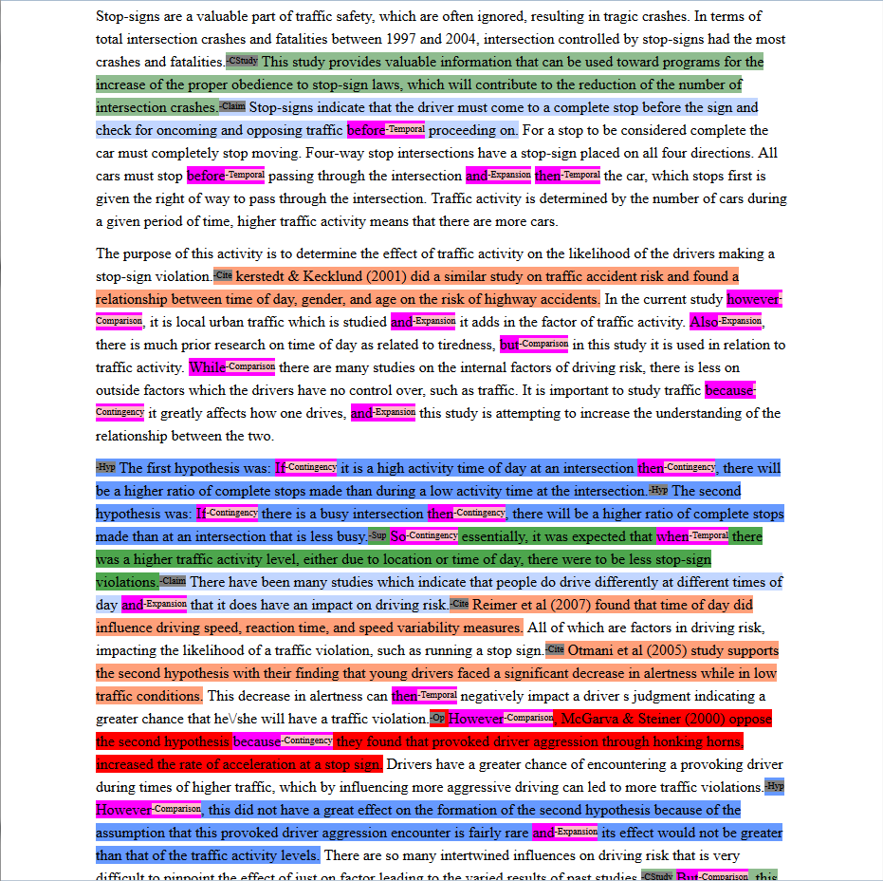
Mining a College Research Methods Essay for Argument Diagram Ontology
(i.e., node and arc types)
Current Study
Claim
Citation
Hypothesis
Supports
Opposes
None
Notes:
Expert score 3 out of 5, 5 is max, 0 is min, integer values only

Slide 8
Mining a High School Essay for a Thesis Statement
Violence in America
In the spring of 2011, John F. Shick met a man in a New Mexico parking lot and
bought two pistols for $810, along with extra clips, ammunition and a holster.
This is one reason that there is so much violence in America, because people who
are mentally ill, and people who aren’t, can just buy a gun anywhere, there are no laws that say they cant. The two biggest factors that contribute to America’s violent society are relaxed gun laws and mental illness.
There are numerous accounts on which people with mental illness don’t receive the
help they need and sometimes do things to things to hurt people, like the account
on which was just mentioned John Shick bought two guns and shot and killed a person…
Notes:
This is another set of comments about thesis statement on a different essay. As you can see, Reviewer #2 identified the wrong sentence as the thesis and Reviewer #3 also expressed some confusion.
Our study is the first step toward solving this problem.

Slide 9
Argument Mining Subtasks
[Peldszus and Stede, 2013]
Scope of today’s talk
Even partial argument mining can support useful applications
  Mostly non-structural (e.g., no relations, no argument schema)
  Application-dependent roles (e.g., no premises)
  But, real data!!

Slide 10
Argument Mining for Education
Challenges
  Noisy data (e.g., adult learners, children)
  Real-time algorithms; robust at scale
  Meaningful features
Opportunities
  Human in the loop (e.g., peer review)
    Errors as student reflection opportunities

Slide 11
Outline
Argumentative Writing / Argument Mining
Algorithms and Applications
Summary and Current Directions

Slide 12
ArgumentPeer Project
Phase I: Argument
Diagramming
Author creates Argument Diagram
Peers review Argument Diagrams
Author revises Argument Diagram

Slide 13
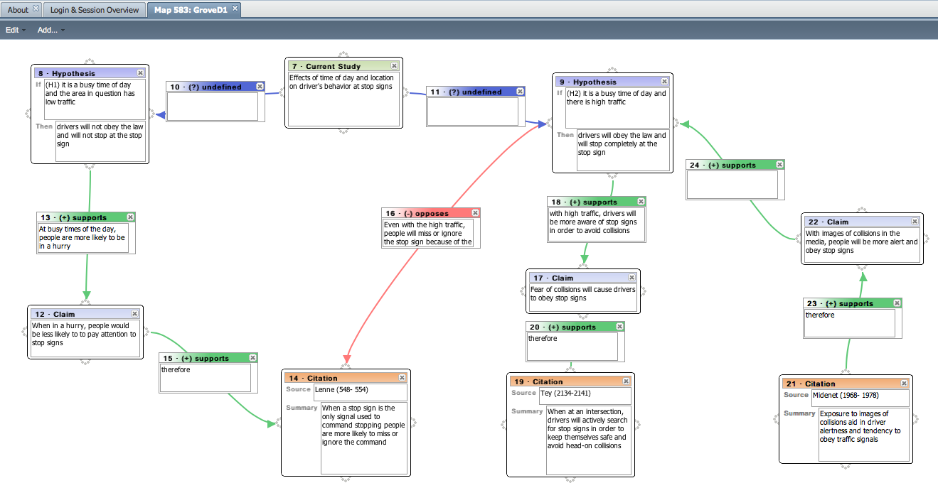
Example Student Argument Diagram
(input via the LASAD system [Pinkwart et al.])
Notes:
very few citations
many explanations for support relationships are incomplete
provided opposition was not explicitly resolved (i.e., why are the supportive bits of evidence for the second
hypothesis stronger than the opposing evidence?).

Slide 14
ArgumentPeer Project
Phase I: Argument
Diagramming
Author creates Argument Diagram
Peers review Argument Diagrams
Author revises Argument Diagram
Author writes paper
Peers review papers
Author revises paper
Phase II: Writing

Slide 15
Why Diagram before Writing?
Argument diagramming can improve essays
  more support and opposition; increased relevance of citations [Ashley et al., 2014]
  more supporting premises, evidence, explicit relations; increased accuracy [Harrell & Wetzel, 2013]
Features extracted from argument diagrams can predict essays grades [Lynch et al., 2014]
Our research: Can argument diagram constructs be mined directly from essays?

Slide 16
Audience Participation: Argument Mining
Written Essay Excerpt:
There have been many studies which indicate that people do drive differently at different times of day and that it does have an impact on driving risk. Reimer et al (2007) found that time of day did influence driving speed, reaction time, and speed variability measures.
Argument Diagram Ontology:
Node Types
  Current Study
  Hypothesis
  Claim
  Citation
Arc Types
  Supports
  Opposes

Slide 17
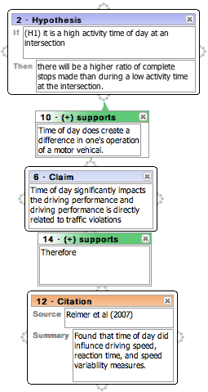
Example Argument Mining Output
There have been many studies which indicate that people do drive differently at different times of day and that it does have an impact on driving risk. [Claim]
Reimer et al (2007) found that time of day did influence driving speed, reaction time, and speed variability measures… [Citation]

Slide 18
Example Argument Mining Output
There have been many studies which indicate that people do drive differently at different times of day and that it does have an impact on driving risk. [Claim]
Reimer et al (2007) found that time of day did influence driving speed, reaction time, and speed variability measures… [Citation]
Citation supports Claim

Slide 19
Audience Participation: Essay Scoring (1 or 4?)
Human Argument Mining
Hypothesis: 1, Supports: 2, Opposes: 1, Citation: 7 (6 unique)
Frequently, people encounter situations in their environment where they can either choose to be prosocial or antisocial. It is therefore of great importance to study what makes people choose either response. Previous research has indicated that as group size increases, prosocial responses decrease, a phenomenon known as the bystander effect (Fischer, Krueger, Greitemeyer, Vogrincic, Kastenmuller, Frey, Heene, Wicher, Kainbacher, 2011). In our particular study, a participant sneezed on an elevator and noted whether or not somebody had a nice response such as “God bless you.” The nice response would be equivalent to a prosocial behavior. The results of this study can give insight into what makes people more or less likely to engage in prosocial behavior in different situations, so this study has good external validity. This research topic is worth of study because the results may show how likely people are to help others in a more critical situation, such as somebody getting mugged, etc. It is important to realize that sneezing on an elevator is not necessarily a dangerous situation to act prosocially in, but the result will lead to a better understanding of whether or not gender and group size contribute to prosocial responses.
Previous research has shown that females seem to be more likely to engage in prosocial behavior as distance decreases, and this correlates to the hypothesis of this particular study (McCullough, Tabak, 2010). From this same previous research, it seems that females are more likely to do this because females tend to behave in more altruistic ways than males. In other words, females should give a nice response to a sneeze more often than males, and this was part of our hypothesis. Previous research has also indicated that people who have the knowledge of how to behave prosocially in a particular situation are more likely to do so (Anker, Feeley, 2011). If somebody in the elevator is from a certain religion or has recently moved and is not aware of what to say after somebody sneezes, then they most likely will not give a response at all, and this was not considered when putting together the results of the study. This should have been important to consider because knowledge of what to say after a sneeze could be a confounding variable in the results. Lastly, previous studies have shown that moral frames often determine whether or not people will give a prosocial response (Thornberg, 2010). Overall, the better somebody’s moral frames are, the more likely they are to give a prosocial response. This correlates to our particular study because the people who didn’t give a response could possibly have negative moral frames. A future experiment could study this and the results would be interesting and could give additional information about what makes people behave prosocially.
In our study, it was hypothesized that as group size increased, the likelihood of a prosocial response would increase, and that females were more likely to give a prosocial response than males. Previous research from McCullough, etc (2011) conflicted with the hypothesis that as group size increases, prosocial responses should increase. McCullough’s study showed this to be the opposite – as group size increases, prosocial behavior decreases, a phenomenon known as the bystander effect. Previous research about gender, however, showed that females are more likely to behave prosocially due to their nature and altruistic characteristics; this evidence supports our hypothesis (Levine, Cassidy, Jentzsch, 2010).

Slide 20
Audience Participation: Essay Scoring (1 or 4?)
Human Argument Mining
Hypothesis: 1, Supports: 5, Opposes: 3, Citation: 15 (6 unique)
In today’s tough economic climate, any factors that may contribute to a successful business or enterprise have become increasingly important. One prevalently researched factor is prosocial behavior which is comparable to helping behaviors. Research has shown that prosocial behaviors have been associated with job satisfaction, productivity, and client satisfaction (Danzis & Stone-­‐Romero, 2009). Therefore the understanding of what situations support and encourage prosocial behaviors could be an asset to any manager or business (Danzis & Stone-­‐ Romero, 2009).
Previous research has focused on relationships of prosocial behavior between gender and the effect of group size. With regards to gender, there has been much debate over whether females or males are inherently more prosocial. Research has been done on gender by implementing a training program on empathy with children in day care centers between the ages of 5-­‐6 Kallipuska, 1991). The results of this study concluded that females were more prosocial than males based on teacher appraisals (Kallipuska, 1991).Other research supports that females are more prosocial but only to familiar individuals or when following a social norm (Danzis & Stone-­‐Romero 2009). In contrast, males were considered to be more “chivalrous”(p.722) which would promote them to exhibit more prosocial behavior toward strangers relative to females(Danzis & Stone-­‐Romero, 2009).
In addition to studies on the relationship between prosocial behavior and gender, there is also research between group sizes and prosocial behavior. One of the most well­‐known psychological phenomena is the bystander effect which describes a diffusion of responsibility as group size increases (Garcia, Weaver, Darley, & Moskowitz, 2002).More recent studies have described an implicit bystander effect which claims that it is even possible to create diffusion of responsibility even when no one else is around by priming participants about group mentality (Garcia, Weaver, Darley, & Moskowitz, 2002). There has even been debate over the implications of the implicit identity effect. One research study claimed that the implicit identity can only be used to inhibit prosocial behavior such as through the bystander effect (Garcia, Weaver, Darley, & Moskowitz, 2002). Yet, conflicting research has found evidence to support a theory that the implicit identity effect can be used to encourage prosocial behavior if it follows the group’s social norms (Levine & Crowther, 2008). Also, a study by Krupka and Weber (2009) found that even when people observe others acting selfishly, on average this produces prosocial behavior due to the focusing effecting of norms (2009).Therefore the focusing effect of norms can be defined as being aware of the behavior of others aroundKrupka & Weber, 2009).
The current study sought to find relationships between prosocial behavior, gender and group size. Prosocial behavior was defined as someone verbally responding to the observer’s sneeze. In order to create a controlled environment, the study took place on elevators in on-­‐campus buildings only. Unlike previous research, our study did not prime the participants before they entered the elevator so it was comparable to the control group of the Krupka & Weber study(2009). I predicted that females would respond more than males and that responses would be more likely in a group of more than two other people on the elevator.According to the Kallipuska study, females appear to be more prosocial and polite than males and would be more likely to respond to a sneeze(1991). With regards to group size, research shows that the focusing effect of norms becomes more apparent when others are present(Krupka & Weber, 2009).One contradiction to this hypothesis would be the Garcia, Weaver, Darley, & Moskowitz study that the implicit bystander effect can cause a diffusion of responsibility in large groups which could cause no one to respond to the sneeze(2002).

Slide 21
Actual Expert Essay Scores (via rubric)
SCORE = 1
Sentences/Words: 22/564
Hypothesis: 1
Supports: 2
Opposes: 1
Citation: 7 (6 unique)
SCORE = 4
Sentences/Words: 26/610
Hypothesis: 1
Supports: 5
Opposes: 3
Citation: 15 (6 unique)

Slide 22
Ontology-Based Argument Mining and Automatic Essay Scoring
[Ong, Litman & Brusilovsky, 2014; Nguyen & Litman, submitted]
System recognizes diagram ontology in essays
System scores essays using recognized ontology
Argument mining subtasks
  Segmentation: sentences
  Segment classification: diagram ontology tags
    E.g., Study, Hypothesis, Opposes, Supports, Claim, Citation (instructor-defined)
    None

Slide 23
Initial Data
52 first-draft essays from two undergraduate psychology courses
  Written after diagramming and peer-feedback
  Average length: 5.2 paragraphs, 28.6 sentences
  Expert scores: Average = 3.03
Notes:
Introductions only because the diagrams focused on the introductory portion of the essays. The rest of the essay consisted of studies that students conducted and the data they collected and analyzed, which is out of scope. First drafts because we wanted to decrease the differences between the diagrams and the essays.

Slide 24
Essay Processing Pipeline
Discourse Processing
  Tag essays with discourse connective senses
    Expansion, Contingency, Comparison, Temporal, Non-discourse
    Tagger from Upenn
Argument Ontology Mining
  Tag essays with diagram ontology elements
    Rule-based algorithm
Ontology-Based Scoring
  Use the mined argument to score the essays
    Rule-based algorithm

Slide 25
Experimental Results: Extrinsic Evaluation
[Ong, Litman & Brusilovsky, 2014]
Spearman Correlation trend between automatically generated and expert scores
    number of automatically generated tags for diagram elements are positively correlated with score
These ranking results can focus teacher or peer reviewer attention on particular types of papers

Slide 26
Current Directions: Intrinsic Evaluation (with H. Nguyen)
Annotation of 92 first-draft essays (Kappa > .6)
  Hypothesis: 148 sentences
  Finding: 388 sentences
  None: 1755 sentences
Features for supervised learning
  Persuasive essays [Stab & Gurevych, 2014]
  LDA-enabled features and constraints
    Seeding to extract argument vs. domain words

Slide 27
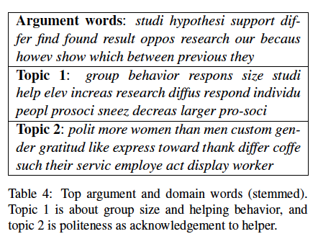
Post-Processed LDA Output
New Features: # domain words, # argument words, argument unigrams
New Constraints: e.g. selected dependency relations

Slide 28
Evaluation Results
Cross-topic performance (top 100 features)
  .50 Kappa (versus .45 for Stab14 baseline)
Holdout performance (optimized feature size)
  .56 Kappa (versus .50)
  135 features (versus 125)
New features significantly improve performance, generalize better, and compact the feature space
Current work: argument relations; essay scoring

Slide 29
Generalization
[Nguyen & Litman, 2015]
Persuasive essay corpus [Stab & Gurevych, 2014]
  Add LDA-enabled features and constraints
  Remove n-grams and production rules
Results
  New features outperform baseline, with large feature space reduction
  Genre-dependent extracted argument words

Slide 30
ArgumentPeer Project
Phase I: Argument
Diagramming
Author creates Argument Diagram
Peers review Argument Diagrams
Author revises Argument Diagram
Author writes paper
AI: Guides reviewing
Peers review papers
Author revises paper
Phase II: Writing

Slide 31
Why Peer Review?
Pros
  Quantity and diversity of review feedback
  Students learn by reviewing
Cons
  Reviews are often not stated in effective ways
  Reviews and papers do not focus on core aspects
    E.g., no discussion of thesis statements

Slide 32

Audience Participation: Argument Mining
(Detect the Thesis)
Violence in America
In the spring of 2011, John F. Shick met a man in a New Mexico parking lot and bought two pistols for $810, along with extra clips, ammunition and a holster. This is one reason that there is so much violence in America, because people who are mentally ill, and people who aren’t, can just buy a gun anywhere, there are no laws that say they cant. The two biggest factors that contribute to America’s violent society are relaxed gun laws and mental illness.
There are numerous accounts on which people with mental illness don’t receive the help they need and sometimes do things to things to hurt people, like the account on which was just mentioned John Shick bought two guns and shot and killed a person. Another account was the sandy hook shooting, Adam Lanza who was mentally ill took the guns from his mother’s house and killed her and a bunch of little kids. The shooting at the midnight screening of Batman, James Holmes has been trying to commit suicide and probably had a mental illness .…
Reviewer | Comment | Back Evaluation
#1 | The two biggest factors that contribute to America violent society are relaxed gun laws and mental illness... I think it’s an okay thesis statement because they teacher gave of us this one and you didn't change it up any. | We didnt have to
#2 | A possible solution could be to get the people the help they need. But the solution might not work because people don’t want to pay to get treatment, and there is no cure | This is not my thesis
#3 | I'm really confused on what the thesis statement is, "The two biggest factors that contribute to America" violent society are relaxed gun laws and mental illness." | That’s obviously my thesis because its the last sentence
#4 | Good thesis. | thanks
Notes:
This is another set of comments about thesis statement on a different essay. As you can see, Reviewer #2 identified the wrong sentence as the thesis and Reviewer #3 also expressed some confusion.
Our study is the first step toward solving this problem.

Slide 33
Identifying Thesis and Conclusion Statements in Student Essays to Scaffold Peer Review
[Falakmasir, Ashley, Schunn, Litman 2014]
How well can machine learning distinguish thesis or conclusion sentences from other sentences in student essays?
  Feature extraction via natural language processing
Argument mining subtasks
  Segmentation: sentences
  Segment classification: probability of being thesis, conclusion, …

Slide 34
Data
432 high school essays from 8 assignments
  18,081 sentences
Thesis/conclusion manually identified by experts
  AP English Language & Composition

Slide 35
Features for Machine Learning
3 feature sets inspired by [Burstein et al. 2003]
  Positional: paragraph number, sentence number in the paragraph, type of paragraph (first, body, last)
  Sentence Level: syntactic, semantic, frequent words
  Essay Level: number of keywords among the most frequent words of the essay, number of words overlapping with the assignment prompt, and a sentence importance score based on Rhetorical Structure Theory
Notes:
We used an iterative process to find the most predictive features for identifying thesis and conclusion statements. Starting with 42 basic computational
linguistic features inspired by (Burstein et al. 2003), such as positional, syntactic, and cue term features, we used several feature selection algorithms to select the most predictive features. We tried different combinations of the predictive features and also added some semantic and rhetorical structure features to improve the model’s accuracy. Since our training set was fairly small, we also tried bootstrapped sampling and finally, we picked 19 features in three categories that were most predictive.

Slide 36
Argument Mining Results
F-Measure on unseen test set
  Thesis Sentences
    Positional Baseline: .57
    Machine Learning: .74
  Conclusion Sentences
    Positional Baseline: .55
    Machine Learning: .67
Even with a small training corpus, NLP features can detect core argument sentences in essays better than the baseline

Slide 37
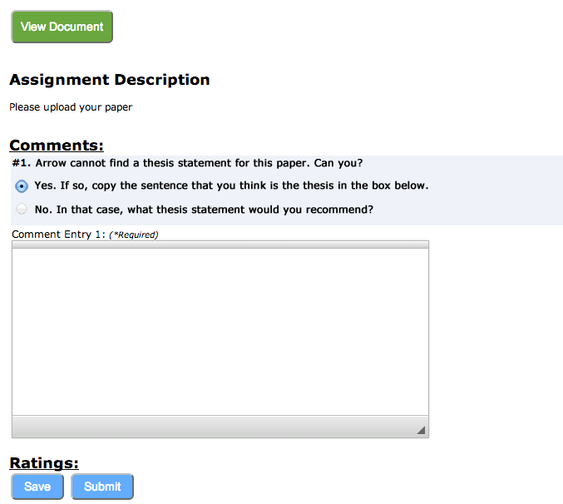
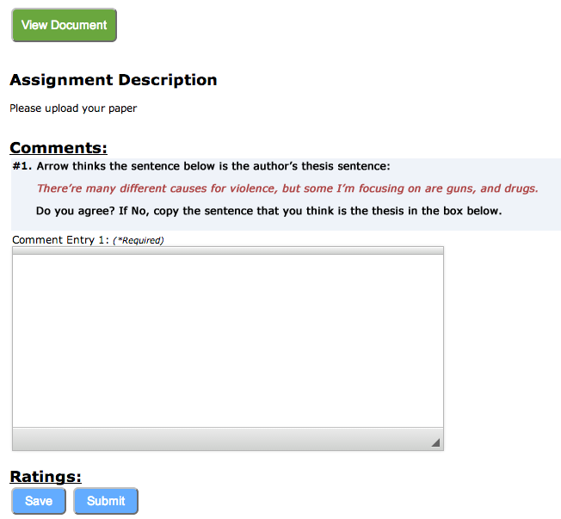
Scaffolding During Peer Review
[Falakmasir, Jabbari et al., in progress]
When argument mining cannot find a thesis sentence, the first peer review prompt is:
When argument mining identifies a thesis sentence, the first peer review prompt is:

Slide 38
Evaluation in High-School Classrooms
Argument mining performance
  E.g., how many actual theses had highest score?
Educational performance
  impact of scaffolding for peer review comments and ultimately essay quality

Slide 39
Outline
Argumentative Writing / Argument Mining
Algorithms and Applications
Summary and Current Directions

Slide 40
Summary
NLP-supported argument mining for teaching and assessing writing
  Feature / Algorithm Development
    Noisy and diverse data
    Meaningful features
    Real-time performance
  Experimental Evaluations
    Ontology-Guided Essay Ranking (university undergraduates)
    Intelligent Scaffolding for Peer Review (high school)
    Response-to-Text Assessment (grade school – not discussed here)
Even non-structural and application-dependent argument mining can support useful applications!

Slide 41
New Work: Temporal Argument Mining
[Zhang and Litman, 2015]
How are arguments changed during paper revision?
  1st Draft: The fifth level of Hell “contains the Wrathful” (110). Wrathful people want to intentionally harm others. Saddam Hussein and Osama Bin Laden come to mind when mentioning wrathful people.
  2nd Draft: The fifth level of Hell “contains the Wrathful” (110). Wrathful people want to intentionally harm others. Fidel Castro comes to mind when mentioning wrathful people
  Revision modifies evidence
    Rather than come -> comes
Argument mining subtasks
  Segmentation: sentences
    Alignment needed between 1st and 2nd paper drafts
  Segment classification: argumentation purpose of revision (if any)

Slide 42
Acknowledgements
SWoRD and ArgumentPeer
  Faculty: Kevin Ashley, Amanda Godley, Chris Schunn
  Postdocs: Alok Baikadi, Amanda Crowell, Lisa Fazio, Jordan Lippman
  PhD Students: Sara DeMartino, Mohammad Falakmasir, Fataneh Jabari, Adam Loretto, Collin Lynch, Huy Nguyen, Wenting Xiong, Fan Zhang
  Undergraduates: Alexandra Brusilovsky, Chris Clark, Nathan Ong
  Staff: Alexsandar Ivetic, Carmela Rizzo

Slide 43



Thank You!
Questions?
Further Information
  http://www.cs.pitt.edu/~litman

