Slide 1
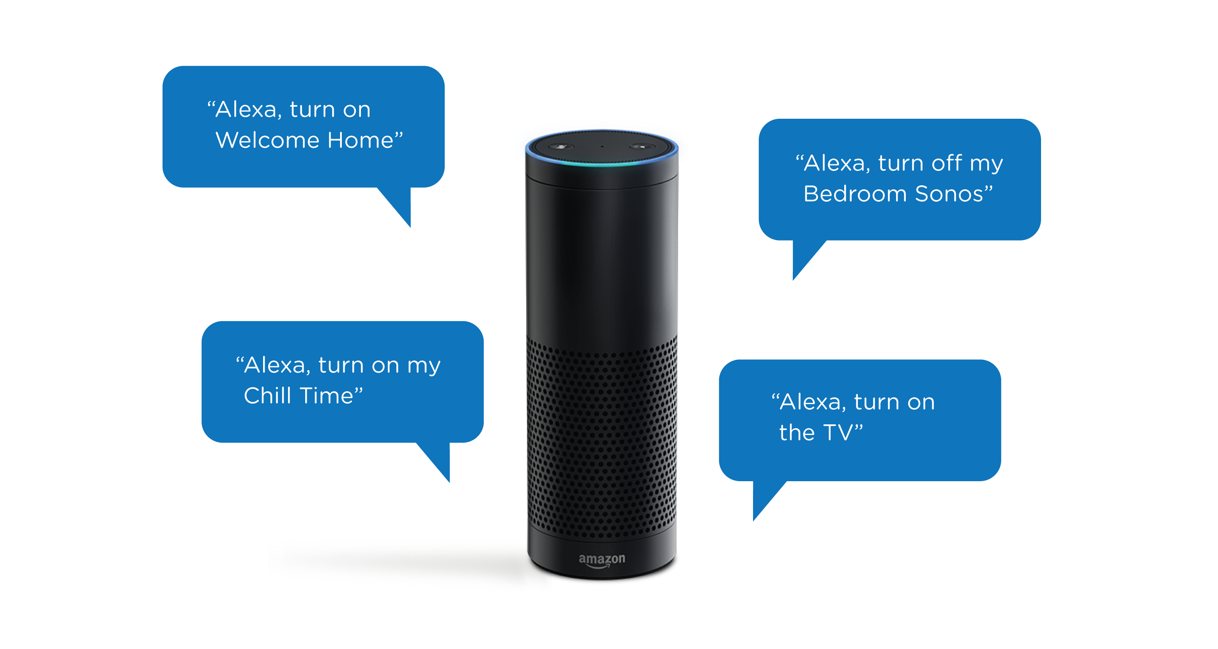
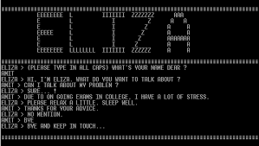
Cooperation in Dialogue Systems from Eliza to Alexa
Diane Litman
Professor, Computer Science Department
Co-Director, Intelligent Systems Program
Senior Scientist, Learning Research & Development Center
University of Pittsburgh
Pittsburgh, PA USA

Slide 2
Dialogue Systems: A Brief History
Computer Interactive Devices
Prototypes Telephone (e.g. smartphones)
1960 1970 1980 1990 2000 2010 2016
Notes:
Eliza 1966, Shrdlu 1970, Voyager 1990, Nuance 1994, Siri 2011

Slide 3
Dialogue Systems: A Brief History
ELIZA
(Chatbots)
Men are all alike.
IN WHAT WAY
They’re always bugging us about something or other.
CAN YOU THINK OF A SPECIFIC EXAMPLE [Weizenbaum, 1966]
Computer Interactive Devices
Prototypes Telephone (e.g. smartphones)
1960 1970 1980 1990 2000 2010 2016
Notes:
Eliza 1966, Shrdlu 1970, Voyager 1990, Nuance 1994, Siri 2011

Slide 4
Dialogue Systems: A Brief History
ELIZA
(Chatbots)
SHRDLU
(Artificial Intelligence)
Pick up a big red block.
OK
Grasp the pyramid.
I DON’T UNDERSTAND WHICH PYRAMID YOU MEAN
[Winograd, 1971]
Computer Interactive Devices
Prototypes Telephone (e.g. smartphones)
1960 1970 1980 1990 2000 2010 2016
Notes:
Eliza 1966, Shrdlu 1970, Voyager 1990, Nuance 1994, Siri 2011

Slide 5
Dialogue Systems: A Brief History
ELIZA
(Chatbots)
SHRDLU
(Artificial Intelligence)
Allen, Cohen, & Perrault
(Plan-based)
Computer Interactive Devices
Prototypes Telephone (e.g. smartphones)
Today’s focus
1960 1970 1980 1990 2000 2010 2016
Notes:
Eliza 1966, Shrdlu 1970, Voyager 1990, Nuance 1994, Siri 2011

Slide 6
Dialogue Systems: A Brief History
ELIZA
(Chatbots)
SHRDLU
(Artificial Intelligence)
VODIS, VOYAGER
(Speech)
How many hotels are there in Cambridge.
I KNOW OF SIX HOTELS IN CAMBRIDGE
[Glass et al., 1995]
Computer Interactive Devices
Prototypes Telephone (e.g. smartphones)
1960 1970 1980 1990 2000 2010 2016
Notes:
Eliza 1966, Shrdlu 1970, Voyager 1990, Nuance 1994, Siri 2011

Slide 7
Dialogue Systems: A Brief History
ELIZA
(Chatbots)
SHRDLU
(Artificial Intelligence)
VODIS, VOYAGER
(Speech)
Startups
Computer Interactive Devices
Prototypes Telephone (e.g. smartphones)
1960 1970 1980 1990 2000 2010 2016
Notes:
Eliza 1966, Shrdlu 1970, Voyager 1990, Nuance 1994, Siri 2011

Slide 8
Dialogue Systems: A Brief History
ELIZA
(Chatbots)
SHRDLU
(Artificial Intelligence)
SIRI
(hybrid approach)
VODIS, VOYAGER
(Speech)
Startups
Computer Interactive Devices
Prototypes Telephone (e.g. smartphones)
1960 1970 1980 1990 2000 2010 2016
Notes:
Eliza 1966, Shrdlu 1970, Voyager 1990, Nuance 1994, Siri 2011

Slide 9
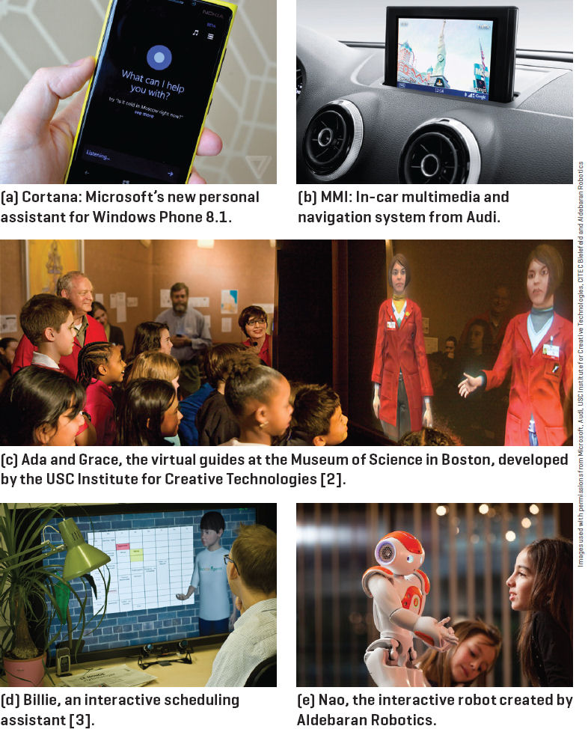
Recent System Landscape
[Lison and Meena,
2014]

Slide 10
Are we done yet?
The Future Directions of Dialogue-Based Intelligent Personal Assistants (SIGdial 2016 panel)
Yes (one of the panelists)
  no bottleneck but privacy!
No (audience members - especially senior NLPers)
  pragmatics, social dimensions, …

Slide 11
Back to 1980: Analyzing Intention in Utterances (Allen & Perrault)
Cooperative behavior in dialogue
  Indirect speech acts, helpful responses, …
A knowledge-based approach
  Plan construction & execution (agent A)
  Plan inference & obstacle detection (Agent B)
  Plan construction & execution (agent B)

Slide 12
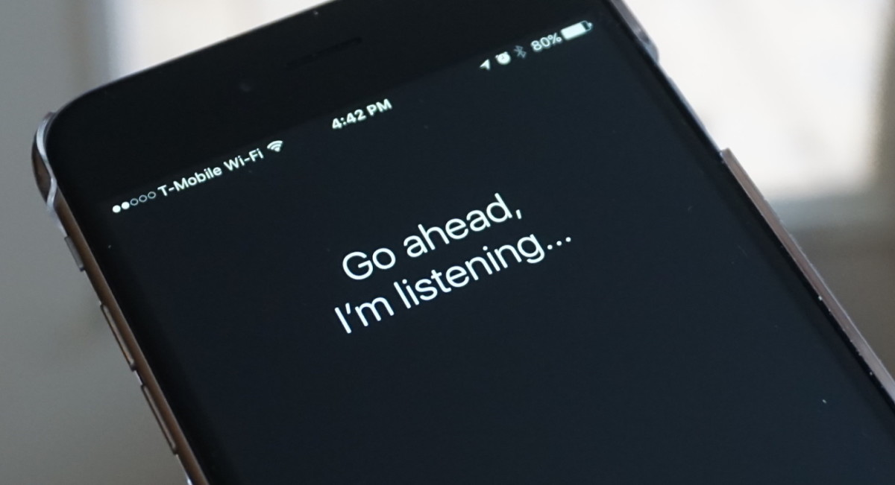
What about Siri?

Slide 13
Indirect Speech Acts (beyond literal meaning)
Diane: I don’t know Megan’s address
Siri: Don’t worry about it, Diane
Diane: Are you able to tell me Megan’s address
Siri: We were talking about you, not me
Diane: Can you tell me Megan’s address
(Do you know Megan’s address)
Siri: Here’s the address for Megan …
____________________________________________
Diane: Tell me Megan’s address
Siri: Here’s the address for Megan ...

Slide 14
Helpful Responses
(more information than requested)
Diane: Is Steve Jobs the chairman of Apple
Siri: Thanks for asking about Steve. Here’s Apple’s web page about him
Diane: What day of the week is election day
Siri: Election Day is on Tuesday, November 8 2016
Diane: When can I watch the World Series
Siri: The Indians face the Cubs in game 3 of the World Series tomorrow at 8:08 PM

Slide 15
Indirect + (Mixed) Helpful
Diane: I’m hungry
Siri: I don’t want you feeling all peckish. Here’s what I found.
15 results displayed
Filtered to be nearby
… but some of the 15 were closed

Slide 16
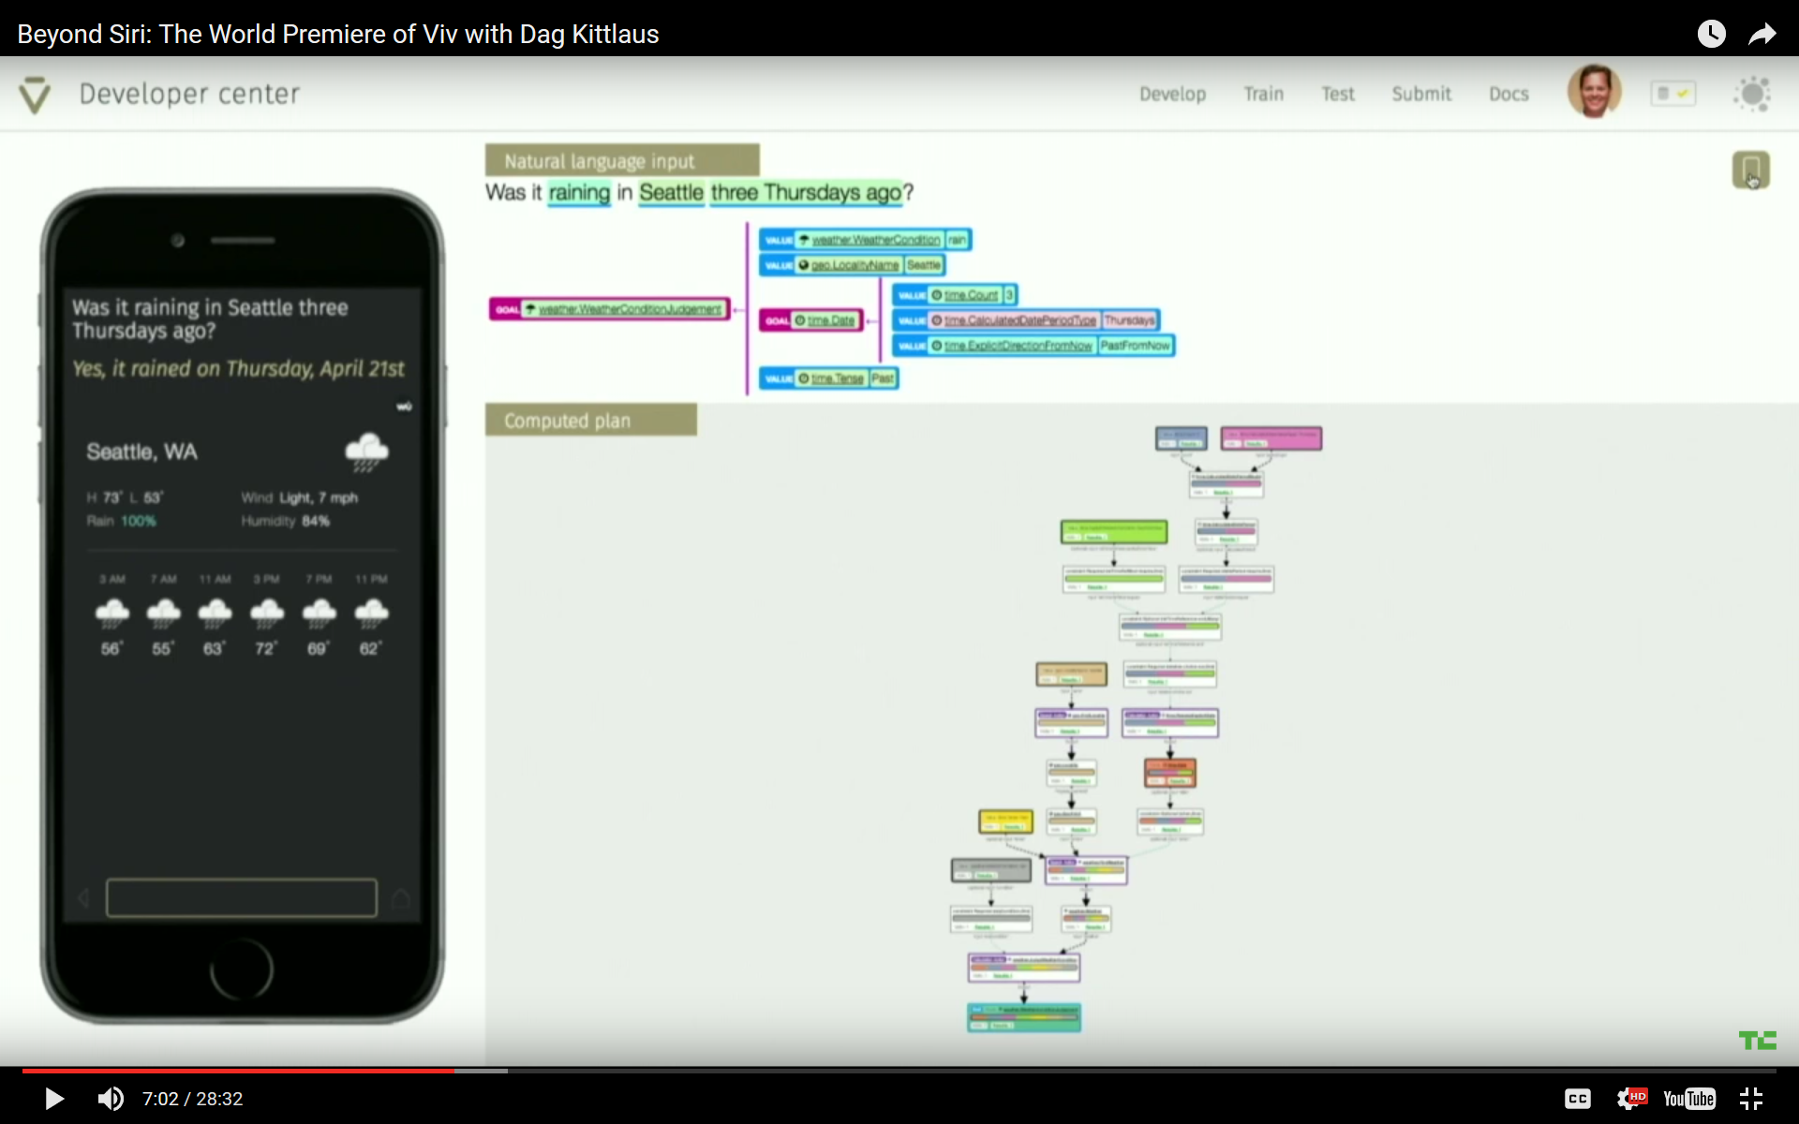
Back to the Future? From Siri to Viv
https://techcrunch.com/2016/05/09/siri-creator-shows-off-first-public-demo-of-viv-the-intelligent-interface-for-everything/

Slide 17
Summary
While cooperative dialogue research was largely abandoned for more practical approaches (my own research included!)
  "There is much to be gained from recognizing not just what was said, but why; from identifying conclusions people naturally draw from both what has been said and hasn't” (Workshop CFP)
Maybe not such an upbill battle anymore?

