Slide 1
Spoken Dialogue Systems for Language Learning
Dr. Diane Litman
Professor, Computer Science Department
Co-Director, Intelligent Systems Program
Senior Scientist, Learning Research & Development Center
University of Pittsburgh
Pittsburgh, PA USA
Derek Brewer Visiting Fellow
Dialogue Systems Group
(Machine Intelligence Laboratory, Engineering Department)

Slide 2
Outline
Spoken Dialogue Systems
  History
  Applications and Architectures
Language Learning Investigations
  Opportunities
  Challenges
  Derek Brewer Visiting Fellowship Research

Slide 3
Spoken Dialogue Systems
Computer systems that can engage in extended human-machine conversations
Benefits of speech as an interface
  Highly intuitive
  Eyes and hands free
  Small devices
  Rich communication channel

Slide 4
Dialogue Systems: A Brief History
Computer Interactive Devices
Prototypes Telephone (e.g. smartphones)
1960 1970 1980 1990 2000 2010 2015
Notes:
Eliza 1966, Shrdlu 1970, Voyager 1990, Nuance 1994, Siri 2011

Slide 5
Dialogue Systems: A Brief History
ELIZA
(Chatbots)
Men are all alike.
IN WHAT WAY
They’re always bugging us about something or other.
CAN YOU THINK OF A SPECIFIC EXAMPLE [Weizenbaum, 1966]
Computer Interactive Devices
Prototypes Telephone (e.g. smartphones)
1960 1970 1980 1990 2000 2010 2015
Notes:
Eliza 1966, Shrdlu 1970, Voyager 1990, Nuance 1994, Siri 2011

Slide 6
Dialogue Systems: A Brief History
ELIZA
(Chatbots)
SHRDLU
(Artificial Intelligence)
Pick up a big red block.
OK
Grasp the pyramid.
I DON’T UNDERSTAND WHICH PYRAMID YOU MEAN
[Winograd, 1971]
Computer Interactive Devices
Prototypes Telephone (e.g. smartphones)
1960 1970 1980 1990 2000 2010 2015
Notes:
Eliza 1966, Shrdlu 1970, Voyager 1990, Nuance 1994, Siri 2011

Slide 7
Dialogue Systems: A Brief History
ELIZA
(Chatbots)
SHRDLU
(Artificial Intelligence)
VODIS, VOYAGER
(Speech)
How many hotels are there in Cambridge.
I KNOW OF SIX HOTELS IN CAMBRIDGE
[Glass et al., 1995]
Computer Interactive Devices
Prototypes Telephone (e.g. smartphones)
1960 1970 1980 1990 2000 2010 2015
Notes:
Eliza 1966, Shrdlu 1970, Voyager 1990, Nuance 1994, Siri 2011

Slide 8
Dialogue Systems: A Brief History
ELIZA
(Chatbots)
SHRDLU
(Artificial Intelligence)
VODIS, VOYAGER
(Speech)
Startups
Computer Interactive Devices
Prototypes Telephone (e.g. smartphones)
1960 1970 1980 1990 2000 2010 2015
Notes:
Eliza 1966, Shrdlu 1970, Voyager 1990, Nuance 1994, Siri 2011

Slide 9
Dialogue Systems: A Brief History
ELIZA
(Chatbots)
SHRDLU
(Artificial Intelligence)
SIRI
(hybrid approach)
VODIS, VOYAGER
(Speech)
Startups
Computer Interactive Devices
Prototypes Telephone (e.g. smartphones)
1960 1970 1980 1990 2000 2010 2015
Notes:
Eliza 1966, Shrdlu 1970, Voyager 1990, Nuance 1994, Siri 2011

Slide 10
My Personal History
ELIZA
(Chatbots)
SHRDLU
(Artificial Intelligence)
SIRI
(hybrid approach)
VODIS, VOYAGER
(Speech)
Startups
Computer Interactive Devices
Prototypes Telephone (e.g. smartphones)
Ph.D.
1960 1970 1980 1990 2000 2010 2015
Notes:
Eliza 1966, Shrdlu 1970, Voyager 1990, Nuance 1994, Siri 2011

Slide 11
My Personal History
ELIZA
(Chatbots)
SHRDLU
(Artificial Intelligence)
SIRI
(hybrid approach)
VODIS, VOYAGER
(Speech)
Startups
Computer Interactive Devices
Prototypes Telephone (e.g. smartphones)
AT&T Bell Labs
1960 1970 1980 1990 2000 2010 2015
Notes:
Eliza 1966, Shrdlu 1970, Voyager 1990, Nuance 1994, Siri 2011

Slide 12
My Personal History
ELIZA
(Chatbots)
SHRDLU
(Artificial Intelligence)
SIRI
(hybrid approach)
VODIS, VOYAGER
(Speech)
Startups
Computer Interactive Devices
Prototypes Telephone (e.g. smartphones)
University of Pittsburgh
1960 1970 1980 1990 2000 2010 2015
Notes:
Eliza 1966, Shrdlu 1970, Voyager 1990, Nuance 1994, Siri 2011

Slide 13
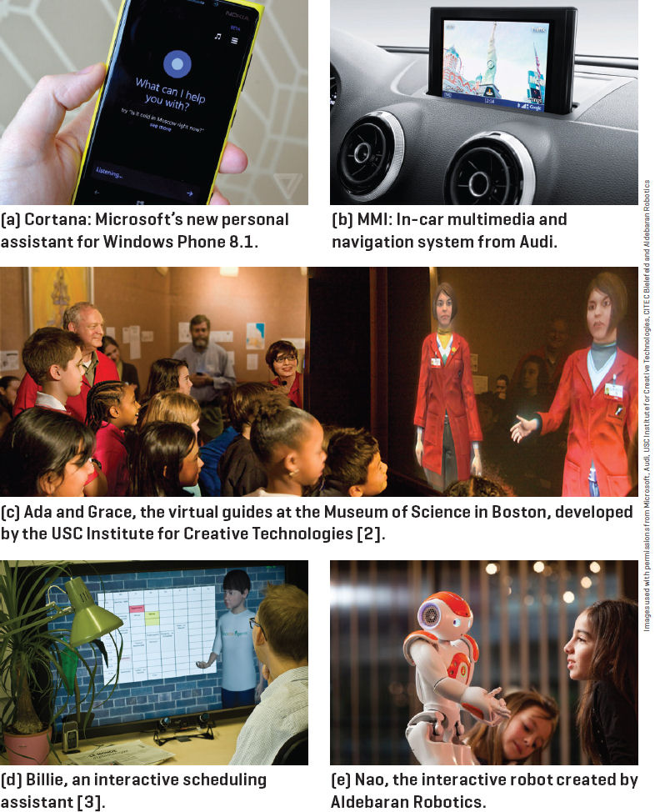
Spoken Dialogue Systems: Examples
[Lison and Meena,
2014]

Slide 14

Typical Architecture
Speech
recognition
Natural language
understanding
Backend
Dialogue
manager
Text-to-speech
or recording
Natural language
generation
Notes:
DB-1338
Db-1337

Slide 15

Typical Architecture
Speech
recognition
I am looking for a place with allendale area
I am looking for a place with annandale area
I am looking for a place with the annandale area
….
I am looking for a place with a annandale area
Notes:
DB-1338

Slide 16
Typical Architecture
Speech
recognition
I am looking for a place with allendale area
Natural language
understanding
System Beliefs
Name | - | .999
Area | allendale | .997
Food | - | .999
Area Code | - | .999
Requestable | - | .053
Notes:
DB-1338
Db-1337

Slide 17
Typical Architecture
Speech
recognition
Natural language
understanding
Area=allendale
Backend
Dialogue
manager
Offer(name=argo tea)
Notes:
DB-1338
Db-1337

Slide 18
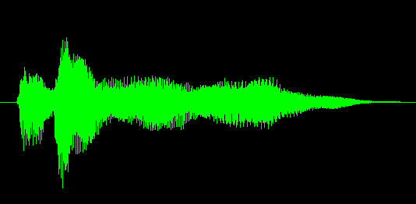
Typical Architecture
Speech
recognition
Natural language
understanding
Backend
Dialogue
manager
Text-to-speech
or recording
Offer(name=argo tea)
Natural language
generation
Argo tea is in the Allendale area
Notes:
DB-1338
Db-1337

Slide 19
Challenges
Input errors
  Hello, what kind of laptop are you after?
  SPEECH RECOGNITION: I WANT IT FOR OF IS THAT
  What product family do you have in mind …
Notes:
Towards open domains

Slide 20
Challenges
Input errors
  Speech recognition (and turn-taking)
  Natural language understanding
Other limitations
  Restricted domains and tasks
  System components are typically ‘hand-crafted’
    costly, don’t easily transfer
A ‘big data’ alternative: statistical systems
  System components are trained from data
  “Deploy, Collect Data and Improve” [Young, 2014]
Notes:
Towards open domains

Slide 21
Outline
Spoken Dialogue Systems
  History
  Applications and Architectures
Language Learning Investigations
  Opportunities
  Challenges
  Derek Brewer Visting Fellowship Research

Slide 22
Why Explore Language Learning?
Existing speaking tests involve human dialogue
Excerpt from IELTS (Cambridge English)
    E: DO YOU WORK OR ARE YOU A STUDENT?
    C: I’m a student in university.
    E: AND WHAT SUBJECT ARE YOU STUDYING?
    C: I’m studying business human resources.
    E: AND WHY DID YOU DECIDE TO STUDY THIS SUBJECT?
    [Seedhouse et al., 2014]
    (Key: E=Examiner; C=Candidate)
Notes:
https://www.youtube.com/watch?v=5nGESyDgmdw
EXTRACT 24, p. 21
IELTS

Slide 23
Current State of Automation
(Spoken Assessment and Training)
Typically non-interactive
  Learner responds to a stimulus
Even when system behavior does vary based on a learner’s prior response(s), skills being assessed do not involve context
  E.g., pronunciation, vocabulary, or grammar

Slide 24
Opportunity?
Testing and computer dialogues share some features
  Questions are selected from familiar topic frames
  Examiners use standardized scripts and phrasings
  Predictors of test scores are active research areas
  Utterance-level (what users say, and how they say it)
    E.g. grammatical errors, pause length
  Dialogue-level
    E.g., topic-scripted question/answer pairs
Tutorial dialogue systems can provide a useful supplement to testing systems (and likely will have higher error tolerance)

Slide 25
Challenges
Speaking assessment differs in many ways from traditional spoken dialogue system applications
Speaking tests have not been designed to take into account technology limitations

Slide 26
More technically…
Conversations with computers are simpler and more constrained than conversations with humans
Not only the dialogue systems but also the users have limited speaking skills
Compared to tutoring in well-defined domains, feedback is harder to generate
The system needs to be configurable by language (not computer) experts, or trainable from data

Slide 27
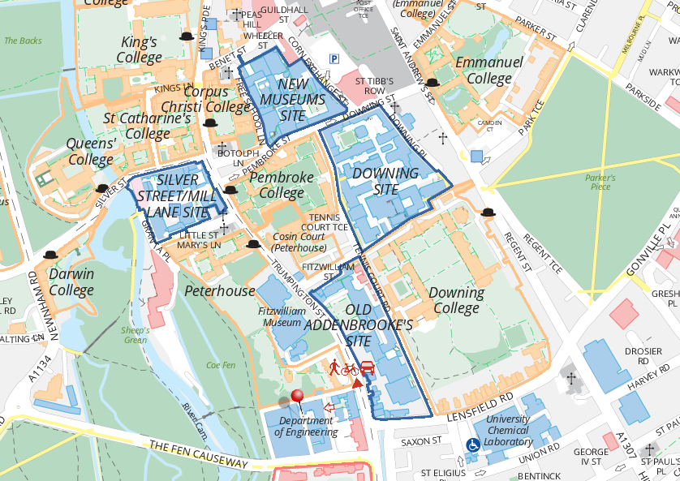
DBVF Proposal: Dialogue Systems for Teaching and Assessing Conversational Skills in Second Language Learning
VocalIQ
The Language Centre
Dialogue Systems Group
Cambridge
English
ALTA Speech Group

Slide 28
Approach: Statistical Dialogue Systems
“Deploy, Collect Data and Improve” [Young, 2014]
Deploy spoken dialogue systems that respect the constraints and best practices of both the dialogue and assessment communities
Collect associated corpora of learner-computer dialogues, then manually score such dialogues to produce “gold-standard” assessments
Compare automated and gold-standard scores, then iterate to improve performance

Slide 29
Deploy: Spoken Dialogue Systems
Laptop Information System
  Dialogue Systems Group (example played earlier)
Restaurant Information System
  VocalIQ (example played earlier)
  Live demonstration available!
Bus Information System(s)
  Previously deployments by research community

Slide 30
Example Bus Dialogue
System: Welcome to the CMU Let's Go bus information system. To get help at any time, just say Help or press zero. What can I do for you?
User (transcribed): um i want to go to Lawrenceville neighbor
User (recognized): I WANT TO GO TO LAWRENCEVILLE GREENSBURG
System: Going to Lawrenceville. Is this correct?
User (transcribed): yes
User (recognized): YES
System: Alright. Where do you want to leave from?
User (transcribed): uh South Side area
User (recognized): THE SOUTH SIDE MARRIOTT
…

Slide 31
Collect Data (1): Spoken Dialogues
Target Population
  Non-native speakers of English
Recruitment
  Amazon Mechanical Turk (crowdsourcing)
  Traditional methods (for bus systems)
Dialogue Corpus (to date)
  Laptops (24), Restaurants (20), Bus1 (20), Bus3 (22)
  Speech files (user side vs. whole conversation)
  System logs (content varies with system)

Slide 32
AMT HIT: Experimenting on Michigan Restaurants
Requirements: Google Chrome; Microphone/speakers (headset); Speak English
Statistics: Setup time: 2min; Minimum task time: 1min; Max task time: 3min
Explanation
In this HIT you will talk to an automated system using natural language. You will be given a task and asked to speak to your browser to solve it (under the heading 'Task for this HIT'). A typical task would be to find a restaurant according to some constraints and then get some information about it (like the phone number).
To start the conversation click the 'Start' button. When you speak you should see the speech recognition results coming up. Once you're done, please say 'thank you, goodbye' and the system will finish. If you're unable to finish your task within 2min please click 'Stop' and submit whatever you've done.
Task for this HIT
You are looking for a place with European food (if possible). Also find something similar but with a place with American food instead. Ask for the attire of that one.
How to get target population?

Slide 33
Collect Data (2): Speaking Assessments
Scores (for each collected dialogue)
Human: Cambridge Language Centre
  Fine-grained rubric
  laptop and bus dialogues manually coded (to date)

Slide 34
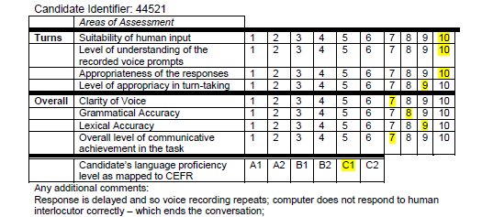
Example: Human Scored Dialogue

Slide 35
Assessed Data (to date)
 | Not Scored | A1 | A2 | B1 | B2 | C1 | C2
Laptop System (Indian callers) | 2 |  |  |  | 3 | 3 | 1
Laptop System (not US, UK, or Australian callers) | 2 |  |  | 1 | 7 | 6
Restaurant System (HIT title in Hindi)
Bus System (Carnegie Mellon U) | 2 |  |  |  | 2 | 14 | 2
Bus System (Cambridge U) | 2 |  |  |  | 3 | 16 | 1
Not all dialogues can be scored
Crowdsourced laptop deployment yielded more of the target population (although sample is still biased towards high scores)

Slide 36
Collect Data (2): Speaking Assessments
Scores (for each collected dialogue)
Human: Cambridge Language Centre
  Fine-grained rubric
  24 laptop dialogues manually coded (to date)
Computer: ALTA Speech Group (in progress)
  Apply previously developed model for predicting overall profiency score of non-interactive speaking

Slide 37
Computer Scoring Approach:
Supervised Machine Learning
Training
Feature Vectors
Learning Algorithm
Training Data
Prediction
Unlabeled Data
Test data
Feature Vector
Predicted
Labels
Predictive Model
Graded Audio -> (Speech Recognition) - > Features -> Grading Model
Challenges: Noisy data , Meaningful features, Real-time prediction
Machine learning figure courtesy of Janyce Wiebe

Slide 38
Improve: Error Analysis
Dialogue corpus feedback (from human scorer)
  Not enough user speech (when system works well)
  Unnatural dialogues (when system works poorly)
    “…the more fluent the human speaker is in English … the less able the computer was to cope with it.” [Ottewell, personal communication]
  Recording only half the conversation
  Scenarios rather than authentic situations
Plan to address using VocalIQ platform

Slide 39
Scoring Algorithm and Results
Algorithm: Developed for prompted (non-dialogue) speech
  Note: some of our dialogues caused system to crash so removed
Results: Pearson correlations (auto vs. human grades)
  R= .52 (n= 22, laptop system, missing replaced with mean)
  R= .41 (n= 21, laptop system, missing value removed)
  R= -.11 (n=15, Cambridge Let's GO challenge system)
  R= .69 (n=14, VocalIQ Michigan system)
  Combining last 3 (n=50), R=0.50

Slide 40
Summary
The time is ripe to explore whether and how current spoken dialogue systems can be applied to teaching and assessing language
Such exploration would be facilitated by more collaboration between the speaking assessment and spoken dialogue communities
Hopefully the Derek Brewer Visiting Fellowship is just the beginning, not the end, of my explorations!

Slide 41
Acknowledgments
Emmanuel College
Dialogue Systems Group, CUED
  Steve Young
  Lu Chen, Milica Gasic, Dongho Kim, Nikola Mrksic, Eddy Su, David Vandyke, Shawn Wen
ALTA Speech Group, CUED
  Mark Gales, Kate Knill, Rogier van Dalen
VocalIQ
  Blaise Thompson
The Language Centre
  Karen Ottewell
Cambridge English

Slide 42
Demonstration Time?

