Slide 1
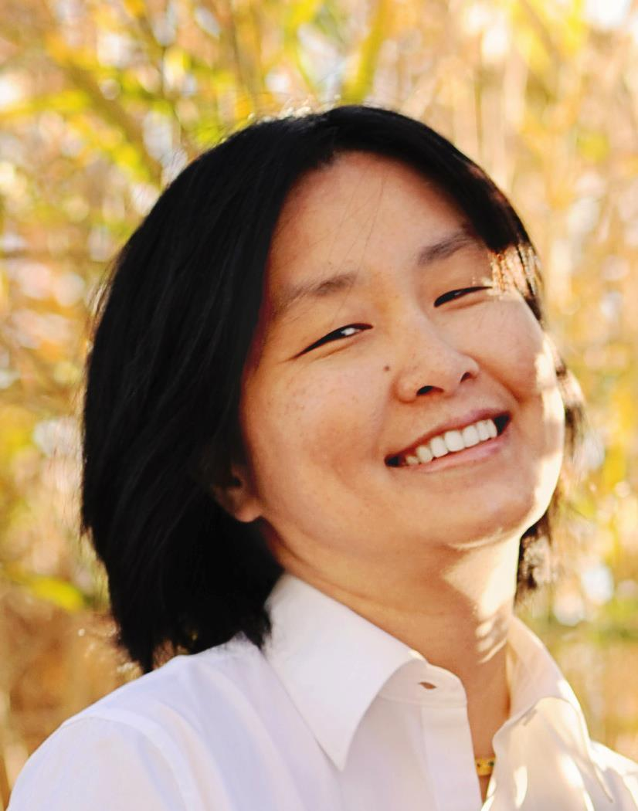
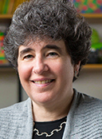
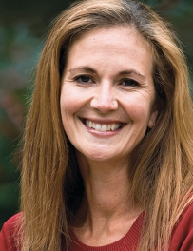
EXP: Development of Human Language Technologies to Improve Disciplinary Writing and Learning through Self-Regulated Revising
NSF ($557,555.00)
Rebecca Hwa
Role: PI
CS, ISP
Current Graduate Students:
Tazin Afrin (CS, Grad)
Omid Kashefi (ISP, Grad)
Christopher Olshefski (Edu, Grad)
Diane Litman
Role: Co-PI
CS, ISP
Current Undergraduate Students:
Sonia Cromp (CS, REU)
Briana Canady (First Experiences in Research)
Lucas Dalessandro (First Experiences in Research)
Chris Park (First Experiences in Research)
Kevin Zhang (First Experiences in Research)
Amanda Godley
Role: Co-PI
Edu, English
Alumni:
Huma Hashemi (ISP, PhD)
Fan Zhang (CS, PhD)
Meghan Dale (Edu, Grad)
Reed Armstrong (CS, BS)
Nicolò Manfredi (CS, BS)
Advisory Board:
Na-Rae Han (Pitt Linguistics)
Harry Hochheiser (Pitt DBMI (HCI))
Joel Tetreault (Grammarly, Inc.)
Charles MacArthur (U Del, School of Ed.)
Paul Kei Matsuda (Arizona State, English)
Notes:
This is a collaborative effort involving both faculty and students from SCI and the School of Ed.
The project involves many different facets of research ideas: from best practices in pedagogy to computational linguistics to the psychology of interface designs.

Slide 2
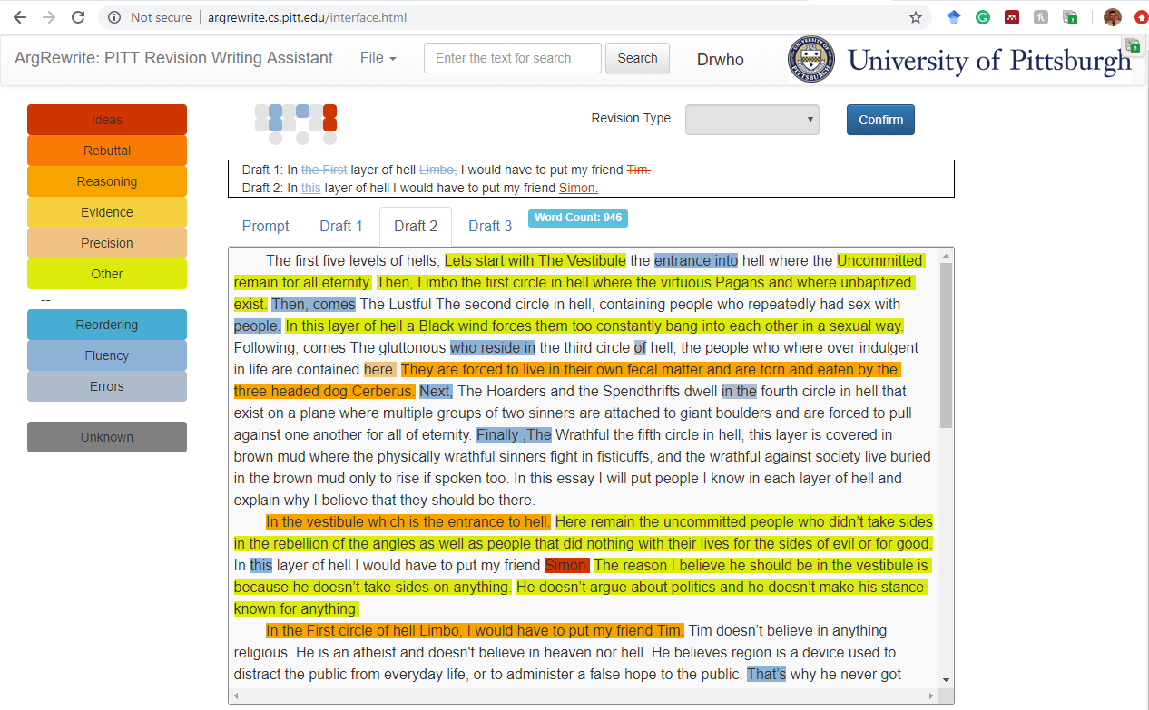
Can computers do more than “diff” to encourage students to revise their essays better?
  Our idea: Have the computer try to recognize the intention behind each of the student’s revisions using natural language processing methods.
    In our user studies, we found that when students see that their true intentions are misunderstood by the system, they will often revise again.
Notes:
In case if it’s useful, I’ve included a prototype screenshot (It’s a little contrived because we’re not done building the full system.)
The left panel shows a color code of the type of intentions we attempt to recognize.
The revisions tagged with one of the warm colors tend to be shifts in semantics
The revision tagged with one of the cool colors tend to be grammatical issues
The main body shows multiple drafts of the essay in a tabbed window pane. Whatever changed from the previous draft is highlighted (color indicates the predicted intention for the revision).
The top text window allows the student to compare changes within one sentence.

