Slide 1
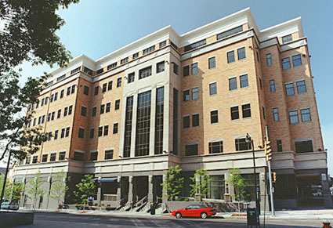
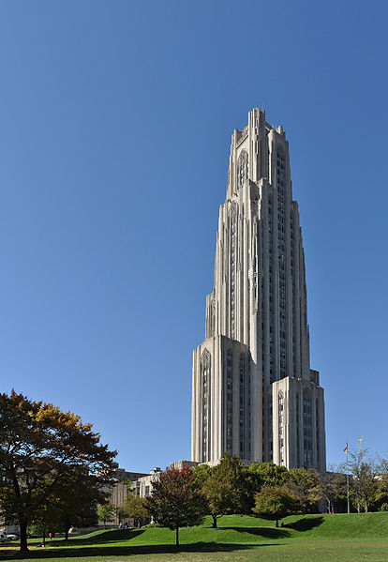

CSD Graduate Program at
Prof. Diane Litman
Computer Science Department
University of Pittsburgh

Slide 2
GPEC: Graduate Programs and Examinations Committee
2013-2014 Membership (Tentative)
  Diane Litman (Chair)
  TBA
This presentation will focus on some of the “details” of our graduate program–MS and PhD

Slide 3
Remember!
You must familiarize yourself with the graduate program regulations (http://www.cs.pitt.edu/grad)
  Master's Degree (MS) Overview
  Doctorate (PhD) Overview
  Full Regulations for Graduate Study
I am only highlighting key aspects today
Let me begin by talking about the MS program first…

Slide 4
MS program
Two tracks: Thesis or Project
30 credits of formal coursework
  Thesis track: 8 courses + MS thesis (CS2000)
  Project track: 9 courses + MS project (CS2910)
  One course from each “foundation” area (with a grade “B” or higher) – next page
  Overall QPA of 3.0 or better, nothing lower than B-
Thesis track: you need to do a formal, public thesis defense in front of a committee (at least three faculty)
Project track: your project supervisor (faculty) will examine project report & presentation
You may petition to count one out-of-dept. course or CS1600-level course

Slide 5
MS program, cont’d
Foundation areas
  Architecture and Compilers
    CS2410 or CS2210
  Operating Systems and Networks
    CS2510 or CS2520
  Artificial Intelligence and Database Systems
    CS2710 or CS2550
  Theory and Algorithms
    CS1511 or CS1510

Slide 6
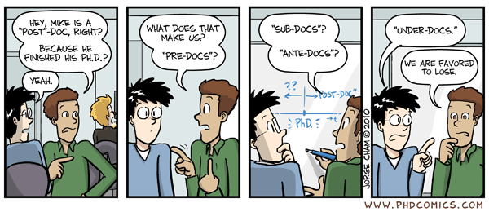
Journey of a PhD student
“When can I finish?” (if ever)
“proposal”
x
x
“prelim”
x
x
“defense”
“comp”
1~1.5 yrs.
<1.5 yrs.
<2 yrs.
8 mos.~? yrs.

Slide 7
PhD program
At least 72 credits
  Formal coursework
  Independent study
  Directed study
  Dissertation research
12 required courses
  Four courses, one from each foundation area (next slide)
  CS2001 & CS2002 (next next slide)
  Six additional (eligible) CSD graduate courses, incl. at least two at the 3000-level
New: CS2003

Slide 8
“Foundation” course req.
Pass one course from four foundation areas:
  Architecture & Compiler (CS2410, CS2210)
  Operating Systems & Networks (CS2510, CS2520)
  Artificial Intelligence & Database Systems (CS2710, CS2550)
  Theory & Algorithms (CS2110, CS2150)
Must obtain B or higher
Pass foundation courses within 4 semesters
Be aware of how often and when each course is typically offered!

Slide 9
CS2001 & CS2002
CS2001: A gentle (or tough?) introduction to grad research & our program
  First few meetings will focus on research methods and dept. research infrastructure
  Then each faculty member will visit the class to discuss his/her research agendas
  An assignment may be given each week
CS2002: Work with two faculty members of interest
  To find interesting research directions
  To find a faculty advisor(s)
Expectation: take these two courses in year 1

Slide 10
CS2003 (New!)
COMPUTER SCIENCE COLLOQUIUM
1 credit
MW 3-4:15
Satisfactory/No Credit (S/NC) grading
Aim: Discuss recent advances in CS

Slide 11
Transferring courses
Courses taken outside the CSD, or prior to enrollment, can sometimes be used to transfer credits and/or place out of requirements
  Must petition GPEC (email gpec@cs.pitt.edu)
No more than 24 credits taken at the MS level (12 additional credits at a higher level)
Note however that
  At most 4 of the 12 required courses may be taken outside the CSD (i.e., 8 courses must be taken within the CSD)
You must submit a petition to GPEC for prior courses
  Within the first two semesters
  Usually in semester one
  Goes through GPEC recomm. & A&S dean’s office
Must also petition to transfer credits from say CMU

Slide 12
Prelim
“prelim”
x
First major milestone
  Goal: Excellent “breadth”
  A student must pass prelim by the end of 3rd semester
“Grade-based”: Pass at least 4 eligible courses at the 2000 level with a grade of A- or higher
  Students are not permitted to repeat a class (with a B grade or higher) to improve to A- or higher
At least 2 of the 4 courses must also be a required foundation area course representing different foundation areas
Expectation: Pass at least two in year 1 and complete within the first 3 regular semesters
  Note that you have one more semester to complete the foundation course requirement

Slide 13
Comp. (oral)
“prelim”
x
x
“comp”
Second major milestone
  Goal: “Depth”
  A student must pass this exam within three calendar years of passing the last one of the prelim (and within four calendar years of admission)
A student must demonstrate sufficient expertise and depth of knowledge in a selected area of foundation
  30-min presentation (reading list) followed by a Q&A session
A committee member of at least 3 CSD faculty that compose the PhD dissertation proposal committee
  The committee has to be approved by the dept. chair at least 4 weeks prior to exam
Expectation: Take comp within 1.5 years once you pass the prelim

Slide 14
Proposal & defense
You don’t have to worry about these now…
  You won’t remember the rules anyway ;-)
Please refer to the CS graduate regulation at http://www.cs.pitt.edu/grad

Slide 15
Advising
Every new grad student has a temporary advisor
  If you still don’t know who your temporary advisor is, ask Keena!
But you must find your (not temporary) primary advisor sooner than later
  Need to file change of advisor paperwork with Keena
  Expectation: Have primary advisor no later than your 4th semester
Your advisor will
  Sign for your registration
  Supervise & guide your research
  Present information about the student in the annual student performance evaluation meeting (“Black Friday”)
  Provide financial support (typically after your 3rd year)

Slide 16
Int’l students
Key: always keep your legal status
  Full-time registration requirement
  Keep your I-20 up-to-date
  Take care when you travel
  Read OIS documents carefully
You can do interns during your study
  Curricular practical training (CPT)
    There are restrictions (e.g., no more than 1 year)
  Optional practical training (OPT)
  Check OIS documents about this

Slide 17
Reg. & statute of limitations
Continuous registration
  Don’t register for 12 months and you’re out
Level of registration
  Register at all times for a number of credits fairly reflecting his/her utilization of dept. resources
  Int’l students must conform to levels set forth by INS (consult OIS)
Statute of limitations
  MS: 4 years
  PhD: 10 years or 8 years (w/ MS credits transfer)

Slide 18
Financial aid
TA
  As a PhD student TA experience is extremely important
  We require that a PhD student have a classroom teaching (not just grading) experience before graduation
    Teach a class or lead weekly recitations
    International students must first pass the Pitt English (oral) test
    Everyone must receive a S rating from the CSD GREAT committee
Fellowship (A&S)
GSR
  Graduate Student Researcher (“RA” in other schools)
Annual Mellon Fellowship competition
External fellowships
  NSF, MSR, IBM, Google, …
  You’ll regularly receive information about fellowship opportunities
  Keep your webpage updated!

Slide 19
Financial aid
TA (normally 1 (+1) year of support offered to new students provided that)
  They are in good academic standing & grad program progress
  They’ve satisfactorily done previous TA duties
After 2 years, responsibility of providing financial support typically moves from the dept to the student’s advisor
GSR
  Between you & your GSR sponsor (normally faculty advisor)
Fellowship
  Eligible? (e.g., QPA > 3.6, publications, …)
  Does advisor endorse?
  Apply!
  Faculty vote for selection (as needed)

Slide 20
Grad committees
GAFA
  Graduate Admissions and Financial Aid Committee
GPEC
  Graduate Programs and Examinations Committee
GREAT
  Graduate Evaluation, Assignment & Training Committee

Slide 21
GPEC
Graduate Programs and Examinations Committee
  Chair: Prof. Diane Litman
Working closely with the graduate programs director, GPEC deals with issues related with individual student’s graduate program–progress, exams, fellowships, and student petitions
You will receive an annual evaluation letter (early spring semester)
Submit petitions to gpec@cs.pitt.edu

Slide 22
Your responsibilities…
Read A&S and CSD regulations!
  Don’t count on someone else (Keena, your advisor, other faculty or students) to make sure that you are compliant with all the rules
Keep your advisor current about your status, progress, and plans
Register for courses on time
Update Keena with your where-abouts
Notify Keena via the correct form if you change your advisor
Provide your advisor with materials for Black Friday (online self-evaluation)
(PhD student) File an application for candidacy at least 8 months (after successful proposal) before defense
(PhD student) Follow A&S procedure for graduation (incl. applying for the degree, giving copies of your thesis to the library)
MOST OF ALL, ENJOY BEING A PART OF THIS CSD!

Slide 23
CS Graduate Program at
Prof. Diane Litman
Computer Science Department
University of Pittsburgh

Slide 24
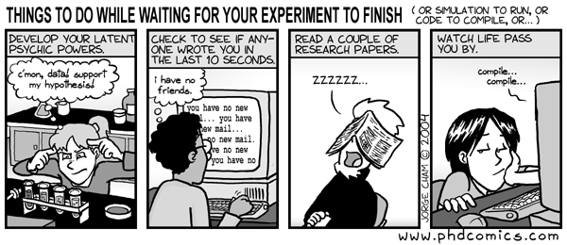
Journey of a grad student
“Will I succeed?”

