Slide 1
Improving Writing and Argumentation with NLP-Supported Peer Review
  Diane Litman
  Professor, Computer Science Department
  Senior Scientist, Learning Research & Development Center
  Co-Director, Intelligent Systems Program
  University of Pittsburgh
  Pittsburgh, PA

Slide 2
Context
Speech and Language Processing for Education
Learning Language
(reading, writing,
speaking)
Tutors
Scoring

Slide 3
Context
Speech and Language Processing for Education
Learning Language
(reading, writing,
speaking)
Using Language
(teaching in the disciplines)
Tutors
Tutorial Dialogue
Systems / Peers
Scoring

Slide 4
Context
Speech and Language Processing for Education
Learning Language
(reading, writing,
speaking)
Using Language
(teaching in the disciplines)
Processing
Language
Readability
Tutors
Tutorial Dialogue
Systems / Peers
Peer Review
Questioning
& Answering
Scoring
Discourse
Coding
Lecture
Retrieval

Slide 5
Outline
SWoRD (Computer-Supported Peer Review)
Intelligent Scaffolding for Peer Reviews of Writing
  Improving Review Quality
  Improving Argumentation with AI-Supported Diagramming
  Identifying Helpful Reviews
Keeping Instructors Well-informed
Summary and Current Directions

Slide 6
SWoRD: A web-based peer review system
[Cho & Schunn, 2007]
Authors submit papers

Slide 7
SWoRD: A web-based peer review system
[Cho & Schunn, 2007]
Authors submit papers
Peers submit (anonymous) reviews
  Instructor designed rubrics

Slide 8
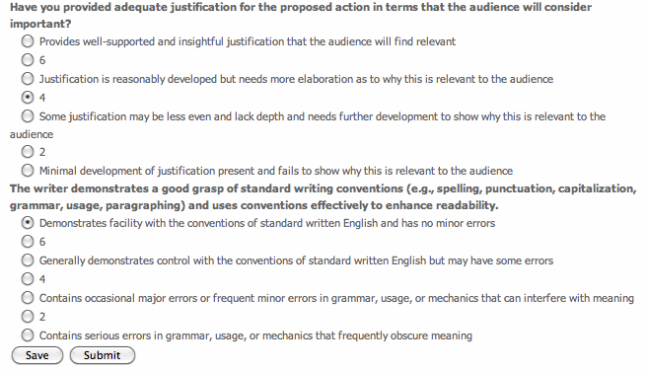

Slide 9
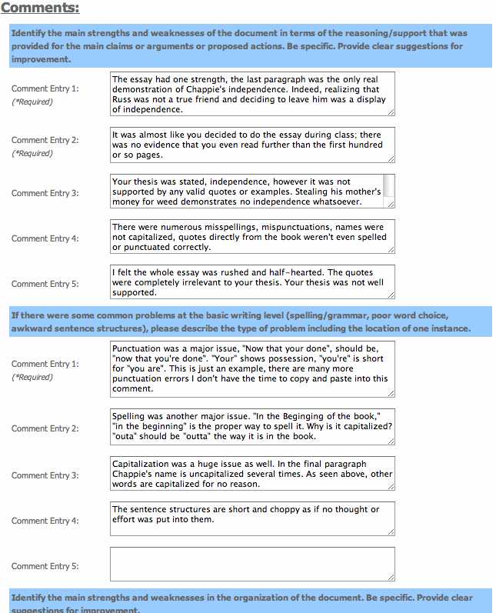

Slide 10
SWoRD: A web-based peer review system
[Cho & Schunn, 2007]
Authors submit papers
Peers submit (anonymous) reviews
Authors resubmit revised papers

Slide 11
SWoRD: A web-based peer review system
[Cho & Schunn, 2007]
Authors submit papers
Peers submit (anonymous) reviews
Authors resubmit revised papers
Authors provide back-reviews to peers regarding review helpfulness

Slide 13
Pros and Cons of Peer Review
  Pros
  Quantity and diversity of review feedback
  Students learn by reviewing
  Cons
Reviews are often not stated in effective ways
Reviews and papers do not focus on core aspects
Students (and teachers) are often overwhelmed by the quantity and diversity of the text comments

Slide 14
Related Research
Natural Language Processing
Helpfulness prediction for other types of reviews
  e.g., products, movies, books
  [Kim et al., 2006; Ghose & Ipeirotis, 2010; Liu et al., 2008;
  Tsur & Rappoport, 2009; Danescu-Niculescu-Mizil et al., 2009]
Other prediction tasks for peer reviews
    Key sentence in papers [Sandor & Vorndran, 2009]
    Important review features [Cho, 2008]
    Peer review assignment [Garcia, 2010]
Cognitive Science
Review implementation correlates with certain review features [Nelson & Schunn, 2008; Lippman et al., 2012]
Difference between student and expert reviews [Patchan et al., 2009]
Notes:
One sentence or two?

Slide 15
Outline
SWoRD (Computer-Supported Peer Review)
Intelligent Scaffolding for Peer Reviews of Writing
  Improving Review Quality
  Improving Argumentation with AI-Supported Diagramming
  Identifying Helpful Reviews
Keeping Instructors Well-informed
Summary and Current Directions

Slide 16
Review Features and Positive Writing Performance [Nelson & Schunn, 2008]
Solutions
Summarization
Understanding
of the Problem
Implementation
Localization

Slide 17
Our Approach: Detect and Scaffold
Detect and direct reviewer attention to key review features such as solutions and localization
  [Xiong & Litman 2010; Xiong, Litman & Schunn, 2010, 2012]
  Example localized review
    The section of the essay on African Americans needs more careful attention to the timing and reasons for the federal governments decision to stop protecting African American civil and political rights.
Detect and direct reviewer and author attention to thesis statements in reviews and papers

Slide 18
Detecting Key Features of Text Reviews
Natural Language Processing to extract attributes from text, e.g.
  Regular expressions (e.g. “the section about”)
  Domain lexicons (e.g. “federal”, “American”)
  Syntax (e.g. demonstrative determiners)
  Overlapping lexical windows (quotation identification)
Machine Learning to predict whether reviews contain localization and solutions

Slide 19
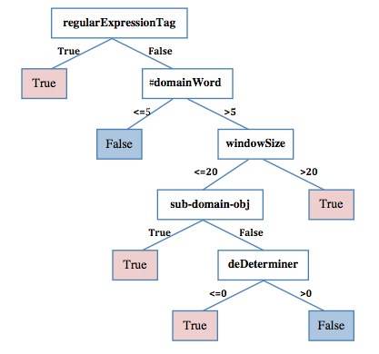
Learned Localization Model
[Xiong, Litman & Schunn, 2010]

Slide 20
Quantitative Model Evaluation
(10 fold cross-validation)
Review Feature | Classroom Corpus | N | Baseline Accuracy | Model Accuracy | Model Kappa | Human Kappa
Localization | History | 875 | 53% | 78% | .55 | .69
 | Psychology | 3111 | 75% | 85% | .58 | .63
Solution | History | 1405 | 61% | 79% | .55 | .79
 | CogSci | 5831 | 67% | 85% | .65 | .86

Slide 21
Intelligent Scaffolding: Pilot Study
(in progress)
When at least 50% of a student’s reviews are classified as localization = False, trigger intelligent scaffolding
  See following screenshots
Deployed Spring 2013 for one assignment in CS 1590 (Social Implications of Computing)

Slide 22
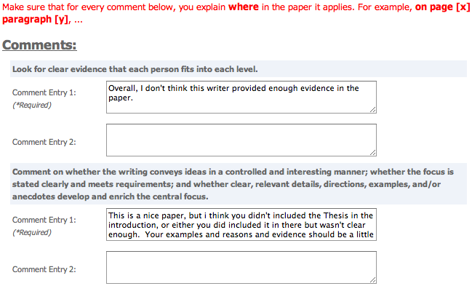
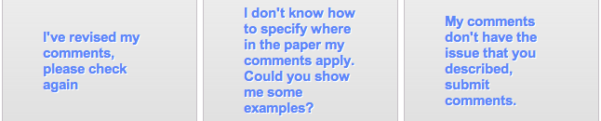
Screenshots
System scaffolds (if needed)
Localization model applied
Localization model applied
Reviewer makes decision

Slide 23
Outline
SWoRD (Computer-Supported Peer Review)
Intelligent Scaffolding for Peer Reviews of Writing
  Improving Review Quality
  Improving Argumentation with AI-Supported Diagramming
  Identifying Helpful Reviews
Keeping Instructors Well-informed
Summary and Current Directions

Slide 24
ArgumentPeer Project
Author writes paper
AI: Guides reviewing
Peers review papers
Author revises paper
Phase II: Writing

Slide 25
ArgumentPeer Project
Phase I: Argument
Diagramming
Author creates Argument Diagram
Peers review Argument Diagrams
Author revises Argument Diagram
Author writes paper
AI: Guides reviewing
Peers review papers
Author revises paper
Phase II: Writing

Slide 26
ArgumentPeer Project
Phase I: Argument
Diagramming
Author creates Argument Diagram
AI: Guides preparing diagram & using it in writing
Peers review Argument Diagrams
Author revises Argument Diagram
Author writes paper
AI: Guides reviewing
Peers review papers
Author revises paper
Phase II: Writing

Slide 27
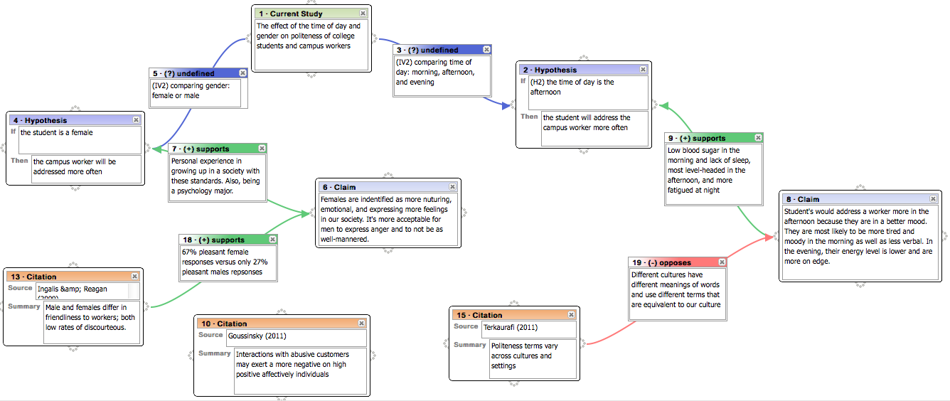
Example Argument Diagram and Review
Not
localized
Localized
The citations presented are solid evidence but are not presented in the best way possible. The justification is understandable but not convincing.
Also the con-argument for the time of day hypothesis is not sufficient. Citation 15 does not oppose the claim.

Slide 28
Detecting Localization in Diagram Reviews
[Nguyen & Litman, 2013]
Localization again correlates with feedback implementation [Lippmann et al., 2012]
Pattern-based detection algorithm
  Numbered ontology type, e.g. citation 15
  Textual component content, e.g. time of day hypothesis
  Unique component, e.g. the con-argument
  Connected component, e.g. support of second hypothesis
  Numerical regular expression, e.g. H1, #10

Slide 29
Quantitative Model Evaluation
(10 fold cross-validation)
Pattern algorithm outperforms prior paper review model
  Diagram review corpus from Research Methods Lab, Fall 2011 (n=590)
Metric | Majority Class | Paper Model | Diagram Model | Combined
Accuracy (%) | 74.07 | 73.98 | 80.34 | 83.78
Kappa | 0.00 | < 0.01 | 0.54 | 0.56
Weighted Precision | 0.55 | 0.55 | 0.83 | 0.84
Weighted Recall | 0.74 | 0.74 | 0.80 | 0.84

Slide 30
Quantitative Model Evaluation
(10 fold cross-validation)
Pattern algorithm outperforms prior paper review model
  Diagram review corpus from Research Methods Lab, Fall 2011 (n=590)
Combining paper and diagram models further improves performance
Metric | Majority Class | Paper Model | Diagram Model | Combined
Accuracy (%) | 74.07 | 73.98 | 80.34 | 83.78
Kappa | 0.00 | < 0.01 | 0.54 | 0.56
Weighted Precision | 0.55 | 0.55 | 0.83 | 0.84
Weighted Recall | 0.74 | 0.74 | 0.80 | 0.84

Slide 31
Learned Localization Model
Localized?
Pattern
Algorithm = yes
Pattern Algorithm = no
yes
#domainWord> 2
#domainWord ≤ 2
windowSize
≤ 16
windowSize
> 16
windowSize
≤ 12
windowSize
> 12
yes
no
no
#domainWord
≤ 0
#domainWord
> 0
no
yes

Slide 32
Outline
SWoRD (Computer-Supported Peer Review)
Intelligent Scaffolding for Peer Reviews of Writing
  Improving Review Quality
  Improving Argumentation with AI-Supported Diagramming
  Identifying Helpful Reviews
Keeping Instructors Well-informed
Summary and Current Directions

Slide 33
Review Helpfulness
Recall that SWoRD supports numerical back ratings of review helpfulness
  The support and explanation of the ideas could use some work. broading the explanations to include all groups could be useful. My concerns come from some of the claims that are put forth. Page 2 says that the 13th amendment ended the war. Is this true? Was there no more fighting or problems once this amendment was added? … The arguments were sorted up into paragraphs, keeping the area of interest clera, but be careful about bringing up new things at the end and then simply leaving them there without elaboration (ie black sterilization at the end of the paragraph). (rating 5)
  Your paper and its main points are easy to find and to follow. (rating 1)

Slide 34
Our Interests
Can helpfulness ratings be predicted from text? [Xiong & Litman, 2011a]
  Can prior product review techniques be generalized/adapted for peer reviews?
  Can peer-review specific features further improve performance?
Impact of predicting student versus expert helpfulness ratings
[Xiong & Litman, 2011b]

Slide 35
Baseline Method: Assessing (Product) Review Helpfulness
[Kim et al., 2006]
Data
  Product reviews on Amazon.com
  Review helpfulness is derived from binary votes (helpful versus unhelpful):
Approach
  Estimate helpfulness using SVM regression based on linguistic features
  Evaluate ranking performance with Spearman correlation
Conclusions
  Most useful features: review length, review unigrams, product rating
  Helpfulness ranking is easier to learn compared to helpfulness ratings: Pearson correlation < Spearman correlation
Notes:
Explain their features

Slide 36
Peer Review Corpus
Peer reviews collected by SWoRD system
  Introductory college history class
  267 reviews (20 – 200 words)
  16 papers (about 6 pages)
Gold standard of peer-review helpfulness
  Average ratings given by two experts.
    Domain expert & writing expert.
    1-5 discrete values
    Pearson correlation r = .4, p < .01
Prior annotations
  Review comment types -- praise, summary, criticism. (kappa = .92)
  Problem localization (kappa = .69), solution (kappa = .79), …

Slide 37
Peer versus Product Reviews
Helpfulness is directly rated on a scale (rather than a function of binary votes)
Peer reviews frequently refer to the related papers
Helpfulness has a writing-specific semantics
Classroom corpora are typically small

Slide 38

Generic Linguistic Features
(from reviews and papers)
Features motivated by Kim’s work
type | Label | Features (#)
Structural | STR | revLength, sentNum, question%, exclamationNum
Lexical | UGR, BGR | tf-idf statistics of review unigrams (#= 2992) and bigrams (#= 23209)
Syntactic | SYN | Noun%, Verb%, Adj/Adv%, 1stPVerb%, openClass%
Semantic (adapted) | TOP | counts of topic words (# = 288) ¹;
 | posW, negW | counts of positive (#= 1319) and negative sentiment words (#= 1752) ²
Meta-data (adapted) | META | paperRating, paperRatingDiff
Topic words are automatically extracted from students’ essays using topic signature software (by Annie Louis)
Sentiment words are extracted from General Inquirer Dictionary
* Syntactic analysis via MSTParser

Slide 39
Specialized Features
Features that are specific to peer reviews
Type | Label | Features (#)
Cognitive Science | cogS | praise%, summary%, criticism%, plocalization%, solution%
Lexical Categories | LEX2 | Counts of 10 categories of words
Localization | LOC | Features developed for identifying problem localization

Slide 40
Experiments
Algorithm
  SVM Regression (SVM^{light})
Evaluation:
  10-fold cross validation
    Pearson correlation coefficient r (ratings)
    Spearman correlation coefficient r_{s} (ranking)
Experiments
  Compare the predictive power of each type of feature for predicting peer-review helpfulness
  Find the most useful feature combination
  Investigate the impact of introducing additional specialized features

Slide 41
Results: Generic Features
Feature Type | r | r_{s}
STR | 0.604+/-0.103 | 0.593+/-0.104
UGR | 0.528+/-0.091 | 0.543+/-0.089
BGR | 0.576+/-0.072 | 0.574+/-0.097
SYN | 0.356+/-0.119 | 0.352+/-0.105
TOP | 0.548+/-0.098 | 0.544+/-0.093
posW | 0.569+/-0.125 | 0.532+/-0.124
negW | 0.485+/-0.114 | 0.461+/-0.097
MET | 0.223+/-0.153 | 0.227+/-0.122
All classes except syntactic and meta-data are significantly correlated
Most helpful features:
  STR (, BGR, posW…)
Best feature combination: STR+UGR+MET
, which means helpfulness ranking is not easier to predict compared to helpfulness rating (suing SVM regressison).

Slide 42
Results: Generic Features
Feature Type | r | r_{s}
STR | 0.604+/-0.103 | 0.593+/-0.104
UGR | 0.528+/-0.091 | 0.543+/-0.089
BGR | 0.576+/-0.072 | 0.574+/-0.097
SYN | 0.356+/-0.119 | 0.352+/-0.105
TOP | 0.548+/-0.098 | 0.544+/-0.093
posW | 0.569+/-0.125 | 0.532+/-0.124
negW | 0.485+/-0.114 | 0.461+/-0.097
MET | 0.223+/-0.153 | 0.227+/-0.122
All-combined | 0.561+/-0.073 | 0.580+/-0.088
STR+UGR+MET | 0.615+/-0.073 | 0.609+/-0.098
Most helpful features:
  STR (, BGR, posW…)
Best feature combination: STR+UGR+MET
, which means helpfulness ranking is not easier to predict compared to helpfulness rating (suing SVM regression).

Slide 43
Results: Generic Features
Feature Type | r | r_{s}
STR | 0.604+/-0.103 | 0.593+/-0.104
UGR | 0.528+/-0.091 | 0.543+/-0.089
BGR | 0.576+/-0.072 | 0.574+/-0.097
SYN | 0.356+/-0.119 | 0.352+/-0.105
TOP | 0.548+/-0.098 | 0.544+/-0.093
posW | 0.569+/-0.125 | 0.532+/-0.124
negW | 0.485+/-0.114 | 0.461+/-0.097
MET | 0.223+/-0.153 | 0.227+/-0.122
All-combined | 0.561+/-0.073 | 0.580+/-0.088
STR+UGR+MET | 0.615+/-0.073 | 0.609+/-0.098
Most helpful features:
  STR (, BGR, posW…)
Best feature combination: STR+UGR+MET
, which means helpfulness ranking is not easier to predict compared to helpfulness rating (using SVM regression).

Slide 44
Results: Specialized Features
Feature Type | r | r_{s}
cogS | 0.425+/-0.094 | 0.461+/-0.072
LEX2 | 0.512+/-0.013 | 0.495+/-0.102
LOC | 0.446+/-0.133 | 0.472+/-0.113
STR+MET+UGR (Baseline) | 0.615+/-0.101 | 0.609+/-0.098
STR+MET+LEX2 | 0.621+/-0.096 | 0.611+/-0.088
STR+MET+LEX2+TOP | 0.648+/-0.097 | 0.655+/-0.081
STR+MET+LEX2+TOP+cogS | 0.660+/-0.093 | 0.655+/-0.081
STR+MET+LEX2+TOP+cogS+LOC | 0.665+/-0.089 | 0.671+/-0.076
All features are significantly correlated with helpfulness rating/ranking
  Weaker than generic features (but not significantly)
  Based on meaningful dimensions of writing (useful for validity and acceptance)

Slide 45
Results: Specialized Features
Feature Type | r | r_{s}
cogS | 0.425+/-0.094 | 0.461+/-0.072
LEX2 | 0.512+/-0.013 | 0.495+/-0.102
LOC | 0.446+/-0.133 | 0.472+/-0.113
STR+MET+UGR (Baseline) | 0.615+/-0.101 | 0.609+/-0.098
STR+MET+LEX2 | 0.621+/-0.096 | 0.611+/-0.088
STR+MET+LEX2+TOP | 0.648+/-0.097 | 0.655+/-0.081
STR+MET+LEX2+TOP+cogS | 0.660+/-0.093 | 0.655+/-0.081
STR+MET+LEX2+TOP+cogS+LOC | 0.665+/-0.089 | 0.671+/-0.076
Introducing high level features does enhance the model’s performance.
    Best model: Spearman correlation of 0.671 and Pearson correlation of 0.665.

Slide 46
Discussion
  Techniques used in ranking product review helpfulness can be effectively adapted to the peer-review domain
    However, the utility of generic features varies across domains
  Incorporating features specific to peer-review appears promising
    provides a theory-motivated alternative to generic features
    captures linguistic information at an abstracted level better for small corpora (267 vs. > 10000)
    in conjunction with generic features, can further improve performance

Slide 47
What if we change the meaning of “helpfulness”?
  Lexical features: transition cues, negation, and suggestion words are useful for modeling student perceived helpfulness
  Cognitive-science features: solution is effective in all helpfulness models; the writing expert prefers praise while the content expert prefers critiques and localization
  Meta features: paper rating is very effective for predicting student helpfulness ratings

Slide 48
Outline
SWoRD (Computer-Supported Peer Review)
Intelligent Scaffolding for Peer Reviews of Writing
  Improving Review Quality
  Improving Argumentation with AI-Supported Diagramming
  Identifying Helpful Reviews
Keeping Instructors Well-informed
Summary and Current Directions

Slide 49
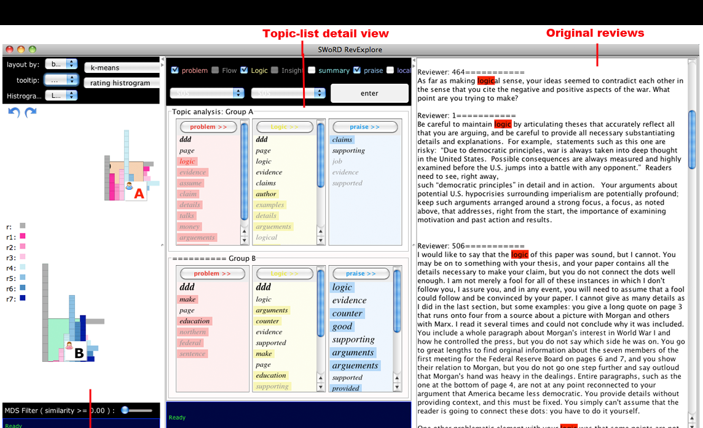
RevExplore: An Analytic Tool for Teachers
[Xiong, Litman, Wang & Schunn, 2012]

Slide 50
Evaluating Topic-Word Analytics
[Xiong & Litman, 2013]
User study (extrinsic evaluation)
  1405 free-text reviews of 24 history papers
  46 recruited subjects
Research questions
  Are topic words useful for peer-review analytics?
  Does the topic-word extraction method matter?
    Topic signatures
    Frequency
  Do results interact with analytic goal, grading rubric, and user demographics?
    Experience with peer review, SWoRD, TAing, grading

Slide 51
Topic Signatures in RevExplore
Domain word masking via topic signatures [Lin & Hovy, 2000; Nenkova & Louis, 2008]
  Target corpus: Student papers
  Background corpus: English Gigaword
  Topic words: Words likely to be in target corpus (chi-square)
Comparison-oriented topic signatures
  User reviews are divided into groups
    High versus low writers (SWoRD paper ratings)
    High versus low reviewers (SWoRD helpfulness ratings)
  Target corpus: Reviews of user group
  Background corpus: Reviews of all users

Slide 52
Comparing Student Reviewers
Method | Reviews by helpful students | Reviews by less helpful students
Topic Signatures | Arguments, immigrants, paper, wrong, theories, disprove, theory | Democratically, injustice, page, facts

Slide 53
Comparing Student Reviewers
Method | Reviews by helpful students | Reviews by less helpful students
Topic Signatures | Arguments, immigrants, paper, wrong, theories, disprove, theory | Democratically, injustice, page, facts
Frequency | Paper, arguments, evidence, make, also, could, argument paragraph | Page, think, argument, essay

Slide 54
Experimental Results
Topic words are effective for peer-review analytics
  Objective metrics (e.g. correct identification of high vs. low student groups)
  Subjective ratings (e.g. “how often did you refer to the original reviews?”)
Topic signature method outperforms frequency
Interactions with:
  Analytic goal (i.e. reviewing vs. writing groupings)
  Reviewing dimensions (i.e. grading rubric)
  User demographics (e.g. prior teaching experience)

Slide 55
Outline
SWoRD (Computer-Supported Peer Review)
Intelligent Scaffolding for Peer Reviews of Writing
  Improving Review Quality
  Improving Argumentation with AI-Supported Diagramming
  Identifying Helpful Reviews
Keeping Instructors Well-informed
Summary and Current Directions

Slide 56
Summary
NLP-supported peer review to improve student writing and reviewing
Detection and scaffolding of useful feedback features
  reviews were often not stated in effective ways
Incorporation of argument diagramming
  reviews and papers did not focus on core aspects
Adaptation of techniques for predicting product review helpfulness
  student information overload
Topic-word analytics for teachers
  teacher information overload

Slide 57
Current Directions: SWoRD in High School
Fall 2012 – Spring 2013
  English, History, Science, Math
  low SES, urban schools
  9 to 12 grade
Classroom contexts
  Little writing instruction
  Variable access to technology
Challenge: different review characteristics
Joint work with Kevin Ashley, Amanda Godley, Chris Schunn
Domain | Praise% | Critique% | Localized% | Solution%
College | 28% | 62% | 53% | 63%
High School | 15% | 52% | 36% | 40%
Notes:
College = history
High-school = TCCL (has higher ratio of praise% and critique% compared to the other one (TACL))
Localized% and solution% are computed within identified critiques

Slide 58
Conversational Systems and Data
Computer dialogue tutors for studying and improving student learning by detecting and responding to student states
  Uncertainty (over and above correctness)
    [Forbes-Riley & Litman, 2011a,b]
  Disengagement (over and above uncertainty)
    [Forbes-Riley & Litman, 2012; Forbes-Riley et al., 2012]
Enabling technologies for dialogue research
  Reinforcement learning to automate system optimization
    [Tetreault & Litman, 2008; Chi et al., 2011a,b]
  Statistical methods to design / evaluate user simulations
    [Ai & Litman, 2011a,b]
  Affect detection from text and speech
    [Drummond & Litman, 2011; Litman et al., 2012]
From tutorial dialogue to multi-party educational conversations
  Lexical entrainment and task success
    [Friedberg, Litman & Paletz, 2012]

Slide 59
Response-to-Text Prompts to Assess Students’ Writing Ability
Dimension-level scoring
  Analysis, Evidence, Organization, Style, Mechanics
Writing in classroom contexts
New work with Richard Correnti and Lindsay Clare Matsumura (Pitt School of Education)

Slide 60




Acknowledgements
SWoRD: K. Ashley, A. Godley, C. Schunn, J. Wang, J. Lippman, A. Crowell, M. Falaksmir, C. Lynch, H. Nguyen, W. Xiong, S. DeMartino
ITSPOKE: K. Forbes-Riley, S. Silliman, J. Tetreault, H. Ai, M. Rotaru, A. Ward, J. Drummond, H. Friedberg, J. Thomason
NLP, Tutoring, & Engineering Design Groups @Pitt: M. Chi, R. Hwa, P. Jordan, S. Katz, K. VanLehn, J. Wiebe, S. Paletz

Slide 61
Thank You!
Questions?
Further Information
  http://www.cs.pitt.edu/~litman/itspoke.html

Slide 62
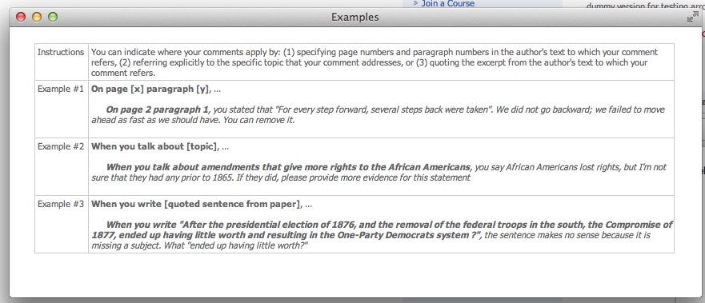
Templates with examples pop up when student clicks “Could you show me some examples?”

Slide 63
Lexical Categories
  Extracted from:
    Coding Manuals
    Decision trees trained with Bag-of-Words
Tag | Meaning | Word list
SUG | suggestion | should, must, might, could, need, needs, maybe, try, revision, want
LOC | location | page, paragraph, sentence
ERR | problem | error, mistakes, typo, problem, difficulties, conclusion
IDE | idea verb | consider, mention
LNK | transition | however, but
NEG | negative | fail, hard, difficult, bad, short, little, bit, poor, few, unclear, only, more
POS | positive | great, good, well, clearly, easily, effective, effectively, helpful, very
SUM | summarization | main, overall, also, how, job
NOT | negation | not, doesn't, don't
SOL | solution | revision, specify, correction

Slide 64
Example Experimental Treatment
TUTOR: Now let’s talk about the net force exerted on the truck. By the same reasoning that we used for the car, what’s the overall net force on the truck equal to?
STUDENT: The force of the car hitting it? [uncertain+correct]
TUTOR (Control System): Good [Feedback] … [moves on]
versus
TUTOR (Experimental System A): Fine. [Feedback] We can derive the net force on the truck by summing the individual forces on it, just like we did for the car. First, what horizontal force is exerted on the truck during the collision? [Remediation Subdialogue]
Notes:
1st Overview study...
And the coding done on the student turns
Parameters extracted from corpora, used to build models
Then I’ll discuss our results – our predictive models

Slide 65
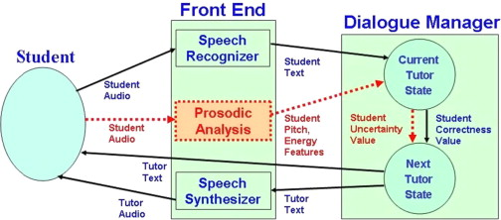
ITSPOKE Architecture

Slide 66
Challenges of High School Data
Different characteristics of feedback comments
More low-level content (language/grammar)
  High School: 32%; College: 9%
More vague comments
  Your essay is short. It has little information and needs work.
  You need to improve your thesis.
Comments often contain multiple ideas
  First, it's too short, doesn't complete the requirements. It's all just straight facts, there is no flow and finally, fix your spelling/typos, spell check's there for a reason. However, you provide evidence, but for what argument? There is absolutely no idea or thought, you are trying to convince the reader that your idea is correct.
Domain | Praise% | Critique% | Localized% | Solution%
College | 28% | 62% | 53% | 63%
High School | 15% | 52% | 36% | 40%
Notes:
College = history
High-school = TCCL (has higher ratio of praise% and critique% compared to the other one (TACL))
Localized% and solution% are computed within identified critiques

