Slide 1

Erin Walker
Joining SCI in January 2019 as an Associate Professor.
Ph.D. in Human-Computer Interaction, B. Sc. In Computer Science and Psychology.
Research interests: intelligent tutoring systems, computer-supported collaborative learning, human-robot interaction, social pedagogical agents

Slide 2
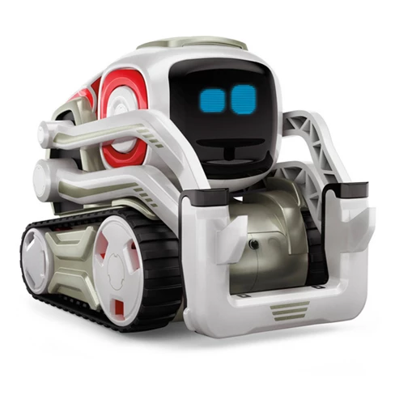
Open Positions
Looking for a PhD student for a funded project:
Goal: Teach middle school students about programming using a Cozmo robot.
Innovation: We will implement social behaviors and dialogue into the robot so that it can encourage the kids and give them feedback.

Slide 3
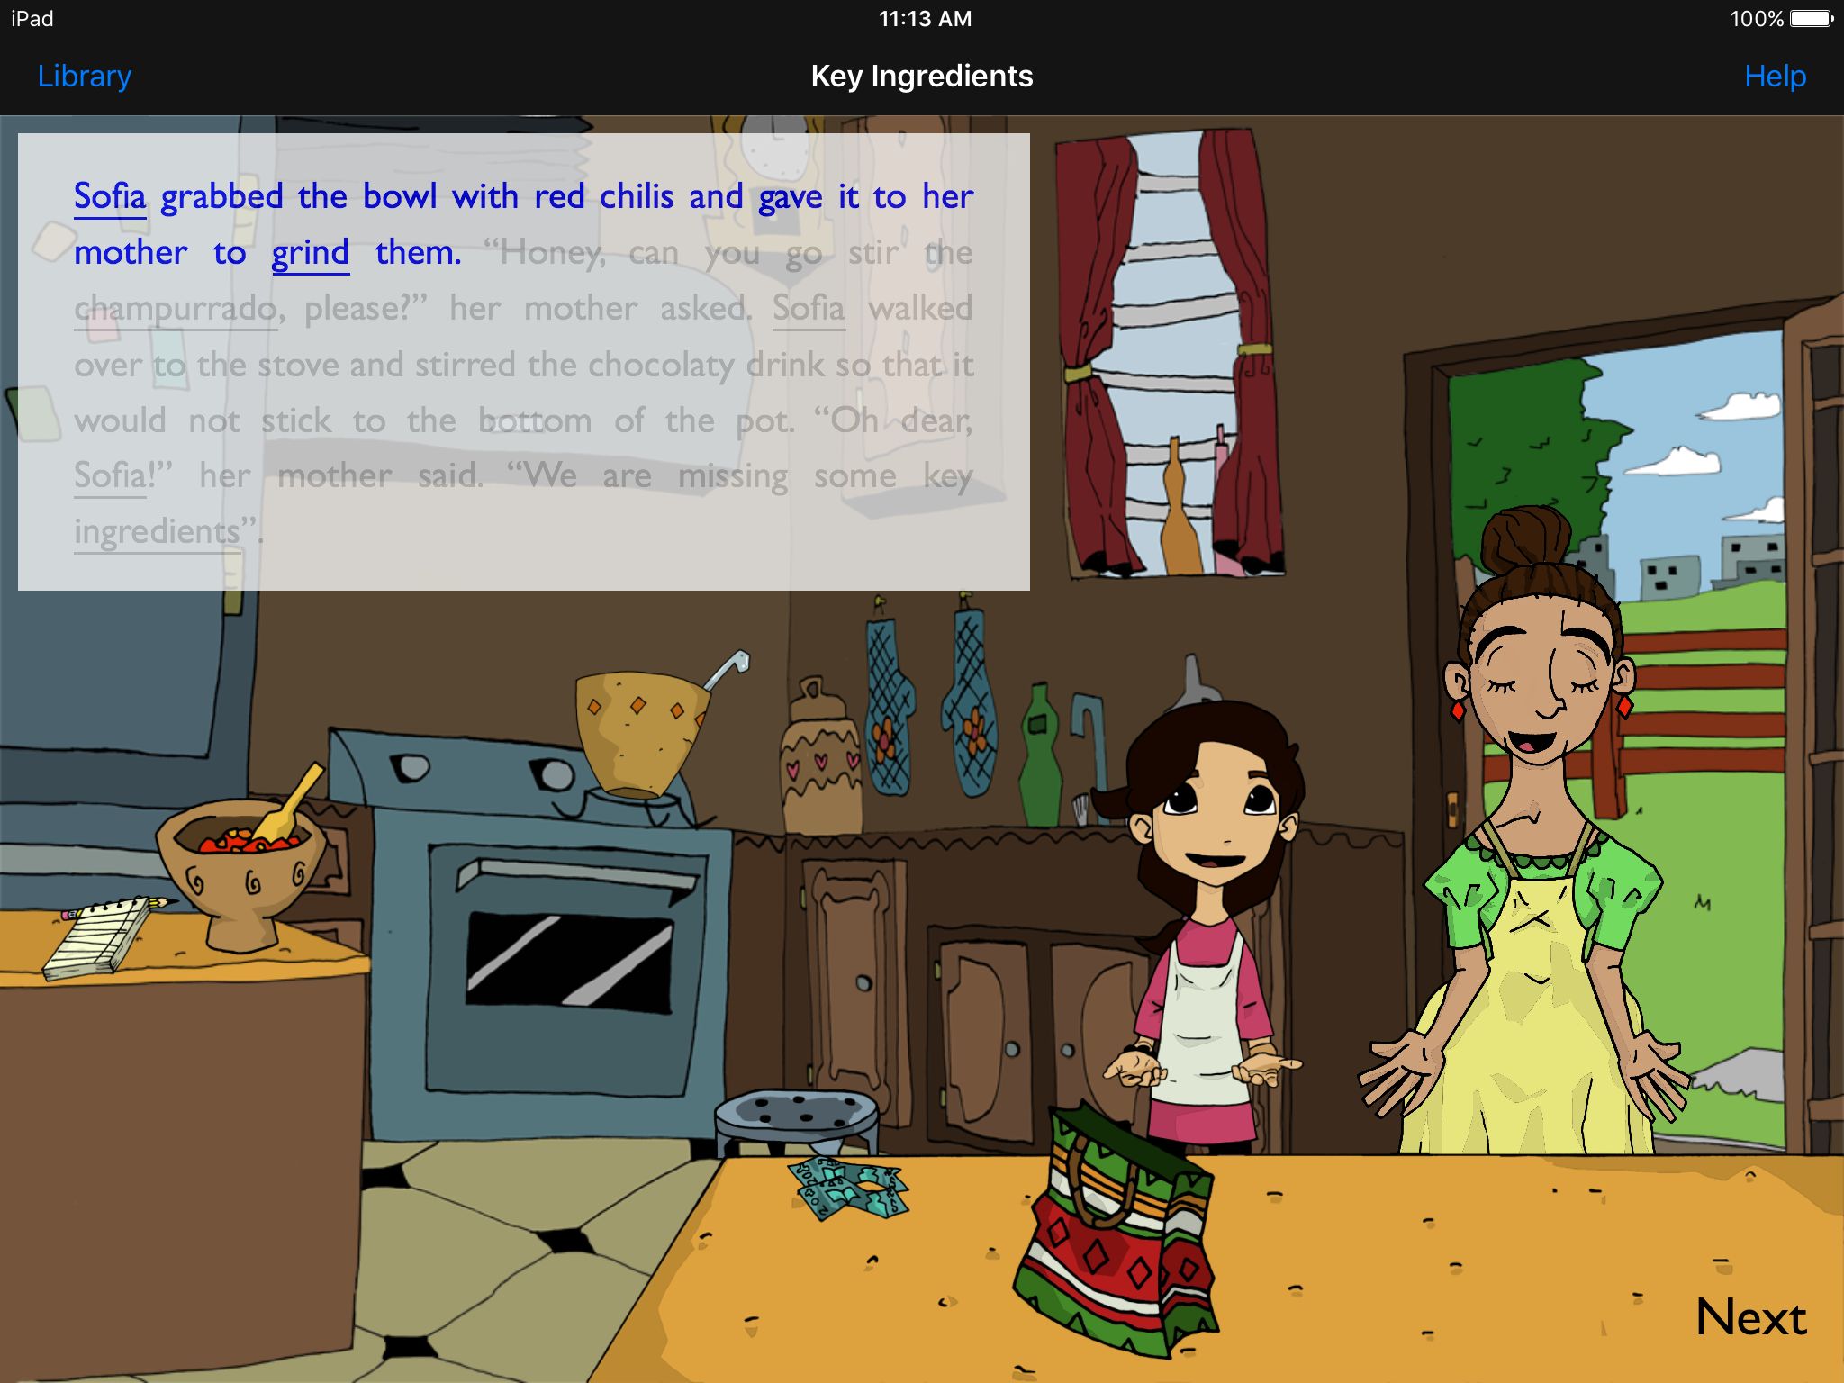
Other projects
Many other ongoing projects:
Use AI to model collaborative learning in middle school mathematics
Collect brain data and intelligent tutoring log data, use machine learning to predict learning outcomes
Develop an intelligent tutoring system to support parents and young children reading together
Open to supervising 2002 projects on these topics or on projects related to technology-mediated learning environments more broadly.
EMBRACE: An ITS for Reading Comprehension

