Slide 1
AI in Education
(a Natural Language Processing Perspective)
Dr. Diane Litman
Professor, Computer Science
Senior Scientist, Learning Research & Development Center
Co-Director, Intelligent Systems Program
Notes:
3-5 minutes

Slide 2
A 20-Year Community Roadmap for AI Research in the US [8/19]
“Personalized, scalable education support. Improve the AI knowledge and skills of people who will lose jobs. Training next generation of AI specialists, data scientists, and software engineers.”
  “In K-12 classrooms, students use adaptive reading and math software from a variety of vendors to receive personalized curricula tailored to their own progress.
  Teachers make use of feedback and scoring systems to help grade assignments, guard against plagiarism, and assess student progress “
Notes:
Where is AI today in r&d?
How will it transform technology?

Slide 3
Current Roadblocks
Lack of large-scale text/speech datasets for machine learning (with student outcomes)
Need for interdisciplinary teams, spanning research to practice
Privacy and ethics

Slide 4

eRevise
Automated Formative Feedback System to Improve Elementary School Students’ Use of Text Evidence in Writing
  Used in 5th and 6th grades Louisiana classrooms
  Based on “essay scoring” AI technology

Slide 5
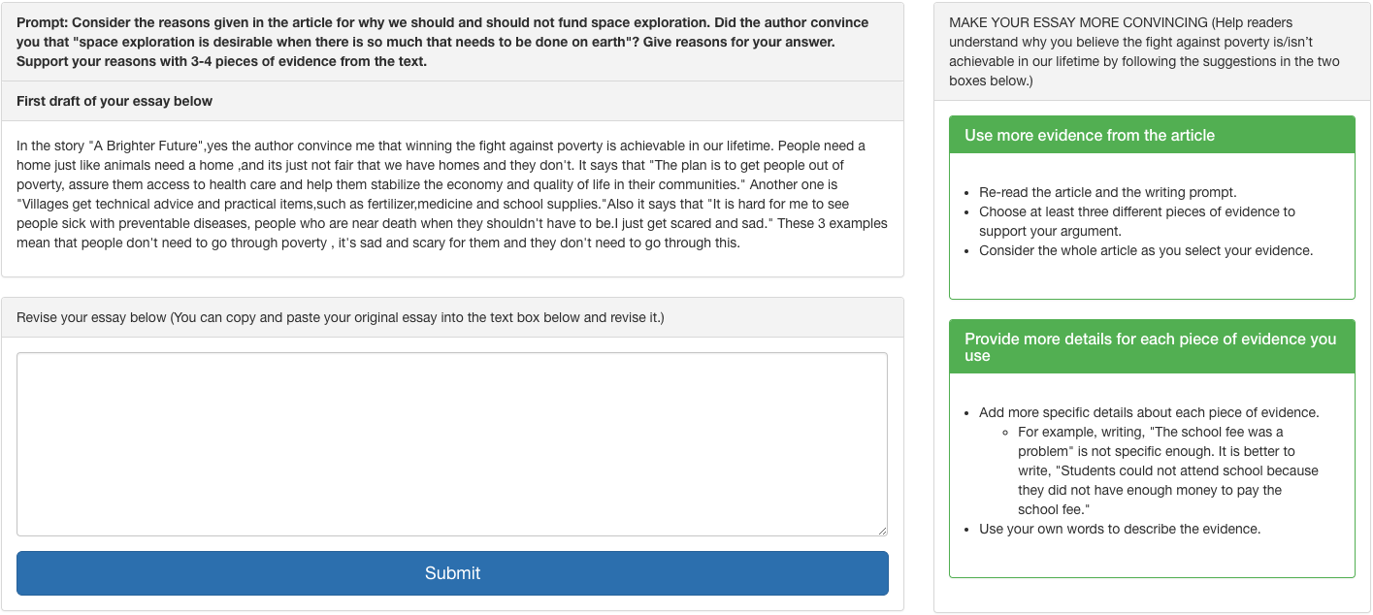

Slide 6
CourseMirror
Enhancing Large Classroom Instructor-Student Interactions
  Previously used in 8 courses at 2 universities, will be used in undergraduate Pitt physics and community college math courses
  Based on “summarization” AI technology

Slide 7
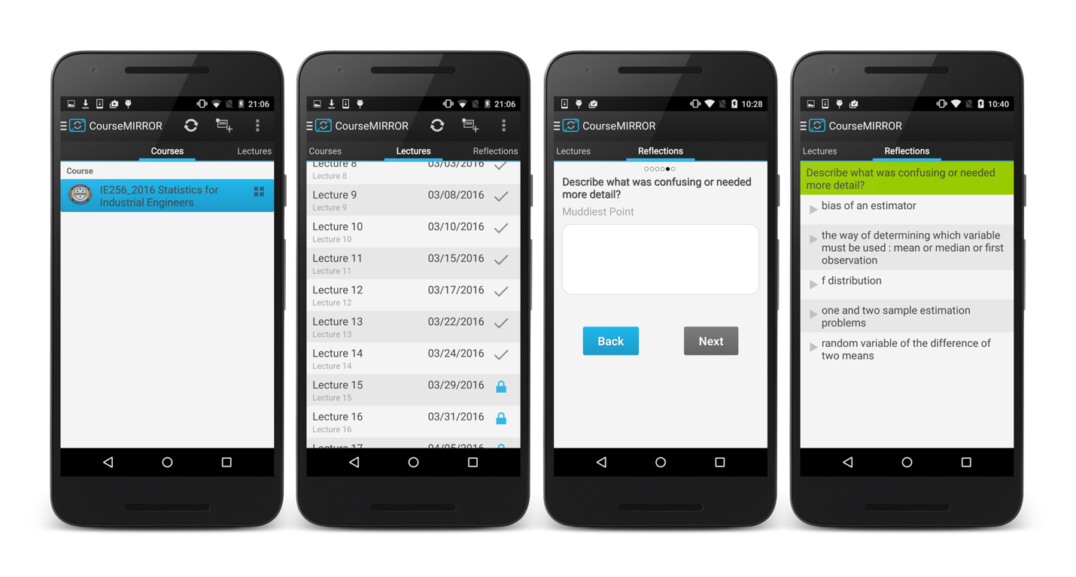

Slide 8

DiscussionTracker
Improving the Teaching of Collaborative Argumentation in High School English Classrooms
  Used by 10 Pittsburgh area high school teachers
  Based on several “text-mining” AI technologies

Slide 10
ArgRewrite
A Web-based Revision Assistant for Argumentative Writing
  Being used in Pitt undergraduate psychology and CS classes
  Based on “revision analysis” AI technology

Slide 11
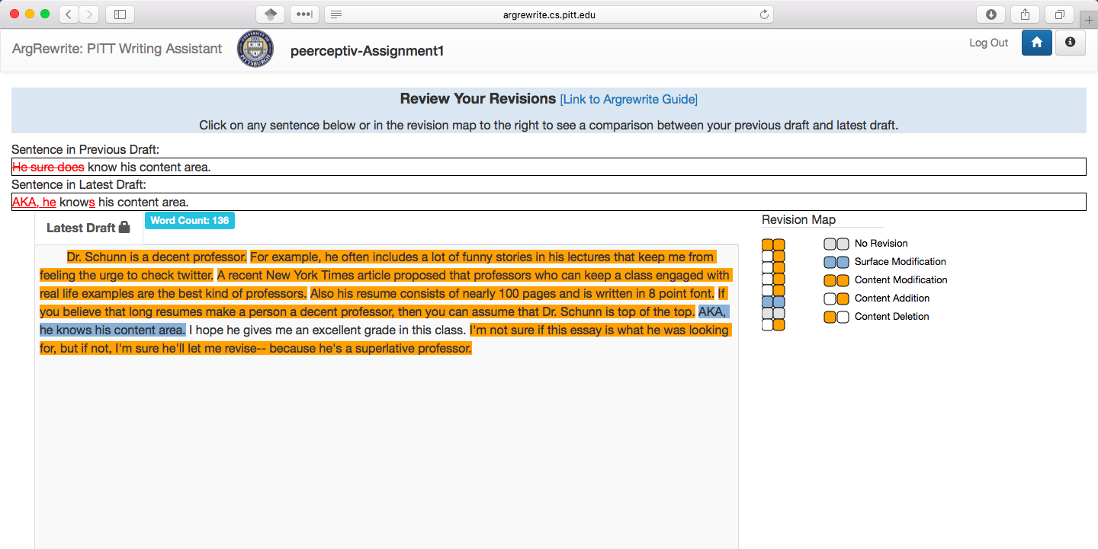

Slide 12
Thank You!
Questions?
Further information
  people.cs.pitt.edu/~litman/

Slide 13

Example: Adaptive dialogue (based on what students say, and how they say it)
SYSTEM: What else do you need to know to find the box‘s acceleration?
Student: the direction [UNCERTAIN]
SYSTEM : If you see a body accelerate, what caused that acceleration?
Student: force [CERTAIN]
SYSTEM : Good job. Say there is only one force acting on the box. How is this force, the box's mass, and its acceleration related?
Student: velocity [UNCERTAIN]
SYSTEM : Could you please repeat that?
Student: velocity [ANNOYED]

Slide 14
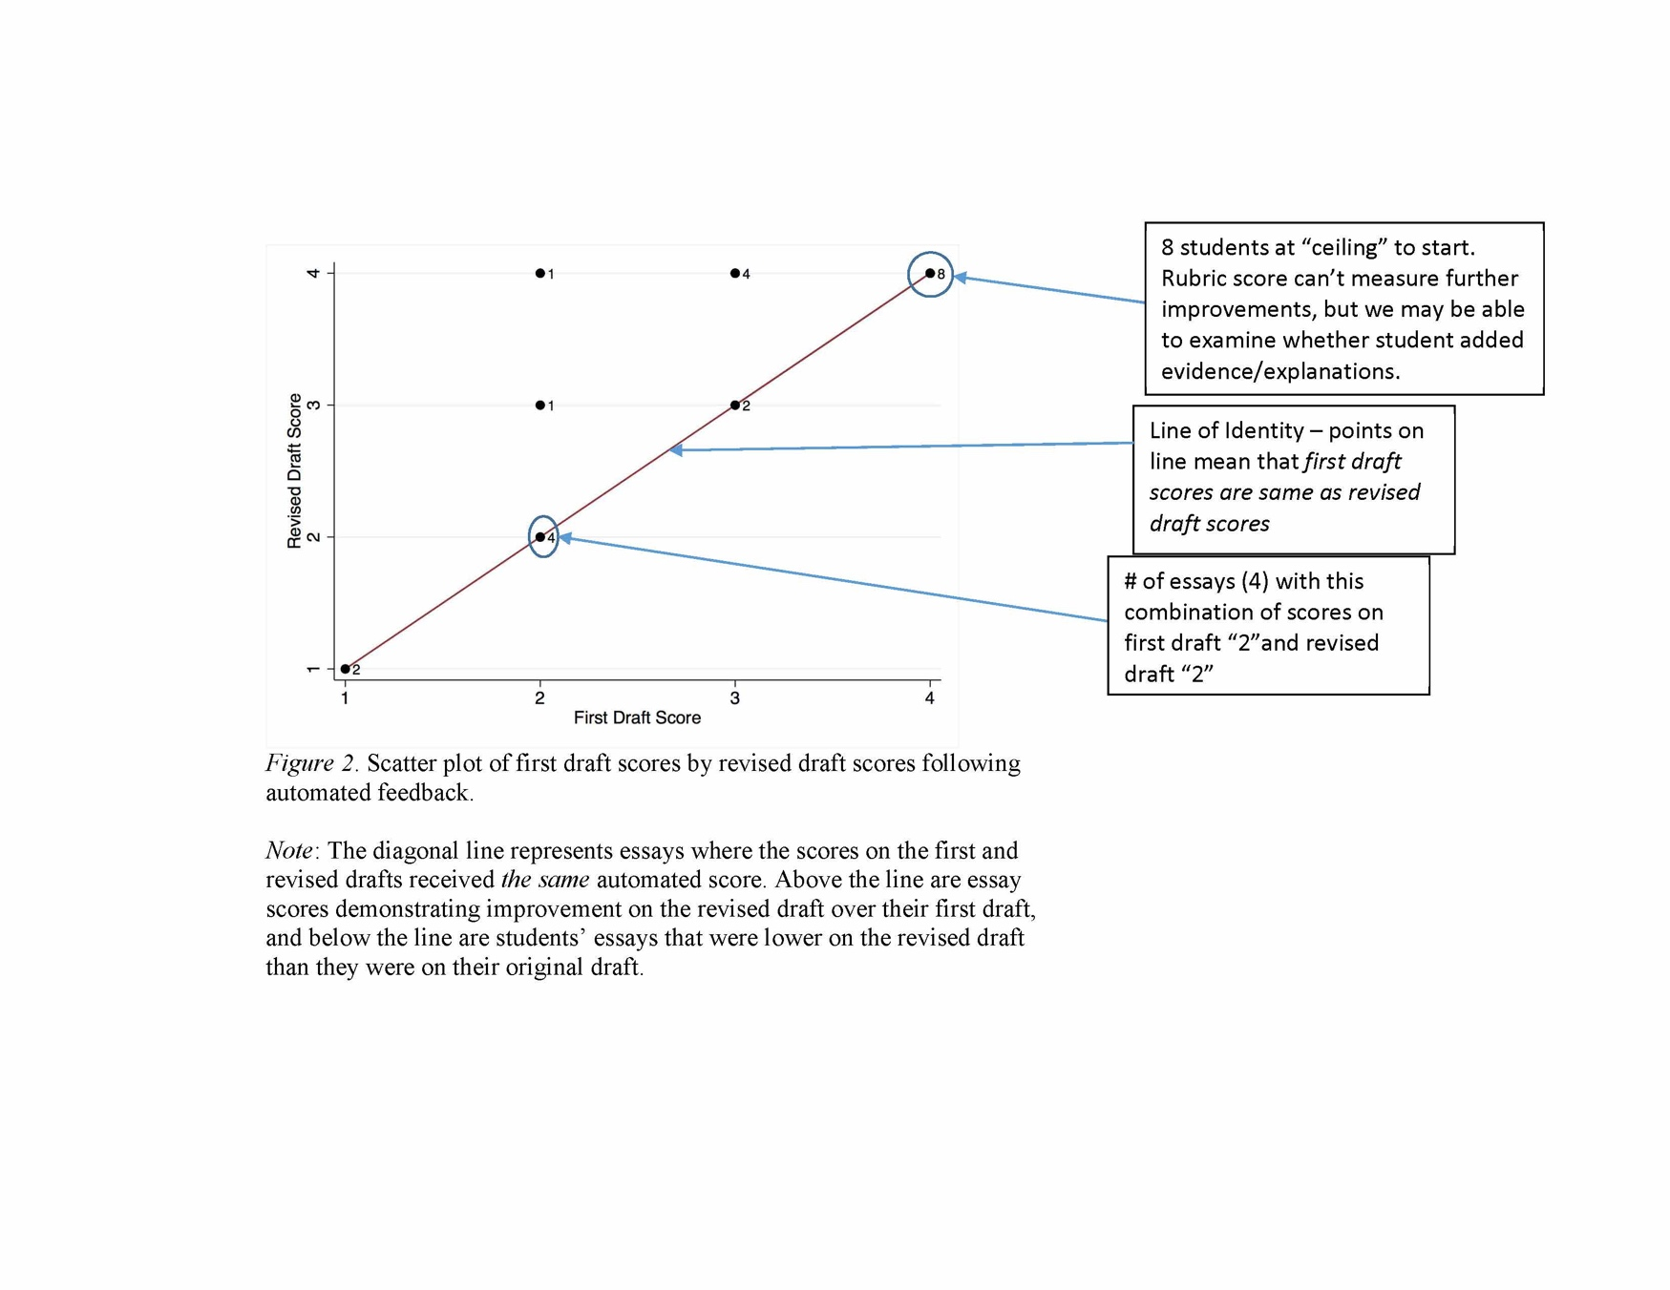

Slide 15
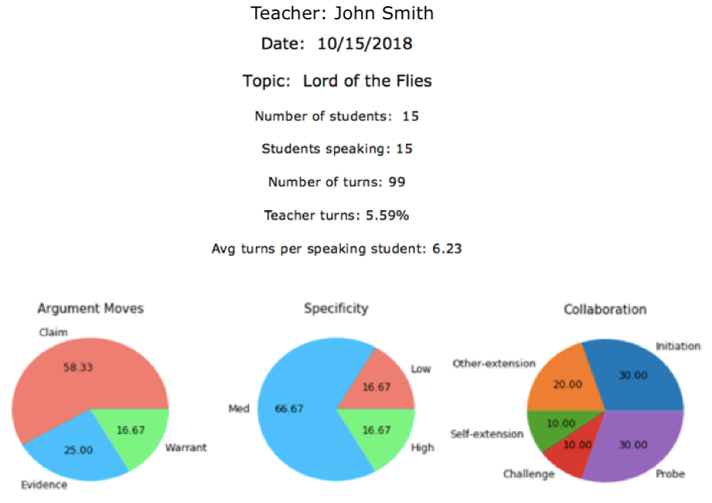

Slide 16
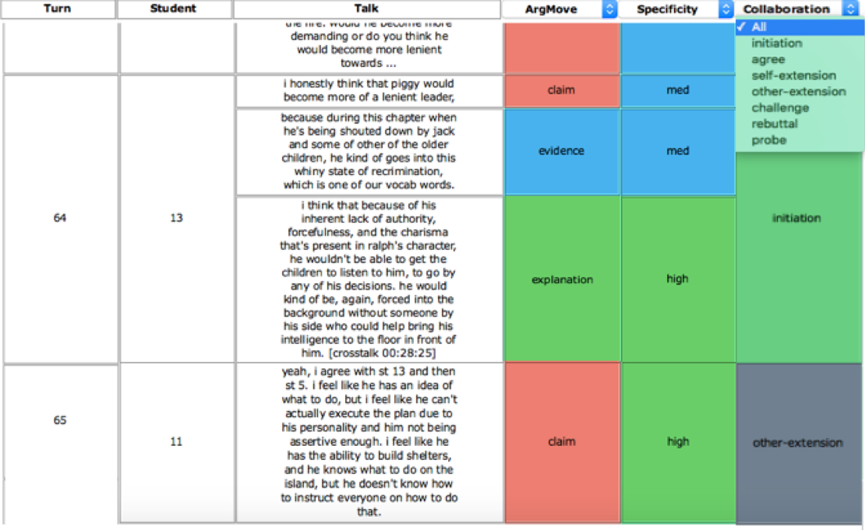

Slide 17
