Slide 1



Temporal Argument Mining for Writing Assistance
Diane Litman
Professor, Computer Science Department
Co-Director, Intelligent Systems Program
Senior Scientist, Learning Research & Development Center
University of Pittsburgh
Pittsburgh, PA USA

Slide 2
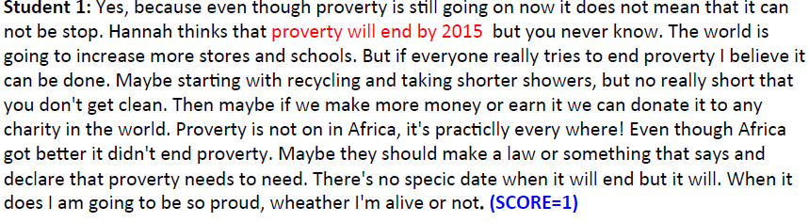
Roles for NLP Argument Mining in Education
Learning Argumentation
Automatic Essay Grading

Slide 3

Roles for NLP Argument Mining in Education
Teaching Using Argumentation
Socratic-Method Dialogue Systems

Slide 4
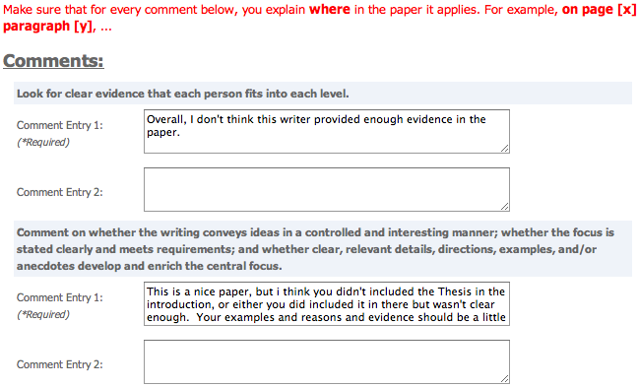
Roles for NLP Argument Mining in Education
Processing Language
Peer Feedback

Slide 5
Today’s Talk:
Learning Argumentation
Temporal Argument Mining of Student Writing
Algorithms and Applications
  Revision Extraction
  Annotation / Classification
  A Writing Revision Analysis System
Open Questions

Slide 6
Research Question
Can temporal argument mining be used to better teach, assess, and understand argumentative writing?
Approach: Technology design and evaluation
  System enhancements that improve student learning
  Argument analytics for teachers
  Experimental platforms to test research predictions

Slide 7
Audience Participation: Temporal Argument Mining
(Revision Analysis via Sentence Alignment)
Draft 1:
In the circle, I would place Bill Clinton because he had an affair with his aide.
Draft 2:
In the third circle of Hell, sinners have uncontrollable lust.
The carnal sinners in this level are punished by a howling, endless wind.
Bill Clinton would be in this level because he had an affair with his aide.
Notes:
This is another set of comments about thesis statement on a different essay. As you can see, Reviewer #2 identified the wrong sentence as the thesis and Reviewer #3 also expressed some confusion.
Our study is the first step toward solving this problem.

Slide 8
Audience Participation: Temporal Argument Mining
(Revision Analysis via Sentence Alignment)
Draft 1:
In the circle, I would place Bill Clinton because he had an affair with his aide.
Draft 2:
In the third circle of Hell, sinners have uncontrollable lust.
The carnal sinners in this level are punished by a howling, endless wind.
Bill Clinton would be in this level because he had an affair with his aide.
R1: Align: null->1 Op: Add Purpose: ?
R2: Align: 1->3 Op: Modify Purpose: ?
….
Notes:
This is another set of comments about thesis statement on a different essay. As you can see, Reviewer #2 identified the wrong sentence as the thesis and Reviewer #3 also expressed some confusion.
Our study is the first step toward solving this problem.

Slide 9
Audience Participation: Temporal Argument Mining
(Revision Analysis via Sentence Alignment)
Draft 1:
In the circle, I would place Bill Clinton because he had an affair with his aide.
Draft 2:
In the third circle of Hell, sinners have uncontrollable lust.
The carnal sinners in this level are punished by a howling, endless wind.
Bill Clinton would be in this level because he had an affair with his aide.
R1: Align: null->1 Op: Add Purpose: Argumentative
R2: Align: 1->3 Op: Modify Purpose: Surface
….
Notes:
This is another set of comments about thesis statement on a different essay. As you can see, Reviewer #2 identified the wrong sentence as the thesis and Reviewer #3 also expressed some confusion.
Our study is the first step toward solving this problem.

Slide 10
Temporal Argument Mining
How are arguments changed during revision?
  Analysis across versions of a text, rather than analyzing the argument structure of a single text
Subtasks
  Segmentation: sentences
    Revision extraction via alignment [Zhang & Litman, 2014]
  Segment classification: argumentative purpose
    Wikipedia features [Zhang & Litman, 2015]
    Contextual methods [Zhang & Litman, 2016]

Slide 11
Revision Extraction
[Zhang & Litman, 2014]
Treat alignment as classification
  Construct sentence pairs using the Cartesian product across drafts
  Compute sentence similarity
  Logistic regression determines whether a pair is aligned or not
Global alignment [Needleman & Wunsch, 1970]
  Sentences are more likely to be aligned if sentences before are aligned
  Starting from the first pair, find the path to maximize likelihood
    s(i, j) = max{s(i−1, j−1)+sim(i, j), s(i− 1, j) + insertcost , s(i, j − 1) + deletecost}
TF*IDF similarity yields the best results
  90 -94% within and across several corpora

Slide 12
Revision Purpose Annotation
[Zhang & Litman, 2015]
2 binary (5 fine-grained) categories
  Argumentative
    Claim
    Warrant
    Evidence
    General content
  Surface
Kappa = .7
  2 high school corpora (>1000 revisions each)

Slide 13
Revision Purpose Classification
[Zhang & Litman, 2015]
Each sentence pair is an instance
Features based on Wikipedia revisions [Adler et al., 2011; Javanmardi et al., 2011; Bronner & Monz, 2012; Daxenberger & Gurevych, 2013]
  Location
  Sentence (first/last in paragraph, exact index)
  Paragraph (first/last in essay, exact index)
  Textual
  Keywords: “because”, “however”, “for example” ….
  Named-entity
  Sentence difference (Levenshtein distance…)
  Revision operation (Add/Delete/Modify)
  Language
  Out of vocabulary words

Slide 14
Experimental Evaluations
Surface vs. argumentative
  Intrinsic (SVM, 10-fold): results significantly better than unigram baseline
  Extrinsic: predicted versus actual labels yield same correlations with writing improvement
Fine-grained
  Intrinsic results mostly outperform unigram baselines
  Feature groups have different impacts

Slide 15
Enhancing Classification with Context
[Zhang & Litman, 2016]
Contextual features
  Original features, but for adjacent sentences
  Changes in cohesion (lexical) & coherence (semantic)
Sequence modeling
Results: Fine-grained labels
  Cohesion significantly improves results for one corpus (SVM, 10-fold)
  Sequence modeling yields best results for both corpora

Slide 16
Application
[Zhang, Hwa, Litman, & Hashemi, 2016]
ArgRewrite: A Web-based Revision Assistant for Argumentative Writings
  www.cs.pitt.edu/˜zhangfan/argrewrite

Slide 17
Revision Overview Interface

Slide 18
Revision Detail Interface

Slide 19
Open Question 1: Relation to Argument Mining?
Current Approach
  Revision extraction by comparing drafts
  (Temporal) Argument mining on each revision
Alternative Approach?
  Argument mining on each draft
  Revision extraction by comparing mined arguments
Also, pipelining vs. joint modeling?

Slide 20
Open Question 2: Relation to Revision Analysis?
Current Approach
  Argumentative annotation scheme
Alternative Approach?
  Something to also cover Wikipedia
  Prediction of revision quality (e.g., is paper getting better?)

Slide 21
Open Question 3: Relation to Discourse Analysis?
Current Approach
  PDTB features
  Sentence as the ADU
Alternative Approach?
  RST features
  “Clause” as the ADU
  Other ways of using NLP discourse parsers

Slide 22
Summary
NLP-supported temporal argument mining for teaching and assessing writing
  Feature / Algorithm Development
    Noisy and diverse data
    Meaningful features
    Real-time performance
  Experimental Evaluations
    Temporal Argument Mining (high school & university corpora)
    Revision Assistant (lab user study)
Even non-structural and application-dependent argument mining can support useful applications!

Slide 23



Thank You!
Questions?
Further Information
  http://www.cs.pitt.edu/~litman

Slide 24
Why teach argumentative writing?
Studies show students:
  lack competence in argument writing (Oostdam, et al., 1994; Oostdam & Emmelot, 1991).
  do not integrate their arguments into a high-level structure or coherent position (Keith, Weiner, & Lesgold, 1991).
  Even if compose-aloud protocols show students mentally connect position statement & supporting details, connections not evident in writing (Durst, 1987).

Slide 25
Argument Mining
“… exploits the techniques and methods of natural language processing … for semi-automatic and automatic recognition and extraction of structured argument data from unstructured … texts.” [SICSA Workshop on Argument Mining, July 2014]

Slide 26
Mining Drafts of a High School Essay for
Argument-Oriented Revisions
  Draft 1:
  In the first circle Limbo where the unbaptized and those before Christ dwell, live in complete darkness.
  There is no other punishment since in life they never experienced the radiance of Christ.
Draft 2:
The first circle Limbo is where the unbaptized go.
They are not punished because they did not know Christ.
Notes:
From slide 30 to 34 title is not right, C1: Example:
----- Meeting Notes (15/11/24 15:10) -----
aligning the sentences, show the gaps
make it like a story

Slide 27
Argument Mining Subtasks
[Peldszus and Stede, 2013]
Scope of today’s talk
Even partial argument mining can support useful applications
  Mostly non-structural (e.g., no relations, no argument schema)
  Often application-dependent roles (e.g., no premises)
  But, real data!!

Slide 28
Argument Mining for Education
Challenges
  Noisy data (e.g., adult learners, children)
  Real-time algorithms; robust at scale
  Meaningful features
Opportunities
  Human in the loop (e.g., peer review)
    Errors as student reflection opportunities

