Slide 1
User Generated Content Analyses using Automated Discourse Processing
(CS 6281: Topics in Computer Science II)
Diane Litman
Shaw Visiting Professor (Semester 1), CS@NUS
Professor, Computer Science Department
Co-Director, Intelligent Systems Program
Senior Scientist, Learning Research & Development Center
University of Pittsburgh
Pittsburgh, PA USA

Slide 2
Goals for Today
Introductions
Administration
Computational Discourse

Slide 3
My Background
Ph.D. Computer Science, University of Rochester
  Plan Recognition and Discourse Analysis: An Integrated Approach for Understanding Dialogues
Artificial Intelligence Principles Research Department, AT&T Bell Labs
  Knowledge Representation and Reasoning
  Discourse Analysis
  Spoken Dialogue Systems
University of Pittsburgh
  Speech and Language Processing (particularly for Education)

Slide 4
Speech and Language Processing for Education
Learning Language
(reading, writing, speaking)
Automatic Essay Grading
Argument Mining

Slide 5

Speech and Language Processing for Education
Using Language
(teaching in the disciplines)
Tutorial Dialogue
Systems

Slide 6
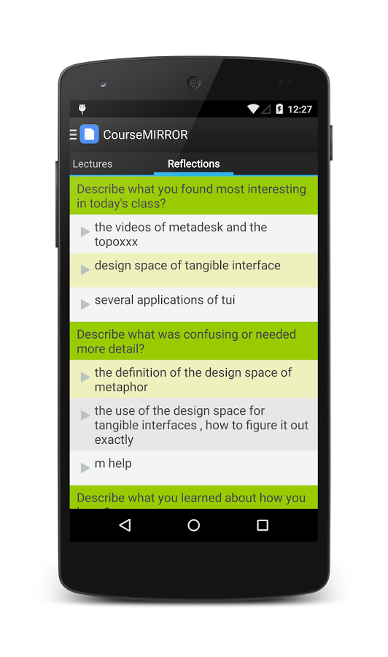
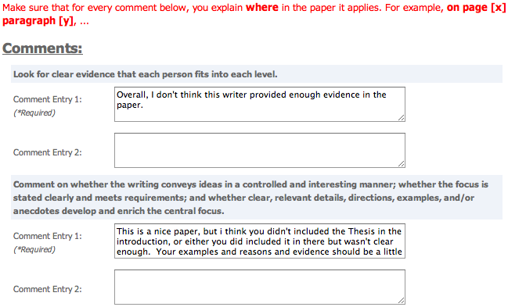
Speech and Language Processing for Education
Processing Language
Peer Feedback
Student Reflections

Slide 7
Innovation Cycle
Systems and Evaluations
Real-World
Problems
Learning and Teaching
Higher Level Learning Processes
Learning Technology
Challenges!
User-generated content
Meaningful constructs
Real-time performance
Scalable approaches
Theoretical and Empirical Foundations

Slide 8
Your Background
Your name
Research interests
Anything else

Slide 9
Goals for Today
Introductions
Administration
Computational Discourse

Slide 10
Module Goals
Computational Discourse (Part I)
Applications to User-Generated Content (Part II)
Also,
  Empirical NLP
  CS Research Methods
  Publishable Paper?!
To the course homepage…

Slide 11
Goals for Today
Introductions
Administration
Computational Discourse

Slide 12
Outline
Computational Discourse
    Topic and Entity Structures
    Functional structures
    Predicate-argument structures
    Tree-like structures
Resources
    Corpora
    Software
Evaluation
    Intrinsic versus Extrinsic
    Quantitative Metrics
Educational Case Studies
    Teaching Writing with Diagramming and Peer Review
    Automated Writing Assessment
Looking Forward

Slide 13
Categories of Knowledge
Phonology
Morphology
Syntax
Semantics
Pragmatics
Discourse

Slide 14
Terminology
Discourse: anything longer than a single utterance or sentence
  Monologue
  Dialogue:
    May be multi-party
    May be human-machine
Discourse conveys more than the individual sentences (through relationships) (i.e. structure)
Linguistic features are associated with discourse structures

Slide 15
Is this text coherent?
“Consider, for example, the difference between passages (18.71) and (18.72). Almost certainly not. The reason is that these utterances, when juxtaposed, will not exhibit coherence. Do you have a discourse? Assume that you have collected an arbitrary set of well-formed and independently interpretable utterances, for instance, by randomly selecting one sentence from each of the previous chapters of this book.”

Slide 16
Or, this?
“Assume that you have collected an arbitrary set of well-formed and independently interpretable utterances, for instance, by randomly selecting one sentence from each of the previous chapters of this book. Do you have a discourse? Almost certainly not. The reason is that these utterances, when juxtaposed, will not exhibit coherence. Consider, for example, the difference between passages (18.71) and (18.72).”

Slide 17
What makes a text coherent?
Discourse structure
  In a coherent text the parts of the discourse exhibit a sensible ordering (and typically are in other relationships)
Rhetorical structure
  The elements in a coherent text are related via meaningful relations (“coherence relations”)
Entity structure
  A coherent text is about some entity or entities, that are referred to in a structured way throughout the text

Slide 18
Outline
Computational Discourse
    Topic and Entity Structures (segmentation)
    Functional structures (segmentation)
    Predicate-argument structures (chunking)
    Tree-like structures (parsing)
Resources
    Corpora
    Software
Evaluation
    Intrinsic versus Extrinsic
    Quantitative Metrics
Educational Case Studies
    Teaching Writing with Diagramming and Peer Review
    Automated Writing Assessment
Looking Forward

Slide 19
Topic Structure
Expository text can be viewed as a linear sequence of topically coherent segments, whose order may be conventionalized
Example: Wikipedia articles about US states
  Wisconsin: Etymology, History, Geography…
  Louisiana: Etymology, Geography, History…
  Vermont: Geography, History, Demographics
Applications: segmenting lectures, meetings, etc. during search

Slide 20
Topic Structure
Computational approaches typically assume that:
  The topic of each segment relates to the topic of the discourse as a whole (e.g., History of Vermont ! Vermont)
  The only relation holding between sister segments, if any, is sequence, though certain sequences may be more common than others
  The topic of a segment will differ from those of its adjacent sisters
  Topic predicts lexical choice

Slide 21
Topic Structure
Making this structure explicit (i.e., topic segmentation) uses either
  semantic-relatedness, where each segment is taken to consist of words more related to each other than to words outside the segment
  topic models, where each segment is taken to be produced by a distinct, compact lexical distribution

Slide 22
Semantic-relatedness
Computational models have:
a metric for assessing the semantic relatedness of terms within a proposed segment
a locality that specifies what units within the text are assessed for semantic relatedness
a threshold for deciding how low relatedness can drop before it signals a shift to another topic

Slide 23
TextTiling [Hearst]
Metric: Cosine similarity, using a vector representation of fixed-length spans in terms of frequency of word stems
Locality: Cosine similarity is computed between adjacent spans
Threshold: Empirically-determined

Slide 24
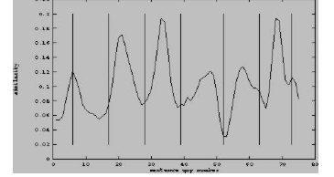
TextTiling [Hearst] – Computed similarity of adjacent blocks
Vertical lines show manual segmentation
Valleys show predicted segmentation

Slide 25
What makes a text coherent? (continued)
Appropriate sequencing of subparts of the discourse -- discourse/topic structure
Appropriate use of referring expressions
  Topics comprise a set of entities and a limited range of things being said about them
Notes:
25

Slide 26
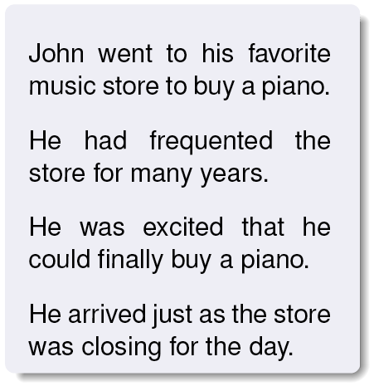
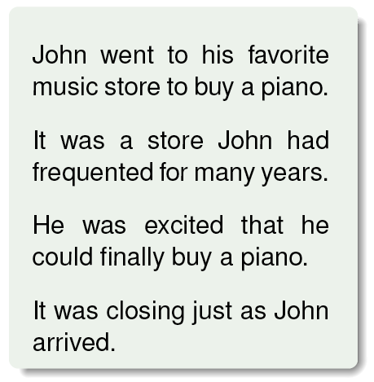
Entity Structures:
Discourses without a clear ‘central entity’ feel less coherent
Notes:
This example is a bit peculiar but is the standard one

Slide 27
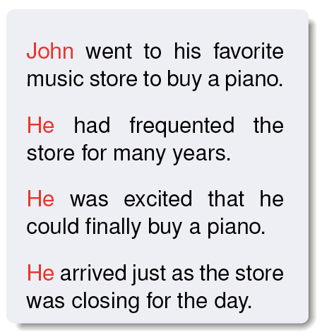
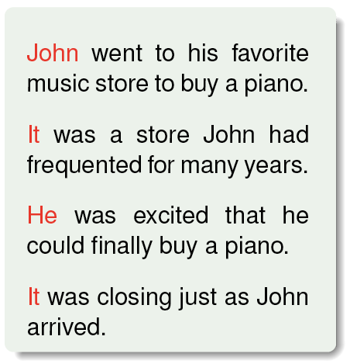
Entity Structures:
Discourses without a clear ‘central entity’ feel less coherent

Slide 28
Exercise: Annotating Topic Structure
The word Wisconsin originates from the name given to the Wisconsin River by one of the Algonquian-speaking American Indian groups living in the region at the time of European contact.^{[12]} French explorer Jacques Marquette was the first European to reach the Wisconsin River, arriving in 1673 and calling the river Meskousing in his journal.^{[13]} Subsequent French writers changed the spelling from Meskousing to Ouisconsin, and over time this became the name for both the Wisconsin River and the surrounding lands. English speakers anglicized the spelling from Ouisconsin to Wisconsin when they began to arrive in large numbers during the early 19th century. The legislature of Wisconsin Territory made the current spelling official in 1845.^{[14]}
The Algonquian word for Wisconsin and its original meaning have both grown obscure. Interpretations vary, but most implicate the river and the red sandstone that lines its banks. One leading theory holds that the name originated from the Miami word Meskonsing, meaning "it lies red," a reference to the setting of the Wisconsin River as it flows through the reddish sandstone of the Wisconsin Dells.^{[15]} Other theories include claims that the name originated from one of a variety of Ojibwa words meaning "red stone place," "where the waters gather," or "great rock."^{[16]}
Wisconsin has been home to a wide variety of cultures over the past 12,000 years. The first people arrived around 10,000 BCE during the Wisconsin Glaciation. These early inhabitants, called Paleo-Indians, hunted now-extinct ice age animals exemplified by the Boaz mastodon, a prehistoric mastodon skeleton unearthed along with spear points in southwest Wisconsin.^{[17]} After the ice age ended around 8000 BCE, people in the subsequent Archaic period lived by hunting, fishing, and gathering food from wild plants. Agricultural societies emerged gradually over the Woodland period between 1000 BCE to 1000 CE. Toward the end of this period, Wisconsin was the heartland of the "Effigy Mound culture", which built thousands of animal-shaped mounds across the landscape.^{[18]} Later, between 1000 and 1500 CE, the Mississippian and Oneota cultures built substantial settlements including the fortified village at Aztalan in southeast Wisconsin.^{[19]} The Oneota may be the ancestors of the modern Ioway and Ho-Chunk tribes who shared the Wisconsin region with the Menominee at the time of European contact.^{[20]} Other American Indian groups living in Wisconsin when Europeans first settled included the Ojibwa, Sauk, Fox, Kickapoo, and Pottawatomie, who migrated to Wisconsin from the east between 1500 and 1700.^{[21]}

Slide 29
Wikipedia: Annotated Topic Structure
Etymology
The word Wisconsin originates from the name given to the Wisconsin River by one of the Algonquian-speaking American Indian groups living in the region at the time of European contact.^{[12]} French explorer Jacques Marquette was the first European to reach the Wisconsin River, arriving in 1673 and calling the river Meskousing in his journal.^{[13]} Subsequent French writers changed the spelling from Meskousing to Ouisconsin, and over time this became the name for both the Wisconsin River and the surrounding lands. English speakers anglicized the spelling from Ouisconsin to Wisconsin when they began to arrive in large numbers during the early 19th century. The legislature of Wisconsin Territory made the current spelling official in 1845.^{[14]}
The Algonquian word for Wisconsin and its original meaning have both grown obscure. Interpretations vary, but most implicate the river and the red sandstone that lines its banks. One leading theory holds that the name originated from the Miami word Meskonsing, meaning "it lies red," a reference to the setting of the Wisconsin River as it flows through the reddish sandstone of the Wisconsin Dells.^{[15]} Other theories include claims that the name originated from one of a variety of Ojibwa words meaning "red stone place," "where the waters gather," or "great rock."^{[16]}
History
Wisconsin has been home to a wide variety of cultures over the past 12,000 years. The first people arrived around 10,000 BCE during the Wisconsin Glaciation. These early inhabitants, called Paleo-Indians, hunted now-extinct ice age animals exemplified by the Boaz mastodon, a prehistoric mastodon skeleton unearthed along with spear points in southwest Wisconsin.^{[17]} After the ice age ended around 8000 BCE, people in the subsequent Archaic period lived by hunting, fishing, and gathering food from wild plants. Agricultural societies emerged gradually over the Woodland period between 1000 BCE to 1000 CE. Toward the end of this period, Wisconsin was the heartland of the "Effigy Mound culture", which built thousands of animal-shaped mounds across the landscape.^{[18]} Later, between 1000 and 1500 CE, the Mississippian and Oneota cultures built substantial settlements including the fortified village at Aztalan in southeast Wisconsin.^{[19]} The Oneota may be the ancestors of the modern Ioway and Ho-Chunk tribes who shared the Wisconsin region with the Menominee at the time of European contact.^{[20]} Other American Indian groups living in Wisconsin when Europeans first settled included the Ojibwa, Sauk, Fox, Kickapoo, and Pottawatomie, who migrated to Wisconsin from the east between 1500 and 1700.^{[21]}

Slide 30
Outline
Computational Discourse
    Topic and Entity Structures
    Functional structures
    Predicate-argument structures
    Tree-like structures
Resources
    Corpora
    Software
Evaluation
    Intrinsic versus Extrinsic
    Quantitative Metrics
Educational Case Studies
    Teaching Writing with Diagramming and Peer Review
    Automated Writing Assessment
Looking Forward

Slide 31
Functional Structure
Texts within a given genre – e.g.,
  news reports
  scientific papers or abstracts
  etc.
  generally share a similar structure, that is independent of topic and reflects the function played by each of their parts

Slide 32
Example
Well-known in academia is the multi-part structure of scientific papers (and also their abstracts)
  Objective (aka Introduction, Background, Aim, Hypothesis)
  Methods (aka Study Design, Methodology, etc.)
  Results (aka Outcomes)
  Discussion
  Optionally, Conclusions
N.B. Not every sentence within a section need realize the same function

Slide 33
Functional Structure
Automatic annotation of functional structure is seen as benefitting:
  Information extraction: Certain types of information are likely to be found in certain sections [Moens]
  Extractive summarization: More “important” sentences are more likely to be found in certain sections
  Sentiment analysis: Words that have an objective sense in one section may have a subjective sense in another [Taboada]
  Citation analysis: A citation may serve different functions in different sections [Teufel]

Slide 34
Functional Structure
Computational approaches to functional structure and segmentation assume that:
  The function of a segment relates to that of the discourse as a whole.
  While relations may hold between sisters (eg, Methods constrain Results), only sequence has been used in modelling.
  Function predicts more than lexical choice:
    indicative phrases such as “results show” (-> Results)
    indicative stop-words such as “then” (-> Method).
  Functional segments usually appear in a specific order, so either sentence position is a feature used in modelling or sequential models are used.

Slide 35
Functional Structure
The internal structure of segments has usually been ignored in high-level functional segmentation
But given the results of work in fine-grained modelling of functional structure, not surprising that Hirohata et al [2008] found that
  Properties of the first sentence of a segment differ from those of the rest.
  Modelling this leads to improved performance in high-level functional segmentation.

Slide 36
Labelled Biomedical Abstracts
Much function-based modelling has been on biomedical text, where texts with explicitly labelled sections serve as free training data for segmenting unlabelled texts.
  BACKGROUND: Mutation impact extraction is a hitherto unaccomplished task in state of the art mutation extraction systems. . . . RESULTS: We present the first rule-based approach for the extraction of mutation impacts on protein properties, categorizing their directionality as positive, negative or neutral. . . . CONCLUSION: . . . Our approaches show state of the art levels of precision and recall for Mutation Grounding and respectable level of precision but lower recall for the task of Mutant-Impact relation extraction. . . . [PMID 21143808]

Slide 37
Analyzing and Scoring Student Essays
The structure of a student’s essay contributes to its quality
  The main point of an essay should come before text that acts to support it.
  Downgrade essay if it doesn’t.
<Introductory material> In Korea, where I grew up, many parents seem to push their children into being doctors, lawyers, engineer etc. </Introductory material> <Main point>Parents believe that their kids should become what they believe is right for them, but most kids have their own choice and often doesn’t choose the same career as their parent’s. </Main point> <Support> I’ve seen a doctor who wasn’t happy at all with her job because she thought that becoming doctor is what she should do. That person later had to switch her job to what she really wanted to do since she was a little girl, which was teaching. </Support>
[Burstein et al 2003]

Slide 38
Exercise: Annotating Functional Structure
Functions: Conclusion (summarize entire argument), Introductory material (context in which thesis, main points, or conclusion are to be interpreted), Irrelevant, Main Point (author’s main message in conjunction with thesis), Support (provide evidence supporting main points, thesis, conclusion), Thesis (writer’s position statement)
“You can’t always do what you want to do,” my mother said. She scolded me for doing what I thought was best for me. It is very difficult to do something that I do not want to do. But now that I am mature enough to take responsibility for my actions, I understand that many times in our lives we have to do what we should do. However, making important decisions, like determining your goal for the future, should be something that you want to do and enjoy doing.
I’ve seen many successful people who are doctors, artists, teachers, designers, etc. In my opinion they were considered successful people because they were able to find what they enjoy doing and worked hard for it. It is easy to determine that he/she is successful, not because it’s what others think, but because he/she have succeed in what he/she wanted to do.
<Introductory material>In Korea, where I grew up, many parents seem to push their childre into being doctors, lawyers, engineer etc. </Introductory material> <Main point> Parents believe that their kids should become what they believe is right for them, but most kids have their own choice and often doesn’t choose the same career as their parent’s </Main point> <Support> I’ve seen a doctor who wasn’t happy at all with her job because she thought that becoming doctor is what she should do. That person later had to switch her job to what she really wanted to do since she was a little girl, which was teaching. </Support>
Parents might know what’s best for their own children on a daily basis, but deciding a long term goal for them should be one’s own decision of what he/she likes to do and wants to do.

Slide 39
Answer: Annotating Functional Structure
Functions: Conclusion, Introductory material, Irrelevant, Main Point, Support, Thesis
<Introductory material> “You can’t always do what you want to do,” my mother said. She scolded me for doing what I thought was best for me. It is very difficult to do something that I do not want to do. </Introductory material> <Thesis> But now that I am mature enough to take responsibility for my actions, I understand that many times in our lives we have to do what we should do. However, making important decisions, like determining your goal for the future, should be something that you want to do and enjoy doing </Thesis>
<Introductory material> I’ve seen many successful people who are doctors, artists, teachers, designers, etc. </Introductory material> <Main point> In my opinion they were considered successful people because they were able to find what they enjoy doing and worked hard for it </Main point> <Irrelevant> It is easy to determine that he/she is successful, not because it’s what others think, but because he/she have succeed in what he/she wanted to do.<Irrelevant>
<Introductory material>In Korea, where I grew up, many parents seem to push their childre into being doctors, lawyers, engineer etc. </Introductory material> <Main point> Parents believe that their kids should become what they believe is right for them, but most kids have their own choice and often doesn’t choose the same career as their parent’s </Main point> <Support> I’ve seen a doctor who wasn’t happy at all with her job because she thought that becoming doctor is what she should do. That person later had to switch her job to what she really wanted to do since she was a little girl, which was teaching. </Support>
<Conclusion>Parents might know what’s best for their own children on a daily basis, but deciding a long term goal for them should be one’s own decision of what he/she likes to do and wants to do. </Conclusion>

Slide 40
Outline
Computational Discourse
    Topic and Entity Structures
    Functional structures
    Predicate-argument structures
    Tree-like structures
Resources
    Corpora
    Software
Evaluation
    Intrinsic versus Extrinsic
    Quantitative Metrics
Educational Case Studies
    Teaching Writing with Diagramming and Peer Review
    Automated Writing Assessment
Looking Forward

Slide 41
Predicate-Argument Structures
Discourse has structure arising from semantic and pragmatic relations that hold between the referents of its clauses.
These “higher-order” pred-arg structures (aka discourse relations or coherence relations) are often explicitly signalled by a discourse connective
  a conjunction like because or but,
  a discourse adverbial like nevertheless or instead.
  though they may be signalled by other means, like that means, what if, etc. [Prasad et al, 2008]).

Slide 42
Predicate-Argument Structures
Coherence relations can also be conveyed through adjacency between clauses or sentences (aka implicit connectives).
  Viewers may not be cheering, either. (implicit= REASON) Soaring rights fees will lead to an even greater clutter of commercials. [wsj 1057]

Slide 43
Predicate-Argument Structures
The Penn Discourse TreeBank (PDTB) (more later) is currently the largest resource manually annotated for discourse connectives, their arguments, and the senses they convey
Snapshot
  Explicit: 18459 tokens
  Implicit: 16224 tokens

Slide 44
Predicate-Argument Structures
Computational models assume that:
  Each predicate/relation has two arguments.
  The arguments can be distinguished
    syntactically, where the arg syntactically attached to an explicit connective is called arg2, and the other, arg1 [Prasad et al, 2008].
    semantically, where one arg of any Causal relation is the cause, and the other, the result) [Oza, 2009]
    positionally, where arg1 of an implicit connective always precedes arg2 [Prasad et al, 2008].

Slide 45
Predicate-Argument Structures
The structure is not necessarily a tree:
  A single span may serve as an argument to multiple relations (ie, have incoming edges from different nodes).
The structure may only be a partial cover of the text.

Slide 46
Serving as an arg to multiple relations
In times past, life-insurance salesmen targeted heads of household, meaning men, but ours is a two-income family and accustomed to it. So if anything happened to me, I’d want to leave behind enough so that my 33-year-old husband would be able to pay off the mortgage . . . [Lee et al., 2006]

Slide 47
Serving as an arg to multiple relations
In times past, life-insurance salesmen targeted heads of household, meaning men, but ours is a two-income family and accustomed to it. So if anything happened to me, I’d want to leave behind enough so that my 33-year-old husband would be able to pay off the mortgage . . . [Lee et al., 2006]

Slide 48
Serving as an arg to multiple relations

Slide 49
Partial connectivity – Disconnected structures
The early omens, we admit, scarcely suggest so wholesome an outcome. The Fleet Street reaction was captured in the Guardian headline, “Departure Reveals Thatcher Poison.” British politicians divide into two groups of chickens, those with their necks cut and those screaming the sky is falling. So far as we can see only two persons are behaving with a dignity recognizing the seriousness of the issues: Mr. Lawson and Sir Alan Walters . . . . [wsj 0553]

Slide 50
Partial connectivity – Disconnected structures
The early omens, we admit, scarcely suggest so wholesome an outcome. Implicit=for example The Fleet Street reaction was captured in the Guardian headline, “Departure Reveals Thatcher Poison.” NoRel British politicians divide into two groups of chickens, those with their necks cut and those screaming the sky is falling. Implicit=thus So far as we can see only two persons are behaving with a dignity recognizing the seriousness of the issues: Mr. Lawson and Sir Alan Walters . . . . [wsj 0553]

Slide 51
Partial connectivity – Disconnected structures

Slide 52
Exercise: Annotating Pred-Arg Structures
Explicit connectives: Specific connectives that indicate a discourse relation.
Implicit connectives: There is no connective, but a relation can be inferred. Remember to propose an explicit connective that could capture this relation.
NoRel: No discourse relation can be perceived.
Arg1/Arg2: For explicit connectives, Arg2 is bound to the connective and Arg1 is the other part of the relation. In all the other cases, the order of the arguments is linear.
Sense of connectives: The type of the relation (e.g. cause, comparison, condition)
Examples to annotate [Prasad et al., 2008]: connective, Arg1, Arg2
Some have raised their cash positions to record levels. High cash positions help buffer a fund when the market falls.
Jacobs is an international engineering and construction concern. Total capital investment at the site could be as much as $400 million, according to Intel.
It was a far safer deal for lenders since NWA had a healthier cash flow and more collateral on hand.
Domestic car sales have plunged 19% since the Big Three ended many of their programs Sept. 30.

Slide 53
Answer: Annotating Pred-Arg Structures
Explicit connectives: Specific connectives that indicate a discourse relation.
Implicit connectives: There is no connective, but a relation can be inferred. Remember to propose an explicit connective that could capture this relation.
NoRel: No discourse relation can be perceived.
Arg1/Arg2: For explicit connectives, Arg2 is bound to the connective and Arg1 is the other part of the relation. In all the other cases, the order of the arguments is linear.
Sense of connectives: The type of the relation (e.g. cause, comparison, temporal)
Examples to annotate [Prasad et al., 2008]: connective, Arg1, Arg2
Some have raised their cash positions to record levels. Implicit=BECAUSE High cash positions help buffer a fund when the market falls. (causal)
Jacobs is an international engineering and construction concern. NoRel Total capital investment at the site could be as much as $400 million, according to Intel.
It was a far safer deal for lenders since NWA had a healthier cash flow and more collateral on hand. (causal)
Domestic car sales have plunged 19% since the Big Three ended many of their programs Sept. 30. (causal and temporal)

Slide 54
Outline
Computational Discourse
    Topic and Entity Structures
    Functional structures
    Predicate-argument structures
    Tree-like structures
Resources
    Corpora
    Software
Evaluation
    Intrinsic versus Extrinsic
    Quantitative Metrics
Educational Case Studies
    Teaching Writing with Diagramming and Peer Review
    Automated Writing Assessment
Looking Forward

Slide 55
Tree-like Structures
Discourse structures mainly as trees, although some more complex graph structures
This module focuses only on RST
  associated corpus and parsers

Slide 56
Introduction to RST
(Rhetorical Structure Theory)
Slides modified from the RST Web site
http://www.sfu.ca/rst/
Maite Taboada and Manfred Stede
May 2009

Slide 57
Rhetorical Structure Theory
Created as part of a project on Natural Language Generation at the Information Sciences Institute (www.isi.edu)
Central publication
  Mann, William C. and Sandra A. Thompson. (1988). Rhetorical Structure Theory: Toward a functional theory of text organization. Text, 8 (3), 243-281.
More recent overview
  Taboada, Maite and William C. Mann. (2006). Rhetorical Structure Theory: Looking back and moving ahead. Discourse Studies, 8 (3), 423-459.
For many more publications and applications, visit the bibliography on the RST web site

Slide 58
Principles
Coherent texts consist of minimal units, which are linked to each other, recursively, through rhetorical relations
  Rhetorical relations also known, in other theories, as coherence or discourse relations
Coherent texts do not show gaps or non-sequiturs
  Therefore, there must be some relation holding among the different parts of the text

Slide 59
Components
Units of discourse
  Texts can be segmented into minimal units, or spans
Nuclearity
  Some spans are more central to the text’s purpose (nuclei), whereas others are secondary (satellites)
  Based on hypotactic and paratactic relations in language
Relations among spans
  Spans are joined into discourse relations
Hierarchy/recursion
  Spans that are in a relation may enter into new relations

Slide 60
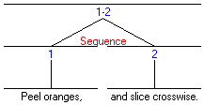
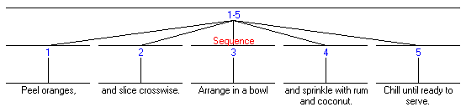
Paratactic (coordinate)
At the sub-sentential level (traditional coordinated clauses)
  Peel oranges, and slice crosswise.
But also across sentences
  1. Peel oranges, 2. and slice crosswise. 3. Arrange in a bowl 4. and sprinkle with rum and coconut. 5. Chill until ready to serve.

Slide 61
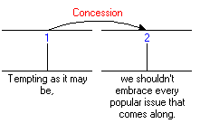
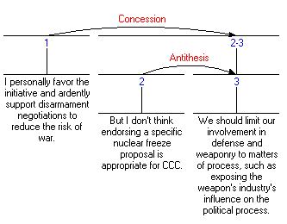
Hypotactic (subordinate)
Sub-sentential Concession relation
Concession across sentences
  Nucleus (spans 2-3) made up of two spans in an Antithesis relation

Slide 62
Relations
Hold between 2 non-overlapping text spans
Most hold between a nucleus and a satellite, although also multi-nuclear
Consisist of
  Constraints on the Nucleus
  Constraints on the Satellite
  Constraints on the combination of Nucleus & Satellite
  The Effect

Slide 63
Example: Evidence
Constraints on the Nucleus
  The reader may not believe N to a degree satisfactory to the writer
Constraints on the Satellite
  The reader believes S or will find it credible
Constraints on the combination of N+S
  The reader’s comprehending S increases their belief of N
Effect (the intention of the writer)
  The reader’s belief of N is increased
Assumes a written text and readers/writers; extensions for spoken language
Definitions of common relations available from the RST web site

Slide 64
Relation types
Subject matter: relate content of text spans
  Cause, Purpose, Condition, Summary
Presentational: more rhetorical in nature; meant to achieve some effect on the reader
  Motivation, Antithesis, Background, Evidence

Slide 65
Relation names (in M&T 1988)
Other classifications are possible, and longer / shorter lists have been proposed

Slide 66
Schemas
They specify how spans of text can co-occur, determining possible RST text structures

Slide 67
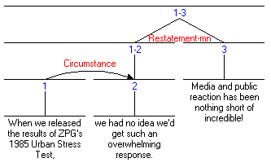
Graphical representation
A horizontal line covers a span of text (possibly made up of further spans
A vertical line signals the nucleus or nuclei
A curve represents a relation, and the direction of the arrow, the direction of satellite towards nucleus
RST tool (for drawing diagrams)
  http://www.wagsoft.com/RSTTool/

Slide 68
How to do an RST analysis
Divide the text into units
  Unit size may vary, depending on the goals of the analysis
  Typically, units are clauses
Examine each unit, and its neighbours. Is there a clear relation holding between them?
If yes, then mark that relation (e.g., Condition)
If not, the unit might be at the boundary of a higher-level relation. Look at relations holding between larger units (spans)
Continue until all the units in the text are accounted for
Remember, marking a relation involves satisfying all 4 fields (especially the Effect). The Effect is the plausible intention that the text creator had.

Slide 69
Some issues
Problems in identifying relations
  Judgments are plausibility judgments. Two analysts might differ in their analyses
Definitions of units
  Vary from researcher to researcher, depending on the level of granularity needed
Relations inventory
  Many available
  Each researcher tends to create their own, but large ones tend to be unmanageable

Slide 70
Applications
Writing research (more later!)
  How are coherent texts created
  RST as a training tool to write effective texts
Natural Language Generation
  Input: communicative goals and semantic representation
  Output: text
Rhetorical/discourse parsing (more later!)
  Rendering of a text in terms of rhetorical relations
  Using signals, mostly discourse markers
Corpus analysis
  Annotation of text with discourse relations (Carlson et al. 2002)
  Application to spoken language (Taboada 2004; references in Taboada and Mann 2006)
Relationship to other discourse phenomena
  Between nuclei and co-reference
For more applications (up to 2005 or so):
  Taboada, Maite and William C. Mann. (2006). Applications of Rhetorical Structure Theory. Discourse Studies, 8 (4), 567-588.

Slide 71
Exercise: Annotating Tree-Like Structures
We should tear the building down, because it is full of asbestos. In principle it is possible to clean it up, but according to the mayor that would be forbiddingly expensive.
  Constructed text from [Peldszus and Stede, 2013]

Slide 72
Answer: RST Analysis [Peldszus & Stede 2013]
Curved lines connect satellite to nucleus
  arrowhead points to nucleus, also indicated by vertical line
Horizontal lines demarcate larger segments
  fused from smaller segments

Slide 73
Other Approaches: Joint Modeling
The assumption that discourse has multiple structures that should be modelled jointly goes back to Grosz & Sidner [1986], who proposed three inter-connected structures for discourse
Example: Joint Functional Segmentation & Pred-Arg modelling
  The ART/CoreSC corpus contains fine-grained (sentence-level) functional annotation of core components of scientific investigations.
  www.aber.ac.uk/en/cs/research/cb/projects/art/art-corpus/

Slide 74
Computational Discourse: Summing Up
Current computational models of discourse structure are tied, more or less, to empirical data
  abstract topics and entity mentions
  conventionalized functions (genre examples)
  predicate-argument structures (e.g., PDTB)
  tree-like discourse structures (e.g., RST)
Since natural coherent discourse involves them all, joint modelling may lead to better understanding/models
As for modelling blog posts, tweets, . . . ???

Slide 75
Outline
Computational Discourse
    Topic and Entity Structures
    Functional structures
    Predicate-argument structures
    Tree-like structures
Resources
    Corpora
    Software
Evaluation
    Intrinsic versus Extrinsic
    Quantitative Metrics
Educational Case Studies
    Teaching Writing with Diagramming and Peer Review
    Automated Writing Assessment
Looking Forward

Slide 76
The Need for Annotated Corpora
Required for supervised machine learning
  Reliability / inter-rater agreement also desirable

Slide 77
Corpora with Discourse Annotations
Penn Discourse Treebank (PDTB) [Prasad et al. 2008]
  http://www.seas.upenn.edu/~pdtb/
    1 million words of Wall Street Journal (aligned with Penn Treebank)
    Annotated for discourse relations and their two arguments
    Distribution of relations in PDTB-2.0
    Distribution of sense tags (highest level of hierarchy)
Similar resources are being created for languages other than English

Slide 78
Corpora with Discourse Annotations
RST Discourse Treeback [Carlson et al., 2002, 2003]
  https://catalog.ldc.upenn.edu/LDC2002T07
    385 Wall Street Journal articles from the Penn Treebank

Slide 79
Outline
Computational Discourse
    Topic and Entity Structures
    Functional structures
    Predicate-argument structures
    Tree-like structures
Resources
    Corpora
    Software
Evaluation
    Intrinsic versus Extrinsic
    Quantitative Metrics
Educational Case Studies
    Teaching Writing with Diagramming and Peer Review
    Automated Writing Assessment
Looking Forward

Slide 80
Software Resources
Many general NLP resources (NLTK, Stanford, etc.)
  Potential features for detecting implicit relations
    e.g. can try to approximate “world knowledge” using lexical and structural features
Discourse-specific resources
  Typically trained on Wall Street Journal

Slide 81
Discourse Connectives Tagger
http://www.cis.upenn.edu/~epitler/discourse.html
Identifies explicit discourse connectives and senses (Expansion, Contingency, Comparison, Temporal) [Pitler & Nenkova, 2009]
  Input: the output of automatic parsers or gold-standard parses
  Output: syntactic trees augmented with tags indicating discourse connectives
  Disambiguates discourse and non-discourse usages:
    John likes to run marathons, and ran 10 last year alone. (Expansion)
    My favorite colors are blue and green. (Non-discourse)
  Disambiguates (PDTB) discourse senses:
    They have not spoken to each other since they saw each other last fall. (Temporal)
    I assumed you were not coming since you never replied to the invitation. (Contingency/Causal)
+ Genre-neutral applicability
- Not all discourse relations are explicitly marked

Slide 82
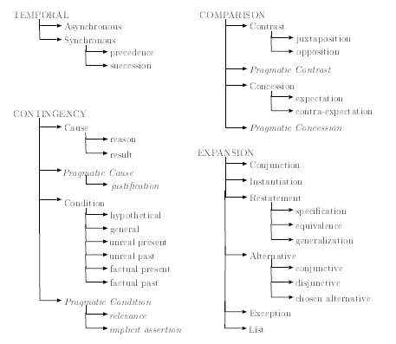
Hierarchy of Sense Tags

Slide 83
Human (h) vs. Discourse Connectives Tagger (d)
1h: Some have raised their cash positions to record levels. Implicit=BECAUSE (causal/contingency) High cash positions help buffer a fund when the market falls.
1d: Some have raised their cash positions to record levels. High cash positions help buffer a fund when (temporal) the market falls. WRONG
2h: Jacobs is an international engineering and construction concern. NoRel Total capital investment at the site could be as much as $400 million, according to Intel.
2d: Jacobs is an international engineering and construction concern. Total capital investment at the site could be as much as $400 million, according to Intel. CORRECT
3h: It was a far safer deal for lenders since (causal/contingency) NWA had a healthier cash flow and more collateral on hand.
3d: It was a far safer deal for lenders since (contingency) NWA had a healthier cash flow and more collateral on hand. CORRECT
4h: Domestic car sales have plunged 19% since (causal/contingency and temporal) the Big Three ended many of their programs Sept. 30.
4d: Domestic car sales have plunged 19% since (contingency) the Big Three ended many of their programs Sept. 30. PARTIALLY CORRECT

Slide 84
A PDTB-Styled Discourse Parser
http://wing.comp.nus.edu.sg/~linzihen/parser/
Sequential pipeline includes a connective classifier, argument labeler, explicit classifier, non-explicit classifier, and attribution span labeler [Lin et al., 2014]

Slide 85
Human vs. PDTB Parser
connective, Arg1, Arg2
3h. It was a far safer deal for lenders since NWA had a healthier cash flow and more collateral on hand. (causal)
3d. It was a far safer deal for lenders since NWA had a healthier cash flow and more collateral on hand. (asynchronous/temporal) arg 1 span and connective sense are wrong
4h. Domestic car sales have plunged 19% since the Big Three ended many of their programs Sept. 30. (causal and temporal)
4d. Domestic car sales have plunged 19% since the Big Three ended many of their programs Sept. 30. (asynchronous/temporal) missing connective sense

Slide 86
A RST-Style Discourse Parser
http://www.cs.toronto.edu/~weifeng/software.html
[Feng and Hirst, 2012]

Slide 87
Human vs. Computer RST Analysis
Computer postulates 5 rather than 4 elementary discourse units, due to:
In principle
it is possible to clean it up,
Differences in relation identification too:
Explanation (includes Evidence), rather than first Evidence
Elaboration, rather than second Evidence (and nucleus span is bigger)
Contrast rather than Antithesis

Slide 88
Human RST vs. Discourse Connectives Tagger
We should tear the building down, because (contingency) it is full of asbestos. In principle it is possible to clean it up, but (comparison) according to the mayor that would be forbiddingly expensive.

Slide 89
Human RST vs. PDTB Parser
We should tear the building down, because (cause/contingency) it is full of asbestos.
We should tear the building down, because it is full of asbestos. Implicit (cause/contingency) In principle it is possible to clean it up, but according to the mayor that would be forbiddingly expensive.

Slide 90
Discourse Connectives vs. PDTB Parser
Discourse Connectives Tagger
We should tear the building down, because (contingency) it is full of asbestos. In principle it is possible to clean it up, but (comparison) according to the mayor that would be forbiddingly expensive.
PDTB Discourse Parser: connective, Arg1, Arg2
We should tear the building down, because (cause/contingency) it is full of asbestos.
We should tear the building down, because it is full of asbestos. Implicit (cause/contingency) In principle it is possible to clean it up, but according to the mayor that would be forbiddingly expensive.

Slide 91
Outline
Computational Discourse
    Topic and Entity Structures
    Functional structures
    Predicate-argument structures
    Tree-like structures
Resources
    Corpora
    Software
Evaluation
    Intrinsic versus Extrinsic
    Quantitative Metrics
Educational Case Studies
    Teaching Writing with Diagramming and Peer Review
    Automated Writing Assessment
Looking Forward

Slide 92
Evaluation
Standard data-driven method
  Train model on a training set
  Look at the model’s performance on some new data
    This is exactly what happens in the real world; we want to know how our model performs on data we haven’t seen
  So use a test set. A dataset which is different than our training set, but is drawn from the same source
    Cross-validation when training + testing corpora are small
  Then we need an evaluation metric to tell us how well our model is doing on the test set.

Slide 93

Quantifying Classification Performance
            Confusion Matrix
Accuracy:
  $\frac{(tp+tn)}{(tp+tn+fp+fn)}$
Precision: % of predicted labels that are correct
  $\frac{tp}{(tp+fp)}$
Recall: % of actual labels that are predicted
  $\frac{tp}{(tp+fn)}$
F-Measure (F₁ score is balanced): Harmonic mean
  2 * $\frac{(precision ∗recall)}{(precision+recall)}$
 | Claim (actual) | Other (actual)
Claim (predicted) | True positive (tp) | False positive (fp)
Other (predicted) | False negative (fn) | True negative (tn)

Slide 94
Intrinsic (in vivo) Evaluation
The predicted values are compared with a manually coded “Gold Standard” (the actual values)
  They may also be compared with the predictions from a baseline model (e.g. majority class prediction)
100% is impossible even for human annotators

Slide 95
Inter-Annotator Reliability
Kappa
  Observed accuracy (actual agreement) corrected for chance (expected agreement)
  (P(A) – P(E) ) / (1 – P(E))
  Online calculators
    E.g., http://vassarstats.net/kappa.html

Slide 96
Extrinsic (in vitro) Evaluation
Incorporate the prediction model in another system, and evaluate that system’s performance

Slide 97
Exercise: Intrinsic Evaluation
 | Claim (actual) | Other (actual)
Claim (predicted) | 29 | 4
Other (predicted) | 41 | 32
Model: Accuracy
Baseline : Accuracy
Claim: Precision, Recall
Other: Precision, Recall
Unweighted Avg. Precision, Recall

Slide 98
Answer: Instrinsic Evaluation
 | Claim (actual) | Other (actual)
Claim (predicted) | 29 | 4
Other (predicted) | 41 | 32
Model: Accuracy = .58, Kappa = .24
Baseline : Accuracy = .66, Kappa = 0
Claim: Precision = .88, Recall =. 41, F = .56
Other: Precision = .44, Recall = .89, F = .59
Unweighted Avg. Precision = .66, Recall = .65, F = .58

Slide 99
Error Analysis
Look at the confusion matrix
See what errors are causing problems

Slide 100
Outline
Computational Discourse
    Topic and Entity Structures
    Functional structures
    Predicate-argument structures
    Tree-like structures
Resources
    Corpora
    Software
Evaluation
    Intrinsic versus Extrinsic
    Quantitative Metrics
Educational Case Studies
    Teaching Writing with Diagramming and Peer Review
    Automated Writing Assessment
Looking Forward

Slide 101
ArgumentPeer Project
Phase I: Argument
Diagramming
Author creates Argument Diagram
Peers review Argument Diagrams
Author revises Argument Diagram
Author writes paper
Peers review papers
Author revises paper
Phase II: Writing

Slide 102
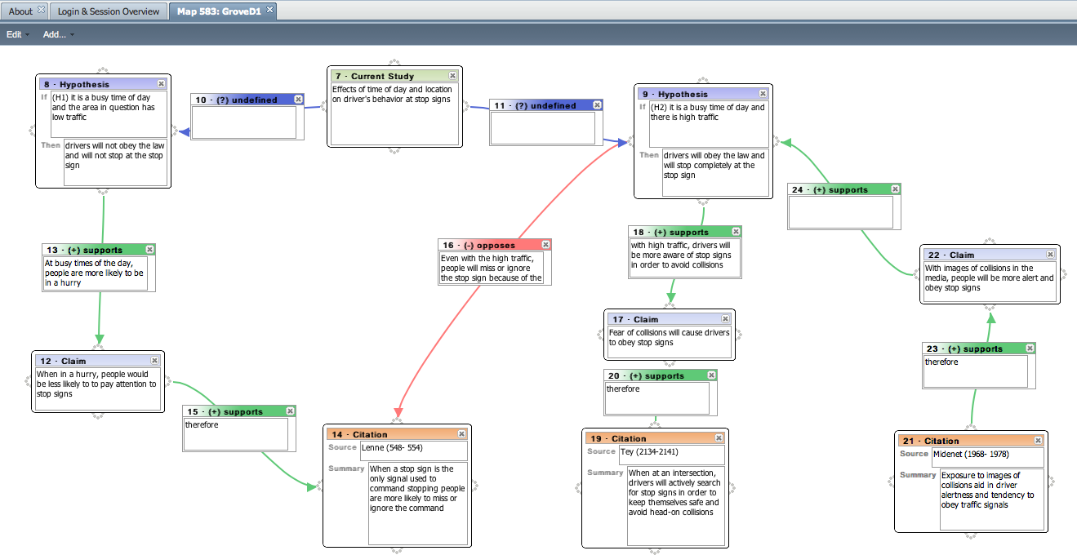
Example Student Argument Diagram
(input via the LASAD system [Pinkwart et al.])
Notes:
very few citations
many explanations for support relationships are incomplete
provided opposition was not explicitly resolved (i.e., why are the supportive bits of evidence for the second
hypothesis stronger than the opposing evidence?).

Slide 103
Ontology-Based Argument Mining and Automatic Essay Scoring
[Ong, Litman, Brusilovsky, 2014]
System recognizes diagram ontology in essays
System scores essays using recognized ontology

Slide 104
Ontology-Based Argument Mining and Automatic Essay Scoring
[Ong, Litman, Brusilovsky, 2014]
System recognizes diagram ontology in essays
System scores essays using recognized ontology
How can we formalize this research in terms of computational discourse?
  What NLP theories/tools could we use?
  How does our data or application add constraints?

Slide 105
Ontology-Based Argument Mining and Automatic Essay Scoring
[Ong, Litman, Brusilovsky, 2014]
System recognizes diagram ontology in essays
System scores essays using recognized ontology
What corpus resources do we need?
How do we evaluate them?

Slide 106
Ontology-Based Argument Mining and Automatic Essay Scoring
[Ong, Litman, Brusilovsky, 2014]
System recognizes diagram ontology in essays
System scores essays using recognized ontology
How can we evaluate argument mining technology?
  Intrinsic
  Extrinsic

Slide 107
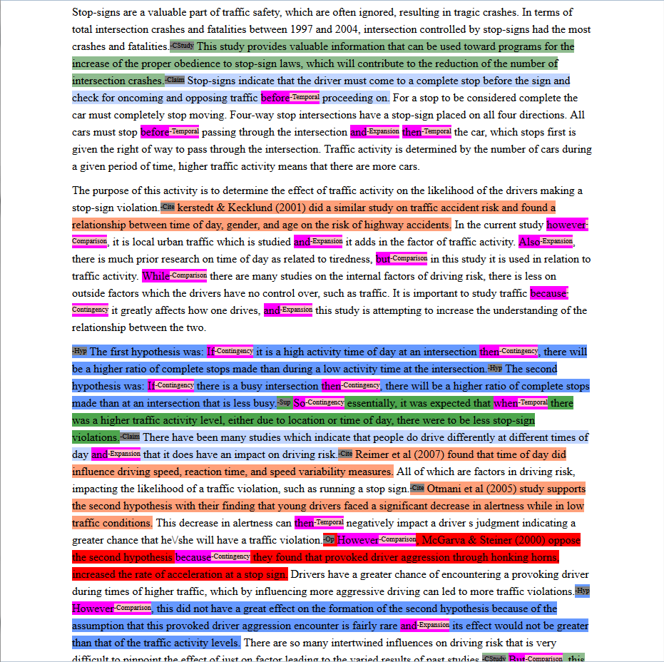
Our
Argument
Mining I/O
Current Study •
Claim •
Citation •
Hypothesis •
Supports •
Opposes •
Notes:
Expert score 3 out of 5, 5 is max, 0 is min, integer values only

Slide 108
Essay Processing Pipeline
Discourse Processing
  Tag essays with discourse connectives software
Argument Ontology Mining
  Tag essays with diagram ontology elements
    Rule-based algorithm
Ontology-Based Scoring
  Use the mined argument to score the essays
    Rule-based algorithm

Slide 109
Extrinsic Evaluation
Do automatically generated scores correlate with expert scores ?
  Yes, for ranking: number of automatically generated tags for diagram elements are positively correlated with expert score

Slide 110
Current Argument Mining Directions
More discourse (e.g. PDTB, RST parsers)
Intrinsic evaluation
  1533 annotated sentences from 60 essays

Slide 111
ArgumentPeer Project
Phase I: Argument
Diagramming
Author creates Argument Diagra
Peers review Argument Diagrams
Author revises Argument Diagram
Author writes paper
AI: Guides reviewing
Peers review papers
Author revises paper
Phase II: Writing

Slide 112
SWoRD: A web-based peer review system
[Cho & Schunn, 2007]
Authors submit papers (or diagrams)
Peers submit reviews
  Problem: no discussion of thesis statements
  Our Approach: detect and scaffold

Slide 113
Identifying Thesis and Conclusion Statements in Student Essays to Scaffold Peer Review
[Falakmasir, Ashley, Schunn, Litman 2014]
Can natural language processing (NLP) detect presence/absence of thesis and conclusion sentences in essays in order to guide peer review?

Slide 114
Identifying Thesis and Conclusion Statements in Student Essays to Scaffold Peer Review
[Falakmasir, Ashley, Schunn, Litman 2014]
Can natural language processing (NLP) detect presence/absence of thesis and conclusion sentences in essays in order to guide peer review?
How can we formalize this research in terms of computational discourse?

Slide 115
Identifying Thesis and Conclusion Statements in Student Essays to Scaffold Peer Review
[Falakmasir, Ashley, Schunn, Litman 2014]
Can natural language processing (NLP) detect presence/absence of thesis and conclusion sentences in essays in order to guide peer review?
How can we formalize this research in terms of computational discourse?
  Segmentation: sentences
  Segment classification: probability of being thesis…

Slide 116
Identifying Thesis and Conclusion Statements in Student Essays to Scaffold Peer Review
[Falakmasir, Ashley, Schunn, Litman 2014]
Can natural language processing (NLP) detect presence/absence of thesis and conclusion sentences in essays in order to guide peer review?
What corpus resources do we need?
How do we evaluate them?
What NLP/theories tools could we use?
How does our data or application add constraints?
How can we do intrinsic or extrinsic evaluations?

Slide 117
Features for Machine Learning
3 feature sets inspired by [Burstein et al. 2003]
  Positional: paragraph number, sentence number in the paragraph, type of paragraph (first, body, last)
  Sentence Level: syntactic, semantic, frequent words
  Essay Level: number of keywords among the most frequent words of the essay, number of words overlapping with the assignment prompt, and a sentence importance score based on Rhetorical Structure Theory
Notes:
We used an iterative process to find the most predictive features for identifying thesis and conclusion statements. Starting with 42 basic computational
linguistic features inspired by (Burstein et al. 2003), such as positional, syntactic, and cue term features, we used several feature selection algorithms to select the most predictive features. We tried different combinations of the predictive features and also added some semantic and rhetorical structure features to improve the model’s accuracy. Since our training set was fairly small, we also tried bootstrapped sampling and finally, we picked 19 features in three categories that were most predictive.

Slide 118
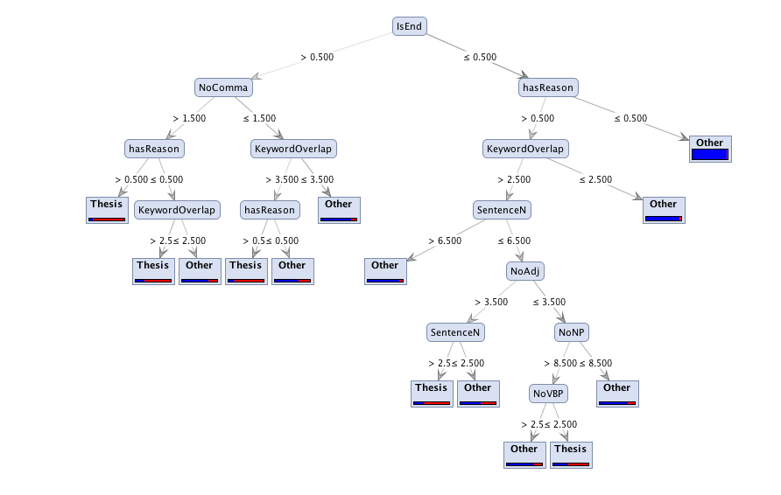
Example Thesis Prediction Model
We trained 3 classifiers:
  Naïve Bayes
  Decision Tree
  Support Vector Machine (SVM)
Notes:
We used 3 different classifiers in order to build our model: Naïve Bayes, Decision Tree, and Support Vector Machine (SVM). We also used the same positional base line as (Burstein et al.) in order to compare the results with their model.
We used 10-fold essay stratified cross validation in order to evaluate our models on the sentence level. In order to evaluate the models on the essay level, we aggregated the results of the sentence level model in order to predict whether an essay contains a thesis/conclusion statement or not. This figure shows the Decision Tree model for predicting thesis statements.

Slide 119
Intrinsic Evaluation
Unseen test set
Even with a small training corpus, NLP features can classify core argument segments of essays better than the baseline

Slide 120
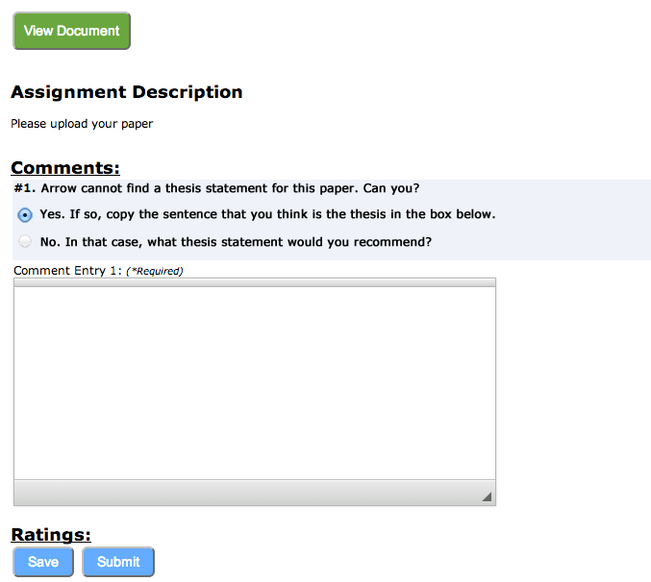
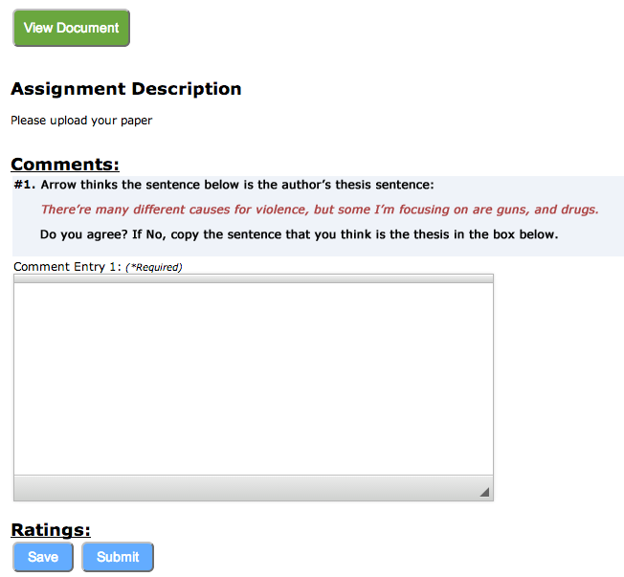
Extrinsic Evaluation: Impact of Scaffolding During Peer Review
When argument mining cannot find a thesis sentence, the first peer review prompt is:
When argument mining identifies a thesis sentence, the first peer review prompt is:

Slide 121
Outline
Computational Discourse
    Topic and Entity Structures
    Functional structures
    Predicate-argument structures
    Tree-like structures
Resources
    Corpora
    Software
Evaluation
    Intrinsic versus Extrinsic
    Quantitative Metrics
Educational Case Studies
    Teaching Writing with Diagramming and Peer Review
    Automated Writing Assessment
Looking Forward

Slide 122
Automatic Scoring of an Analytical
Response-To-Text Assessment (RTA)
[Rahimi, Litman, Correnti, Matsumura, Wang & Kisa, 2014]
Writing assessment via interpretable features that operationalize the Evidence rubric of RTA

Slide 123
Rubric for the Evidence dimension of RTA
1 | 2 | 3 | 4
Features one or no pieces of evidence | Features at least 2 pieces of evidence | Features at least 3 pieces of evidence | Features at least 3 pieces of evidence
Selects inappropriate or little evidence from the text; may have serious factual errors and omissions | Selects some appropriate but general evidence from the text; may contain a factual error or omission | Selects appropriate and concrete, specific evidence from the text | Selects detailed, precise, and significant evidence from the text
Demonstrates little or no development or use of selected evidence | Demonstrates limited development or use of selected evidence | Demonstrates use of selected details from the text to support key idea | Demonstrates integral use of selected details from the text to support and extend key idea
Summarize entire text or copies heavily from text | Evidence provided may be listed in a sentence, not expanded upon | Attempts to elaborate upon Evidence | Evidence must be used to support key idea / inference(s)

Slide 124
Automatic Scoring of an Analytical
Response-To-Text Assessment (RTA)
[Rahimi, Litman, Correnti, Matsumura, Wang & Kisa, 2014]
Writing assessment via interpretable features that operationalize the Evidence rubric of RTA
  Problem formalization in terms of computational discourse?
  What corpus resources do we need?
  How do we evaluate them?
  What NLP theories/tools could we use?
  How does our data or application add constraints?
  How can we do intrinsic or extrinsic evaluations?

Slide 125
Prompt and Good Essay
Prompt: Did the author provide a convincing argument that winning the fight against poverty is achievable in our lifetime? Explain why or why not with 3-4 examples from the text to support your answer.
Example Essay, Score of 4 on Evidence dimension: I was convinced that winning the fight of poverty is achievable in our lifetime. Many people couldn't afford medicine or bed nets to be treated for malaria . Many children had died from this dieseuse even though it could be treated easily. But now, bed nets are used in every sleeping site . And the medicine is free of charge. Another example is that the farmers' crops are dying because they could not afford the nessacary fertilizer and irrigation . But they are now, making progess. Farmers now have fertilizer and water to give to the crops. Also with seeds and the proper tools . Third, kids in Sauri were not well educated. Many families couldn't afford school . Even at school there was no lunch . Students were exhausted from each day of school. Now, school is free . Children excited to learn now can and they do have midday meals . Finally, Sauri is making great progress. If they keep it up that city will no longer be in poverty. Then the Millennium Village project can move on to help other countries in need.
Word windows containing evidence are highlighted

Slide 126
Automatic Scoring Approach
Experts derive a decision tree from the rubric
Define features based on the tree and extract them from the essays
Perform a supervised classification using the extracted features
Experts derive a decision tree from the rubric
Define some features based on the tree and extract them from the essays
Perform a supervised classification using extracted features

Slide 127
Extrinsic Evaluation
Proposed features outperform both baselines
Absolute performance improves on less noisy data

Slide 128
Outline
Computational Discourse
    Topic and Entity Structures
    Functional structures
    Predicate-argument structures
    Tree-like structures
Resources
    Corpora
    Software
Evaluation
    Intrinsic versus Extrinsic
    Quantitative Metrics
Educational Case Studies
    Teaching Writing with Diagramming and Peer Review
    Automated Writing Assessment
Looking Forward

Slide 129
Open Challenges
Annotation Schemes and Annotated Corpora
Enabling NLP and Discourse Technology
Human Annotation versus Computer Analysis
  Genre-Neutral vs. Genre-Specific Features & Methods
  Fine-Grained vs. Coarse-Grained Annotations

Slide 130
References
Azar, M. (1999). Argumentative text as rhetorical structure: An application of rhetorical structure theory. Argumentation, 13, 97-114.
Budzynska, K., Janier, M. , Reed, C., Saint-Dizier, P., Stede, M. & Yakorska, O. (2014). A model for processing illocutionary structures and argumentation in debates. In: Proc. of LREC, Reykavik.
Burstein, J., Marcu, D. & Knight, K. (2003). Finding the WRITE stuff: Automatic identification of discourse structure in student essays. IEEE Intelligent Systems: Special Issue on Advances in NLP, 18:32–39.
Carlson, L., Marcu, D. & Okurowski, M.E. (2002). RST discourse treebank, LDC2002T07 [Corpus]. Philadelphia, PA: Linguistic Data Consortium.
Carlson, L., Marcu, D., & Okurowski, M. E. (2003). Building a discourse-tagged corpus in the framework of rhetorical structure theory (pp. 85-112). Springer Netherlands.
Cho, K. & Schunn, C.D. (2007). Scaffolded writing and rewriting in the discipline: A web-based reciprocal peer review system. Computers and Education, 48.
Falakmasir, M. H, Ashley, K. D, Schunn, C. D. & Litman, D. J. (2014). Identifying thesis and conclusion statements in student essays to scaffold peer review. In Proceedings 12th International Conference on Intelligent Tutoring Systems, Honolulu, HI.
Feng, V. W., & Hirst, G. (2011). Classifying arguments by scheme. In Proceedings 49th ACL, Portland, OR, 987-996.
Feng, V. W., & Hirst, G. (2012). Text-level discourse parsing with rich linguistic features. In Proceedings 50th ACL, Jeju, Korea, 60-68.
Green, N. L. (2010). Representation of argumentation in text with rhetorical structure theory. Argumentation, 24, 181-196.
Grosz, B. J. Sidner, C. L. (1986). Attention, intentions, and the structure of discourse. Computational Linguistics 12, 3, 175-204.
Hirohata, K., Okazaki, N., Ananiadou, S. & Ishizuka, M. (2008). Identifying sections in scientific abstracts using conditional random fields. In Proc. 3rd Int’l Joint Conf. on Natural Language Processing, 381–388.
Lee, A., Prasad, R., Joshi, A., Dinesh, N. & Webber, B. (2006). Complexity of dependencies in discourse. In Proc. 5th Int’l Workshop on Treebanks and Linguistic Theories, Prague.
Lin, Z., Ng, H. T., & Kan, M. (2014). A PDTB-Styled End-to-End Discourse Parser. Natural Language Engineering, 20, 51-184.
Madnani, N., Heilman, M., Tetrault, J. & Chodorow, M. (2012). Identifying high-level organizational elements in argumentative discourse. In Proceedings NAACL-HLT, 20–28, Montreal, Quebec, Canada.
Mann, W. C. & Thompson, S. A. (1988). Rhetorical Structure Theory: Toward a functional theory of text organization. Text, 8 (3), 243-281.
Ong, N., Litman, D & Brusilovsky, A. (2014). Ontology-based argument mining and automatic essay scoring. In Proceedings of the 1st ACL Workshop on Argumentation Mining, Baltimore, MD.
Oza, U., Prasad, R., Kolachina, S., Sharma, D. M., & Joshi, A. (2009). The Hindi Discourse Relation Bank. In Proc. 3rd Linguistic Annotation Workshop, Singapore.

Slide 131
References
Palau, M . & Moens, M. F. (2009). Argumentation mining: The detection, classification and structure of arguments in text. In Proceedings of the ICAIL, Barcelona, Spain, 98-109.
Peldszus, A. & Stede, M. (2013). From argument diagrams to argumentation mining in texts: A survey. International Journal of Cognitive Informatics and Natural Intelligence, 7(1), 1-31.
Pinkwart, N., Ashley, K., Aleven, V. & Lynch, C. (2008). Graph Grammars: an ITS Technology for Diagram Representations. In Proceedings of The 21st International FLAIRS Conference, Special Track on Intelligent Tutoring Systems, 433-438.
Pitler, E. & Nenkova, A. (2009). Using Syntax to Disambiguate Explicit Discourse Connectives in Text. In Proceedings of ACL.
Prasad, R., Dinesh, N., Lee, A., Miltsakaki, E., Robaldo, L., Joshi, A. & Webber, B. (2008). The Penn Discourse TreeBank 2.0. In Proc. 6th Int’l Conference on Language Resources and Evaluation, Marrakech, Morocco.
Rahimi, Z., Litman, D., Correnti, R, Matsumura, L. C, Wang, E. & Kisa, Z. (2014). Automatic scoring of an analytical Response-To-Text assessment, In Proceedings 12th International Conference on Intelligent Tutoring Systems, 601-610, Honolulu, HI.
Reed, C. (2005). Preliminary Results from an Argument Corpus. In Proceedings of the IX Symposium on Social Communication, Santiago de Cuba, pp5 76-580.
Saint-Dizier, P. (2012). Processing natural language arguments with the TextCoop platform. Journal of Argumentation and Computation, 3(1), 49-82.
Stab, C. & Gurevych, I. (2014). Annotating argument components and relations in persuasive essays. In Proceedings of the the 25th International Conference on Computational Linguistics, Dublin.
Stab, C. & Gurevych, I. (2014, to appear) Identifying Argumentative Discourse Structures in Persuasive Essays. In Proceedings Conference on Empirical Methods in Natural Language Processing.
Taboada, M. (2004). Building Coherence and Cohesion: Task-Oriented Dialogue in English and Spanish. Amsterdam and Philadelphia: John Benjamins.
Taboada, M. & Mann, W. C. (2006a). Applications of Rhetorical Structure Theory. Discourse Studies, 8 (4), 567-588.
Taboada, M. & Mann, W. C. (2006b). Rhetorical Structure Theory: Looking back and moving ahead. Discourse Studies, 8 (3), 423-459.
Teufel, S. & Moens, M. (2002). Summarizing scientific articles – experiments with relevance and rhetorical status. Computational Linguistics, 28(4), 409-445.

Slide 132
Final Questions?

