Slide 1



Natural Language Processing and Applications in Education
Diane Litman
Professor, Computer Science Department
Co-Director, Intelligent Systems Program
Senior Scientist, Learning Research & Development Center
University of Pittsburgh
Pittsburgh, PA USA
Notes:
Based on JHU16

Slide 2
Natural Language Processing (NLP)
Getting computers to perform useful and interesting tasks involving human languages
  languages such as English, Spanish, Chinese, etc.
  as opposed to computer languages such as Python

Slide 3
Why is NLP needed?
  An enormous amount of machine readable text, audio, and video is now available
  Conversational agents such as Siri and Alexa are becoming an important form of human-computer communication

Slide 4
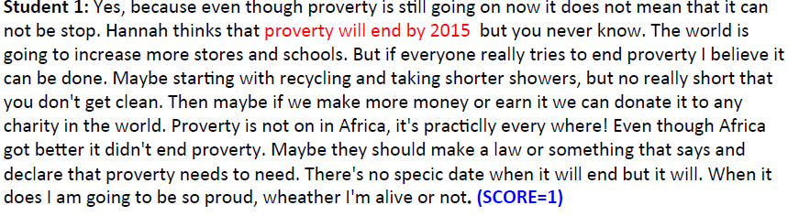
Roles for Language Processing in Education
Learning Language
(e.g., reading, writing, speaking)
Automatic Essay Grading

Slide 5
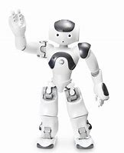

Roles for Language Processing in Education
Using Language
(e.g., teaching in the disciplines)
Dialogue Systems for STEM

Slide 6
Roles for Language Processing in Education
Using Language
(e.g., teaching in the disciplines)
Classroom Discussion Dashboard
 | Student Talk | Specificity
S1 | Some people they just ask for a job is just like, some money. | Low
S1 | It's like, I think she already knew that they weren't going to get it, but she, she couldn't do anything except just encourage them cause that's the only thing, like she [xx]. That's why she kinda supported it, but she already knew that they weren't going to get it. | Medium
S2 | She was already talking about how she didn't think that they were going to get it. | Medium

Slide 7
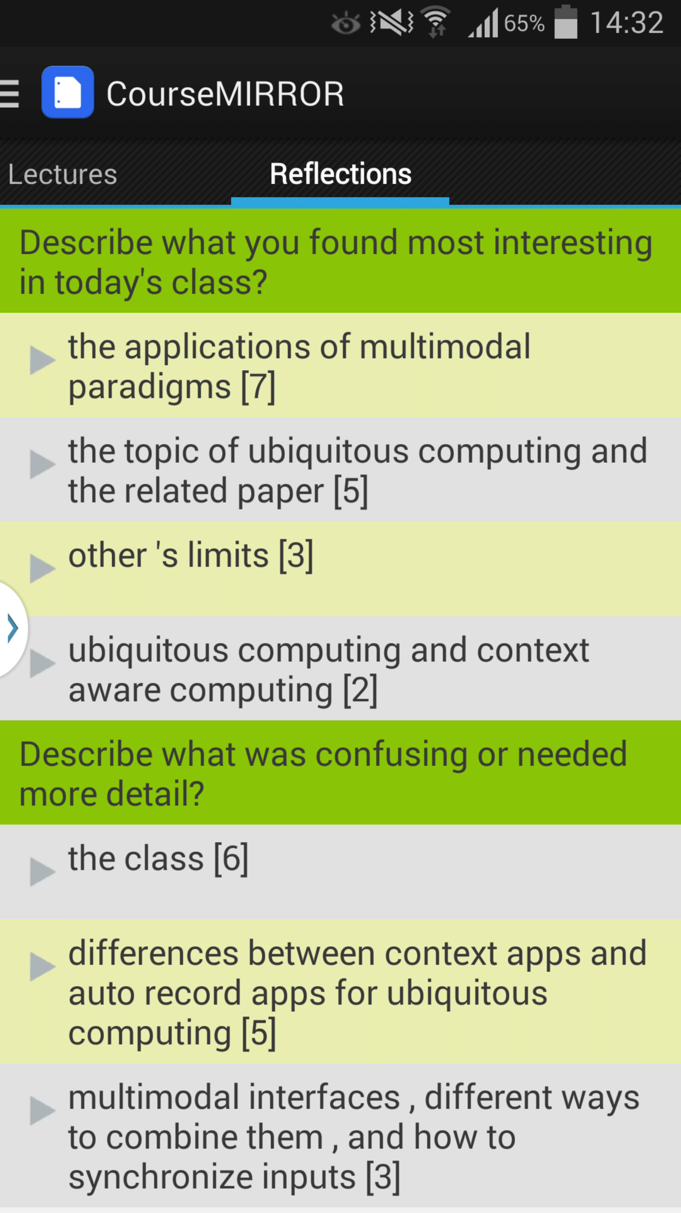
Roles for Language Processing in Education
Processing Language
Summarizing Student Reflections

Slide 8






PETAL (Pitt Educational Technology And Language) Lab
Learning Language Using Language Processing Language
Haoran Zhang (5th year) Luca Lugini (6th year) Luca Lugini (6th year)
Tazin Afrin (5th year) Mingzhi Yu (4th year) Ahmed Magooda (4th year)
Ravneet Singh (2nd year)

Slide 9
NLP for Education Research Lifecycle
Systems and Evaluations
Real-World
Problems
Learning and Teaching
Higher Level Learning Processes
NLP-Based Educational Technology
Challenges!
User-generated content
Meaningful constructs
Real-time performance
Theoretical and Empirical Foundations

Slide 10
Today’s Talk:
Learning Language
Argumentative Writing / Argument Mining
Algorithms for Argument Mining
Applications in Automated Writing Assessment
Summary and Current Directions

Slide 11
Research Question
Can argument mining be used to better teach, assess, and understand argumentative text and speech?
Approach: Technology design and evaluation
  System enhancements that improve student learning
  Argument analytics for teachers
  Experimental platforms to test research predictions

Slide 12
Argument Mining
“… exploits the techniques and methods of natural language processing … for semi-automatic and automatic recognition and extraction of structured argument data from unstructured … texts.” [SICSA Workshop on Argument Mining, July 2014]

Slide 13
Mining a Grade School Text-Based Essay for Evidence
I was convinced that winning the fight of poverty is achievable in our lifetime. Many people couldn't afford medicine or bed nets to be treated for malaria . Many children had died from this dieseuse even though it could be treated easily. But now, bed nets are used in every sleeping site . And the medicine is free of charge. Another example is that the farmers' crops are dying because they could not afford the nessacary fertilizer and irrigation . But they are now, making progess. Farmers now have fertilizer and water to give to the crops. Also with seeds and the proper tools . Third, kids in Sauri were not well educated. Many families couldn't afford school . Even at school there was no lunch . Students were exhausted from each day of school. Now, school is free . Children excited to learn now can and they do have midday meals . Finally, Sauri is making great progress. If they keep it up that city will no longer be in poverty. Then the Millennium Village project can move on to help other countries in need.

Slide 14
Mining a College Essay for Claims, Premises and their Support/Attack Relations
⁽¹⁾[Taking care of thousands of citizens who suffer from disease or illiteracy is more urgent and pragmatic than building theaters or sports stadiums]_{Claim}.
⁽²⁾As a matter of fact, [an uneducated person may barely appreciate musicals]_{Premise}, whereas [a physical damaged person, resulting from the lack of medical treatment, may no longer participate in any sports games]_{Premise}. ⁽³⁾Therefore, [providing education and medical care is more essential and prioritized to the government]_{Claim}.
Claim(1)
Premise(2.1) supports Claim(1)
Premise(2.1) supports Claim(3)
Premise(2.2) supports Claim(1)
Premise(2.2) supports Claim(3)
Claim(3) supports Claim(1)
Claim(3)
Premise (2.1)
Premise (2.2)

Slide 15
Mining a High School Text-Based Classroom Discussion for Claim, Evidence, Warrants
Student | Transcript | Component
S1 | She’s like really just protecting Willy from everything | claim
 | Like at the end of the book remember how she was telling the kids to leave and never come back | evidence
 | Like she’s not even caring about them, she’s carying about Willy. | warrant
S2 | It’s like she’s concerned with him trying to … | claim

Slide 16
Argument Mining Subtasks
[Peldszus and Stede, 2013]
Scope of today’s talk
Even partial argument mining can support useful applications

Slide 17
Today’s Talk:
Learning Language
Argumentative Writing / Argument Mining
Algorithms for Argument Mining
Applications in Automated Writing Assessment
Summary and Current Directions

Slide 18

Why Automatic Writing Assessment?
Essential for Massive Open Online Courses (MOOCs) and tutoring systems
Even in traditional classes, frequent assignments can limit the amount of teacher feedback
Notes:
The first question is that you may ask is why Automatic Essay Assessment is important.
Well, in order to Score and provide feedback on written assignments in Tutoring systems and MOOCs, it is essential to have reliable AES systems. Even in class rooms with large number of students and frequent writing assignments, Providing individual feedback to students is a burden and a very time consuming task for teatures.
Consider the capitalization

Slide 19
Using Natural Language Processing for Scoring Writing and Providing Feedback At-Scale
IES Grant w. Rip Correnti and Lindsay Clare Matsumara
Initial work
  Summative writing assessment via meaningful features that operationalize the Evidence and Organization rubrics of RTA
Current work
  Formative assessment for students and teachers
Argument mining subtasks
  segmentation: spans of text
  segment classification: evidence from text (or not)

Slide 20
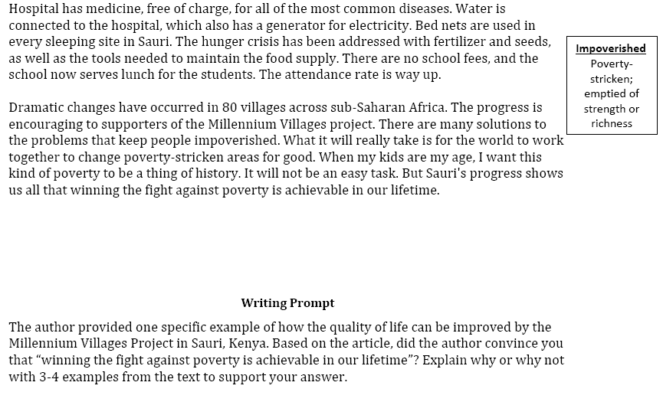
An Example Writing Assessment Task: Response to Text (RTA)
MVP, Time for Kids – informational text

Slide 21
Evidence Assessment via Argument Mining
Summative: SCORE=4
I was convinced that winning the fight of poverty is achievable in our lifetime. Many people couldn't afford medicine or bed nets to be treated for malaria . Many children had died from this dieseuse even though it could be treated easily. But now, bed nets are used in every sleeping site . And the medicine is free of charge. Another example is that the farmers' crops are dying because they could not afford the nessacary fertilizer and irrigation . But they are now, making progess. Farmers now have fertilizer and water to give to the crops. Also with seeds and the proper tools . Third, kids in Sauri were not well educated. Many families couldn't afford school . Even at school there was no lunch . Students were exhausted from each day of school. Now, school is free . Children excited to learn now can and they do have midday meals . Finally, Sauri is making great progress. If they keep it up that city will no longer be in poverty. Then the Millennium Village project can move on to help other countries in need.
Formative: Elaborate: Give a detailed and clear explanation of how the evidence supports your argument.

Slide 22
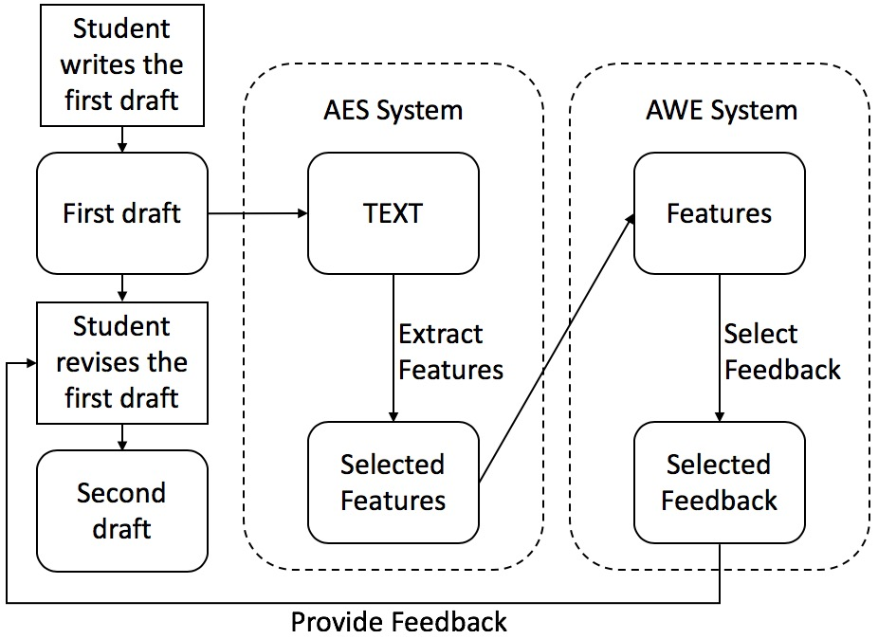
eRevise: System Usage & Architecture

Slide 23
eRevise: System Usage & Architecture

Slide 24
eRevise: System Usage & ArchitectUre

Slide 25
eRevise: System Usage & Architecture

Slide 26
eRevise: System Usage & Architecture

Slide 27
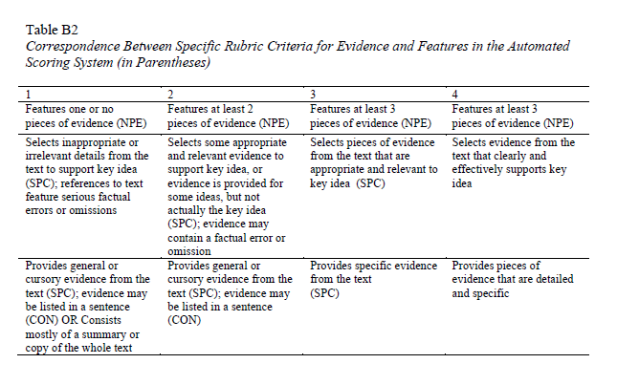
Automated Essay Scoring (AES)
[Rahimi, Litman et al., 2017]
(

Slide 28
An Alternative Approach
[Zhang & Litman, 2018]
eRevise uses this rubric-based AES system
  Enhanced via word-embeddings [Zhang & Litman, 2017]
  Requires education experts to pre-encode knowledge of the source article
  Requires computer science experts to handcraft predictive features for AES
We have also developed a co-attention-based neural network for source-dependent AES
  Increases reliability (not sure about validity)
  Eliminates human source encoding and feature engineering

Slide 29
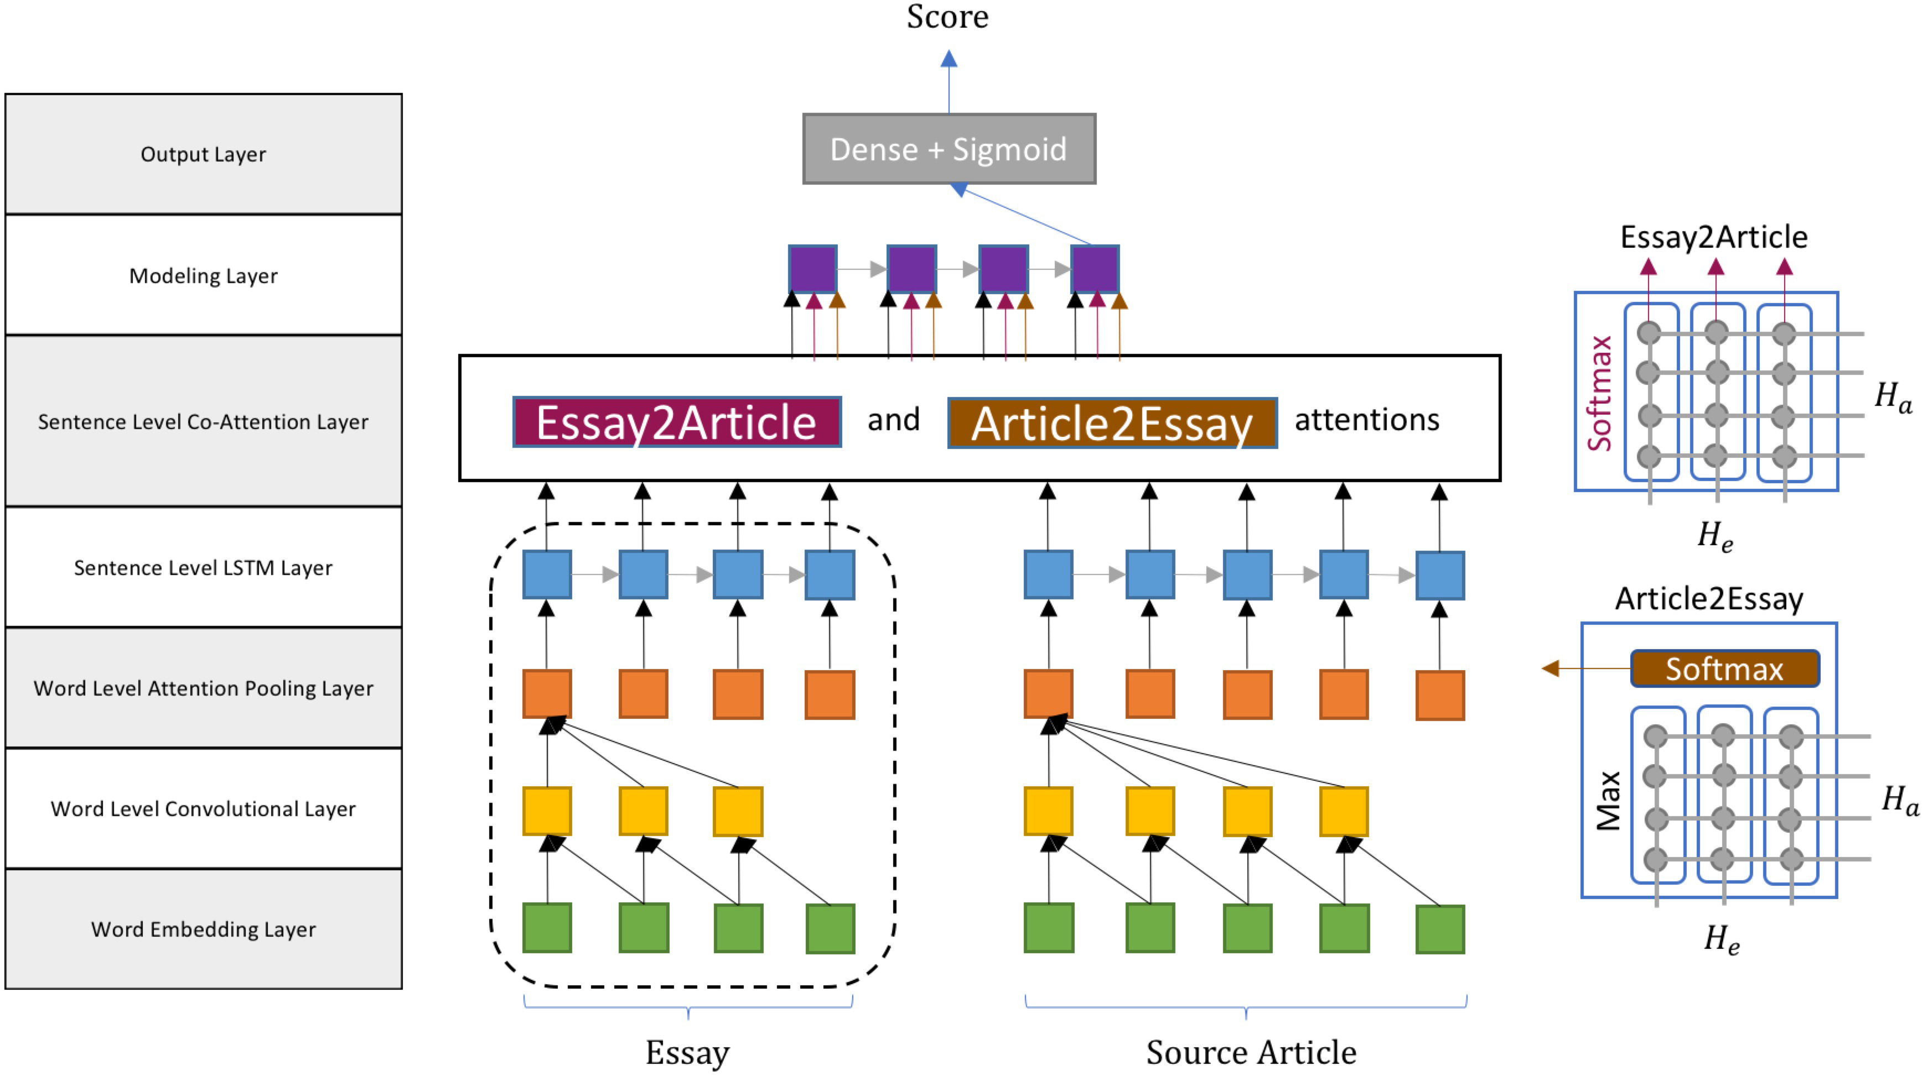

Slide 30
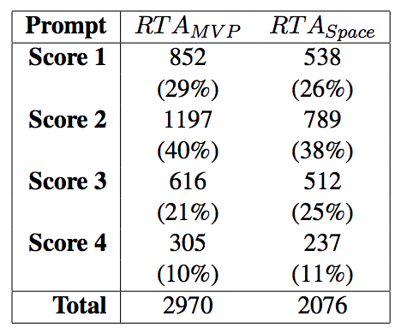
Evaluation Data
Source Excerpt
  Today, Yala Sub-District Hospital has medicine, free of charge, for all of the most common diseases. Water is connected to the hospital, which also has a generator for electricity. Bed nets are used in every sleeping site in Sauri...
Essay Prompt
  The author provided one specific example of how the quality of life can be improved by the Millennium Villages Project in Sauri, Kenya. Based on the article, did the author provide a convincing argument that winning the fight against poverty is achievable in our lifetime? Explain why or why not with 3-4 examples from the text to support your answer.
Evidence List:
Yala sub district hospital has medicine
medicine free charge
medicine most common diseases
water connected hospital
hospital generator electricity
bed nets used every sleeping site

Slide 31
Results
CO-ATTN significantly increases Quadratic Weighted Kappa of eRevise AES
 | eRevise | SELF-ATTN | CO-ATTN
MVP | .653 | .701 | .718
Space | .632 | .690 | .702

Slide 32
Results
CO-ATTN significantly increases Quadratic Weighted Kappa of eRevise AES
  Also improves neural baseline, and for Kaggle data
 | eRevise | SELF-ATTN | CO-ATTN
MVP | .653 | .701 | .718
Space | .632 | .690 | .702

Slide 33
Automatic Writing Evaluation (AWE)
NPE indicates the breadth of unique topics
SPC indicates the number of unique pieces of evidence
A matrix of these two matches each essay to appropriate feedback

Slide 34
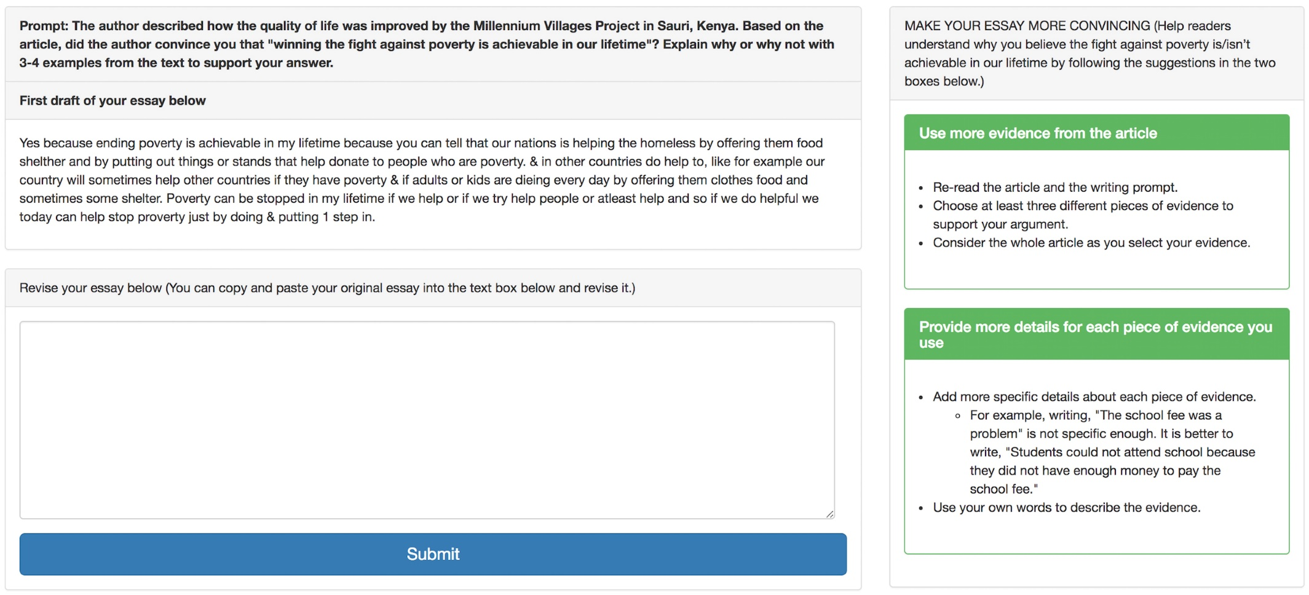
Revision and Formative Feedback Screenshot

Slide 35
Spring 2018 Pilot Deployment
[Zhang, Magooda, Litman et al., 2019]
Seven 5th and 6th grade teachers in two public rural parishes in LA
  Students wrote/revised an essay using eRevise for RTA_{mvp}
  143 students completed all tasks
Mean RTA Evidence scores improved from first to second draft
  Human graders (p ≤ 0.08)
  AES in eRevise (p = 0.001)
AES feature values increased from first to second draft
  NPE (p ≤ 0.003)
  SPC_TOTAL_MERGED (p ≤ 0.001)
Notes:
MAKE YOUR ESSAY MORE CONVINCING
Help readers understand why you believe the fight against poverty is/isn’t achievable in our lifetime by following the suggestions highlighted in green.
…
Provide more details for each piece of evidence you use
Go back to the article to find the evidence you chose and add specific details to your response
Check that you give enough details about the examples you use. People reading your essay who may not have read the article should be able to understand what the example is about
For example, writing, “The school fee was a problem” is not specific enough. It is better to write, “Students could not attend school because they did not have enough money to pay the school fee.”
Try using your own words when using evidence from the articles
Explain the evidence
If you quoted evidence from the article, say again clearly in your own words what the evidence means
Tell your reader why you included each piece of evidence. Explain how the evidence helps to make your point
Connect the evidence to your argument
Tie the evidence not only to the point you are making within a paragraph, but to your overall argument in response to the writing prompt
Elaborate. Give a detailed and clear explanation of how the evidence supports your argument

Slide 36
2018-2019 Deployment
A new study with almost 50 teachers in Louisiana
eRevise used for both RTA_{mvp} and RTA_{space}
More teacher support as well as a control-condition
Analysis in progress

Slide 37
Additional Directions
Automatic extraction of evidence from source
  LDA / turbo-topic [Rahimi & Litman, 2016]
  Attention from neural network [Zhang & Litman, in progress]
Revision analysis across drafts
  extraction/classification of revisions [Zhang & Litman, 2015, 2016]
  web-based revision assistant [Zhang et al., 2016]
  editor roles [Afrin & Litman, 2019]

Slide 38
Today’s Talk:
Learning Language
Argumentative Writing / Argument Mining
Algorithms for Argument Mining
Applications in Automated Writing Assessment
Summary and Current Directions

Slide 39
Context-Aware Argument Mining
[Nguyen & Litman 2015, 2016, 2017]
Global: Writing prompts as supervision to seeded LDA
  argument and domain word extraction
Local: Surrounding text as a context-rich representation of argument components
  multi-sentential windows or Bayesian topic segmentation
Argument mining subtasks
  segmentation: spans of text
  segment classification: major claim, claim, premise
  relation identification: e.g., support or not
Argument mining subtasks
  segmentation: spans of text
  segment classification: major claim, claim premise
  relation identification: e.g., support or not

Slide 40
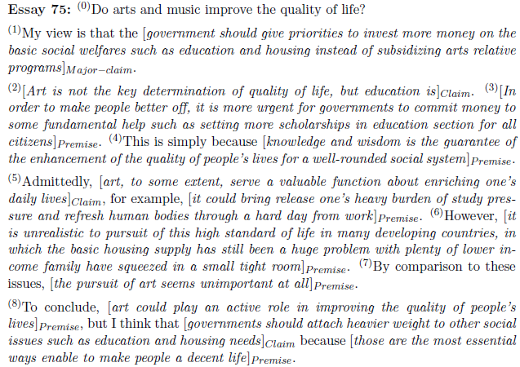
Persuasive Essay Corpus [Stab & Gurevych, 2014]
Major-claim(1)
Support
Claim(2)

Slide 41
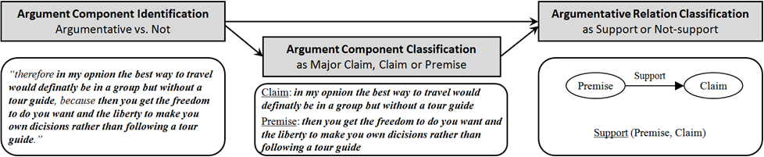
Our End-to-End Argument Mining System

Slide 42
Our End-to-End Argument Mining System

Slide 43
Argument & Domain Words:
Creating Seeds
Development corpus
  6794 persuasive essays with post titles collected from www.essayforum.com
10 argument seeds
  agree, disagree, reason, support, advantage, disadvantage, think, conclusion, result, opinion
3077 domain seeds
  in title, but not argument seeds or stop words

Slide 44
Post-Processing LDA Output
Compute three weights for each LDA topic
  Domain weight is the sum of domain seed frequencies
  Argument weight is the number of argument seeds
  Combined weight = Argument weight – Domain weight
Find the best number of topics with the highest ratio of combined weight of top-2 topics
The argument word list is the LDA topic with the largest combined weight given the best number of topics

Slide 45
Resulting Argument/Domain Words
36 LDA topics
263 (stemmed) argument words
  seed variants (e.g., believe, viewpoint, argument, claim)
  connectives (e.g., therefore, however, despite)
  stop words
1806 (stemmed) domain words
Topic 1 (argument words) | reason exampl support agre think becaus disagre statement opinion believe therefor idea conclus ...
Topic 2 (domain words) | citi live big hous place area small apart town build communiti factori urban ...
Topic 3 (domain words) | children parent school educ teach kid adult grow childhood behavior taught ...

Slide 46

Feature Sets for Argument Component Classification
Stab14 (Stab & Gurevych 2014)
Nguyen15 (Nguyen & Litman 2015)
Nguyen16 (Nguyen & Litman 2016)
1-, 2-, 3-grams
Argument words as unigrams
Nguyen15v2
Numbers of common words with title and preceding sentence
Comparative & superlative adverbs and POS
Plural first person pronouns
Discourse relation labels
Lexical
(I)
Verbs, adverbs, presence of model verb
Discourse connectives,
Singular first person pronouns
Same as Stab14
(I)
Parse
(II)
Production rules
Argument subject-verb pairs
Tense of main verb
#sub-clauses, depth of parse tree
(II)
Same as Stab14
Structure
(III)
#tokens, token ratio, #punctuation, sentence position, first/last paragraph, first/last sentence of paragraph
Same as Stab14
(III)
Context
(IV)
#tokens, #punctuation, #sub-clauses, modal verb in preceding/following sentences
(IV)

Slide 47
Feature Sets for Argument Component Classification
Stab14 (Stab & Gurevych 2014)
Nguyen15 (Nguyen & Litman 2015)
Nguyen16 (Nguyen & Litman 2016)
1-, 2-, 3-grams
Argument words as unigrams
Nguyen15v2
Numbers of common words with title and preceding sentence
Comparative & superlative adverbs and POS
Plural first person pronouns
Discourse relation labels
Lexical
(I)
Verbs, adverbs, presence of model verb
Discourse connectives,
Singular first person pronouns
Same as Stab14
(I)
Parse
(II)
Production rules
Argument subject-verb pairs
Tense of main verb
#sub-clauses, depth of parse tree
(II)
Same as Stab14
Structure
(III)
#tokens, token ratio, #punctuation, sentence position, first/last paragraph, first/last sentence of paragraph
Same as Stab14
(III)
Context
(IV)
#tokens, #punctuation, #sub-clauses, modal verb in preceding/following sentences
(IV)

Slide 48
Feature Sets for Argument Component Classification
Stab14 (Stab & Gurevych 2014)
Nguyen15 (Nguyen & Litman 2015)
Nguyen16 (Nguyen & Litman 2016)
1-, 2-, 3-grams
Argument words as unigrams
Nguyen15v2
Numbers of common words with title and preceding sentence
Comparative & superlative adverbs and POS
Plural first person pronouns
Discourse relation labels
Lexical
(I)
Verbs, adverbs, presence of model verb
Discourse connectives,
Singular first person pronouns
Same as Stab14
(I)
Parse
(II)
Production rules
Argument subject-verb pairs
Tense of main verb
#sub-clauses, depth of parse tree
(II)
Same as Stab14
Structure
(III)
#tokens, token ratio, #punctuation, sentence position, first/last paragraph, first/last sentence of paragraph
Same as Stab14
(III)
Context
(IV)
#tokens, #punctuation, #sub-clauses, modal verb in preceding/following sentences
(IV)

Slide 49
A Sample of our Experimental Results
10x10-fold cross validation
Best values in bold
* means significantly worse than Nguyen16
LDA-enabled and other proposed features improve performance
 | Stab14 | Nguyen15 | Nguyen16
Accuracy | 0.787* | 0.792* | 0.805
Kappa | 0.639* | 0.649* | 0.673
Precision | 0.741* | 0.745* | 0.763
Recall | 0.694* | 0.698* | 0.720

Slide 50
Cross-Topic Evaluation
11 single-topic groups
  E.g., Technologies (11 essays), National Issues (10), School (8), Policies (7)
1 mixed topic group of 17 essays (< 3 essays per topic)
Proposed features are more robust across topics
  Larger performance difference with Stab14 baseline
  Performance matches 10X10 fold experiment
 | Stab14 | Nguyen15 | Nguyen16
Accuracy | 0.780* | 0.796 | 0.807
Kappa | 0.623* | 0.654 | 0.675
Precision | 0.722* | 0.757* | 0.771
Recall | 0.670* | 0.695* | 0.722

Slide 51
Our End-to-End Argument Mining System

Slide 52

Feature Sets for Argument Relation Identification
TOPIC
Common features
Common
  BASELINE features except word pairs and production rules
TOPIC, WINDOW and COMBINED
  To evaluate local contextual features in isolation and combined
FULL takes all features together
BASELINE
Topic context features
COMBINED
Common features
Common features
Word pairs + Production rules
Topic context features +
Window context features
WINDOW
Common features
Window context features

Slide 53
Feature Sets for Argument Relation Identification
TOPIC
Common features
Common
  BASELINE features except word pairs and production rules
TOPIC, WINDOW and COMBINED
  To evaluate local contextual features in isolation and combined
FULL takes all features together
BASELINE
Topic context features
COMBINED
Common features
Common features
Word pairs + Production rules
Topic context features +
Window context features
WINDOW
Common features
Window context features

Slide 54
A Sample of our Experimental Results
Data split: 80% training and 20% test
  Compare with prior reported results [Stab & Gurevych, 2014]
Window-size heuristic with best half-size = 3
  Determined through cross-validation in training set
 | Reported | BASELINE | TOPIC | WINDOW | COMBINED
Accuracy | 0.863 | 0.869 | 0.857 | 0.857 | 0.870
F1 | 0.722 | 0.722 | 0.703 | 0.724 | 0.753*
F1:Support | 0.519 | 0.519 | 0.488 | 0.533 | 0.583*
*: p < 0.05 in comparison with Baseline. Values smaller than baseline are underlined. Best values are in bold.

Slide 55
A Sample of our Experimental Results
Data split: 80% training and 20% test
  Compare with prior reported results [Stab & Gurevych, 2014]
Window-size heuristic with best half-size = 3
  Determined through cross-validation in training set
 | Reported | BASELINE | TOPIC | WINDOW | COMBINED
Accuracy | 0.863 | 0.869 | 0.857 | 0.857 | 0.870
F1 | 0.722 | 0.722 | 0.703 | 0.724 | 0.753*
F1:Support | 0.519 | 0.519 | 0.488 | 0.533 | 0.583*
*: p < 0.05 in comparison with Baseline. Values smaller than baseline are underlined. Best values are in bold.

Slide 56

A Sample of our Experimental Results
Data split: 80% training and 20% test
  Compare with prior reported results [Stab & Gurevych, 2014]
Window-size heuristic with best half-size = 3
  Determined through cross-validation in training set
 | Reported | BASELINE | TOPIC | WINDOW | COMBINED
Accuracy | 0.863 | 0.869 | 0.857 | 0.857 | 0.870
F1 | 0.722 | 0.722 | 0.703 | 0.724 | 0.753*
F1:Support | 0.519 | 0.519 | 0.488 | 0.533 | 0.583*
*: p < 0.05 in comparison with Baseline. Values smaller than baseline are underlined. Best values are in bold.
Combining Topic-context and Window-context features yields the best results

Slide 57
Summary of (Intrinsic Evaluation) Results
Methods for creating context-aware features:
  significantly improve argument mining performance (component classification, relation identification)
  generalize better across different prompts
  compact the feature space
However, when pipelined together, can end-to-end argument mining improve essay performance?
  extrinsic evaluation [Nguyen & Litman, 2018]

Slide 58
Our End-to-End Argument Mining System

Slide 59
Argumentation Feature Sets for Essay Scoring
 | Argument Component Features (AC)
1, 2 3, 4 5 6 7 | Number and fraction of argument components over total number of sentences in essay Number and fraction of argumentative sentences Total number of words in argument components Number of paragraphs containing argument components Whether the essay has paragraph without any argument component
 | Argument Component Label Features (CL)
8 9, 10 11, 12 13 | Number of Major Claims Number and fraction of Claims over total number of sentences Number and fraction of Premises Average number of Premises per Claim
 | Argument Flow Features (AF)
14 15 16 17 – 24 | Number of paragraphs that contain Major Claims and Claims Number of paragraphs that contain Major Claims and Premises Number of paragraphs that contain Claims and Premises Frequency of 8 typed bigrams of argument components
 | Argumentative Relation Features (RL)
25 26 27 28 | Number of supported Claims Number of dangling Claims Number of supporting Premises Number of paragraphs that have support relations
 | Argumentation Structure Typology Features (TS)
29 30 31 32 33 | Number of Chain-structures Number of Tree-structures Number of Tree-structures with height = 1 Number of paragraphs that contain Chain-structures Number of paragraphs that contain Tree-structures
  Features are both new & from prior studies [Beigman Klevanov et al. 2016, Ghosh et al, 2016, Persing & Ng 2015, Wachsmuth et al. 2016]

Slide 60
Experiment(s): Automated Essay Scoring (AES) with Argumentation Features
Baseline AES model
  Enhanced AI Scoring Engine (EASE)
  Features:
    Length: counts of words, characters, punctuations, average word length
    Prompt: count and fraction of words in commons with prompts
    Bag of words: unigrams, bigrams
    Part-of-speech: count and fraction of “good” POS sequences
Our model
  EASE augmented with argumentation features (based on the output of our pre-trained, end-to end argument mining system)
Scoring corpus: Persuasive essays of Kaggle ASAP data
  Prompt 1: 1783 essays about good vs. bad effects of computers
  Prompt 2: 1800 essays about censorship in libraries
  Holistically scored
https://github.com/edx/ease. Top 3 of Kaggle ASAP competition (2012)

Slide 61
Cross-Prompt Results
Experiment with different feature combinations for an upper-bound performance
  Set 1→2: EASE + AC + CL + TS
  Set 2→1: EASE + AC + RL + TS
Feature set | Set: 1→2 |  | Set: 2→1
 | Kappa | QWK | Kappa | QWK
[Phandi et al., 2015] | n/a | 0.545 | n/a | n/a
[Dong & Zhang, 2016] | n/a | 0.569 | n/a | n/a
EASE | 0.234 | 0.585 | 0.048 | 0.491
EASE + ARG | 0.298 | 0.622 | 0.049 | 0.493
Our best | 0.336 | 0.649 | 0.053 | 0.529

Slide 62
Cross-Prompt Results
Experiment with different feature combinations for an upper-bound performance
  Set 1→2: EASE + AC + CL + TS
  Set 2→1: EASE + AC + RL + TS
Feature set | Set: 1→2 |  | Set: 2→1
 | Kappa | QWK | Kappa | QWK
[Phandi et al., 2015] | n/a | 0.545 | n/a | n/a
[Dong & Zhang, 2016] | n/a | 0.569 | n/a | n/a
EASE | 0.234 | 0.585 | 0.048 | 0.491
EASE + ARG | 0.298 | 0.622 | 0.049 | 0.493
Our best | 0.336 | 0.649 | 0.053 | 0.529
Argumentation features help improve cross-prompt performance
  Even when computed using the output of an end-to-end argument mining system that was trained on the persuasive essay corpus!
Both component-based and relation-based features show up in the best combination
Similar results in a second corpus of graded essays (from native language identification shared task)

Slide 63
Context-Aware Argument Mining: Summary
Novel contextual features for argument mining
  Algorithm for argument and domain word extraction
  Context-window framework
Use of argument mining output for automated essay scoring
  Extrinsic evaluation of end-to-end argument mining systems
  Comprehensive analysis of a large set of argument-enabled features
Comprehensive evaluations

Slide 64
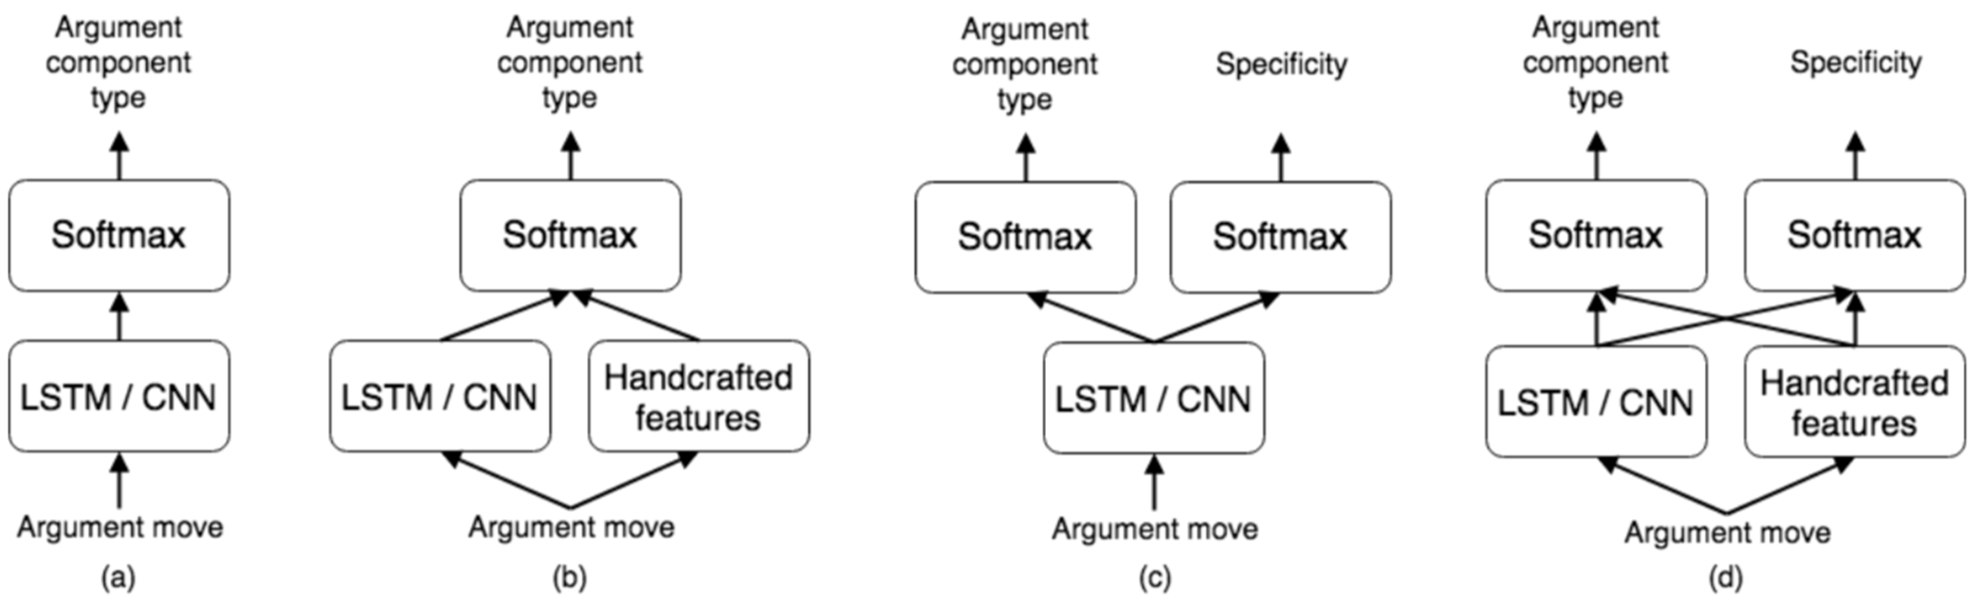
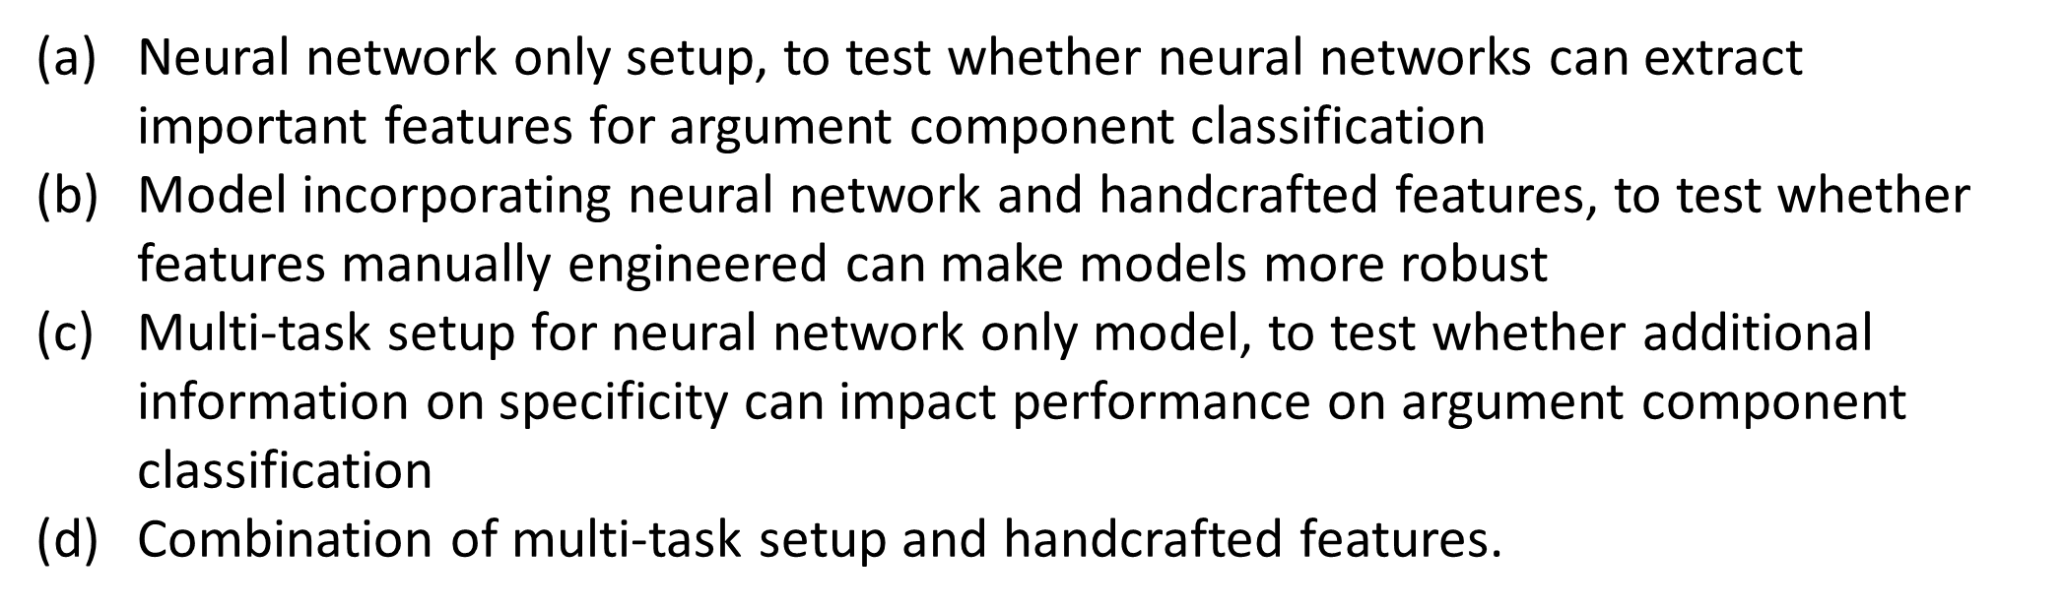

From Essays to Transcripts
Source-based, multi-party ELA classroom discussions [Lugini & Litman, 2018]

Slide 65
Additional Directions
DiscussionTracker teacher dashboard
  Wizard-of-oz deployments in Pittsburgh high schools
Multi-task learning
Student modeling
Dialogue context

Slide 66
Summarizing Student Reflections
Student reflections have been shown to improve both learning and teaching
In large lecture classes (e.g. undergraduate STEM), it is hard for teachers to read all the reflections
  Same problem for MOOCs
Notes:
The first question is that you may ask is why Automatic Essay Assessment is important.
Well, in order to Score and provide feedback on written assignments in Tutoring systems and MOOCs, it is essential to have reliable AES systems. Even in class rooms with large number of students and frequent writing assignments, Providing individual feedback to students is a burden and a very time consuming task for teatures.
Consider the capitalization

Slide 67
Student Reflections and a TA’s Summary
Reflection Prompt: Describe what was confusing or needed more detail.
Student Responses
S1: Graphs of attraction/repulsive & interatomic separation
S2: Property related to bond strength
S3: The activity was difficult to comprehend as the text fuzzing and difficult to
read.
S4: Equations with bond strength and Hooke's law
S5: I didn't fully understand the concept of thermal expansion
S6: The activity ( Part III)
S7: Energy vs. distance between atoms graph and what it tells us
S8: The graphs of attraction and repulsion were confusing to me
… (rest omitted, 53 student responses in total)
Summary created by the Teaching Assistant
1) Graphs of attraction/repulsive & atomic separation [10*]
2) Properties and equations with bond strength [7]
3) Coefficient of thermal expansion [6]
4) Activity part III [4]
* Numbers in brackets indicate the number of students who semantically mention each phrase (i.e., student coverage)

Slide 68
Enhancing Large Classroom Instructor-Student Interactions via Summarization
CourseMIRROR: A mobile app for collecting and browsing student reflections
  [Fan, Luo, Menekse, Litman, & Wang, 2015]
  [Luo, Fan, Menekse, Wang, & Litman, 2015]
A phrase-based approach to extractive summarization of student-generated content
  [Luo & Litman, 2015]

Slide 69
Student Reflections and a TA’s Summary
Reflection Prompt: Describe what was confusing or needed more detail.
Student Responses
S1: Graphs of attraction/repulsive & interatomic separation
S2: Property related to bond strength
S3: The activity was difficult to comprehend as the text fuzzing and difficult to
read.
S4: Equations with bond strength and Hooke's law
S5: I didn't fully understand the concept of thermal expansion
S6: The activity ( Part III)
S7: Energy vs. distance between atoms graph and what it tells us
S8: The graphs of attraction and repulsion were confusing to me
… (rest omitted, 53 student responses in total)

Slide 70
Challenges for (Extractive) Summarization
  Student reflections range from single words to multiple sentences
  Concepts (represented as phrases in the reflections) that are semantically mentioned by more students are more important to summarize
  Deployment on mobile app

Slide 71
Phrase-Based Summarization
Stage 1: Candidate Phrase Extraction
  Noun phrases (with filtering)
Stage 2: Phrase Clustering
  Estimate student coverage with semantic similarity
Stage 3: Phrase Ranking
  Rank clusters by student coverage
  Select one phrase per cluster

Slide 72
From Paper to Mobile App
[Luo et al., 2015]
Two semester long pilot deployments during Fall 2014
Average ratings of 3.7 (5 Likert-scale) on survey questions
  I often read reflection summaries
  I benefited from reading the reflection summaries
Qualitative feedback
  “It's interesting to see what other people say and that can teach me something that I didn't pay attention to.”
  “Just curious about whether my points are accepted or not.”

Slide 73
Talk Summary
NLP-supported argument mining for educational applications at scale
  Feature / Algorithm Development
    Noisy and diverse data
    Meaningful features
    Real-time performance
  Experimental Evaluations
    Response-to-Text Assessment (grade school)
    Argument Mining (undergraduates; web)
    Revision Analysis (grade school; Pitt psychology and CS)
Even non-structural and application-dependent argument mining can support useful applications!

Slide 74



Thank You!
Questions?
Further information, data, and software
  http://www.cs.pitt.edu/~litman

Slide 75
Audience Participation: Temporal Argument Mining
(Revision Analysis via Sentence Alignment)
Draft 1:
In the circle, I would place Bill Clinton because he had an affair with his aide.
Draft 2:
In the third circle of Hell, sinners have uncontrollable lust.
The carnal sinners in this level are punished by a howling, endless wind.
Bill Clinton would be in this level because he had an affair with his aide.
Notes:
This is another set of comments about thesis statement on a different essay. As you can see, Reviewer #2 identified the wrong sentence as the thesis and Reviewer #3 also expressed some confusion.
Our study is the first step toward solving this problem.

Slide 76
Audience Participation: Temporal Argument Mining
(Revision Analysis via Sentence Alignment)
Draft 1:
In the circle, I would place Bill Clinton because he had an affair with his aide.
Draft 2:
In the third circle of Hell, sinners have uncontrollable lust.
The carnal sinners in this level are punished by a howling, endless wind.
Bill Clinton would be in this level because he had an affair with his aide.
R1: Align: null->1 Op: Add Purpose: Argumentative
R2: Align: 1->3 Op: Modify Purpose: Surface
….
Notes:
This is another set of comments about thesis statement on a different essay. As you can see, Reviewer #2 identified the wrong sentence as the thesis and Reviewer #3 also expressed some confusion.
Our study is the first step toward solving this problem.

Slide 77
Temporal Argument Mining
How are arguments changed during revision?
Argument mining subtasks
  Segmentation: sentences
    Revision extraction via alignment [Zhang & Litman, 2014]
  Segment classification: argumentative purpose
    Wikipedia features [Zhang & Litman, 2015]
    Contextual methods [Zhang & Litman, 2016]

Slide 78
Revision Extraction
[Zhang & Litman, 2014]
Treat alignment as classification
  Construct sentence pairs using the Cartesian product across drafts
  Compute sentence similarity
  Logistic regression determines whether a pair is aligned or not
Global alignment [Needleman & Wunsch, 1970]
  Sentences are more likely to be aligned if sentences before are aligned
  Starting from the first pair, find the path to maximize likelihood
    s(i, j) = max{s(i−1, j−1)+sim(i, j), s(i− 1, j) + insertcost , s(i, j − 1) + deletecost}
TF*IDF similarity yields the best results
  90 -94% within and across several corpora

Slide 79
Revision Purpose Annotation
[Zhang & Litman, 2015]
2 binary (5 fine-grained) categories
  Argumentative
    Claim
    Warrant
    Evidence
    General content
  Surface
Kappa = .7
  2 high school corpora (>1000 revisions each)

Slide 80
Revision Purpose Classification
[Zhang & Litman, 2015]
Each sentence pair is an instance
Features based on Wikipedia revisions [Adler et al., 2011; Javanmardi et al., 2011; Bronner & Monz, 2012; Daxenberger & Gurevych, 2013]
  Location
  Sentence (first/last in paragraph, exact index)
  Paragraph (first/last in essay, exact index)
  Textual
  Keywords: “because”, “however”, “for example” ….
  Named-entity
  Sentence difference (Levenshtein distance…)
  Revision operation (Add/Delete/Modify)
  Language
  Out of vocabulary words

Slide 81
Experimental Evaluations
Surface vs. argumentative
  Intrinsic (SVM, 10-fold): results significantly better than unigram baseline
  Extrinsic: predicted versus actual labels yield same correlations with writing improvement
Fine-grained
  Intrinsic results mostly outperform unigram baselines
  Feature groups have different impacts

Slide 82
Enhancing Classification with Context
[Zhang & Litman, 2016]
Contextual features
  Original features, but for adjacent sentences
  Changes in cohesion (lexical) & coherence (semantic)
Sequence modeling
Results: Fine-grained labels
  Cohesion significantly improves results for one corpus (SVM, 10-fold)
  Sequence modeling yields best results for both corpora

Slide 83
Other Directions
New features from discourse analysis (PDTB)
Joint extraction and classification

Slide 84
Application
[Zhang, Hwa, Litman, & Hashemi, 2016]
ArgRewrite: A Web-based Revision Assistant for Argumentative Writings
  www.cs.pitt.edu/˜zhangfan/argrewrite

Slide 85
Revision Overview Interface

Slide 86
Revision Detail Interface

Slide 87
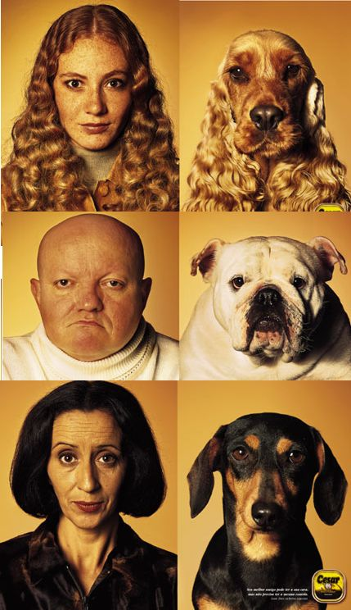
Teams Project: Entrainment and Task Success in Team Conversations

Slide 88
Teams Project: Entrainment and Task Success in Team Conversations
Multi-party entrainment measures that are computable using NLP
Applications
  Conversational agents
  Browsers for (un)successful teams

Slide 89
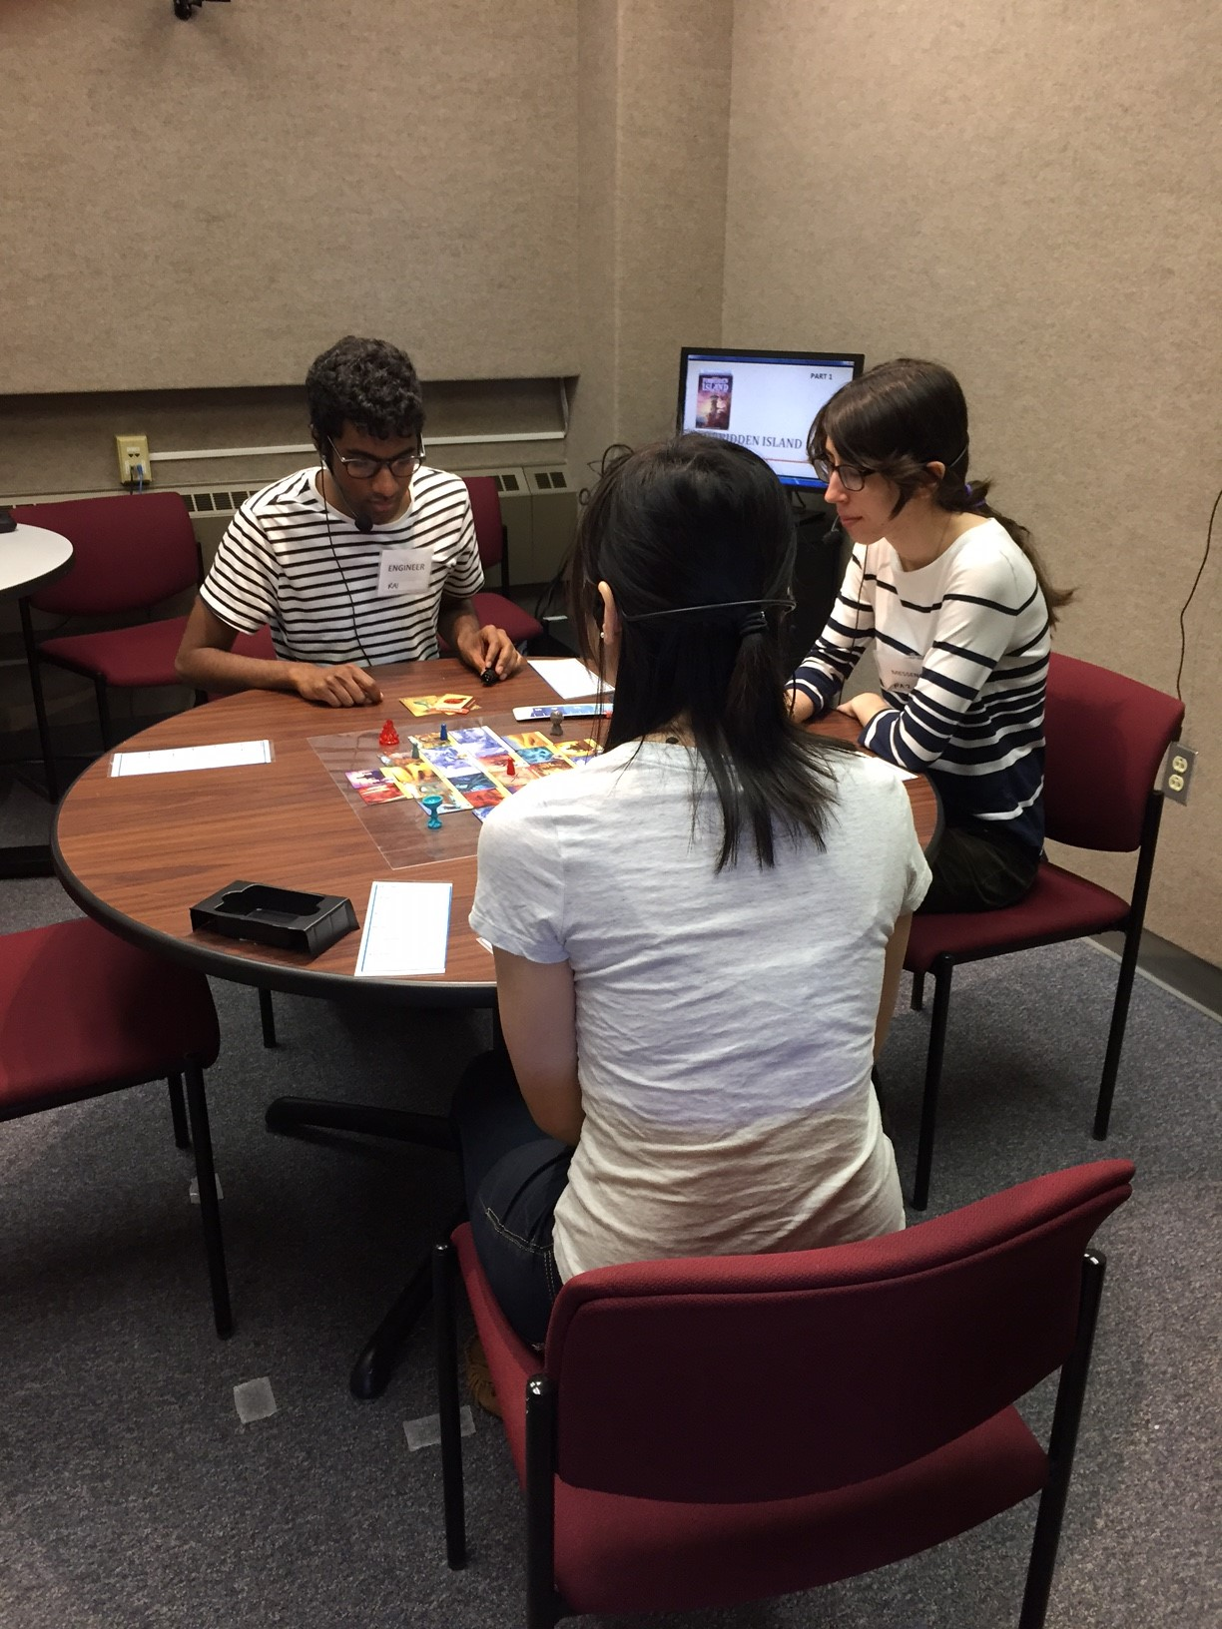
Experimentally Collected Data
Experimental Design
  Team Training or Not
  First vs. Second Games
Audio-Video
  47 hours
  63 teams
Questionnaires
  216 individuals

Slide 90
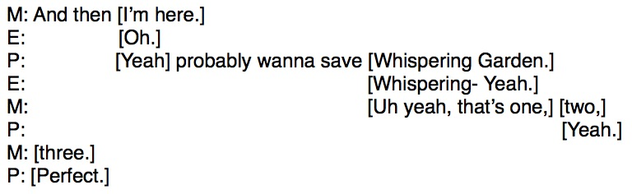
What teams say (transcriptions)

Slide 91
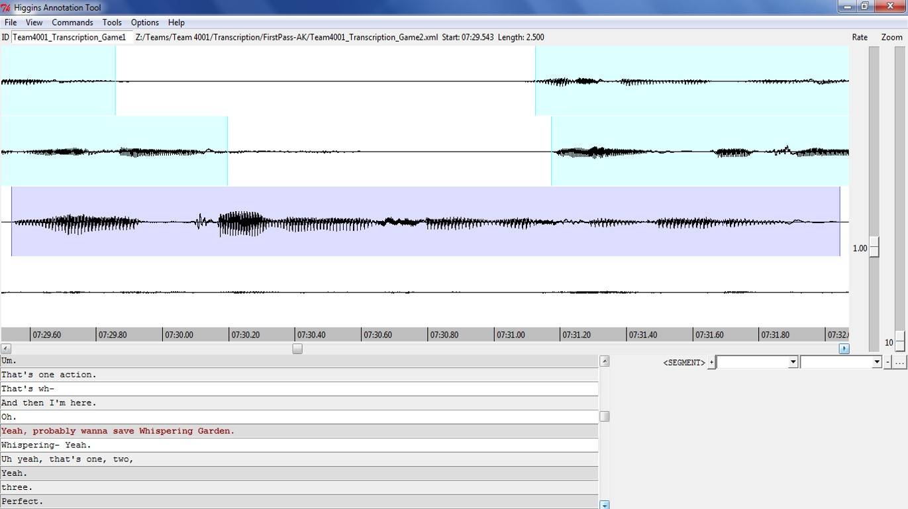
How teams say it (audio)

Slide 92
How teams say it (video)
Non-verbal communication
  Gaze
  Gesture
  Facial expressions
  Etc.

