Slide 1



Argument Mining from Text and its Application in Education
Diane Litman
Professor, Computer Science Department
Director, Intelligent Systems Program
Senior Scientist, Learning Research & Development Center
University of Pittsburgh
Pittsburgh, PA USA
Notes:
Based on JHU16

Slide 2
Natural Language Processing (NLP)
Getting computers to perform useful and interesting tasks involving human languages
  languages such as English, Spanish, Chinese, etc.
  as opposed to computer languages such as Python

Slide 3
Why is NLP needed?
  An enormous amount of machine readable text, audio, and video is now available
  Conversational agents such as Siri and Alexa are becoming an important form of human-computer communication

Slide 4
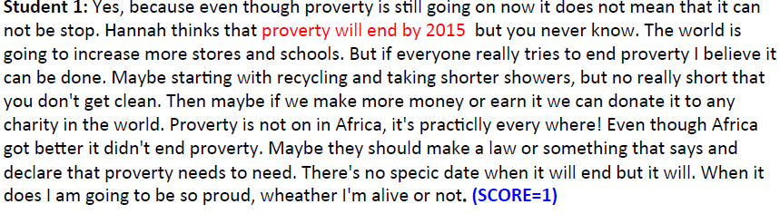
Roles for Language Processing in Education
Learning Language
(e.g., reading, writing, speaking)
Automatic Essay Grading

Slide 5

Roles for Language Processing in Education
Using Language
(e.g., teaching in the disciplines)
Tutorial Dialogue Systems for STEM

Slide 6
Roles for Language Processing in Education
Using Language
(e.g., teaching in the disciplines)
Classroom Discussion Dashboard
 | Student Talk | Specificity
S1 | Some people they just ask for a job is just like, some money. | Low
S1 | It's like, I think she already knew that they weren't going to get it, but she, she couldn't do anything except just encourage them cause that's the only thing, like she [xx]. That's why she kinda supported it, but she already knew that they weren't going to get it. | Medium
S2 | She was already talking about how she didn't think that they were going to get it. | Medium

Slide 7
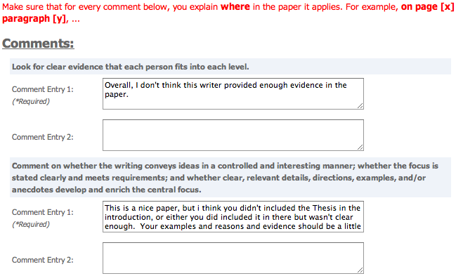
Roles for Language Processing in Education
Processing Language
(e.g.. from MOOCs)
Peer Feedback

Slide 8






2017-2018 Litman Lab
Learning Language Using Language Processing Language
Haoran Zhang (3rd year) Zahra Rahimi (6th year, ISP)
Tazin Afrin (3rd year) Luca Lugini (4th year)
Ahmed Magooda (2nd year) Mingzhi Yu (2nd year)

Slide 9
NLP for Education Research Lifecycle
Systems and Evaluations
Real-World
Problems
Learning and Teaching
Higher Level Learning Processes
NLP-Based Educational Technology
Challenges!
User-generated content
Meaningful constructs
Real-time performance
Theoretical and Empirical Foundations

Slide 10
Today’s Talk:
Learning Language
Argumentative Writing / Argument Mining
Algorithms for Argument Mining
Applications in Automated Writing Assessment
Summary and Current Directions

Slide 11
Why teach argumentative writing?
Studies show students:
  lack competence in argument writing (Oostdam, et al., 1994; Oostdam & Emmelot, 1991).
  do not integrate their arguments into a high-level structure or coherent position (Keith, Weiner, & Lesgold, 1991).
  Even if compose-aloud protocols show students mentally connect position statement & supporting details, connections not evident in writing (Durst, 1987).

Slide 12
Research Question
Can argument mining be used to better teach, assess, and understand argumentative writing?
Approach: Technology design and evaluation
  System enhancements that improve student learning
  Argument analytics for teachers
  Experimental platforms to test research predictions

Slide 13
Argument Mining
“… exploits the techniques and methods of natural language processing … for semi-automatic and automatic recognition and extraction of structured argument data from unstructured … texts.” [SICSA Workshop on Argument Mining, July 2014]

Slide 14
Mining a Grade School Essay for Evidence
I was convinced that winning the fight of poverty is achievable in our lifetime. Many people couldn't afford medicine or bed nets to be treated for malaria . Many children had died from this dieseuse even though it could be treated easily. But now, bed nets are used in every sleeping site . And the medicine is free of charge. Another example is that the farmers' crops are dying because they could not afford the nessacary fertilizer and irrigation . But they are now, making progess. Farmers now have fertilizer and water to give to the crops. Also with seeds and the proper tools . Third, kids in Sauri were not well educated. Many families couldn't afford school . Even at school there was no lunch . Students were exhausted from each day of school. Now, school is free . Children excited to learn now can and they do have midday meals . Finally, Sauri is making great progress. If they keep it up that city will no longer be in poverty. Then the Millennium Village project can move on to help other countries in need.

Slide 15
Mining a Student Essay for Argumentation Structure
⁽¹⁾[Taking care of thousands of citizens who suffer from disease or illiteracy is more urgent and pragmatic than building theaters or sports stadiums]_{Claim}.
⁽²⁾As a matter of fact, [an uneducated person may barely appreciate musicals]_{Premise}, whereas [a physical damaged person, resulting from the lack of medical treatment, may no longer participate in any sports games]_{Premise}. ⁽³⁾Therefore, [providing education and medical care is more essential and prioritized to the government]_{Claim}.
Claim(1)
Premise(2.1) supports Claim(1)
Premise(2.1) supports Claim(3)
Premise(2.2) supports Claim(1)
Premise(2.2) supports Claim(3)
Claim(3) supports Claim(1)
Claim(3)
Premise (2.1)
Premise (2.2)

Slide 16
Argument Mining Subtasks
[Peldszus and Stede, 2013]
Scope of today’s talk
Even partial argument mining can support useful applications
  Mostly non-structural (e.g., no relations, no argument schema)
  Often application-dependent roles (e.g., no premises)
  But, real data!!

Slide 17
Argument Mining for Education
Challenges
  Noisy data (e.g., adult learners, children)
  Real-time algorithms; robust at scale
  Meaningful features
Opportunities
  Human in the loop (e.g., peer review)
    Errors as student reflection opportunities

Slide 18
Today’s Talk:
Learning Language
Argumentative Writing / Argument Mining
Algorithms for Argument Mining
Applications in Automated Writing Assessment
Summary and Current Directions

Slide 19
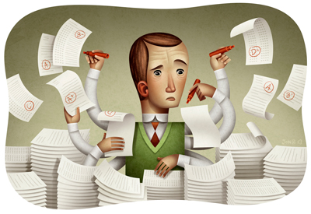
Why Automatic Writing Assessment?
Essential for Massive Open Online Courses (MOOCs) and tutoring systems
Even in traditional classes, frequent assignments can limit the amount of teacher feedback
Notes:
The first question is that you may ask is why Automatic Essay Assessment is important.
Well, in order to Score and provide feedback on written assignments in Tutoring systems and MOOCs, it is essential to have reliable AES systems. Even in class rooms with large number of students and frequent writing assignments, Providing individual feedback to students is a burden and a very time consuming task for teatures.
Consider the capitalization

Slide 20
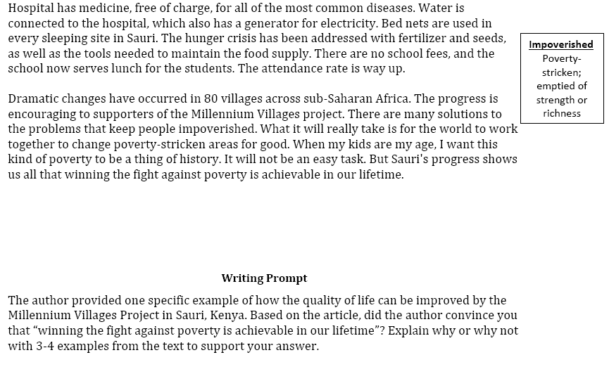
An Example Writing Assessment Task: Response to Text (RTA)
MVP, Time for Kids – informational text

Slide 21
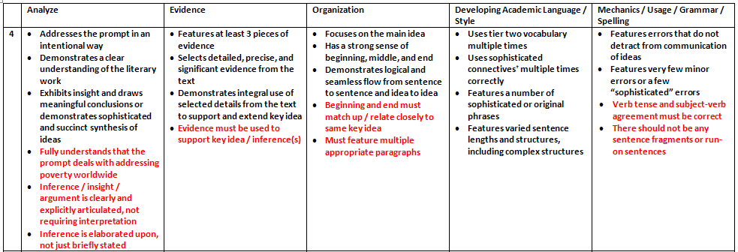
Excerpt from the Scoring Rubric

Slide 22
Audience Participation: Evidence Scoring (1 or 4?)
Student 1: Yes, because even though proverty is still going on now it does not mean that it can not be stop. Hannah thinks that proverty will end by 2015 but you never know. The world is going to increase more stores and schools. But if everyone really tries to end proverty I believe it can be done. Maybe starting with recycling and taking shorter showers, but no really short that you don't get clean. Then maybe if we make more money or earn it we can donate it to any charity in the world. Proverty is not on in Africa, it's practiclly every where! Even though Africa got better it didn't end proverty. Maybe they should make a law or something that says and declare that proverty needs to need. There's no specic date when it will end but it will. When it does I am going to be so proud, wheather I'm alive or not.
Student 2: I was convinced that winning the fight of poverty is achievable in our lifetime. Many people couldn't afford medicine or bed nets to be treated for malaria . Many children had died from this dieseuse even though it could be treated easily. But now, bed nets are used in every sleeping site . And the medicine is free of charge. Another example is that the farmers' crops are dying because they could not afford the nessacary fertilizer and irrigation . But they are now, making progess. Farmers now have fertilizer and water to give to the crops. Also with seeds and the proper tools . Third, kids in Sauri were not well educated. Many families couldn't afford school . Even at school there was no lunch . Students were exhausted from each day of school. Now, school is free . Children excited to learn now can and they do have midday meals . Finally, Sauri is making great progress. If they keep it up that city will no longer be in poverty. Then the Millennium Village project can move on to help other countries in need.

Slide 23
Automatic Scoring via Argument Mining
Student 1: Yes, because even though proverty is still going on now it does not mean that it can not be stop. Hannah thinks that proverty will end by 2015 but you never know. The world is going to increase more stores and schools. But if everyone really tries to end proverty I believe it can be done. Maybe starting with recycling and taking shorter showers, but no really short that you don't get clean. Then maybe if we make more money or earn it we can donate it to any charity in the world. Proverty is not on in Africa, it's practiclly every where! Even though Africa got better it didn't end proverty. Maybe they should make a law or something that says and declare that proverty needs to need. There's no specic date when it will end but it will. When it does I am going to be so proud, wheather I'm alive or not. (SCORE=1)
Student 2: I was convinced that winning the fight of poverty is achievable in our lifetime. Many people couldn't afford medicine or bed nets to be treated for malaria . Many children had died from this dieseuse even though it could be treated easily. But now, bed nets are used in every sleeping site . And the medicine is free of charge. Another example is that the farmers' crops are dying because they could not afford the nessacary fertilizer and irrigation . But they are now, making progess. Farmers now have fertilizer and water to give to the crops. Also with seeds and the proper tools . Third, kids in Sauri were not well educated. Many families couldn't afford school . Even at school there was no lunch . Students were exhausted from each day of school. Now, school is free . Children excited to learn now can and they do have midday meals . Finally, Sauri is making great progress. If they keep it up that city will no longer be in poverty. Then the Millennium Village project can move on to help other countries in need. (SCORE=4)

Slide 24
Automatic Scoring of an Analytical
Response-To-Text Assessment (RTA)
[Rahimi, Litman, Correnti, Wang & Matsumura, 2017]
Initial work
  writing assessment via meaningful features that operationalize the Evidence and Organization rubrics of RTA
Current work
  informative feedback for students and teachers
  large-scale research on the impact of instruction and policies
Argument mining subtasks
  segmentation: spans of text
  segment classification: evidence from text (or not)

Slide 25
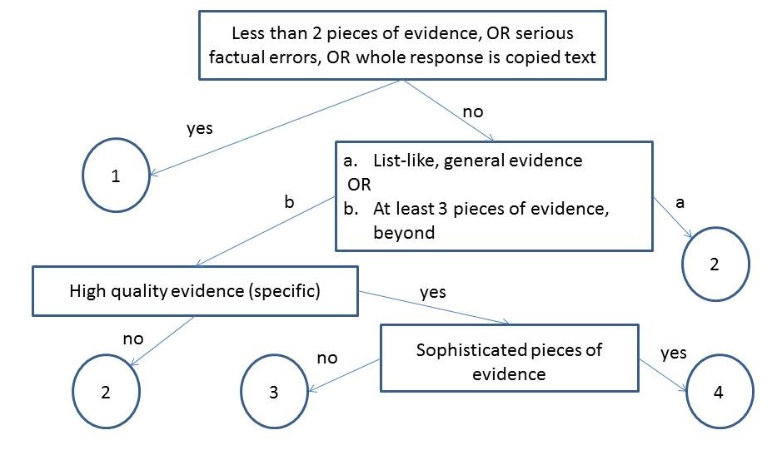
Rubric-Based Features
Notes:
What is evidence topic subtopic,
Copping how much copy is copying

Slide 26
Our Features
Number of Pieces of Evidence (NPE)
  Topics and words based on the text and experts
Notes:
What is evidence topic subtopic,
Copping how much copy is copying

Slide 27
Our Features
Notes:
What is evidence topic subtopic,
Copping how much copy is copying

Slide 28
Our Features
Concentration (CON)
High concentration essays have fewer than 3 sentences with topic words (i.e., evidence is not elaborated)
Notes:
What is evidence topic subtopic,
Copping how much copy is copying

Slide 29
Our Features
Notes:
What is evidence topic subtopic,
Copping how much copy is copying

Slide 30
Our Features
Specificity (SPC)
Specific examples from different parts of the text
Notes:
What is evidence topic subtopic,
Copping how much copy is copying

Slide 31
Our Features
Word Count (WOC)
Potentially helpful fallback feature (temporarily )
Notes:
What is evidence topic subtopic,
Copping how much copy is copying

Slide 32
Corpora
Data [Correnti et al., 2013]
  1569 essays from grades 5-6
    Short, many spelling and grammatical errors
  1045 essays from grades 6-8

Slide 33
Experimental Evaluation
Baseline1 [Mayfield 13]: one of the best methods from the Hewlett Foundation competition [Shermis and Hamner, 2012]
  Features: primarily bag of words (top 500)
Baseline2: Latent Semantic Analysis
  Based on the scores of the 10 most similar essays, weighted by semantic similarity [Miller 03]
Notes:
Make shorter

Slide 34
Results
Proposed features outperform both baselines
  validity plus increased reliability!

Slide 35
Generalization of Results
Features also outperform baselines on
  essays from grades 6-8 and combined datasets
  another source text

Slide 36
Additional Directions
Coherence of evidence (Organization rubric)
  topic-based (rather than lexical) grids and chains [Rahimi, Litman, Wang & Correnti, 2015]
Automatic extraction of evidence from source
  replace expert knowledge with data-driven LDA / turbo-topic [Rahimi and Litman, 2016]
Robust evidence matching between essay and source
  replace lexical matching with word embedding [Zhang & Litman, 2017]

Slide 37
Today’s Talk:
Learning Language
Argumentative Writing / Argument Mining
Algorithms for Argument Mining
Applications in Automated Writing Assessment
Summary and Current Directions

Slide 38
Audience Participation: Argument Mining
Written Essay Excerpt:
There have been many studies which indicate that people do drive differently at different times of day and that it does have an impact on driving risk. Reimer et al (2007) found that time of day did influence driving speed, reaction time, and speed variability measures.
Argument Ontology:
Components
  Current Study
  Hypothesis
  Claim
  Citation
Relations
  Supports
  Opposes

Slide 39
Audience Participation: Argument Mining
Written Essay Excerpt:
There have been many studies which indicate that people do drive differently at different times of day and that it does have an impact on driving risk. Reimer et al (2007) found that time of day did influence driving speed, reaction time, and speed variability measures.
Argument Ontology:
Components
  Current Study
  Hypothesis
  Claim
  Citation
Relations
  Supports
  Opposes

Slide 40
Audience Participation: Essay Scoring (1 or 4?)
Human Argument Mining
Hypothesis: 1, Supports: 2, Opposes: 1, Citation: 7 (6 unique)
Frequently, people encounter situations in their environment where they can either choose to be prosocial or antisocial. It is therefore of great importance to study what makes people choose either response. Previous research has indicated that as group size increases, prosocial responses decrease, a phenomenon known as the bystander effect (Fischer, Krueger, Greitemeyer, Vogrincic, Kastenmuller, Frey, Heene, Wicher, Kainbacher, 2011). In our particular study, a participant sneezed on an elevator and noted whether or not somebody had a nice response such as “God bless you.” The nice response would be equivalent to a prosocial behavior. The results of this study can give insight into what makes people more or less likely to engage in prosocial behavior in different situations, so this study has good external validity. This research topic is worth of study because the results may show how likely people are to help others in a more critical situation, such as somebody getting mugged, etc. It is important to realize that sneezing on an elevator is not necessarily a dangerous situation to act prosocially in, but the result will lead to a better understanding of whether or not gender and group size contribute to prosocial responses.
Previous research has shown that females seem to be more likely to engage in prosocial behavior as distance decreases, and this correlates to the hypothesis of this particular study (McCullough, Tabak, 2010). From this same previous research, it seems that females are more likely to do this because females tend to behave in more altruistic ways than males. In other words, females should give a nice response to a sneeze more often than males, and this was part of our hypothesis. Previous research has also indicated that people who have the knowledge of how to behave prosocially in a particular situation are more likely to do so (Anker, Feeley, 2011). If somebody in the elevator is from a certain religion or has recently moved and is not aware of what to say after somebody sneezes, then they most likely will not give a response at all, and this was not considered when putting together the results of the study. This should have been important to consider because knowledge of what to say after a sneeze could be a confounding variable in the results. Lastly, previous studies have shown that moral frames often determine whether or not people will give a prosocial response (Thornberg, 2010). Overall, the better somebody’s moral frames are, the more likely they are to give a prosocial response. This correlates to our particular study because the people who didn’t give a response could possibly have negative moral frames. A future experiment could study this and the results would be interesting and could give additional information about what makes people behave prosocially.
In our study, it was hypothesized that as group size increased, the likelihood of a prosocial response would increase, and that females were more likely to give a prosocial response than males. Previous research from McCullough, etc (2011) conflicted with the hypothesis that as group size increases, prosocial responses should increase. McCullough’s study showed this to be the opposite – as group size increases, prosocial behavior decreases, a phenomenon known as the bystander effect. Previous research about gender, however, showed that females are more likely to behave prosocially due to their nature and altruistic characteristics; this evidence supports our hypothesis (Levine, Cassidy, Jentzsch, 2010).

Slide 41
Audience Participation: Essay Scoring (1 or 4?)
Human Argument Mining
Hypothesis: 1, Supports: 5, Opposes: 3, Citation: 15 (6 unique)
In today’s tough economic climate, any factors that may contribute to a successful business or enterprise have become increasingly important. One prevalently researched factor is prosocial behavior which is comparable to helping behaviors. Research has shown that prosocial behaviors have been associated with job satisfaction, productivity, and client satisfaction (Danzis & Stone-­‐Romero, 2009). Therefore the understanding of what situations support and encourage prosocial behaviors could be an asset to any manager or business (Danzis & Stone-­‐ Romero, 2009).
Previous research has focused on relationships of prosocial behavior between gender and the effect of group size. With regards to gender, there has been much debate over whether females or males are inherently more prosocial. Research has been done on gender by implementing a training program on empathy with children in day care centers between the ages of 5-­‐6 Kallipuska, 1991). The results of this study concluded that females were more prosocial than males based on teacher appraisals (Kallipuska, 1991).Other research supports that females are more prosocial but only to familiar individuals or when following a social norm (Danzis & Stone-­‐Romero 2009). In contrast, males were considered to be more “chivalrous”(p.722) which would promote them to exhibit more prosocial behavior toward strangers relative to females(Danzis & Stone-­‐Romero, 2009).
In addition to studies on the relationship between prosocial behavior and gender, there is also research between group sizes and prosocial behavior. One of the most well­‐known psychological phenomena is the bystander effect which describes a diffusion of responsibility as group size increases (Garcia, Weaver, Darley, & Moskowitz, 2002).More recent studies have described an implicit bystander effect which claims that it is even possible to create diffusion of responsibility even when no one else is around by priming participants about group mentality (Garcia, Weaver, Darley, & Moskowitz, 2002). There has even been debate over the implications of the implicit identity effect. One research study claimed that the implicit identity can only be used to inhibit prosocial behavior such as through the bystander effect (Garcia, Weaver, Darley, & Moskowitz, 2002). Yet, conflicting research has found evidence to support a theory that the implicit identity effect can be used to encourage prosocial behavior if it follows the group’s social norms (Levine & Crowther, 2008). Also, a study by Krupka and Weber (2009) found that even when people observe others acting selfishly, on average this produces prosocial behavior due to the focusing effecting of norms (2009).Therefore the focusing effect of norms can be defined as being aware of the behavior of others aroundKrupka & Weber, 2009).
The current study sought to find relationships between prosocial behavior, gender and group size. Prosocial behavior was defined as someone verbally responding to the observer’s sneeze. In order to create a controlled environment, the study took place on elevators in on-­‐campus buildings only. Unlike previous research, our study did not prime the participants before they entered the elevator so it was comparable to the control group of the Krupka & Weber study(2009). I predicted that females would respond more than males and that responses would be more likely in a group of more than two other people on the elevator.According to the Kallipuska study, females appear to be more prosocial and polite than males and would be more likely to respond to a sneeze(1991). With regards to group size, research shows that the focusing effect of norms becomes more apparent when others are present(Krupka & Weber, 2009).One contradiction to this hypothesis would be the Garcia, Weaver, Darley, & Moskowitz study that the implicit bystander effect can cause a diffusion of responsibility in large groups which could cause no one to respond to the sneeze(2002).

Slide 42
Actual Expert Essay Scores (via rubric)
SCORE = 1
Sentences/Words: 22/564
Hypothesis: 1
Supports: 2
Opposes: 1
Citation: 7 (6 unique)
SCORE = 4
Sentences/Words: 26/610
Hypothesis: 1
Supports: 5
Opposes: 3
Citation: 15 (6 unique)

Slide 43
Context-Aware Argument Mining
[Nguyen & Litman 2015, 2016, 2017]
Global: Writing prompts as supervision to seeded LDA
  argument and domain word extraction
Local: Surrounding text as a context-rich representation of argument components
  multi-sentential windows or Bayesian topic segmentation
Corpora
  Ontology annotated peer review essays (prior example)
  Claim/premise annotated persuasive essays (today)
Argument mining subtasks
  segmentation: spans of text
  segment classification: major claim, claim premise
  relation identification: e.g., support or not
Argument mining subtasks
  segmentation: spans of text
  segment classification: major claim, claim premise
  relation identification: e.g., support or not

Slide 44
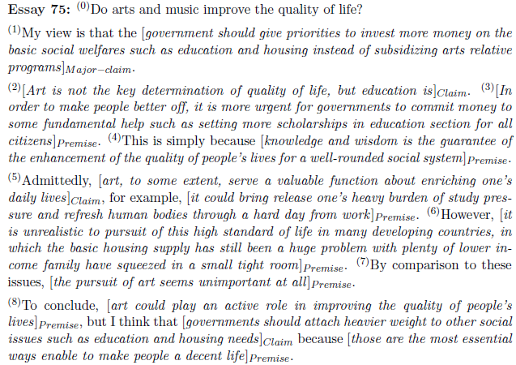
Persuasive Essay Corpus [Stab & Gurevych, 2014]
Major-claim(1)
Support
Claim(2)

Slide 45
Context-Aware Argument Mining
[Nguyen & Litman 2015, 2016, 2017]
Global: Writing prompts as supervision to seeded LDA
  argument and domain word extraction
Local: Surrounding text as a context-rich representation of argument components
  multi-sentential windows or Bayesian topic segmentation
Corpora
  Ontology annotated peer review essays (ArgumentPeer)
  Claim/premise annotated persuasive essays (today)
Argument mining subtasks
  segmentation: spans of text
  segment classification: major claim, claim, premise
  relation identification: e.g., support or not
Argument mining subtasks
  segmentation: spans of text
  segment classification: major claim, claim premise
  relation identification: e.g., support or not

Slide 46
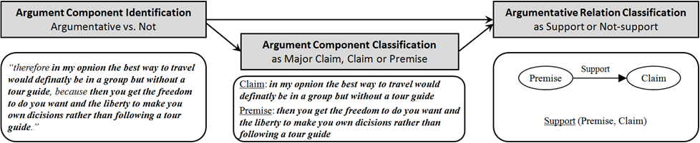
Our End-to-End Argument Mining System

Slide 47
Our End-to-End Argument Mining System

Slide 48
Argument & Domain Words:
Creating Seeds
Development corpus
  6794 persuasive essays with post titles collected from www.essayforum.com
10 argument seeds
  agree, disagree, reason, support, advantage, disadvantage, think, conclusion, result, opinion
3077 domain seeds
  in title, but not argument seeds or stop words

Slide 49
Post-Processing LDA Output
Compute three weights for each LDA topic
  Domain weight is the sum of domain seed frequencies
  Argument weight is the number of argument seeds
  Combined weight = Argument weight – Domain weight
Find the best number of topics with the highest ratio of combined weight of top-2 topics
The argument word list is the LDA topic with the largest combined weight given the best number of topics

Slide 50
Resulting Argument/Domain Words
36 LDA topics
263 (stemmed) argument words
  seed variants (e.g., believe, viewpoint, argument, claim)
  connectives (e.g., therefore, however, despite)
  stop words
1806 (stemmed) domain words
Topic 1 (argument words) | reason exampl support agre think becaus disagre statement opinion believe therefor idea conclus ...
Topic 2 (domain words) | citi live big hous place area small apart town build communiti factori urban ...
Topic 3 (domain words) | children parent school educ teach kid adult grow childhood behavior taught ...

Slide 51

Feature Sets for Argument Component Classification
Stab14 (Stab & Gurevych 2014)
Nguyen15 (Nguyen & Litman 2015)
Nguyen16 (Nguyen & Litman 2016)
1-, 2-, 3-grams
Argument words as unigrams
Nguyen15v2
Numbers of common words with title and preceding sentence
Comparative & superlative adverbs and POS
Plural first person pronouns
Discourse relation labels
Lexical
(I)
Verbs, adverbs, presence of model verb
Discourse connectives,
Singular first person pronouns
Same as Stab14
(I)
Parse
(II)
Production rules
Argument subject-verb pairs
Tense of main verb
#sub-clauses, depth of parse tree
(II)
Same as Stab14
Structure
(III)
#tokens, token ratio, #punctuation, sentence position, first/last paragraph, first/last sentence of paragraph
Same as Stab14
(III)
Context
(IV)
#tokens, #punctuation, #sub-clauses, modal verb in preceding/following sentences
(IV)

Slide 52
Feature Sets for Argument Component Classification
Stab14 (Stab & Gurevych 2014)
Nguyen15 (Nguyen & Litman 2015)
Nguyen16 (Nguyen & Litman 2016)
1-, 2-, 3-grams
Argument words as unigrams
Nguyen15v2
Numbers of common words with title and preceding sentence
Comparative & superlative adverbs and POS
Plural first person pronouns
Discourse relation labels
Lexical
(I)
Verbs, adverbs, presence of model verb
Discourse connectives,
Singular first person pronouns
Same as Stab14
(I)
Parse
(II)
Production rules
Argument subject-verb pairs
Tense of main verb
#sub-clauses, depth of parse tree
(II)
Same as Stab14
Structure
(III)
#tokens, token ratio, #punctuation, sentence position, first/last paragraph, first/last sentence of paragraph
Same as Stab14
(III)
Context
(IV)
#tokens, #punctuation, #sub-clauses, modal verb in preceding/following sentences
(IV)

Slide 53
Feature Sets for Argument Component Classification
Stab14 (Stab & Gurevych 2014)
Nguyen15 (Nguyen & Litman 2015)
Nguyen16 (Nguyen & Litman 2016)
1-, 2-, 3-grams
Argument words as unigrams
Nguyen15v2
Numbers of common words with title and preceding sentence
Comparative & superlative adverbs and POS
Plural first person pronouns
Discourse relation labels
Lexical
(I)
Verbs, adverbs, presence of model verb
Discourse connectives,
Singular first person pronouns
Same as Stab14
(I)
Parse
(II)
Production rules
Argument subject-verb pairs
Tense of main verb
#sub-clauses, depth of parse tree
(II)
Same as Stab14
Structure
(III)
#tokens, token ratio, #punctuation, sentence position, first/last paragraph, first/last sentence of paragraph
Same as Stab14
(III)
Context
(IV)
#tokens, #punctuation, #sub-clauses, modal verb in preceding/following sentences
(IV)

Slide 54
A Sample of our Experimental Results
10x10-fold cross validation
Best values in bold
* means significantly worse than Nguyen16
LDA-enabled and other proposed features improve performance
 | Stab14 | Nguyen15 | Nguyen16
Accuracy | 0.787* | 0.792* | 0.805
Kappa | 0.639* | 0.649* | 0.673
Precision | 0.741* | 0.745* | 0.763
Recall | 0.694* | 0.698* | 0.720

Slide 55
Cross-Topic Evaluation
11 single-topic groups
  E.g., Technologies (11 essays), National Issues (10), School (8), Policies (7)
1 mixed topic group of 17 essays (< 3 essays per topic)
Proposed features are more robust across topics
  Larger performance difference with Stab14 baseline
  Performance matches 10X10 fold experiment
 | Stab14 | Nguyen15 | Nguyen16
Accuracy | 0.780* | 0.796 | 0.807
Kappa | 0.623* | 0.654 | 0.675
Precision | 0.722* | 0.757* | 0.771
Recall | 0.670* | 0.695* | 0.722

Slide 56
Held-Out Test Sets
Stab’s split: 72 training essays, 18 testing essays
Nguyen’s split: 75 training essays, 15 testing essays
Findings hold when comparing to prior published results (and results based on our re-implementation)
 | Stab best | Our SMO | Nguyen best | Our LibLINEAR
Accuracy | 0.77 | 0.82 | 0.83 | 0.84
Kappa | - | 0.68 | 0.69 | 0.71
Precision | 0.33 | 0.79 | 0.79 | 0.81
Recall | 0.68 | 0.73 | 0.74 | 0.76

Slide 57
Our End-to-End Argument Mining System

Slide 58

Feature Sets for Argument Relation Identification
TOPIC
Common features
Common
  BASELINE features except word pairs and production rules
TOPIC, WINDOW and COMBINED
  To evaluate local contextual features in isolation and combined
FULL takes all features together
BASELINE
Topic context features
COMBINED
Common features
Common features
Word pairs + Production rules
Topic context features +
Window context features
WINDOW
Common features
Window context features

Slide 59
Feature Sets for Argument Relation Identification
TOPIC
Common features
Common
  BASELINE features except word pairs and production rules
TOPIC, WINDOW and COMBINED
  To evaluate local contextual features in isolation and combined
FULL takes all features together
BASELINE
Topic context features
COMBINED
Common features
Common features
Word pairs + Production rules
Topic context features +
Window context features
WINDOW
Common features
Window context features

Slide 60
A Sample of our Experimental Results
Data split: 80% training and 20% test
  Compare with prior reported results [Stab & Gurevych, 2014]
Window-size heuristic with best half-size = 3
  Determined through cross-validation in training set
 | Reported | BASELINE | TOPIC | WINDOW | COMBINED
Accuracy | 0.863 | 0.869 | 0.857 | 0.857 | 0.870
F1 | 0.722 | 0.722 | 0.703 | 0.724 | 0.753*
F1:Support | 0.519 | 0.519 | 0.488 | 0.533 | 0.583*
*: p < 0.05 in comparison with Baseline. Values smaller than baseline are underlined. Best values are in bold.

Slide 61
A Sample of our Experimental Results
Data split: 80% training and 20% test
  Compare with prior reported results [Stab & Gurevych, 2014]
Window-size heuristic with best half-size = 3
  Determined through cross-validation in training set
 | Reported | BASELINE | TOPIC | WINDOW | COMBINED
Accuracy | 0.863 | 0.869 | 0.857 | 0.857 | 0.870
F1 | 0.722 | 0.722 | 0.703 | 0.724 | 0.753*
F1:Support | 0.519 | 0.519 | 0.488 | 0.533 | 0.583*
*: p < 0.05 in comparison with Baseline. Values smaller than baseline are underlined. Best values are in bold.

Slide 62

A Sample of our Experimental Results
Data split: 80% training and 20% test
  Compare with prior reported results [Stab & Gurevych, 2014]
Window-size heuristic with best half-size = 3
  Determined through cross-validation in training set
 | Reported | BASELINE | TOPIC | WINDOW | COMBINED
Accuracy | 0.863 | 0.869 | 0.857 | 0.857 | 0.870
F1 | 0.722 | 0.722 | 0.703 | 0.724 | 0.753*
F1:Support | 0.519 | 0.519 | 0.488 | 0.533 | 0.583*
*: p < 0.05 in comparison with Baseline. Values smaller than baseline are underlined. Best values are in bold.
Combining Topic-context and Window-context features yields the best results

Slide 63
Summary of (Intrinsic Evaluation) Results
Methods for creating context-aware features:
  significantly improve argument mining performance (component classification, relation identification)
  generalize better across different prompts
  compact the feature space
However, when pipelined together, can end-to-end argument mining improve essay performance?
  extrinsic evaluation

Slide 64
Persuasive essay writing rubrics
TOEFL iBT Independent Writing
    “is well organized and well developed, using clearly appropriate explanations, exemplifications and/or details”
Kaggle ASAP: automated student assessment prize
    “Has fully elaborated reasons with specific details”
Research Methods classes at Pitt
    “Brief high-level overview of study design and clear statement of hypotheses? Appropriate integration of conflicting research findings into a convincing argument for at least one hypothesis?”
…
Argument mining offers new capabilities that consider argumentation aspect
Derive features from output of argument mining models
Augment automated essay scoring systems
Enable automated writing feedback

Slide 65
Our End-to-End Argument Mining System

Slide 66
Argumentation Feature Sets for Essay Scoring
 | Argument Component Features (AC)
1, 2 3, 4 5 6 7 | Number and fraction of argument components over total number of sentences in essay Number and fraction of argumentative sentences Total number of words in argument components Number of paragraphs containing argument components Whether the essay has paragraph without any argument component
 | Argument Component Label Features (CL)
8 9, 10 11, 12 13 | Number of Major Claims Number and fraction of Claims over total number of sentences Number and fraction of Premises Average number of Premises per Claim
 | Argument Flow Features (AF)
14 15 16 17 – 24 | Number of paragraphs that contain Major Claims and Claims Number of paragraphs that contain Major Claims and Premises Number of paragraphs that contain Claims and Premises Frequency of 8 typed bigrams of argument components
 | Argumentative Relation Features (RL)
25 26 27 28 | Number of supported Claims Number of dangling Claims Number of supporting Premises Number of paragraphs that have support relations
 | Argumentation Structure Typology Features (TS)
29 30 31 32 33 | Number of Chain-structures Number of Tree-structures Number of Tree-structures with height = 1 Number of paragraphs that contain Chain-structures Number of paragraphs that contain Tree-structures
  Features are both new & from prior studies [Beigman Klevanov et al. 2016, Ghosh et al, 2016, Persing & Ng 2015, Wachsmuth et al. 2016]

Slide 67
Argumentation Feature Sets for Essay Scoring
 | Argument Component Features (AC)
1, 2 3, 4 5 6 7 | Number and fraction of argument components over total number of sentences in essay Number and fraction of argumentative sentences Total number of words in argument components Number of paragraphs containing argument components Whether the essay has paragraph without any argument component
 | Argument Component Label Features (CL)
8 9, 10 11, 12 13 | Number of Major Claims Number and fraction of Claims over total number of sentences Number and fraction of Premises Average number of Premises per Claim
 | Argument Flow Features (AF)
14 15 16 17 – 24 | Number of paragraphs that contain Major Claims and Claims Number of paragraphs that contain Major Claims and Premises Number of paragraphs that contain Claims and Premises Frequency of 8 typed bigrams of argument components
 | Argumentative Relation Features (RL)
25 26 27 28 | Number of supported Claims Number of dangling Claims Number of supporting Premises Number of paragraphs that have support relations
 | Argumentation Structure Typology Features (TS)
29 30 31 32 33 | Number of Chain-structures Number of Tree-structures Number of Tree-structures with height = 1 Number of paragraphs that contain Chain-structures Number of paragraphs that contain Tree-structures
  Features are both new & from prior studies [Beigman Klevanov et al. 2016, Ghosh et al, 2016, Persing & Ng 2015, Wachsmuth et al. 2016]

Slide 68
Argument Flow [Wachsmuth et al., 2016]
Ngrams of typed argument components
  Ex: Claim – Premise – Premise
My view is that the government should give priorities to invest more money on the basic social welfares such as education and housing instead of subsidizing arts relative programs_{MajorClaim}.Art is not the key determination of quality of life, but education is_{Claim}. In order to make people better off, it is more urgent for governments to commit money to some fundamental help such as setting more scholarships in education section for all citizens_{Premise}. This is simply because knowledge and wisdom is the guarantee of the enhancement of the quality of people's lives for a well-rounded social system_{Premise}.

Slide 69
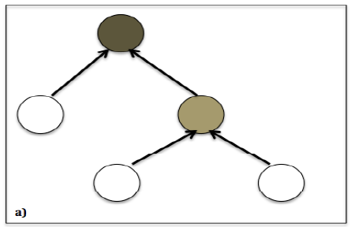
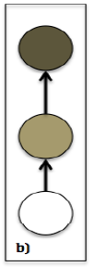
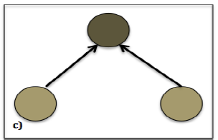
Argumentation Structure Typology [Ghosh et al., 2016]
Claims are linked with supporting premises
Classify 3 tree-like structures
Tree depth > 1
Chain
Tree depth = 1

Slide 70
Experiment(s): Automated Essay Scoring (AES) with Argumentation Features
Baseline AES model
  Enhanced AI Scoring Engine (EASE)
  Features:
    Length: counts of words, characters, punctuations, average word length
    Prompt: count and fraction of words in commons with prompts
    Bag of words: unigrams, bigrams
    Part-of-speech: count and fraction of “good” POS sequences
Our model
  EASE augmented with argumentation features (based on the output of our pre-trained, end-to end argument mining system)
Scoring corpus: Persuasive essays of Kaggle ASAP data
  Prompt 1: 1783 essays about good vs. bad effects of computers
  Prompt 2: 1800 essays about censorship in libraries
  Holistically scored
https://github.com/edx/ease. Top 3 of Kaggle ASAP competition (2012)

Slide 71
Cross-Prompt Results
Experiment with different feature combinations for an upper-bound performance
  Set 1→2: EASE + AC + CL + TS
  Set 2→1: EASE + AC + RL + TS
Feature set | Set: 1→2 |  | Set: 2→1
 | Kappa | QWK | Kappa | QWK
[Phandi et al., 2015] | n/a | 0.545 | n/a | n/a
[Dong & Zhang, 2016] | n/a | 0.569 | n/a | n/a
EASE | 0.234 | 0.585 | 0.048 | 0.491
EASE + ARG | 0.298 | 0.622 | 0.049 | 0.493
Our best | 0.336 | 0.649 | 0.053 | 0.529

Slide 72
Cross-Prompt Results
Experiment with different feature combinations for an upper-bound performance
  Set 1→2: EASE + AC + CL + TS
  Set 2→1: EASE + AC + RL + TS
Feature set | Set: 1→2 |  | Set: 2→1
 | Kappa | QWK | Kappa | QWK
[Phandi et al., 2015] | n/a | 0.545 | n/a | n/a
[Dong & Zhang, 2016] | n/a | 0.569 | n/a | n/a
EASE | 0.234 | 0.585 | 0.048 | 0.491
EASE + ARG | 0.298 | 0.622 | 0.049 | 0.493
Our best | 0.336 | 0.649 | 0.053 | 0.529
Argumentation features help improve cross-prompt performance
  Even when computed using the output of an end-to-end argument mining system that was trained on the persuasive essay corpus!
Both component-based and relation-based features show up in the best combination
Similar results in a second corpus of graded essays (from native language identification shared task)

Slide 73
Context-Aware Argument Mining: Summary
Novel contextual features for argument mining (AM)
  Algorithm for argument and domain word extraction
  Context-window framework
Use of AM output for automated essay scoring (AES)
  Extrinsic evaluation of end-to-end argument mining systems
  Comprehensive analysis of a large set of argument-enabled features
AM and AES models are evaluated comprehensively
  Cross-fold vs. cross-topic vs. cross-corpus training/testing splits
  Manually annotated versus predicted system outputs
  Different corpora, AM annotation schemas, student writing fluency and essay quality
  Strong baselines

Slide 74
Talk Summary
NLP-supported argument mining for educational applications at scale
  Feature / Algorithm Development
    Noisy and diverse data
    Meaningful features
    Real-time performance
  Experimental Evaluations
    Response-to-Text Assessment (grade school)
    Argument Mining (undergraduates; web)
Even non-structural and application-dependent argument mining can support useful applications!

Slide 75



Thank You!
Questions?
Further information, data, and software
  http://www.cs.pitt.edu/~litman

Slide 76
Audience Participation: Temporal Argument Mining
(Revision Analysis via Sentence Alignment)
Draft 1:
In the circle, I would place Bill Clinton because he had an affair with his aide.
Draft 2:
In the third circle of Hell, sinners have uncontrollable lust.
The carnal sinners in this level are punished by a howling, endless wind.
Bill Clinton would be in this level because he had an affair with his aide.
Notes:
This is another set of comments about thesis statement on a different essay. As you can see, Reviewer #2 identified the wrong sentence as the thesis and Reviewer #3 also expressed some confusion.
Our study is the first step toward solving this problem.

Slide 77
Audience Participation: Temporal Argument Mining
(Revision Analysis via Sentence Alignment)
Draft 1:
In the circle, I would place Bill Clinton because he had an affair with his aide.
Draft 2:
In the third circle of Hell, sinners have uncontrollable lust.
The carnal sinners in this level are punished by a howling, endless wind.
Bill Clinton would be in this level because he had an affair with his aide.
R1: Align: null->1 Op: Add Purpose: Argumentative
R2: Align: 1->3 Op: Modify Purpose: Surface
….
Notes:
This is another set of comments about thesis statement on a different essay. As you can see, Reviewer #2 identified the wrong sentence as the thesis and Reviewer #3 also expressed some confusion.
Our study is the first step toward solving this problem.

Slide 78
Temporal Argument Mining
How are arguments changed during revision?
Argument mining subtasks
  Segmentation: sentences
    Revision extraction via alignment [Zhang & Litman, 2014]
  Segment classification: argumentative purpose
    Wikipedia features [Zhang & Litman, 2015]
    Contextual methods [Zhang & Litman, 2016]

Slide 79
Revision Extraction
[Zhang & Litman, 2014]
Treat alignment as classification
  Construct sentence pairs using the Cartesian product across drafts
  Compute sentence similarity
  Logistic regression determines whether a pair is aligned or not
Global alignment [Needleman & Wunsch, 1970]
  Sentences are more likely to be aligned if sentences before are aligned
  Starting from the first pair, find the path to maximize likelihood
    s(i, j) = max{s(i−1, j−1)+sim(i, j), s(i− 1, j) + insertcost , s(i, j − 1) + deletecost}
TF*IDF similarity yields the best results
  90 -94% within and across several corpora

Slide 80
Revision Purpose Annotation
[Zhang & Litman, 2015]
2 binary (5 fine-grained) categories
  Argumentative
    Claim
    Warrant
    Evidence
    General content
  Surface
Kappa = .7
  2 high school corpora (>1000 revisions each)

Slide 81
Revision Purpose Classification
[Zhang & Litman, 2015]
Each sentence pair is an instance
Features based on Wikipedia revisions [Adler et al., 2011; Javanmardi et al., 2011; Bronner & Monz, 2012; Daxenberger & Gurevych, 2013]
  Location
  Sentence (first/last in paragraph, exact index)
  Paragraph (first/last in essay, exact index)
  Textual
  Keywords: “because”, “however”, “for example” ….
  Named-entity
  Sentence difference (Levenshtein distance…)
  Revision operation (Add/Delete/Modify)
  Language
  Out of vocabulary words

Slide 82
Experimental Evaluations
Surface vs. argumentative
  Intrinsic (SVM, 10-fold): results significantly better than unigram baseline
  Extrinsic: predicted versus actual labels yield same correlations with writing improvement
Fine-grained
  Intrinsic results mostly outperform unigram baselines
  Feature groups have different impacts

Slide 83
Enhancing Classification with Context
[Zhang & Litman, 2016]
Contextual features
  Original features, but for adjacent sentences
  Changes in cohesion (lexical) & coherence (semantic)
Sequence modeling
Results: Fine-grained labels
  Cohesion significantly improves results for one corpus (SVM, 10-fold)
  Sequence modeling yields best results for both corpora

Slide 84
Other Directions
New features from discourse analysis (PDTB)
Joint extraction and classification

Slide 85
Application
[Zhang, Hwa, Litman, & Hashemi, 2016]
ArgRewrite: A Web-based Revision Assistant for Argumentative Writings
  www.cs.pitt.edu/˜zhangfan/argrewrite

Slide 86
Revision Overview Interface

Slide 87
Revision Detail Interface

Slide 88
Summarizing Student Reflections
Student reflections have been shown to improve both learning and teaching
In large lecture classes (e.g. undergraduate STEM), it is hard for teachers to read all the reflections
  Same problem for MOOCs
Notes:
The first question is that you may ask is why Automatic Essay Assessment is important.
Well, in order to Score and provide feedback on written assignments in Tutoring systems and MOOCs, it is essential to have reliable AES systems. Even in class rooms with large number of students and frequent writing assignments, Providing individual feedback to students is a burden and a very time consuming task for teatures.
Consider the capitalization

Slide 89
Student Reflections and a TA’s Summary
Reflection Prompt: Describe what was confusing or needed more detail.
Student Responses
S1: Graphs of attraction/repulsive & interatomic separation
S2: Property related to bond strength
S3: The activity was difficult to comprehend as the text fuzzing and difficult to
read.
S4: Equations with bond strength and Hooke's law
S5: I didn't fully understand the concept of thermal expansion
S6: The activity ( Part III)
S7: Energy vs. distance between atoms graph and what it tells us
S8: The graphs of attraction and repulsion were confusing to me
… (rest omitted, 53 student responses in total)

Slide 90
Student Reflections and a TA’s Summary
Reflection Prompt: Describe what was confusing or needed more detail.
Student Responses
S1: Graphs of attraction/repulsive & interatomic separation
S2: Property related to bond strength
S3: The activity was difficult to comprehend as the text fuzzing and difficult to
read.
S4: Equations with bond strength and Hooke's law
S5: I didn't fully understand the concept of thermal expansion
S6: The activity ( Part III)
S7: Energy vs. distance between atoms graph and what it tells us
S8: The graphs of attraction and repulsion were confusing to me
… (rest omitted, 53 student responses in total)
Summary created by the Teaching Assistant
1) Graphs of attraction/repulsive & atomic separation [10*]
2) Properties and equations with bond strength [7]
3) Coefficient of thermal expansion [6]
4) Activity part III [4]
* Numbers in brackets indicate the number of students who semantically mention each phrase (i.e., student coverage)

Slide 91
Enhancing Large Classroom Instructor-Student Interactions via Summarization
CourseMIRROR: A mobile app for collecting and browsing student reflections
  [Fan, Luo, Menekse, Litman, & Wang, 2015]
  [Luo, Fan, Menekse, Wang, & Litman, 2015]
A phrase-based approach to extractive summarization of student-generated content
  [Luo & Litman, 2015]

Slide 92
Challenges for (Extractive) Summarization
  Student reflections range from single words to multiple sentences
  Concepts (represented as phrases in the reflections) that are semantically mentioned by more students are more important to summarize
  Deployment on mobile app

Slide 93
Phrase-Based Summarization
Stage 1: Candidate Phrase Extraction
  Noun phrases (with filtering)
Stage 2: Phrase Clustering
  Estimate student coverage with semantic similarity
Stage 3: Phrase Ranking
  Rank clusters by student coverage
  Select one phrase per cluster

Slide 94
Data
An Introduction to Materials Science and Engineering Class
53 undergraduates generated reflections via paper
3 reflection prompts
  Describe what you found most interesting in today's class.
  Describe what was confusing or needed more detail.
  Describe what you learned about how you learn.
12 (out of 25) lectures have TA-generated summaries for each of the 3 prompts

Slide 95
Quantitative Evaluation
Summarization baseline algorithms
  Keyphrase extraction
  Sentence extraction
  Sentence extraction methods using NPs
Performance in terms of human-computer overlap
  R-1, R-2, R-SU4 (Rouge scores)
Results
  Our method outperforms all baselines for F-measure

Slide 96

From Paper to Mobile App
[Luo et al., 2015]
Two semester long pilot deployments during Fall 2014
Average ratings of 3.7 (5 Likert-scale) on survey questions
  I often read reflection summaries
  I benefited from reading the reflection summaries
Qualitative feedback
  “It's interesting to see what other people say and that can teach me something that I didn't pay attention to.”
  “Just curious about whether my points are accepted or not.”

Slide 97
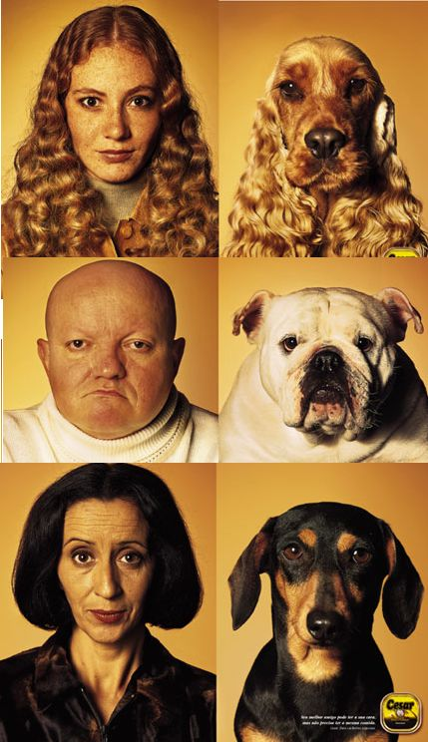
Teams Project: Entrainment and Task Success in Team Conversations

Slide 98
Teams Project: Entrainment and Task Success in Team Conversations
Multi-party entrainment measures that are computable using NLP
Applications
  Conversational agents
  Browsers for (un)successful teams

Slide 99
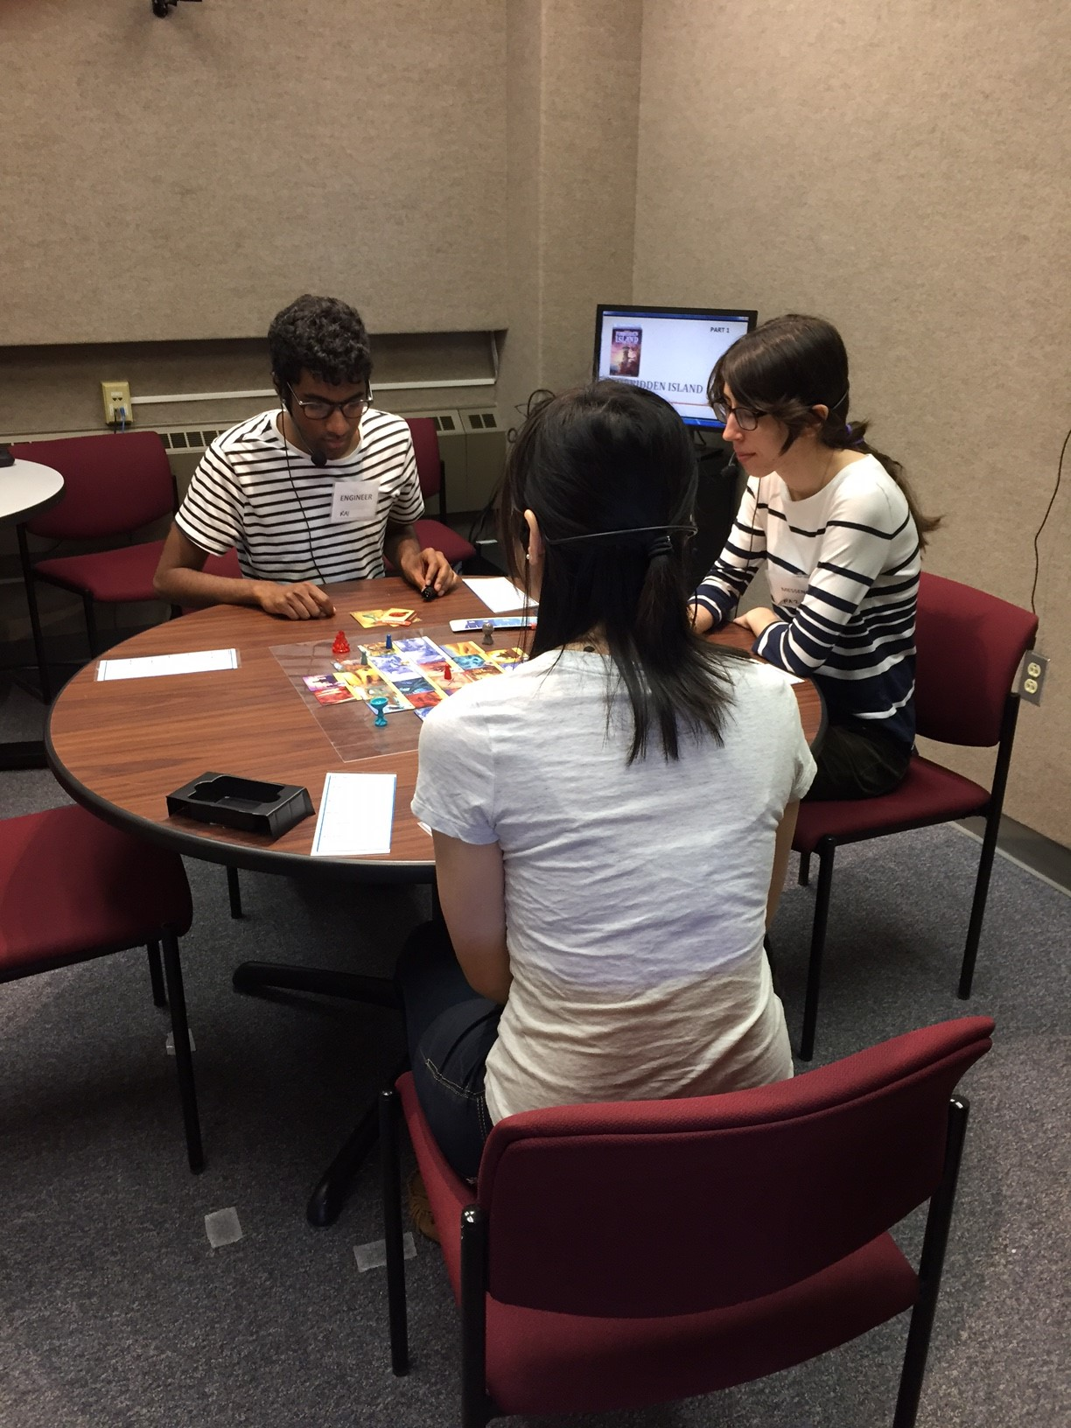
Experimentally Collected Data
Experimental Design
  Team Training or Not
  First vs. Second Games
Audio-Video
  47 hours
  63 teams
Questionnaires
  216 individuals

Slide 100
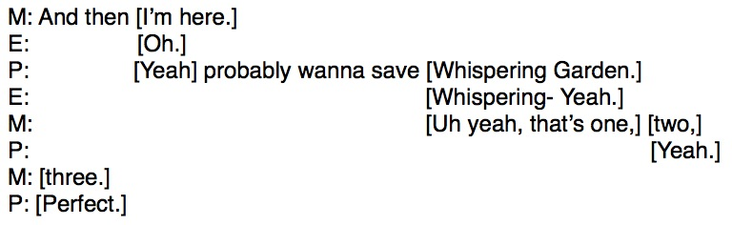
What teams say (transcriptions)

Slide 101
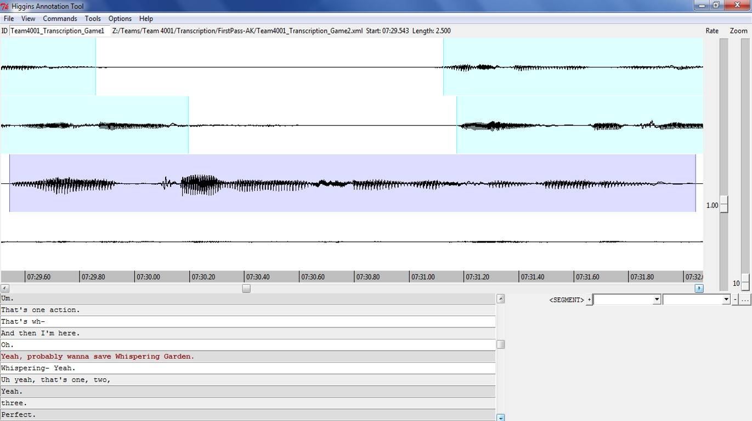
How teams say it (audio)

Slide 102
How teams say it (video)
Non-verbal communication
  Gaze
  Gesture
  Facial expressions
  Etc.

