Slide 1



Natural Language Processing for
Enhancing Teaching and Learning at Scale
Diane Litman
  Professor, Computer Science Department
  Co-Director, Intelligent Systems Program
  Senior Scientist, Learning Research & Development Center
University of Pittsburgh
Pittsburgh, PA USA
Notes:
Online reviews is an important information resources for our everyday life.
Reviews play an important role in consumer purchase decisions, and thus has an economic impact on product sales
Stats:
-71% of consumers read online reviews. -55% of consumers trust a local business more after reading positive online reviews. -50% of consumers are more likely to use a local business having read positive reviews. -67% of consumers trust online reviews as much as personal recommendations.

Slide 2
Natural Language Processing (NLP)
Getting computers to perform useful and interesting tasks involving human languages
  languages such as English, Spanish, Chinese, etc.
  as opposed to computer languages such as Python

Slide 3
Why is NLP needed?
  An enormous amount of machine readable text, audio, and video is now available
  Conversational agents such as Siri and Alexa are becoming an important form of human-computer communication
  2731 being taught this spring

Slide 4
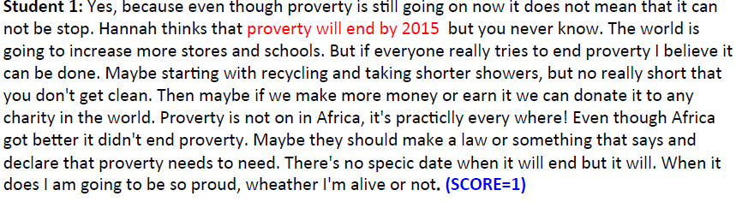
Roles for Language Processing in Education
Learning Language
(e.g., reading, writing, speaking)
Automatic Essay Grading

Slide 5

Roles for Language Processing in Education
Using Language
(e.g., teaching in the disciplines)
Tutorial Dialogue Systems for STEM

Slide 6
Roles for Language Processing in Education
Processing Language
(e.g,. from MOOCs)

Slide 7
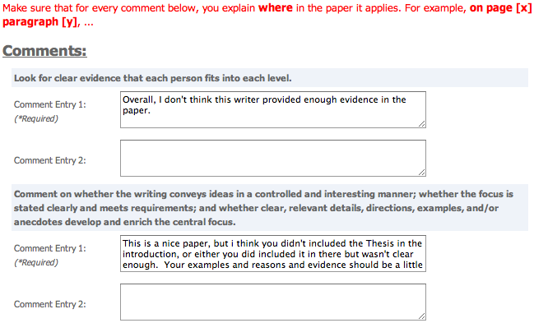
Roles for Language Processing in Education
Processing Language
(e.g.. from MOOCs)
Peer Feedback

Slide 8

Roles for Language Processing in Education
Processing Language
(e.g., from MOOCs)
Student Reflections

Slide 9





Roles for Language Processing in Education
Learning Language Using Language Processing Language
(writing: argumentation (speaking: group (user-generated
and revision) conversations) content)
Huy Nguyen Zahra Rahimi Wencan Luo
(finishing) (5th year ISP) (finishing)
Fan Zhang Luca Lugini
(finishing) (3rd year)

Slide 10
NLP for Education Research Lifecycle
Systems and Evaluations
Real-World
Problems
Learning and Teaching
Higher Level Learning Processes
NLP-Based Educational Technology
Challenges!
User-generated content
Meaningful constructs
Real-time performance
Theoretical and Empirical Foundations

Slide 11
Example Research Question
Can argument mining be used to better teach, assess, and understand argumentative writing?
Approach: Technology design and evaluation
  System enhancements that improve student learning
  Argument analytics for teachers
  Experimental platforms to test research predictions

Slide 12
Argument Mining
“… exploits the techniques and methods of natural language processing … for semi-automatic and automatic recognition and extraction of structured argument data from unstructured … texts.” [SICSA Workshop on Argument Mining, July 2014]

Slide 13
Mining a Grade School Essay for Evidence
I was convinced that winning the fight of poverty is achievable in our lifetime. Many people couldn't afford medicine or bed nets to be treated for malaria . Many children had died from this dieseuse even though it could be treated easily. But now, bed nets are used in every sleeping site . And the medicine is free of charge. Another example is that the farmers' crops are dying because they could not afford the nessacary fertilizer and irrigation . But they are now, making progess. Farmers now have fertilizer and water to give to the crops. Also with seeds and the proper tools . Third, kids in Sauri were not well educated. Many families couldn't afford school . Even at school there was no lunch . Students were exhausted from each day of school. Now, school is free . Children excited to learn now can and they do have midday meals . Finally, Sauri is making great progress. If they keep it up that city will no longer be in poverty. Then the Millennium Village project can move on to help other countries in need.

Slide 14
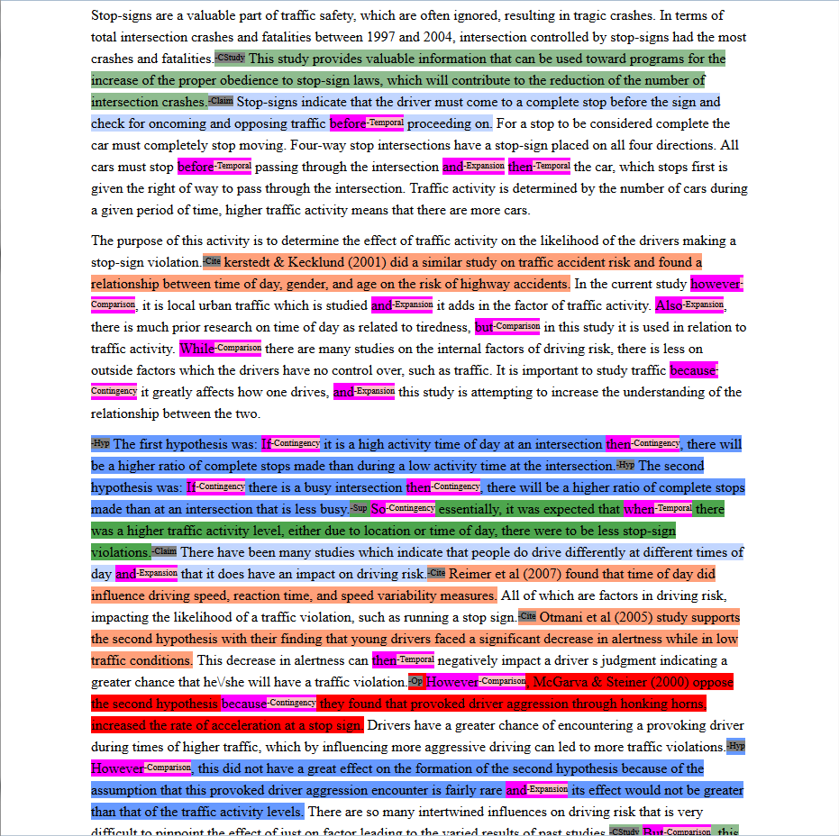
Mining a College Essay for Argument Diagram Ontology
(i.e., node and arc types)
Current Study
Claim
Citation
Hypothesis
Supports
Opposes
None
Notes:
Expert score 3 out of 5, 5 is max, 0 is min, integer values only

Slide 15
Mining Drafts of a High School Essay for
Argument-Oriented Revisions
  Draft 1:
  In the first circle Limbo where the unbaptized and those before Christ dwell, live in complete darkness.
  There is no other punishment since in life they never experienced the radiance of Christ.
Draft 2:
The first circle Limbo is where the unbaptized go.
They are not punished because they did not know Christ.
Notes:
From slide 30 to 34 title is not right, C1: Example:
----- Meeting Notes (15/11/24 15:10) -----
aligning the sentences, show the gaps
make it like a story

Slide 16
Argument Mining Subtasks
[Peldszus and Stede, 2013]
Scope of today’s talk
Even partial argument mining can support useful applications
  Mostly non-structural (e.g., no relations, no argument schema)
  Often application-dependent roles (e.g., no premises)
  But, real data!!

Slide 17
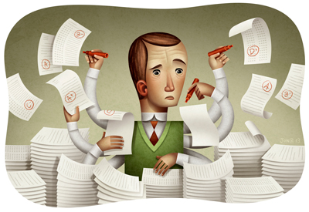
Why Automatic Writing Assessment?
Essential for Massive Open Online Courses (MOOCs) and tutoring systems
Even in traditional classes, frequent assignments can limit the amount of teacher feedback
Notes:
The first question is that you may ask is why Automatic Essay Assessment is important.
Well, in order to Score and provide feedback on written assignments in Tutoring systems and MOOCs, it is essential to have reliable AES systems. Even in class rooms with large number of students and frequent writing assignments, Providing individual feedback to students is a burden and a very time consuming task for teatures.
Consider the capitalization

Slide 18
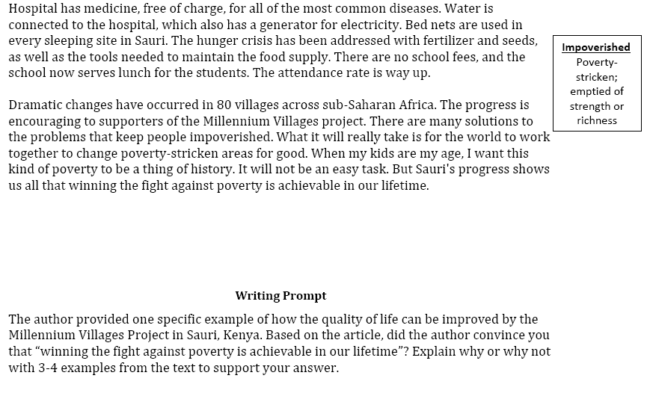
An Example Writing Assessment Task: Response to Text (RTA)
MVP, Time for Kids – informational text

Slide 19
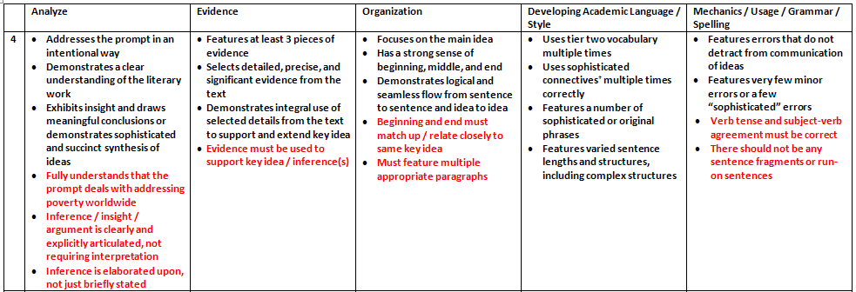
Excerpt from the Scoring Rubric

Slide 20
Audience Participation: Evidence Scoring (1 or 4?)
Student 1: Yes, because even though proverty is still going on now it does not mean that it can not be stop. Hannah thinks that proverty will end by 2015 but you never know. The world is going to increase more stores and schools. But if everyone really tries to end proverty I believe it can be done. Maybe starting with recycling and taking shorter showers, but no really short that you don't get clean. Then maybe if we make more money or earn it we can donate it to any charity in the world. Proverty is not on in Africa, it's practiclly every where! Even though Africa got better it didn't end proverty. Maybe they should make a law or something that says and declare that proverty needs to need. There's no specic date when it will end but it will. When it does I am going to be so proud, wheather I'm alive or not.
Student 2: I was convinced that winning the fight of poverty is achievable in our lifetime. Many people couldn't afford medicine or bed nets to be treated for malaria . Many children had died from this dieseuse even though it could be treated easily. But now, bed nets are used in every sleeping site . And the medicine is free of charge. Another example is that the farmers' crops are dying because they could not afford the nessacary fertilizer and irrigation . But they are now, making progess. Farmers now have fertilizer and water to give to the crops. Also with seeds and the proper tools . Third, kids in Sauri were not well educated. Many families couldn't afford school . Even at school there was no lunch . Students were exhausted from each day of school. Now, school is free . Children excited to learn now can and they do have midday meals . Finally, Sauri is making great progress. If they keep it up that city will no longer be in poverty. Then the Millennium Village project can move on to help other countries in need.

Slide 21
Automatic Scoring via Argument Mining
Student 1: Yes, because even though proverty is still going on now it does not mean that it can not be stop. Hannah thinks that proverty will end by 2015 but you never know. The world is going to increase more stores and schools. But if everyone really tries to end proverty I believe it can be done. Maybe starting with recycling and taking shorter showers, but no really short that you don't get clean. Then maybe if we make more money or earn it we can donate it to any charity in the world. Proverty is not on in Africa, it's practiclly every where! Even though Africa got better it didn't end proverty. Maybe they should make a law or something that says and declare that proverty needs to need. There's no specic date when it will end but it will. When it does I am going to be so proud, wheather I'm alive or not. (SCORE=1)
Student 2: I was convinced that winning the fight of poverty is achievable in our lifetime. Many people couldn't afford medicine or bed nets to be treated for malaria . Many children had died from this dieseuse even though it could be treated easily. But now, bed nets are used in every sleeping site . And the medicine is free of charge. Another example is that the farmers' crops are dying because they could not afford the nessacary fertilizer and irrigation . But they are now, making progess. Farmers now have fertilizer and water to give to the crops. Also with seeds and the proper tools . Third, kids in Sauri were not well educated. Many families couldn't afford school . Even at school there was no lunch . Students were exhausted from each day of school. Now, school is free . Children excited to learn now can and they do have midday meals . Finally, Sauri is making great progress. If they keep it up that city will no longer be in poverty. Then the Millennium Village project can move on to help other countries in need. (SCORE=4)

Slide 22
Automatic Scoring of an Analytical
Response-To-Text Assessment (RTA)
[Rahimi, Litman, Correnti, Matsumura, Wang & Kisa, 2014]
Current work
  writing assessment via meaningful features that operationalize the Evidence rubric of RTA
Long-term goals
  informative feedback for students and teachers
  large-scale research on the impact of instruction and policies
Argument mining subtasks
  segmentation: spans of text
  segment classification: evidence from text (or not)

Slide 23
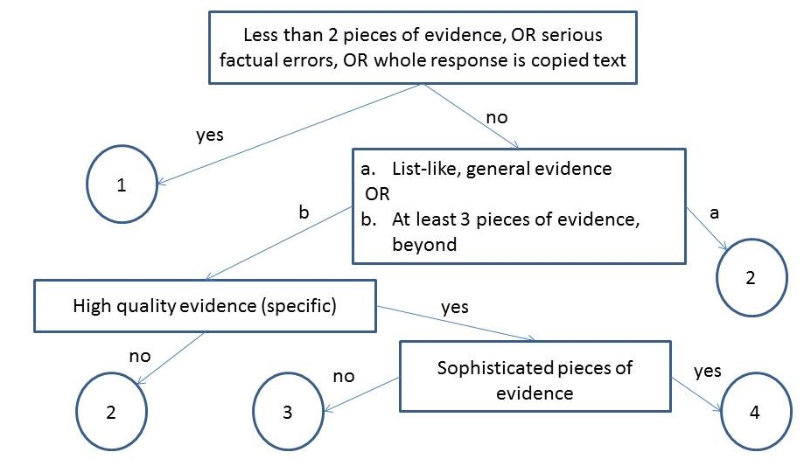
Rubric-Based Features
Notes:
What is evidence topic subtopic,
Copping how much copy is copying

Slide 24
Our Features
Number of Pieces of Evidence (NPE)
  Topics and words based on the text and experts
Notes:
What is evidence topic subtopic,
Copping how much copy is copying

Slide 25
Our Features
Notes:
What is evidence topic subtopic,
Copping how much copy is copying

Slide 26
Our Features
Concentration (CON)
High concentration essays have fewer than 3 sentences with topic words (i.e., evidence is not elaborated)
Notes:
What is evidence topic subtopic,
Copping how much copy is copying

Slide 27
Our Features
Notes:
What is evidence topic subtopic,
Copping how much copy is copying

Slide 28
Our Features
Specificity (SPC)
Specific examples from different parts of the text
Notes:
What is evidence topic subtopic,
Copping how much copy is copying

Slide 29
Our Features
Word Count (WOC)
Potentially helpful fallback feature (temporarily )
Notes:
What is evidence topic subtopic,
Copping how much copy is copying

Slide 30
Corpora
Data [Correnti et al., 2013]
  1569 essays from grades 5-6
    Short, many spelling and grammatical errors
  1045 essays from grades 6-8

Slide 31
Experimental Evaluation
Baseline1 [Mayfield 13]: one of the best methods from the Hewlett Foundation competition [Shermis and Hamner, 2012]
  Features: primarily bag of words (top 500)
Baseline2: Latent Semantic Analysis
  Based on the scores of the 10 most similar essays, weighted by semantic similarity [Miller 03]
Notes:
Make shorter

Slide 32
Results
Proposed features outperform both baselines
  validity plus increased reliability!

Slide 33
Other Results
Removing features significantly degrades performance
Wordcount is only useful for discriminating score 4 (where no rubric features were defined)
Features also outperform baselines on essays from grades 6-8

Slide 34
Additional Directions
Coherence of evidence (Organization rubric)
  topic-based (rather than lexical) methods
    topic grids, topic chains [Rahimi, Litman, Wang & Correnti, 2015]
Automatic extraction of evidence from source
  replace expert knowledge with data-driven methods
    LDA, turbo-topic [Rahimi and Litman, 2016]
Domain adaptation across grade-levels

Slide 35
ArgumentPeer Project
Phase I: Argument
Diagramming
Author creates Argument Diagram
Peers review Argument Diagrams
Author revises Argument Diagram
Author writes paper
Peers review papers
Author revises paper
Phase II: Writing

Slide 36
Audience Participation: Argument Mining
Written Essay Excerpt:
There have been many studies which indicate that people do drive differently at different times of day and that it does have an impact on driving risk. Reimer et al (2007) found that time of day did influence driving speed, reaction time, and speed variability measures.
Argument Ontology:
Components
  Current Study
  Hypothesis
  Claim
  Citation
Relations
  Supports
  Opposes

Slide 37
Audience Participation: Argument Mining
Written Essay Excerpt:
There have been many studies which indicate that people do drive differently at different times of day and that it does have an impact on driving risk. Reimer et al (2007) found that time of day did influence driving speed, reaction time, and speed variability measures.
Argument Ontology:
Components
  Current Study
  Hypothesis
  Claim
  Citation
Relations
  Supports
  Opposes

Slide 38
Audience Participation: Essay Scoring (1 or 4?)
Human Argument Mining
Hypothesis: 1, Supports: 2, Opposes: 1, Citation: 7 (6 unique)
Frequently, people encounter situations in their environment where they can either choose to be prosocial or antisocial. It is therefore of great importance to study what makes people choose either response. Previous research has indicated that as group size increases, prosocial responses decrease, a phenomenon known as the bystander effect (Fischer, Krueger, Greitemeyer, Vogrincic, Kastenmuller, Frey, Heene, Wicher, Kainbacher, 2011). In our particular study, a participant sneezed on an elevator and noted whether or not somebody had a nice response such as “God bless you.” The nice response would be equivalent to a prosocial behavior. The results of this study can give insight into what makes people more or less likely to engage in prosocial behavior in different situations, so this study has good external validity. This research topic is worth of study because the results may show how likely people are to help others in a more critical situation, such as somebody getting mugged, etc. It is important to realize that sneezing on an elevator is not necessarily a dangerous situation to act prosocially in, but the result will lead to a better understanding of whether or not gender and group size contribute to prosocial responses.
Previous research has shown that females seem to be more likely to engage in prosocial behavior as distance decreases, and this correlates to the hypothesis of this particular study (McCullough, Tabak, 2010). From this same previous research, it seems that females are more likely to do this because females tend to behave in more altruistic ways than males. In other words, females should give a nice response to a sneeze more often than males, and this was part of our hypothesis. Previous research has also indicated that people who have the knowledge of how to behave prosocially in a particular situation are more likely to do so (Anker, Feeley, 2011). If somebody in the elevator is from a certain religion or has recently moved and is not aware of what to say after somebody sneezes, then they most likely will not give a response at all, and this was not considered when putting together the results of the study. This should have been important to consider because knowledge of what to say after a sneeze could be a confounding variable in the results. Lastly, previous studies have shown that moral frames often determine whether or not people will give a prosocial response (Thornberg, 2010). Overall, the better somebody’s moral frames are, the more likely they are to give a prosocial response. This correlates to our particular study because the people who didn’t give a response could possibly have negative moral frames. A future experiment could study this and the results would be interesting and could give additional information about what makes people behave prosocially.
In our study, it was hypothesized that as group size increased, the likelihood of a prosocial response would increase, and that females were more likely to give a prosocial response than males. Previous research from McCullough, etc (2011) conflicted with the hypothesis that as group size increases, prosocial responses should increase. McCullough’s study showed this to be the opposite – as group size increases, prosocial behavior decreases, a phenomenon known as the bystander effect. Previous research about gender, however, showed that females are more likely to behave prosocially due to their nature and altruistic characteristics; this evidence supports our hypothesis (Levine, Cassidy, Jentzsch, 2010).

Slide 39
Audience Participation: Essay Scoring (1 or 4?)
Human Argument Mining
Hypothesis: 1, Supports: 5, Opposes: 3, Citation: 15 (6 unique)
In today’s tough economic climate, any factors that may contribute to a successful business or enterprise have become increasingly important. One prevalently researched factor is prosocial behavior which is comparable to helping behaviors. Research has shown that prosocial behaviors have been associated with job satisfaction, productivity, and client satisfaction (Danzis & Stone-­‐Romero, 2009). Therefore the understanding of what situations support and encourage prosocial behaviors could be an asset to any manager or business (Danzis & Stone-­‐ Romero, 2009).
Previous research has focused on relationships of prosocial behavior between gender and the effect of group size. With regards to gender, there has been much debate over whether females or males are inherently more prosocial. Research has been done on gender by implementing a training program on empathy with children in day care centers between the ages of 5-­‐6 Kallipuska, 1991). The results of this study concluded that females were more prosocial than males based on teacher appraisals (Kallipuska, 1991).Other research supports that females are more prosocial but only to familiar individuals or when following a social norm (Danzis & Stone-­‐Romero 2009). In contrast, males were considered to be more “chivalrous”(p.722) which would promote them to exhibit more prosocial behavior toward strangers relative to females(Danzis & Stone-­‐Romero, 2009).
In addition to studies on the relationship between prosocial behavior and gender, there is also research between group sizes and prosocial behavior. One of the most well­‐known psychological phenomena is the bystander effect which describes a diffusion of responsibility as group size increases (Garcia, Weaver, Darley, & Moskowitz, 2002).More recent studies have described an implicit bystander effect which claims that it is even possible to create diffusion of responsibility even when no one else is around by priming participants about group mentality (Garcia, Weaver, Darley, & Moskowitz, 2002). There has even been debate over the implications of the implicit identity effect. One research study claimed that the implicit identity can only be used to inhibit prosocial behavior such as through the bystander effect (Garcia, Weaver, Darley, & Moskowitz, 2002). Yet, conflicting research has found evidence to support a theory that the implicit identity effect can be used to encourage prosocial behavior if it follows the group’s social norms (Levine & Crowther, 2008). Also, a study by Krupka and Weber (2009) found that even when people observe others acting selfishly, on average this produces prosocial behavior due to the focusing effecting of norms (2009).Therefore the focusing effect of norms can be defined as being aware of the behavior of others aroundKrupka & Weber, 2009).
The current study sought to find relationships between prosocial behavior, gender and group size. Prosocial behavior was defined as someone verbally responding to the observer’s sneeze. In order to create a controlled environment, the study took place on elevators in on-­‐campus buildings only. Unlike previous research, our study did not prime the participants before they entered the elevator so it was comparable to the control group of the Krupka & Weber study(2009). I predicted that females would respond more than males and that responses would be more likely in a group of more than two other people on the elevator.According to the Kallipuska study, females appear to be more prosocial and polite than males and would be more likely to respond to a sneeze(1991). With regards to group size, research shows that the focusing effect of norms becomes more apparent when others are present(Krupka & Weber, 2009).One contradiction to this hypothesis would be the Garcia, Weaver, Darley, & Moskowitz study that the implicit bystander effect can cause a diffusion of responsibility in large groups which could cause no one to respond to the sneeze(2002).

Slide 40
Actual Expert Essay Scores (via rubric)
SCORE = 1
Sentences/Words: 22/564
Hypothesis: 1
Supports: 2
Opposes: 1
Citation: 7 (6 unique)
SCORE = 4
Sentences/Words: 26/610
Hypothesis: 1
Supports: 5
Opposes: 3
Citation: 15 (6 unique)

Slide 41
Argument Mining via Argument/Domain Words
[Nguyen & Litman 2015, 2016]
Prompt-abstracted argument mining
  LDA-enabled features and constraints
    Seeding to extract argument vs. domain words
  Intrinsic evaluation
Corpora
  Ontology annotated peer review essays (prior project)
  Claim/premise annotated persuasive essays (today)
    [Stab & Gurevych, 2014]

Slide 42
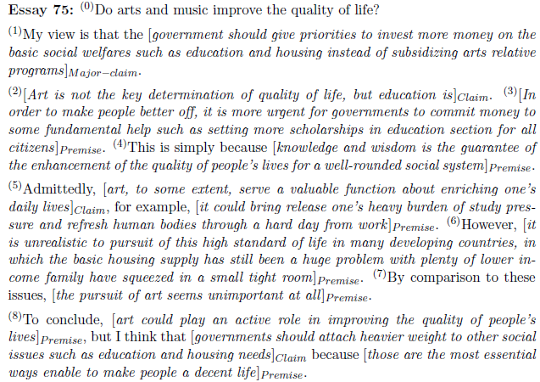
Persuasive Essay Corpus
Major-claim(1)
Support
Claim(2)

Slide 43
Creating Seeds
Development corpus
  6794 persuasive essays with post titles collected from www.essayforum.com
10 argument seeds
  agree, disagree, reason, support, advantage, disadvantage, think, conclusion, result, opinion
3077 domain seeds
  in title, but not argument seeds or stop words

Slide 44
Post-Processing LDA Output
Compute three weights for each LDA topic
  Domain weight is the sum of domain seed frequencies
  Argument weight is the number of argument seeds
  Combined weight = Argument weight – Domain weight
Find the best number of topics with the highest ratio of combined weight of top-2 topics
The argument word list is the LDA topic with the largest combined weight given the best number of topics

Slide 45
Resulting Argument/Domain Words
36 LDA topics
263 (stemmed) argument words
  seed variants (e.g., believe, viewpoint, argument, claim)
  connectives (e.g., therefore, however, despite)
  stop words
1806 (stemmed) domain words
Topic 1 (argument words) | reason exampl support agre think becaus disagre statement opinion believe therefor idea conclus ...
Topic 2 (domain words) | citi live big hous place area small apart town build communiti factori urban ...
Topic 3 (domain words) | children parent school educ teach kid adult grow childhood behavior taught ...

Slide 46

Full Feature Sets for 3 Methods
Stab14 (Stab & Gurevych 2014)
Nguyen15 (Nguyen & Litman 2015)
Nguyen16 (Nguyen & Litman 2016)
1-, 2-, 3-grams
Argument words as unigrams
Nguyen15v2
Numbers of common words with title and preceding sentence
Comparative & superlative adverbs and POS
Plural first person pronouns
Discourse relation labels
Lexical
(I)
Verbs, adverbs, presence of model verb
Discourse connectives,
Singular first person pronouns
Same as Stab14
(I)
Parse
(II)
Production rules
Argument subject-verb pairs
Tense of main verb
#sub-clauses, depth of parse tree
(II)
Same as Stab14
Structure
(III)
#tokens, token ratio, #punctuation, sentence position, first/last paragraph, first/last sentence of paragraph
Same as Stab14
(III)
Context
(IV)
#tokens, #punctuation, #sub-clauses, modal verb in preceding/following sentences
(IV)

Slide 47
Experimental Results
10x10-fold cross validation
Best values in bold
* means significantly worse than Nguyen16
LDA-enabled and other proposed features improve performance
 | Stab14 | Nguyen15 | Nguyen16
Accuracy | 0.787* | 0.792* | 0.805
Kappa | 0.639* | 0.649* | 0.673
Precision | 0.741* | 0.745* | 0.763
Recall | 0.694* | 0.698* | 0.720

Slide 48
Cross-Topic Evaluation
11 single-topic groups
  E.g., Technologies (11 essays), National Issues (10), School (8), Policies (7)
1 mixed topic group of 17 essays (< 3 essays per topic)
Proposed features are more robust across topics
  Larger performance difference with Stab14 baseline
  Performance matches 10X10 fold experiment
 | Stab14 | Nguyen15 | Nguyen16
Accuracy | 0.780* | 0.796 | 0.807
Kappa | 0.623* | 0.654 | 0.675
Precision | 0.722* | 0.757* | 0.771
Recall | 0.670* | 0.695* | 0.722

Slide 49
Held-Out Test Sets
Stab’s split: 72 training essays, 18 testing essays
Nguyen’s split: 75 training essays, 15 testing essays
Findings hold when comparing to prior published results (rather than results based on our re-implementation)
 | Stab best | Our SMO | Nguyen best | Our LibLINEAR
Accuracy | 0.77 | 0.82 | 0.83 | 0.84
Kappa | - | 0.68 | 0.69 | 0.71
Precision | 0.33 | 0.79 | 0.79 | 0.81
Recall | 0.68 | 0.73 | 0.74 | 0.76

Slide 50
Discussion & Current Directions
New features significantly improve performance, generalize better, and compact the feature space
Current work
  argument relations
  essay scoring

Slide 51
ArgumentPeer Project
Phase I: Argument
Diagramming
Author creates Argument Diagram
Peers review Argument Diagrams
Author revises Argument Diagram
Author writes paper
Peers review papers
Author revises paper
Phase II: Writing

Slide 52
Audience Participation: Temporal Argument Mining
(Revision Analysis via Sentence Alignment)
Draft 1:
In the circle, I would place Bill Clinton because he had an affair with his aide.
Draft 2:
In the third circle of Hell, sinners have uncontrollable lust.
The carnal sinners in this level are punished by a howling, endless wind.
Bill Clinton would be in this level because he had an affair with his aide.
Notes:
This is another set of comments about thesis statement on a different essay. As you can see, Reviewer #2 identified the wrong sentence as the thesis and Reviewer #3 also expressed some confusion.
Our study is the first step toward solving this problem.

Slide 53
Audience Participation: Temporal Argument Mining
(Revision Analysis via Sentence Alignment)
Draft 1:
In the circle, I would place Bill Clinton because he had an affair with his aide.
Draft 2:
In the third circle of Hell, sinners have uncontrollable lust.
The carnal sinners in this level are punished by a howling, endless wind.
Bill Clinton would be in this level because he had an affair with his aide.
Notes:
This is another set of comments about thesis statement on a different essay. As you can see, Reviewer #2 identified the wrong sentence as the thesis and Reviewer #3 also expressed some confusion.
Our study is the first step toward solving this problem.

Slide 54
Audience Participation: Temporal Argument Mining
(Revision Analysis via Sentence Alignment)
Draft 1:
In the circle, I would place Bill Clinton because he had an affair with his aide.
Draft 2:
In the third circle of Hell, sinners have uncontrollable lust.
The carnal sinners in this level are punished by a howling, endless wind.
Bill Clinton would be in this level because he had an affair with his aide.
R1: Align: null->1 Op: Add Purpose: ?
R2: Align: 1->3 Op: Modify Purpose: ?
….
Notes:
This is another set of comments about thesis statement on a different essay. As you can see, Reviewer #2 identified the wrong sentence as the thesis and Reviewer #3 also expressed some confusion.
Our study is the first step toward solving this problem.

Slide 55
Audience Participation: Temporal Argument Mining
(Revision Analysis via Sentence Alignment)
Draft 1:
In the circle, I would place Bill Clinton because he had an affair with his aide.
Draft 2:
In the third circle of Hell, sinners have uncontrollable lust.
The carnal sinners in this level are punished by a howling, endless wind.
Bill Clinton would be in this level because he had an affair with his aide.
R1: Align: null->1 Op: Add Purpose: Argumentative
R2: Align: 1->3 Op: Modify Purpose: Surface
….
Notes:
This is another set of comments about thesis statement on a different essay. As you can see, Reviewer #2 identified the wrong sentence as the thesis and Reviewer #3 also expressed some confusion.
Our study is the first step toward solving this problem.

Slide 56
Temporal Argument Mining
How are arguments changed during revision?
Argument mining subtasks
  Segmentation: sentences
    Revision extraction via alignment [Zhang & Litman, 2014]
  Segment classification: argumentative purpose
    Wikipedia features [Zhang & Litman, 2015]
    Contextual methods [Zhang & Litman, 2016]

Slide 57
Revision Extraction
[Zhang & Litman, 2014]
Treat alignment as classification
  Construct sentence pairs using the Cartesian product across drafts
  Compute sentence similarity
  Logistic regression determines whether a pair is aligned or not
Global alignment [Needleman & Wunsch, 1970]
  Sentences are more likely to be aligned if sentences before are aligned
  Starting from the first pair, find the path to maximize likelihood
    s(i, j) = max{s(i−1, j−1)+sim(i, j), s(i− 1, j) + insertcost , s(i, j − 1) + deletecost}
TF*IDF similarity yields the best results
  90 -94% within and across several corpora

Slide 58
Revision Purpose Annotation
[Zhang & Litman, 2015]
2 binary (5 fine-grained) categories
  Argumentative
    Claim
    Warrant
    Evidence
    General content
  Surface
Kappa = .7
  2 high school corpora (>1000 revisions each)

Slide 59
Revision Purpose Classification
[Zhang & Litman, 2015]
Each sentence pair is an instance
Features based on Wikipedia revisions [Adler et al., 2011; Javanmardi et al., 2011; Bronner & Monz, 2012; Daxenberger & Gurevych, 2013]
  Location
  Sentence (first/last in paragraph, exact index)
  Paragraph (first/last in essay, exact index)
  Textual
  Keywords: “because”, “however”, “for example” ….
  Named-entity
  Sentence difference (Levenshtein distance…)
  Revision operation (Add/Delete/Modify)
  Language
  Out of vocabulary words

Slide 60
Experimental Evaluations
Surface vs. argumentative
  Intrinsic (SVM, 10-fold): results significantly better than unigram baseline
  Extrinsic: predicted versus actual labels yield same correlations with writing improvement
Fine-grained
  Intrinsic results mostly outperform unigram baselines
  Feature groups have different impacts

Slide 61
Enhancing Classification with Context
[Zhang & Litman, 2016]
Contextual features
  Original features, but for adjacent sentences
  Changes in cohesion (lexical) & coherence (semantic)
Sequence modeling
Results: Fine-grained labels
  Cohesion significantly improves results for one corpus (SVM, 10-fold)
  Sequence modeling yields best results for both corpora

Slide 62
Application
[Zhang, Hwa, Litman, & Hashemi, 2016]
ArgRewrite: A Web-based Revision Assistant for Argumentative Writings
  www.cs.pitt.edu/˜zhangfan/argrewrite

Slide 63
Revision Overview Interface

Slide 64
Revision Detail Interface

Slide 65
Summarizing Student Reflections
Student reflections have been shown to improve both learning and teaching
In large lecture classes (e.g. undergraduate STEM), it is hard for teachers to read all the reflections
  Same problem for MOOCs
Notes:
The first question is that you may ask is why Automatic Essay Assessment is important.
Well, in order to Score and provide feedback on written assignments in Tutoring systems and MOOCs, it is essential to have reliable AES systems. Even in class rooms with large number of students and frequent writing assignments, Providing individual feedback to students is a burden and a very time consuming task for teatures.
Consider the capitalization

Slide 66
Student Reflections and a TA’s Summary
Reflection Prompt: Describe what was confusing or needed more detail.
Student Responses
S1: Graphs of attraction/repulsive & interatomic separation
S2: Property related to bond strength
S3: The activity was difficult to comprehend as the text fuzzing and difficult to
read.
S4: Equations with bond strength and Hooke's law
S5: I didn't fully understand the concept of thermal expansion
S6: The activity ( Part III)
S7: Energy vs. distance between atoms graph and what it tells us
S8: The graphs of attraction and repulsion were confusing to me
… (rest omitted, 53 student responses in total)

Slide 67
Student Reflections and a TA’s Summary
Reflection Prompt: Describe what was confusing or needed more detail.
Student Responses
S1: Graphs of attraction/repulsive & interatomic separation
S2: Property related to bond strength
S3: The activity was difficult to comprehend as the text fuzzing and difficult to
read.
S4: Equations with bond strength and Hooke's law
S5: I didn't fully understand the concept of thermal expansion
S6: The activity ( Part III)
S7: Energy vs. distance between atoms graph and what it tells us
S8: The graphs of attraction and repulsion were confusing to me
… (rest omitted, 53 student responses in total)
Summary created by the Teaching Assistant
1) Graphs of attraction/repulsive & atomic separation [10*]
2) Properties and equations with bond strength [7]
3) Coefficient of thermal expansion [6]
4) Activity part III [4]
* Numbers in brackets indicate the number of students who semantically mention each phrase (i.e., student coverage)

Slide 68
Enhancing Large Classroom Instructor-Student Interactions via Summarization
CourseMIRROR: A mobile app for collecting and browsing student reflections
  [Fan, Luo, Menekse, Litman, & Wang, 2015]
  [Luo, Fan, Menekse, Wang, & Litman, 2015]
A phrase-based approach to extractive summarization of student-generated content
  [Luo & Litman, 2015]

Slide 69
Challenges for (Extractive) Summarization
  Student reflections range from single words to multiple sentences
  Concepts (represented as phrases in the reflections) that are semantically mentioned by more students are more important to summarize
  Deployment on mobile app

Slide 70
Phrase-Based Summarization
Stage 1: Candidate Phrase Extraction
  Noun phrases (with filtering)
Stage 2: Phrase Clustering
  Estimate student coverage with semantic similarity
Stage 3: Phrase Ranking
  Rank clusters by student coverage
  Select one phrase per cluster

Slide 71
Data
An Introduction to Materials Science and Engineering Class
53 undergraduates generated reflections via paper
3 reflection prompts
  Describe what you found most interesting in today's class.
  Describe what was confusing or needed more detail.
  Describe what you learned about how you learn.
12 (out of 25) lectures have TA-generated summaries for each of the 3 prompts

Slide 72
Quantitative Evaluation
Summarization baseline algorithms
  Keyphrase extraction
  Sentence extraction
  Sentence extraction methods using NPs
Performance in terms of human-computer overlap
  R-1, R-2, R-SU4 (Rouge scores)
Results
  Our method outperforms all baselines for F-measure

Slide 73
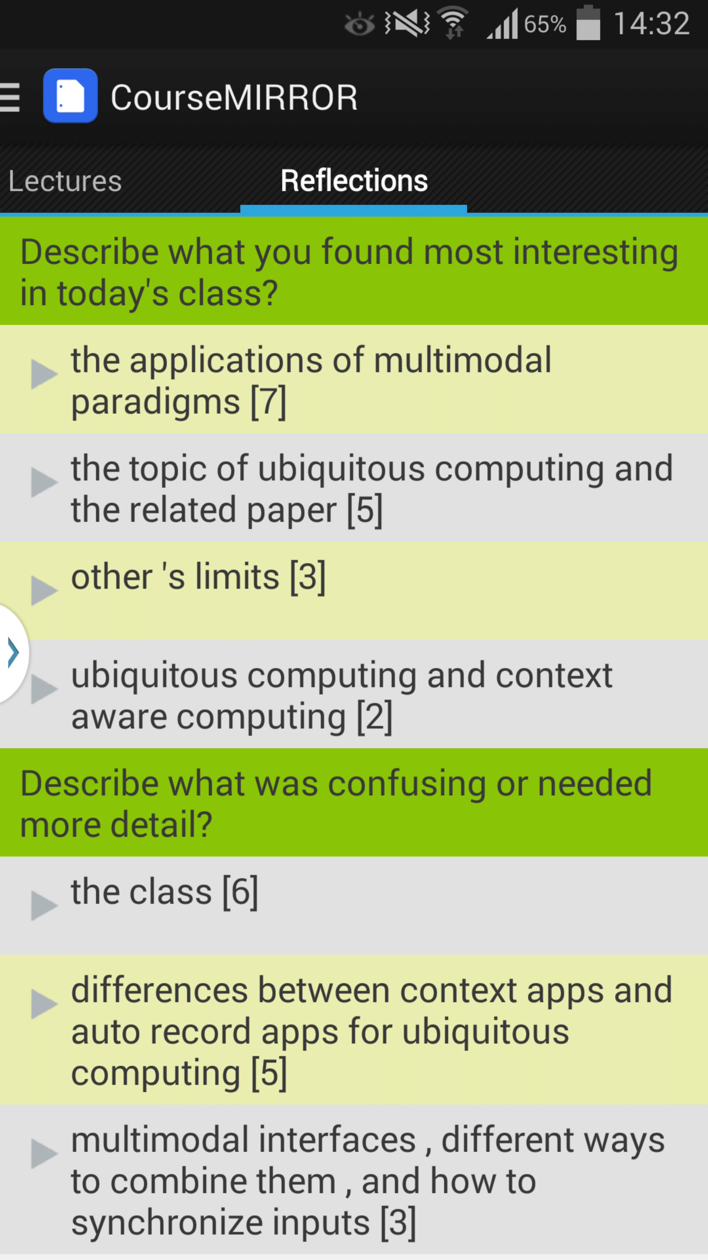
From Paper to Mobile App
[Luo et al., 2015]
Two semester long pilot deployments during Fall 2014
Average ratings of 3.7 (5 Likert-scale) on survey questions
  I often read reflection summaries
  I benefited from reading the reflection summaries
Qualitative feedback
  “It's interesting to see what other people say and that can teach me something that I didn't pay attention to.”
  “Just curious about whether my points are accepted or not.”

Slide 74
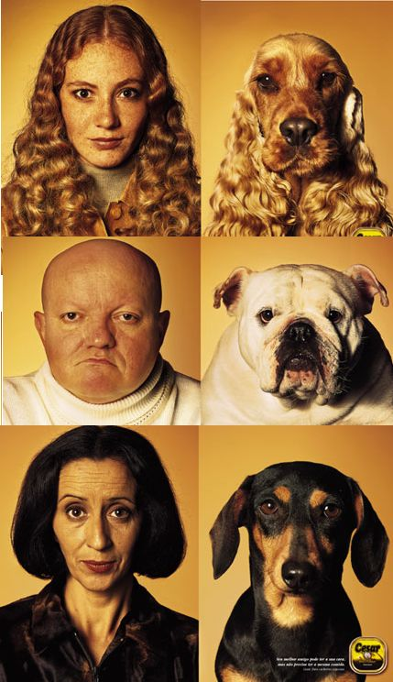
Teams Project: Entrainment and Task Success in Team Conversations

Slide 75
Teams Project: Entrainment and Task Success in Team Conversations
Multi-party entrainment measures that are computable using NLP
Applications
  Conversational agents
  Browsers for (un)successful teams

Slide 76
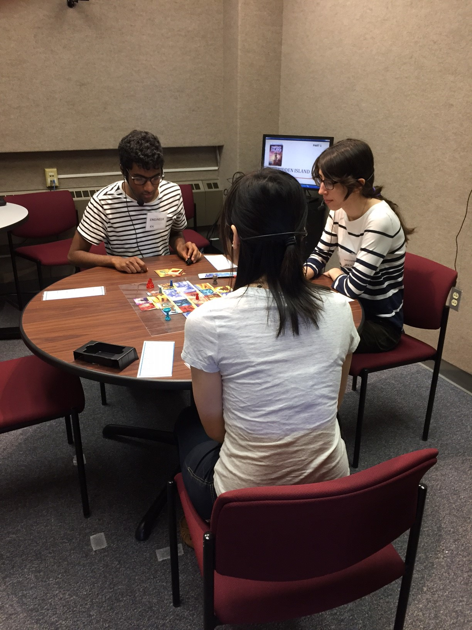
Experimentally Collected Data
Experimental Design
  Team Training or Not
  First vs. Second Games
Audio-Video
  47 hours
  63 teams
Questionnaires
  216 individuals

Slide 77
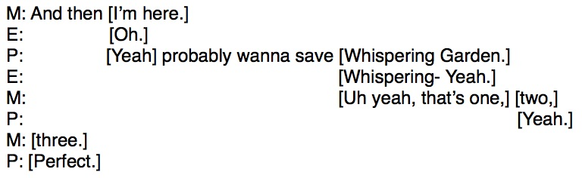
What teams say (transcriptions)

Slide 78
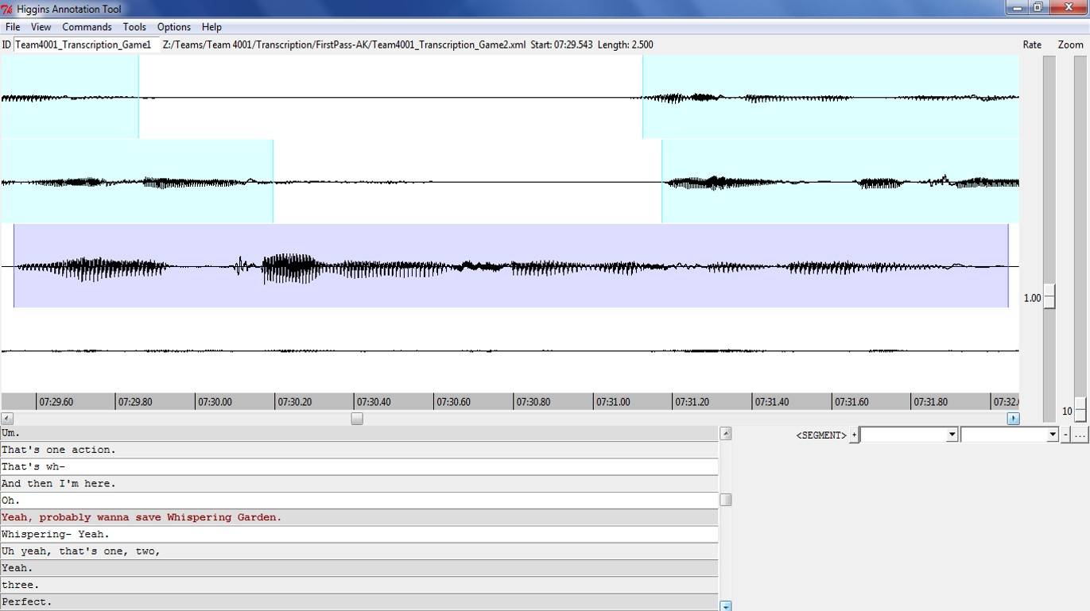
How teams say it (audio)

Slide 79
How teams say it (video)
Non-verbal communication
  Gaze
  Gesture
  Facial expressions
  Etc.

Slide 80
Summing Up: Common Themes
NLP can support teaching and learning at scale
  RTA: From manual to automated writing assessment
  SWoRD: Enhancing peer review with intelligent scaffolding
  CourseMIRROR: A mobile app with automatic summarization
Many opportunities and challenges
  Characteristics of student generated content
  Model desiderata (e.g., beyond accuracy)
  Interactions between (noisy) NLP & Educational Technology

Slide 81
Peer Review
An alternative for grading writing at scale in MOOCs
Also used in traditional classes
  Quantity and diversity of review feedback
  Students learn by reviewing

Slide 82
SWoRD: A web-based peer review system
[Cho & Schunn, 2007]
Authors submit papers
Peers submit (anonymous) reviews
  Students provide numerical ratings and text comments
  Problem: text comments are often not stated effectively

Slide 83
One Aspect of Review Quality
Localization: Does the comment pinpoint where in the paper the feedback applies? [Nelson & Schunn 2008]
  There was a part in the results section where the author stated “The participants then went on to choose who they thought the owner of the third and final I.D. to be…” the ‘to be’ is used wrong in this sentence. (localized)
  The biggest problem was grammar and punctuation. All the writer has to do is change certain tenses and add commas and colons here and there. (not localized)

Slide 84
Our Approach for Improving Reviews
Detect reviews that lack localization and solutions
  [Xiong & Litman 2010; Xiong, Litman & Schunn 2010, 2012; Nguyen & Litman 2013, 2014]
Scaffold reviewers in adding these features
  [Nguyen, Xiong & Litman 2014]

Slide 85
Detecting Key Features of Text Reviews
Natural Language Processing to extract attributes from text, e.g.
  Regular expressions (e.g. “the section about”)
  Domain lexicons (e.g. “federal”, “American”)
  Syntax (e.g. demonstrative determiners)
  Overlapping lexical windows (quotation identification)
Supervised Machine Learning to predict whether reviews contain localization and solutions

Slide 86
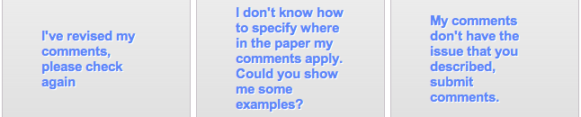
Localization Scaffolding
System scaffolds (if needed)
Localization model applied
Localization model applied
Reviewer makes decision (e.g. DISAGREE)

Slide 87
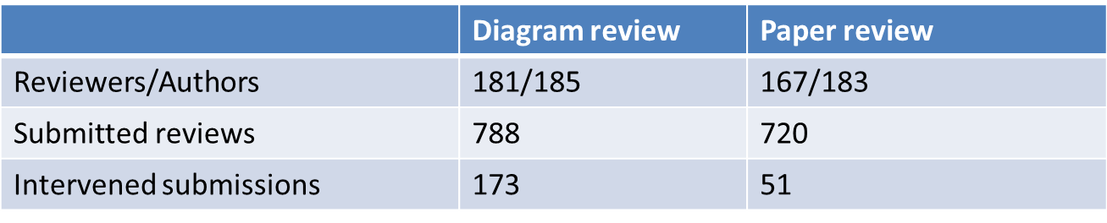
A First Classroom Evaluation
[Nguyen, Xiong & Litman, 2014]
NLP extracts attributes from reviews in real-time
Prediction models use attributes to detect localization
Scaffolding if < 50% of comments predicted as localized
Deployment in undergraduate Research Methods
  Diagrams → Diagram reviews → Papers → Paper reviews

Slide 88
Results: Can we Automate?
Comment Level (System Performance)
  Detection models significantly outperform baselines
  Results illustrate model robustness during classroom deployment
    testing data is from different classes than training data
Close to with reported results (in experimental setting) of previous studies (Xiong & Litman 2010, Nguyen & Litman 2013)
  Prediction models are robust even in not-identical training-testing
 | Diagram review |  | Paper review
 | Accuracy | Kappa | Accuracy | Kappa
Majority baseline | 61.5% (not localized) | 0 | 50.8% (localized) | 0
Our models | 81.7% | 0.62 | 72.8% | 0.46

Slide 89
Results: Can we Automate?
Review Level (student perspective of system)
  Students do not know the localization threshold
  Scaffolding is thus incorrect only if all comments are already localized

Slide 90
Results: Can we Automate?
Review Level (student perspective of system)
  Students do not know the localization threshold
  Scaffolding is thus incorrect only if all comments are already localized
Only 1 incorrect intervention at review level!
 | Diagram review | Paper review
Total scaffoldings | 173 | 51
Incorrectly triggered | 1 | 0

Slide 91
Results: New Educational Technology
Student Response to Scaffolding
Why are reviewers disagreeing?
  No correlation with true localization ratio
Reviewer response | REVISE | DISAGREE
Diagram review | 54 (48%) | 59 (52%)
Paper review | 13 (30%) | 30 (70%)

Slide 92
A Deeper Look: Student Learning
 | # and % of comments (diagram reviews)
NOT Localized → Localized | 26 | 30.2%
Localized → Localized | 26 | 30.2%
NOT Localized → NOT Localized | 33 | 38.4%
Localized → NOT Localized | 1 | 1.2%
Comment localization is either improved or remains the same after scaffolding
  Localization revision continues after scaffolding is removed
  Replication in college psychology and 2 high school math corpora

Slide 93
Current Directions
RTA
  Formative feedback (for students)
  Analytics (for instruction and policy)
SWoRD
  Solution scaffolding (for students as reviewers)
  From reviews to papers (for students as authors)
  Analytics (for teachers)
CourseMIRROR
  Improving reflection quality (for students)
  Beyond ROUGE evaluation (for teachers)

Slide 94
Use our Technology and Data!
Peer Review
  SWoRD
    NLP-enhanced system is free with research agreement
  Peerceptiv (by Panther Learning)
    Commercial (non-enhanced) system has a small fee
CourseMirror
  App (both Android and iOS)
  Reflection dataset

Slide 95



Thank You!
Questions?
Further Information
  http://www.cs.pitt.edu/~litman

