Slide 1



Argument Mining from Text for Teaching and Assessing Writing
Diane Litman
Professor, Computer Science Department
Senior Scientist, Learning Research & Development Center
Co-Director, Intelligent Systems Program

Slide 2
Speech and Language Processing for Education
Learning Language
(reading, writing,
speaking)
Automatic
Grading
(Zahra Rahimi, ISP)
Argument Mining
(Huy Nguyen, CS; Fan Zhang, CS)

Slide 3

Speech and Language Processing for Education
Using Language
(teaching in the disciplines)
Tutorial Dialogue
Systems
(Mike Lipschultz, CS)

Slide 4
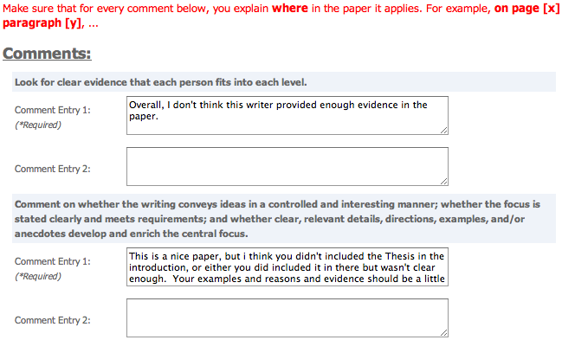
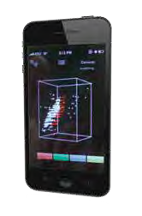
Speech and Language Processing for Education
Processing Language
(e.g. from MOOCs)
Peer Feedback
(Huy Nguyen, CS)
Learning Analytics
(Wencan Luo, CS;
Your name here?)

Slide 5
Innovation Cycle
Systems and Evaluations
Real-World
Problems
Learning and Teaching
Higher Level Learning Processes
Learning Technology
Challenges!
Noisy data
Meaningful constructs
Real-time performance
Scalable approaches
Theoretical and Empirical Foundations

Slide 6
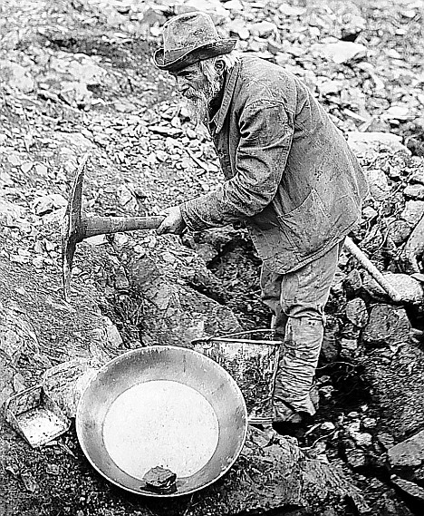

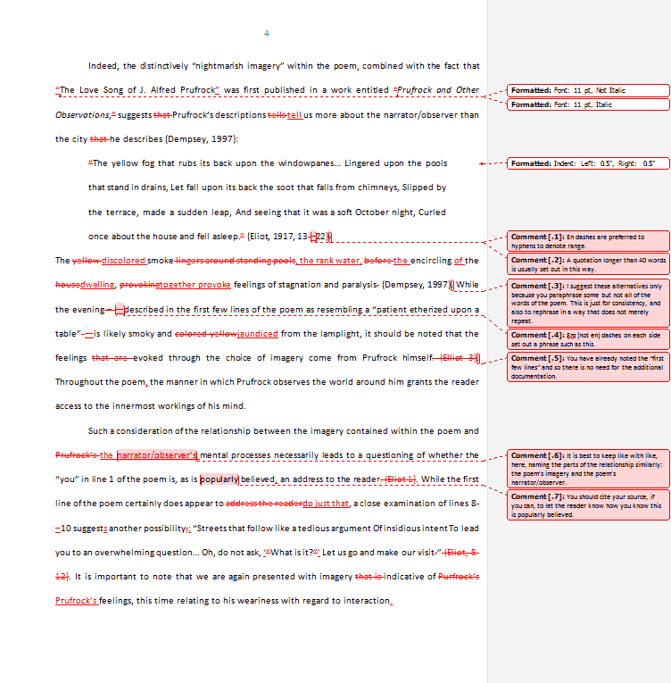
Writing Research is a Goldmine for NLP
Can we automate human coding?
New Educational Technology!
Learning Science at Scale!

Slide 7
Outline
Argumentative Writing / Argument Mining
Algorithms and Applications
  Automated Writing Assessment
  Teaching with Diagramming and Peer Review
Summary and Current Directions

Slide 8
Why teach argumentative writing?
In argumentative or scientific writing, authors need to:
  communicate a position, claim, or hypothesis,
  use it to frame reasons and evidence presented,
  integrate others’ arguments, anticipate/refute counterarguments (Durst, 1987; Mitchell, 2001; Nystrand & Graff, 2001; Yeh, 1998).
Studies show students:
  lack competence in argument writing (Oostdam, et al., 1994; Oostdam & Emmelot, 1991).
  do not integrate their arguments into a high-level structure or coherent position (Keith, Weiner, & Lesgold, 1991).
  Even if compose-aloud protocols show students mentally connect position statement & supporting details, connections not evident in writing (Durst, 1987).

Slide 9
Research Question
Can argument mining be used to better teach, assess, and understand argumentative writing?
Approach: Technology design and evaluation
  System enhancements that improve student learning
  Argument analytics for teachers
  Experimental platforms to test research predictions

Slide 10
Argument Mining
“… exploits the techniques and methods of natural language processing … for semi-automatic and automatic recognition and extraction of structured argument data from unstructured … texts.” [SICSA Workshop on Argument Mining, July 2014]

Slide 11
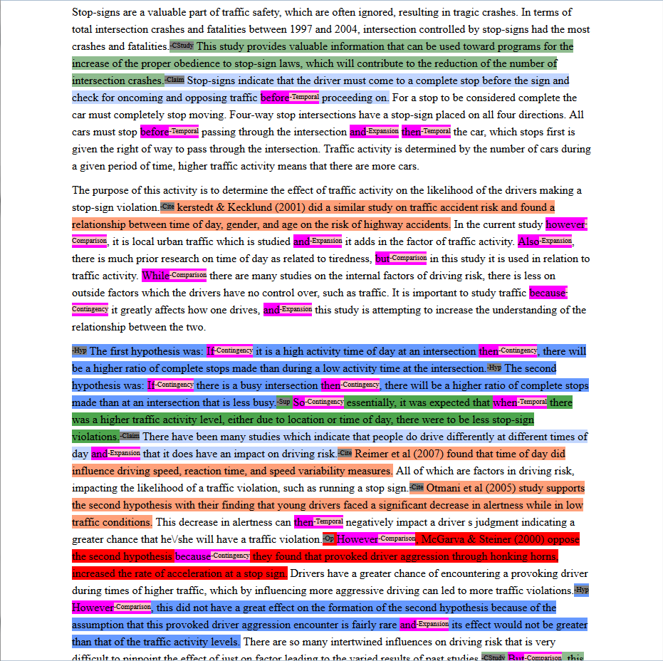
Mining a College Essay for Argument Diagram Ontology
(i.e., node and arc types)
Current Study
Claim
Citation
Hypothesis
Supports
Opposes
None
Notes:
Expert score 3 out of 5, 5 is max, 0 is min, integer values only

Slide 12
Mining a Grade School Essay for Evidence
I was convinced that winning the fight of poverty is achievable in our lifetime. Many people couldn't afford medicine or bed nets to be treated for malaria . Many children had died from this dieseuse even though it could be treated easily. But now, bed nets are used in every sleeping site . And the medicine is free of charge. Another example is that the farmers' crops are dying because they could not afford the nessacary fertilizer and irrigation . But they are now, making progess. Farmers now have fertilizer and water to give to the crops. Also with seeds and the proper tools . Third, kids in Sauri were not well educated. Many families couldn't afford school . Even at school there was no lunch . Students were exhausted from each day of school. Now, school is free . Children excited to learn now can and they do have midday meals . Finally, Sauri is making great progress. If they keep it up that city will no longer be in poverty. Then the Millennium Village project can move on to help other countries in need.

Slide 13
Mining a High School Essay for a Thesis Statement
Violence in America
In the spring of 2011, John F. Shick met a man in a New Mexico parking lot and
bought two pistols for $810, along with extra clips, ammunition and a holster.
This is one reason that there is so much violence in America, because people who
are mentally ill, and people who aren’t, can just buy a gun anywhere, there are no laws that say they cant. The two biggest factors that contribute to America’s violent society are relaxed gun laws and mental illness.
There are numerous accounts on which people with mental illness don’t receive the
help they need and sometimes do things to things to hurt people, like the account
on which was just mentioned John Shick bought two guns and shot and killed a person…
Notes:
This is another set of comments about thesis statement on a different essay. As you can see, Reviewer #2 identified the wrong sentence as the thesis and Reviewer #3 also expressed some confusion.
Our study is the first step toward solving this problem.

Slide 14
Argument Mining Subtasks
[Peldszus and Stede, 2013]
Scope of today’s talk
Even partial argument mining can support useful applications
  Mostly non-structural analysis (e.g., no relations, no argument schema)
  Application-dependent roles (e.g., no premises)
  But, real data!!

Slide 15
Machine Learning Approach (Supervised)
Training
Feature Vectors
Learning Algorithm
Training Data
Prediction
Unlabeled Data
Test data
Feature Vector
Predicted
Labels
Predictive Model
Slide courtesy of Janyce Wiebe

Slide 16
Feature Vectors
Representing Images
  The features might correspond to single pixels
  The feature value might be the intensity of the corresponding pixel
Representing Documents
  The features might correspond to single words
  The feature value might be the frequency of the corresponding word in the document.
Slide courtesy of Janyce Wiebe

Slide 17
Feature Vectors
There are many differences between African and Asian elephants. The differences …
Feature Extraction
American
differences
elephants
African
Asian
car
lions
…..
…..
…..
…..
1
0
1
…..
0
2
…..
1
…..
0
…..
Bag-of-Words Feature Representation
Slide courtesy of Janyce Wiebe

Slide 18
Machine Learning (Supervised)
Supervised learning has the best performance for challenging Natural Language Processing (NLP) problems
  Usually the more training data we have, the better the performance
Disadvantages
  Creating training data is expensive and time-consuming
  Domain dependence
Slide courtesy of Janyce Wiebe

Slide 19
Domain Dependence
The performance of supervised learning suffers when the training and test data come from different domains.
  Differences in vocabulary and writing style
For educational tasks, we are confronted with many potential differences … you can write about anything, writers range from kids to adults!
A major issue in educational applications
Slide modified from Janyce Wiebe

Slide 20
More on Educational Applications
Challenges for Natural Language Processing (beyond Machine Learning challenges)
  Noisy data (e.g., adult learners, children)
  Real-time algorithms; robust at scale
  Meaningful features
Opportunities
  Human in the loop (e.g., peer review)
    Errors as student reflection opportunities

Slide 21
Outline
Argumentative Writing / Argument Mining
Algorithms and Applications
  Automated Writing Assessment
  Teaching with Diagramming and Peer Review
Summary and Current Directions

Slide 22
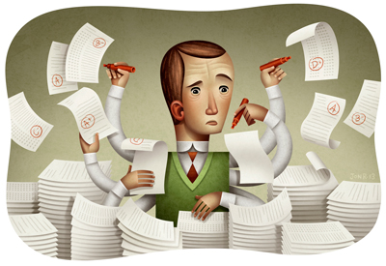
Why Automatic Writing Assessment?
Essential for Massive Open Online Courses (MOOCs) and tutoring systems
Even in traditional classes, frequent assignments can limit the amount of teacher feedback
Notes:
The first question is that you may ask is why Automatic Essay Assessment is important.
Well, in order to Score and provide feedback on written assignments in Tutoring systems and MOOCs, it is essential to have reliable AES systems. Even in class rooms with large number of students and frequent writing assignments, Providing individual feedback to students is a burden and a very time consuming task for teatures.
Consider the capitalization

Slide 23
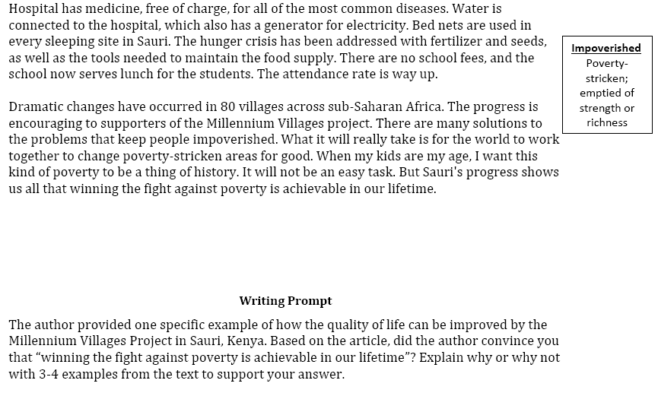
An Example Writing Assessment Task: Response to Text (RTA)
MVP, Time for Kids – informational text

Slide 24
Rubric for the Evidence dimension of RTA
1 | 2 | 3 | 4
Features one or no pieces of evidence | Features at least 2 pieces of evidence | Features at least 3 pieces of evidence | Features at least 3 pieces of evidence
Selects inappropriate or little evidence from the text; may have serious factual errors and omissions | Selects some appropriate but general evidence from the text; may contain a factual error or omission | Selects appropriate and concrete, specific evidence from the text | Selects detailed, precise, and significant evidence from the text
Demonstrates little or no development or use of selected evidence | Demonstrates limited development or use of selected evidence | Demonstrates use of selected details from the text to support key idea | Demonstrates integral use of selected details from the text to support and extend key idea
Summarize entire text or copies heavily from text | Evidence provided may be listed in a sentence, not expanded upon | Attempts to elaborate upon Evidence | Evidence must be used to support key idea / inference(s)

Slide 25
Audience Participation: Evidence Scoring (1 or 4?)
Student 1: Yes, because even though proverty is still going on now it does not mean that it can not be stop. Hannah thinks that proverty will end by 2015 but you never know. The world is going to increase more stores and schools. But if everyone really tries to end proverty I believe it can be done. Maybe starting with recycling and taking shorter showers, but no really short that you don't get clean. Then maybe if we make more money or earn it we can donate it to any charity in the world. Proverty is not on in Africa, it's practiclly every where! Even though Africa got better it didn't end proverty. Maybe they should make a law or something that says and declare that proverty needs to need. There's no specic date when it will end but it will. When it does I am going to be so proud, wheather I'm alive or not.
Student 2: I was convinced that winning the fight of poverty is achievable in our lifetime. Many people couldn't afford medicine or bed nets to be treated for malaria . Many children had died from this dieseuse even though it could be treated easily. But now, bed nets are used in every sleeping site . And the medicine is free of charge. Another example is that the farmers' crops are dying because they could not afford the nessacary fertilizer and irrigation . But they are now, making progess. Farmers now have fertilizer and water to give to the crops. Also with seeds and the proper tools . Third, kids in Sauri were not well educated. Many families couldn't afford school . Even at school there was no lunch . Students were exhausted from each day of school. Now, school is free . Children excited to learn now can and they do have midday meals . Finally, Sauri is making great progress. If they keep it up that city will no longer be in poverty. Then the Millennium Village project can move on to help other countries in need.

Slide 26
Automatic Scoring via Argument Mining
Student 1: Yes, because even though proverty is still going on now it does not mean that it can not be stop. Hannah thinks that proverty will end by 2015 but you never know. The world is going to increase more stores and schools. But if everyone really tries to end proverty I believe it can be done. Maybe starting with recycling and taking shorter showers, but no really short that you don't get clean. Then maybe if we make more money or earn it we can donate it to any charity in the world. Proverty is not on in Africa, it's practiclly every where! Even though Africa got better it didn't end proverty. Maybe they should make a law or something that says and declare that proverty needs to need. There's no specic date when it will end but it will. When it does I am going to be so proud, wheather I'm alive or not. (SCORE=1)
Student 2: I was convinced that winning the fight of poverty is achievable in our lifetime. Many people couldn't afford medicine or bed nets to be treated for malaria . Many children had died from this dieseuse even though it could be treated easily. But now, bed nets are used in every sleeping site . And the medicine is free of charge. Another example is that the farmers' crops are dying because they could not afford the nessacary fertilizer and irrigation . But they are now, making progess. Farmers now have fertilizer and water to give to the crops. Also with seeds and the proper tools . Third, kids in Sauri were not well educated. Many families couldn't afford school . Even at school there was no lunch . Students were exhausted from each day of school. Now, school is free . Children excited to learn now can and they do have midday meals . Finally, Sauri is making great progress. If they keep it up that city will no longer be in poverty. Then the Millennium Village project can move on to help other countries in need. (SCORE=4)

Slide 27
Automatic Scoring of an Analytical
Response-To-Text Assessment (RTA)
[Rahimi, Litman, Correnti, Matsumura, Wang & Kisa, 2014]
Long-term goals
  informative feedback for students and teachers
  large-scale research on the impact of instruction and policies
Current work
  writing assessment via meaningful features that operationalize the Evidence rubric of RTA
Argument mining subtasks
  segmentation: spans of text
  segment classification: evidence from text (or not)

Slide 28
Automatic Scoring Approach
Experts derive a decision tree from the rubric
Define features based on the tree and extract them from the essays
Perform supervised machine learning using the extracted features
Experts derive a decision tree from the rubric
Define some features based on the tree and extract them from the essays
Perform supervised machine learning using extracted features

Slide 29
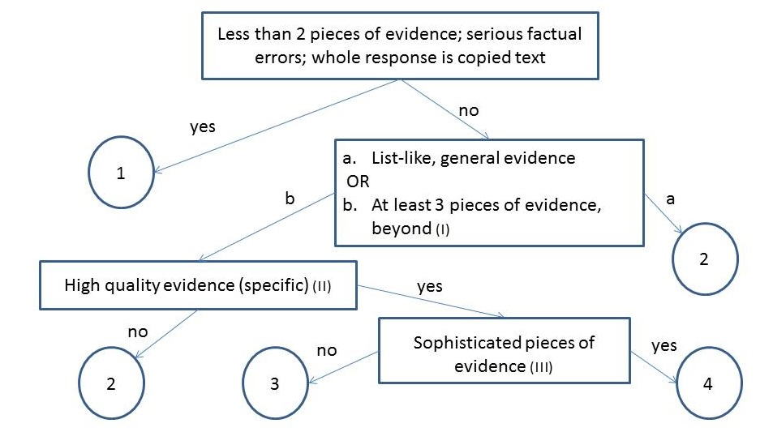
Scoring Essays for Evidence

Slide 30
Automatic Scoring Approach
Experts derive a decision tree from the rubric
Define features based on the tree and extract them from the essays
Perform supervised machine learning using the extracted features
Experts derive a decision tree from the rubric
Define some features based on the tree and extract them from the essays
Perform supervised machine learning using extracted features

Slide 31
Feature Vectors
A feature vector is the representation of the raw data that is input to the learning algorithm
It is often an N-dimensional vector of numerical values
Selecting informative features is important for the performance of the learning algorithm

Slide 32
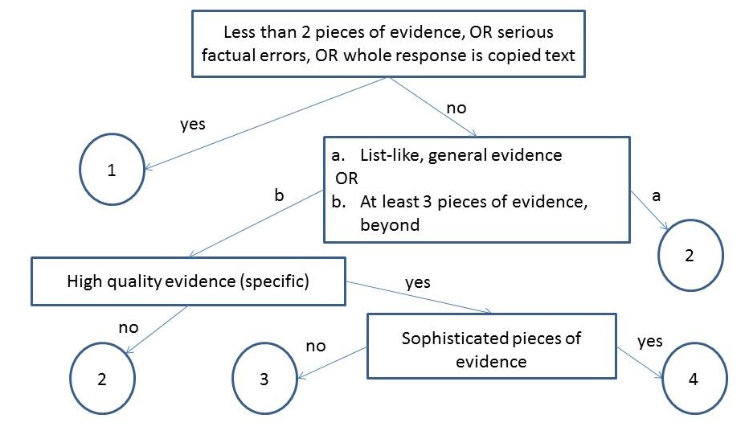
Our Features
Notes:
What is evidence topic subtopic,
Copping how much copy is copying

Slide 33
Our Features
Number of Pieces of Evidence (NPE)
  Topics and words based on the text and experts
Notes:
What is evidence topic subtopic,
Copping how much copy is copying

Slide 34
Our Features
Notes:
What is evidence topic subtopic,
Copping how much copy is copying

Slide 35
Our Features
Concentration (CON)
High concentration essays have fewer than 3 sentences with topic words (i.e., evidence is not elaborated)
Notes:
What is evidence topic subtopic,
Copping how much copy is copying

Slide 36
Our Features
Notes:
What is evidence topic subtopic,
Copping how much copy is copying

Slide 37
Our Features
Specificity (SPC)
Specific examples from different parts of the text
Notes:
What is evidence topic subtopic,
Copping how much copy is copying

Slide 38
Our Features
Word Count (WOC)
Potentially helpful fallback feature (temporarily )
Notes:
What is evidence topic subtopic,
Copping how much copy is copying

Slide 39
Example Feature Vectors
Essay with Score=1 (from audience participation)
Essay with Score=4 (from audience participation)
NPE | CON | WOC | SPC
1 | 1 | 166 | 0 | 0 | 0 | 0 | 0 | 1 | 1 | 0
NPE | CON | WOC | SPC
4 | 0 | 187 | 0 | 0 | 1 | 4 | 3 | 3 | 5 | 1
Notes:
Highlite potential feadbacks

Slide 40
Automatic Scoring Approach
Experts derive a decision tree from the rubric
Define features based on the tree and extract them from the essays
Perform a supervised machine learning using the extracted features
Experts derive a decision tree from the rubric
Define some features based on the tree and extract them from the essays
Perform supervised machine learning using extracted features

Slide 41
Supervised Machine Learning
Data [Correnti et al., 2013]
  1560 essays written by students in grades 4-6
    Short, many spelling and grammatical errors

Slide 42
Experimental Evaluation
Baseline1 [Mayfield 13]: one of the best methods from the Hewlett Foundation competition [Shermis and Hamner, 2012]
  Features: primarily bag of words (top 500)
Baseline2: Latent Semantic Analysis
  Based on the scores of the 10 most similar essays, weighted by semantic similarity [Miller 03]
Notes:
Make shorter

Slide 43
Results: Can we Automate?
Proposed features outperform both baselines

Slide 44
Other Results
Removing features significantly degrades performance
Wordcount is only useful for discriminating score 4 (where no rubric features were defined)
Features also outperform baselines on essays from grades 6-8

Slide 45
Current Directions
New types of argument mining
  segmentation: sentences
  segment classification: thesis statement
  relation identification: supports (evidence, thesis)
Evidence supports the key idea (i.e., the thesis statement)
Evidence supports the key idea (the thesis statement)

Slide 46
Outline
Argumentative Writing / Argument Mining
Algorithms and Applications
  Automated Writing Assessment
  Teaching with Diagramming and Peer Review
Summary and Current Directions

Slide 47
ArgumentPeer Project
Phase I: Argument
Diagramming
Author creates Argument Diagram
Peers review Argument Diagrams
Author revises Argument Diagram

Slide 48
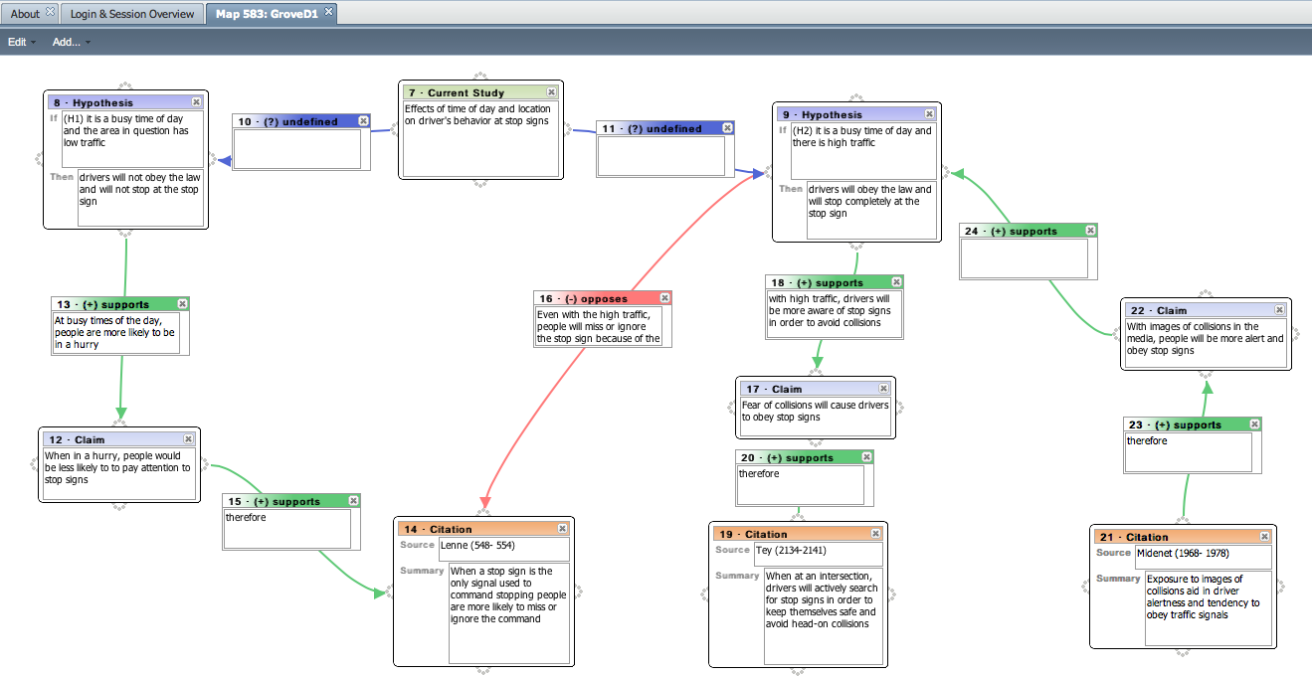
Example Student Argument Diagram
(input via the LASAD system [Pinkwart et al.])
Notes:
very few citations
many explanations for support relationships are incomplete
provided opposition was not explicitly resolved (i.e., why are the supportive bits of evidence for the second
hypothesis stronger than the opposing evidence?).

Slide 49
ArgumentPeer Project
Phase I: Argument
Diagramming
Author creates Argument Diagram
Peers review Argument Diagrams
Author revises Argument Diagram
Author writes paper
Peers review papers
Author revises paper
Phase II: Writing

Slide 50
Why Diagram before Writing?
Argument diagramming can improve essays
  more support and opposition; increased relevance of citations [Ashley et al., 2014]
  more supporting premises, evidence, explicit relations; increased accuracy [Harrell & Wetzel, 2013]
Features extracted from argument diagrams can predict essays grades [Lynch et al., 2014]
Our research: Can argument diagram constructs be mined directly from essays?

Slide 51
Audience Participation: Argument Mining
Written Essay Excerpt:
There have been many studies which indicate that people do drive differently at different times of day and that it does have an impact on driving risk. Reimer et al (2007) found that time of day did influence driving speed, reaction time, and speed variability measures.
Argument Diagram Ontology:
Node Types
  Current Study
  Hypothesis
  Claim
  Citation
Arc Types
  Supports
  Opposes

Slide 52
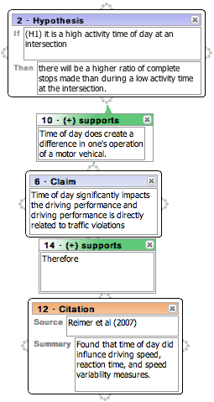
Example Argument Mining Output
There have been many studies which indicate that people do drive differently at different times of day and that it does have an impact on driving risk. [Claim]
Reimer et al (2007) found that time of day did influence driving speed, reaction time, and speed variability measures… [Citation]

Slide 53
Example Argument Mining Output
There have been many studies which indicate that people do drive differently at different times of day and that it does have an impact on driving risk. [Claim]
Reimer et al (2007) found that time of day did influence driving speed, reaction time, and speed variability measures… [Citation]
Citation supports Claim

Slide 54
Audience Participation: Essay Scoring (1 or 4?)
Human Argument Mining
Hypothesis: 1, Supports: 2, Opposes: 1, Citation: 7 (6 unique)
Frequently, people encounter situations in their environment where they can either choose to be prosocial or antisocial. It is therefore of great importance to study what makes people choose either response. Previous research has indicated that as group size increases, prosocial responses decrease, a phenomenon known as the bystander effect (Fischer, Krueger, Greitemeyer, Vogrincic, Kastenmuller, Frey, Heene, Wicher, Kainbacher, 2011). In our particular study, a participant sneezed on an elevator and noted whether or not somebody had a nice response such as “God bless you.” The nice response would be equivalent to a prosocial behavior. The results of this study can give insight into what makes people more or less likely to engage in prosocial behavior in different situations, so this study has good external validity. This research topic is worth of study because the results may show how likely people are to help others in a more critical situation, such as somebody getting mugged, etc. It is important to realize that sneezing on an elevator is not necessarily a dangerous situation to act prosocially in, but the result will lead to a better understanding of whether or not gender and group size contribute to prosocial responses.
Previous research has shown that females seem to be more likely to engage in prosocial behavior as distance decreases, and this correlates to the hypothesis of this particular study (McCullough, Tabak, 2010). From this same previous research, it seems that females are more likely to do this because females tend to behave in more altruistic ways than males. In other words, females should give a nice response to a sneeze more often than males, and this was part of our hypothesis. Previous research has also indicated that people who have the knowledge of how to behave prosocially in a particular situation are more likely to do so (Anker, Feeley, 2011). If somebody in the elevator is from a certain religion or has recently moved and is not aware of what to say after somebody sneezes, then they most likely will not give a response at all, and this was not considered when putting together the results of the study. This should have been important to consider because knowledge of what to say after a sneeze could be a confounding variable in the results. Lastly, previous studies have shown that moral frames often determine whether or not people will give a prosocial response (Thornberg, 2010). Overall, the better somebody’s moral frames are, the more likely they are to give a prosocial response. This correlates to our particular study because the people who didn’t give a response could possibly have negative moral frames. A future experiment could study this and the results would be interesting and could give additional information about what makes people behave prosocially.
In our study, it was hypothesized that as group size increased, the likelihood of a prosocial response would increase, and that females were more likely to give a prosocial response than males. Previous research from McCullough, etc (2011) conflicted with the hypothesis that as group size increases, prosocial responses should increase. McCullough’s study showed this to be the opposite – as group size increases, prosocial behavior decreases, a phenomenon known as the bystander effect. Previous research about gender, however, showed that females are more likely to behave prosocially due to their nature and altruistic characteristics; this evidence supports our hypothesis (Levine, Cassidy, Jentzsch, 2010).

Slide 55
Audience Participation: Essay Scoring (1 or 4?)
Human Argument Mining
Hypothesis: 1, Supports: 5, Opposes: 3, Citation: 15 (6 unique)
In today’s tough economic climate, any factors that may contribute to a successful business or enterprise have become increasingly important. One prevalently researched factor is prosocial behavior which is comparable to helping behaviors. Research has shown that prosocial behaviors have been associated with job satisfaction, productivity, and client satisfaction (Danzis & Stone-­‐Romero, 2009). Therefore the understanding of what situations support and encourage prosocial behaviors could be an asset to any manager or business (Danzis & Stone-­‐ Romero, 2009).
Previous research has focused on relationships of prosocial behavior between gender and the effect of group size. With regards to gender, there has been much debate over whether females or males are inherently more prosocial. Research has been done on gender by implementing a training program on empathy with children in day care centers between the ages of 5-­‐6 Kallipuska, 1991). The results of this study concluded that females were more prosocial than males based on teacher appraisals (Kallipuska, 1991).Other research supports that females are more prosocial but only to familiar individuals or when following a social norm (Danzis & Stone-­‐Romero 2009). In contrast, males were considered to be more “chivalrous”(p.722) which would promote them to exhibit more prosocial behavior toward strangers relative to females(Danzis & Stone-­‐Romero, 2009).
In addition to studies on the relationship between prosocial behavior and gender, there is also research between group sizes and prosocial behavior. One of the most well­‐known psychological phenomena is the bystander effect which describes a diffusion of responsibility as group size increases (Garcia, Weaver, Darley, & Moskowitz, 2002).More recent studies have described an implicit bystander effect which claims that it is even possible to create diffusion of responsibility even when no one else is around by priming participants about group mentality (Garcia, Weaver, Darley, & Moskowitz, 2002). There has even been debate over the implications of the implicit identity effect. One research study claimed that the implicit identity can only be used to inhibit prosocial behavior such as through the bystander effect (Garcia, Weaver, Darley, & Moskowitz, 2002). Yet, conflicting research has found evidence to support a theory that the implicit identity effect can be used to encourage prosocial behavior if it follows the group’s social norms (Levine & Crowther, 2008). Also, a study by Krupka and Weber (2009) found that even when people observe others acting selfishly, on average this produces prosocial behavior due to the focusing effecting of norms (2009).Therefore the focusing effect of norms can be defined as being aware of the behavior of others aroundKrupka & Weber, 2009).
The current study sought to find relationships between prosocial behavior, gender and group size. Prosocial behavior was defined as someone verbally responding to the observer’s sneeze. In order to create a controlled environment, the study took place on elevators in on-­‐campus buildings only. Unlike previous research, our study did not prime the participants before they entered the elevator so it was comparable to the control group of the Krupka & Weber study(2009). I predicted that females would respond more than males and that responses would be more likely in a group of more than two other people on the elevator.According to the Kallipuska study, females appear to be more prosocial and polite than males and would be more likely to respond to a sneeze(1991). With regards to group size, research shows that the focusing effect of norms becomes more apparent when others are present(Krupka & Weber, 2009).One contradiction to this hypothesis would be the Garcia, Weaver, Darley, & Moskowitz study that the implicit bystander effect can cause a diffusion of responsibility in large groups which could cause no one to respond to the sneeze(2002).

Slide 56
Actual Expert Essay Scores (via rubric)
SCORE = 1
Sentences/Words: 22/564
Hypothesis: 1
Supports: 2
Opposes: 1
Citation: 7 (6 unique)
SCORE = 4
Sentences/Words: 26/610
Hypothesis: 1
Supports: 5
Opposes: 3
Citation: 15 (6 unique)

Slide 57
Ontology-Based Argument Mining and Automatic Essay Scoring
[Ong, Litman, Brusilovsky, 2014], [Nguyen & Litman, in progress]
System recognizes diagram ontology in essays
System scores essays using recognized ontology
Argument mining subtasks
  Segmentation: sentences
  Segment classification: diagram ontology tags
    E.g., Study, Hypothesis, Opposes, Supports, Claim, Citation (instructor-defined)
    None

Slide 58
Most Recent Data
First-draft essays from two undergraduate psychology courses
  Written after diagramming and peer-feedback
2291 sentences annotated for diagram ontology
  148 hypothesis sentences
  261 support sentences
  135 opposition sentences
  388 SO sentences (7 sentences were labeled differently by two coders)
  Class distribution: 6%, 11%, 6%, 17%
Notes:
Introductions only because the diagrams focused on the introductory portion of the essays. The rest of the essay consisted of studies that students conducted and the data they collected and analyzed, which is out of scope. First drafts because we wanted to decrease the differences between the diagrams and the essays.

Slide 59
Most Recent Results
Classify each sentence as
  hypothesis
  support/opposition
  neither
SVM algorithm evaluated with cross-validation
  Baseline [Stab14]
    kappa=.51, f-measure=.70
  New features
    kappa=.58, f-measure=.75

Slide 60
Example Argument Mining Features
Non-word Features
Linguistic features Comparison indicator: JJR, JJS, RBR, RBS Discourse connectives: Contingency, Comparison, Expansion, Temporal
Statistic features Sentence depth: depth of parse tree Sentence length: number of tokens Ratio of domain words and sentence length Ratio of argument words and sentence length Ratio of SBAR’s length and sentence length
Position features Sentence Id: numerical Relative position (before or after) to the first citation: binary Relative position (1-distance or 2-distance or ELSE) to the nearest citation before: 3-ary Relative position (1-distance or 2-distance ELSE) to the nearest citation after: 3-ary
Class features Citation label: True/False Number of citations before the current sentence

Slide 61
Use of Topic Modeling
LDA
LDA-filtered dependency pair | Pairs of subject-predicate that subjects are argument words They found, study shows
LDA-filtered head nouns | Head nouns of NP that nouns are argument word Study that
LDA-computed argument words | Hypothesis, finding, study, opposition, support
LDA-computed #argument words | Numerical, no normalized by sentence length
LDA-computed #domain words | Numerical, no normalized by sentence length

Slide 62
Current Argument Mining Directions (with H. Nguyen)
More Machine Learning Experiments
New Argument Mining Subtasks
  Relation identification (e.g., citation supports claim)
  Argument completion

Slide 63
New Work: Temporal Argument Mining
[Zhang and Litman, 2014]
How are arguments changed during paper revision?
  1st Draft: The fifth level of Hell “contains the Wrathful” (110). Wrathful people want to intentionally harm others. Saddam Hussein and Osama Bin Laden come to mind when mentioning wrathful people.
  2nd Draft: The fifth level of Hell “contains the Wrathful” (110). Wrathful people want to intentionally harm others. Fidel Castro comes to mind when mentioning wrathful people
  Revision modifies evidence
    Rather than come -> comes
Argument mining subtasks
  Segmentation: sentences
    Alignment needed between 1st and 2nd paper drafts
  Segment classification: argumentation purpose of revision (if any)

Slide 64
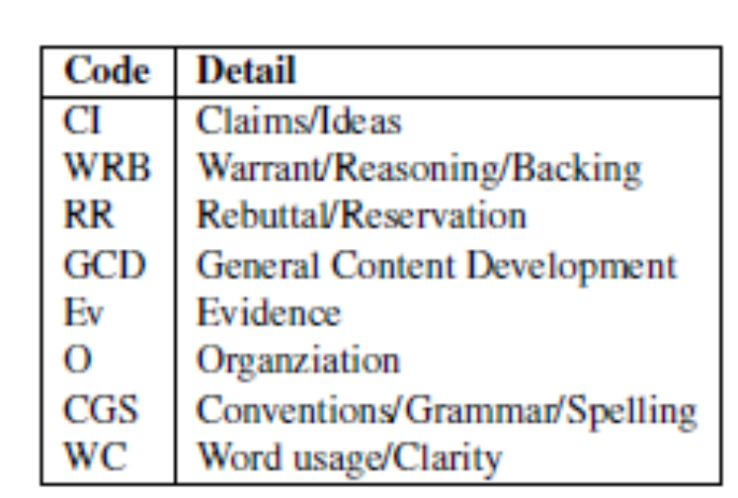
Data Annotation
27 pairs of 1st/2nd drafts from a high school course

Slide 65
Experiments
Corpus analysis
  Do codes predict learning / paper quality?
Automatic prediction
  Binary classification
    Surface vs Content
    F-measure=.7
  9-way classification
  Gold-standard versus automatic alignments

Slide 66
Wikipedia Features

Slide 67
ArgumentPeer Project
Phase I: Argument
Diagramming
Author creates Argument Diagram
Peers review Argument Diagrams
Author revises Argument Diagram
Author writes paper
AI: Guides reviewing
Peers review papers
Author revises paper
Phase II: Writing

Slide 68
Outline
Argumentative Writing / Argument Mining
Algorithms and Applications
  Automated Writing Assessment
  Teaching with Diagramming and Peer Review
Summary and Current Directions

Slide 69
Summary
NLP-supported argument mining for teaching and assessing writing
  Feature / Algorithm Development
    Noisy and diverse data
    Meaningful features
    Real-time performance
  Experimental Evaluations
    Response-to-Text Assessment (grade school)
    Ontology-Guided Argument Mining (undergraduates)
    Temporal Argument Mining (high school)
    Intelligent Scaffolding for Peer Review
Even non-structural and application-dependent argument mining can support useful applications!

Slide 70
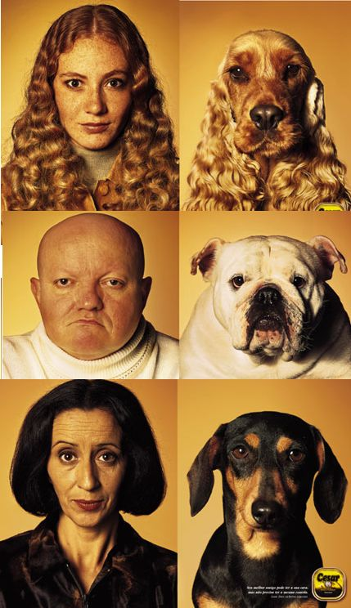

New project! GSRs possibly needed!
(5/2015? 1/2016)
Entrainment & Task Success in Team Conversations
  Multimodal data collection and analysis

Slide 71

Beyond Educational Applications
User-Generated Reviews
Wikipedia Revisions

Slide 72




Thank You!
Questions?
Further Information
  http://www.cs.pitt.edu/~litman

Slide 73
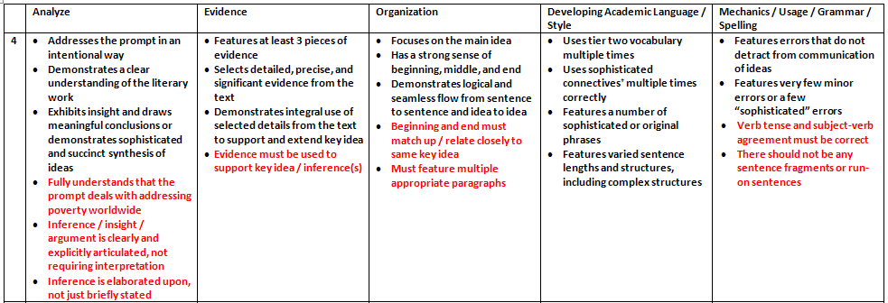
Sample Scoring Rubric

Slide 74
Ontology-Based Argument Mining and Automatic Essay Scoring
[Ong, Litman, Brusilovsky, 2014]
System recognizes diagram ontology in essays
System scores essays using recognized ontology
Argument mining subtasks
  Segmentation: sentences
  Segment classification: diagram ontology tags
    E.g., Study, Hypothesis, Opposes, Supports, Claim, Citation (instructor-defined)
    None

Slide 75
Data
52 first-draft essays from two undergraduate psychology courses
  Written after diagramming and peer-feedback
  Average length: 5.2 paragraphs, 28.6 sentences
  Expert scores: Average = 3.03
Notes:
Introductions only because the diagrams focused on the introductory portion of the essays. The rest of the essay consisted of studies that students conducted and the data they collected and analyzed, which is out of scope. First drafts because we wanted to decrease the differences between the diagrams and the essays.

Slide 76
Argument
Mining I/O
Current Study •
Claim •
Citation •
Hypothesis •
Supports •
Opposes •
Notes:
Expert score 3 out of 5, 5 is max, 0 is min, integer values only

Slide 77
Essay Processing Pipeline
Discourse Processing
  Identify discourse (i.e., potentially argument-related) uses of connectives
    John likes to run marathons, and ran 10 last year alone. (Discourse/Expansion)
    My favorite colors are blue and green. (Non-discourse)
  Tag essays with discourse connective senses
    Expansion, Contingency, Comparison, Temporal
    Tagger from Upenn
Argument Ontology Mining
  Tag essays with diagram ontology elements
    Rule-based algorithm
Ontology-Based Scoring
  Use the mined argument to score the essays
    Rule-based algorithm

Slide 78
Example of Argument Mining
This is the first sentence of the example essay
Tagged as Current Study

Slide 79
Ordered Rule Applications
Rule 1: Opposes
Does the sentence begins with a Comparison discourse connective?
  no
Does the sentence contain any of the string prefixes from {conflict, oppose} and a four-digit number (intended as a year for a citation)?
  no

Slide 80
Example Ontology tag
Rule 6 (broken down, yes to all questions): Current Study
Is the sentence is in the first or last paragraph?
Does the sentence contain at least one word from {study, research}?
Does the sentence not contain the words from {past, previous, prior} (first letter case-insensitive)?
Does the sentence not contain the string prefixes from {hypothes, predict}?
Does the sentence not contain a four-digit number?
Notes:
Red means not satisfied

Slide 81



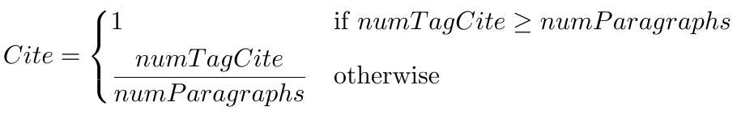

Computing the Score

Slide 82
Scoring Example
In this document:
3 Current Study
3 Hypothesis
1 Opposes
1 Supports
2 Claim
3 Citation
CStudy = 1
Hyp = 1
Op = 1
SupOrClaim = 1
Cite = 1
AutoScore = 5
Expert score = 3
Notes:
Mention that the whole essay did not fit in the page.

Slide 83
Experimental Results
Spearman Correlation between automatically generated and expert scores
    number of automatically generated tags for diagram elements are positively correlated with score
    trend statistical significance level
That is, scores can be ranked
These ranking results in turn can focus teacher or peer reviewer attention on particular types of papers

Slide 84
Why Peer Review?
Pros
  Quantity and diversity of review feedback
  Students learn by reviewing
Cons
  Reviews are often not stated in effective ways
  Reviews and papers do not focus on core aspects

Slide 85
SWoRD: A web-based peer review system
[Cho & Schunn, 2007]
Authors submit papers (or diagrams)
Peers submit reviews
  Problem: reviews are often not stated effectively
  Example: no discussion of thesis statements
  Our Approach: detect and scaffold

Slide 86

Audience Participation: Argument Mining
(Detect the Thesis)
Violence in America
In the spring of 2011, John F. Shick met a man in a New Mexico parking lot and bought two pistols for $810, along with extra clips, ammunition and a holster. This is one reason that there is so much violence in America, because people who are mentally ill, and people who aren’t, can just buy a gun anywhere, there are no laws that say they cant. The two biggest factors that contribute to America’s violent society are relaxed gun laws and mental illness.
There are numerous accounts on which people with mental illness don’t receive the help they need and sometimes do things to things to hurt people, like the account on which was just mentioned John Shick bought two guns and shot and killed a person. Another account was the sandy hook shooting, Adam Lanza who was mentally ill took the guns from his mother’s house and killed her and a bunch of little kids. The shooting at the midnight screening of Batman, James Holmes has been trying to commit suicide and probably had a mental illness .…
Reviewer | Comment | Back Evaluation
#1 | The two biggest factors that contribute to America violent society are relaxed gun laws and mental illness... I think it’s an okay thesis statement because they teacher gave of us this one and you didn't change it up any. | We didnt have to
#2 | A possible solution could be to get the people the help they need. But the solution might not work because people don’t want to pay to get treatment, and there is no cure | This is not my thesis
#3 | I'm really confused on what the thesis statement is, "The two biggest factors that contribute to America" violent society are relaxed gun laws and mental illness." | That’s obviously my thesis because its the last sentence
#4 | Good thesis. | thanks
Notes:
This is another set of comments about thesis statement on a different essay. As you can see, Reviewer #2 identified the wrong sentence as the thesis and Reviewer #3 also expressed some confusion.
Our study is the first step toward solving this problem.

Slide 87
Identifying Thesis and Conclusion Statements in Student Essays to Scaffold Peer Review
[Falakmasir, Ashley, Schunn, Litman 2014]
How well can machine learning distinguish thesis or conclusion sentences from other sentences in student essays?
  Feature extraction via natural language processing
Argument mining subtasks
  Segmentation: sentences
  Segment classification: probability of being thesis, conclusion, …

Slide 88
Data
432 high school essays from 8 assignments
  18,081 sentences
Thesis/conclusion manually identified by experts
  AP English Language & Composition

Slide 89
Features for Machine Learning
3 feature sets inspired by [Burstein et al. 2003]
  Positional: paragraph number, sentence number in the paragraph, type of paragraph (first, body, last)
  Sentence Level: syntactic, semantic, frequent words
  Essay Level: number of keywords among the most frequent words of the essay, number of words overlapping with the assignment prompt, and a sentence importance score based on Rhetorical Structure Theory
Notes:
We used an iterative process to find the most predictive features for identifying thesis and conclusion statements. Starting with 42 basic computational
linguistic features inspired by (Burstein et al. 2003), such as positional, syntactic, and cue term features, we used several feature selection algorithms to select the most predictive features. We tried different combinations of the predictive features and also added some semantic and rhetorical structure features to improve the model’s accuracy. Since our training set was fairly small, we also tried bootstrapped sampling and finally, we picked 19 features in three categories that were most predictive.

Slide 90
Argument Mining Results
F-Measure on unseen test set
  Thesis Sentences
    Positional Baseline: .57
    Machine Learning: .74
  Conclusion Sentences
    Positional Baseline: .55
    Machine Learning: .67
Even with a small training corpus, NLP features can detect core argument sentences in essays better than the baseline

Slide 91
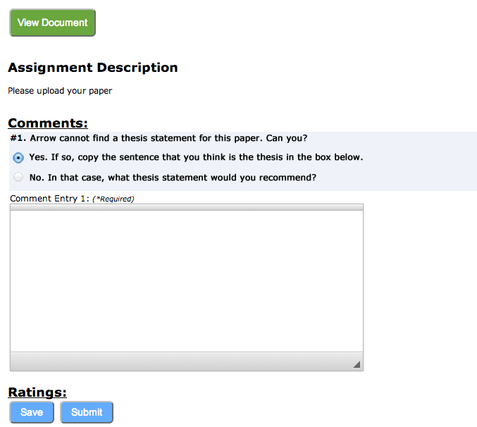
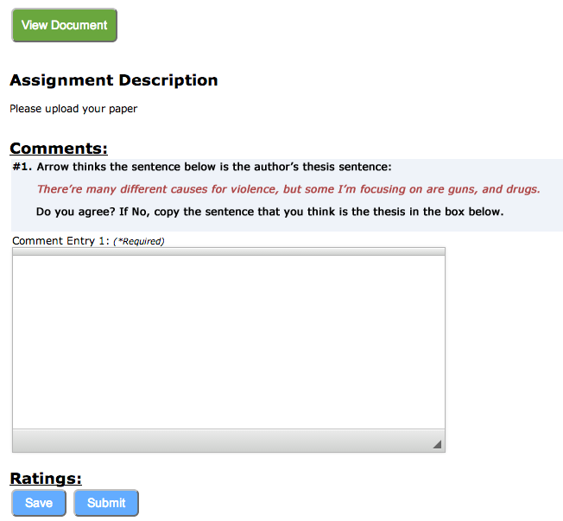
Scaffolding During Peer Review
[Falakmasir, Jabbari et al., in progress]
When argument mining cannot find a thesis sentence, the first peer review prompt is:
When argument mining identifies a thesis sentence, the first peer review prompt is:

Slide 92
First Classroom Results
Argument mining performance
  23/35 theses had highest score
Current work
  impact of scaffolding for peer review comments

