Slide 1
Automatically Predicting
Peer-Review Helpfulness
  Diane Litman
  Computer Science Department
  Learning Research & Development Center
  Intelligent Systems Program
  University of Pittsburgh
  (Joint project with Wenting Xiong, Chris Schunn, Kevin Ashley)

Slide 2
Context
Speech and Language Processing for Education
Learning Language
(reading, writing,
speaking)
Using Language
(to teach everything else)
Processing
Language
Readability
Tutors
Tutorial Dialogue
Systems / Peers
Questioning
& Answering
Scoring
CSCL
Discourse
Coding
Lecture
Retrieval

Slide 3
Context
Speech and Language Processing for Education
Learning Language
(reading, writing,
speaking)
Using Language
(to teach everything else)
Processing
Language
Readability
Tutors
Tutorial Dialogue
Systems / Peers
Peer Review
Questioning
& Answering
Scoring
CSCL
Discourse
Coding
Lecture
Retrieval

Slide 4
Related Research
Natural Language Processing
Helpfulness prediction for other types of reviews
  e.g., products, movies, books
  [Kim et al., 2006; Ghose & Ipeirotis, 2010; Liu et al., 2008;
  Tsur & Rappoport, 2009; Danescu-Niculescu-Mizil et al. 2009]
Other prediction tasks for peer reviews
    Key sentence in papers [Sandor & Vorndran, 2009]
    Important review features [Cho, 2008]
    Peer review assignment [Garcia, 2010]
Cognitive Science
Review implementation correlates with localization etc. [Nelson & Schunn, 2008]
Difference between student and expert reviews [Patchan et al., 2009]
Notes:
One sentence or two?

Slide 5
Outline
SWoRD
Improving Review Quality
Identifying Helpful Reviews
What is the Meaning of Helpfulness?
Summary and Current Directions

Slide 6
SWoRD: A web-based peer review system
[Cho & Schunn, 2007]
Authors submit papers

Slide 7
SWoRD: A web-based peer review system
[Cho & Schunn, 2007]
Authors submit papers
Peers submit (anonymous) reviews
  Instructor designed rubrics

Slide 8
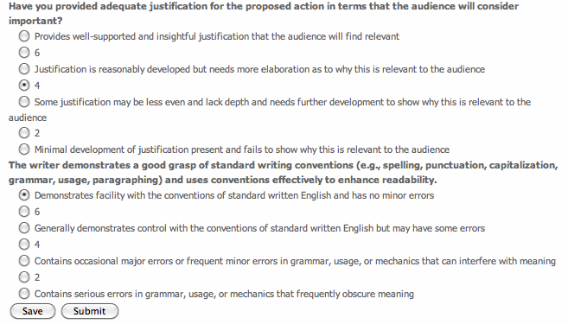

Slide 9
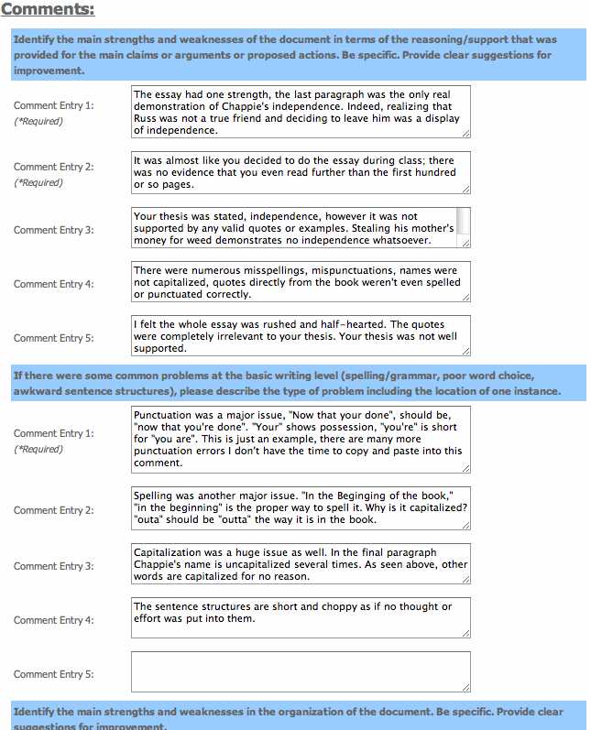

Slide 10
SWoRD: A web-based peer review system
[Cho & Schunn, 2007]
Authors submit papers
Peers submit (anonymous) reviews
Authors resubmit revised papers

Slide 11
SWoRD: A web-based peer review system
[Cho & Schunn, 2007]
Authors submit papers
Peers submit (anonymous) reviews
Authors resubmit revised papers
Authors provide back-reviews to peers regarding review helpfulness

Slide 13
Pros and Cons of Peer Review
  Pros
  Quantity and diversity of review feedback
  Students learn by reviewing
  Cons
Reviews are often not stated in effective ways
Reviews and papers do not focus on core aspects
Students do not have a process for organizing and responding to reviews

Slide 14
Outline
SWoRD
Improving Review Quality
Identifying Helpful Reviews
What is the Meaning of Helpfulness?
Summary and Current Directions

Slide 15
Review Features and Positive Writing Performance [Nelson & Schunn, 2008]
Solutions
Summarization
Understanding
of the Problem
Implementation
Localization

Slide 16
Our Approach: Detect and Scaffold
Detect and direct reviewer attention to key review features such as solutions and localization

Slide 17
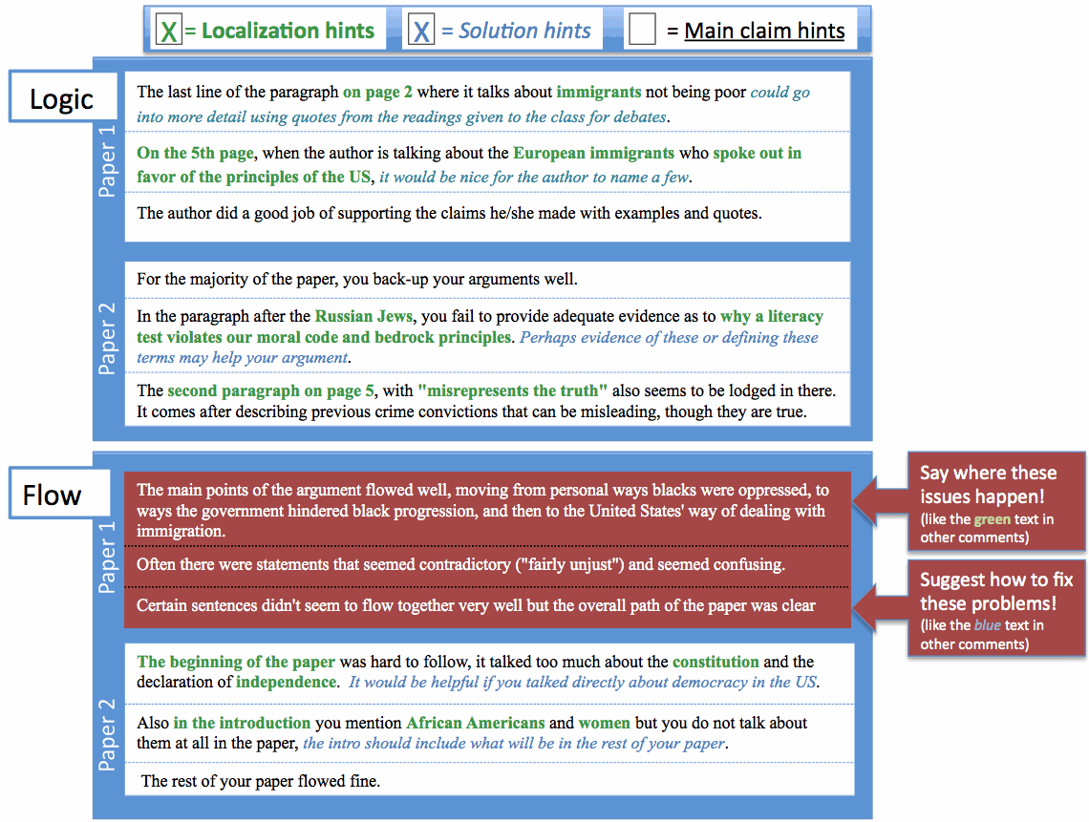

Slide 18
Detecting Key Features of Text Reviews
Natural Language Processing to extract attributes from text, e.g.
  Regular expressions (e.g. “the section about”)
  Domain lexicons (e.g. “federal”, “American”)
  Syntax (e.g. demonstrative determiners)
  Overlapping lexical windows (quotation identification)
Machine Learning to predict whether reviews contain localization and solutions

Slide 19
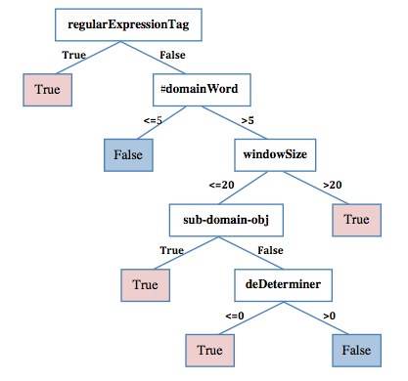
Learned Localization Model
[Xiong, Litman & Schunn, 2010]

Slide 20
Quantitative Model Evaluation
(10 fold cross-validation)
Review Feature | Classroom Corpus | N | Baseline Accuracy | Model Accuracy | Model Kappa | Human Kappa
Localization | History | 875 | 53% | 78% | .55 | .69
 | Psychology | 3111 | 75% | 85% | .58 | .63
Solution | History | 1405 | 61% | 79% | .55 | .79
 | CogSci | 5831 | 67% | 85% | .65 | .86

Slide 21
Outline
SWoRD
Improving Review Quality
Identifying Helpful Reviews
What is the Meaning of Helpfulness?
Summary and Current Directions

Slide 22
Review Helpfulness
Recall that SWoRD supports numerical back ratings of review helpfulness
  The support and explanation of the ideas could use some work. broading the explanations to include all groups could be useful. My concerns come from some of the claims that are put forth. Page 2 says that the 13th amendment ended the war. Is this true? Was there no more fighting or problems once this amendment was added? … The arguments were sorted up into paragraphs, keeping the area of interest clera, but be careful about bringing up new things at the end and then simply leaving them there without elaboration (ie black sterilization at the end of the paragraph). (rating 5)
  Your paper and its main points are easy to find and to follow. (rating 1)

Slide 23
Our Interests
Can helpfulness ratings be predicted from text? [Xiong & Litman, 2011a]
  Can prior product review techniques be generalized/adapted for peer reviews?
  Can peer-review specific features further improve performance?
Impact of predicting student versus expert helpfulness ratings
[Xiong & Litman, 2011b]

Slide 24
Baseline Method: Assessing (Product) Review Helpfulness
[Kim et al. 2006]
Data
  Product reviews on Amazon.com
  Review helpfulness is derived from binary votes (helpful versus unhelpful):
Approach
  Estimate helpfulness using SVM regression based on linguistic features
  Evaluate ranking performance with Spearman correlation
Conclusions
  Most useful features: review length, review unigrams, product rating
  Helpfulness ranking is easier to learn compared to helpfulness ratings: Pearson correlation < Spearman correlation
Notes:
Explain their features

Slide 25
Peer Review Corpus
Peer reviews collected by SWoRD system
  Introductory college history class
  267 reviews (20 – 200 words)
  16 papers (about 6 pages)
Gold standard of peer-review helpfulness
  Average ratings given by two experts.
    Domain expert & writing expert.
    1-5 discrete values
    Pearson correlation r = .4, p < .01
Prior annotations
  Review comment types -- praise, summary, criticism. (kappa = .92)
  Problem localization (kappa = .69), solution (kappa = .79), …

Slide 26
Peer versus Product Reviews
Helpfulness is directly rated on a scale (rather than a function of binary votes)
Peer reviews frequently refer to the related papers
Helpfulness has a writing-specific semantics
Classroom corpora are typically small

Slide 27

Generic Linguistic Features
(from reviews and papers)
Features motivated by Kim’s work
type | Label | Features (#)
Structural | STR | revLength, sentNum, question%, exclamationNum
Lexical | UGR, BGR | tf-idf statistics of review unigrams (#= 2992) and bigrams (#= 23209)
Syntactic | SYN | Noun%, Verb%, Adj/Adv%, 1stPVerb%, openClass%
Semantic (adapted) | TOP | counts of topic words (# = 288) ¹;
 | posW, negW | counts of positive (#= 1319) and negative sentiment words (#= 1752) ²
Meta-data (adapted) | META | paperRating, paperRatingDiff
Topic words are automatically extracted from students’ essays using topic signature software (by Annie Louis)
Sentiment words are extracted from General Inquirer Dictionary
* Syntactic analysis via MSTParser

Slide 28
Specialized Features
Features that are specific to peer reviews
    Lexical categories are learned in a semi-supervised way (next slide)
Type | Label | Features (#)
Cognitive Science | cogS | praise%, summary%, criticism%, plocalization%, solution%
Lexical Categories | LEX2 | Counts of 10 categories of words
Localization | LOC | Features developed for identifying problem localization

Slide 29
Lexical Categories
  Extracted from:
    Coding Manuals
    Decision trees trained with Bag-of-Words
Tag | Meaning | Word list
SUG | suggestion | should, must, might, could, need, needs, maybe, try, revision, want
LOC | location | page, paragraph, sentence
ERR | problem | error, mistakes, typo, problem, difficulties, conclusion
IDE | idea verb | consider, mention
LNK | transition | however, but
NEG | negative | fail, hard, difficult, bad, short, little, bit, poor, few, unclear, only, more
POS | positive | great, good, well, clearly, easily, effective, effectively, helpful, very
SUM | summarization | main, overall, also, how, job
NOT | negation | not, doesn't, don't
SOL | solution | revision, specify, correction

Slide 30
Experiments
Algorithm
  SVM Regression (SVM^{light})
Evaluation:
  10-fold cross validation
    Pearson correlation coefficient r (ratings)
    Spearman correlation coefficient r_{s} (ranking)
Experiments
  Compare the predictive power of each type of feature for predicting peer-review helpfulness
  Find the most useful feature combination
  Investigate the impact of introducing additional specialized features

Slide 31
Results: Generic Features
Feature Type | r | r_{s}
STR | 0.604+/-0.103 | 0.593+/-0.104
UGR | 0.528+/-0.091 | 0.543+/-0.089
BGR | 0.576+/-0.072 | 0.574+/-0.097
SYN | 0.356+/-0.119 | 0.352+/-0.105
TOP | 0.548+/-0.098 | 0.544+/-0.093
posW | 0.569+/-0.125 | 0.532+/-0.124
negW | 0.485+/-0.114 | 0.461+/-0.097
MET | 0.223+/-0.153 | 0.227+/-0.122
All classes except syntactic and meta-data are significantly correlated
Most helpful features:
  STR (, BGR, posW…)
Best feature combination: STR+UGR+MET
, which means helpfulness ranking is not easier to predict compared to helpfulness rating (suing SVM regressison).

Slide 32
Results: Generic Features
Feature Type | r | r_{s}
STR | 0.604+/-0.103 | 0.593+/-0.104
UGR | 0.528+/-0.091 | 0.543+/-0.089
BGR | 0.576+/-0.072 | 0.574+/-0.097
SYN | 0.356+/-0.119 | 0.352+/-0.105
TOP | 0.548+/-0.098 | 0.544+/-0.093
posW | 0.569+/-0.125 | 0.532+/-0.124
negW | 0.485+/-0.114 | 0.461+/-0.097
MET | 0.223+/-0.153 | 0.227+/-0.122
All-combined | 0.561+/-0.073 | 0.580+/-0.088
STR+UGR+MET | 0.615+/-0.073 | 0.609+/-0.098
Most helpful features:
  STR (, BGR, posW…)
Best feature combination: STR+UGR+MET
, which means helpfulness ranking is not easier to predict compared to helpfulness rating (suing SVM regression).

Slide 33
Results: Generic Features
Feature Type | r | r_{s}
STR | 0.604+/-0.103 | 0.593+/-0.104
UGR | 0.528+/-0.091 | 0.543+/-0.089
BGR | 0.576+/-0.072 | 0.574+/-0.097
SYN | 0.356+/-0.119 | 0.352+/-0.105
TOP | 0.548+/-0.098 | 0.544+/-0.093
posW | 0.569+/-0.125 | 0.532+/-0.124
negW | 0.485+/-0.114 | 0.461+/-0.097
MET | 0.223+/-0.153 | 0.227+/-0.122
All-combined | 0.561+/-0.073 | 0.580+/-0.088
STR+UGR+MET | 0.615+/-0.073 | 0.609+/-0.098
Most helpful features:
  STR (, BGR, posW…)
Best feature combination: STR+UGR+MET
, which means helpfulness ranking is not easier to predict compared to helpfulness rating (using SVM regression).

Slide 34
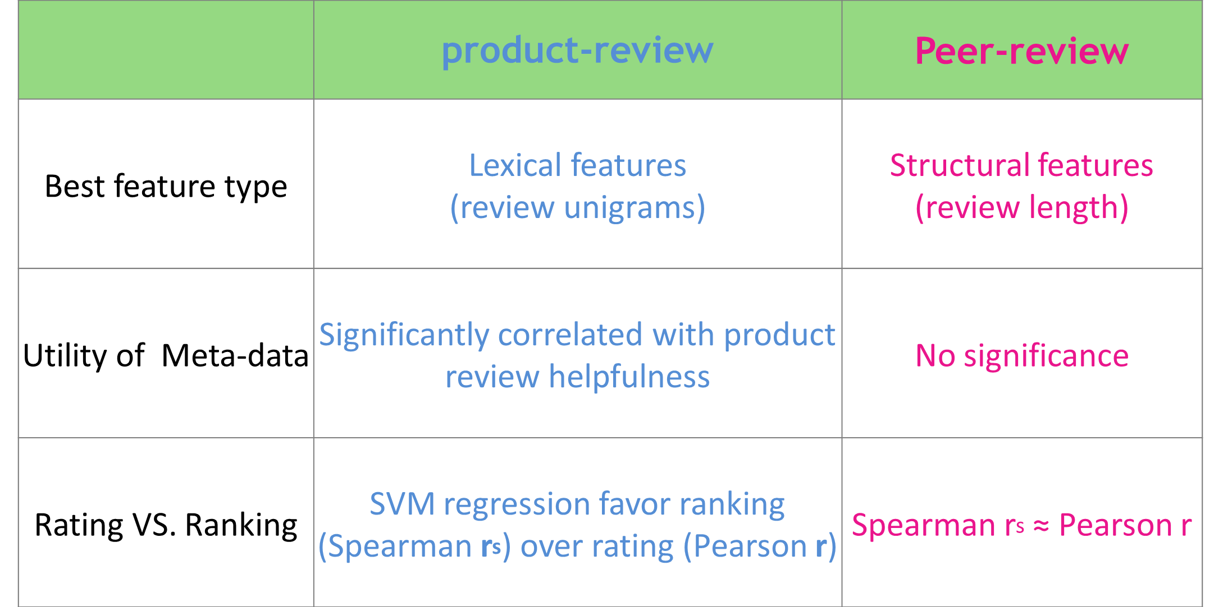
Discussion (1)
Effectiveness of generic features across domains
Same best generic feature combination (STR+UGR+MET)
But…

Slide 35
Results: Specialized Features
Feature Type | r | r_{s}
cogS | 0.425+/-0.094 | 0.461+/-0.072
LEX2 | 0.512+/-0.013 | 0.495+/-0.102
LOC | 0.446+/-0.133 | 0.472+/-0.113
STR+MET+UGR (Baseline) | 0.615+/-0.101 | 0.609+/-0.098
STR+MET+LEX2 | 0.621+/-0.096 | 0.611+/-0.088
STR+MET+LEX2+TOP | 0.648+/-0.097 | 0.655+/-0.081
STR+MET+LEX2+TOP+cogS | 0.660+/-0.093 | 0.655+/-0.081
STR+MET+LEX2+TOP+cogS+LOC | 0.665+/-0.089 | 0.671+/-0.076
All features are significantly correlated with helpfulness rating/ranking
  Weaker than generic features (but not significantly)
  Based on meaningful dimensions of writing (useful for validity and acceptance)

Slide 36
Results: Specialized Features
Feature Type | r | r_{s}
cogS | 0.425+/-0.094 | 0.461+/-0.072
LEX2 | 0.512+/-0.013 | 0.495+/-0.102
LOC | 0.446+/-0.133 | 0.472+/-0.113
STR+MET+UGR (Baseline) | 0.615+/-0.101 | 0.609+/-0.098
STR+MET+LEX2 | 0.621+/-0.096 | 0.611+/-0.088
STR+MET+LEX2+TOP | 0.648+/-0.097 | 0.655+/-0.081
STR+MET+LEX2+TOP+cogS | 0.660+/-0.093 | 0.655+/-0.081
STR+MET+LEX2+TOP+cogS+LOC | 0.665+/-0.089 | 0.671+/-0.076
Introducing high level features does enhance the model’s performance.
    Best model: Spearman correlation of 0.671 and Pearson correlation of 0.665.

Slide 37
Discussion (2)
  Techniques used in ranking product review helpfulness can be effectively adapted to the peer-review domain
    However, the utility of generic features varies across domains
  Incorporating features specific to peer-review appears promising
    provides a theory-motivated alternative to generic features
    captures linguistic information at an abstracted level better for small corpora (267 vs. > 10000)
    in conjunction with generic features, can further improve performance

Slide 38
Outline
SWoRD
Improving Review Quality
Identifying Helpful Reviews
What is the Meaning of Helpfulness?
Summary and Current Directions

Slide 39
What if we change the meaning of “helpfulness”?
  Helpfulness may be perceived differently by different types of people
Experiment: feature selection using different helpfulness ratings
      Student peers (avg.)
      Experts (avg.)
      Writing expert
      Content expert
Notes:
What gold-standard to use for the machine learning task??
Investigating differences in perceived peer-review helpfulness
between students and experts
between different types of expert

Slide 40
Example 1
Difference between students and experts
  Student rating = 7
  Expert-average = 2
  Student rating = 3
  Expert-average rating = 5
The author also has great logic in this paper. How can we consider the United States a great democracy when everyone is not treated equal. All of the main points were indeed supported in this piece.
I thought there were some good opportunities to provide further data to strengthen your argument. For example the statement “These methods of intimidation, and the lack of military force offered by the government to stop the KKK, led to the rescinding of African American democracy.” Maybe here include data about how …
(omit 126 words)
Note: Student rating scale is from 1 to 7, while expert rating scale is from 1 to 5
Notes:
Explain the difference:
Less helpful thought by the expert may because
Only praise no critiques not constructive
The comment is not supported with enough paper content.

Slide 41
Example 1
Difference between students and experts
  Student rating = 7
  Expert-average rating = 2
  Student rating = 3
  Expert-average rating = 5
The author also has great logic in this paper. How can we consider the United States a great democracy when everyone is not treated equal. All of the main points were indeed supported in this piece.
I thought there were some good opportunities to provide further data to strengthen your argument. For example the statement “These methods of intimidation, and the lack of military force offered by the government to stop the KKK, led to the rescinding of African American democracy.” Maybe here include data about how …
(omit 126 words)
Paper content
Note: Student rating scale is from 1 to 7, while expert rating scale is from 1 to 5
Notes:
Explain the difference:
Less helpful thought by the expert may because
Only praise no critiques not constructive
The comment is not supported with enough paper content.

Slide 42
Example 1
Difference between students and experts
  Student rating = 7
  Expert-average rating = 2
  Student rating = 3
  Expert-average rating = 5
Critique
The author also has great logic in this paper. How can we consider the United States a great democracy when everyone is not treated equal. All of the main points were indeed supported in this piece.
I thought there were some good opportunities to provide further data to strengthen your argument. For example the statement “These methods of intimidation, and the lack of military force offered by the government to stop the KKK, led to the rescinding of African American democracy.” Maybe here include data about how …
(omit 126 words)
praise
Note: Student rating scale is from 1 to 7, while expert rating scale is from 1 to 5
Notes:
Explain the difference:
Less helpful thought by the expert may because
Only praise no critiques not constructive
The comment is not supported with enough paper content.

Slide 43
Example 2
Difference between content expert and writing expert
  Writing-expert rating = 2
  Content-expert rating = 5
  Writing-expert rating = 5
  Content-expert rating = 2
Your over all arguements were organized in some order but was unclear due to the lack of thesis in the paper. Inside each arguement, there was no order to the ideas presented, they went back and forth between ideas. There was good support to the arguements but yet some of it didnt not fit your arguement.
First off, it seems that you have difficulty writing transitions between paragraphs. It seems that you end your paragraphs with the main idea of each paragraph. That being said, … (omit 173 words) As a final comment, try to continually move your paper, that is, have in your mind a logical flow with every paragraph having a purpose.

Slide 44
Example 2
Difference between content expert and writing expert
  Writing-expert rating = 2
  Content-expert rating = 5
  Writing-expert rating = 5
  Content-expert rating = 2
Your over all arguements were organized in some order but was unclear due to the lack of thesis in the paper. Inside each arguement, there was no order to the ideas presented, they went back and forth between ideas. There was good support to the arguements but yet some of it didnt not fit your arguement.
First off, it seems that you have difficulty writing transitions between paragraphs. It seems that you end your paragraphs with the main idea of each paragraph. That being said, … (omit 173 words) As a final comment, try to continually move your paper, that is, have in your mind a logical flow with every paragraph having a purpose.
Argumentation issue
Transition issue

Slide 45
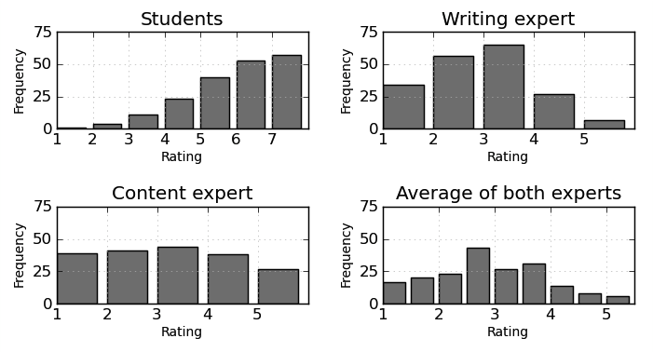
Difference in helpfulness rating distribution

Slide 46
Corpus
Previous annotated peer-review corpus
  Introductory college history class
  16 papers
  189 reviews
  Helpfulness ratings
  Expert ratings from 1 to 5
          Content expert and writing expert
          Average of the two expert ratings
  Student ratings from 1 to 7
Notes:
Paper topics
Descriptive information about the review
#words
#sentences

Slide 47
Experiment
Two feature selection algorithms
    Linear Regression with Greedy Stepwise search (stepwise LR)
      selected (useful) feature set
    Relief Feature Evaluation with Ranker (Relief)
      Feature ranks
Ten-fold cross validation

Slide 48
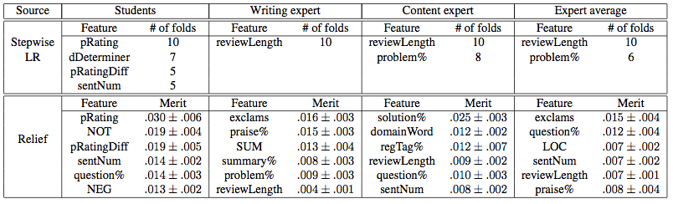
Sample Result: All Features
Feature selection of all features
    Students are more influenced by meta features, demonstrative determiners, number of sentences, and negation words
    Experts are more influenced by review length and critiques
    Content expert values solutions, domain words, problem localization
    Writing expert values praise and summary
Notes:
Though localization is more important than problem within the non-linguistic feautre set, when combined all features together, problem is more useful than lcoalization, due to the interaction among features. (regTag, LOC implies localization information)

Slide 49
Sample Result: All Features
Feature selection of all features
    Students are more influenced by meta features, demonstrative determiners, number of sentences, and negation words
    Experts are more influenced by review length and critiques
    Content expert values solutions, domain words, problem localization
    Writing expert values praise and summary
Notes:
Though localization is more important than problem within the non-linguistic feautre set, when combined all features together, problem is more useful than lcoalization, due to the interaction among features. (regTag, LOC implies localization information)

Slide 50
Sample Result: All Features
Feature selection of all features
    Students are more influenced by social-science features, demonstrative determiners, number of sentences, and negation words
    Experts are more influenced by review length and critiques
    Content expert values solutions, domain words, problem localization
    Writing expert values praise and summary
Notes:
Though localization is more important than problem within the non-linguistic feautre set, when combined all features together, problem is more useful than lcoalization, due to the interaction among features. (regTag, LOC implies localization information)

Slide 51
Sample Result: All Features
Feature selection of all features
    Students are more influenced by meta features, demonstrative determiners, number of sentences, and negation words
    Experts are more influenced by review length and critiques
    Content expert values solutions, domain words, problem localization
    Writing expert values praise and summary
Notes:
Though localization is more important than problem within the non-linguistic feautre set, when combined all features together, problem is more useful than lcoalization, due to the interaction among features. (regTag, LOC implies localization information)

Slide 52
Sample Result: All Features
Feature selection of all features
    Students are more influenced by meta features, demonstrative determiners, number of sentences, and negation words
    Experts are more influenced by review length and critiques
    Content expert values solutions, domain words, problem localization
    Writing expert values praise and summary
Notes:
Though localization is more important than problem within the non-linguistic feautre set, when combined all features together, problem is more useful than lcoalization, due to the interaction among features. (regTag, LOC implies localization information)

Slide 53
Other Findings
  Lexical features: transition cues, negation, and suggestion words are useful for modeling student perceived helpfulness
  Cognitive-science features: solution is effective in all helpfulness models; the writing expert prefers praise while the content expert prefers critiques and localization
  Meta features: paper rating is very effective for predicting student helpfulness ratings

Slide 54
Outline
SWoRD
Improving Review Quality
Identifying Helpful Reviews
What is the Meaning of Helpfulness?
Summary and Current Directions

Slide 55
Summary
Techniques used in predicting product review helpfulness can be effectively adapted to the peer-review domain
  Only minor modifications to semantic and meta-data features
  The utility of generic features (e.g. meta-data) varies between domains
Predictive performance can be further improved by incorporating specialized features capturing information specific to peer-reviews
The type of helpfulness to be predicted influences the utility of different features for automatic prediction
  Generic features are more predictive when modeling students
  Specialized (theory-supported) features are more useful for modeling experts

Slide 56
Future Work
Generate specialized features fully automatically
  Combine helpfulness prediction with our prior study of automatically identifying problem localization and solution
Evaluate our model on data sets of other classes, and on reviews of not only writing but also argument diagrams
Perceived versus “true” helpfulness
Extrinisic evaluation in SWoRD

Slide 57
Thank you!
Questions?
SWoRD volunteers? https://sites.google.com/site/swordlrdc/

Slide 58
Related Work
Analysis of review helpfulness in Natural Language Processing
  Predict helpfulness ranking of product reviews (Kim 2006)
  Subjectivity analysis is useful for examining review helpfulness and their socio-economic impact (Ghose 2007)
  Helpfulness depends on reviewers’ expertise, writing style, and the review timeliness (Liu 2008)
  REVRANK: unsupervised algorithm for selecting the most helpful book reviews. (Tsur et al. 2009)
Notes:
1 determine whether a review is positive or negative by using machine learning algorithm
Lexical features (unigram, bigram…), Maximum entropy, naïve bayes, svm
address the rating-inference problem, wherein rather than simply decide whether a review is "thumbs up" or "thumbs down", as in previous sentiment analysis work, one must determine an author's evaluation with respect to a multi-point scale (e.g., one to five "stars")
(Propose a meta-algorithm, based on a metric labeling formulation of the problem, that alters a given n-ary classifier's output in an explicit attempt to ensure that similar items receive similar labels.)
parse-and praraphrase paradigm (adverb-adjective-noun phrases based on clause structure) help to predict the degree of sentiment

Slide 59
SWoRD: A web-based peer review system
[Cho & Schunn, 2007]
Authors submit papers
Peers submit (anonymous) reviews
Authors resubmit revised papers
Authors provide back-reviews to peers regarding review helpfulness
Note: Lots of text (sometimes even annotated)!

Slide 60
Our Solution
Phase I:
Argument diagramming
Source texts
Author creates Argument Diagram
Peers review Argument Diagrams
AI: Guides preparing diagram and using it in writing
Author revises Argument Diagram
Author writes paper
AI: Guides reviewing
Peers review papers
Author revises paper
Phase II: Writing

Slide 61
Argument diagram student created with LASAD
9 · (+) supports Link: 1
Active touch participants were able to more accurately identify objects because they had the use of sensitive fingertips in exploring the objects
8 · Citation Link: 1
(Craig 2001)
1 · Hypothesis Link: 1
If: Participants are assigned to the active condition
Then: they will be better at correctly identifying stimuli than participants in the passive condition.
6 · Citation Link: 1
(Gibson 1962)
7 · (+) supports Link: 1
Active touch is more effective than passive touch
11 · (+) supports Link: 2
Active touch improved through the development levels but passive touch stayed the same (hand size may play role)
10 · Citation Link: 2
(Cronin 1977)
2 · Hypothesis Link: 2
If: The participant has small hands
Then: they will be better at recognizing objects than regardless of what condition they’re in..
20 · (+) supports Link: 2
Sensory perceptors in smaller hands are closer together, allowing for more accurate object acuity
17 · Citation Link: 2
(Peters 2009)

Slide 62
Features (1)
Computational linguistic features
  Generic NLP features used in product review analysis (Kim et al., 2006)
    Domain words (#domainWord)
      288 words extracted from all students’ papers
      Using topic-lexicon extraction software provided by Annie Louis
    Sentiment words (#posWord, #negWord)
      1915 positive and 2291 negative words from General Inquirer Dictionaries
Feature Type | Features
Structural | reviewLength, sentNum, sentLengthAve, question%, exclams
Lexical | ten lexical categories
Syntactic | nouns%, verbs%, 1stPVerb%, adjective/adverb%, openClass%
Semantic | #domainWord, #posWord, #negWord
Notes:
Computed from the output of syntactic analysis (use dependency parser to parse it first and then automatically compute the linguistic features)
Ten lexical categories direct to another table in the next slides
2291 negative words 1915 positive words

Slide 63
Features (2)
Computational linguistic features
  Localization features for automatically predicting problem localization (Xiong and Litman, 2010)
    windowSize
      For each review sentence, we search for the most likely referred window of words in the related paper, and windowSize is the average number of words of all windows
      s
Feature | Example/Description
regTag% | “On page five, …”
dDeterminer | “To support this argument, you should provide more ….”
windowSize | The amount of context information regarding the related paper

Slide 64
Features (3)
Non-linguistic features
  Cognitive-science features (Nelson and Schunn, 2009)
    Praise%, problem%, summary%
    Localization%, solution%
  Social-science features (Kim et al., 2006; Danescu-Niculescu-Mizil et al., 2009)
    pRating – paper rating:
    pRatingDiff – variation:

Slide 65
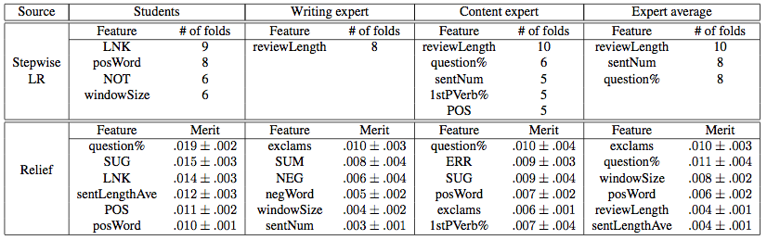
Result (1)
Feature selection of computational linguistic features
    All but writing expert value questions
    Students favor clear sign of logic flow and opinions (e.g. suggestions, transitions, positive words, and paper context)
    Experts prefer longer reviews
Notes:
For all of them
Expets
Student → clear sign of flow, pos
Expert both, difference

Slide 66
Result (1)
Feature selection of computational linguistic features
    All but writing expert value questions
    Students favor clear sign of logic flow and opinions (e.g. suggestions, transitions, positive words, and paper context)
    Experts prefer longer reviews
Notes:
For all of them
Expets
Student → clear sign of flow, pos
Expert both, difference

Slide 67
Result (1)
Feature selection of computational linguistic features
    All but writing expert value questions
    Students favor clear sign of logic flow and opinions (e.g. suggestions, transitions, positive words, and paper context)
    Experts prefer longer reviews
Notes:
For all of them
Expets
Student → clear sign of flow, pos
Expert both, difference

Slide 68
Result (1)
Feature selection of computational linguistic features
    All but writing expert value questions
    Students favor clear sign of logic flow and opinions (e.g. suggestions, transitions, positive words, and paper context)
    Experts prefer longer reviews
Notes:
For all of them
Expets
Student → clear sign of flow, pos
Expert both, difference

Slide 69
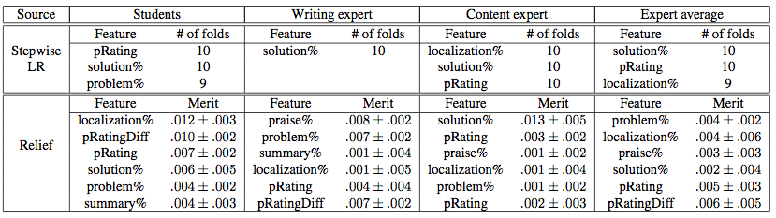
Result (2)
Feature selection of non-linguistic features
    Both students and experts like solutions
    Students are more influenced by paper rating
    Students, content expert, and expert average favor localized reviews

Slide 70
Result (2)
Feature selection of non-linguistic features
    Both students and experts like solutions
    Students are more influenced by paper rating
    Students, content expert, and expert average favor localized feedback

Slide 71
Result (2)
Feature selection of non-linguistic features
    Both students and experts like solutions
    Students are more influenced by paper rating
    Students, content expert, and expert average favor localized feedback

Slide 72
Result (2)
Feature selection of non-linguistic features
    Both students and experts like solutions
    Students are more influenced by paper rating
    Students, content expert, and expert average favor localized feedback

