Slide 1


Towards an NLP-based Intelligent Revision Assistant for Argumentative Writings
Diane Litman
Computer Science Department &
Learning Research and Development Center
University of Pittsburgh
(Joint work with Fan Zhang)

Slide 2



Why revisions?
A desirable writing process
Better essay!
Write the first draft
Feedback on the problems of the essay
Revise and write the second draft
Feedback on the revision
…
Rewriting skills!

Slide 3
Our approach
Build a revision assistant
  Identify the changes made by the author
  Provide feedback on changes made by the author
Currently focus on argumentative writings

Slide 4
The roadmap
Preparing revision data
(Zhang and Litman, BEA15)
Revision schema definition
Data collection and data analysis
Automatic revision identification
Revision extraction
Revision classification
Tool user study
Tool development
User study

Slide 5
Revision schema definition
Granularity for revisions: sentence-level
  Simplifies manual annotation and automatic processing
Types of revisions
  Content level
    Thesis, (Rebuttal), Reasoning, Evidence, General, (Precision)
  Surface level
    Reordering, Fluency, Errors

Slide 6
Revision examples
Draft 1
The next level is the level for angry people.
Saddam Hussein can be put in this circle.
He is a ruthless dictator and killed many people.
He deserves to be in the level of Hell.
Draft 2
The next level is the level for angry people.
Osama Bin Laden should be put in this level.
He is a terrorist and killed innocent people.
He deserves to be in the level of Hell.
2-2, Modify, Thesis
3-Null, Delete, Reasoning
Null-3, Add, Reasoning

Slide 7
The roadmap
Preparing revision data
(Zhang and Litman, BEA15)
Revision schema definition
Data collection and data analysis
Automatic revision identification
Revision extraction
Revision classification
Tool user study
Tool development
User study

Slide 8
Sources of data
Corpora written by
  High school students
  University students
Collected via
  An online collaborative writing system SWoRD
  The user study of the tool (ArgRewrite) developed

Slide 9
Can the data be reliably annotated?
Agreement on sentence alignment
  Alignment agreement (Raghava et al., 2003)
  0.9877 on Ugrad1, Ugrad2, 0.9843 on HSchool1
Agreement on revision type labeling
  Cohen’s Kappa
  0.75 on HSchool1, 0.69 on HSchool2, 0.71 on ArgRewrite

Slide 10
Is the annotated data useful?
HSchool1
  Two drafts collected (Draft1 and Draft2)
  Draft1 and Draft2 graded by experts
HSchool2
  Students write two drafts on one topic (Draft1 and Draft2) and write the other draft on another topic (Essay2)
  Draft1 and Essay2 graded by experts

Slide 11
Data analysis results
  Approach
    Pearson correlation between revision number and Draft2/Essay2 score controlling Draft1 score
Conclusion
  It is important to make more content revisions
    Significant correlation between content revisions in Draft1 and Draft2 score
  The transfer learning effect
    Significant correlation between content revisions in Draft1 and Essay2 score

Slide 12
The roadmap
Preparing revision data
(Zhang and Litman, BEA15)
Revision schema definition
Data collection and data analysis
Automatic revision identification
(Zhang and Litman, BEA14)
(Zhang and Litman, BEA15)
(Zhang and Litman, NAACL16)
(Zhang and Litman, COLING16)
Revision extraction
Revision classification
Tool user study
Tool development
User study

Slide 13
Automatic revision identification
Pipeline solution
Input
Output
Raw Text: Draft1 and Draft2
Revisions: revision types on aligned sentence pairs

Slide 14
Automatic revision identification
Pipeline solution
Input
Output
Raw Text: Draft1 and Draft2
Revision extraction
Aligned sentence pairs
Revisions: revision types on aligned sentence pairs

Slide 15
Automatic revision identification
Pipeline solution
Input
Output
Raw Text: Draft1 and Draft2
Revision extraction
Aligned sentence pairs
Revision classification
Revisions: revision types on aligned sentence pairs

Slide 16
The roadmap
Preparing revision data
(Zhang and Litman, BEA15)
Revision schema definition
Data collection and data analysis
Automatic revision identification
(Zhang and Litman, BEA14)
(Zhang and Litman, BEA15)
(Zhang and Litman, NAACL16)
(Zhang and Litman, COLING16)
Revision extraction
Revision classification
Tool user study
Tool development
User study

Slide 17
Revision extraction
Basically a sentence alignment problem
  Binary classification (aligned or not aligned)
    Model: Logistic Regression Classifier
    Features: edit distance, TF*IDF cosine similarity, word overlap
  Dynamic programming to capture global similarity
    Adapted the Needleman-Wunsch algorithm
Results
  Accuracy between .91-.99 on five corpora

Slide 18
The roadmap
Preparing revision data
(Zhang and Litman, BEA15)
Revision schema definition
Data collection and data analysis
Automatic revision identification
(Zhang and Litman, BEA14)
(Zhang and Litman, BEA15)
(Zhang and Litman, NAACL16)
(Zhang and Litman, COLING16)
Revision extraction
Revision classification
Tool user study
Tool development
User study

Slide 19
I. Do existing features & approaches work?
Idea
  Treat each sentence pair as an instance for classification
Based on prior work on Wikipedia revision classifications
  (Adler et al., 2011; Javanmardi et al., 2011; Bronner and Monz, 2012; Daxenberger and Gurevych, 2013)

Slide 20
Existing features used for classification
Location
  Location of sentence (First/Last sentence of paragraph, exact location index of sentence)
  Location of paragraph (First/Last paragraph of essay, extract paragraph index)
Textual
  Keywords: “because”, “however”, “for example”, ….
  Named entity features (Whether there is NER detected)
  Sentence difference features (Levenshtein distance…)
  Revision operation (Add/Delete/Modify)
Language
  Count of OOV(out of vocabulary) words

Slide 21
Existing features: evaluation
Surface vs. Content classification
  Results significantly better than unigram features
Binary classification for each category
  Results almost significantly better than the unigram features for all categories
  Feature groups have different impacts on categories
    Location features are more predictive for Thesis revisions
    Textual/Language features are more predictive for Fluency revisions

Slide 22
2. Using contextual information to improve performance
“Contextual” features
  Using the features of adjacent sentences
  Using cohesion (lexical)/coherence (semantic) changes
“Contextual” approach
  Sequence labeling instead of single-instance classification

Slide 23
Using contextual information: evaluation
Approach
  Baseline: SVM + Wikipedia features
  Experiments
    (E1) SVM + contextual features + Wikipedia features
    (E2) CRF + contextual features + Wikipedia features
Results
  E2 (0.644) > E1 (0.626) > Baseline (0.615)

Slide 24
3. Using discourse information to improve performance
Utilizing the existing discourse framework
  PDTB (Penn Discourse Treebank)
Features
  Features directly from annotated PDTB
  Features from inferred PDTB

Slide 25
Penn Discourse Treebank
Example
  (1) Use of dispersants was approved when a test on the third day showed some positive results, officials said.

Slide 26
Penn Discourse Treebank
Example
  (1) Use of dispersants was approved when a test on the third day showed some positive results, officials said.

Slide 27
Penn Discourse Treebank
Example
  (1) Use of dispersants was approved when a test on the third day showed some positive results, officials said.
ARGUMENT1
ARGUMENT2

Slide 28
Penn Discourse Treebank
Example
  (1) Use of dispersants was approved when a test on the third day showed some positive results, officials said.
ARGUMENT1
Connective
ARGUMENT2

Slide 29
Penn Discourse Treebank
Example
  (1) Use of dispersants was approved when a test on the third day showed some positive results, officials said.
ARGUMENT1
Connective
ARGUMENT2
Sense: Contingency

Slide 30
Penn Discourse Treebank
Example
  (1) Use of dispersants was approved when a test on the third day showed some positive results, officials said.
ARGUMENT1
Connective
ARGUMENT2
Sense: Contingency

Slide 31
Weakness of PDTB
Local analysis:
  Usually labeled between adjacent sentences/clauses
Idea:
  An automatic approach to infer long distance relations

Slide 32
PDTBTree: tree construction
Lvl1
EntRel
1-2
Lvl2
3-4
Contingency
EntRel
Lvl3
5-6
Contingency
Lvl4
6-7
Lvl5
2-3
Expansion
4-5
Expansion
7-8
Contingency
1
2
3
4
5
6
7
8

Slide 33
Using discourse information: evaluation
Approach
  Baseline:
    CRF + prior features
  Experiment
    (E1) baseline + Direct discourse features
    (E2) E1 + Inferred discourse features
Results
  E2 (0.678) > E1 (0.648) >= Baseline (0.643)

Slide 34
The roadmap
Preparing revision data
(Zhang and Litman, BEA15)
Revision schema definition
Data collection and data analysis
Automatic revision identification
(Zhang and Litman, BEA14)
(Zhang and Litman, BEA15)
(Zhang and Litman, NAACL16)
(Zhang and Litman, COLING16)
Revision extraction
Revision classification
Tool user study
(Zhang et al., NAACL16demo)
(Zhang et al., ACL2017)
Tool development
User study

Slide 35
The ArgRewrite tool study
(joint work with Fan Zhang, Rebecca Hwa, Huma Hashemi)
Interface difference: Compare ArgRewrite with a control interface
ArgRewrite feedback impact: Require participants to record whether they agree with the revision type recognized by the system
To remove the possible impact of revision identification errors
  “Wizard-of-Oz” study using the manual annotation

Slide 36
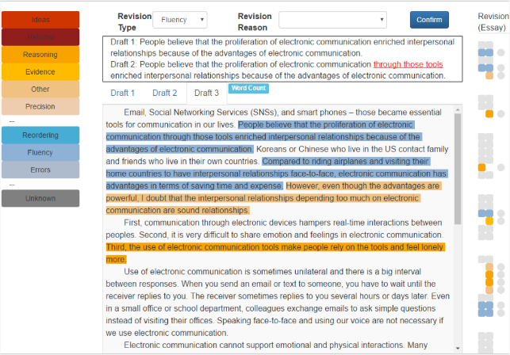
The ArgRewrite interface

Slide 37
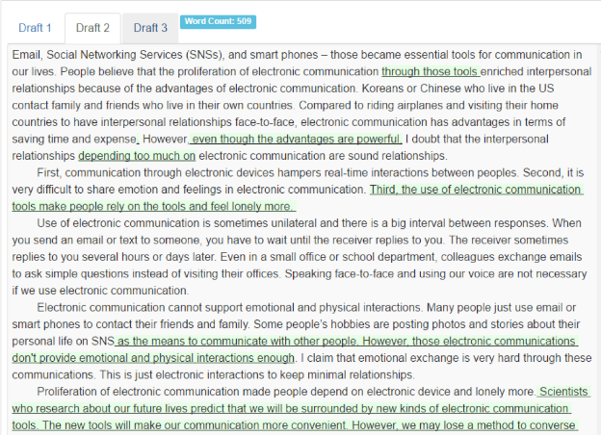
The Diff interface

Slide 38
Data analysis
Interface difference
  Experimental group agrees with the statement “The system helps me to recognize the weakness of my essay” more
  Control interface is ineffective when participants have to reflect on many changes
Impact of disagreements with revision feedback
  Positive correlation between number of revisions and the number of cases in which the revisions annotated as Surface are intended to be Content by the participants

Slide 39
Summary
Preparing revision data
Created useful revision schema that can be reliably annotated
Revision schema definition
Data collection and data analysis
Automatic revision identification
Developed and improved algorithms for revision identification
Revision extraction
Revision classification
Tool user study
User study suggests that the developed tool is useful
Tool development
User study

Slide 40
What’s next?
Development of Human Language Technologies to Improve Disciplinary Writing and Learning through Self-Regulated Revising
  Cyberlearning NSF award with Amanda Godley & Rebecca Hwa

Slide 41
Thank you!
http://argrewrite.cs.pitt.edu/#corpus

Slide 42
Descriptive statistics
Collected via SWoRD
Corpus | Writers | Size | D1Num | D2Num | Topic
Align1 | Undergraduate | 11 | 23 | 23 | The role the Big Data played in Obama’s presidential campaign
Align2 | Undergraduate | 10 | 25 | 25 | Intellectual property
HSchool1 | High School | 47 | 38 | 53 | Dante’s Inferno
HSchool2 | High School | 63 | 26 | 29 | Rhetorical strategies used by the speaker/author
Science | High School | 9 | 13 | 17 | Science reports

Slide 43
Descriptive statistics
Collected via SWoRD
Corpus | Writers | Size | D1Num | D2Num | Topic
Align1 | Undergraduate | 11 | 23 | 23 | The role the Big Data played in Obama’s presidential campaign
Align2 | Undergraduate | 10 | 25 | 25 | Intellectual property
HSchool1 | High School | 47 | 38 | 53 | Dante’s Inferno
HSchool2 | High School | 63 | 26 | 29 | Rhetorical strategies used by the speaker/author
Science | High School | 9 | 13 | 17 | Science reports

Slide 44
Descriptive statistics
Collected via ArgRewrite
  Topic: whether the proliferation of electronic communications enriches or hinders the development of interpersonal relationships
Corpus | Writers | Size | D1Num | D2Num | D3Num
ArgRewrite | College (ESL) | 20 | 19 | 20 | 26
 | College (Native) | 40 | 19 | 20 | 27

Slide 45
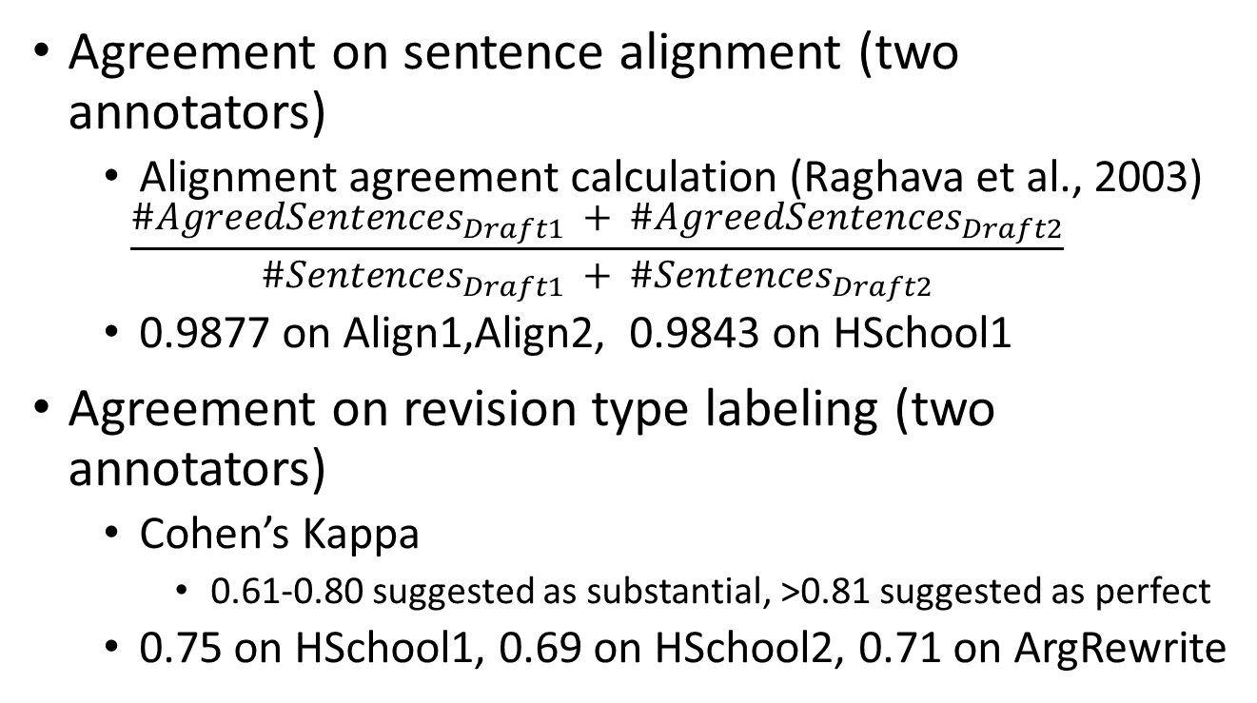
Data annotation: can revisions be reliably annotated?
Agreement on sentence alignment (two annotators)
  Alignment agreement calculation (Raghava et al., 2003)
  0.9877 on Align1,Align2, 0.9843 on HSchool1
Agreement on revision type labeling (two annotators)
  Cohen’s Kappa
    0.61-0.80 suggested as substantial, >0.81 suggested as perfect
  0.75 on HSchool1, 0.69 on HSchool2, 0.71 on ArgRewrite

Slide 46
Data analysis: is the schema useful?
HSchool1
  Two drafts collected (Draft1 and Draft2)
  Draft1 and Draft2 graded by experts
HSchool2
  Students write two drafts on one topic (Draft1 and Draft2) and write the other draft on another topic (Essay2)
  Draft1 and Essay2 graded by experts

Slide 47
Revision extraction
Stage 1
  Create the cartesian product of the sentence sets and classify
    TFIDF/Levenshtein distance/Word Overlap
    Train a classifier to classify alignment or not
Draft1
Draft2
1
1
2
2
3
3
4
4
5

Slide 48
Revision extraction
Stage 1
  Create the cartesian product of the sentence sets and classify
    TFIDF/Levenshtein distance/Word Overlap
    Train a classifier to classify alignment or not
Draft1
Draft2
1
1
2
2
3
3
4
4
5

Slide 49
Revision extraction
Stage 1
  Create the cartesian product of the sentence sets and classify
    TFIDF/Levenshtein distance/Word Overlap
    Train a classifier to classify yes or not
Stage 2.
  s(i, j) = max{s(i−1, j−1)+sim(i, j), s(i− 1, j) + insertcost , s(i, j − 1) + deletecost}
  (Needleman and Wunsch, 1970)
Draft1
Draft2
1
1
2
2
3
3
4
4
5

Slide 50
Revision extraction: evaluation
Approach
  Metric: Alignment agreement with gold standard
  10 fold (student) cross-validation
Results
    Align1: 0.99
    Align2: 0.96
    HSchool1: 0.92
    HSchool2: 0.91
    ArgRewrite: 0.93

Slide 51
Hypotheses
H2.1 The existing features and approaches in Wikipedia revision classification can be adapted to the prediction of argumentative writing revisions
H2.2 Using contextual information can improve the classification performance
H2.3 Using discourse information can improve the classification performance

Slide 52
Existing features: evaluation
Approach
  Classification model: SVM
  Baseline: unigram features
  Metric: unweighted avg F1
Experiments
  Surface vs. Content classification
  Binary classification for each category

Slide 53
Contextual features: using features of adjacent sentences
Draft 1
Draft 2
1
1
Features_Up
Location
Text
Language
2
2
3
3
4
4
Features_Down
5
5

Slide 54
Contextual features: using cohesion and coherence features
Measure similarity between blocks
Draft 1
Draft 2
1
1
2
2
3
3
4
4
5
5

Slide 55
Contextual features: using cohesion and coherence features
1
1
2
2
Cohesion_Down_Old/Coherence_Down_Old
3
3
4
4
5
5

Slide 56
Contextual features: using cohesion and coherence features
1
1
2
2
Cohesion_Up_Old/Coherence_Up_Old
3
3
4
4
5
5

Slide 57
Contextual features: using cohesion and coherence features
1
1
2
2
Cohesion_Up_New/Coherence_Up_New
3
3
4
4
5
5

Slide 58
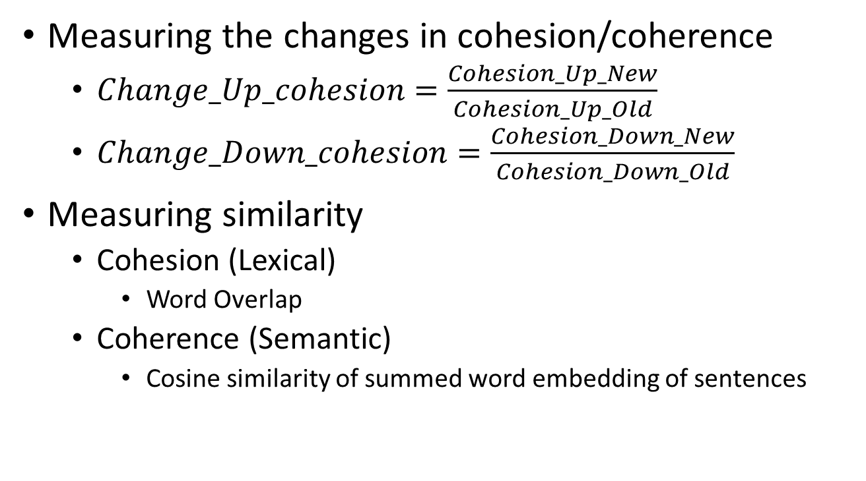
Contextual features: using cohesion and coherence features
Measuring the changes in cohesion/coherence
  $Change_Up_cohesion=\frac{Cohesion_Up_New}{Cohesion_Up_Old}$
  $Change_Down_cohesion=\frac{Cohesion_Down_New}{Cohesion_Down_Old}$
Measuring similarity
  Cohesion (Lexical)
    Word Overlap
  Coherence (Semantic)
    Cosine similarity of summed word embedding of sentences

Slide 59
Contextual approach: sequence labeling
Observation
  There exists dependencies between adjacent revisions
    “Thesis” changes are likely to be followed by “Reasoning” changes
  The occurrence pattern of revisions are different
    “Surface” changes are less likely to occur next to each other
Solution
  Transform the problem to a sequence labeling problem
    Using Conditional Random Fields (CRFs) for sequence labeling

Slide 60
Revision sequence transformation
Draft 1
Draft 2
1
1
Thesis, Modify
2
2
Evidence, Delete
3
Evidence, Add
3
4
4

Slide 61
Revision sequence transformation
Sequence labeling
Nochange
1
1
2
2
Claim
3
Evidence
3
Evidence
4
4
Nochange

Slide 62
H2.2 Using contextual information: evaluation
Approach
  5-class classification
    Thesis vs. Reasoning vs. Evidence vs. General vs. Surface
  Metric: unweighted average F1
  Baseline: SVM + H2.1 features
  Experiments
    (E1) SVM + contextual features + H2.1 features
    (E2) CRF + contextual features + H2.1 features
Results
  E2 (0.644) > E1 (0.626) > Baseline (0.615)

Slide 63
Penn Discourse Treebank
Example
  (1) Use of dispersants was approved when a test on the third day showed some positive results, officials said.

Slide 64
Penn Discourse Treebank
Example
  (1) Use of dispersants was approved when a test on the third day showed some positive results, officials said.

Slide 65
Penn Discourse Treebank
Example
  (1) Use of dispersants was approved when a test on the third day showed some positive results, officials said.
ARGUMENT1
ARGUMENT2

Slide 66
Penn Discourse Treebank
Example
  (1) Use of dispersants was approved when a test on the third day showed some positive results, officials said.
ARGUMENT1
Connective
ARGUMENT2

Slide 67
Penn Discourse Treebank
Example
  (1) Use of dispersants was approved when a test on the third day showed some positive results, officials said.
ARGUMENT1
Connective
ARGUMENT2
Sense: Contingency

Slide 68
Penn Discourse Treebank
Example
  (1) Use of dispersants was approved when a test on the third day showed some positive results, officials said.
  (2) Mrs Yeargin is lying. They found students in an advanced class a year earlier who said she gave them similar help.
ARGUMENT1
Connective
ARGUMENT2
Sense: Contingency

Slide 69
Penn Discourse Treebank
Example
  (1) Use of dispersants was approved when a test on the third day showed some positive results, officials said.
  (2) Mrs Yeargin is lying. They found students in an advanced class a year earlier who said she gave them similar help.
ARGUMENT1
Connective
ARGUMENT2
Sense: Contingency

Slide 70
Penn Discourse Treebank
Example
  (1) Use of dispersants was approved when a test on the third day showed some positive results, officials said.
  (2) Mrs Yeargin is lying. Implicit = because They found students in an advanced class a year earlier who said she gave them similar help.
ARGUMENT1
Connective
ARGUMENT2
Sense: Contingency
ARGUMENT1
ARGUMENT2
Sense: Contingency

Slide 71
Penn Discourse Treebank (PDTB)
Relation types
  EntRel, Explicit, Implicit, AltLex, NoRel
Relation senses
  Comparison
  Contingency
  Temporal
  Expansion

Slide 72
Features directly from annotated PDTB
Draft 1
Draft 2
1
1
2
2
Discourse_Up_Old:
Expansion_Explicit
Discourse_Up_New: Contingency_Explicit
3
3
Discourse_Down_Old:Expansion_Explicit
Discourse_Down_New:
Expansion_Explicit
4
4
5
5

Slide 73
Features directly from annotated PDTB
Discourse_Up_Old_2: Not available!
Draft 1
Draft 2
Discourse_Up_New_2: Not available!
1
1
2
2
Discourse_Up_Old:
Expansion_Explicit
Discourse_Up_New: Contingency_Explicit
3
3
Discourse_Down_Old:Expansion_Explicit
Discourse_Down_New:
Expansion_Explicit
4
4
5
5

Slide 74
Inferring PDTB relations
Intuitions
  Intuition 1. Long distance discourse relations can be inferred from adjacent discourse relations
  Intuition 2. The importance of discourse relations to argumentation varies even if the relation types are the same
Solution
  PDTBSegment
  PDTBTree

Slide 75
Importance of relations are different to the argument structure
The lustful are those who long and crave for one another.
The person guilty of lust is put in this layer of hell because of his over indulgence of sexual-pleasure.
The man who is stuck in this layer is Hue Heffner.
He has devoted his entire life for other people ’s lustful pleasure and his own.
He has spent millions on working on his mansion which is for the purpose of other lustful desires.
People who were stuck in this layer are constantly whipped around and “ banging ” into one another.
What you do in your Earthly presence follows with you into Hell.
For him and like many others he is now tortured in a whirlwind of torment with others lustful accommodators with himself.
Contingency
Contingency
Notes:
do short examples of this in the beginning

Slide 76
Importance of relations are different to the argument structure
The lustful are those who long and crave for one another.
The person guilty of lust is put in this layer of hell because of his over indulgence of sexual-pleasure.
The man who is stuck in this layer is Hue Heffner.
He has devoted his entire life for other people ’s lustful pleasure and his own.
He has spent millions on working on his mansion which is for the purpose of other lustful desires.
People who were stuck in this layer are constantly whipped around and “ banging ” into one another.
What you do in your Earthly presence follows with you into Hell.
For him and like many others he is now tortured in a whirlwind of torment with others lustful accommodators with himself.
Contingency
Contingency
Notes:
do short examples of this in the beginning

Slide 77
PDTBTree relation inference: example
(1) The lustful are those who long and crave for one another. (2) The person guilty of lust is put in this layer of hell because of his over indulgence of sexual-pleasure. (3) The man who is stuck in this layer is Hue Heffner. (4) He has devoted his entire life for other people ’s lustful pleasure and his own. (5) He has spent millions on working on his mansion which is for the purpose of other lustful desires. (6) People who were stuck in this layer are constantly whipped around and “ banging ” into one another. (7) What you do in your Earthly presence follows with you into Hell. (8) For him and like many others he is now tortured in a whirlwind of torment with others lustful accommodators with himself.
1
2
3
4
5
6
7
8
EntRel
Expansion
Cont
Expan
EntRel
Cont
Cont

Slide 78
PDTBTree relation inference: example
(1) The lustful are those who long and crave for one another. (2) The person guilty of lust is put in this layer of hell because of his over indulgence of sexual-pleasure. (3) The man who is stuck in this layer is Hue Heffner. (4) He has devoted his entire life for other people ’s lustful pleasure and his own. (5) He has spent millions on working on his mansion which is for the purpose of other lustful desires. (6) People who were stuck in this layer are constantly whipped around and “ banging ” into one another. (7) What you do in your Earthly presence follows with you into Hell. (8) For him and like many others he is now tortured in a whirlwind of torment with others lustful accommodators with himself.
0.35
0.56
0.22
0.55
0.36
0.14
0.15
1
2
3
4
5
6
7
8
EntRel
Expansion
Cont
Expan
EntRel
Cont
Cont
Semantic similarity by cosine of embeddings

Slide 79
Approach 1: PDTBSegment
(1) The lustful are those who long and crave for one another. (2) The person guilty of lust is put in this layer of hell because of his over indulgence of sexual-pleasure. (3) The man who is stuck in this layer is Hue Heffner. (4) He has devoted his entire life for other people ’s lustful pleasure and his own. (5) He has spent millions on working on his mansion which is for the purpose of other lustful desires. (6) People who were stuck in this layer are constantly whipped around and “ banging ” into one another. (7) What you do in your Earthly presence follows with you into Hell. (8) For him and like many others he is now tortured in a whirlwind of torment with others lustful accommodators with himself.
0.35
0.56
0.22
0.55
0.36
0.14
0.15
1
2
3
4
5
6
7
8
EntRel
Expansion
Cont
Expan
EntRel
Cont
Conti
Semantic similarity by cosine of embeddings

Slide 80
Approach 1: PDTBSegment
4
Contingency
Expansion
1
5
EntRel
EntRel
2
6
Contingency
Expansion
7
3
Contingency
8

Slide 81
Approach 1: PDTBSegment
4
Contingency
Expansion
1
5
EntRel
EntRel
2
6
Contingency
Expansion
7
Contingency’
3
Contingency
Contingency’’
8

Slide 82
PDTBTree construction
Constructing importance levels
0.35
0.56
0.22
0.55
0.36
0.14
0.15
1
2
3
4
5
6
7
8
EntRel
Expansion
Cont
Expan
EntRel
Cont
Cont

Slide 83
PDTBTree construction
0.35
0.56
0.22
0.55
0.36
0.14
0.15
1
2
3
4
5
6
7
8
EntRel
Expansion
Cont
Expan
EntRel
Cont
Cont

Slide 84
PDTBTree construction
Expansion
2-3
0.35
0.22
0.55
0.36
0.14
0.15
0.56
1
2
3
4
5
6
7
8
EntRel
Cont
Expan
EntRel
Cont
Cont

Slide 85
PDTBTree construction
Expansion
2-3
0.08
0.12
0.55
0.36
0.14
0.15
0.56
1
2
3
4
5
6
7
8
EntRel
Cont
Expan
EntRel
Cont
Cont

Slide 86
PDTBTree construction
Expansion
2-3
0.08
0.12
0.55
0.36
0.14
0.15
1
2
3
4
5
6
7
8
EntRel
Cont
Expan
EntRel
Cont
Cont

Slide 87
PDTBTree construction
Expansion
Expansion
2-3
0.10
4-5
0.08
0.11
0.55
0.14
0.15
1
2
3
4
5
6
7
8
EntRel
Cont
EntRel
Cont
Cont

Slide 88
PDTBTree construction
Expansion
Expansion
2-3
0.10
4-5
0.08
0.11
0.14
0.15
1
2
3
4
5
6
7
8
EntRel
Cont
EntRel
Cont
Cont

Slide 89
PDTBTree construction
Expansion
Expansion
2-3
0.10
4-5
0.08
0.11
0.14
0.15
1
2
3
4
5
6
7
8
EntRel
Cont
EntRel
Cont
Cont

Slide 90
PDTBTree construction
Expansion
Expansion
2-3
0.10
4-5
0.08
0.11
0.14
0.15
1
2
3
4
5
6
7
8
EntRel
Cont
EntRel
Cont
Cont

Slide 91
PDTBTree construction
Expansion
Expansion
Contingency
2-3
0.10
4-5
7-8
0.08
0.11
0.12
1
2
3
4
5
6
7
8
EntRel
Cont
EntRel
Cont

Slide 92
PDTBTree construction
Contingency
0.14
6-7
Expansion
Expansion
Contingency
2-3
4-5
7-8
0.08
0.10
1
2
3
4
5
6
7
8
EntRel
Cont
EntRel

Slide 93
PDTBTree construction
EntRel
5-6
Contingency
6-7
Expansion
Expansion
Contingency
2-3
4-5
7-8
0.08
0.10
1
2
3
4
5
6
7
8
EntRel
Cont

Slide 94
PDTBTree construction
Contingency
3-4
EntRel
5-6
Contingency
Expansion
Expansion
6-7
Contingency
2-3
4-5
7-8
0.08
1
2
3
4
5
6
7
8
EntRel

Slide 95
PDTBTree construction
EntRel
1-2
Contingency
3-4
EntRel
5-6
Contingency
6-7
Expansion
Expansion
Contingency
2-3
4-5
7-8
0.08
1
2
3
4
5
6
7
8

Slide 96
PDTBTree construction
Lvl1
EntRel
1-2
Lvl2
3-4
Contingency
EntRel
Lvl3
5-6
Contingency
Lvl4
6-7
Lvl5
2-3
Expansion
4-5
Expansion
7-8
Contingency
1
2
3
4
5
6
7
8

Slide 97
PDTBTree construction
Lvl1
EntRel
1-2
Lvl2
3-4
Contingency
EntRel
Lvl3
5-6
Contingency
Lvl4
6-7
Lvl5
2-3
Expansion
4-5
Expansion
7-8
Contingency
1
2
3
4
5
6
7
8

Slide 98
Features from inferred PDTB relations
Pros:
  Increases features that can be used in revision classification
Cons:
  Computing complexity in relation inference
    PDTB relation inference at the paragraph level
  Possible inference errors
    Utilizing distance between sentences to reduce the impact of PDTB inference errors

Slide 99
Features from PDTBSegment
4
Contingency
Expansion
1
5
EntRel
EntRel
2
6
Contingency
Expansion
Dist:2
7
Contingency’, 1/2
3
Contingency
8

Slide 100
PDTBSegment
4
Dist:2
Contingency
Expansion
1
Dist:1
5
Contingency’’, 1/3 * 1/ 2
EntRel
EntRel
2
6
Contingency
Expansion
7
Contingency, 1/2
3
Contingency
8

Slide 101
PDTBTree: tree construction
Lvl1
EntRel
1-2
Lvl2
3-4
Contingency
EntRel
Lvl3
5-6
Contingency
Lvl4
6-7
Lvl5
2-3
Expansion
4-5
Expansion
7-8
Contingency
1
2
3
4
5
6
7
8

Slide 102
PDTBTree: tree construction
Lvl1
EntRel
1-2
Lvl2
3-4
Contingency
EntRel
Lvl3
5-6
Contingency
Lvl4
6-7
Lvl5
2-3
Expansion
4-5
Expansion
7-8
Contingency
1
2
3
4
5
6
7
8

Slide 103
PDTBTree: tree construction
Lvl1
EntRel
1-2
Lvl2
3-4
Contingency
EntRel
Lvl3
5-6
Dist:1
Dist:2
Contingency
Lvl4
6-7
Lvl5
2-3
Expansion
4-5
Expansion
7-8
Contingency
1
2
3
4
5
6
7
8

Slide 104

PDTBTree: tree construction
Lvl1
EntRel
1-2
Lvl2
3-4
Contingency
EntRel
Lvl3
5-6
Dist:1
Dist:2
Contingency
Lvl4
6-7
Lvl5
2-3
Expansion
4-5
Expansion
7-8
Contingency
1
2
3
4
5
6
7
8
Contingency’, $\frac{1}{2^{1+2}}$

Slide 105
Joint approach for revision identification
H2.4 The joint approach can have a better performance than the pipeline approach
Input
Output
Raw Text: Draft1 and Draft2
Revision extraction
Aligned sentence pairs
Revision classification
Revisions: revision types on aligned sentence pairs

Slide 106
Joint revision identification
(Zhang and Litman, to be submitted)
Basic idea
  Sequence generation based on sequence labeling likelihood
Problems
  How do we describe alignment and type information together into one sequence?
    Moving cursor
  How do we have a sequence when we do not have the alignment?
    Bootstrap by sampling and iteratively update

Slide 107
Revisions to one sequence: example
Draft 1
Draft 2
1
1
Thesis, Modify
2
2
Evidence, Delete
3
Evidence, Add
3
4
4

Slide 108
Revisions to one sequence: example
Start with cursors
1
1
Thesis, Modify
2
2
Evidence, Delete
3
Evidence, Add
3
4
4

Slide 109
Revisions to one sequence: example
Move cursors
1
1
EditStep: Move-Move-Nochange
Thesis, Modify
2
2
Evidence, Delete
3
Evidence, Add
3
4
4

Slide 110
Revisions to one sequence: example
Move cursors
1
1
EditStep: Move-Move-Nochange
Thesis, Modify
2
2
EditStep: Move-Move-Thesis
Evidence, Delete
3
Evidence, Add
3
4
4

Slide 111
Revisions to one sequence: example
Move cursors
1
1
EditStep: Move-Move-Nochange
Thesis, Modify
2
2
EditStep: Move-Move-Thesis
Evidence, Delete
3
EditStep: Move-Keep-Evidence
Evidence, Add
3
4
4

Slide 112
Revisions to one sequence: example
Move cursors
1
1
EditStep: Move-Move-Nochange
Thesis, Modify
2
2
EditStep: Move-Move-Thesis
Evidence, Delete
3
EditStep: Move-Keep-Evidence
Evidence, Add
3
EditStep: Keep-Move-Evidence
4
4

Slide 113
Revisions to one sequence: example
Move cursors
1
1
EditStep: Move-Move-Nochange
Thesis, Modify
2
2
EditStep: Move-Move-Thesis
Evidence, Delete
3
EditStep: Move-Keep-Evidence
Evidence, Add
3
EditStep: Keep-Move-Evidence
4
4
EditStep: Move-Move-Nochange

Slide 114
Revisions to one sequence: example
Now we have a sequence!
EditSequence
Move cursors
1
1
EditStep: Move-Move-Nochange
Thesis, Modify
2
2
EditStep: Move-Move-Thesis
Evidence, Delete
3
EditStep: Move-Keep-Evidence
Evidence, Add
3
EditStep: Keep-Move-Evidence
4
4
EditStep: Move-Move-Nochange

Slide 115
Now we have a sequence…
We can
  Sequence labeling on the sequence
    Identifies the types of revisions
    Have the likelihood of the current alignment and revision type
  Mutating the sequence according to the likelihood of sequence labeling
    Correcting the sentence alignments
Problems to solve
  How to mutate?
  Where to start? (We must have a sequence first)

Slide 116
Sequence mutation: example
Let’s assume we have a starting sequence first…
M-M-Nochange
M-M-Nochange
M-M-Nochange
M-M-Nochange
M for Move, K for Keep

Slide 117
Sequence mutation: example
Sequence labeling with CRF
M-M-Nochange
M-M-Nochange
M-M-Nochange
M-M-Surface
M-M-Nochange
M-M-Surface
M-M-Nochange
M-M-Nochange
Sequence likelihood: 0.08

Slide 118
Sequence mutation: example
Sequence labeling with CRF
M-M-Nochange
M-M-Nochange
P: 0.99
M-M-Nochange
M-M-Surface
P: 0.35
M-M-Nochange
M-M-Surface
P: 0.03
M-M-Nochange
M-M-Nochange
P: 0.99
Sequence likelihood: 0.08

Slide 119
Sequence mutation: example
Sequence labeling with CRF
M-M-Nochange
M-M-Nochange
P: 0.99
M-M-Nochange
M-M-Surface
P: 0.35
M-M-Nochange
M-M-Surface
P: 0.03
M-M-Nochange
M-M-Nochange
P: 0.99
Sequence likelihood: 0.08

Slide 120
Sequence mutation: example
Mutate at the least likely EditStep
M-M-Nochange
M-M-Nochange
P: 0.99
M-M-Nochange
M-M-Surface
P: 0.35
M-M-Nochange
M-M-Surface
P: 0.03
Mutate!
M-M-Nochange
M-M-Nochange
P: 0.99
Sequence likelihood: 0.08

Slide 121
Sequence mutation: example
Mutate at the least likely EditStep
M-M-Nochange
M-M-Nochange
P: 0.99
M-M-Nochange
M-M-Nochange
M-M-Surface
P: 0.35
M-M-Nochange
M-M-Nochange
M-M-Surface
P: 0.03
M-K-Nochange
M-M-Nochange
M-M-Nochange
P: 0.99
K-M-Nochange
Sequence likelihood: 0.08
M-M-Nochange

Slide 122
Sequence mutation: example
Sequence labeling on the mutated sequence
M-M-Nochange
P: 0.99
M-M-Nochange
M-M-Surface
P: 0.35
M-M-Nochange
M-M-Surface
P: 0.03
M-K-Nochange
M-M-Nochange
P: 0.99
K-M-Nochange
Sequence likelihood: 0.08
M-M-Nochange

Slide 123
Sequence mutation: example
Sequence labeling on the mutated sequence
M-M-Nochange
P: 0.99
M-M-Nochange
M-M-Nochange
P: 0.99
M-M-Surface
P: 0.35
M-M-Nochange
M-M-Thesis
P: 0.41
M-M-Surface
P: 0.03
M-K-Nochange
M-K-Reasoning
P: 0.55
M-M-Nochange
P: 0.99
K-M-Nochange
K-M-Reasoning
P: 0.50
Sequence likelihood: 0.08
M-M-Nochange
M-M-Nochange
P: 0.99
Sequence likelihood: 0.32

Slide 124
Sequence mutation: example
Sequence labeling on the mutated sequence
M-M-Nochange
P: 0.99
M-M-Nochange
M-M-Nochange
P: 0.99
M-M-Surface
P: 0.35
M-M-Nochange
M-M-Thesis
P: 0.41
M-M-Surface
P: 0.03
M-K-Nochange
M-K-Reasoning
P: 0.55
M-M-Nochange
P: 0.99
K-M-Nochange
K-M-Reasoning
P: 0.50
Sequence likelihood: 0.08
M-M-Nochange
M-M-Nochange
P: 0.99
If larger, choose the new sequence to mutate
Else select the previous sequence
Sequence likelihood: 0.32

Slide 125
Sequence mutation: example
Possible mutation from the new sequence
M-M-Nochange
P: 0.99
M-M-Nochange
M-M-Nochange
P: 0.99
M-M-Surface
P: 0.35
M-M-Nochange
M-M-Thesis
P: 0.41
M-M-Surface
P: 0.03
M-K-Nochange
M-K-Reasoning
P: 0.55
M-M-Nochange
P: 0.99
K-M-Nochange
K-M-Reasoning
P: 0.50
Sequence likelihood: 0.08
M-M-Nochange
M-M-Nochange
P: 0.99
If larger, choose the new sequence to mutate
Else select the previous sequence
Sequence likelihood: 0.32

Slide 126
How to have a start sequence?
Dummy sequence
  Start with all Draft1 sentences deleted and Draft2 sentences added
Revision extraction
  Use the previous sentence alignment results
Bootstrap EditSequence Generation
  Idea: use the previous revisions to predict the next possible revision
  Recurrent Neural Networks (LSTM)

Slide 127
LSTM EditSequence generation: example
1
2
3
4
1
2
3
4

Slide 128
LSTM EditSequence generation: example
S1
Features
1
2
3
4
1
2
3
4

Slide 129
LSTM EditSequence generation: example
O1
Softmax
LSTM Units
S1
Features
1
2
3
4
1
2
3
4

Slide 130
LSTM EditSequence generation: example
M-M-Nochange
Sample
Softmax
O1
LSTM Units
S1
Features
1
2
3
4
1
2
3
4

Slide 131
LSTM EditSequence generation: example
M-M-Nochange
Softmax
O1
LSTM Units
S1
1
2
3
4
1
2
3
4

Slide 132
LSTM EditSequence generation: example
M-M-Nochange
Softmax
O1
LSTM Units
S1
S2
1
2
3
4
1
2
3
4

Slide 133
LSTM EditSequence generation: example
M-M-Nochange
Softmax
O1
O2
LSTM Units
S1
S2
1
2
3
4
1
2
3
4

Slide 134
LSTM EditSequence generation: example
M-M-Nochange
M-K-Reasoning
Softmax
O1
O2
LSTM Units
S1
S2
1
2
3
4
1
2
3
4

Slide 135
LSTM EditSequence generation: example
M-M-Nochange
M-K-Reasoning
Softmax
O1
O2
LSTM Units
S1
S2
1
2
3
4
1
2
3
4

Slide 136
LSTM EditSequence generation: example
M-M-Nochange
M-K-Reasoning
Softmax
O1
O2
LSTM Units
S1
S2
S3
1
2
3
4
1
2
3
4

Slide 137
LSTM EditSequence generation: example
M-M-Nochange
M-K-Reasoning
K-M-Reasoning
Softmax
O1
O2
O3
LSTM Units
S1
S2
S3
1
2
3
4
1
2
3
4

Slide 138
LSTM EditSequence generation: example
M-M-Nochange
M-K-Reasoning
K-M-Reasoning
Softmax
O1
O2
O3
O4
LSTM Units
S1
S2
S3
S4
1
2
3
4
1
2
3
4

Slide 139
LSTM EditSequence generation: example
M-M-Nochange
M-K-Reasoning
K-M-Reasoning
M-M-Surface
Softmax
O1
O2
O3
O4
LSTM Units
S1
S2
S3
S4
1
2
3
4
1
2
3
4

Slide 140
LSTM EditSequence generation: example
M-M-Nochange
M-K-Reasoning
K-M-Reasoning
M-M-Surface
Softmax
O1
O2
O3
O4
LSTM Units
S1
S2
S3
S4
S5
1
2
3
4
1
2
3
4

Slide 141
LSTM EditSequence generation: example
M-M-Nochange
M-K-Reasoning
K-M-Reasoning
M-M-Surface
M-M-Nochange
Softmax
O1
O2
O3
O4
O5
LSTM Units
S1
S2
S3
S4
S5
1
2
3
4
1
2
3
4

Slide 142
LSTM EditSequence generation: example
M-M-Nochange
M-K-Reasoning
K-M-Reasoning
M-M-Surface
M-M-Nochange
Softmax
O1
O2
O3
O4
O5
LSTM Units
S1
S2
S3
S4
S5
1
2
3
4
End
1
2
3
4

Slide 143
LSTM EditSequence generation: example
Sequence generated!
M-M-Nochange
M-K-Reasoning
K-M-Reasoning
M-M-Surface
M-M-Nochange
Softmax
O1
O2
O3
O4
O5
LSTM Units
S1
S2
S3
S4
S5
1
2
3
4
End
1
2
3
4

Slide 144
Joint identification for argumentative writing revisions
Overall Structure

Slide 145
H2.4 Joint approach: evaluation
Approach
  5-class experiment in H2.3
  Metric
    Alignment accuracy
    Revision precision
    Revision recall
  Pipeline Baseline
    Revision extraction: (Zhang and Litman, BEA2014)
    Revision classification: CRF + H2.1 + H2.2 + H2.3 features
Results
  Alignment accuracy: Experiment (0.948) > Baseline (0.940)
  Precision: Experiment (0.427) > Baseline (0.397)
  Recall: Experiment (0.406) > Baseline (0.376)

Slide 146
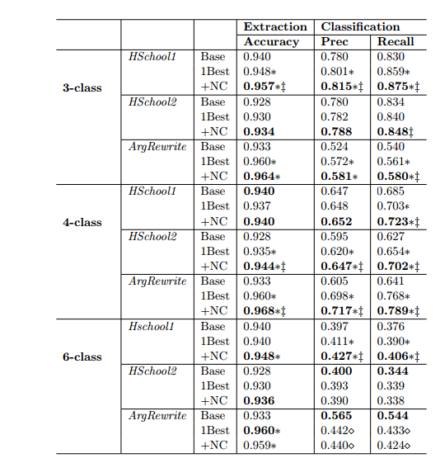
H2.4 Joint approach: evaluation

Slide 147
The roadmap
Preparing revision data
(Zhang and Litman, BEA15)
Revision schema definition
Data collection and data analysis
Automatic revision identification
(Zhang and Litman, BEA14)
(Zhang and Litman, BEA15)
(Zhang and Litman, NAACL16)
(Zhang and Litman, COLING16)
Revision extraction
Revision classification
Tool user study
(Zhang et al., NAACL16demo)
(Zhang et al., ACL2017)
Tool development
User study

Slide 148
The ArgRewrite tool
(Zhang et al., NAACL2016demo)
Design principles
  Taxonomy of revisions should not confuse users
  Encourage users to think about revisions holistically than focusing on low-level details
  Encourage users to re-evaluate whether they succeeded in making changes between drafts

Slide 149
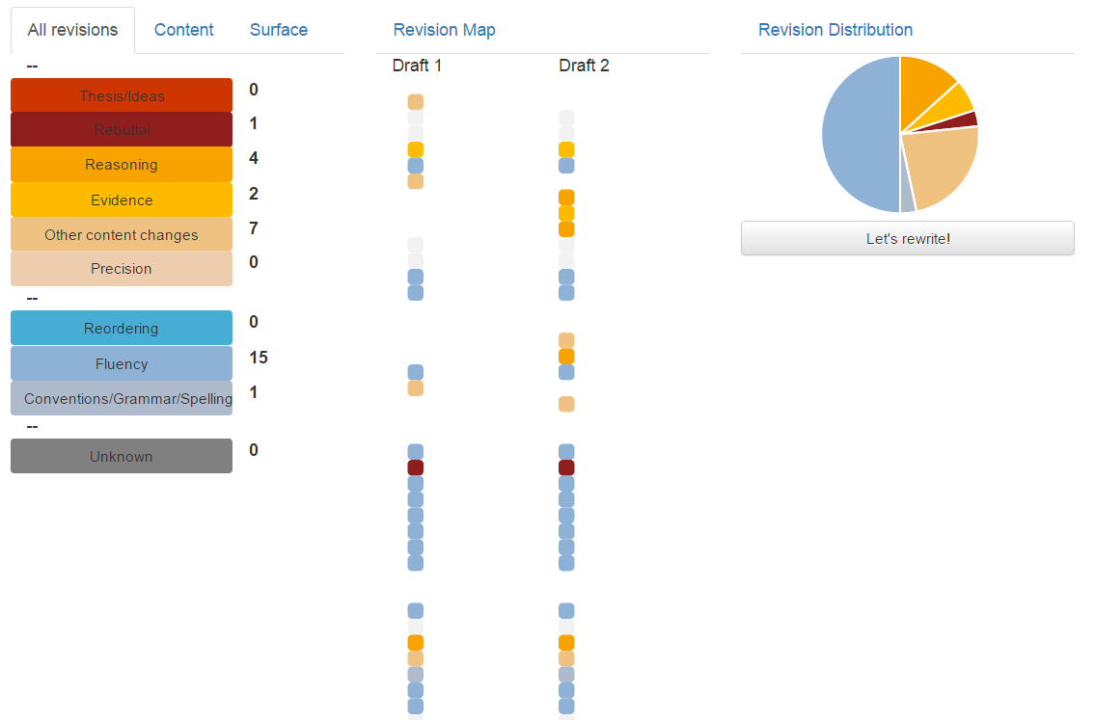
The ArgRewrite tool: overview

Slide 150
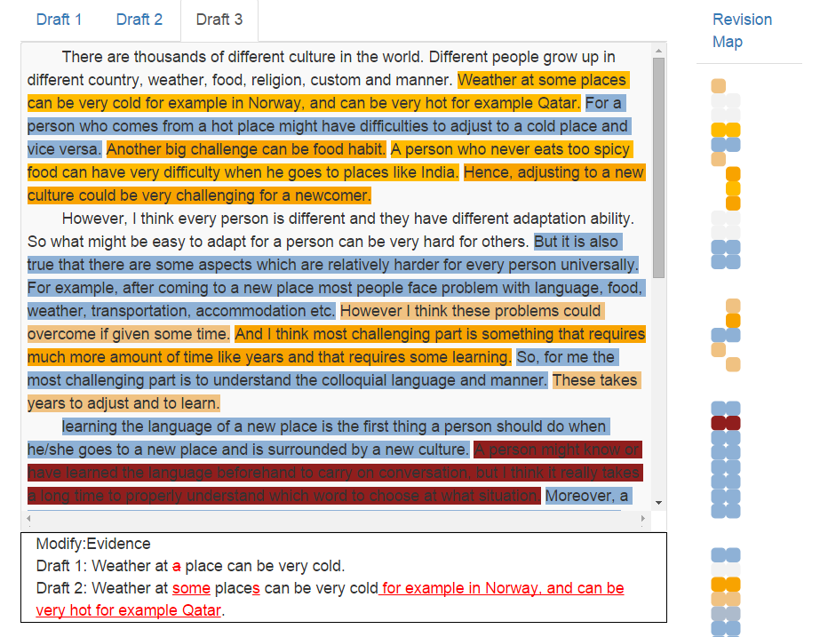
The ArgRewrite tool: detail

Slide 151
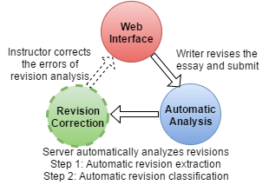
The ArgRewrite Tool

Slide 152
The ArgRewrite tool
Web Interface
Instructor corrects errors
Writer revises the essay and submit
Revision Correction
Automatic Analysis
Server automatically analyzes

Slide 153
The roadmap
Preparing revision data
(Zhang and Litman, BEA15)
Revision schema definition
Data collection and data analysis
Automatic revision identification
(Zhang and Litman, BEA14)
(Zhang and Litman, BEA15)
(Zhang and Litman, NAACL16)
(Zhang and Litman, COLING16)
Revision extraction
Revision classification
Tool user study
(Zhang et al., NAACL16demo)
(Zhang et al., ACL2017)
Tool development
User study

Slide 154
The roadmap
Preparing revision data
(Zhang and Litman, BEA15)
Revision schema definition
Data collection and data analysis
Automatic revision identification
(Zhang and Litman, BEA14)
(Zhang and Litman, BEA15)
(Zhang and Litman, NAACL16)
(Zhang and Litman, COLING16)
Revision extraction
Revision classification
Tool user study
(Zhang et al., NAACL16demo)
(Zhang et al., ACL2017)
Tool development
User study

Slide 155
Hypotheses
H3.1 There is a difference in participants’ revising behaviors depending on which aspects of the revision schema are used to provide feedback
H3.2 If the recognized revision purpose from the revision feedback differs from the participants’ revision intention, participants will further modify their revision

Slide 156
The ArgRewrite study
(Zhang et al., ACL2017)
To investigate the hypotheses:
  H3.1: Compare ArgRewrite with a control interface
  H3.2: Require the participants to record whether they agree with the revision type recognized by the system
To remove the possible impact of revision identification errors
  “Wizard-of-Oz” study using the manual annotation

Slide 157
The ArgRewrite interface (Experiment group)

Slide 158
The diff interface (Control group)

Slide 159
The process of ArgRewrite study
60 participants (40 Native and 20 ESL)
Draft1
Draft2
Draft3
PreStudy Survey
PostStudy Survey
Write Draft1@home
Write Draft2@home
Write Draft3@lab
Annotated Revisions 1
Annotated Revisions 2

Slide 160
The process of ArgRewrite study
60 participants (40 Native and 20 ESL)
Draft1
Draft2
Draft3
PreStudy Survey
PostStudy Survey
Write Draft1@home
Write Draft2@home
Write Draft3@lab
Annotated Revisions 1
Annotated Revisions 2
Requirement:
400 words, making a single main point with two supporting examples

Slide 161
The process of ArgRewrite study
60 participants (40 Native and 20 ESL)
Draft1
Draft2
Draft3
PreStudy Survey
PostStudy Survey
Write Draft1@home
Write Draft2@home
Write Draft3@lab
Annotated Revisions 1
Annotated Revisions 2
Requirement:
400 words, strengthen the essay by adding one more example; then add a rebuttal to an opposing idea

Slide 162
The process of ArgRewrite study
60 participants (40 Native and 20 ESL)
Draft1
Draft2
Draft3
PreStudy Survey
PostStudy Survey
Write Draft1@home
Write Draft2@home
Write Draft3@lab
Annotated Revisions 1
Annotated Revisions 2
Requirement:
400 words, strengthen the essay by adding one more example; then add a rebuttal to an opposing idea

Slide 163
The process of ArgRewrite study
60 participants (40 Native and 20 ESL)
Draft1
Draft2
Draft3
PreStudy Survey
PostStudy Survey
Write Draft1@home
Write Draft2@home
Write Draft3@lab
Annotated Revisions 1
Annotated Revisions 2
Requirement:
No word limit
Experiment group reports self revision type recognition

Slide 164
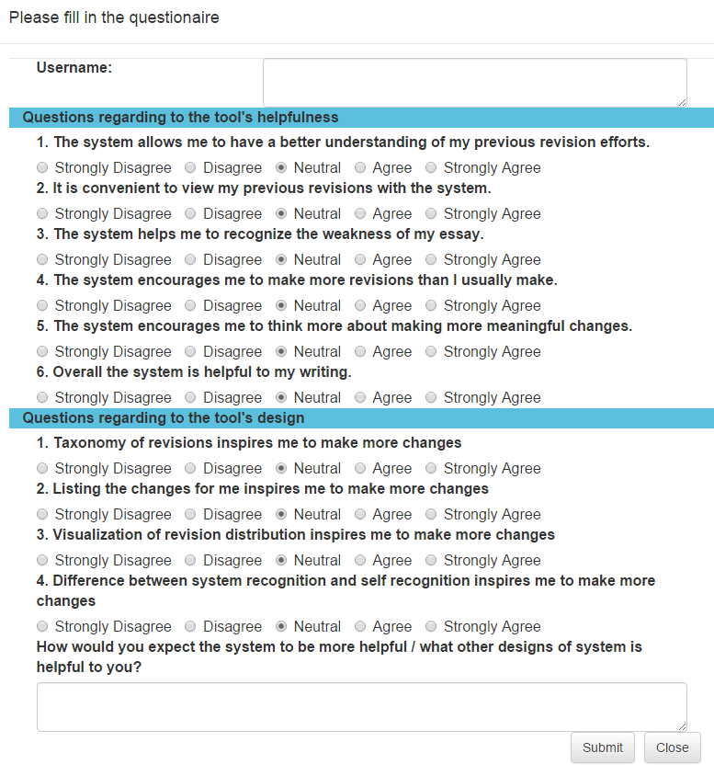
The process of ArgRewrite study: poststudy survey (Experiment)

Slide 165
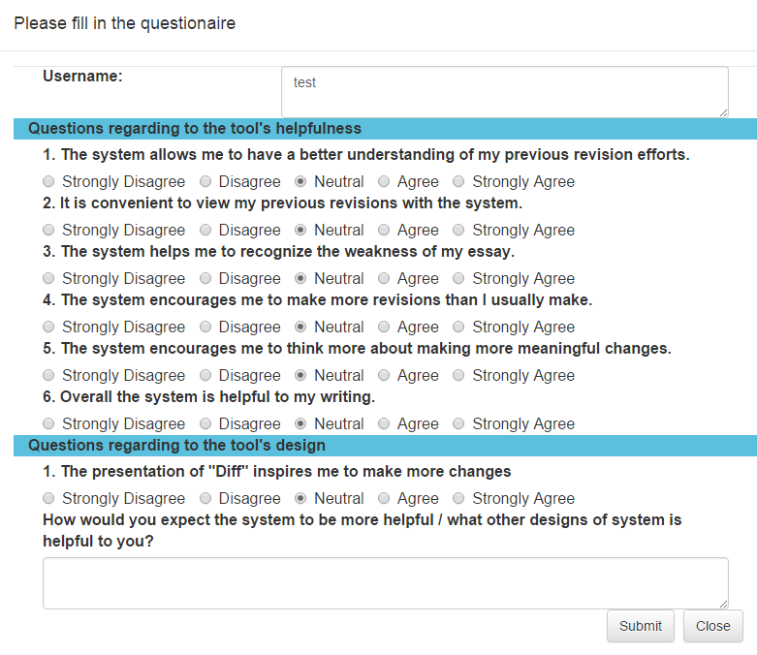
The process of ArgRewrite study: poststudy survey (Control)

Slide 166
The process of ArgRewrite study
60 participants (40 Native and 20 ESL)
Draft1
Draft2
Draft3
PreStudy Survey
PostStudy Survey
Write Draft1@home
Write Draft2@home
Write Draft3@lab
Requirement:
No word limit
Experiment group reports self revision type recognition
Annotated Revisions 1
Annotated Revisions 2
Rev12
Rev23

Slide 167
Data analysis
Approach
  ANOVA test to compare groups
    Subjective measures: post-study survey answers
    Objective measures: the number of revisions
  Pearson correlation to determine correlation between quantitative measures

Slide 168
Data analysis
For H3.1 (Interface difference)
  Experiment group agree with the statement “The system helps me to recognize the weakness of my essay” more
    3.97 vs. 3.17 , p < 0.003
  Control interface is ineffective when participants have to reflect on many changes
    Negative correlation between “it is convenient to view my previous revisions with the system” and number of Rev12 (ρ=-.36 and p < .05)

Slide 169
Data analysis
For H3.2 (impact of disagreed revision feedback)
  Negative correlation between Rev23 and number of cases in which the revisions annotated as Content are verified by the participants
  Positive correlation between Rev23 and the number of cases in which the revisions annotated as Surface are intended to be Content by the participants
  Ratio of change
    Disagreed Rev12 got further revised: 45/53 = 0.849
    Rev12 got further revised: 161/394 = 0.408
    Agreed Rev12 further revised: 67/341 = 0.196

Slide 170
Data analysis
Also tested the impact of native language spoken by the users
  “Language” is used as another factor in ANOVA
  Native speakers tend to make more Content changes (p< 0.03)
  ESL speakers tend to make more Surface changes (p < 0.02)

Slide 171
Summary
Preparing revision data
Created useful revision schema that can be reliably annotated
Revision schema definition
Data collection and data analysis
Automatic revision identification
Developed and improved algorithms for revision identification
Revision extraction
Revision classification
Tool user study
User study suggests that the developed tool is useful
Tool development
User study

Slide 172
The process of ArgRewrite study
60 participants (40 Native and 20 ESL)
Draft1
Draft2
Draft3
PreStudy Survey
PostStudy Survey
Write Draft1@home
Write Draft2@home
Write Draft3@lab
Annotated Revisions 1
Annotated Revisions 2

Slide 173
The process of ArgRewrite study
60 participants (40 Native and 20 ESL)
Draft1
Draft2
Draft3
PreStudy Survey
PostStudy Survey
Write Draft1@home
Write Draft2@home
Write Draft3@lab
Annotated Revisions 1
Annotated Revisions 2
Requirement:
400 words, making a single main point with two supporting examples

Slide 174
The process of ArgRewrite study
60 participants (40 Native and 20 ESL)
Draft1
Draft2
Draft3
PreStudy Survey
PostStudy Survey
Write Draft1@home
Write Draft2@home
Write Draft3@lab
Annotated Revisions 1
Annotated Revisions 2
Requirement:
400 words, strengthen the essay by adding one more example; then add a rebuttal to an opposing idea

Slide 175
The process of ArgRewrite study
60 participants (40 Native and 20 ESL)
Draft1
Draft2
Draft3
PreStudy Survey
PostStudy Survey
Write Draft1@home
Write Draft2@home
Write Draft3@lab
Annotated Revisions 1
Annotated Revisions 2
Requirement:
400 words, strengthen the essay by adding one more example; then add a rebuttal to an opposing idea

Slide 176
The process of ArgRewrite study
60 participants (40 Native and 20 ESL)
Draft1
Draft2
Draft3
PreStudy Survey
PostStudy Survey
Write Draft1@home
Write Draft2@home
Write Draft3@lab
Annotated Revisions 1
Annotated Revisions 2
Requirement:
No word limit
Experiment group reports self revision type recognition

Slide 177
The process of ArgRewrite study: poststudy survey (Experiment)

Slide 178
The process of ArgRewrite study: poststudy survey (Control)

Slide 179
The process of ArgRewrite study
60 participants (40 Native and 20 ESL)
Draft1
Draft2
Draft3
PreStudy Survey
PostStudy Survey
Write Draft1@home
Write Draft2@home
Write Draft3@lab
Requirement:
No word limit
Experiment group reports self revision type recognition
Annotated Revisions 1
Annotated Revisions 2
Rev12
Rev23

Slide 180
Data analysis
Approach
  ANOVA test to compare groups
    Subjective measures: post-study survey answers
    Objective measures: the number of revisions
  Pearson correlation to determine correlation between quantitative measures

Slide 181
Data analysis
For H3.1 (Interface difference)
  Experiment group agree with the statement “The system helps me to recognize the weakness of my essay” more
    3.97 vs. 3.17 , p < 0.003
  Control interface is ineffective when participants have to reflect on many changes
    Negative correlation between “it is convenient to view my previous revisions with the system” and number of Rev12 (ρ=-.36 and p < .05)

Slide 182
Data analysis
For H3.2 (impact of disagreed revision feedback)
  Negative correlation between Rev23 and number of cases in which the revisions annotated as Content are verified by the participants
  Positive correlation between Rev23 and the number of cases in which the revisions annotated as Surface are intended to be Content by the participants
  Ratio of change
    Disagreed Rev12 got further revised: 45/53 = 0.849
    Rev12 got further revised: 161/394 = 0.408
    Agreed Rev12 further revised: 67/341 = 0.196

Slide 183
Data analysis
Also tested the impact of native language spoken by the users
  “Language” is used as another factor in ANOVA
  Native speakers tend to make more Content changes (p< 0.03)
  ESL speakers tend to make more Surface changes (p < 0.02)

Slide 184
Summary
Preparing revision data
Created useful revision schema that can be reliably annotated
Revision schema definition
Data collection and data analysis
Automatic revision identification
Developed and improved algorithms for revision identification
Revision extraction
Revision classification
Tool user study
User study suggests that the developed tool is useful
Tool development
User study

Slide 185
Joint approach for revision identification
Error propagation of the pipeline approach
Input
Output
Raw Text: Draft1 and Draft2
Revision extraction
Aligned sentence pairs
Revision classification
Revisions: revision types on aligned sentence pairs
The joint approach can have a better performance than the pipeline approach

