Slide 1
Educational Technology
(a natural language processing perspective)
  Diane Litman
  Professor, Computer Science Department
  Senior Scientist, Learning Research & Development Center
  Co-Director, Intelligent Systems Program
  University of Pittsburgh

Slide 2
What is Natural Language Processing?
“The goal of this new field is to get computers to perform useful tasks involving human language, tasks like enabling human-machine communication, improving human-human communication, or simply doing useful processing of text or speech.”
[Jurafsky and Martin 2008]
Well-known applications
  Telephone call centers/operators
  Apple’s SIRI
  Google translate

Slide 3
Educational Contexts
Speech and Language Processing for Education
Learning Language
(reading, writing,
speaking)

Slide 4
Educational Contexts
Speech and Language Processing for Education
Learning Language
(reading, writing,
speaking)
Using Language
(in the disciplines)
Tutorial Dialogue
Systems

Slide 5
Educational Contexts
Speech and Language Processing for Education
Learning Language
(reading, writing,
speaking)
Using Language
(in the disciplines)
Processing
Language
Tutorial Dialogue
Systems
Peer Review

Slide 6
Intelligent Tutoring Systems
Students who receive one-on-one instruction perform as well as the top two percent of students who receive traditional classroom instruction [Bloom 1984]
Unfortunately, providing every student with a personal human tutor is infeasible
  Develop computer tutors instead

Slide 7
Tutorial Dialogue Systems
Why is one-on-one tutoring so effective?
  “...there is something about discourse and natural language (as opposed to sophisticated pedagogical strategies) that explains the effectiveness of unaccomplished human [tutors].”
    [Graesser, Person et al. 2001]
Notes:
KVL: In 4 studies now, we have ties between human tutors and reading controls (Why2 Spring 2002, Why2 fall 2003, Art’s masters student, Rod Roscoe’s study). Thus, you should definitely assert that the hypothesis in bullet one is true. At best it is a commonly believed working hypothesis that we are still being tested.

Slide 8
ITSPOKE: Intelligent Tutoring SPOKEn Dialogue System
Detects and responds to student uncertainty and disengagement (over and above correctness)
  To date: problem-solving dialogues for qualitative physics
Funded by the National Science Foundation

Slide 9
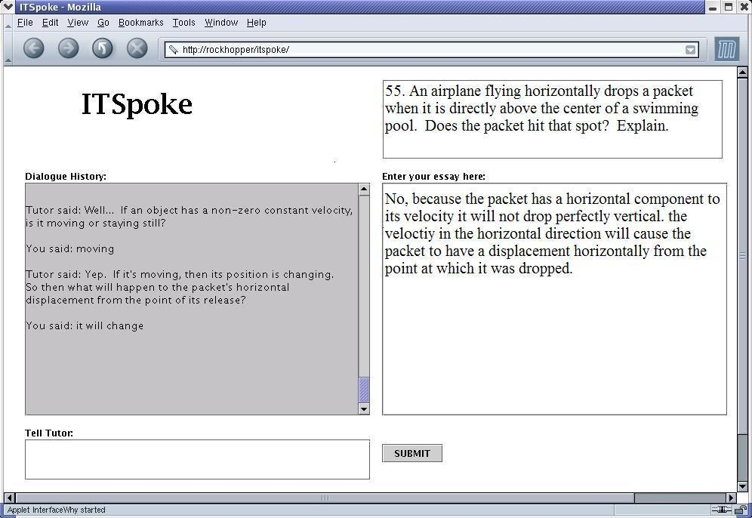

Slide 11


Slide 12
Example Student States in ITSPOKE
ITSPOKE: What else do you need to know to find the box‘s acceleration?
Student: the direction [UNCERTAIN]
ITSPOKE : If you see a body accelerate, what caused that acceleration?
Student: force [CERTAIN]
ITSPOKE : Good job. Say there is only one force acting on the box. How is this force, the box's mass, and its acceleration related?
Student: velocity [UNCERTAIN]
ITSPOKE : Could you please repeat that?
Student: velocity [ANNOYED]

Slide 13

Disengagement is also of interest
User sings answer indicating lack of interest in its purpose
ITSPOKE: What vertical force is always exerted on an object near the surface of the earth?
USER: Gravity
(disengaged, certain)

Slide 14
ITSPOKE Experimental Procedure
College students without physics
  Read a small background document
  Take a multiple-choice Pretest
  Work 5 problems (dialogues) with ITSPOKE
  Take an isomorphic Posttest
Goal is to optimize Learning Gain
  e.g., Posttest – Pretest

Slide 15
Treatments in Different Conditions
TUTOR: Now let’s talk about the net force exerted on the truck. By the same reasoning that we used for the car, what’s the overall net force on the truck equal to?
STUDENT: The force of the car hitting it? [uncertain+correct]
TUTOR (Original System): Good [Feedback] … [moves on]
versus
TUTOR (Experimental System): Fine. [Feedback] We can derive the net force on the truck by summing the individual forces on it, just like we did for the car. First, what horizontal force is exerted on the truck during the collision? [Remediation Subdialogue]
Notes:
1st Overview study...
And the coding done on the student turns
Parameters extracted from corpora, used to build models
Then I’ll discuss our results – our predictive models

Slide 16
Experimental Results
Responding to student uncertainty (over and above correctness) improves ITSPOKE’s performance
  Student learning
  Dialogue efficiency
Responding to student disengagement (over and above uncertainty) even further improves performance

Slide 17
Rimac: From Lab to High School
A physics dialogue tutor that engages students in reflective dialogue
Other Participants
  Dr. Sandra Katz (LRDC)
  Dr. Pamela Jordan (LRDC)
  Professor Michael Ford (School of Education)
  Physics teachers from area high schools
    Central Catholic, Fox Chapel, PPS, Springdale
Funded by the Department of Education

Slide 18
Practical and Scientific Goals
Improve an already effective problem-solving tutor, by helping students understand physics concepts
  Approach: Engage students in qualitative, “reflective discussions” after they solve quantitative problems
Test a hypothesis about what makes human one-on-one tutoring very effective
  Abstraction and specialization support learning

Slide 19
Reflective Dialogue Excerpt
Problem: Calculate the speed at which a hailstone, falling from 9000 meters out of a cumulonimbus cloud, would strike the ground, presuming that air friction is negligible.
    Solved on paper (or within another computer tutoring system)
Reflection Question: How do we know that we have an acceleration in this problem?
  Student: b/c the final velocity is larger than the starting velocity, 0.
  Tutor: Right, a change of velocity implies acceleration …

Slide 20
Educational Contexts
Speech and Language Processing for Education
Learning Language
(reading, writing,
speaking)
Using Language
(in the disciplines)
Processing
Language
Tutorial Dialogue
Systems
Peer Review

Slide 21
SWoRD: A Web-Based Reciprocal Peer Review System
Intelligent Scaffolding for Peer Reviews of Writing
Other Participants
  Professor Christian Schunn (LRDC, Psychology)
  Professor Kevin Ashley (LRDC, Law)
  Professor Amanda Godley (School of Education)
  Teachers from area high schools
    Central Catholic, City High, McKeesport, Propel, St. Joseph’s
    Disciplines include English, Humanities, Math, Science
Funded by the Department of Education

Slide 22
Scaffolded Writing and Rewriting
Authors submit papers
Reviewers submit (anonymous) feedback
Authors revise and resubmit papers
Authors provide back-ratings to reviewers regarding feedback helpfulness

Slide 23
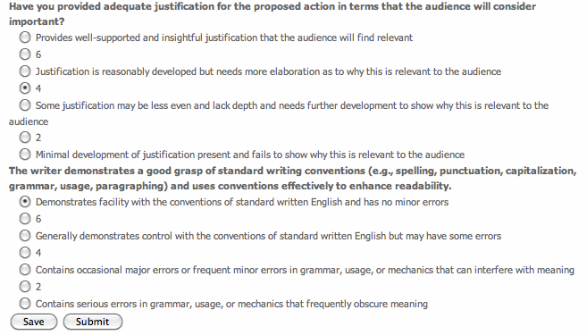

Slide 24
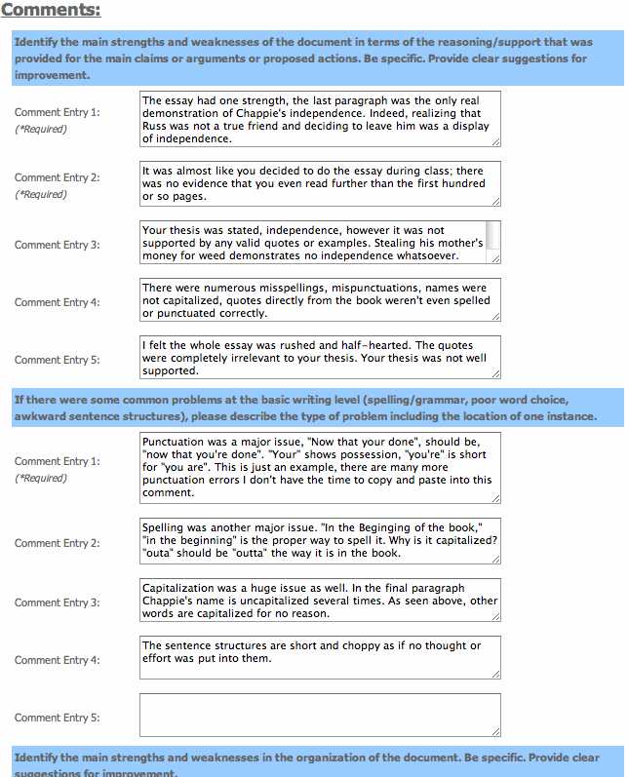

Slide 26
Some Remaining Weaknesses
Feedback is often not stated in effective ways
Feedback & papers often do not focus on core aspects
Students and teachers are often overwhelmed by the quantity and diversity of feedback

Slide 27
Feedback Features and Positive Writing Performance [Nelson & Schunn, 2008]
Solutions
Summarization
Understanding
of the Problem
Implementation
Localization

Slide 28
Our Approach: Detect and Scaffold
Detect and direct reviewer attention to key feedback features such as solutions
Detect and direct reviewer and author attention to thesis statements in papers and feedback

Slide 29
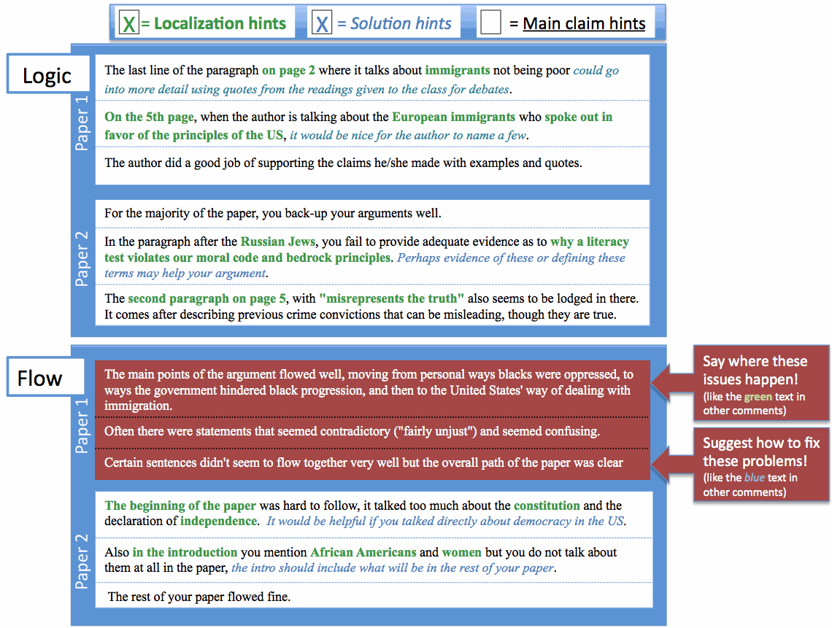

Slide 30
Detecting Key Features of Text
Natural Language Processing to extract attributes from text, e.g.
  Regular expressions (e.g. “the section about”)
  Domain lexicons (e.g. “federal”, “American”)
  Syntax (e.g. demonstrative determiners)
  Overlapping lexical windows (quotation identification)
Machine Learning to predict whether feedback contains localization and solutions, and whether papers contain a thesis statement

Slide 31
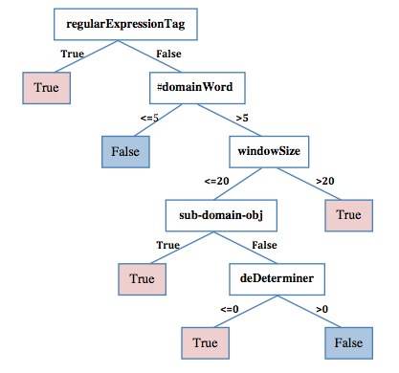
Learned Localization Model

Slide 32
Quantitative Model Evaluation
Feedback Feature | Classroom Corpus | N | Baseline Accuracy | Model Accuracy
Localization | History | 875 | 53% | 78%
 | Psychology | 3111 | 75% | 85%
Solution | History | 1405 | 61% | 79%
 | CogSci | 5831 | 67% | 85%

Slide 33
Predicting Feedback Helpfulness
Recall that SWoRD supports numerical back ratings of feedback helpfulness
  My concerns come from some of the claims that are put forth. Page 2 says that the 13th amendment ended the war. Is this true? Was there no more fighting or problems once this amendment was added? … (rating 5)
  Your paper and its main points are easy to find and to follow. (rating 1)

Slide 34
Predicting Expert Ratings
Structural attributes (e.g. review length, number of questions), lexical statistics, and meta-data (e.g. paper ratings) developed for product reviews (e.g. Amazon) are also useful for peer feedback
Features specialized for peer-review (e.g. localization) can further improve performance
Other work: student helpfulness ratings

Slide 35
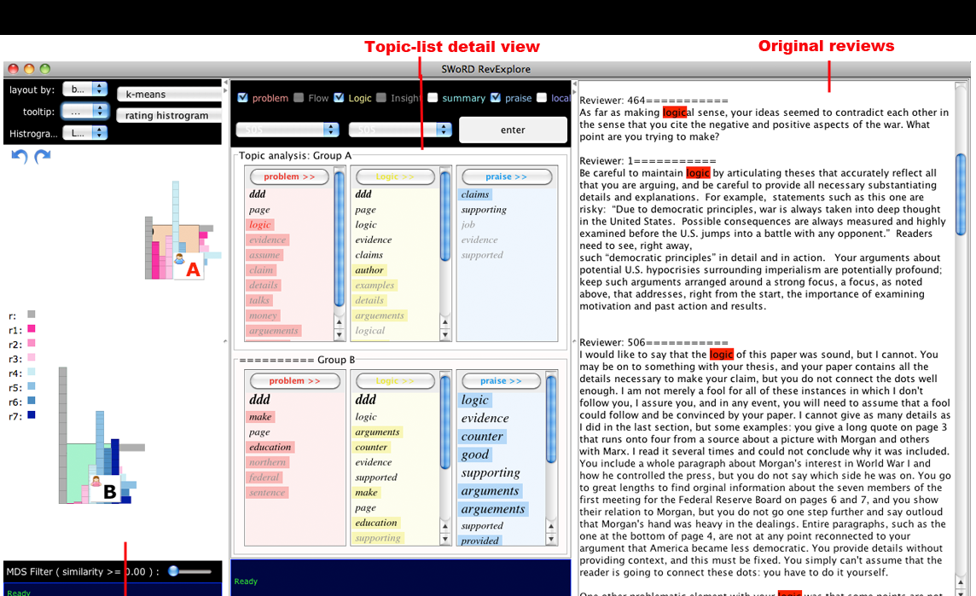
What about Teachers?

Slide 36
Summing Up
Natural Language Processing is of great interest to researchers in Educational Technology
  Computer dialogue tutors can be built and can serve as a valuable aid to student learning
  Techniques such as those used in predicting product review helpfulness can be effectively exploited in the peer-review domain to detect desirable feedback features

Slide 37
Opportunities for Collaboration!!!!
Tutorial Dialogue
  Dialogue tutor for problem solving and/or reflection for an introductory computer science topic
Peer Review
  From paper review to program review
Or, your ideas here (e.g., flipped classrooms, lecture browsing, question generation, scoring)
Types of involvement
  support for complimentary use of existing SWoRD software
  paid consultant and/or summer partnership for extending current research to computer science education
    dlitman@pitt.edu

Slide 38
Thank You!
Questions?
Further Information
  http://www.cs.pitt.edu/~litman/itspoke.html
  dlitman@pitt.edu

