Slide 1
Ontology-Based Argument Mining and Automatic Essay Scoring
Nathan Ong, Diane Litman, Alexandra Brusilovsky
University of Pittsburgh
First Workshop on Argumentation Mining (52nd ACL)
June 26, 2014
Notes:
10 MINUTES ONLY

Slide 2
ArgumentPeer Project
(w/ Kevin Ashley & Chris Schunn)
Teach Writing and Argumentation with AI-Supported Diagramming and Peer Review
  Diagrammatic Argument Outlines (via LASAD)
  Argumentative/Persuasive Essays (via SWoRD)
  Peer review of both diagrams and essays (via SWoRD)
Allocate to computers and humans the tasks that each does best

Slide 3
Argument Mining in ArgumentPeer
Expert defines diagram ontology
  Current Study, Hypothesis, Opposes, Supports, Claim, Citation
System recognizes diagram ontology elements in associated essays
System scores essays based on recognized ontology elements

Slide 4
Corpus
52 first-draft essays from two undergraduate psychology courses
  Written after diagramming and peer-feedback
  Average length: 5.2 paragraphs, 28.6 sentences
  Expert scores: Average = 3.03
Notes:
Introductions only because the diagrams focused on the introductory portion of the essays. The rest of the essay consisted of studies that students conducted and the data they collected and analyzed, which is out of scope. First drafts because we wanted to decrease the differences between the diagrams and the essays.

Slide 5
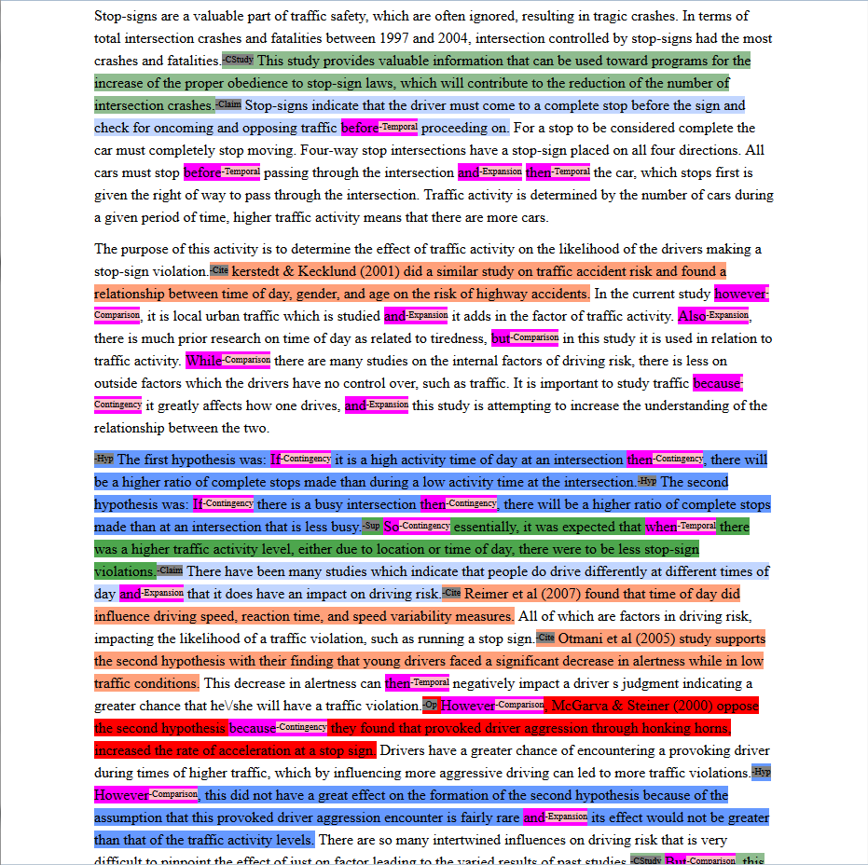
Argument
Mining I/O
Current Study •
Claim •
Citation •
Hypothesis •
Supports •
Opposes •
Notes:
Expert score 3 out of 5, 5 is max, 0 is min, integer values only

Slide 6
Essay Processing Pipeline
Discourse Processing
  Tag essays with discourse connective senses
  Expansion, Contingency, Comparison, Temporal
    Tagger from UPenn
Argument Ontology Mining
  Tag essays with diagram ontology elements
    Rule-based algorithm
Ontology-Based Scoring
  Use the mined argument to score the essays
    Rule-based algorithm

Slide 7
Example of Argument Mining
This is the first sentence of the example essay
Tagged as Current Study

Slide 8
Ordered Rule Applications
Rule 1: Opposes
Does the sentence begins with a Comparison discourse connective?
  no
Does the sentence contains any of the string prefixes from {conflict, oppose} and a four-digit number (intended as a year for a citation)?
  no

Slide 9
Example Ontology tag
Rule 6 (broken down, yes to all questions): Current Study
Is the sentence is in the first or last paragraph?
Does the sentence contains at least one word from {study, research}?
Does the sentence not contain the words from {past, previous, prior} (first letter case-insensitive)?
Does the sentence not contain the string prefixes from {hypothes, predict}?
Does the sentence not contain a four-digit number?
Notes:
Red means not satisfied

Slide 10



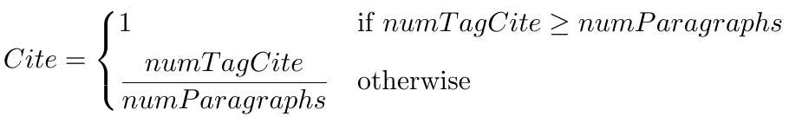

Computing the Score

Slide 11
Scoring Example
In this document:
3 Current Study
3 Hypothesis
1 Opposes
1 Supports
2 Claim
3 Citation
CStudy = 1
Hyp = 1
Op = 1
SupOrClaim = 1
Cite = 1
AutoScore = 5
Expert score = 3
Notes:
Mention that the whole essay did not fit in the page.

Slide 12
Experimental Results
Hypotheses
  Automatically generated scores should be similar to expert scores
  Automatically generated scores should correlate with expert scores
Evaluation
  extrinsic evaluation of argument mining via essay scoring

Slide 13
Results
One sample T-Test:
Automatic scores are generally significantly different from expert scores
Algorithm tends to overscore
Expert Score | Average | T-value | n | P-value
1 | 4.33 | --- | 1 | ---
2 | 3.23 | 3.21 | 8 | 0.0125
3 | 3.30 | 2.10 | 31 | 0.0444
4 | 3.80 | -1.00 | 12 | 0.3370
5 | --- | --- | 0 | ---

Slide 14
Results
Spearman Correlation between automatically generated and expert scores is significant
Thus, scores can be ranked
However, Pearson Correlation is not significant
rho | 0.9975
p | 2.313E-59

Slide 15
Conclusions
Hypothesis 2 (automatically generated scores should correlate with expert scores): supported
  number of automatically generated tags for diagram elements are positively correlated with score
Hypothesis 1 (automatically generated scores should be similar to expert scores): not supported
  the scoring algorithm, ontology-recognition algorithm, or both, are currently not good enough

Slide 16
Future Work
Improve ontology-mining and scoring algorithms
  Parsing more discourse information (e.g. PDTB, RST)
  Exploiting the diagrams directly
  Data-driven algorithm development
Intrinsic as well as extrinsic evaluation
  Newly annotated essay corpus

Slide 17
Questions?
Acknowledgements
  National Science Foundation
More Information
  https://sites.google.com/site/swordlrdc/

