Slide 1
What is
Natural Language Processing?
Professor Diane Litman
University of Pittsburgh

Slide 2
Natural Language Processing
(NLP)
Getting computers to perform useful and interesting tasks involving human languages
  languages such as English, Spanish, Chinese, etc.
  as opposed to computer languages such as Python, Unity, etc.

Slide 3
Why is NLP needed?
  An enormous amount of knowledge is now available in machine readable form as natural language text
    the web
  Conversational agents are becoming an important form of human-computer communication
    Siri
  Much of human-human communication is now mediated by computers
    facebook

Slide 4
From languages to information
For humans, this is effortlessly easy
But for computers, it’s rather difficult to go from “language” to information
  Human language text
  Speech
  Web pages
  Social networks (and other networks)
  Genome sequences

Slide 5







Commercial World
Lots of exciting stuff going on…
Notes:
Also lots of stuff going on in the non-commercial world.
Anyone who can program with an internet connection.

Slide 6
Beyond Web Search
Who is the chair of Pitt Computer Science?
Google: About 659,000 results (0.36 seconds)
Department of Computer Science | University of Pittsburgh
www.cs.pitt.edu/‎
Department of Computer Science Founded in 1966 ... trusted to co-chair again the 2nd International Workshop on Collaborative Big Data (C-Big2013) to be held ...

Slide 7
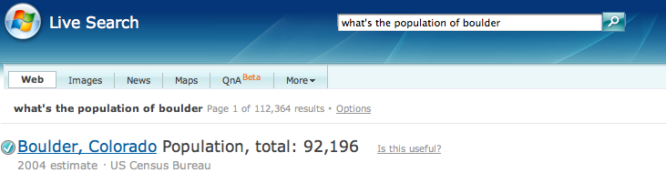
Web Question-Answering

Slide 8
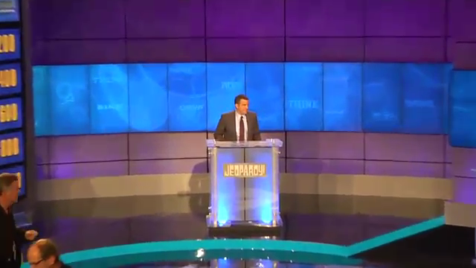
Question Answering: IBM’s Watson

Slide 9
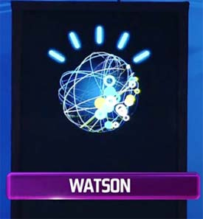
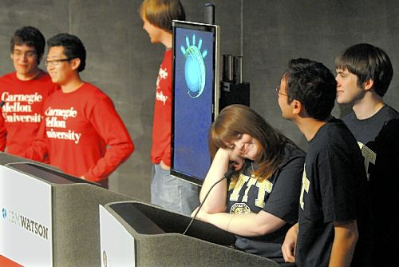
Deep Q/A to Jeopardy Winner

Slide 10
Analytics such as Sentiment Analysis
Data-mining of blogs, discussion forums, message boards, user groups, and other forms of user generated media
  Product marketing information
  Political opinion tracking
  Social network analysis
  Buzz analysis (what’s hot, what topics are people talking about right now)
  NSA

Slide 11
Livejournal.com:
I, me, my on or after Sep 11, 2001
Cohn, Mehl, Pennebaker. 2004. Linguistic markers of psychological change surrounding September 11, 2001. Psychological Science 15, 10: 687-693.
Graph from Pennebaker slides

Slide 12
September 11 LiveJournal.com study:
We, us, our
Cohn, Mehl, Pennebaker. 2004. Linguistic markers of psychological change surrounding September 11, 2001. Psychological Science 15, 10: 687-693.
Graph from Pennebaker slides

Slide 13
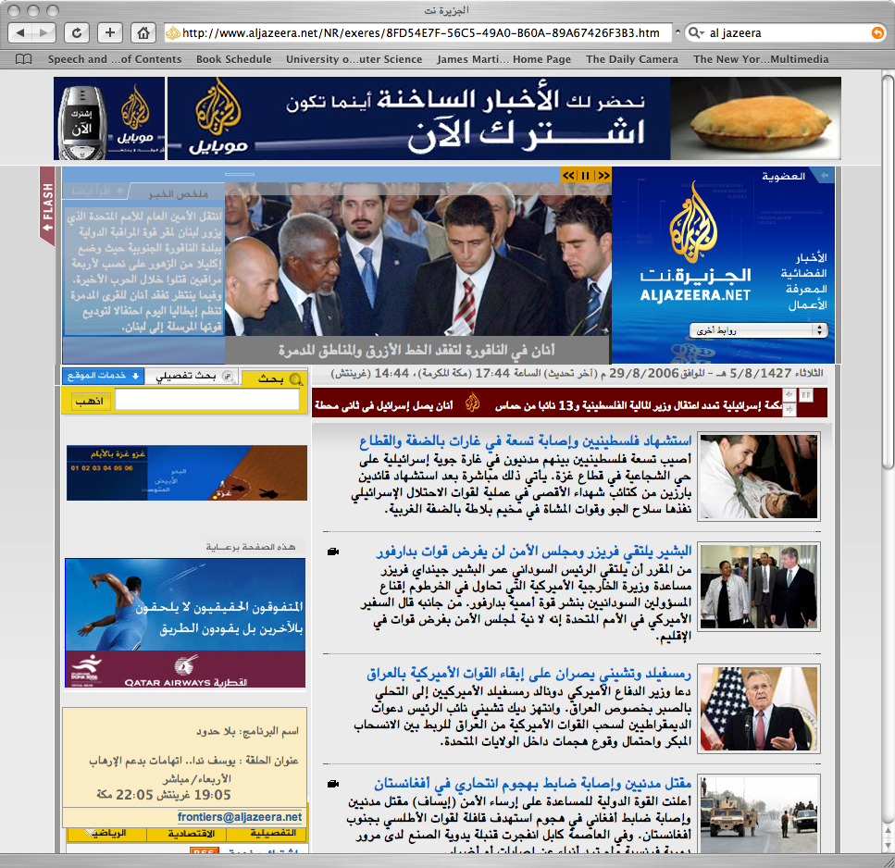
Google Translate

Slide 14
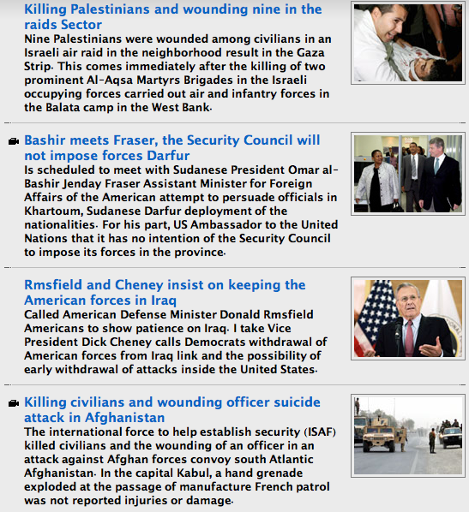
Google Translate

Slide 15
Machine Translation
http://translate.google.com/
http://imtranslator.net/translate-and-speak/
http://www.translation-telephone.com

Slide 16
Information Extraction
Event: Curriculum mtg
Date: Jan-16-2012
Start: 10:00am
End: 11:30am
Where: Gates 159
Subject: curriculum meeting
Date: January 15, 2012
To: Dan Jurafsky
Hi Dan, we’ve now scheduled the curriculum meeting.
It will be in Gates 159 tomorrow from 10:00-11:30.
-Chris
Create new Calendar entry

Slide 17
Computational Biology: Comparing Sequences
AGGCTATCACCTGACCTCCAGGCCGATGCCC
TAGCTATCACGACCGCGGTCGATTTGCCCGAC
-AGGCTATCACCTGACCTCCAGGCCGA--TGCCC---
| | | | | | | | | | | | | x | | | | | | | | | | |
TAG-CTATCAC--GACCGC--GGTCGATTTGCCCGAC
Sequence comparison is key to
Finding genes
Determining function
Uncovering the evolutionary processes

Slide 18
From Understanding to Interaction
Chatbots
  http://www.pandorabots.com/pandora/talk?botid=f5d922d97e345aa1
  http://www.jabberwacky.com/

Slide 19
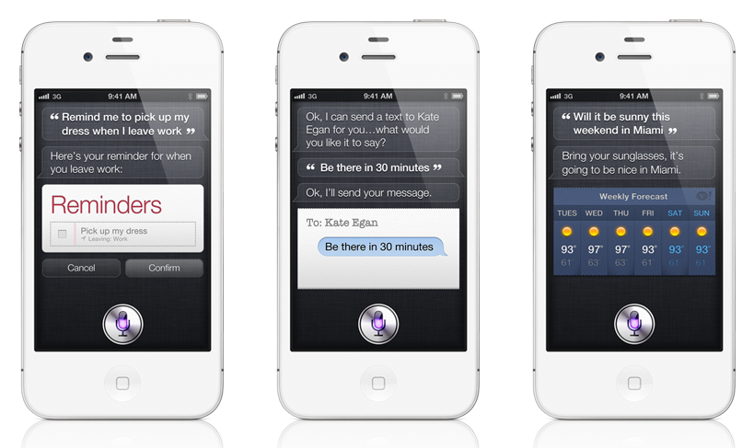
Siri

Slide 20
Spoken Dialogue Systems
Systems that interact with users via speech
Speech
Recognition
user
Spoken Dialog
System
Cloud,
DB, web,
smartphone
TTS or
recording

Slide 21

My Interests: Computer Tutors

Slide 22
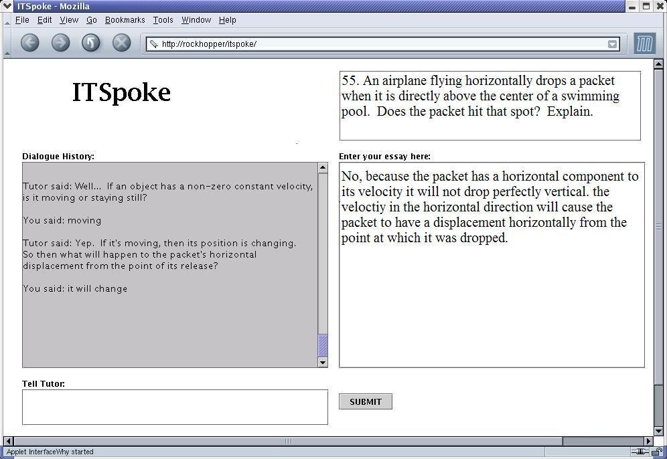

Slide 23
Why is NLP hard?

Slide 24
Ambiguity
Find at least 5 meanings of this sentence:
  I made her duck

Slide 25
Ambiguity
Find at least 5 meanings of this sentence:
  I made her duck
I cooked waterfowl for her benefit (to eat)
I cooked waterfowl belonging to her
I created the (plaster?) waterfowl she owns
I caused her to quickly lower her head or body
I waved my magic wand and turned her into undifferentiated waterfowl

Slide 26
Ambiguity is Pervasive: Speech to Text!!!!
  I mate or duck
  I’m eight or duck
  Eye maid; her duck
  Aye mate, her duck
  I maid her duck
  I’m aid her duck
  I mate her duck
  I’m ate her duck
  I’m ate or duck
  I mate or duck

Slide 27
Why else is natural language understanding difficult?
non-standard English
segmentation issues
idioms
Great job @justinbieber! Were SOO PROUD of what youve accomplished! U taught us 2 #neversaynever & you yourself should never give up either♥
dark horse
get cold feet
lose face
throw in the towel
the New York-New Haven Railroad
the New York-New Haven Railroad
world knowledge
tricky entity names
newly coined words
unfriend
retweet
Mary and Sue are sisters.
Mary and Sue are mothers.
Where is A Bug’s Life playing …
Let It Be was recorded …
But that’s what makes it fun!

