Slide 1
Analyzing Collaborative Argumentation in Text-based Classroom Discussions
Luca Lugini Computer Science University of Pittsburgh
Dr. Diane Litman Computer Science University of Pittsburgh
Dr. Adriana Kovashka Computer Science University of Pittsburgh
Dr. Erin Walker Computer Science University of Pittsburgh
Dr. Kevin Ashley School of Law University of Pittsburgh

Slide 2
Outline
Introduction
Datasets
Part 1: Annotation of Classroom Discussions (completed)
Part 2: Automatically Predicting Specificity for Classroom Discussions (completed)
Part 3: Argument Component Classification for Classroom Discussions (partially completed)
Part 4: Joint Learning of Different Aspects of Classroom Discussions

Slide 3
Introduction
Collaborative argumentation:
the process of building evidence-based, reasoned knowledge through dialogue
Why?
student-centered discussions and elaborated student talk during collaborative argumentation are indicators of robust learning opportunities [CCSS, 2010, NGSS, 2013, Grossman et al., 2014]

Slide 4
Introduction
High quality student discussions in English Language Arts (ELA) classrooms have a positive impact on students’ reasoning, reading and writing skills [Reznitskaya and Gregory, 2013, Graham and Perin, 2007, Applebee et al, 2003]
Specificity of argument moves (claims, evidence, reasoning) is related to discussion quality [Chisholm and Godley, 2011, Lee, 2006]

Slide 5
Challenges in Classroom Discussions
Teacher tasks:
Manage the discussion
Accomplish instructional goals
Keep track of students who speak and how much
Keep track of what they said
Take notes
Possibly plan interventions

Slide 6

Challenges in Classroom Discussions

Slide 7
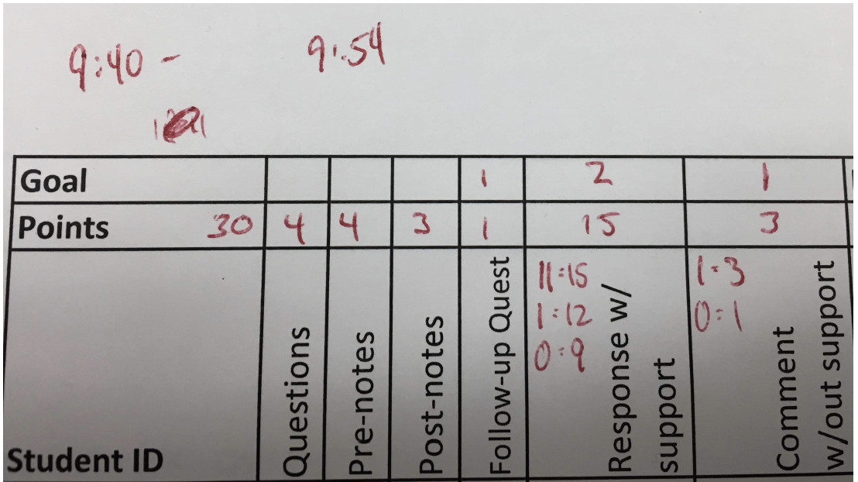
Challenges in Classroom Discussions
Grading rubric

Slide 8
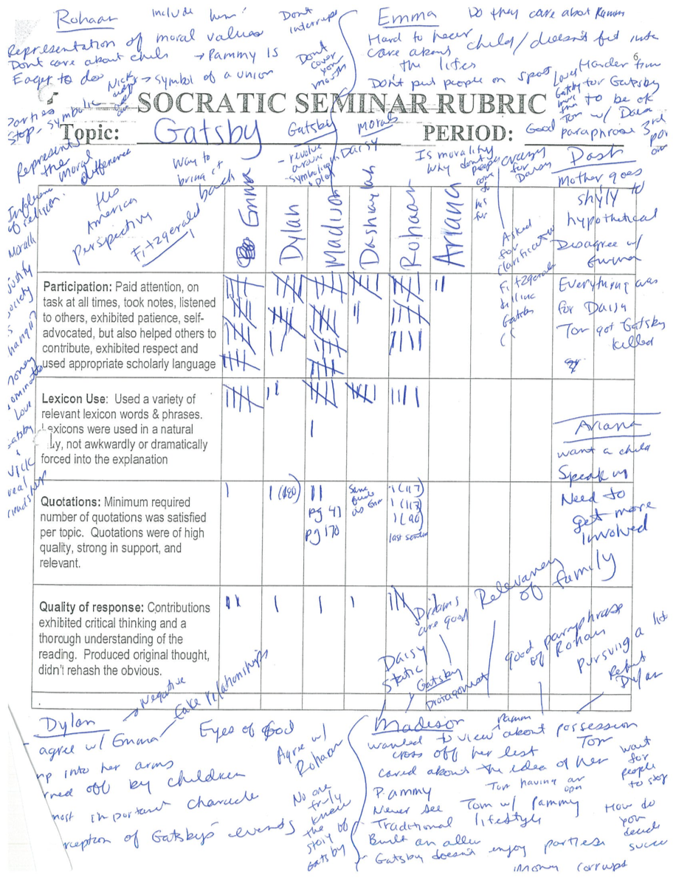
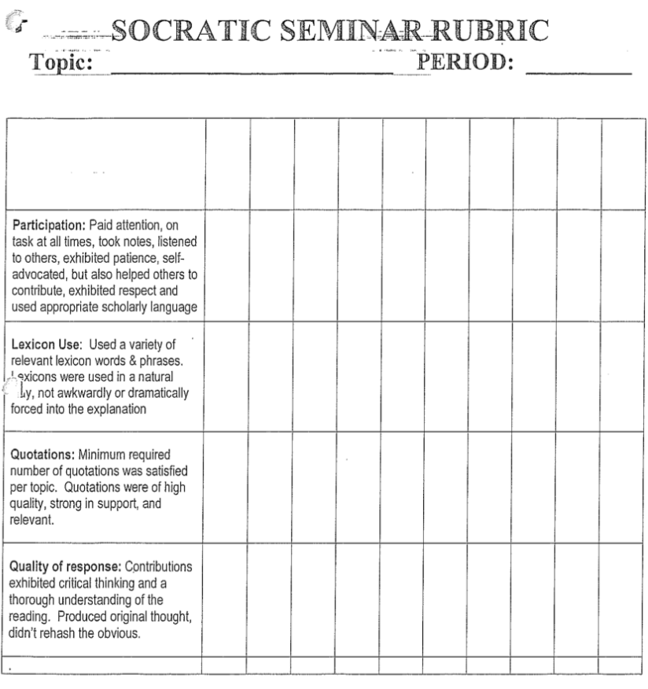
Challenges in Classroom Discussions
Grading rubric

Slide 9
Challenges in Classroom Discussions
Teachers struggle to acquire skills for effectively understanding and teaching collaborative argumentation [Lampert et al., 2010]
As a result, teachers spend more time on lectures and individual work
Resources for teachers:
Professional development, individual/group coaching [Caughlan et al., 2013, Pehmer et al., 2015, Wilson, 2013]
Not sustainable in long term

Slide 10
Solution: Develop Tools to Assist Teachers/Students
Previous studies:
Teacher self-assessment of classroom discussions, analyzing frequency of participation [Chen et al., 2014]
Detecting teacher questions from classroom discussion recordings [Blanchard et al., 2016]
Providing TAs with feedback on instructor/student talk ratio and wait time [Gerritsen et al., 2015]
Not focused on content of student talk

Slide 11
This Proposal
Problems to solve:
What aspects of student talk are important?
  Need to define annotation scheme
  The scheme should allow for reliable manual annotations
How to automatically predict such aspects?
  Need to develop automated tools for each aspect
  The tools need to be accurate enough
Currently here

Slide 12
Outline
Introduction
Datasets
Part 1: Annotation of Classroom Discussions (completed)
Part 2: Automatically Predicting Specificity for Classroom Discussions (completed)
Part 3: Argument Component Classification for Classroom Discussions (partially completed)
Part 4: Joint Learning of Different Aspects of Classroom Discussions

Slide 13
Classroom Discussions Datasets
Dataset | Discussions | Argument Moves | AVG # moves per discussion | Annotations | Cohen Kappa
D1 | 23 | 2057 | 89.4 | Specificity | 0.714, 0.9
D2 | 73 | 2047 | 28.0 | Argument component, Specificity | 0.629 (AC) 0.641 (SPEC)
D3 | 30 | 3834 | 127.8 | Argument component, Specificity, Collaboration | TBD
D | 103 | 5881 | 57.1 | Argument component, Specificity, Collaboration | TBD
Part 1
(SPEC)
Part 2
(AC)
Part 4
Parts 3&4

Slide 14
AMI Meeting Corpus
Multi-modal dataset with 100 hours of meetings
Multi-party transcriptions of spoken dialogues
Several annotations:
Topic segmentation
Abstractive/extractive summaries
Named entities
Dialogue acts (139 meetings)
Individual actions
Focus of attention
Part 4

Slide 15
Outline
Introduction
Datasets
Part 1: Annotation of Classroom Discussions (completed)
Part 2: Automatically Predicting Specificity for Classroom Discussions (completed)
Part 3: Argument Component Classification for Classroom Discussions (partially completed)
Part 4: Joint Learning of Different Aspects of Classroom Discussions

Slide 16
Annotation of Classroom Discussions
Goal: capture aspects of classroom talk that contribute to discussion quality and learning opportunities
Part 1 Research Hypothesis
H1: The proposed annotation scheme can be used by humans to reliably annotate important aspects of student talk in classroom discussions.

Slide 17
Annotation of Classroom Discussions
Argumentation
Previously used to assess quality of classroom discussions [Reznitskaya et al., 2009, Chisholm and Godley, 2011]
Student reasoning is believed to be particularly important [Kim, 2014a, McLaren et al., 2010]
Specificity
Shown to have impact on discussion quality [Chisholm and Godley, 2011, Sohmer et al., 2009]

Slide 18
Related Work
Argumentation
Educationally-oriented studies [Ghosh et al., 2016, Klebanov et al., 2016, Persing and Ng, 2016, Wachsmuth et al., 2016, Stab and Gurevych, 2017, Nguyen and Litman, 2018]
Online multi-party dialogue studies [Swanson et al., 2015, Misra et al., 2015]
Specificity
Annotation scheme for specificity in newspaper articles [Li and Nenkova, 2015, Louis and Nenkova, 2011, Louis and Nenkova, 2012, Li et al., 2016, Gao et al., 2019]
Specificity annotations coupled with argumentation [Carlile et al., 2018]
Not multi-party
Not for argument component classification
Sentence as unit of analysis;
Not text-based
Different argument components

Slide 19
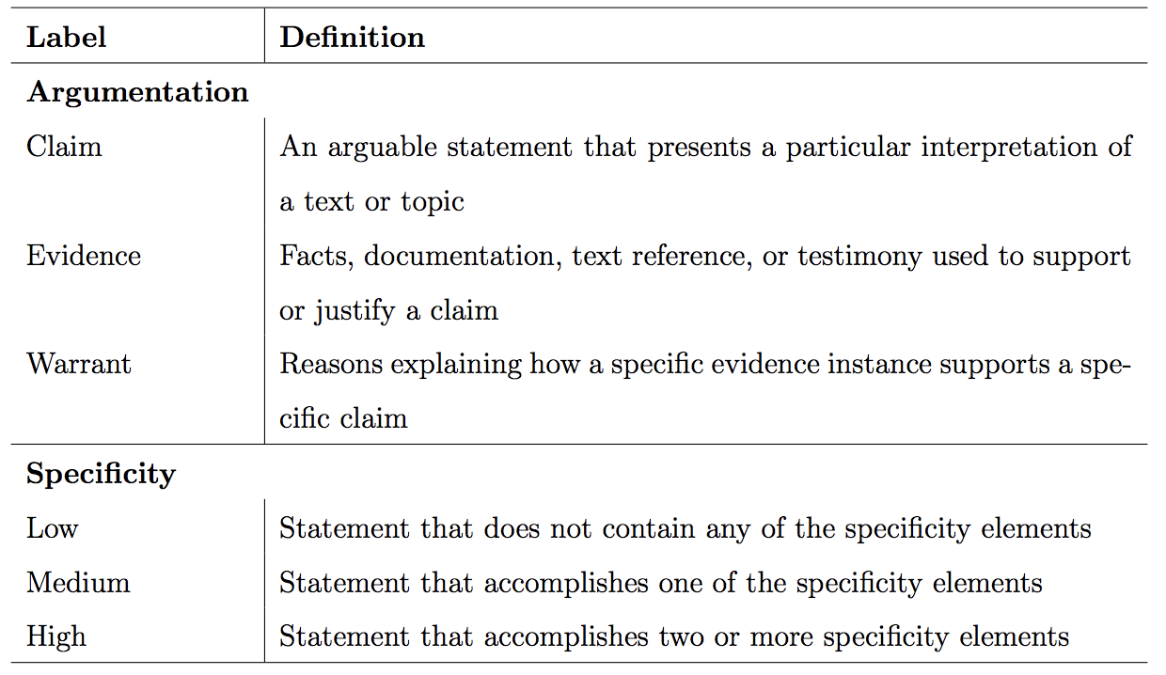
Proposed Annotation Scheme
Specificity elements of an argument move:
Specific to one or a selected few characters or scenes
Makes significant qualifications or elaborations
Uses content-specific vocabulary
Provides a chain of reasons

Slide 20
Example of Annotated Transcript
Move | Student | Argument Move | Argument | Spec
23 | S1 | She’s like really just protecting Willy from everything. | claim | med
24 | S1 | Like at the end of the book remember how she was telling the kids to leave and never come back. | evidence | med
25 | S1 | Like she’s not even caring about them, she’s caring about Willy. | warrant | med
41 | S2 | It’s like she’s concerned with him trying to [inaudible] and he’s concerned with trying to make her happy, you know? So he feels like he’s failing when he’s not making her happy like | claim | high
42 | S2 | ”Let’s bring your mother some good news” | evidence | high
43 | S2 | but she knew that, there wasn’t any good news, so she wanted to act happy so he wouldn’t be in pain. | warrant | high
Elements of specificity:
1. involves one character or scene
2. makes substantial qualifications or elaboration
3. uses content-specific vocabulary
4. provides a chain of reasons
55 | S3 | Some people they just ask for a job is just like, some money. | evidence | low

Slide 21
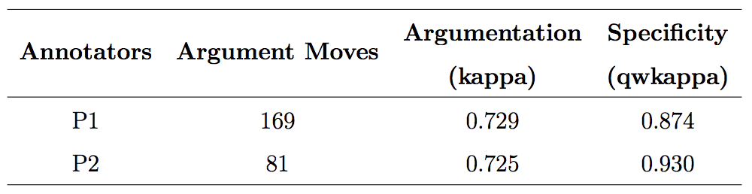
Reliability Study
2 annotator pairs:
P1, 2 discussions
P2, 1 discussion
40 students
250 argument moves
Substantial agreement
Almost perfect agreement

Slide 22

Part 1 Summary
We proposed an annotation scheme for two theoretically-motivated aspects of student talk in classroom discussion
We demonstrated that the annotation scheme can be used by humans to reliably annotate transcripts of classroom discussions
Part 1 Research Hypothesis
H1: The proposed annotation scheme can be used by humans to reliably annotate important aspects of student talk in classroom discussions.
Contribution shared with Christopher Olshefski

Slide 23
Outline
Introduction
Datasets
Part 1: Annotation of Classroom Discussions (completed)
Part 2: Automatically Predicting Specificity for Classroom Discussions (completed)
Part 3: Argument Component Classification for Classroom Discussions (partially completed)
Part 4: Joint Learning of Different Aspects of Classroom Discussions

Slide 24
Automatically Predicting Specificity
Goal: develop a computational model for predicting specificity in text-based classroom discussions
Part 2 Research Hypothesis
H2: The annotations of features of student talk can be reliably automated
H2.1: The proposed model for specificity prediction delivers better
performance than systems developed for other domains

Slide 25
Related Work
Specificity for human and automated summaries [Louis and Nenkova, 2011]
Speciteller - predicting specificity of sentences [Li and Nenkova, 2015]
Speciteller scores highly correlated to argument quality in online dialogues [Swanson et al., 2015]
More recently:
Predicting specificity in social media posts [Gao et al., 2019]
Specificity for argument persuasion in student essays [Ke et al., 2018]
Generalizing specificity across domains [Ko et al., 2019]
Inspired by our proposed model

Slide 26
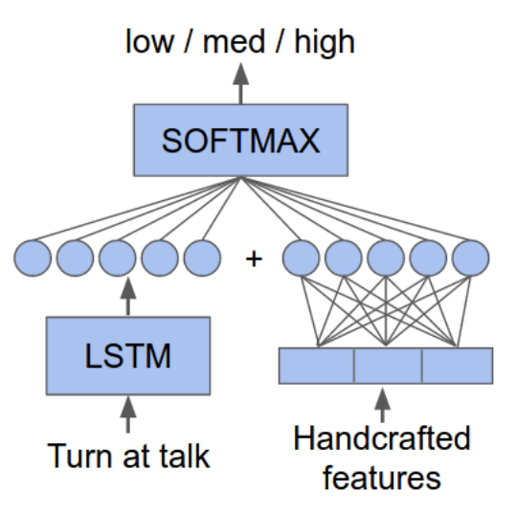
Proposed Model
Main idea - combining:
Handcrafted features
  Speciteller (length, # connectives, # subjective and polar words, AVG word familiarity and imageability, # numbers, # symbols, word embeddings)
  Online dialogue (# pronouns, statistics for word length, tf-idf unigram and bigram, POS unigram, bigram and trigram)
  Additional features (pronouns, named entities, book-related)
Neural network
  Argument move embeddings with Long Short Term Memory (LSTM) recurrent neural network
Argument Move

Slide 27
Dataset D1
23 text-based classroom discussions (English Language Arts)
5 discussions coded by a pair of annotators, QWKappa 0.714
9 discussions coded by a second pair of annotators: QWKappa 0.9
9 discussions single coded
5 - 13 students per discussion
Argument Moves | Specificity
 | Low | Med | High
2057 | 730 (36%) | 974 (47%) | 353 (17%)

Slide 28
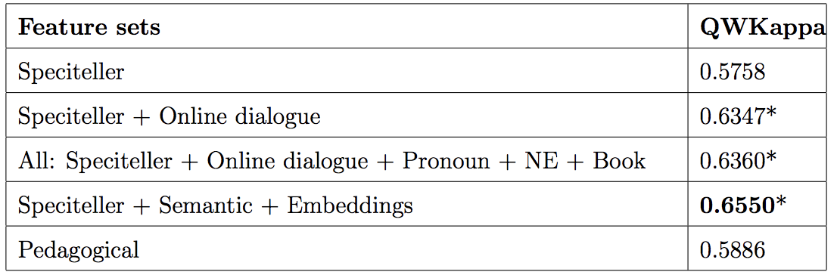
Results
Speciteller features offer a respectable baseline
Online dialogue features significantly increase performance
Best performance obtained using hybrid model (neural network + handcrafted features)
Pedagogical features can be used for teacher/student feedback

Slide 29
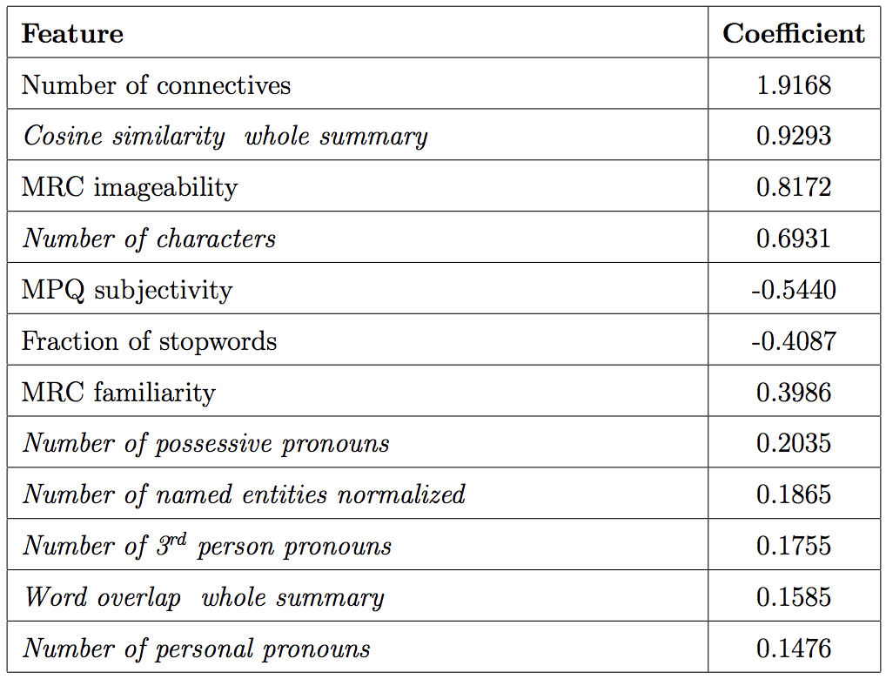
Results - Pedagogical Features

Slide 30
Part 2 Summary
We investigated several computational models for predicting specificity in classroom discussions
We proposed a hybrid system which combines a neural network and handcrafted features to train a robust specificity classifier
We proposed a set of pedagogically meaningful features for predicting specificity and providing feedback
Part 2 Research Hypothesis
H2.1: The proposed model for specificity prediction delivers better performance than systems developed for other domains

Slide 31
Outline
Introduction
Datasets
Part 1: Annotation of Classroom Discussions (completed)
Part 2: Automatically Predicting Specificity for Classroom Discussions (completed)
Part 3: Argument Component Classification for Classroom Discussions (partially completed)
Part 4: Joint Learning of Different Aspects of Classroom Discussions

Slide 32
Automatically Predicting Argument Components
Goal: develop a computational model for predicting argument components in text-based classroom discussions
Part 3 Research Hypotheses
H2: The annotations of features of student talk can be reliably automated
H2.2: Performance of an existing argument mining model can be improved
by using features developed for argument mining in online dialogues
H2.3: Modeling speaker-dependent contextual information will improve
argument component classification performance

Slide 33
Related Work
Argumentation in educational domain - largely aimed at student essays:
Argument strength for automated essay scoring [Persing and Ng, 2015]
Joint argument identification and classification [Stab and Gurevych, 2014]
Identifying argument words and domain words [Nguyen and Litman, 2015]
wLDA, improving cross-topic performance [Nguyen and Litman, 2016]
Argumentation in multi-party domain - largely focused on online dialogues:
Extracting arguments from online dialogues [Swanson et al., 2015]
Argument facets of dyadic online forum discussions [Misra et al., 2015]
Argument component identification/classification in user-generated web discourse [Habernal and Gurevych, 2017]
Not multi-party
Not spoken discussions
Different annotation scheme
Not spoken discussions
Different annotation scheme

Slide 34
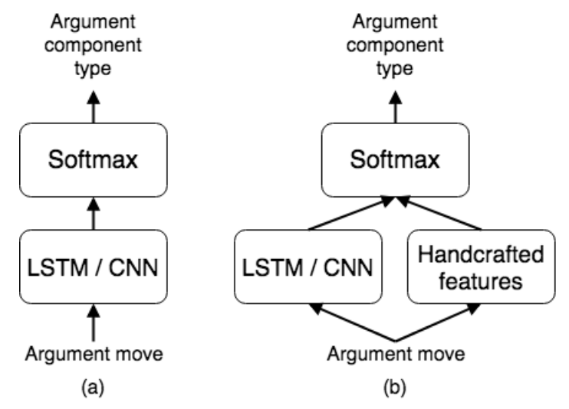
Proposed Models
3 types of models:
Neural network only model
Recurrent or convolutional neural network
Hybrid neural network + handcrafted features:
wLDA features
Online dialogue features (same as Part 2)
Recurrent or convolutional neural network
Logistic regression-based

Slide 35
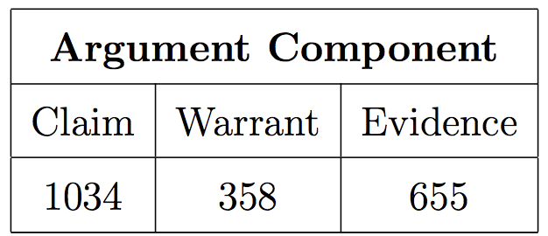
Dataset D2
73 high school-level text-based discussions, 2057 argument moves
Turns manually segmented into argument moves (Argumentative Discourse Units)
50 discussions (1049 argument moves) double-coded, Cohen kappa 0.629

Slide 36
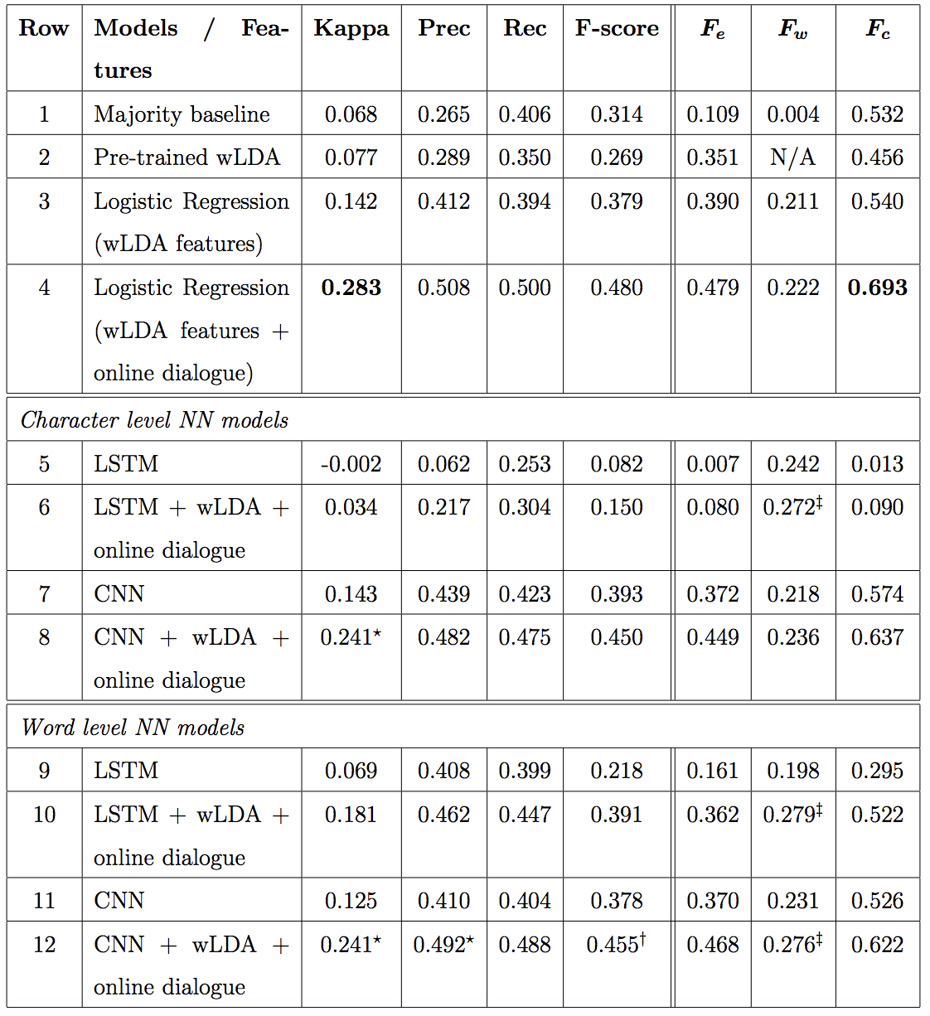
Results
wLDA features perform reasonably well for claims and evidence

Slide 37
Results
Neural Network only:
CNN models achieve similar performance to wLDA features

Slide 38
Results
Neural Network only:
CNN models achieve similar performance to wLDA features
CNN outperform LSTM

Slide 39
Results
Neural Network only:
CNN models achieve similar performance to wLDA features
CNN outperform LSTM
Word embeddings are essential for LSTM

Slide 40
Results
Logistic regression model shows best overall performance

Slide 41
Results
Hybrid models outperform neural network-only models

Slide 42
Part 3 - Completed Work Summary
We evaluated the performance of an existing argument mining system and extended it with additional feature sets
We developed hybrid models based on neural networks and handcrafted features
We provided experimental evaluation of CNN and LSTM networks, both character- and word-based
Part 3 Research Hypothesis
H2.2: Performance of an existing argument mining model can be improved by using features developed for argument mining in online dialogues

Slide 43
Part 3 Proposed Work - Modeling Speaker-dependent Contextual information
Student | Argument Move | Argument Component | Specificity
S1 | I kind of agree but I think there’s more to it than just the fact that they love each other. I think that Oberon really loves her, as long as she’s submissive to him, | Claim | High
S1 | because the only reason this entire thing started is because she wouldn’t just listen to what he wanted to give her ... or, she would give him the Indian kid or whatever. So then, because of that he kind of goes out of his way to just make her look foolish and says,“When I had at my pleasure taunted her and she in mild terms begged my patience I then did ask of her changeling the child.” So he waits until she kind of makes a fool of herself and comes back to him to lift the spell. | Evidence | High
S1 | So I think that while they are in love with each other, I think that [inaudible 00:11:20] at the end of it she kind of just goes back to being submissive. | Warrant | Med
Notes:
Warrants cannot exist without evidence and claim

Slide 44
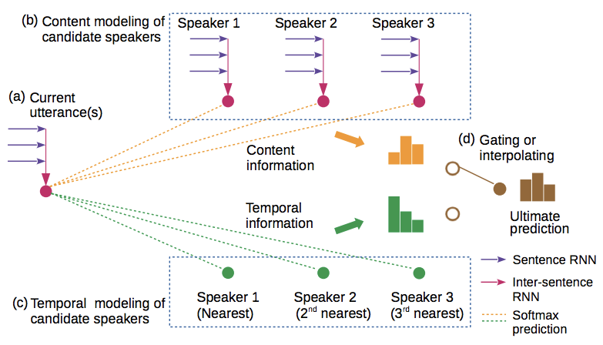
Modeling Context with Neural Networks
Speaker classification in multi-party conversations [Meng et al., 2018]
Only local context considered
Context modeled with respect to target variable (speaker)

Slide 45
Modeling Context with Neural Networks
Modeling dialogue history for dialogue generation [Li et al., 2017]:
Concatenate previous 2 utterances to current one
Context in dialogue act classification [Ortega and Vu, 2017]:
Analyze different neural network structures for combining sentences in local context
Modeling “(context, response)” for domain adaptation [Lison and Bibauw, 2017]
Sample weight based on weighted sum of the 2 elements
Only local context considered
Do not consider speaker information

Slide 46
Proposed Speaker-dependent Context Model
Goal: capture contextual information to better understand argumentation in multi-party text-based discussions and train more robust models
Part 3 Research Hypotheses
H2: The annotations of features of student talk can be reliably automated
H2.3: Modeling speaker-dependent contextual information will improve
argument component classification performance

Slide 47
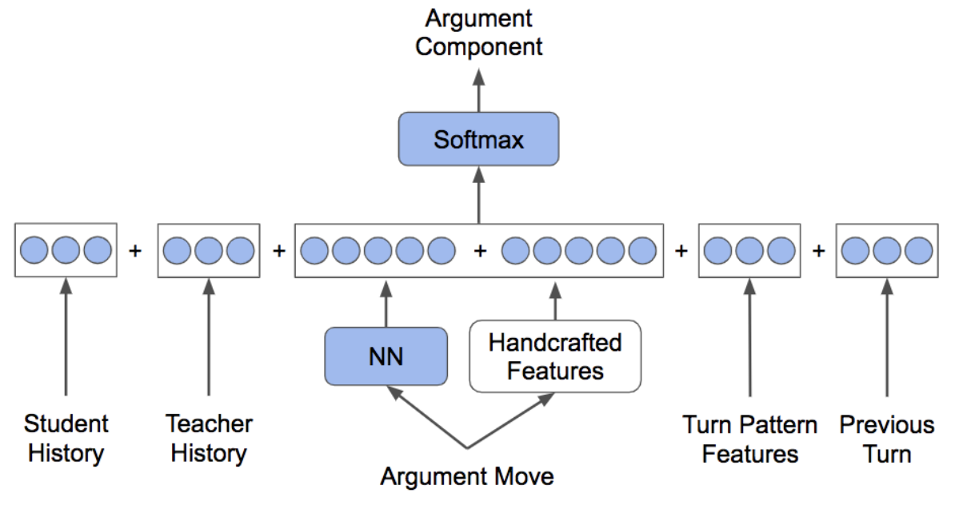
Proposed Speaker-dependent Context Model
Previous Argument Move
Global context
baseline2
Local context

Slide 48
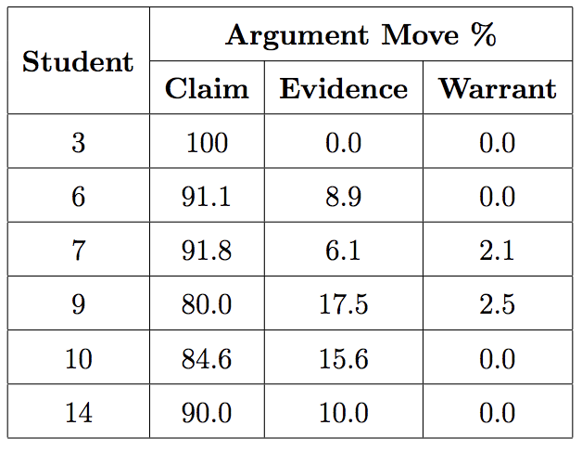
Student History
Dynamic process
We can model an approximation

Slide 49
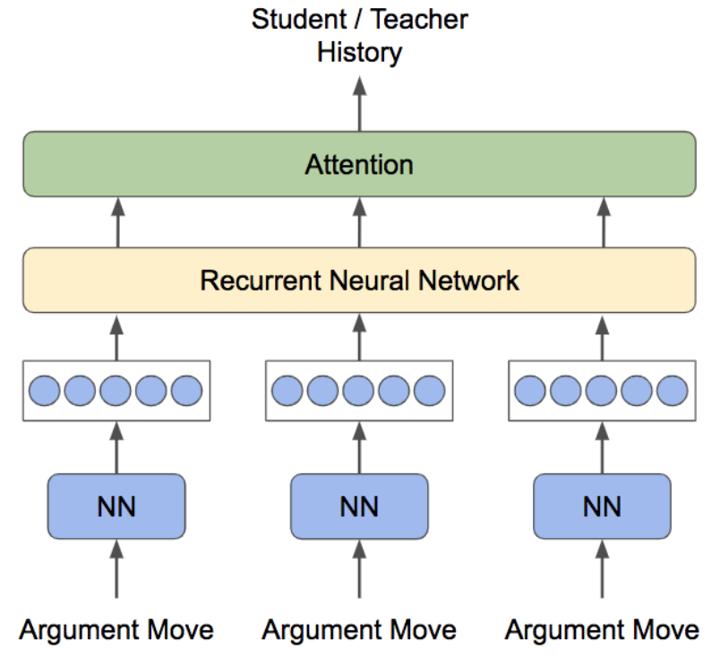
Student History

Slide 50
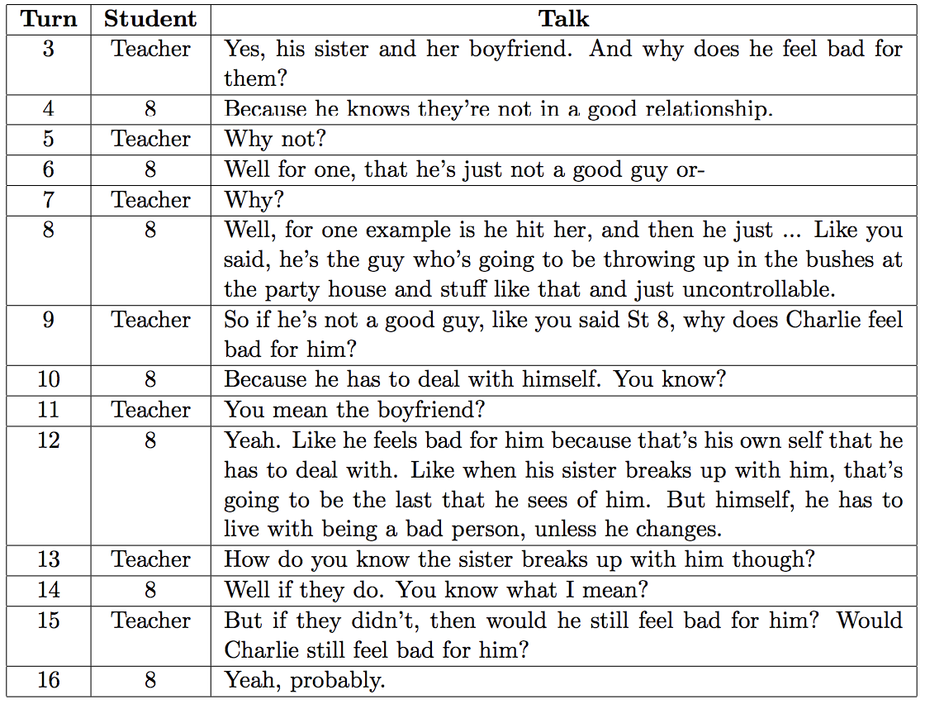
Teacher History
Capture text-related concepts

Slide 51
Local Context
Turn pattern features:
did the student speak before?
how many argument moves ago the student last spoke
how long (number of argument moves) the student has been speaking
did the teacher speak during the preceding turn?
how many argument moves ago the teacher last spoke
Embedding of the previous argument move

Slide 52
Evaluation - Experiment 1
Test individual context modules:
Extend baseline2 with Local Context
Extend baseline2 with Student History
Extend baseline2 with Teacher History
Goal: evaluate importance of each of the context sources, and long-term dependencies in student/teacher history

Slide 53
Evaluation - Experiment 2
Extend baseline2 with all the proposed contextual features
Goal: test if combination of local and global context features can outperform individual ones (from experiment 1)

Slide 54
Evaluation - Experiment 3
Adapt the proposed model to a different problem:
Predict dialogue acts on the AMI dataset
Goal: test whether our modeling of contextual information can be effective beyond argument component classification

Slide 55
Part 3 - Proposed Work Summary
We proposed to investigate the importance of context from multiple sources in argument component classification for multi-party classroom discussions
We proposed experiments to test whether we can model context similarly for a different task on multi-party spoken dialogues

Slide 56
Outline
Introduction
Datasets
Part 1: Annotation of Classroom Discussions (completed)
Part 2: Automatically Predicting Specificity for Classroom Discussions (completed)
Part 3: Argument Component Classification for Classroom Discussions (partially completed)
Part 4: Joint Learning of Different Aspects of Classroom Discussions

Slide 57
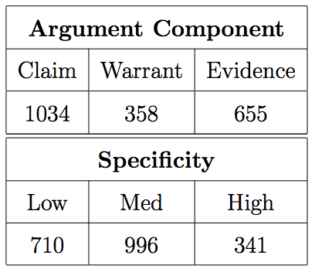
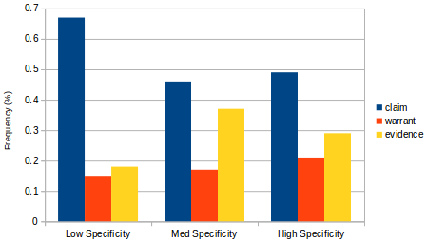
Joint Learning of Different Aspects of Classroom Discussions
Class distributions for dataset D2

Slide 58
Joint Learning
Multi-Task Learning [Collobert and Weston, 2008]:
Multiple tasks for the same data
Shared parameters
Task losses are combined during training, then backpropagated
POS Tagging
NER
Text

Slide 59
Related Work
Applications of Multi-task learning in NLP:
CNN for 6 tasks (SRL, POS tagging, chunking, NER, semantically related words, language modeling) [Collobert and Weston, 2008]
Neural Machine Translation on multiple languages [Dong et al., 2015]
and in Argumentation:
Transfer learning framed as multi-task learning for argument component classification in low-resource settings [Schulz et al., 2018]
Investigating the role of argumentation in rhetorical analysis [Lauscher et al., 2018]
Not using different tasks
Not focusing on argument component classification performance
Notes:
Rhetorical analysis: discourse role, citation purpose, subjective aspect, summarization relevance

Slide 60
Proposed Multi-Task Models
Goal: take full advantage of the annotation scheme proposed and develop a joint model for all aspects of collaborative argumentation
Part 4 Research Hypothesis
H3: A model for jointly predicting all features of student talk using multi-task learning will outperform the individual models trained separately on each of the features

Slide 61
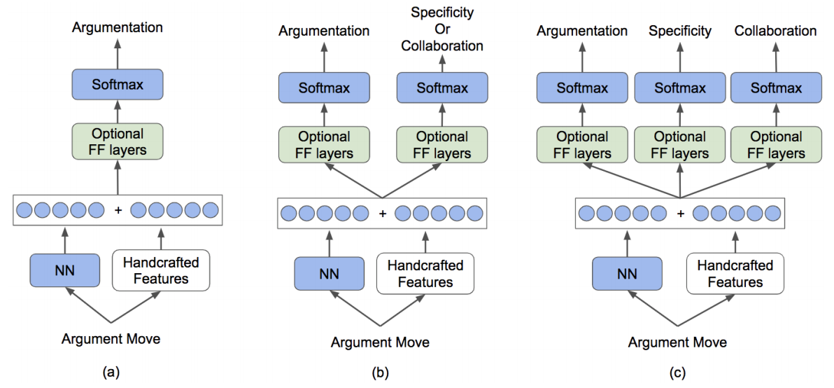
Proposed Multi-Task Models
Single-task model
2-tasks model
3-tasks model

Slide 62
Pilot Study
Implemented multi-task model for argument components and specificity
Tested on dataset D2
Normalized Mutual Information (NMI) = 0.039

Slide 63
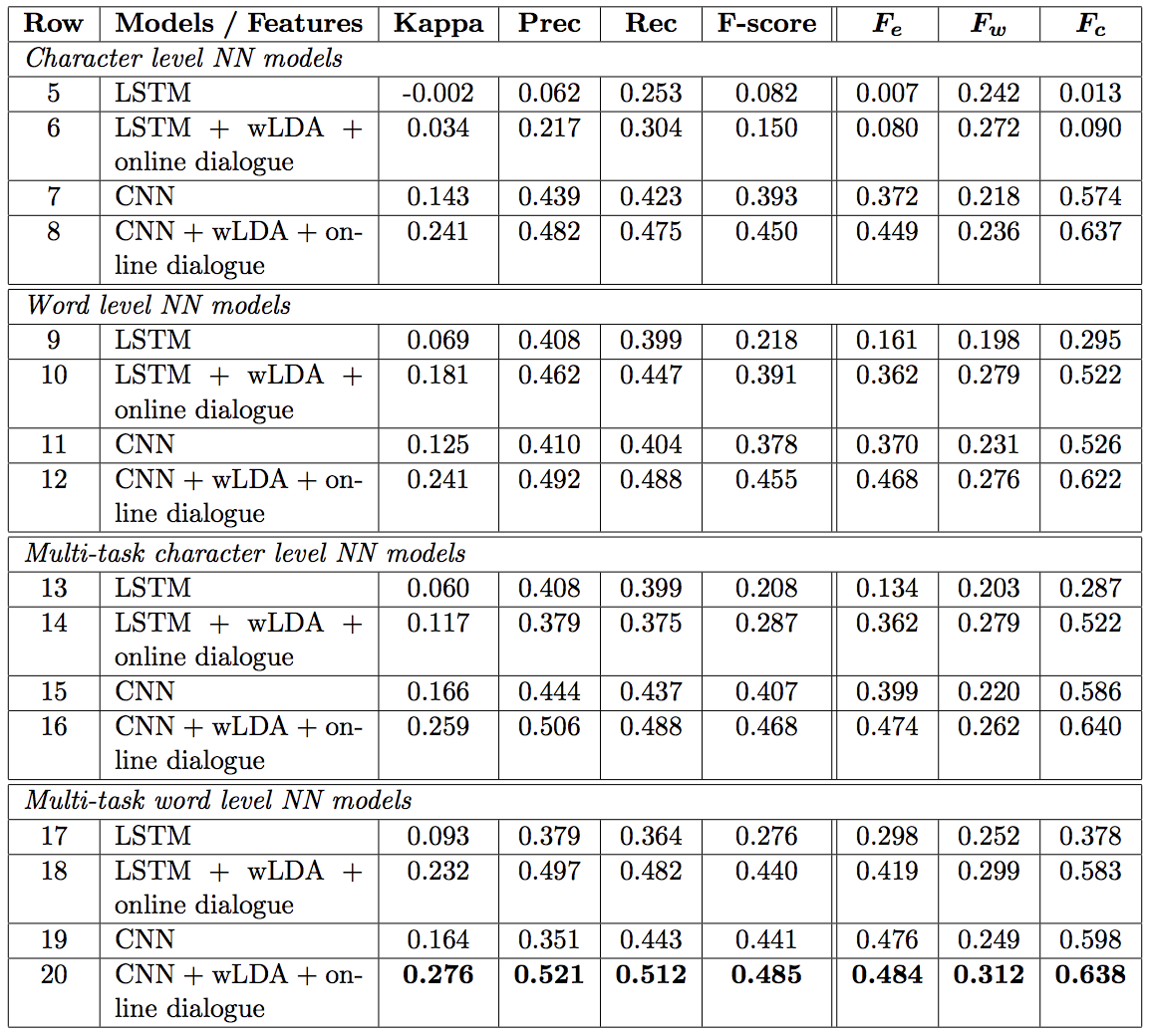
Pilot Study Results
Findings:
Multi-task models generally outperform single-task ones
LSTM models benefit more than CNN
Only a multi-task model achieved F_{w} > 0.3

Slide 64
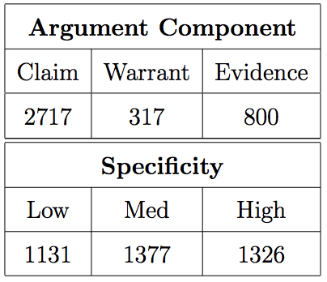
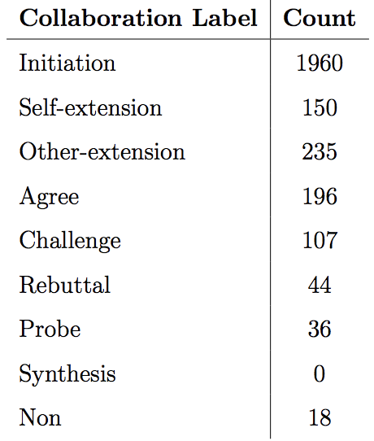
Pilot Study 2
Normalized Mutual Information on dataset D3:
0.062 for argument component - specificity
0.279 for argument component - collaboration
0.061 for specificity - collaboration
All three higher than pilot study 1

Slide 65
Evaluation - Experiment 1
Implement 2-tasks models
Goal: test whether a second tasks helps argument component classification, rank secondary tasks

Slide 66
Evaluation - Experiment 2
Implement 3-tasks model
Goal: test whether a third task can develop a more robust model than experiment 1

Slide 67
Evaluation - Experiment 3
Combine proposed models in Part 3 and Part 4:
best performing contextual features
best performing multi-task model
Goal: test whether contextual features and multi-task learning can be combined to outperform their individual performance

Slide 68
Part 4 Summary
We proposed to jointly model multiple aspects of classroom talk through multi-task learning
We proposed experimental evaluations to investigate in detail which tasks can benefit from each other
We proposed to combine findings from Part 3 and Part 4 to make use of contextual information and multi-task learning simultaneously to improve performance on each task

Slide 69
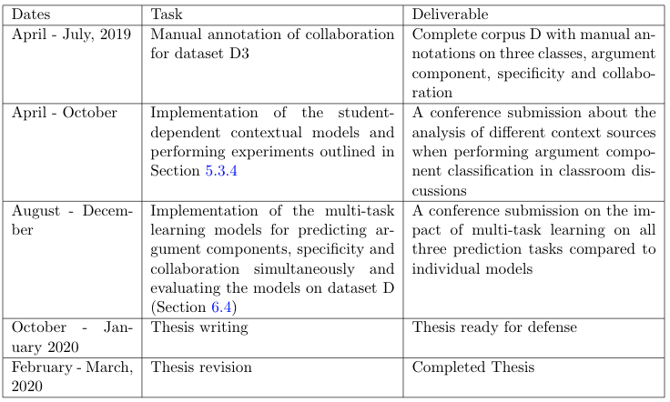
Timeline

Slide 70
Thank you!

