Slide 1
AI-Enhanced
Teaching and Learning
Dr. Diane Litman
  Professor, Computer Science Department
  Director, Intelligent Systems Program
  Senior Scientist, Learning Research & Development Center
University of Pittsburgh

Slide 2
NITRD: National AI R&D Strategic Plan (10/16)
“AI-enhanced learning schools can be universally available, with automated tutoring that gauges the development of the student. AI tutors can complement in-person teachers and focus education on advanced and/or remedial learning appropriate to the student. AI tools can foster life-long learning and the acquisition of new skills for all members of society.”
Notes:
http://cra.org/ccc/task-forces/ai/
The Networking and Information Technology Research and Development

Slide 3
Grand Challenge Competitions
Global Learning $15M X-Prize (current)
  Empower children to take control of their learning
Hewlett Foundation Automated Student Assessment $200K Prize (4 years ago)
  Essay Scoring
  Short Answer Scoring
Notes:
open source and scalable software that will enable children in developing countries to teach themselves basic reading, writing and arithmetic within 18 month

Slide 4
My Focus: NLP for Educational Innovation
Natural Language Processing (NLP): Getting computers to perform useful and interesting tasks involving human languages
  Machine-readable text, audio, and video
  Intelligent personal assistants (Alexa, Cortana, Siri, …)

Slide 5
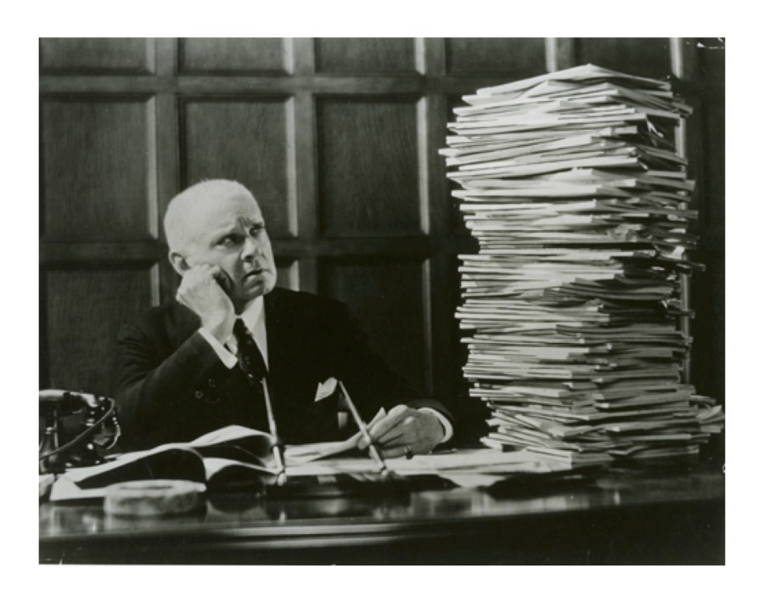
Learning Language: Writing

Slide 6
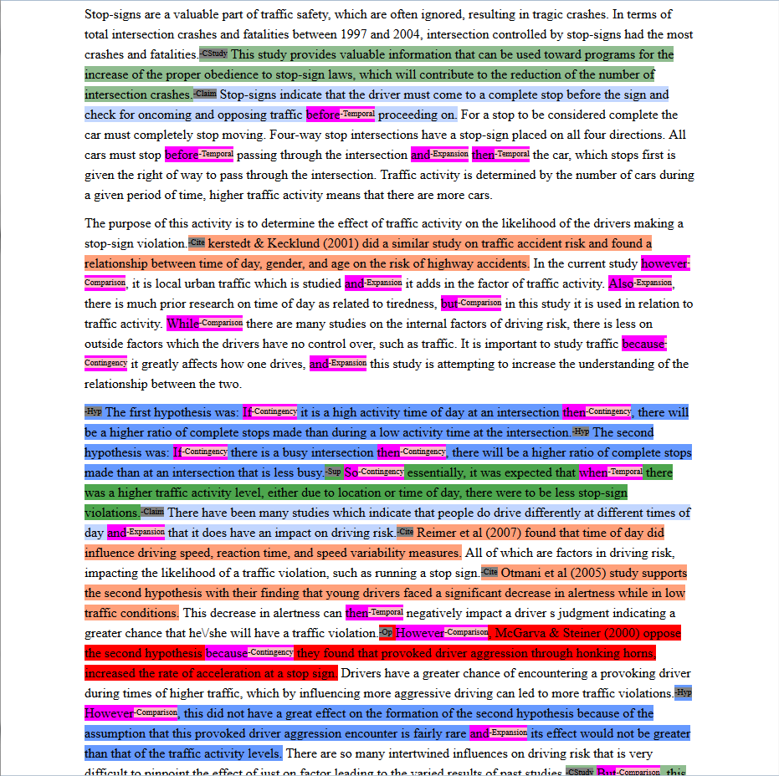
Argument Mining of Writing (assessment/ feedback)
Current Study
Claim
Citation
Hypothesis
Supports
Opposes
None
Notes:
Expert score 3 out of 5, 5 is max, 0 is min, integer values only

Slide 7
Formative Feedback on Student Reviewing
System
feedback (if needed)
Reviewer makes decision (AGREE)
NLP model applied
NLP model applied

Slide 8
ArgRewrite: Revision Writing Assistant

Slide 9
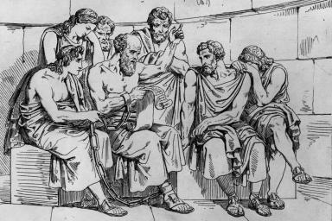
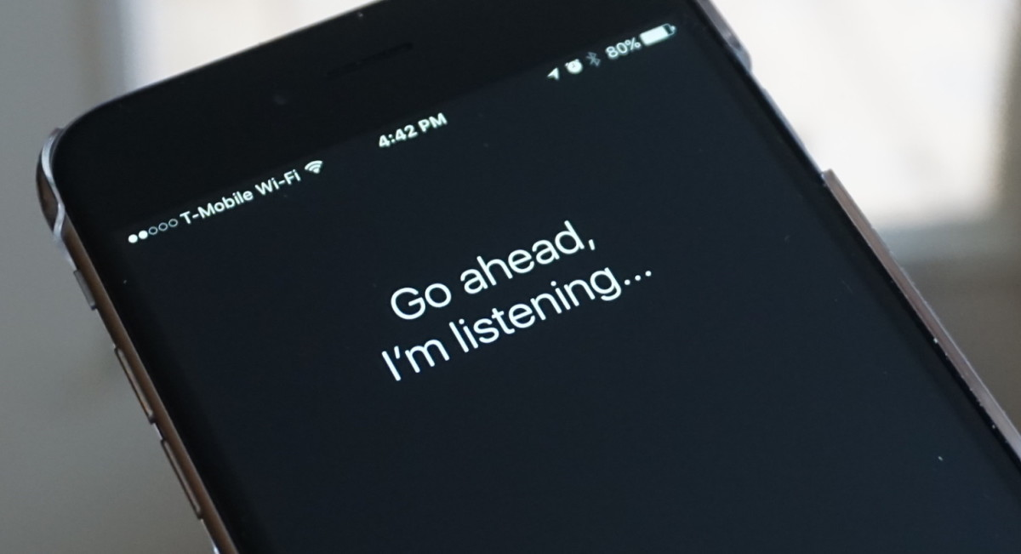

Using Language: Teaching Physics
From Socrates to Siri
Personalized tutorial dialogue systems based on what students say, and how they say it

Slide 10
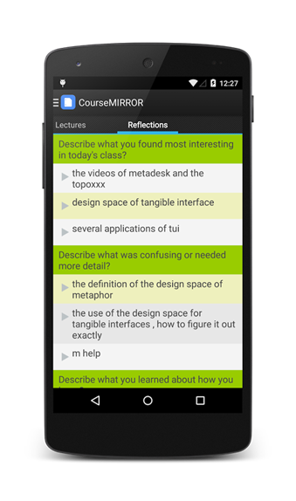


Processing Language:
Summarizing Student Reflections

Slide 11
Final Thoughts
NLP for teaching and learning at scale is an area of potentially broad impact
Many technical opportunities & challenges
Notes:
Noisy student generated content
Educationally-meaningful predictive constructs
Real-time performance

Slide 12
Roles for NLP in Educational Innovation
[Litman, AAAI 2016]
Teaching and learning language related subjects
  Reading, writing, speaking
Using language to teach any subject
  Teaching in the disciplines
Processing language to support students, teachers, researchers and policy-makers
  MOOCs, textbooks, lectures, social media

