Slide 1
Natural Language Processing for Writing Research: From Peer Review to Automated Assessment
  Diane Litman
  Senior Scientist, Learning Research & Development Center
  Professor, Computer Science Department
  Director, Intelligent Systems Program

Slide 2
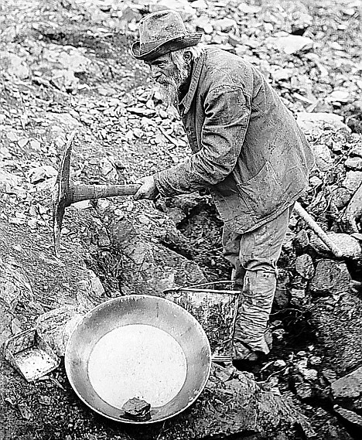

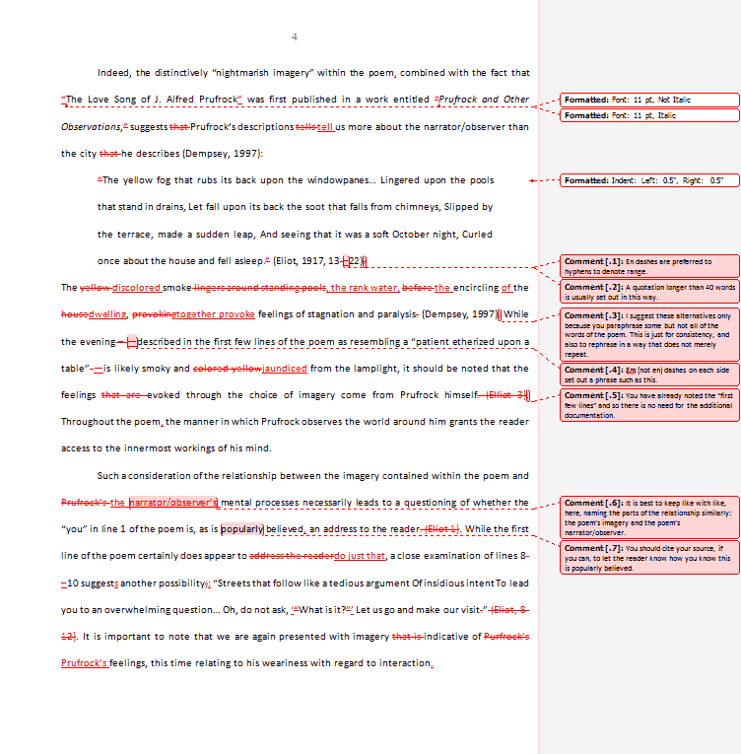
Writing Research is a Goldmine for NLP
Can we automate human coding?
New Educational Technology!
Learning Science at Scale!

Slide 3
Two Case Studies
SWoRD and Argument Peer
  w/ Kevin Ashley, Amanda Godley, Chris Schunn
Response to Text Assessment
  w/ Rip Correnti, Lindsay Clare Matsumara

Slide 4
SWoRD: A web-based peer review system
[Cho & Schunn, 2007]
Authors submit papers (or diagrams)
Peers submit reviews
  Problem: reviews are often not stated effectively
  Example: no localization
    Justification is sufficient but unclear in some parts.
  Our Approach: detect and scaffold
    Justification is sufficient but unclear in the section on African Americans

Slide 5
Localization Scaffolding
Make sure that for every comment below, you explain where in the diagram it applies. For example, you can indicate where your comments apply by:
(1) Specifying node(s) and/or arc(s) in the author's diagram to which your comment refers
Your conflicting/supporting [node-type] is really solid!
(2) Quoting the excerpt from the author's textual content of node and/or arc to which your comment refers
For your [node-type] that talks about body chemistry and cortisol levels, you should clarify how that is related to politeness specifically.
(3) Referring explicitly to the specific line of argumentation that your comment addresses
Why does claim [node-ID] support the idea that people will be more polite in the evening?
I’ve revised my comments. Please check again.
I don’t know how to specify where in the diagram my comments apply. Could you show me some examples?
My comments don’t have the issue that you describe. Please submit comments.

Slide 6
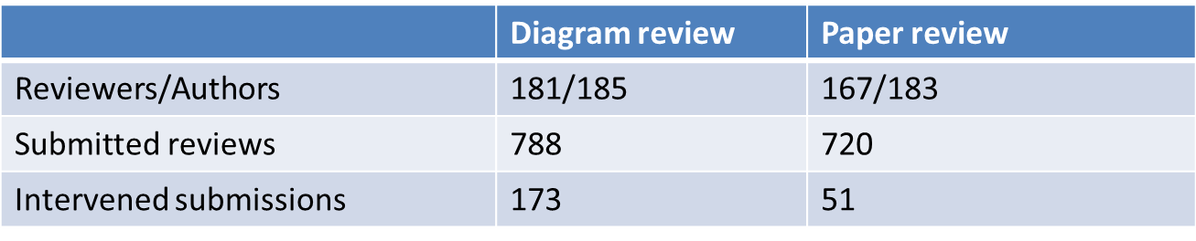
A First Classroom Evaluation
[Nguyen, Xiong & Litman, 2014]
NLP extracts attributes from reviews in real-time
Prediction models use attributes to detect localization
Scaffolding if < 50% of comments predicted as localized
Deployment in undergraduate Research Methods

Slide 7
Results: Can we Automate?
Comment Level
Review Level
 | Diagram review |  | Paper review
 | Accuracy | Kappa | Accuracy | Kappa
Majority baseline | 61.5% (not localized) | 0 | 50.8% (localized) | 0
Our models | 81.7% | 0.62 | 72.8% | 0.46
 | Diagram review | Paper review
Total scaffoldings | 173 | 51
Incorrectly triggered | 1 | 0

Slide 8
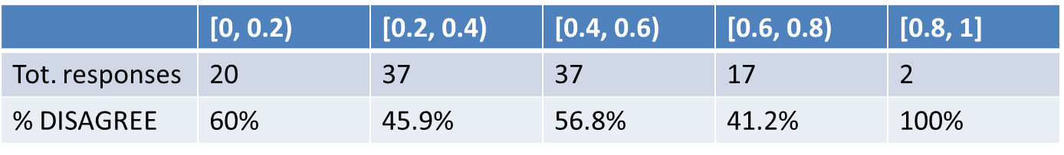
Results: New Educational Technology
Response to Scaffolding
Why are reviewers disagreeing?
  No correlation with true localization ratio (diagrams)
Reviewer response | REVISE | DISAGREE
Diagram review | 54 (48%) | 59 (52%)
Paper review | 13 (30%) | 30 (70%)

Slide 9
A Deeper Look: Revision Performance
 | # and % of comments (diagram reviews)
NOT Localized → Localized | 26 | 30.2%
Localized → Localized | 26 | 30.2%
NOT Localized → NOT Localized | 33 | 38.4%
Localized → NOT Localized | 1 | 1.2%
Comment localization is either improved or remains the same after scaffolding
  Localization revision continues after scaffolding is removed
  (see poster!)

Slide 10
A Deeper Look: Revision Performance
 | # and % of comments (diagram reviews)
NOT Localized → Localized | 26 | 30.2%
Localized → Localized | 26 | 30.2%
NOT Localized → NOT Localized | 33 | 38.4%
Localized → NOT Localized | 1 | 1.2%
Open questions
  Are reviewers improving localization quality?
  Interface issues, or rubric non-applicability?

Slide 11
Automatic Scoring of an Analytical
Response-To-Text Assessment (RTA)
[Rahimi, Litman, Correnti, Matsumura, Wang & Kisa, 2014]
Long-term goal
  informative feedback for students and teachers
Current work
  interpretable, NLP-based features that operationalize the Evidence rubric of RTA

Slide 12
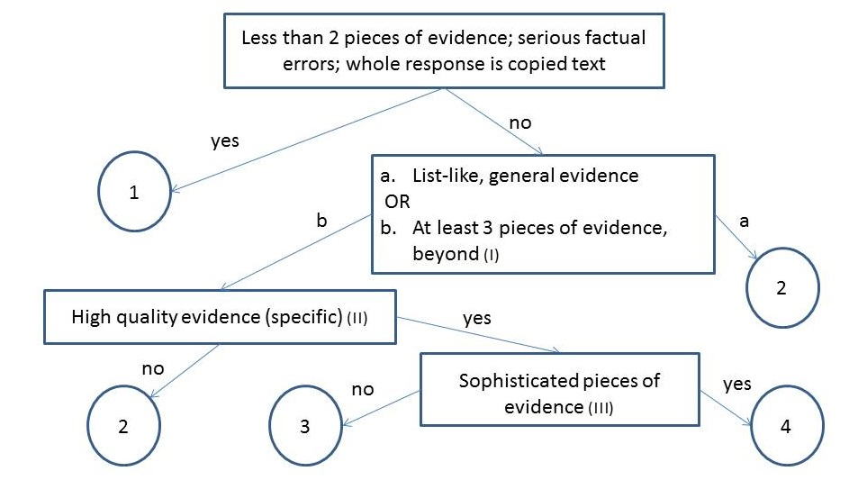
Scoring Essays for Evidence

Slide 13
Rubric-Derived Features
Number of Pieces of Evidence (NPE)
  Topics and words defined based on the text and by experts
  Window-based algorithm
Concentration (CON)
  High concentration: fewer than 3 sentences with topic words
Specificity (SPC)
  Specific examples from different parts of the text
  Window-based algorithm
Word Count (WOC)
  Temporary fallback feature

Slide 14
Essay with score of 4 on Evidence
I was convinced that winning the fight of poverty is achievable in our lifetime. Many people couldn't afford medicine or bed nets to be treated for malaria . Many children had died from this dieseuse even though it could be treated easily. But now, bed nets are used in every sleeping site . And the medicine is free of charge. Another example is that the farmers' crops are dying because they could not afford the nessacary fertilizer and irrigation . But they are now, making progess. Farmers now have fertilizer and water to give to the crops. Also with seeds and the proper tools . Third, kids in Sauri were not well educated. Many families couldn't afford school . Even at school there was no lunch . Students were exhausted from each day of school. Now, school is free . Children excited to learn now can and they do have midday meals . Finally, Sauri is making great progress. If they keep it up that city will no longer be in poverty. Then the Millennium Village project can move on to help other countries in need.
NPE | CON | WOC | SPC
4 | 0 | 187 | 0 | 0 | 1 | 4 | 3 | 3 | 5 | 1

Slide 15
Results: Can we Automate?
Proposed features outperform both baselines

Slide 16
Results: Can we Automate?
Absolute performance improves on less noisy data
  Complete: Complete dataset (n = 1569)
  Subset: Doubly-coded essays where raters agree (n=353)
  less training data, and only for our features

Slide 17
Other Results
See poster
  Feature analysis
  Spelling correction
Predictive utility generalizes to a second dataset

Slide 18
New NLP-Supported Directions
Teacher dashboard for high school science writing
  LRDC grant -> (expected) NSF DRK-12
  w/ Amanda Godley & Chris Schunn
Peer review search and analytics in MOOCS
  Google award
Student reflections in undergraduate STEM
  LRDC grant
  w/ Muhsin Menekse & Jingtao Wang

Slide 19



Thank You!
Questions?
Further Information
  http://www.cs.pitt.edu/~litman

Slide 20
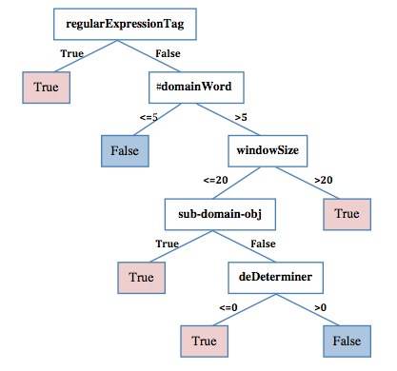
Paper Review Localization Model
[Xiong, Litman & Schunn, 2010]

Slide 21
Diagram Review Localization Model
[Nguyen & Litman, 2013]
Localization again correlates with feedback implementation [Lippmann et al., 2012]
Pattern-based detection algorithm
  Numbered ontology type, e.g. citation 15
  Textual component content, e.g. time of day hypothesis
  Unique component, e.g. the con-argument
  Connected component, e.g. support of second hypothesis
  Numerical regular expression, e.g. H1, #10

Slide 22
Results: Revision Performance
 | Number (pct.) of comments of diagram reviews
 | Scope=In |  | Scope=Out |  | Scope=No
NOT Loc. → Loc. | 26 | 30.2% | 7 | 87.5% | 3 | 12.5%
Loc. → Loc. | 26 | 30.2% | 1 | 12.5% | 16 | 66.7%
NOT Loc. → NOT Loc. | 33 | 38.4% | 0 | 0% | 5 | 20.8%
Loc. → NOT Loc. | 1 | 1.2% | 0 | 0% | 0 | 0%
Comment localization is either improved or remains the same after scaffolding]
Localization revision continues after scaffolding is removed
Are reviewers improving localization quality, or performing other types of revisions?
Interface issues, or rubric non-applicability?

Slide 23
Rubric for the Evidence dimension of RTA
1 | 2 | 3 | 4
Features one or no pieces of evidence | Features at least 2 pieces of evidence | Features at least 3 pieces of evidence | Features at least 3 pieces of evidence
Selects inappropriate or little evidence from the text; may have serious factual errors and omissions | Selects some appropriate but general evidence from the text; may contain a factual error or omission | Selects appropriate and concrete, specific evidence from the text | Selects detailed, precise, and significant evidence from the text
Demonstrates little or no development or use of selected evidence | Demonstrates limited development or use of selected evidence | Demonstrates use of selected details from the text to support key idea | Demonstrates integral use of selected details from the text to support and extend key idea
Summarize entire text or copies heavily from text | Evidence provided may be listed in a sentence, not expanded upon | Attempts to elaborate upon Evidence | Evidence must be used to support key idea / inference(s)

Slide 24
Essay with score of 1 on Evidence
Yes, because even though proverty is still going on now it does not mean that it can not be stop. Hannah thinks that proverty will end by 2015 but you never know. The world is going to increase more stores and schools. But if everyone really tries to end proverty I believe it can be done. Maybe starting with recycling and taking shorter showers, but no really short that you don't get clean. Then maybe if we make more money or earn it we can donate it to any charity in the world. Proverty is not on in Africa, it's practiclly every where! Even though Africa got better it didn't end proverty. Maybe they should make a law or something that says and declare that proverty needs to need. There's no specic date when it will end but it will. When it does I am going to be so proud, wheather I'm alive or not.
NPE | CON | WOC | SPC
0 | 1 | 166 | 0 | 0 | 0 | 0 | 0 | 1 | 1 | 0

Slide 25
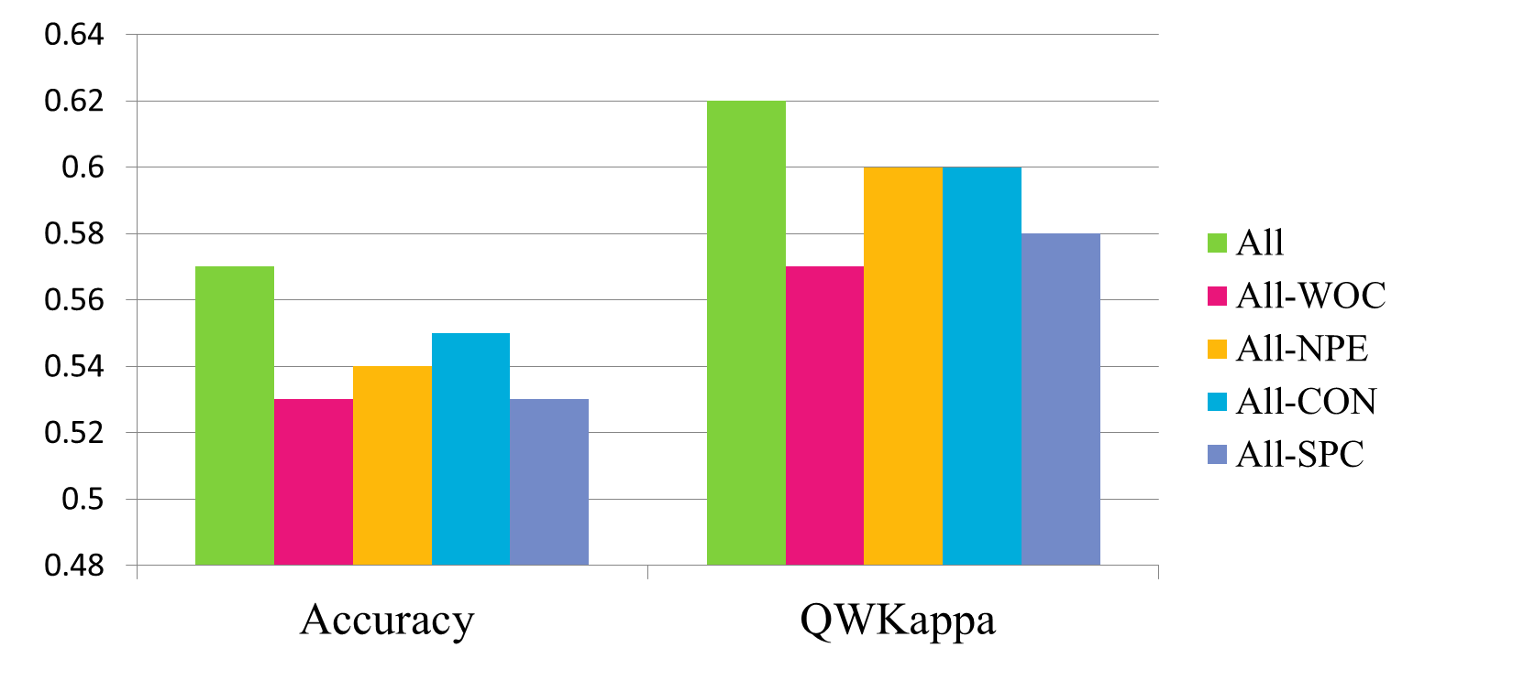

Slide 26
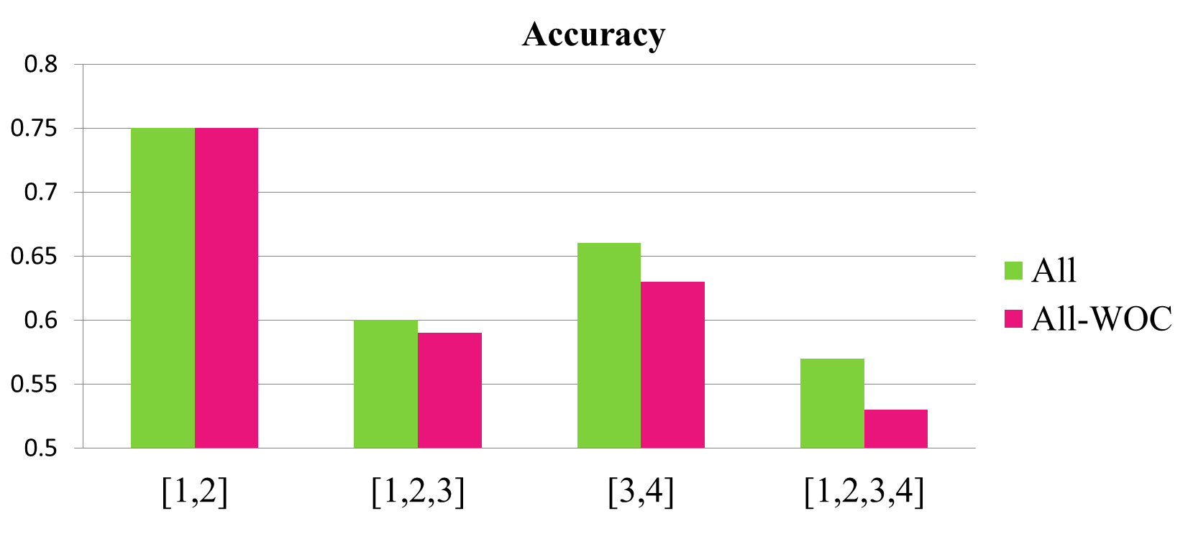

Slide 27
Future RTA Directions
New features and other scoring dimensions
Full automation
  extraction of topics and words
  spelling correction
Downstream applications for teachers and students

Slide 28
New NLP-Supported Directions
Additional measures of peer review quality
  Solutions to problems
  Helpfulness
  Impact on writing quality
Teacher dashboard (internal grant -> likely NSF DRK-12)
  Reviews
    Quality metrics (localization, solution, helpfulness)
    Topic-word analytics
    Review summarization
  Papers
    Revision behavior

Slide 29
Summing Up: Common Themes
NLP for supporting writing research at scale
  Learning science
  Educational technology
Many opportunities and challenges
  Characteristics of student writing
    Prior NLP software often trained on newspaper texts
  Model desiderata
    Beyond accuracy
  Interactions between NLP and Educational Technologies
    Robustness to noisy predictions
    Implicit feedback for lifelong computer learning

