Slide 1





Transforming
Limitations into Opportunities
Old-school teaching
Peer interaction
Reform teaching
??

Slide 2
SWoRD as the Context
Tested by > 27,000 users around the world:
  US (CA, WA, IA, KS, NC, TX, GA, FL, MD, PA, MA, NY), Canada, England, Netherlands, Estonia, Chile, Singapore, Korea, China
Used in:
  English Lit/Composition, History, Philosophy, Communications, Law, Linguistics, Women’s Studies
  Biology, Physics, Math, Statistics, Chemistry, Astronomy, Computer Science, Neuroscience, Engineering, Architecture, Pharmacy
  Psychology, Nursing, Medicine, Social Work, Education, Business, Accounting, Communication Disorders

Slide 3

https://sword.pantherlearning.com

Slide 4
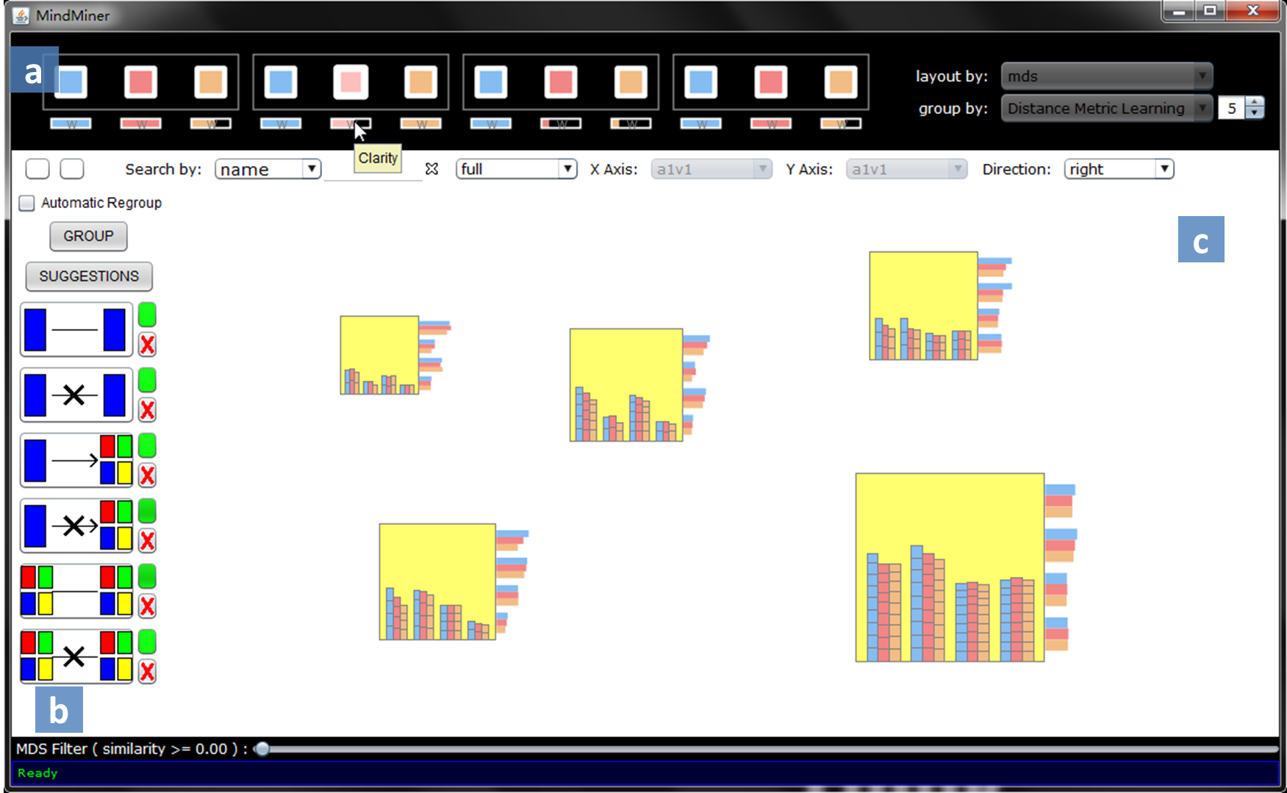
MindMiner
Internal Grant
(Ashley, Litman, Wang, Schunn)
Characterizing patterns across a class in:
  Comments (Litman)
  Performances (Wang)
  Revisions (Schunn&Ashley)

Slide 5
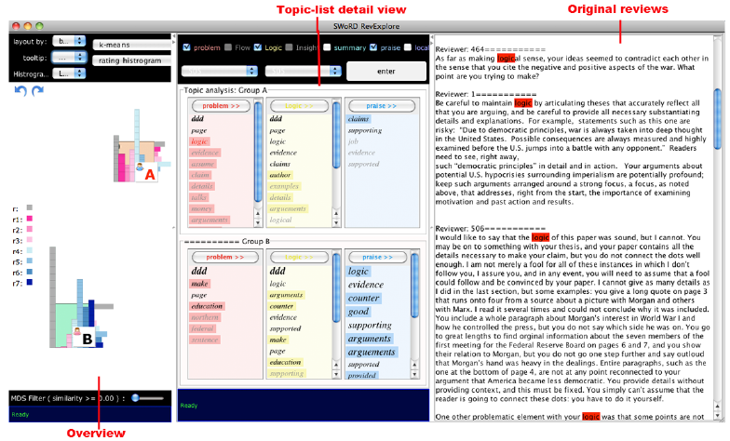
Internal Grant
(Ashley, Litman, Wang, Schunn)
Characterizing patterns across a class in:
  Comments (Litman)
  Performances (Wang)
  Revisions (Schunn&Ashley)

Slide 6
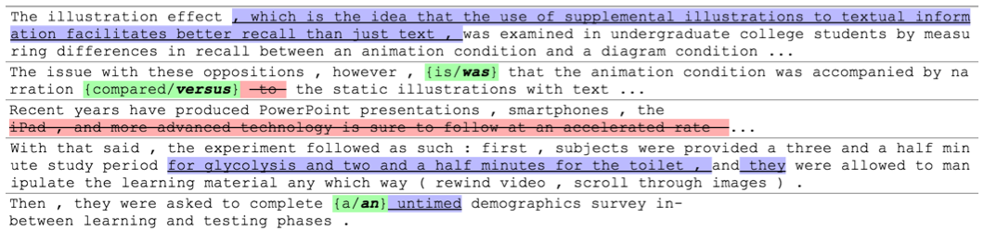
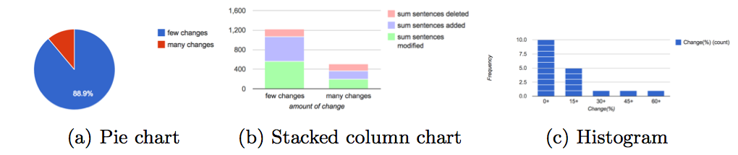
Internal Grant
(Ashley, Litman, Wang, Schunn)
Characterizing patterns across a class in:
  Comments (Litman)
  Performances (Wang)
  Revisions (Schunn&Ashley)

Slide 7
Internal Grant
(Ashley, Litman, Wang, Schunn)
NSF DR-K12
(Litman, Godley, Schunn)
Characterizing patterns across a class in:
  Comments (Litman)
  Performances (Wang)
  Revisions (Schunn&Ashley)
Teacher dashboard (capturing problems):
  Unhelpful comments, Poorly localized comments
  Low document dimensions
  Low accuracy dimensions
  Weak revisions

Slide 8
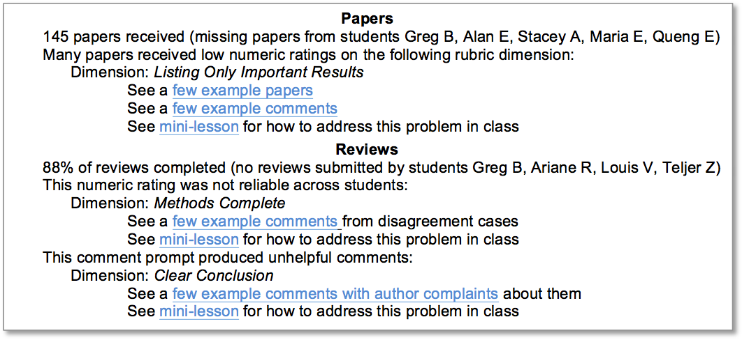
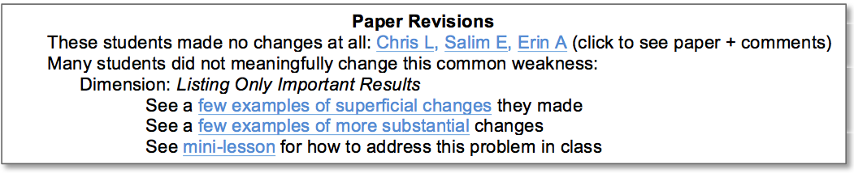
A teacher dashboard

Slide 9
Internal Grant
(Ashley, Litman, Wang, Schunn)
NSF DR-K12
(Litman, Godley, Schunn)
Characterizing patterns across a class in:
  Comments (Litman)
  Performances (Wang)
  Revisions (Schunn&Ashley)
Teacher dashboard (capturing problems):
  Unhelpful comments, Poorly localized comments
  Low document dimensions
  Low accuracy dimensions
  Weak revisions
Data-centric Teacher Resource Exchange
  Context markers
  Performance metrics

Slide 10
Internal Grant
(Ashley, Litman, Wang, Schunn)
NSF DR-K12
(Litman, Godley, Schunn)
Characterizing patterns across a class in:
  Comments (Litman)
  Performances (Wang)
  Revisions (Schunn&Ashley)
Teacher dashboard (capturing problems):
  Unhelpful comments, Poorly localized comments
  Low document dimensions
  Low accuracy dimensions
  Weak revisions
Data-centric Teacher Resource Exchange
  Context markers
  Performance metrics
Resources for teacher pathways
  Places to start; Early lessons; Advanced examples

