Slide 1
Interactive Dialogue Systems
Professor Diane Litman
Computer Science Department
& Learning Research and Development Center
University of Pittsburgh
Pittsburgh, PA USA

Slide 2

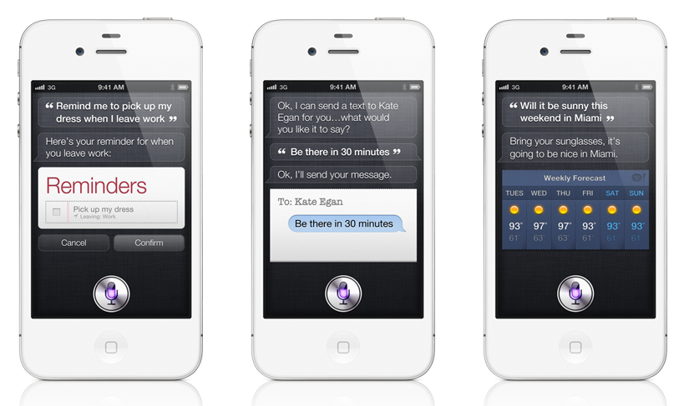

Slide 3
Interactive Dialogue Systems
Systems that can engage in extended human-machine conversations
Enabling technologies
  natural language processing (NLP)
  spoken language processing (SLP)
  (artificial intelligence)

Slide 4
Typical (Pipeline) Architecture
Speech
recognition
Natural language
understanding
Cloud,
database,
web,
smartphone,
etc.
Dialogue
manager
Text-to-speech
or recording
Natural language
generation

Slide 5
Assessment Opportunities
Utterance-level
  What a user says, and how a user says it
Dialogue-level
  Discourse structure, turn-taking, etc.

Slide 6
Utterance-level Assessment
The dialogue manager uses the assessments from the speech and natural language understanding components, in conjunction with an internal state representation, to decide what to do next (in real-time)

Slide 7
Example: Finite-State Dialogue Manager
States correspond to system utterances
Assessments of user utterances determine state transitions

Slide 8
Many Possible Assessment Dimensions
Syntactic
Semantic
Pragmatic
Prosodic
Etc.

Slide 9
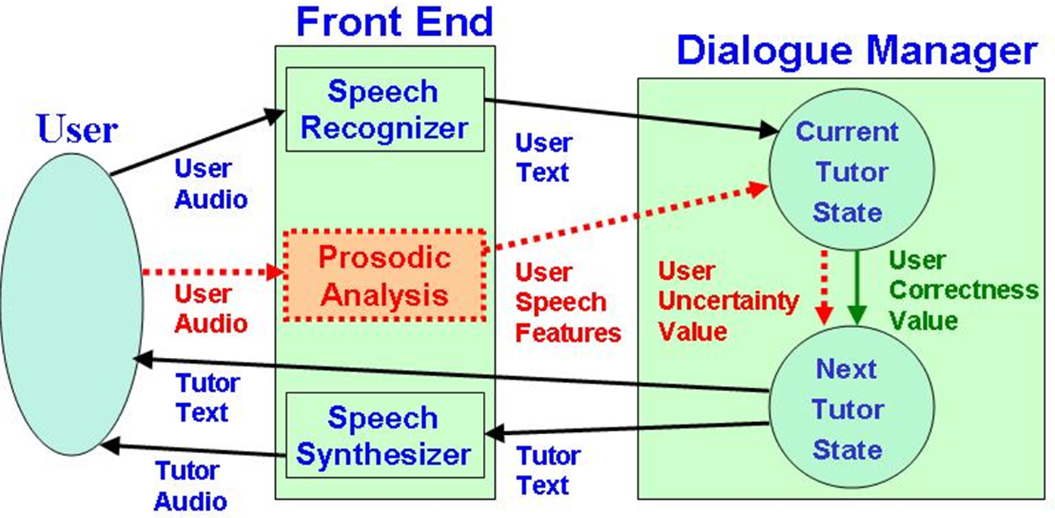
Example: ITSPOKE (Intelligent Tutoring Spoken Dialogue System)

Slide 10
Utterance-level Assessments:
Affective Semantic

Slide 11
Challenges of Interactive Dialogue
Example: Semantic assessment
Comparison with a reference answer (via NLP)
  lexical similarity
  paraphrase and entailment
  on or off-topic
Similar to short-answer scoring, but…

Slide 12
Challenges (continued)
Dialogue systems typically assign a label corresponding to an allowable state transition, rather than a numerical score
  e.g., correct, partially correct, wrong
User answers are often more spontaneous and unconstrained, making them harder to process

Slide 13
Challenges (continued)
Real-time constraints also eliminate the use of certain speech and language technologies
Confidence and belief information can often compensate for noisy assessments
Some behaviors only occur in interactive dialogue

Slide 14
Dialogue-level Assessment
Involves multiple utterances of the dialogue for analysis, and reflects the fact that dialogue is a joint activity
  e.g. topical coherence, forward and backward-looking dialogue acts, turn-taking, grounding, etc.
  appropriate use of explicit linguistic markers
Can be used for real-time system operation, but also for post-hoc evaluation of the system and/or user’s conversational abilities

Slide 15
Opportunity
Goal: assess the dialogue abilities of humans from their interactions with dialogue systems
Method: adapt current evaluation paradigms

Slide 16
Challenges
Unlike utterance assessment, no reference answer
Conversations with computers (versus humans) differ due to technology limitations
Current evaluation methods (next slides) were designed for purposes other than assessment
  building better dialogue systems; corpus queries
  ranking (rather than scoring) is often sufficient and more accurate

Slide 17
Evaluating Spoken Dialogue Systems
Develop predictive models of user satisfaction from dialogue-level factors
  Task success
  Dialogue efficiency (turns, minutes, etc.)
  Dialogue quality (response time, repair ratio, etc.)

Slide 18
Evaluating Computer Simulations of Human Users
Rate/rank dialogues using automatic measures
  High-level dialogue features (number of turns, words)
  Dialogue style/cooperativeness (dialogue act distributions)
  Task success/efficiency
  Speech recognition quality (rejections, confidence scores)
  User dialogue behavior (barge-ins, help requests)

Slide 19
Is Dialogue 1 > Dialogue 2?
Dialogue 1: Example dialog with a human user
ITSPOKE: The best law of motion to use is Newton’s third law. Do you recall what it says?
Student: In free fall there is an equal and opposite force.
ITSPOKE: Newton’s third law says that every force has an equal and opposite reaction force. If you hit the wall harder, is the force of your fist acting on the wall greater or less?
Dialogue 2: Example dialogue with a computer simulation
ITSPOKE: The best law of motion to use is Newton’s third law. Do you recall what it says?
Student: More.
ITSPOKE: Newton’s third law says ...

Slide 20
Summary
The use of speech and language technologies to assess spoken interactive dialogue, both now and in the future
  Utterance versus dialogue-level assessment
  Opportunities as well as challenges

Slide 21
Thank You!
Questions?
Further information
  www.cs.pitt.edu/~litman

