Slide 1

Context-aware Argument Mining and Its Application in Education
University of Pittsburgh, April 14, 2017
Huy Nguyen
PhD Dissertation Defense
Committee
Dr. Diane Litman (dissertation advisor), Computer Science Department
Dr. Rebecca Hwa, Computer Science Department
Dr. Adriana Kovashka, Computer Science Department
Dr. Kevin Ashley, Law School

Slide 2


A Not-very-short Introduction

Slide 3
A brief history of argument mining
Argumentation structure in essays
Argument in product reviews
[Stab & Gurevych., 2014]
[Wyner et al., 2012]
Claim and evidence extraction in Wikipedia
End-to-end argument mining in essays
[Levy et al., 2014]
[Persing & Ng, 2016]
[Stab & Gurevych, 2016]
Argumentative discourse analyzer
Argument acceptability in online debate
Argumentation structure in short texts
[Burstein et al., 2003]
[Cabrio & Villata, 2012]
[Peldszus & Stede, 2015]
Argumentative zoning
Argument detection in legal texts
Support verifiability in user comments
[Teufel, 1999]
[Moens et al., 2007]
[Park & Cardie., 2014]

Slide 4
Structured vs. abstract argumentation theories
Abstract argumentation
  Argument as a primary element without internal structure
  Study relation between arguments for argument acceptability
Structured argumentation
  Argument components and their interactions
  Typically employed in argument mining in texts
    Models textual representation of arguments
  Argument component types: premise/evidence, claim/conclusion

Slide 5
What is argument mining?
“[…] the automatic discovery of an argumentative text portion, and the identification of the relevant components of the argument presented there.”
An argument consists of a non-empty set of premises supporting a conclusion
Argument component: argumentative discourse unit (ADU)
  E.g., text segment, sentence, clause
[Peldszus & Stede, 2013]

Slide 6
Argument mining tasks
Argument component identification
  Separates argumentative from non-argumentative text units
  Recognizes the boundaries of argument components
⁽¹⁾[Taking care of thousands of citizens who suffer from disease or illiteracy is more urgent and pragmatic than building theaters or sports stadiums]. ⁽²⁾As a matter of fact, [an uneducated person may barely appreciate musicals], whereas [a physical damaged person, resulting from the lack of medical treatment, may no longer participate in any sports games]. ⁽³⁾Therefore, [providing education and medical care is more essential and prioritized to the government].

Slide 7
Argument mining tasks (2)
Argument component classification
  Labels argument components with their argumentative roles
  E.g., premise, claim
⁽¹⁾[Taking care of thousands of citizens who suffer from disease or illiteracy is more urgent and pragmatic than building theaters or sports stadiums]_{Claim}. ⁽²⁾As a matter of fact, [an uneducated person may barely appreciate musicals]_{Premise}, whereas [a physical damaged person, resulting from the lack of medical treatment, may no longer participate in any sports games]_{Premise}. ⁽³⁾Therefore, [providing education and medical care is more essential and prioritized to the government]_{Claim}.

Slide 8
Argument mining tasks (3)
Argumentative relation classification
  Recognizes if two argument components are argumentatively related or not
  Identifies argumentative functions of the relations, e.g., support, attack
⁽¹⁾[Taking care of thousands of citizens who suffer from disease or illiteracy is more urgent and pragmatic than building theaters or sports stadiums]_{Claim}. ⁽²⁾As a matter of fact, [an uneducated person may barely appreciate musicals]_{Premise}, whereas [a physical damaged person, resulting from the lack of medical treatment, may no longer participate in any sports games]_{Premise}. ⁽³⁾Therefore, [providing education and medical care is more essential and prioritized to the government]_{Claim}.
Premise(2.1) supports Claim(1)
Premise(2.1) supports Claim(3)
Premise(2.2) supports Claim(1)
Premise(2.2) supports Claim(3)
Claim(3) supports Claim(1)

Slide 9
Argument mining tasks (4)
Argumentation structure identification
  Constructs the graphical representation (i.e., tree) of arguments in which edges are direct attachments between argument components
Claim(1)
⁽¹⁾[Taking care of thousands of citizens who suffer from disease or illiteracy is more urgent and pragmatic than building theaters or sports stadiums]_{Claim}. ⁽²⁾As a matter of fact, [an uneducated person may barely appreciate musicals]_{Premise}, whereas [a physical damaged person, resulting from the lack of medical treatment, may no longer participate in any sports games]_{Premise}. ⁽³⁾Therefore, [providing education and medical care is more essential and prioritized to the government]_{Claim}.
Premise(2.1) supports Claim(1)
Premise(2.1) supports Claim(3)
Premise(2.2) supports Claim(1)
Premise(2.2) supports Claim(3)
Claim(3) supports Claim(1)
Claim(3)
Premise (2.1)
Premise (2.2)

Slide 10
Context is crucial for resolving ambiguity
Example 1: It helps relieve tension and stress… Exercising improves self esteem and confidence.
Coreference resolution
Example 2: People who are addicted to games, especially online games, can eventually bear dangerous consequences…
Although it is undeniable that computer is a crucial part of human life, it still has its bad side
Topic context
Context-aware
Example 3: Firstly, pictures can influence the way people think. For example, nowadays horrendous images are displayed on the cigarette boxes to illustrate the consequences of smoking. As a result, statistics show a slight reduction in the number of smokers, indicating that they realize the effects of the negative habit.
Example 3: Firstly, pictures can influence the way people think. For example, nowadays horrendous images are displayed on the cigarette boxes to illustrate the consequences of smoking. As a result, statistics show a slight reduction in the number of smokers, indicating that they realize the effects of the negative habit.
Local context

Slide 11
Contextual features in prior studies
Features extracted from surrounding sentences
  Words, POS
  Prediction labels of preceding/following components
  Cosine similarity with the topic sentence
Processed textual input isolatedly
  Component classification: sentences, clauses
  Relation classification: pairs of sentences and/or clauses
  Did not investigate semantic relations between context sentences
⁽¹⁾Firstly, pictures can influence the way people think.
⁽²⁾For example, nowadays horrendous images are displayed on the cigarette boxes to illustrate the consequences of smoking.
⁽³⁾As a result, statistics show a slight reduction in the number of smokers, indicating that they realize the effects of the negative habit.

Slide 12
Context-aware argument mining
Writing topics/prompts as an supervision to sublanguage identification
  Argument and domain word extraction
  Topic context (global)
Surrounding text as a context-rich representation of the argument component
  Window context (local)
Hypothesis
  Argument mining can be improved w.r.t prediction performance by considering contextual information at both local and global levels when developing prediction features
⁽¹⁾Firstly, pictures can influence the way people think.
⁽²⁾For example, nowadays horrendous images are displayed on the cigarette boxes to illustrate the consequences of smoking.
⁽³⁾As a result, statistics show a slight reduction in the number of smokers, indicating that they realize the effects of the negative habit.

Slide 13
Application in education
Argumentation and argumentative writing receive increasing attention
  Key focuses of Common Core Standard
  Standardized tests, academic content courses
Existing automated scoring systems only considers grammar, vocabulary, mechanics, discourse structure
  A demand for “argumentation-aware” automated writing evaluation systems
Emerging attention to evaluating argument aspect of essays
  Thesis clarity, evidence use , critical question, argument strength
[Beigman Klebanov et al., 2016]
[Persing & Ng, 2013]
[Rahimi & Litman, 2014]
[Song et al., 2014]
[Persing & Ng, 2015]

Slide 14

Persuasive essay writing rubrics
TOEFL iBT Independent Writing
    “is well organized and well developed, using clearly appropriate explanations, exemplifications and/or details”
Kaggle ASAP: automated student assessment prize
    “Has fully elaborated reasons with specific details”
Research Methods classes at Pitt
    “Brief high-level overview of study design and clear statement of hypotheses? Appropriate integration of conflicting research findings into a convincing argument for at least one hypothesis?”
…
Argument mining offers new capabilities that consider argumentation aspect
Derive features from output of argument mining models
Augment automated essay scoring systems
Enable automated writing feedback

Slide 15
Research hypotheses
H1-1: Proposed topic-context features improves argument component identification
H1-2: Proposed topic-context and segment-context features improves argumentative relation classification
H2: Prediction output of our argument mining models help improve automated argumentative essay scoring

Slide 16
Corpora
Argument mining
  Persuasive essays: practice writings by ESL learners
  Academic essays: APA-style writings by college students
Automated essay scoring
  TOEFL11: real-test essays by ESL learners
  Kaggle ASAP essays: by 7 – 10 grade students
Corpora are widely different
  Data sizes, annotation schemes
  Writer expertise, writing fluency & quality
[Stab & Gurevych, 2014; 2016]
[Barstow et al., 2015]
[Blanchard et al., 2013]
[Automated Student Assessment Prize, https://www.kaggle.com/c/asap-aes]

Slide 17
Research outline
Context-aware argument component classification
  Argument and domain word extraction
Context-aware argumentative relation mining
  Context-window heuristics: window-size vs. text segmentation
Argumentation features for improving automated essay scoring
  Extrinsic evaluation of argument mining systems
  Cross-domain AES
Discussions and future work

Slide 18

Context-aware argument component classification

Slide 19
Introduction
Problem statement
  Given argument components (or argumentative sentences) as inputs, recognize their argumentative roles
  Assuming argument component boundaries are provided
Data
  Persuasive1 corpus: 90 persuasive essays by ESL leaners
  Academic corpus: 115 academic writing from College Psychology classes in 2014
Models
  Baseline: Stab & Gurevych, EMNLP 2014
  Proposed: Nguyen & Litman, ARGMINING 2015; FLAIRS 2016
[Stab & Gurevych, 2014]
[Barstow et al., 2015]

Slide 20
Data summary
Persuasive1 corpus: 90 essays
Academic corpus: 115 essays
Argumentative label | #instances
MajorClaim | 90 | (4.8%)
Claim | 429 | (22.8%)
Premise | 1033 | (55.0%)
Non-argumentative | 327 | (17.4%)
Total | 1879 | (100%)
Argumentative label | #sentences
Hypothesis | 185 | (5.6%)
Finding | 131 | (4.0%)
Non-argumentative | 2998 | (90.4%)
Total | 3314 | (100%)
Cohen’s kappa = 0.79
Krippendorff’s α_{U} = 0.72
⁽²⁾Although these studies demonstrate the bystander effect and diffusion of responsibility, other studies oppose these ideas. ⁽³⁾One strong study that opposes the bystander effect was done in 1980 by Junji Harada that showed that increase in group size, even in a face to face proximity, did not decrease the likelihood of being helped (Harada, 1980)_{Finding(Opposition)}. … ⁽⁴⁾The hypothesis, based on the bystander effect demonstrated in Wegner’s study (1978), is that with more people around, less people will take the time to help the girl pick up her papers (Wegner, 1978) _{Hypothesis}.
My view is that the government should give priorities to invest more money on the basic social welfares such as education and housing instead of subsidizing arts relative programs_{MajorClaim}.
Art is not the key determination of quality of life, but education is_{Claim}. In order to make people better off, it is more urgent for governments to commit money to some fundamental help such as setting more scholarships in education section for all citizens_{Premise}.

Slide 21
Baseline model (Stab14)
Lexical features
  1-, 2-, 3-grams
  Verbs, adverbs, presence of modal verb
  Discourse connectives, singular first person pronouns
Syntactic features:
  Production rules, e.g., VP → VBG NP
  Tense of main verb
  Number of subclauses, depth of parse tree
Structural features
  Numbers of tokens, punctuations
  Sentence and paragraph positions
Contextual features:
  Preceding and following sentences
  Numbers of tokens, punctuations, subclauses, and presence of modal verb

Slide 22
Limitation of prior studies
Large and sparse feature space by n-grams and production rules
  Model argumentative discourse, but have much noise
  Feature selection helps, but still not efficient
Indicator features are effective but have limited coverage
  Stab & Gurevych used 55 discourse connectives
Sublanguage identification has not been applied to argument mining
  Separation of organizational content (shell) from topical content
  Offer a better possibility to model argumentative discourse
    Argument words vs. domain words
[Stab & Gurevych, 2014]
[Mochales & Moens, 2008]
[Madnani et al., 2012]
[Du et al., 2014]
[Seaghdha & Teufel, 2014]

Slide 23
Sublanguage identification in argumentative texts
Shell language vs. content
  Shell: sequence of words providing organization framework for an argument
  Supervised sequence model to determine shell boundaries
Rhetorical language model
  Word probabilities in a document-specific topic model or a rhetorical language model
  Unsupervised probabilistic topic model based on LDA
[Madnani et al., 2012]
Example: The argument states that based on the result of the recent research, there probably were grizzly bears in Labrador… There is a possibility that they were a third kind of bear apart from black and grizzly bears.
[Seaghdha & Teufel, 2014]
Example: Many algorithms that compare protein structures can reveal similarities that suggest related biological functions, even at great evolutionary distances. Proteins with related function often exhibit differences in binding specificity, but few algorithms identify structural variations that effect specificity.

Slide 24
Proposed argument and domain word extraction
[Nguyen & Litman, 2015]
Argument words: words that signal the argumentative content, and are commonly used across different argument topics
  E.g., believe, view, should
Domain words: specific terminologies commonly used within the topic domain
  E.g., education, art
Enable novel features for argument mining models
Example: My view is that the government should give priorities to invest more money on the basic social welfares such as education and housing instead of subsidizing arts relative programs.

Slide 25
Extraction algorithm
Requires a large essay set with writing prompts
Starts with argument keyword set
  Manually pre-selected
  Domain seed words = prompt words – argument keywords – stop words
  In-prompt frequency of domain seed words
Post-processes LDA output
  LDA topics approximate writing topics but not completely
  Identify LDA of argument words and maximize its difference from other LDA topics
  Weight of LDA topic = #argument keywords – Σ frequencies of domain seed words
  Argument word list is the LDA topic with the largest weight

Slide 26
Development data for AD word extraction
Persuasive development set
  6794 unannotated essays from essayforum.com
  10 argument key words
    Most frequent in prompts
    agree, disagree, reason, support, advantage, disadvantage, think, conclusion, result, opinion
  3077 domain seed words
Output (best k = 36)
  263 argument words
  1806 domain words
Academic development set
  254 unannotated essays from classes in 2011 and 2013
  5 argument key words
    Specified in writing assignment
    hypothesis, support, opposition, finding, study
  264 domain seeds
Output (best k = 11)
  315 argument words
  1582 domain words
k: number of LDA topics

Slide 27
Example argument and domain words
Persuasive Set
Topic 1: reason example support agree think because disagree statement opinion believe therefore idea conclusion …
Topic 2: city live big house place area small building apart town community factory urban …
Topic 3: children parent school education teach kid adult grow childhood behavior taught …
Academic Set
Topic 1: study research observe result hypothesis time finding however predict support expect opposition …
Topic 2: response stranger group greet confederate individual verbal social size people sneeze …
Topic 3: more gender women polite female male men behavior differ prosocial express gratitude …
Only top words for each LDA topic are shown
Topic 1 is the argument word list

Slide 28
Proposed models
Nguyen15v2: Nguyen & Litman (2015) without argument and domain word counts
  Replaces generic n-gram and production rules with AD word features
wLDA+4: Nguyen & Litman (2016a)
  Introduces new features to model argument indicators and abstract over writing topics
Ablated models
  Evaluate the contribution of AD word extraction
  woLDA
    Disables argument/domain word-based features in wLDA+4
  Seed
    Replaces extracted AD words with argument keywords and domain seed words

Slide 29

Model summary
Stab14 (Stab & Gurevych 2014b)
Nguyen15v2
wLDA+4
1-, 2-, 3-grams
Argument words as unigrams
Nguyen15v2
Lexical
(I)
Verbs, adverbs, presence of model verb
Discourse connectives,
Singular first person pronouns
(I)
Same as Stab14
Numbers of common words with title and preceding sentence
Comparative & superlative adverbs and POS
Plural first person pronouns
Discourse relation labels
Parse
(II)
Production rules
Argumentative subject-verb pairs
Tense of main verb
#sub-clauses, depth of parse tree
(II)
Same as Stab14
Structure
(III)
#tokens, token ratio, #punctuation, sentence position, first/last paragraph, first/last sentence of paragraph
(III)
Same as Stab14
Context
(IV)
#tokens, #punctuation, #sub-clauses, modal verb in preceding/following sentences
(IV)

Slide 30

Experiment results
Stab14 performs worse then our two proposed models Nguyen15v2 and wLDA+4
Two ablated models are significantly worse than wLDA+4
10-fold cross validation
  SVM learning algorithm + Top 100 features ranked by InfoGain algorithm
[Stab & Gurevych, 2014]
 | Stab14 | Nguyen15v2 | woLDA | Seed | wLDA+4
Accuracy | 0.787* | 0.792* | 0.780* | 0.781* | 0.805
Kappa | 0.639* | 0.649* | 0.629* | 0.632* | 0.673
Precision | 0.741* | 0.745* | 0.746* | 0.740* | 0.763
Recall | 0.694* | 0.698* | 0.695* | 0.695* | 0.720
Persuasive1 Corpus
 | Stab14 | Nguyen15v2 | woLDA | Seed | wLDA+4
Accuracy | 0.934* | 0.942+ | 0.933* | 0.935* | 0.941
Kappa | 0.558* | 0.635 | 0.528* | 0.564* | 0.629
Precision | 0.804* | 0.830+ | 0.829 | 0.826 | 0.825
Recall | 0.628* | 0.695 | 0.594* | 0.637* | 0.695
Academic Corpus
*: p < 0.05, +: p < 0.1 in comparison with wLDA+4

Slide 31
Experiment results (2)
Cross-topic validation
Nguyen15v2 and wLDA+4 significantly outperform Stab14 and two ablated models
 | Stab14 | Nguyen15v2 | woLDA | Seed | wLDA+4
Accuracy | 0.780* | 0.796 | 0.774* | 0.776* | 0.807
Kappa | 0.623* | 0.654+ | 0.618* | 0.623* | 0.675
Precision | 0.722* | 0.757* | 0.751 | 0.734 | 0.771
Recall | 0.670* | 0.695* | 0.681* | 0.686* | 0.722
Persuasive1 Corpus
12 groups
 | Stab14 | Nguyen15v2 | woLDA | Seed | wLDA+4
Accuracy | 0.928* | 0.939+ | 0.931* | 0.935* | 0.944
Kappa | 0.491* | 0.598+ | 0.474* | 0.547* | 0.630
Precision | 0.768 | 0.832 | 0.866 | 0.839* | 0.851
Recall | 0.565* | 0.664 | 0.551* | 0.617* | 0.686
Academic Corpus
5 groups

Slide 32
Summary
A novel semi-supervised algorithm to extract argument and domain words from argumentative essays
Propose to use extracted argument and domain words as features and constraints
  Efficiently replace generic n-grams and production rules for better performance
New features to model argument indicators and abstract over writing topics
  Improve cross-topic performance
The results prove strongly our first hypothesis H1-1
  Proposed topic-context features improve argument component classification

Slide 33
Context-aware argumentative relation mining

Slide 34
Introduction
Problem statement
  Given a pair of source and target argument components, determine whether a relation holds from the source to the target and classify the argumentative function of the relation
Data
  Persuasive1 corpus
    Does not consider cross-paragraph pairs
    Pairs are classified as Support vs. Not-support
  Academic corpus
    Relations are annotated regardless paragraph boundaries
    Pairs are classified as Support vs. Opposition vs. None
Models
  Baseline: Stab14
  Proposed: Nguyen & Litman, ACL 2016

Slide 35
Data summary
Persuasive1 corpus
6330 ordered pairs
  Support vs. Not-support
  Source and target are in the same paragraph
Academic corpus
834 ordered pairs
  Support vs. Opposition vs. No-relation
  No paragraph constraint
Label | #pairs
Support | 989 | (16%)
Not-support Attack No-relation | 5341 103 5238 | (84%) (2%) (82%)
Total | 6330 | (100%)
Label | #pairs
Support | 50 | (6%)
Opposition | 82 | (10%)
No-relation | 702 | (84%)
Total | 834 | (100%)
Cohen’s kappa = 0.67
Krippendorff’s α = 0.81

Slide 36
Baseline model (Stab14)
Lexical features
  Pairs of words (from source and target), pair of first words
  Number of words in common, presence of modal verb
Syntactic features:
  Production rules, e.g., VP → VBG NP
Structural features
  Numbers of words in source and target, word count difference
  Sentence positions of source and target, position difference
  Whether source and target are first or last sentences of paragraph
  Does target occurs before source
Indicator features
  If source and target starts with a discourse connective
Predicted type features
  Predicted argumentative labels of source and target components
Sentence …
Sentence 1: Firstly, picture can influence the way people think.
Target
Sentence 2: For example, nowadays horrendous images are displayed on the cigarette boxes to illustrate the consequences of smoking.
Sentence 3: As a result, statistics show a slight reduction in the number of smokers, indicating that they realize the effects of the negative habit.
Source
Sentence …

Slide 37
Limitation of prior studies
Depended on heavy features, e.g., word pairs, production rules
  To be replaced by our proposed features
Topic-based features were not yet explored
  Widely used for argument component classification
Contextual features were used limitedly
  Words and POS in adjacent sentences
Single-sentence inputs limit the use of sematic relation features
  Semantic similarity and textual entailment between sentence sets
  Discourse relations between the input and its surrounding text
[Levy et al., 2014]
[Nguyen & Litman, 2016]
[Peldzus & Stede, 2015]
[Brian & Rambow, 2011]
[Cabrio & Villata, 2012]
[Boltuzic & Snajder, 2014]

Slide 38
Proposed contextual features
Topic-context features (global context)
  Exploit argument and domain word lexicons
  Model topically-related words
    Domain words that share LDA topic(s)
Window-context features (local context)
  Group argument component with its adjacent sentences
  Model content-relatedness by semantic relations
    Discourse relations
    Semantic textual similarity
    Textual entailment
People who are addicted to games, especially online games, can eventually bear dangerous consequences…
Although it is undeniable that computer is a crucial part of human life, it still has its bad side
⁽¹⁾Firstly, pictures can influence the way people think. ⁽²⁾For example, nowadays horrendous images are displayed on the cigarette boxes to illustrate the consequences of smoking. ⁽³⁾As a result, statistics show a slight reduction in the number of smokers, indicating that they realize the effects of the negative habit.

Slide 39
Proposed topic-context features
[Nguyen & Litman, 2016b]
Argument word features:
  Argument words in source and target, pairs of argument words
  Number of argument words in common, argument word count difference
Domain word features:
  Number of domain words in common, domain word count difference
  Number of domain word pairs that share LDA topic(s), pairs that share no LDA topic
Dependency parse features:
  MainVerb-Subject dependency triples, e.g., nsubj(believe, I)

Slide 40
Proposed context-window framework
[Nguyen & Litman, 2016b]
Definition: Context-window of argument component
  Text segment formed by neighboring sentences and the component itself
  The neighboring sentences (context sentences) must be in the same paragraph
Context-window formation
  Window-size heuristic
    With half-size = n, form a window of size 2n at most
  Text segmentation heuristic
    Context window consists of sentences of the same paragraph and segment output of a text segment program
Overlap resolution
  Overlapping context sentences are assigned to source window

Slide 41
Context-window example
Sentence…
Target
Sentence 1: Firstly, picture can influence the way people think.
Sentence 2: For example, nowadays horrendous images are displayed on the cigarette boxes to illustrate the consequences of smoking.
Component
Sentence 3: As a result, statistics show a slight reduction in the number of smokers, indicating that they realize the effects of the negative habit.
Source
Sentence…

Slide 42
Context-window features
[Nguyen & Litman, 2016b]
Word count
  Number of words in common of covering sentences of source and target with preceding and following context sentences
Discourse relation
  Discourse relations between context sentences, and within covering sentences of source and target
  Discourse relation between each pair of source and target sentences
Discourse marker
  Whether a discourse marker is present before the covering sentence or not
Discourse features are enabled by PDTB and RST parsers
[Ji & Eisenstein, 2014]
[Wang & Lan 2015]

Slide 43
Proposed sematic relation features
Semantic textual similarity (STS) features
  STS score between source and target sentences
  Max STS score among pairs of source and target context sentences
    STS score between each source context sentence and target sentence
    STS score between each target content sentence and source sentence
Textual entailment (TE) features
  TE score between source and target sentences
  TE score between source context window and target sentence
  Max TE score among pairs of source context sentences and target sentence
Context-window enables aggregating score features for better performance

Slide 44

Model summary
TOPIC
Common features (features in common among models)
  Baseline features except word pairs and production rules
TOPIC, WINDOW and COMBINED
  To evaluate Topic-context and Window-context features in isolation and combination
FULL model takes all features together
Common features
BASELINE
COMBINED
COMBINED+REL
Topic context features
Common features
Common features
Common features
Word pairs + Production rules
Topic context features +
Window context features
Topic context features +
Window context features +
Semantic relation features
WINDOW
Common features
Window context features

Slide 45
Experiment results in Persuasive1 corpus
Data split: 80% training and 20% test
  Compare with reported results in the prior study
Window-size heuristic with best half-size = 3
  Determined through cross-validation in training set
[Stab & Gurevych, 2014]
Combining Topic-context and Window-context features yields the best results
 | Reported | BASELINE | TOPIC | WINDOW | COMBINED (half-size = 3)
Accuracy | 0.863 | 0.869 | 0.857 | 0.857 | 0.870
F1 | 0.722 | 0.722 | 0.703 | 0.724 | 0.753*
Precision | 0.739 | 0.758 | 0.728 | 0.729 | 0.754
Recall | 0.705 | 0.699 | 0.685 | 0.720 | 0.752*
F1:Support | 0.519 | 0.519 | 0.488 | 0.533 | 0.583*
F1:Not-support | 0.920 | 0.925 | 0.917 | 0.916 | 0.923
*: p < 0.05 in comparison with Baseline. Values smaller than baseline are underlined. Best values are in boldface.

Slide 46
Experiment results in Academic corpus
10x5-fold cross validation
Window size heuristic with half-size = 1
  No half-size optimization due to small data
All 3 proposed models significantly outperform BASELINE
 | BASELINE | TOPIC | WINDOW | COMBINED (half-size = 1)
Accuracy | 0.828 | 0.823* | 0.819* | 0.829
F1 | 0.493 | 0.540* | 0.521* | 0.553*
Precision | 0.529 | 0.560* | 0.536* | 0.575*
Recall | 0.472 | 0.525* | 0.510* | 0.536*
F1:Support | 0.260 | 0.399* | 0.300* | 0.405*
F1:Opposition | 0.307 | 0.317 | 0.360* | 0.344*
F1:No-relation | 0.912 | 0.904* | 0.904* | 0.909*

Slide 47
Model performance with text segmentation heuristic
Compare COMBINED’s performance with two heuristics for context-window
  10x5-fold cross validation
  Text segmentation: Bayesian Topic Segmentation algorithm
  Window-size heuristic with best half-size n
    n = 3 for Persuasive1 corpus
    n = 8 for Academic corpus
[Eisenstein & Barzilay, 2008]
Text seg. outperforms the best half-size in Persuasive1
but performs worse than half-size in Academic
 | Persuasive1 corpus |  | Academic corpus
 | COMBINED Half-size = 3 | COMBINED Text seg. | COMBINED Half-size = 8 | COMBINED Text seg.
Accuracy | 0.871 | 0.873* | 0.836* | 0.829
F1 | 0.743 | 0.746* | 0.571* | 0.545
Precision | 0.758 | 0.762* | 0.590* | 0.567
Recall | 0.731 | 0.734* | 0.556* | 0.530
*: p < 0.05

Slide 48
Model performance with semantic relation features
10x5-fold cross validation
Sematic relation features help improve performance with different base models
 | Persuasive1 corpus |  |  |  | Academic corpus
 | Half-size = 3 |  | Text segmentation |  | Half-size = 8 |  | Text segmentation
 | COMBINED | COMBINED + REL | COMBINED | COMBINED + REL | COMBINED | COMBINED + REL | COMBINED | COMBINED + REL
Accuracy | 0.871 | 0.872 | 0.873 | 0.873 | 0.836 | 0.837 | 0.829 | 0.833*
F1 | 0.743 | 0.745 | 0.746 | 0.747 | 0.571 | 0.573 | 0.545 | 0.556*
Precision | 0.758 | 0.759 | 0.762 | 0.762 | 0.590 | 0.593 | 0.567 | 0.578*
Recall | 0.731 | 0.733 | 0.734 | 0.735 | 0.556 | 0.558 | 0.530 | 0.540*

Slide 49
Summary
Proposed context-aware argumentative relation mining
  Makes use of contextual features from topic and context window
  Context windows enables aggregated semantic relation features for better performance
Proposed two heuristics for forming context windows
  Window-size is simple but needs size optimization
  Text segmentation shows promising result when it outperform window-size in persuasive essays
The results prove strongly our second hypothesis H1-2
  Proposed topic- and window-context features improve argumentative relation classification

Slide 50
Argumentation features for improving automated essay scoring

Slide 51
Introduction
Application of Argument Mining (AM) in Automated Essay Scoring (AES)
  End-to-end AM
  Impact of AM accuracy to AES performance
  Argumentation features for improving AES performance
AES data
  TOEFL11: real-test essays by ESL learners
  Kaggle ASAP essays: by 7 – 10 grade students
Argument mining models
  Base models: Stab & Gurevych, 2014
  Our proposed models
[Blanchard et al., 2013]
[Automated Student Assessment Prize, https://www.kaggle.com/c/asap-aes]

Slide 52
Prior studies
Argumentation features improve AES
  Input of AM is gold-standard argument components
  Simplified argumentative relation classification
  Word-count baseline
Argumentation features from output of end-to-end AM
  Insignificant improvement to a word-count baseline
Sequences of argument components as features
  Significantly improved an ngram baseline
  Trait score: organization, argument strength
[Ghosh et al., 2016]
[Beigman Klebanov et al., 2016]
[Wachsmuth et al., 2016]

Slide 53
Argument mining pipeline
ArgS: Stab & Gurevych 2014
ArgN: our proposed context aware AM
Stacked with a CRF model for argument component identification
CRF
ArgS vs. ArgN
ArgS vs. ArgN
Argument Component Identification
Argumentative vs. Not
Argumentative Relation Classification
as Support or Attack
Argument Component Classification
as Major Claim, Claim or Premise
“In conclusion, I would concede that city life has its own advantages. Nonetheless, peaceful atmosphere, friendliness of people, and green landscape strongly convince me that a small town is the best place for me to live in. I love the life in my town.”
Attack (Premise1, Claim)
Support (Premise2, Claim)
Premise1
Attack
Claim
Premise 1: city life has its own advantages
Premise 2: peaceful atmosphere, friendliness of people, and green landscape strongly convince me
Claim: a small town is the best place for me to live in
Support
Premise2

Slide 54
Argument component identification
Sentences are segmented into components
  Ex: “It’s true that technology and computers do make their jobs easier but it cannot definitely replace them.”
CRF model
  Structural: token position, punctuation, sentence position
  Syntactic: POS, lowest common ancestor, lexico-syntactic
  Conditional probability
  Argument/Domain words
[Stab & Gurevych, 2016]
[Proposed in our study]

Slide 55
Training data for AM pipelines
ArgS was trained following the original implementation
  Persuasive1 corpus with 90 essays
ArgN was trained with the new persuasive corpus
  Using the training set of 322 essays
CRF model was trained with the 322-essay set
[Stab & Gurevych, 2014]
[Stab & Gurevych, 2016]
Persuasive1 corpus
Persuasive2 corpus, training set
Class label | #instances
MajorClaim | 90 | (6%)
Claim | 429 | (28%)
Premise | 1033 | (66%)
Support | 989 | (16%)
Not-support | 5341 | (84%)
Essays | 90
Class label | #instances
MajorClaim | 598 | (12%)
Claim | 1202 | (25%)
Premise | 3023 | (53%)
Support | 2846 | (16%)
Not-support | 14404 | (84%)
Essays | 322

Slide 56

AES data
TOEFL11
  TOEFL test essays, written by ESL learners
  Essay grades were categorized: A, B, C
  TE107 set: 107 essays of two prompts
    Annotated for AM
Persuasive essays of Kaggle ASAP data
  Prompt 1: 1783 essays about good vs. bad effects of computers
  Prompt 2: 1800 essays about censorship in libraries
[Blanchard et al., 2013]
AM
AES
[Ghosh et al., 2016]

Slide 57
Study 1: AM accuracy
AM pipelines are tested on TE107 data
TE107 data
Test performance, input are true argument components. *: p < 0.05
Class label | #instances
MajorClaim | 105 | (9%)
Claim | 468 | (40%)
Premise | 603 | (51%)
Support | 507 | (11%)
Not-support | 4179 | (89%)
AM Pipeline | F1:MajorClaim | F1:Claim | F1:Premise | F1:Support | F1:Not-support
ArgS | 0.453 | 0.295 | 0.710 | 0.148 | 0.917
ArgN | 0.622* | 0.508* | 0.751* | 0.211* | 0.915
ArgN significantly outperforms ArgS
AM performance is greatly affected by the segmentation accuracy
Argument component identification
F1 | Precision | Recall | F1:B | F1:I | F1:O
0.578 | 0.575 | 0.591 | 0.436 | 0.757 | 0.540
Test performance, input are predicted argument components. *: p < 0.05
AM Pipeline | F1:MajorClaim | F1:Claim | F1:Premise | F1:Support | F1:Not-support
ArgS | 0.078 | 0.226 | 0.343 | 0.088 | 0.962*
ArgN | 0.156* | 0.258* | 0.404* | 0.126* | 0.947

Slide 58
Study 2: Impact of AM accuracy to AES performance
Extrinsically evaluate ArgS and ArgN in a AES tasks
  Te107 data
  10x10-fold cross-validation with Logistic Regression
  Report quadratic-weighted-kappa (qwk)
Features extracted from true argument components and argumentative relations
Hypothesis
  Feature from more accurate AM can predict essay score more accurately

Slide 59
Argumentation Feature Sets
 | Argumentation Feature sets
 | Argument Component Features (AC)
1, 2 3, 4 5 6 7 | Number and fraction of argument components over total number of sentences in essay Number and fraction of argumentative sentences Total number of words in argument components Number of paragraphs containing argument components Whether the essay has paragraph without any argument component
 | Argument Component Label Features (CL)
8 9, 10 11, 12 13 | Number of Major Claims Number and fraction of Claims over total number of sentences Number and fraction of Premises Average number of Premises per Claim
 | Argument Flow Features (AF)
14 15 16 17 – 24 | Number of paragraphs that contain Major Claims and Claims Number of paragraphs that contain Major Claims and Premises Number of paragraphs that contain Claims and Premises Frequency of 8 typed bigrams of argument components
 | Argumentative Relation Features (RL)
25 26 27 28 | Number of supported Claims Number of dangling Claims Number of supporting Premises Number of paragraphs that have support relations
 | Argumentation Structure Typology Features (TS)
29 30 31 32 33 | Number of Chain-structures Number of Tree-structures Number of Tree-structures with height = 1 Number of paragraphs that contain Chain-structures Number of paragraphs that contain Tree-structures
33 features in 5 categories
  from prior studies
  proposed in this study
[Persing & Ng, 2015]
[Wachsmuth et al., 2016]
[Ghosh et al., 2016]
[Beigman Klebanov et al., 2016]

Slide 60
Argument flow features
[Wachsmuth et al., 2016]
Sequence of typed components
  Ex: Claim – Premise – Premise
Bigrams of typed components
3 types of components
We use 8 bigrams
  Major Claim – Major Claim is ignored
My view is that the government should give priorities to invest more money on the basic social welfares such as education and housing instead of subsidizing arts relative programs_{MajorClaim}.
Art is not the key determination of quality of life, but education is_{Claim}. In order to make people better off, it is more urgent for governments to commit money to some fundamental help such as setting more scholarships in education section for all citizens_{Premise}. This is simply because knowledge and wisdom is the guarantee of the enhancement of the quality of people's lives for a well-rounded social system_{Premise}.

Slide 61
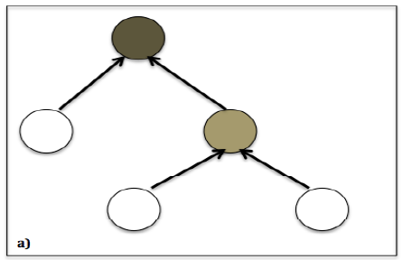
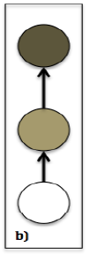
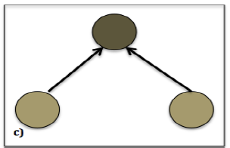
Argumentation structure typology features
[Ghosh et al., 2016]
Claims are linked with supporting premises
Classify 3 tree-like structures
Tree depth > 1
Chain
Tree depth = 1

Slide 62
Essay score prediction results (qwk)
Component-based features predict essay scores better than relation-based features
ArgN’s features perform better than ArgS’ features, except TS
10x10-fold cross validation
TrueLabel: argumentation features are extracted from true labels of components and relations
TE107 data statistics
Inputs of AM are true components. **: higher with p < 0.01, †: smaller with p < 0.01
#essays | 107
#prompts | 2
Low score (C) | 31
Medium score (B) | 36
High score (A) | 40
Feature set | AC | CL | AF | RL | TS | All
TrueLabel | 0.765 | 0.768** | 0.686 | 0.747** | 0.620** | 0.636
ArgN | 0.765 | 0.744 | 0.695 | 0.454 | 0.139 † | 0.608
ArgS | 0.765 | 0.729 † | 0.577 † | 0.423 † | 0.165 | 0.559 †
Inputs of AM are predicted components. **: p < 0.01, *: p < 0.05
Feature set | AC | CL | AF | RL | TS | All
ArgN | 0.716 | 0.633 | 0.512** | 0.312* | 0.057 | 0.536
ArgS | 0.716 | 0.603 | 0.423 | 0.259 | 0.189** | 0.514

Slide 63
Study 3: Improving AES with argumentation features
Base AES model
  Enhanced AI Scoring Engine (EASE)
  Features:
    Length: counts of words, characters, punctuations, average word length
    Prompt: count and fraction of words in commons with prompts
    Bag of words: unigrams, bigrams
    Part-of-speech: count and fraction of “good” POS sequences
Proposed model
  EASE augmented with argumentation features
Persuasive essays of Kaggle ASAP data
  Prompt 1: 1783 essays about good vs. bad effects of computers
  Prompt 2: 1800 essays about censorship in libraries
https://github.com/edx/ease. Top 3 of Kaggle ASAP competition (2012)

Slide 64
In-domain performance
5-fold cross validation with a stochastic gradient boosting classification algorithm
Results in [Phandi et al., 2015] are reported
Argumentation features help improve a competitive base AES model
Kaggle ASAP data statistics
*: significant difference from EASE (p < 0.05)
 | Essay set 1 | Essay set 2
#essays | 1783 | 1800
Average length | 350 | 350
Score range | 2–12 | 1–6
Median | 8 | 3
Feature set | Essay set 1 |  | Essay set 2
 | Kappa | QWK | Kappa | QWK
[Phandi et al., 2015] | n/a | 0.781 | n/a | 0.621
EASE | 0.316 | 0.792 | 0.463 | 0.663
ARG | 0.308 | 0.763 | 0.414 | 0.612
EASE + ARG | 0.328* | 0.797 | 0.475* | 0.676

Slide 65
Cross-domain AES
Domain adaptation in AES as a remedy for the lack of data
Different machine learning approaches have been proposed
  Correlated linear regression, automatic features using neural network
This study is not about domain adaptation
  But evaluates AM features in cross-domain settings
  Demonstrates the domain-independence characteristic of argumentation features
Cross-domain experiment
  Essay scores of source (training) domain are scaled to range [-1, 1]
  AES models are trained with new score range
  Predicted scores of target (test) domain are scaled to original range
Phandi et al., 2015
Dong & Zhang, 2016
Phandi et al., 2015

Slide 66
Cross-domain results
EASE in regression mode
Predicted scores are rounded to compute Kappa measures
Experiment with different feature combinations for an upper-bound performance
  Set 1→2: EASE + AC + CL + TS
  Set 2→1: EASE + AC + RL + TS
Argumentation features help improve cross-domain performance
Both component-based and relation-based features show up in the best combination
Feature set | Set: 1→2 |  | Set: 2→1
 | Kappa | QWK | Kappa | QWK
[Phandi et al., 2015] | n/a | 0.545 | n/a | n/a
[Dong & Zhang, 2016] | n/a | 0.569 | n/a | n/a
EASE | 0.234 | 0.585 | 0.048 | 0.491
EASE + ARG | 0.298 | 0.622 | 0.049 | 0.493
Our best | 0.336 | 0.649 | 0.053 | 0.529

Slide 67
Summary
This study brings up a strong proof of application of argument mining in AES
  Output of end-to-end argument mining for improving holistic score prediction in persuasive essay
  The largest argumentation feature set have ever been studied
  A competitive AES model as the baseline
  In- and cross-domain evaluations
Extrinsic evaluation of AM models using AES task
  Argumentation features of more accurate AM model can predict essay scores more accurately

Slide 68
Conclusions and future work

Slide 69
Contribution summary
Novel contextual features for improving argument mining
  Algorithm for argument and domain word extraction
  Context-window framework
Extensive studies on improving automated essay scoring with argument mining output
  Extrinsic evaluation of argument mining systems
  Comprehensive analysis of a large set of argumentation features
  In- and cross-domain validation of AES
AM and AES models are evaluated comprehensively for strongest proofs
  Cross-fold, cross-topic, end-to-end validation
  Different corpora, annotation schemas, writing fluency and quality

Slide 70
Future work
Improve and compare our AD extraction algorithm with related work
  Lexicon quality, impact on argument mining
Implement joint-prediction of argument components and argumentative relations
  Advantage of mutual-information between the two problems
  Successes proved in prior studies
Deploy and expand our research
  Automated assessment of argumentative writing in peer-review/tutoring systems
  Application in different text genres, e.g., user comments, online debates

Slide 71

Thank you!

Slide 72

Back-ups

Slide 73
Abstract argumentation example
(A1) The use of cell-phones while driving is a public hazard.
(A2) Research shows that drivers speaking on a mobile phone have much slower reactions in braking tests than non-users, and are worse even than if they have been drinking.
A2
(A3) Regulation could negate the safety benefits of having a phone in the car. When you’re stuck in traffic, calling to say you’ll be late can reduce stress and make you less inclined to drive aggressively to make up lost time.
A4
A3
A1
(A4) If one is late, there is little difference in apologizing while in their car over a cell phone and apologizing in front of their boss at the office. So, they should have the restraint to drive at the speed limit, arriving late, and being willing to apologize then; an apologetic cell phone call in a car to a boss shouldn’t be the cause of one being able to then relax, slow-down, and drive the speed-limit.
[Cabrio & Villata, 2012]

Slide 74
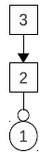
Structured argumentation example
⁽¹⁾[We should tear the building down.] ⁽²⁾[On the other hand, many people liked the view from the roof.] ⁽³⁾[On weekends in summer, the roof is usually crowded with sunset partygoers.]
[Peldzus & Stede, 2013]

Slide 75
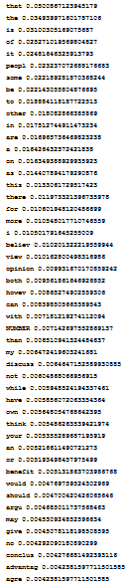
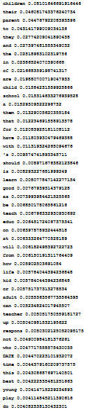
LDA topics vs. writing topics
believe
children
music
view
parent
art
…
opinion
school
creative
however
learn
talent
discuss
teach
idea

Slide 76
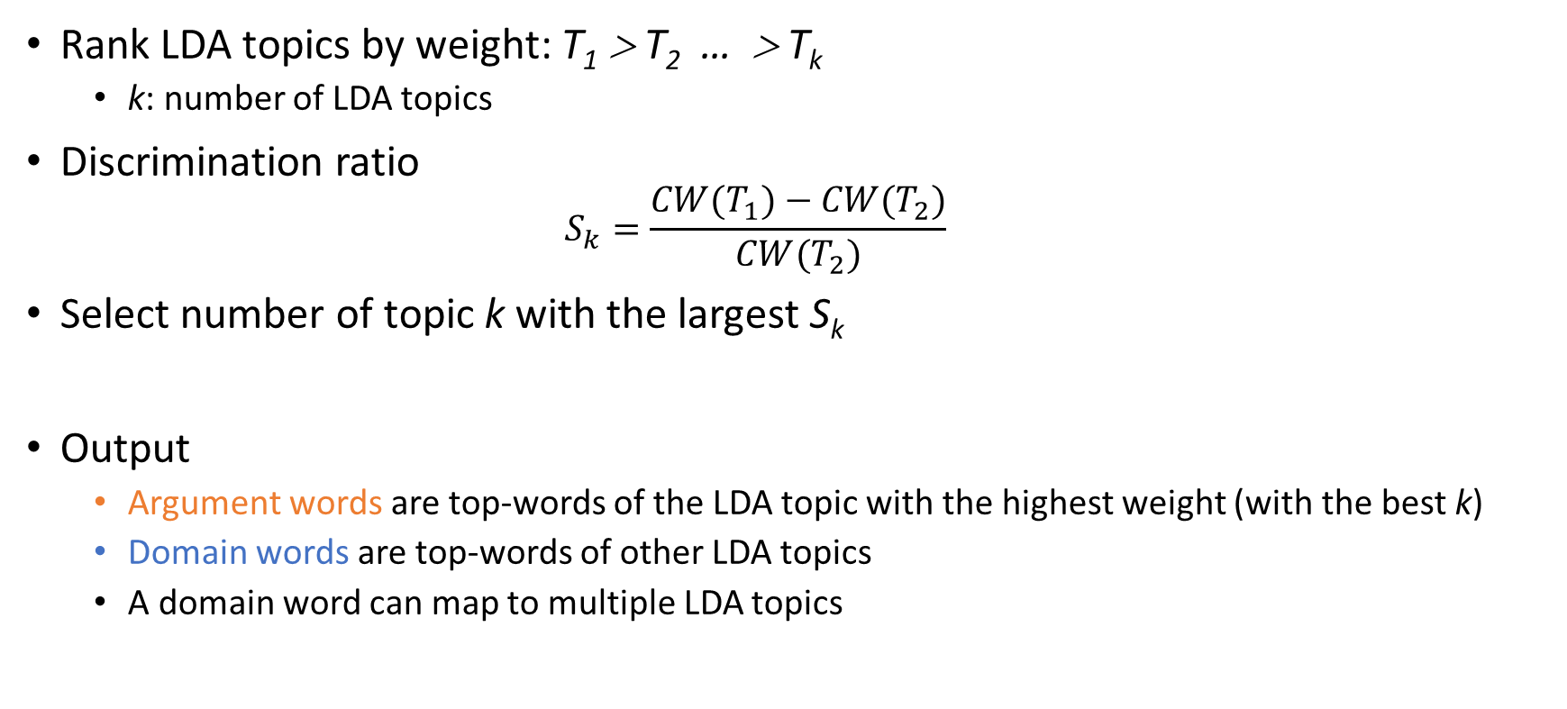
Maximization step
Rank LDA topics by weight: T₁ > T₂ … > T_{k}
  k: number of LDA topics
Discrimination ratio
  $$S_{k}=\frac{CW(T_{1})−CW(T_{2})}{CW(T_{2})}$$
Select number of topic k with the largest S_{k}
Output
  Argument words are top-words of the LDA topic with the highest weight (with the best k)
  Domain words are top-words of other LDA topics
  A domain word can map to multiple LDA topics

Slide 77
Topic groups
Persuasive1 corpus
  Technologies (11 essays), National Issues (10), School (8), Policies (7), and a mixed group of 17 essays of minor topics (each has less than 3 essays), e.g., Prepared Food (2 essays).
Academic corpus
  Attractiveness as a function of clothing color (20 essays), Email-response rate as a function of recipient size (22), Helping-behavior with effects of gender and group size (31), Politeness as a function of gender (23), Self-description and word choices with influences of gender and self-esteem (19).

Slide 78
Example domain word feature
Essay 54: museum and art gallery will disappear soon?
  Source: [more and more people can watch exhibitions through television or internet at home due to modern technology]Premise
  Target: [some people think museums and art galleries will disappear soon]Claim
An argument word pair is people-think
There are 35 pairs of domain words
  A pair of two domain words that share an LDA topic is exhibitions-art
  A pair of two domain words that do not share any LDA topic is internet-galleries

Slide 79
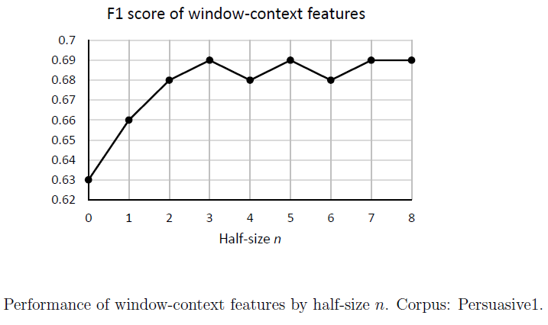
Window-size in Persuasive1 corpus

Slide 80
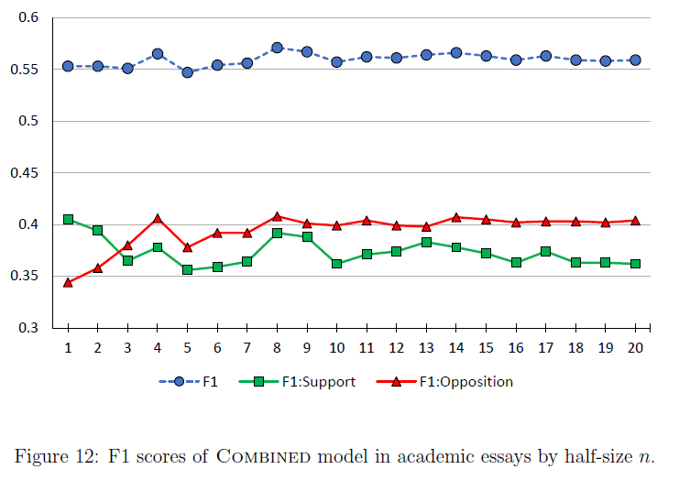
Window-size in Academic corpus

Slide 81
Our proposed base AES model
LENGTH features
  Word count, sentence count, character count
  Average sentence length, average word length
CONTENT features
  Spelling errors, stop words, prompts, vocabulary, commas, punctuations

Slide 82
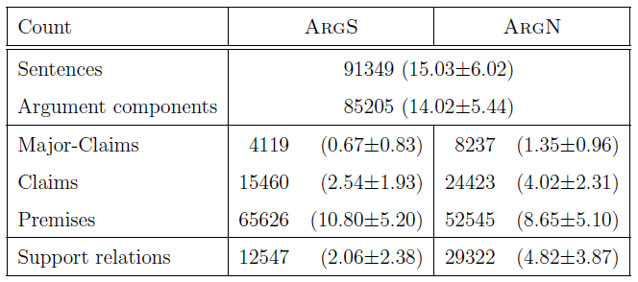
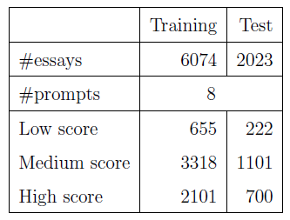
Beigman Klebanov’s data and AM output

Slide 83
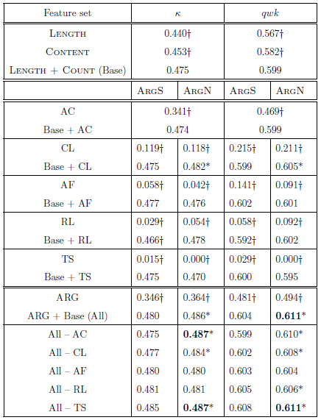
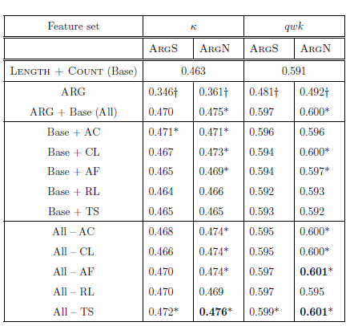
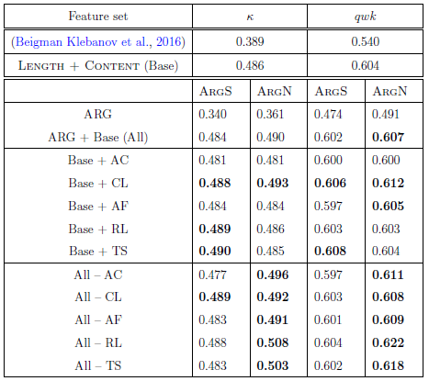
10-fold cross validation
Test performance
Cross-prompt validation

Slide 84


