Slide 1
Advisory Board Meeting for the CourseMIRROR Project
October 26, 2018

Slide 2
Advisory Board Members
Michelene Chi
Arizona State
Clark Chinn
Rutgers
Mitchell Nathan
UW - Madison
Tim Nokes-Malach
Pitt & LRDC
Jingtao Wang
Google

Slide 3
Research Team - Faculty
Muhsin Menekse – School of Engineering Education at Purdue
Diane Litman – Department of Computer Science at Pitt & LRDC
Ala Samarapungavan – Department of Educational Sciences at Purdue
Xiangmin Fan – Institute of Software at Chinese Academy of Sciences
Jingtao Wang – Google (former co-PI)

Slide 4
Research Team – Graduate Students
Saira Anwar, Purdue University
Asefeh Kardgar, Purdue University
Ahmed Ashraf Butt, Purdue University
Wei Guo, University of Pittsburgh
Ahmed Ezzat, University of Pittsburgh
Luca Lugini, University of Pittsburgh

Slide 5
Brief History
  Project started in 2014, with a seed grant from the Learning Research Development Center.
  Initial team included Drs. Menekse, Litman and Wang.
  Xiangmin Fan and Wencan Luo were first graduate students on the project, and now they are our alumni (two doctoral dissertations with the first grant).
  Implemented in 12 classrooms and collected large data of student reflections.
  Published 11 papers so far.
  Datasets were made available for further research.
  More details on www.coursemirror.com

Slide 6
What is the CourseMIRROR project?
  The primary question was “How can we modify the passive nature of lectures and enhance students’ engagement and learning outcomes in large-lectures?”
  We developed a mobile application (called CourseMIRROR) that prompts students to reflect on course content after each class and receive feedback on their reflections.
  In large lecture courses, students' ability to reflect on course content and get feedback on these reflections is limited by class size and instructor availability. At the same time, instructors often don't have access to students' reflections for each class.
  By leveraging Natural Language Processing (NLP) and mobile learning technologies, CourseMIRROR aims to overcome these barriers and help students and instructors gain insights into what was or was not learned.

Slide 7
The Reflection and Feedback (RF) Cycle
S1. “It was confusing to find a proper way for all the functions to work together.”
S2. “I am still a little bit confused with how the function scripts work.”
Reflections help both students and their instructors to engage in diagnosis and identify gaps or difficulties in comprehension of knowledge and skills.
Seeking new information (e.g. identifying supplementary materials).
Deploying targeted study strategies individually or in study groups such as explanation, elaboration, or extra problem solving practice.
Seeking additional tutoring support from the instructor, teaching assistants, or peers.
Instructors can use diagnostic information from reflections to provide feedback that scaffolds strategic learning responses (e.g., providing additional information/learning resources, study guides or practice problems, and targeted tutoring sessions).
Notes:
We hypothesize that the RF cycle can potentially enhance student learning through multiple pathways.
For example, students’ reflections help both students and their instructors to engage in diagnosis and identify gaps or difficulties in comprehension and/or application of knowledge and skills. Following diagnosis, students might independently engage in a variety of strategic responses to improve their learning such as: a) seeking new information (e.g. identifying supplementary materials/resources), b) deploying targeted study strategies individually or in study groups such as explanation, elaboration and integration, or extra problem solving practice, or c) seeking additional tutoring support from the instructor, teaching assistants, or peers.
Simultaneously, instructors can use diagnostic information from student reflections to provide feedback that scaffolds strategic learning responses: e.g., providing additional information/learning resources, study guides or practice problems, and targeted tutoring sessions.

Slide 8
Research Findings
Students were willing to submit reflections in a timely manner.
Students benefitted from the reflection and feedback cycle enabled by CourseMIRROR.
Majority of the students gave positive ratings in terms of usability and effectiveness of CourseMIRROR.
Reflection summaries allowed instructors to understand students’ difficulties efficiently.
Students enjoyed reading summaries of reflections from their classmates.
The reflection quality improved over time.
Analysis of automated and human generated summaries were comparative.

Slide 9
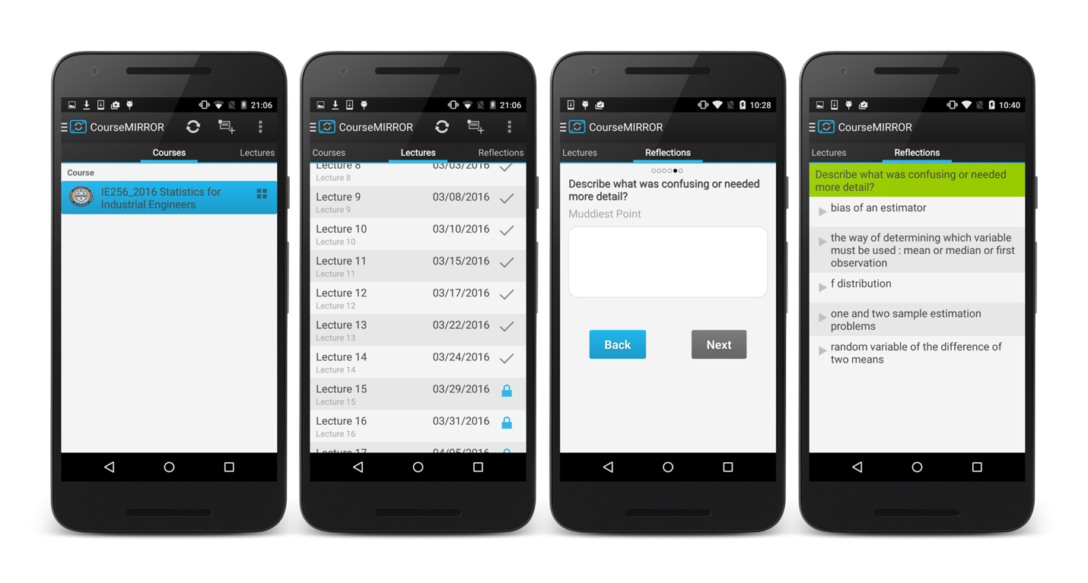
CourseMIRROR - Mobile In-Situ Reflections and Review with Optimized Rubrics
Standard Version
Notes:
Available at Google Play Store and Apple App Store

Slide 10
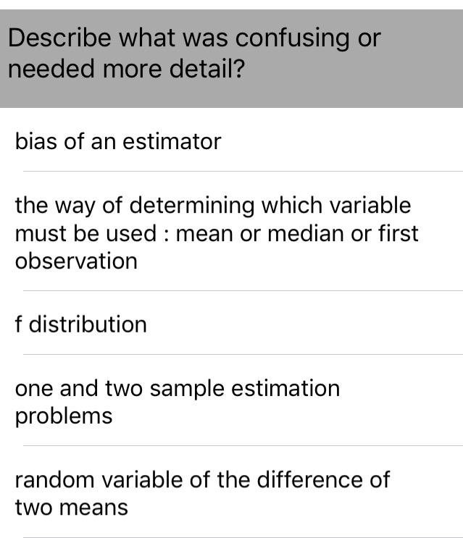
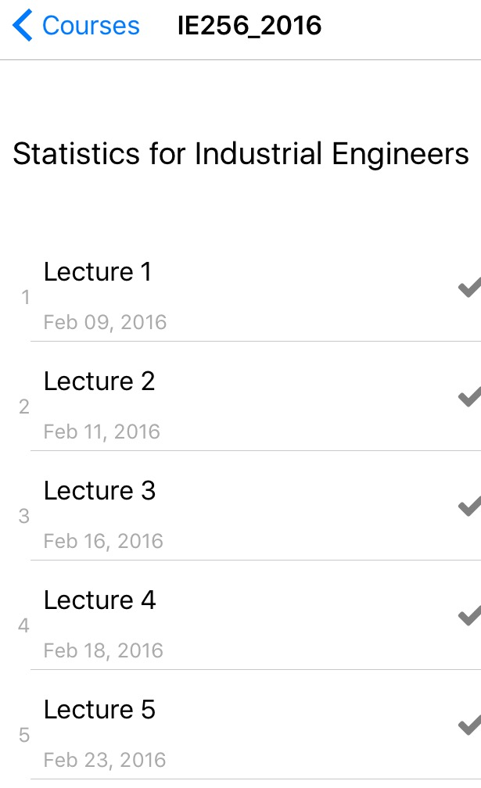
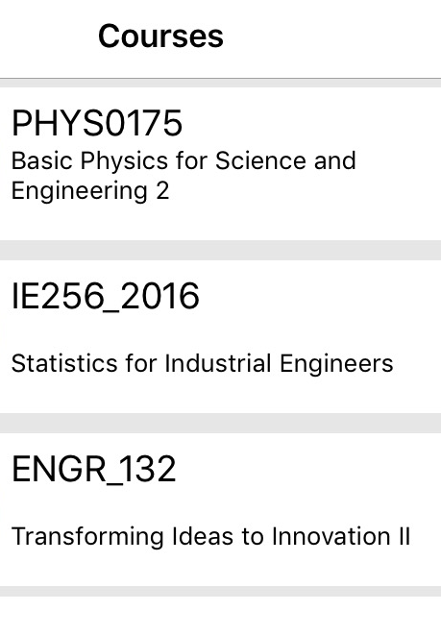
Coursemirror – Standard Version
Describe what you found interesting in the lecture?
Describe what was confusing or needed more details?
Point of Interest
Muddiest Points
Back
Submit
Back
Submit
Primary Interfaces for the standard version of CourseMIRROR, left to right: a) Course list, b) Lecture list, c) Reflection writing page, and d) Reflection summary page.

Slide 11
Questions to Advisory Board
1) What questions do you have about the standard version of the application?
2) What is your opinion about the application, question prompts or the interfaces?
3) What in your view can be done to improve this application?

Slide 12
IES Grant – Development
  Development and Innovation grant for four years.
  We promised IES to develop:
    An improved version of the mobile application (both for Apple iOS and Google Android systems).
    Web tools for instructors.
    Improve the quality of NLP-generated summaries.
    Update the project website.
    Professional development materials.

Slide 13
IES Grant – Research Questions
How can we use NLP to create coherent, accurate, and instructionally useful summaries by using students’ reflections? Can we use NLP to automate the coding of reflection quality? What is the level of agreement between human coders and automated algorithms to create summaries?
How can we design engaging mobile interfaces to collect high quality reflections and improve students’ response rates? What are the ideal web tools and instructor interfaces for instructors to effectively manage and browse the student reflections?
How can we design a mobile learning system to improve students’ reflection and instructor feedback? How does this mobile learning system affect students’ academic outcomes and engagement in introductory level undergraduate STEM courses?
How can we support instructors to provide effective feedback to their students? What are the best strategies to implement the proposed interventions in large-lecture classrooms?

Slide 14
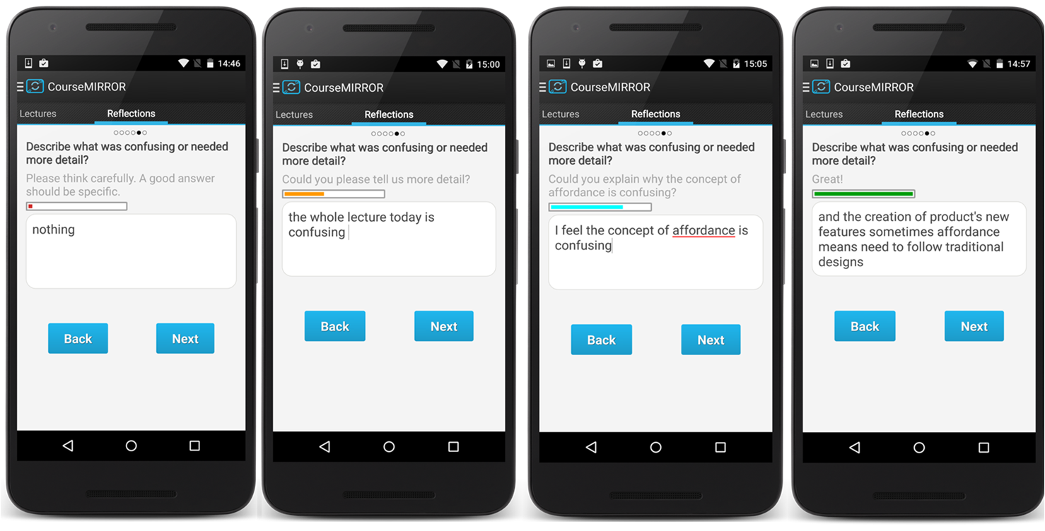
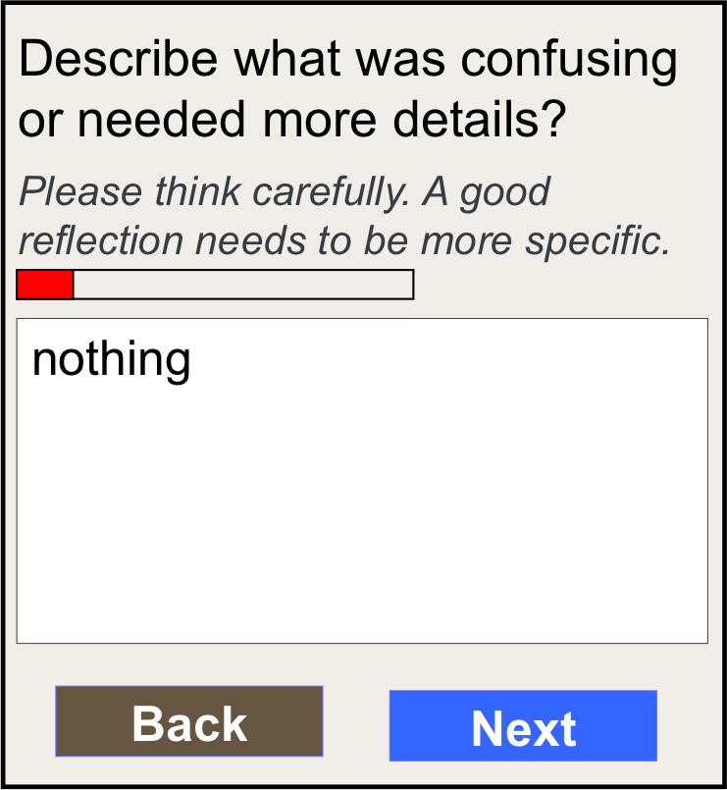
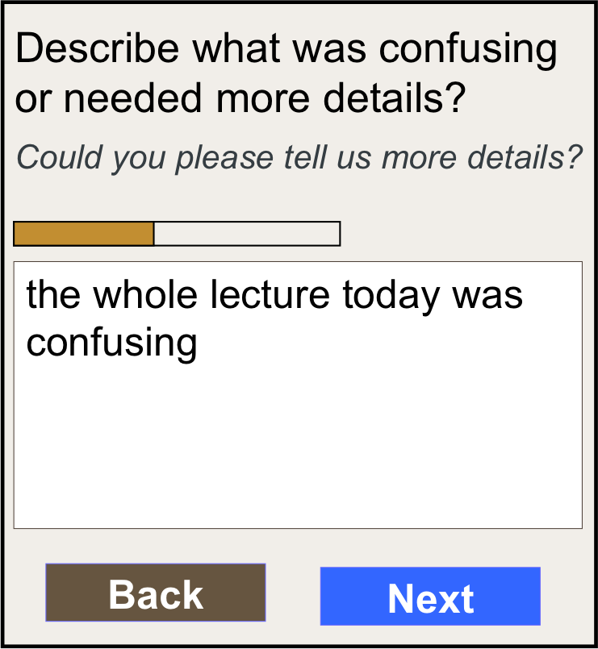
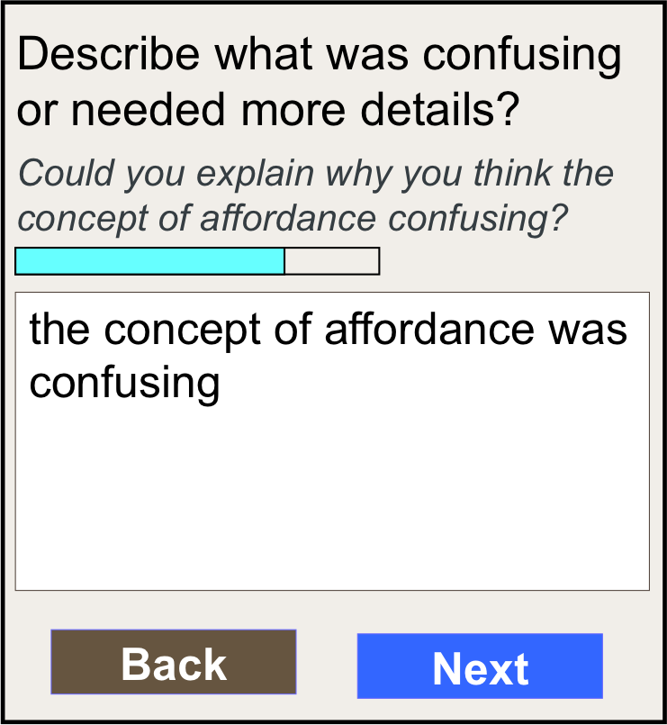
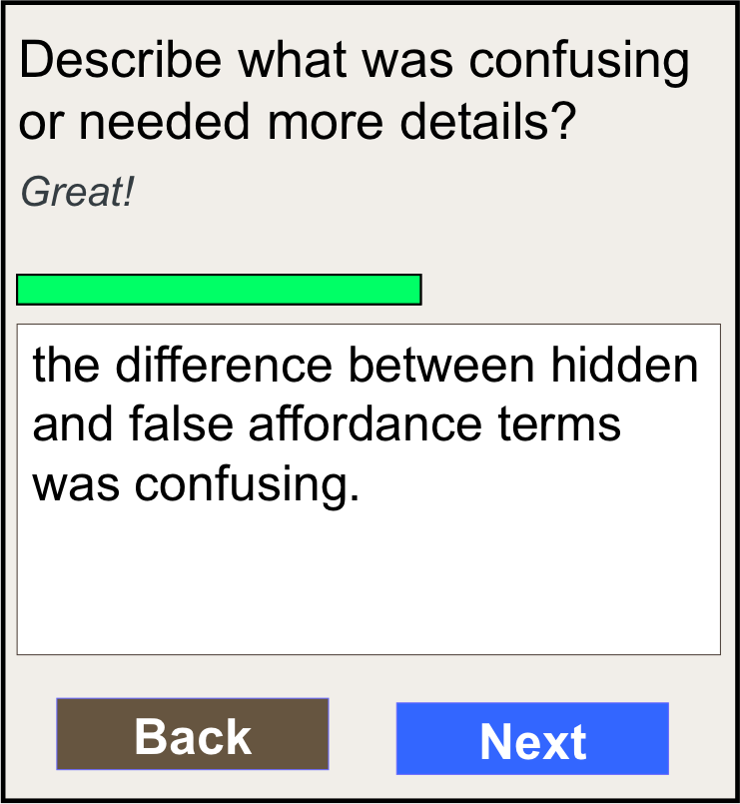
Adaptive Version of CourseMIRROR
Describe what was confusing or needed more details?
Describe what was confusing or needed more details?
Describe what was confusing or needed more details?
Describe what was confusing or needed more details?
Please think carefully. A good reflection needs to be more specific.
Great!
Could you please tell us more details?
Could you explain why you think the concept of affordance confusing?
nothing
the whole lecture today was confusing
the difference between hidden and false affordance terms was confusing.
the concept of affordance was confusing
Back
Back
Next
Back
Next
Back
Next
Next
Adaptive version will monitor the reflection quality in real-time to scaffold the reflection writing process

Slide 15
Questions to Advisory Board
1) What is your suggestion about adding an adaptive feature in the application?
2) What level of scaffolding will be appropriate for students in the adaptive version?

Slide 16
Web Tools and Instructor Interfaces
We will develop web tools and instructor interfaces for faculty to effectively manage and understand the student reflections.
From a functionality perspective, the interface should be able to display a quick and glance-able global overview of reflection and summary information.
There will be three major components for the web tools: (1) course logistics; (2) reflection visualization; and (3) lecture enhancement.

Slide 17
Interviews with Instructors
We are planning to have interviews with at least four instructors before developing web tools.
Topics that will be covered include:
  Understanding faculty background information,
  Introducing CourseMIRROR application and getting feedback,
  Getting their suggestions for features in Instructor web tool,
  Suggestions about improving the application features to facilitate the web tool.

Slide 18
Interviews with Instructors
We are planning to ask questions such as:
“Along with summaries, what other information you may like to get from student’s reflection?”
Some examples:
  Word count. Does the reflection getting shorter or longer?
  The percentage of submission for each lecture?
  The number of submission change over the time?
  Any analysis (such as descriptive)?
  Interfaces (pictorial, tables or forms)?
  Something else?

Slide 19
Questions to Advisory Board
What else can we ask to instructors?
What other information is valuable to get from instructors before developing an instructor web tool?

Slide 20
Guidelines for Instructors
We will create administrative guidelines and suggestions for instructors on the effective use of CourseMIRROR.
We will be developing guidelines regarding how instructors can effectively utilize the reflection summaries to provide feedback to students.
These guidelines will also be part of the design principles for the instructor web tools.
They will include instructional strategies and specific examples.

Slide 21
IES Grant – Research (Small-Scale Studies)
  Small- scale lab studies:
Project team will conduct multiple small-scale usability and feasibility study with students. Students will be asked to think aloud as they try out improved mobile tools and to provide us with real time feedback on their experiences with the tools.

Slide 22
IES Grant – Research (Classroom Studies)
  By year 2, we will start collecting data from classrooms.
  Physics classes at the University of Pittsburgh and Math classes at the Ivy Tech Community College.
  In year 2, we will collect baseline data, with no interventions (i.e., business as usual instruction).

Slide 23
IES Grant – Research (Classroom Studies)
  We are planning to collect students’ data on learning outcomes and motivational constructs.
  Data for learning outcomes as exam scores, course grades, and standardized conceptual tests.
  Data for motivational constructs as achievement goals (AGQ-R) and self-regulation (MSLQ).
  Classroom observations to understand the level of classroom interactions and the activities used by the instructors.
  Interviews with instructors.

Slide 24
Questions to Advisory Board
  Any suggestions for surveys/measures or observation protocols?
  Any existing interview protocol that we can use?

Slide 25
IES Grant – Research (Classroom Studies)
  By year 3, we will implement pilot studies.
  Students will be asked to use CourseMIRROR application and instructors will be asked to utilize/integrate student reflections into their teaching.
  Instructors will receive the first Professional Development on how to use CourseMIRROR and web tools effectively prior to implementation.

Slide 26
IES Grant – Research (Classroom Studies)
  Similar to baseline data collection, we will collect:
  Learning outcomes as exam scores, course grades, and standardized conceptual tests.
  Data for motivational constructs as achievement goals (AGQ-R) and self-regulation (MSLQ).
  Classroom observations to understand the level of classroom interactions and the activities used by the instructors.
  Interviews with instructors.
  And student reflections.

Slide 27
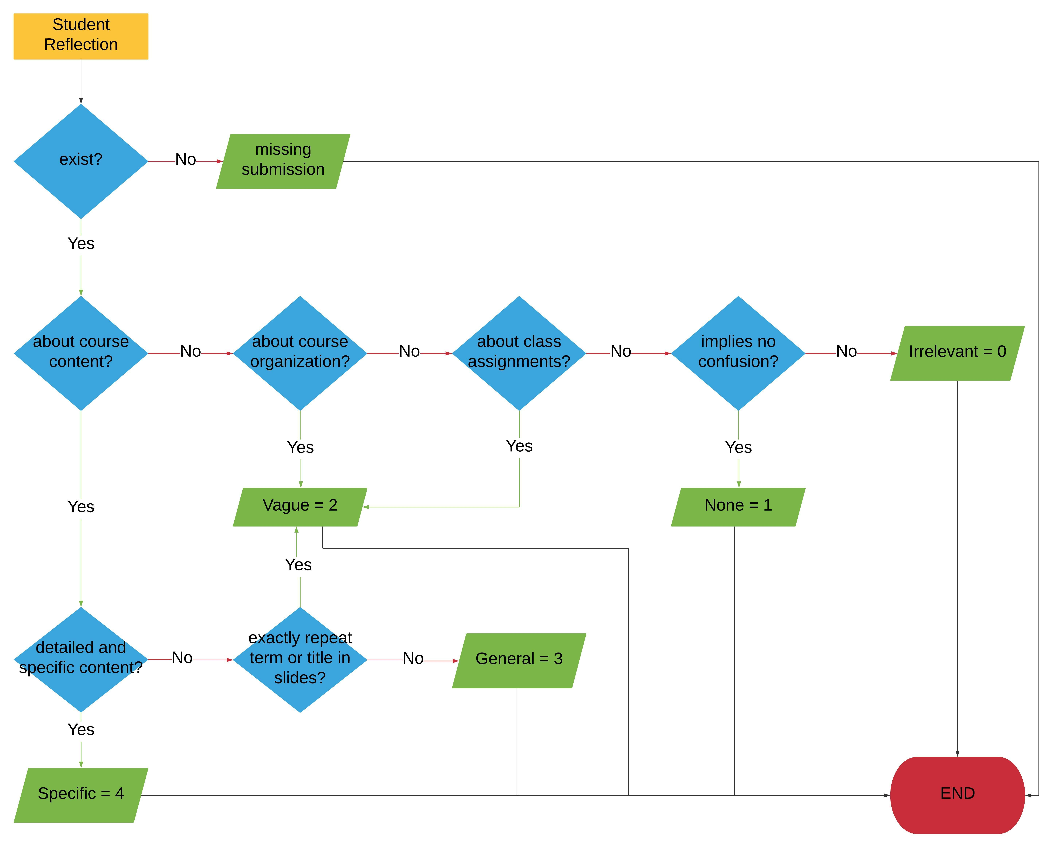
Evaluating the Reflection Quality

Slide 28
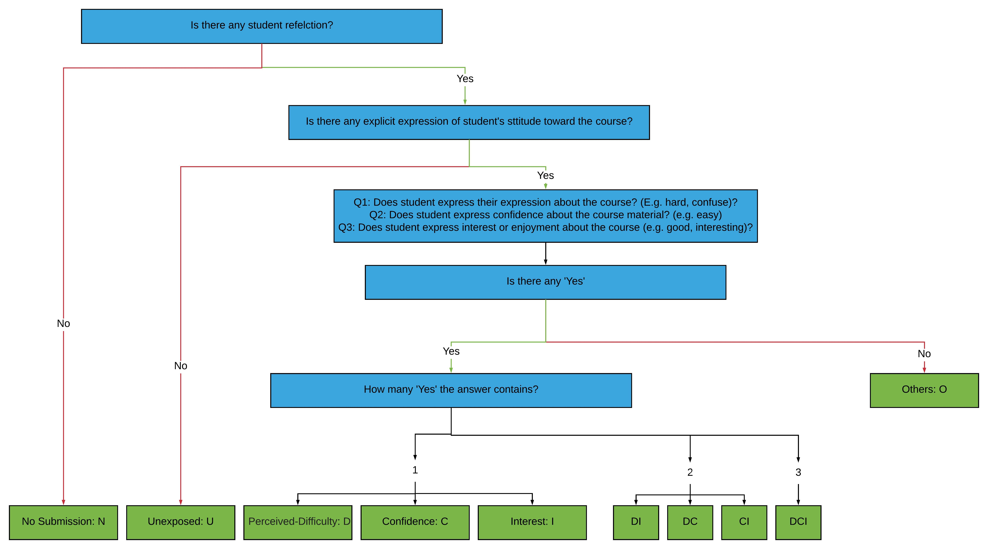
Evaluating the Attitudes from Reflections

Slide 29
Questions to Advisory Board
In what other ways that we can evaluate the student reflections?
Is there any additional literature that you can recommend related to student reflections?

Slide 30
Thank You!
Any other questions, suggestions, or feedback.

