Slide 1
Computing Research and Education
at The University of Pittsburgh
Econ
Social
sciences.
Pub.
Health.
Physics
Math
Bio.
Medical
school.
Eng.
Chem.
School of Information Science
Department of
Computer Science
(Arts & Sciences)
Department of Electrical and Computer Engineering
(School of Engineering)
Department of Biomedical Informatics
Department of Computational Biology
The School of Business
The Pittsburgh Supercomputing Center

Slide 2
Inter-disciplinary programs
Intelligent Systems Program (G)
Scientific Computing Program (UG)
DBMI, SIS, Psychology, …
Telecommunication Program (G)
Math.
Department of
Computer Science
Computational Modeling and Simulation (G)
SIS
Biology
ECE
Bioinformatics Program (UG)
Computer Engineering Program (G+UG)
Med. School
+ CMU
Computational Biology Program (G)

Slide 3
Department of Computer Science
Algorithms
Graphics
Data Management
Artificial Intelligence
21 T/S faculty
(now 19)
+ 4 Lecturers
Networks
Security
Architecture and Compilers
Distributed and Parallel Systems
Real-Time Systems

Slide 4
Artificial Intelligence
Machine learning
Data mining
Natural language processing
Rebecca Hwa
Milos Hauskrecht
Diane Litman
Janyce Wiebe

Slide 5
Data mining and machine leaning
Analysis of high dimensional datasets
Real world data:
high dimensional (thousands of variables)
time series
imperfect (missing data)
Tasks :
(1) Identify important patterns in data
Use them to support a variety of prediction and discovery tasks
Identification of relations/dependencies among variables
(2) Identify unusual patterns in data
  Outlier detection

Slide 6
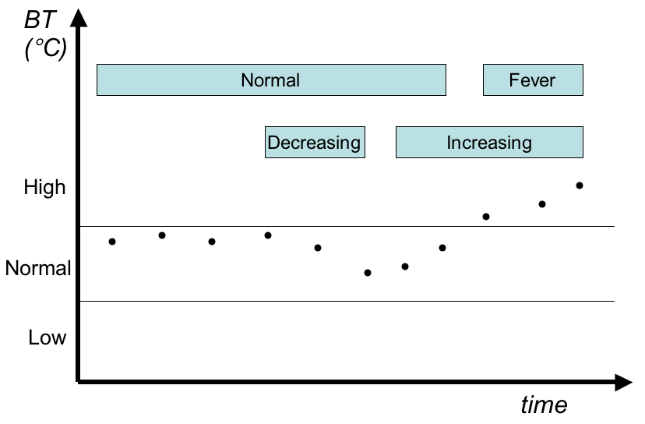
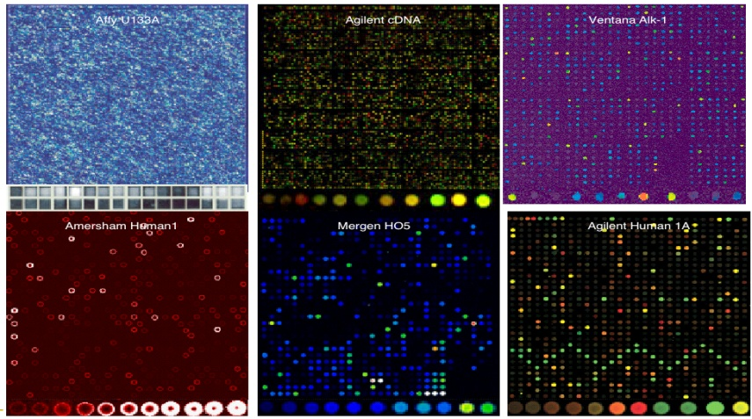
Biomedical and bioinformatics applications
Data:
Clinical data: thousands of labs, measurements in time
Bioinformatics data: DNA and proteomic arrays, Mass spectrometry data, SNP (single nucleotide polymorphism) arrays
Tasks:
Disease detection (e.g. cancer screening)
Predict therapy response
Detection of unusual patterns
Patient-monitoring and alerting
Identification of relations among diseases/variables
Notes:
all pictures were meant to illustrate the datasets we work with and analyze.
The first picture illustrates time series data for one of the clinical variables (I believe it was blood pressure). In my NIH grant we analyze time series for hundreds of clinical variables.
The second picture shows two mass spectrometry proteomic profiles from one of the UPCI's cancer studies. Peaks reflect the content of the proteins/peptides in the specimen, in our case mostly blood or serum.
The third picture is a visualization of DNA microarray data for different microarray technologies. The third picture is really illustrative and not from our datasets.

Slide 7
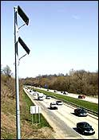
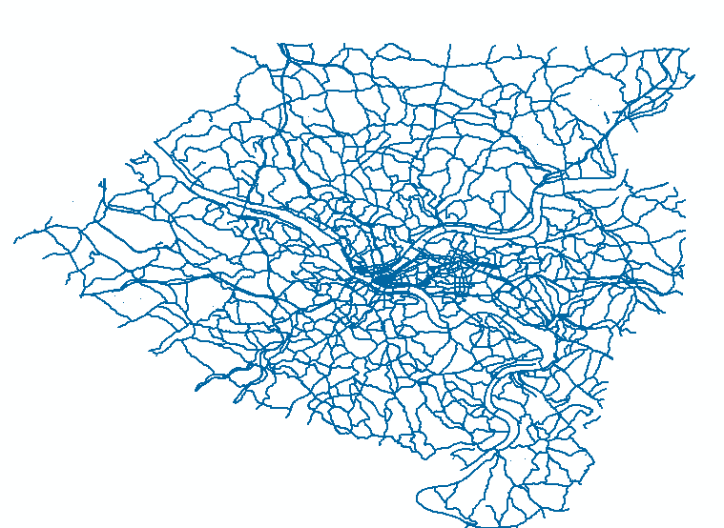
Traffic applications
Data:
Data from sensors placed on highways, roads
Infrastructure data (maps)
Tasks:
Probabilistic models of the traffic system
Traffic prediction
Route optimization

Slide 8
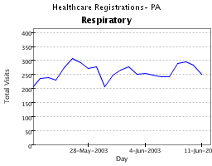
NLP + ML for Monitoring Acute Lower Respiratory Syndrome
NLP and machine leaning
NLP Modules
ALRS
Classifier
Emergency
Department
Reports
Locate
Instances of
55 conditions
Assign
values to contextual
features
Determine values
For 55 conditions
Notes:
This is a collaboration between Rebecca Hwa, Jan Wiebe, and researchers in the Department of Biomedical Informatics in the medical school. The lead PI is Wendy Chapman, an assistant professor in DBMI

Slide 9
Subjectivity Analysis: opinions, emotions, motivations, speculations, sentiments
Natural Language processing
Information Extraction of
  NL expressions
  Components
  Properties
Angolans are terrified of the Marburg virus
Source Attitude Target
Negative Emotion
Intensity: High
Opinion Frame
Source: Angolans
Polarity: negative
Attitude: emotion
Intensity: high
Target: Marburg virus
. . .
Notes:
9
We perform information extraction on what are called subjective expressions, which are expressions of opinions, motivations, emotions, sentiments and so on in natural language.
The start, the system needs to recognize that there is a subjective expression in the first place. Here we have that the angolans are terrified of the marburg virus.
Then, we want to recognize the holder – whose subjectivity it is – here, whose emotion it is.
And, we want to recognize the topic of the subjectivity – here, what the people are afraid of.
This is all represented in a frame-based representation.

Slide 10


Fine-grained Opinions
Australian press has launched a bitter attack on Italy after seeing their beloved Socceroos eliminated on a controversial late penalty. Italian coach Lippi has also been blasted for his comments after the game.
In the opposite camp Lippi is preparing his side for the upcoming game with Ukraine. He hailed 10-man Italy's determination to beat Australia and said the penalty was rightly given.
Opinion Frame
Source: Australian Press
Polarity: negative
Attitude: sentiment
Intensity: high
Target: Italy
. . .
Socceroos
Australian Press
penalty
Italy
Marcello Lippi
Notes:
10
[Perhaps delete this slide; might be too much]
Here is an extended example, which shows two perspectives on an issue.
[Read it.]
Here, we see negative opinions of the Australian press against Italy; a negative attitude toward the late penalty;
Skipping to the end, the coach has a positive opinion toward the penalty (it was rightly given)
So, the idea is for all of the individual expressions of opinions to be identified...

Slide 11
Extraction and Summarization of Opinions
Provide technology that can aid analysts in their
  extracting socio-behavioral information from text
  monitoring public health awareness, knowledge and speculations about disease outbreaks, …
Enrich Information Extraction, Question Answering, and Visualization tools
Notes:
11
An earlier movie you saw is about CERATOPS’ work on extracting events from text. In this phase of our work, we go further and extract opinions, and then summarize them for use in text processing applications.

Slide 12
Spoken Dialog Systems
Natural Language processing
Systems that interact with users via speech
Provide automated telephone or microphone access to a back-end
Advantages: naturalness, efficiency, eyes and hands free
Speech
Recognition
user
Spoken Dialog
System
DB, web,
system
TTS or
recording
TTS= text-to-Speech
Notes:
So what is a SDS? At a very high level we can think of it as a system that provides spoken, natural language access to a backend database. Typically this is through a telephone though it could as well be through a microphone attached to your PC. So at the front end of such a system is an ASR or automatic speech recognition system through which the system listens to the user and a text-to-speech or TTS component through which the system speaks to the user. At the backend is a database; and in the middle sits the component that determines how the system responds to the user – that we can think of as a dialogue strategy or dialogue policy or manager. This is the component we are interested in.

Slide 13
Intelligent Tutoring Systems
Education
  Classroom instruction [most frequent form]
  Human (one-on-one) tutoring [most effective form]
Computer tutors – Intelligent Tutoring Systems
  Not as good as human tutors
  Ways to address the performance gap
    (Spoken) dialog systems
    Affective (dialog) systems (exploit user’s emotion – affection)
    Respond to both what a user says, and how it is said
Evaluation and Automatic System Optimization
  How can we tell if we are improving a system?
  Can systems be tested with simulated rather than real users?
  Can a system learn to optimize behavior based on prior data?
Notes:
Education methods
Improve understanding not only of what student says but also how he says it

Slide 14
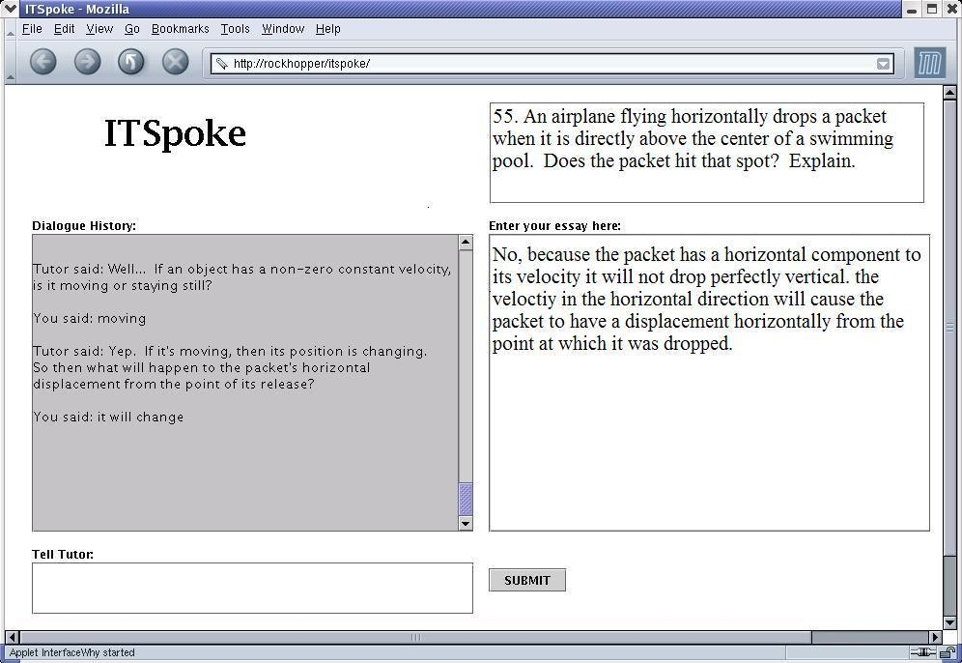
Intersection of two fields
  Spoken Dialog Systems
  Intelligent Tutoring Systems

Slide 15

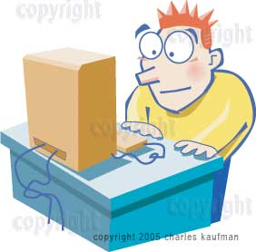
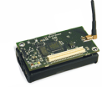

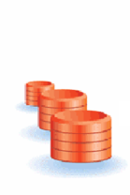
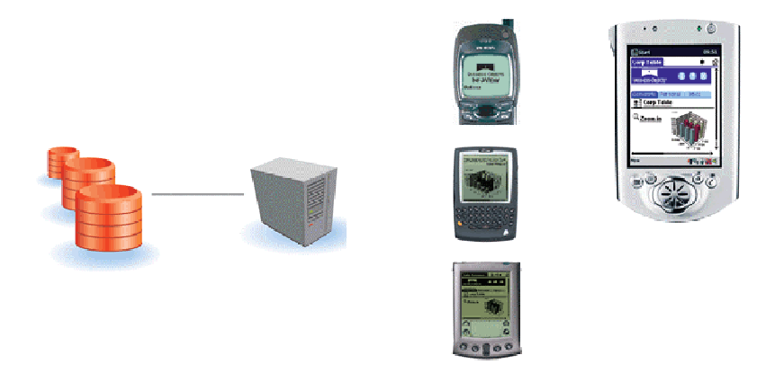

Data Management
Mobile data management
Web and real-time data management
Stream data management
Scientific data management
Panos Chrysanthis
Alex Labrinidis
Data Acquisition
Web Data Management
Data Flow
Data Stream Processing
Data Dissemination

Slide 16
Mobile data management (sensor databases)
Energy-efficiency in-network aggregation
for continuous (monitoring) queries
Hierarchical output filters that reduce energy consumption while
bounding loss in aggregate data quality
Support views that maintain in-network Top-k Views
Cross-layer optimization for collision-avoidance
Multi-criteria routing for sensor networks to prolong lifetime and improve quality of data
  Self-adapting data routing to meet user specified QoS and QoD requirements based on machine learning
Efficient data acquisition with mobile sensors
    Data acquisition is scheduled at perimeter sensors and storage at core nodes as spatiotemporal aggregates

Slide 17
Energy-efficiency in-network storage and processing
of queries in ad-hoc networks
Load balancing of storage and query hot-spots in Data-Centric Storage schemes
  Zone sharing, data replication and dynamic restructuring the reading to sensor mappings
Similarity-aware query processing in sensor networks with data centric storage
  Utilizing recent query materializations in the form of sensor views

Slide 18
Data stream management systems
Alerting/Monitoring Service
  Register query (filter) ahead of time
  “Match” against incoming data stream
  Generate “events” & notify users
Examples:
  Stock market monitoring
  Transient alerts (LSST)
  Google alerts
  Detection of outbreak of diseases
Objective: Policies for scheduling the execution of multiple continuous queries and load shedding which improve the freshness and performance of a DSMS (response time, processing rate, fairness)
Solution Characteristics :
  Efficient implementation
  Scheduling join operators
  Exploits shared operators

Slide 19

User centric web data management
4:26 AM ET
Given an option, would you prefer slightly-stale results fast OR fresh results, slightly delayed?
Users care about Timeliness and Staleness
Combining performance metrics
  Set constraint on one and optimize the other
  Construct a single metric based on weights
Scheduling policies (FIFO, update high, query high) do not optimize both metrics
Proposed Contracts Framework converts performance on individual metric into “worth” to users combining
  quality of service and
  quality of data
FIFO-UH
[11591,0]
FIFO
[322,0.07]
Response Time (ms)
FIFO-QH
[23,0.26]
S
t
a
l
e
n
e
s
s
(
#
u
u
)

Slide 20
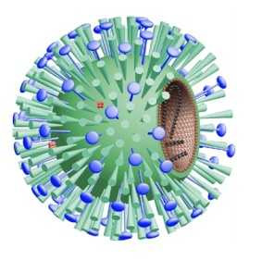
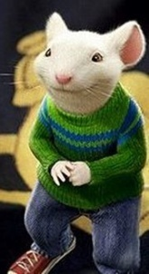
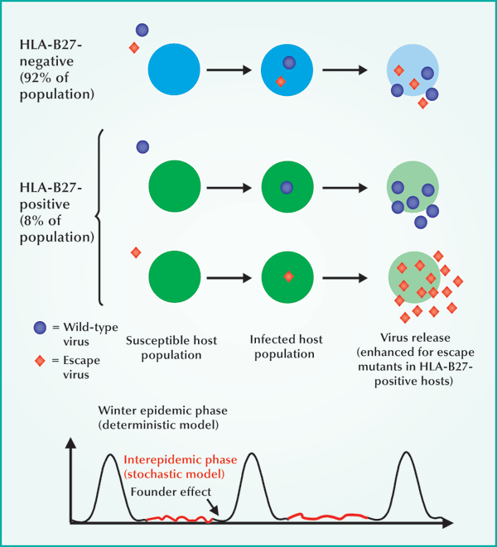
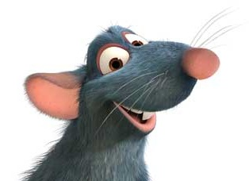
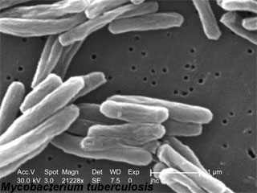
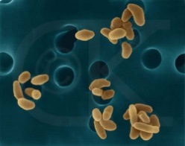

Biological data management
Center for Modeling Pulmonary Immunity
+
=
NIH-funded (2005 - 2009)
Builds mathematical models and a data exchange server to
  Record all experimental information
  Enable sharing & interoperability across centers
  Presents a User-Centric View-Based Annotation Framework for Data
  Allow continuous Scientific Workflows

Slide 21
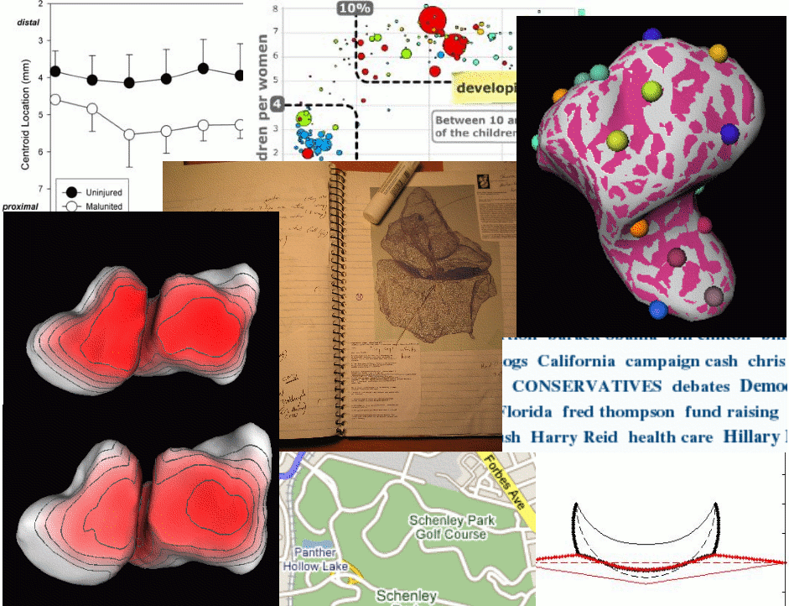
Modeling, visualization
And
Computer Graphics
Visual mining
Exploratory visualization
Physically-based modeling
Interactive tools
Elisabeta Marai

Slide 22
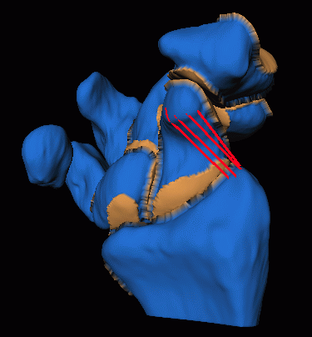
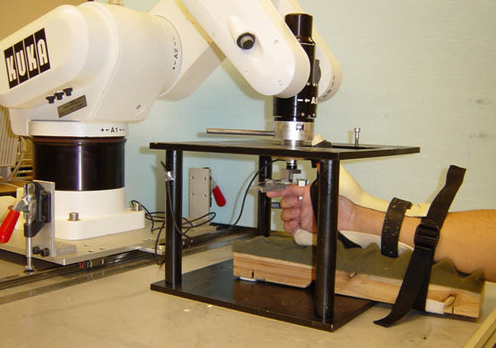

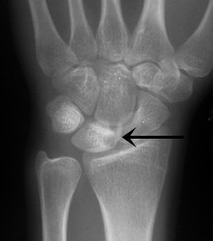
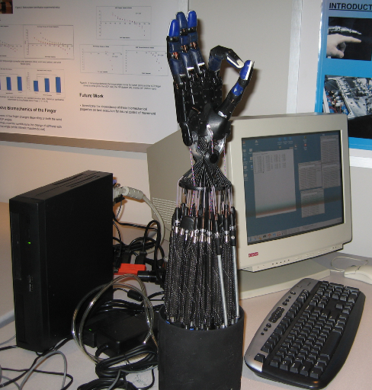
Image Processing, Modeling & Simulation of Biological Structures
w/ UPMC Orthopedics
Medical measurements (images, motion, forces etc)
Incomplete data (half of parameters not measurable)
Uncertainty associated w/ input data
Multiple sources of data (e.g., literature reports)
Predictive models and simulations
Notes:
22
For example, in collaboration with the dept of Orthopaedics in the Pitt School of Medicine, the Visualization lab pioneers new image processing, and graphics-based modeling and simulation techniques to enable the construction of predictive models of anatomical structures from incomplete data. Such data include medical measurements (most of them uncertain and incomplete), literature reports, expert knowledge etc.

Slide 23
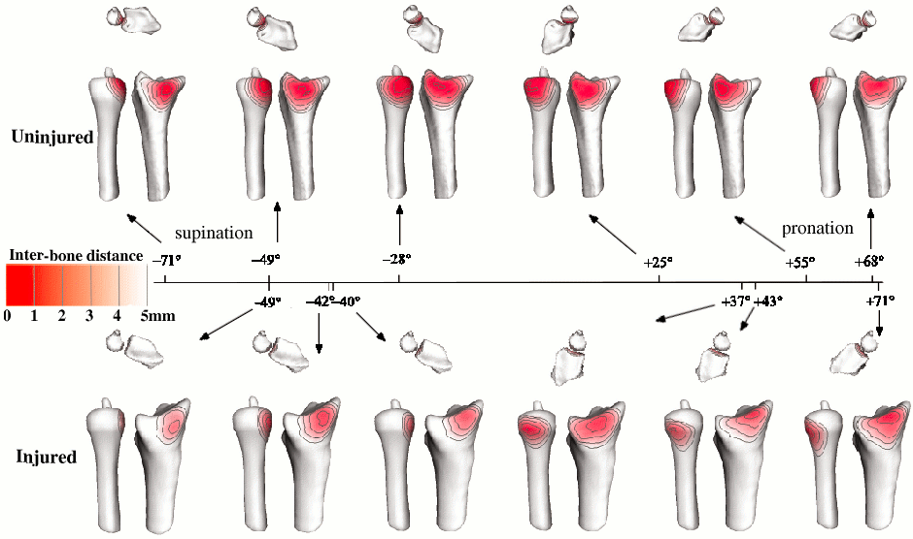
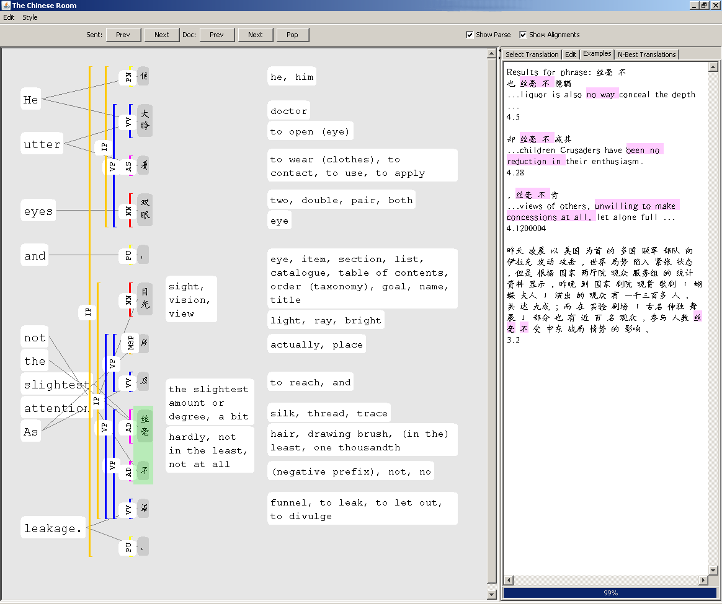
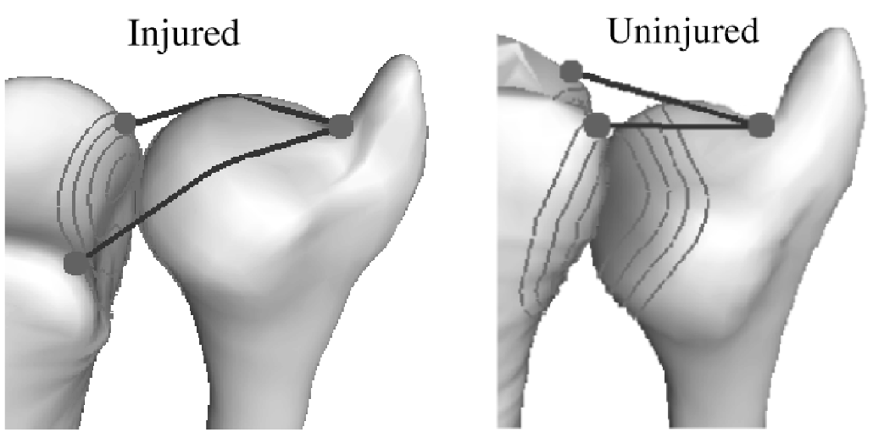
Exploratory Visualization and Analysis
Biomedical anomaly detection (exploratory visualization)
Collaborative analysis of defective machine translations
23
Notes:
23
In a different research direction, the lab develops new techniques to blend modeling, visualization, and analysis of scientific and abstract data into a seamless loop. The approach assists scientists in the exploration of data, helping them detect anomalies and interesting patterns. On the left, an example of anomaly detection from biomedical data.
On the right is shown a snapshot of The Chinese Room, a visualization interface developed by the lab for decoding and correcting poor
machine translations. The application helps machine translation researchers develop better machine translation systems.

Slide 24
Computer Networks
Network Protocols
Wireless Networks
Security
Power Management
Adam Lee
Rami Melhem
Daniel Mosse
Taieb Znati

Slide 25






Determination of access rights
Security and Trust: Adam Lee
Ex: Disaster response, supply chain management, p2p, grid computing, the Web…
Trust management systems seek to address this problem
  Declarative access control policies
  Cryptographic credentials
  Runtime proof construction techniques to make authorization decisions
Current research:
  Flexible access control and usable policy management
  Decentralized knowledge management in adversarial environments
✔
Policy
+
=
Notes:
Briefly state advantages (intensional policies rather than long ACLs, formal proofs, iterative, etc)

Slide 26

Flexible proof-based authorization
OK!
NO!
≠
Project 1: Approximate proofs and risk-based analysis
Project 2: Subjective metrics
Notes:
Project 1: Human decision making involves belief revision based on judgment calls. Investigating ways to automate this process while minimizing organizational risk. Goal is to develop a decision-theoretic semantics for access control and flexible proof construction techniques to approximate this “gold standard”
Project 2: Integrating vertical trust metrics (digital credentials, etc) with horizontal trust metrics (reputation, interaction history, etc). Many interesting query optimization problems to address.
NSF proposals submitted on both of these topics

Slide 27




Management of distributed knowledge in adversarial settings?
Theory
Common knowledge?
Distributed knowledge?
Proof system
features
What is provable?
Practice
Application
requirements
Protocols, algorithms,
and cryptography
Applications: information flow in hospitals, sensor as logical db, pervasive, social networks and gossip, etc…
Notes:
Interested in theory and practice of distributed knowledge management w.r.t. access control decision making in adversarial settings.
Applications: information flow in hospitals, sensor as logical db, pervasive, social networks and gossip, etc…

Slide 28

Secure Critical Information Infrastructure
A system that provides a lot of information to the Emergency Managers, who actually coordinate emergency responses
Need to be secure, otherwise cannot be used widely
It is critical since once it it will be depended upon
EMs, utility companies, everyone must collaborate.
System does data gathering, and provides suggestions to Emergency Managers
System does NOT act by itself, unless there is no one at helm
Collaboration with GSPIA
Notes:
28
`

Slide 29
Computer Architecture and Compilers
Chip design
Memory and Cache Systems
Interconnections
Power management
Donald Chiarulli
Bruce Childers
Sangyeun Cho
Rami Melhem
Youtao Zhang

Slide 30
Low Power Terabyte Main Memory using
Phase Change Memory
Innovative Memory Technology
Problem: Increased main memory demand
  New apps w/CMPs need terabyte+
  DRAM: High power consumption, problematic organization, reliability (SEUs)
Solution: Replace DRAM with PCM
  No idle power (solid state), eases organization, no SEUs
  Slower (3x), asymmetric read/write latency, wears out quickly
  Performance management, write minimization, wear leveling

Slide 31
Yield & Reliability Enhancement for
On-Chip Multicore Memories in Nano-scale Technology
On-chip Memory
Problem: Increase in defects & process variation for CMPs
  Worst-case design: infeasible due to tighter margins
  On-processor memory components: highly susceptible
Solution: “Soft yield” trades performance for better chip yield
  Test & plan for repairs during manufacturing
  Deployment adapts microarchitecture to gracefully degrade
  Collaborator: Sangyeun
T-CAR: Test and Continuous Adaptive Repair

Slide 32
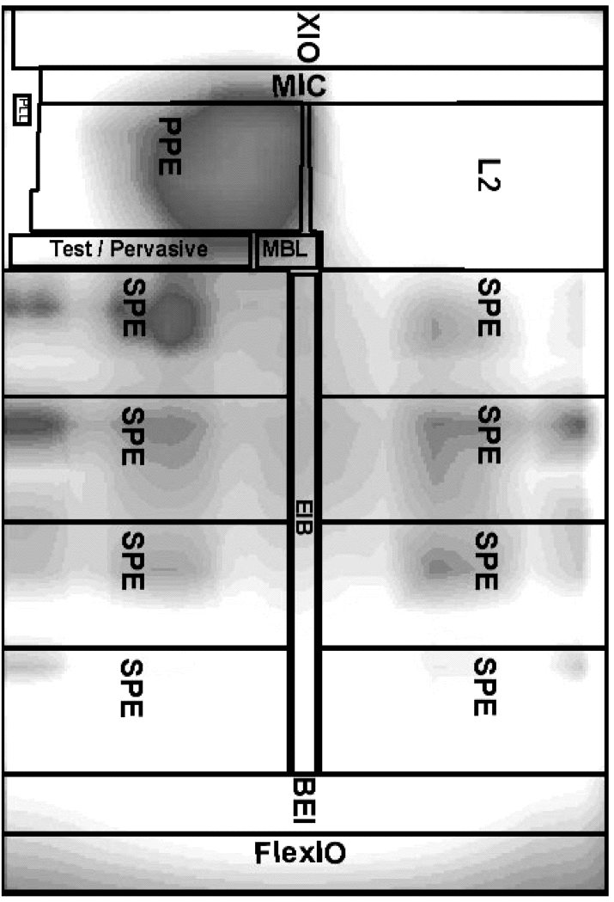
Robust Execution Environment for Multicore Systems
Managing Multicores
Problem: Increasing on-chip run-time variability in CMPs
Solution: React and adapt to the variability as it happens
  Thermal hotspots, power consumption, wear-out/failure
  Dynamic thread compilation, specialization, & scheduling
  Collaborators: Kandemir & Irwin (PSU), Davidson & Soffa (UVA)
Thermal map of Cell
Possible adaptations
Continuous adaptation
Graphs courtesy of Mahmut Kandemir

Slide 33
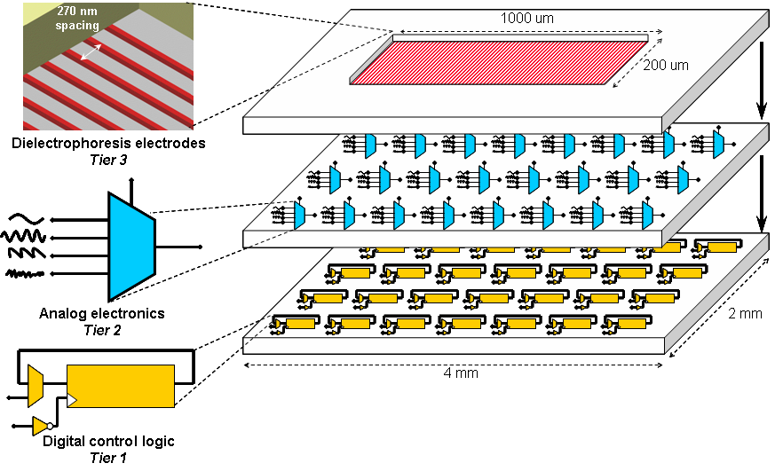
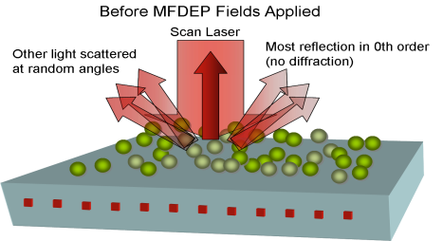
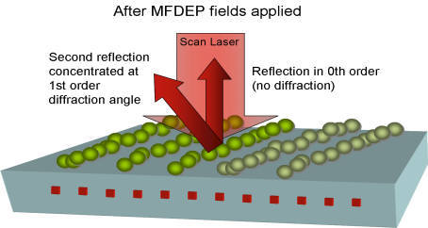
3D Lab-on-Chip for Separation, Purification, and Assay of Nanoscale Bio-Particles in Mixtures
Donald. Chiarulli, Computer Science, Steve Levitan. ECE,
Fred Homa, School of Medicine
A revolutionary design that supports direct separation, isolation and population measurements of specific cell types, viruses and biological macromolecules
Overview
We exploit the fact that the polysilicon layer is very close to the top surface of the device to create very large and dense electrode arrays for Multiple Frequency Dielectrophoresis (MFDEP) This is only possible by using the upside-down configuration of tier 1 chip in the MIT-LL 3D process.
MFDEP is a new technique that allows selective manipulation of specific biological particles in mixtures. Each particle experiences a different force magnitude and/or direction based on the field frequency in the region and the electrical properties of the particle.
In 3D integration technology we can build electrode arrays in the polysilicon of tier one, just 600nm from the MFDEP chamber. These electrode arrays are 10-20X smaller and denser, and 100-1000X larger than the closest comparable lab-on-chip technology.
Outcome: Much higher sensitivity, large mixture fractionation, and low power, in a tightly integrated implementation.
System Architecture
Tier 1:
Dense electrode array in poly
Micro-fluidic trench in overglass
Tier 2:
Analog Switch array
Individually addresses each electrode with externally driven or internal synthetic waveform
Tier 3:
Digital control logic
Supports complex spatial and temporal waveform sequences
Optical Detection and Assay Technology
This is the only device capable of non-destructive detection and assay of bio-particles smaller than the diffraction limit of visible microscopy.
Features Enabled by 3D integration Technology
Ultra sensitive MFDEP.
  70 nanoSiemens/Hz.conductivity difference
Lower Device Operating Power
  High electrode density = lower fieldvoltages
Multiple fractions
  Large array for complex mixture fractionation
Detection and Assay Capable:
  Detection and assay with low cost (CD-type) micro-optical readout

Slide 34
Real-time systems
Scheduling
Fault-tolerance
Real-time Control
High performance computing
Discrete event simulations
Grid based simulations
Particle-particle simulations
Load-balancing
Automatic parallelization
34
Notes:
34

