Slide 1
Leveraging Automated Essay Scoring and Feedback to Improve Students’
Response-to-Text Writing
Elaine Wang, RAND
Diane Litman, Department of Computer Science
Richard Correnti, Learning Sciences and Policy
Lindsay Clare Matsumura, Learning Sciences and Policy
University of Pittsburgh, Learning Research and Development Center (LRDC)
Education and Labor Brown Bag
February 19, 2019
Notes:
(Elaine)
Thanks for being here. As you can see, the title of the presentation is _____. This is part of a study funded by IES. I was a part of the project as a grad student at the University of Pittsburgh, and have continued to contribute to it.

Slide 2
Full Project Team
PIs (University of Pittsburgh, Learning Research and Development Center)
  Diane Litman, Computer Science & Intelligent Systems
  Richard (Rip) Correnti, Learning Sciences & Policy
  Lindsay Clare Matsumura, Learning Sciences & Policy
Subcontractor
  Elaine Wang, RAND
Graduate Students (University of Pittsburgh)
  Emily Howe, Learning Sciences & Policy
  Ahmed Magooda, Computer Science
  Rafael Quintana, Learning Sciences & Policy
  Zahra Rahimi, Intelligent Systems
  Colin Zhang, Computer Science
Study Coordinator
  Lisa Correnti, Learning Research and Development Center
Notes:
(Elaine)
This is the full project team. My co-presenters today are _____ , the PIs from Pitt.

Slide 3
Outline of Presentation
Motivation for present research
Response-Text-Assessment (RTA)
Our prior work: Automated essay scoring (AES) of RTA
Our current work: eRevise: Automated feedback system for RTA
Notes:
(Elaine)
The project spans three areas of interest: 1) writing instruction and development; 2) educational assessment and measurement; and 3) education technology, specifically using natural language processing and machine learning in service of improving instruction and learning.
Because I think this is the first exposure for most of you to this strand of work, the presentation is more of a high-level overview of this project, touching lightly on each of these areas.
What that looks like today is we’ll take you through the arc of our project:
our motivation for it
the development of the Response to Text Assessment (RTA)
our work on automating the scoring of the RTA
and then our current work on the automated feedback system.
If there’s substantive interest in a particular part of our work, I’d be happy to volunteer for future Brown Bag to go more in depth.

Slide 4
Studying response-to-text writing instruction at-scale and supporting students’ acquisition of this skill requires development of new tools
Recent ambitious reform in literacy standards (e.g., CCSS, 2010) emphasize having students support claims with appropriate text evidence, but students struggle with this, and teachers struggle to teach the skill
Research on practices that support development of these skills is necessary
However, lack of quality assessments to assess students’ text-based writing skills is a barrier to conducting such research
Furthermore, a reliable and valid method for scoring such assessments at-scale is needed
Features of the automated essay scoring (AES) system can be leveraged into formative feedback system to inform teachers’ instruction and students’ response-to-text writing improvement
Notes:
(Elaine)
So what’s motivating the line of research we’ve embarked on?
Recent ambitious reform in literacy standards (e.g., CCSS, 2010) emphasize having students support claims with appropriate text evidence, but students struggle with these skills, likely because literacy and writing instruction has not traditionally focused on writing in response to text
Research on practices that support development of these skills and that inform students’ developmental trajectory is necessary; they may guide development of instructional policies
However, lack of quality assessments to assess students’ text-based writing skills is a barrier to conducting such research; at the time, pre-PARCC, students were rarely asked to write in response to text
Furthermore, a method for scoring such assessments at-scale is needed; in contrast to most existing systems, such a system should assess substantive constructs of writing and demonstrate validity, in addition to reliability, of scores
Features of the automated essay scoring (AES) system can be leveraged into formative feedback system to inform teachers’ instruction and students’ response-to-text writing improvement

Slide 5
Response-to-Text Assessment (RTA)
Notes:
(Rip/Lindsay?)
So where this all started was the development of a research tool to enable us/the field to study teachers’ instruction and students proficiency in text-based writing.
We called what we developed the Response-to-Text Assessment (RTA).

Slide 6
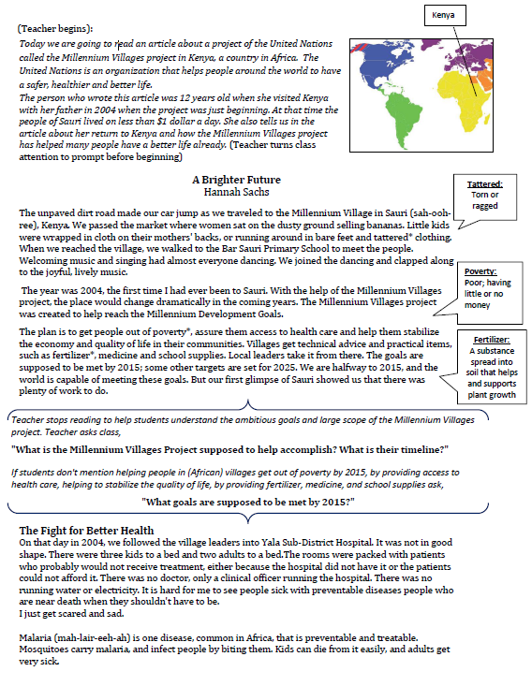
Response-to-Text-Assessment (RTA)
Notes:
(Rip/Lindsay?)
The RTA is a classroom writing task/assessment for 5th-8th grade students
It is based on non-fiction Times for Kids article about Millennium Villages Project (MVP), a UN initiative to help sub-Saharan African countries achieve better quality of life
We actually have another version of the RTA, based on an article about space exploration, that we are also working with, but today we’ll focus on our work with the MVP article.
Assessment administration involves teacher reading the article aloud to students while students follow along in their own copy. Drawing on Questioning the Author technique, teacher pauses to define vocabulary we have identified and to ask comprehension questions we have provided.

Slide 7
RTA Writing Prompt
The author provided one specific example of how the quality of life can be improved by the Millennium Villages Project in Sauri, Kenya. Based on the article, did the author convince you that ”winning the fight against poverty is achievable in our lifetime”? Explain why or why not with 3-4 examples from the text to support your answer.
Correnti, R., Matsumura, L.C., Hamilton, L.S., & Wang, E. (2013). Assessing students' skills at writing in response to texts. Elementary School Journal, 114(2), 142-177.
Notes:
(Rip/Lindsay?)
Then, teachers give students this writing prompt. And they respond on their own.
The whole administration takes about 1 hour. Students should have about 40 minutes to write.
For details about development and administration, see our published articles.

Slide 8
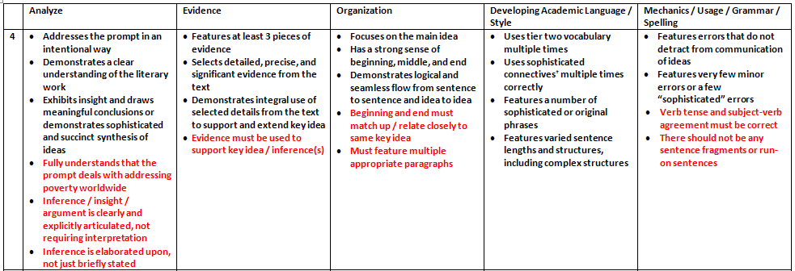
RTA is scored on five dimensions
Notes:
(Rip/Lindsay?)
The RTA is scored along 5 dimensions with 4-point rubric
Here is an excerpt of the rubric, showing the criteria for top scores
As we develop automated essay scoring system, we focused on Evidence Use because…
Importance in CCSS and ELA curriculum
Other AES systems have tended to focus on less substantive dimensions (or holistic scoring)
So for the past years and for the rest of the presentation, we’ll focus on Evidence specifically.

Slide 9
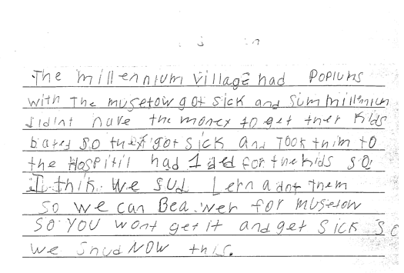
Examples of student responses scoring low (1) on Evidence dimension
Sample 1
Sample 2
Yes, because even though proverty is still going on now it does not mean that it can not be stop. Hannah thinks that proverty will end by 2015 but you never know. The world is going to increase more stores and schools. But if everyone really tries to end proverty I believe it can be done. Maybe starting with recycling and taking shorter showers, but no really short that you don't get clean. Then maybe if we make more money or earn it we can donate it to any charity in the world. Proverty is not on in Africa, it's practiclly every where! Even though Africa got better it didn't end proverty. Maybe they should make a law or something that says and declare that proverty needs to need. There's no specic date when it will end but it will. When it does I am going to be so proud, wheather I'm alive or not.
Notes:
(Rip/Lindsay?)
Just so you have a sense of the student responses and use of evidence, here are examples of two responses that receive a score of 1 on Evidence Use.
Yellow highlight represents reference to the text. So the first sample made some references to the text, though it did not use the text in service of answering the prompt. In the second sample, no text-based evidence was used at all.
---------
The Millenium Village has *problems* with the *mosquitoes* and got sick and some Millenium didn’t have the money to get their kids bed nets so they got sick and took them to the hospital had 1 bed for the kids So I think we should learn about them so we can be aware for *mosquitoes* so you won’t get it and get sick so we *should know* this

Slide 10
Example of student response scoring high (4) on Evidence dimension
I was convinced that winning the fight of poverty is achievable in our lifetime. Many people couldn't afford medicine or bed nets to be treated for malaria. Many children had died from this dieseuse even though it could be treated easily. But now, bed nets are used in every sleeping site. And the medicine is free of charge. Another example is that the farmers' crops are dying because they could not afford the nessacary fertilizer and irrigation. But they are now, making progess. Farmers now have fertilizer and water to give to the crops. Also with seeds and the proper tools. Third, kids in Sauri were not well educated. Many families couldn't afford school. Even at school there was no lunch. Students were exhausted from each day of school. Now, school is free. Children excited to learn now can and they do have midday meals. Finally, Sauri is making great progress. If they keep it up that city will no longer be in poverty. Then the Millennium Village project can move on to help other countries in need.
Notes:
(Rip/Lindsay?)
And here’s a response that scored 4 on Evidence use. There’s quite a number of pieces, and they connect to the students’ claims and argument.

Slide 11
Our Prior Work:
Automated Essay Scoring (AES) of RTA
Notes:
(Elaine)
We have conducted and published several studies on writing instruction using the RTA. Cumulatively, up to that point, about 3500 students in our various studies have completed the RTA. But each piece of student writing was hand-scored by trained raters.
Our first piece of work under the grant was to build a system to automate the scoring of the RTA, specifically focusing on students’ Evidence Use.

Slide 12
Research Questions
What does an AES system used to rate the Evidence dimension of the RTA look like?
What is the reliability of AES scores?
What is the validity of AES scores?
Notes:
(Elaine)
Our research questions are _____.
The resulting AES was a collaboration of experts in computer science and NLP, and experts in teaching and learning and writing research (and developers of the RTA).
Diane will talk a bit about the system…

Slide 13
Our AES system uses Natural Language Processing (NLP) features inspired by the rubric
We developed three substantive NLP features
    NPE (Number of pieces of evidence): Multiple pieces of evidence drawn from different parts of the text
    SPC: (Specificity): Specific details for each piece of evidence are provided
    CON: Concentration: High concentration signals listing of evidence without elaboration/explanation of evidence and receives a low score
The algorithm also considers the following non-substantive feature:
    Word count
Rahimi, Z., Litman, D., Correnti, R., Matsumura, L.C., Wang, E. & Kisa, Z. (2014). Automatic scoring of an analytical response-to-text assessment. In S. Trausan-Matu, S., Boyer, K., Crosby, & M., Panourgia, K. (Eds.). Intelligent Tutoring Systems. Paper presented at the 12th International Conference on Intelligent Tutoring Systems (ITS), Honolulu, HI (601-610). Springer.
Notes:
(Diane – please write text if slide bullets aren’t enough to talk from; just 1 min for this slide)

Slide 14
AES system was developed and tested on two corpora
Corpus 1
  From literacy study in single large urban district in MD
  n = 1,569 responses from 5th and 6th graders
  Human scores by expert (n=702)
  Double-scored by trained undergraduates (n=867)
Corpus 2
  From literacy study in urban districts in CA
  n = 2,000 assessments from 6th, 7th, and 8th graders
    Approximately 800 used to date
  Double-scored by trained undergraduates
Notes:
(Diane – please write/revise text if slide bullets aren’t enough to talk from; just 1 min for this slide)
Explain training process and kappas?
Train – use a supervised machine learning algorithm (here, random forest) to learn a model for predicting an essay's Evidence score based on its NLP features
Test – given a new essay, compute its NLP features and then apply the learned model
QWK – unlike accuracy, controlled for chance; unlike kappa, certain errors are worse than others

Slide 15
AES scores demonstrate reliability with “gold standard” human scores
Our rubric-based models perform as well as (if not better than) other models
  Kappa 0.61-0.62 compared to 0.46-0.61
Rahimi, Z., Litman, D., Correnti, R., Wang, E., & Matsumura, L.C. (2017). Assessing Students' use of evidence and organization in response-to-text writing: Using natural language processing for rubric-based automated scoring. International Journal of Artificial Intelligence in Education, 1-35. DOI 10.1007/s40593-017-0143-2
Notes:
(Diane – please write text focusing on establishing reliability of system. Rip’s slides will focus on validity)

Slide 16
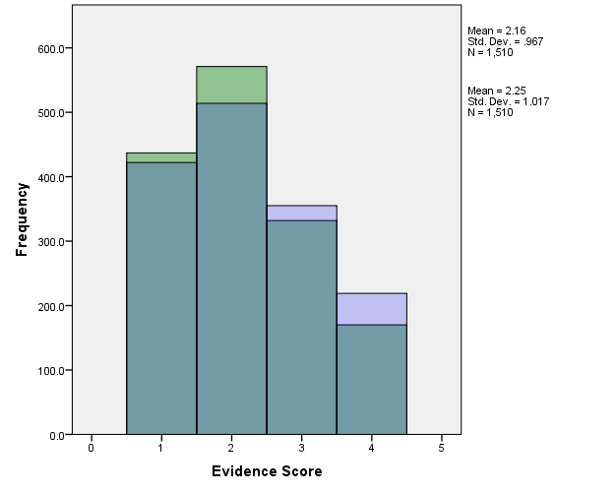
Comparison of the distribution of the AES (light green) and human (light purple)
scores and their overlap (teal) for the 1,529 scored essays.
Notes:
(Diane)
This is just a histogram showing the distribution of the scores, as rated by:
the computer (light green)
as rated by humans (light purple)
And where they overlap (teal)
You can see there is considerable overlap, and therefore reliability, though it looks that humans skew toward higher scores.

Slide 17
Validity of AES scores matter too!
To build a stronger validity argument, we examined relationship of human- and AES-generated ratings with:
measures of student achievement
    Both human scores and AES scores correlate with students’ scores on the state standardized test (including reading and math scale scores)
measures of instructional quality
    AES scores are sensitive to differences in opportunities-to-learn analytic writing (OTL_{wrt}) instruction across classrooms, but not as sensitive to differences in skills-based (i.e., basic) comprehension instruction
Correnti, R., Matsumura, L.C., & Wang, E., Litman, D., Rahimi, Z., & Kisa, Z. (submitted). Automated scoring of students’ use of text evidence in writing.
Correnti, R., Matsumura, L.C., Hamilton, L.S., & Wang, E. (2012). Combining multiple measures of students’ opportunities to develop analytic text-based writing. Educational Assessment, 17(2-3), 132-161.
Notes:
Our hypothesis has been that the development of students’ analytic, text-based writing skills is linked to an opportunity structure consisting of four domains:
1) writing tasks that are of a high cognitive demand,
2) opportunities for students to provide elaborated communication,
3) activities analyzing and synthesizing text in the context of discussing or doing writing (i.e., activities integrating comprehension and writing), and
4) repeated exposure to developing general writing skills (e.g., application of the writing process) as well as repeated exposure writing analytically in response to high cognitive demand tasks
Our operationalization of an OTLwrt measure consists of a factor using multiple methods to collect information about; high-level tasks from collection of response-to-text assignments; analytic comprehension in combination with in-class writing activities aggregated from daily instructional logs (sampling 30-45 days across the year), and time spent in writing from the logs and from an annual survey

Slide 18
Predictive validity of opportunities-to-learn analytic writing (OTL_{wrt}) holds
Table: Effects of OTL Analytic Writing on RTA Evidence Scores (Human versus Computer) in Multivariate Models with Simultaneous Prediction of Reading and Math State Standardized Achievement Scores
 | RTA Evidence Scores
Classroom Covariates⁺ | Human |  |  |  | AES
Intercept, β_{m00} | 0.06 |  | 0.14 |  | -0.01 |  | 0.15
Grade, β_{m01} | -0.02 |  | 0.17 |  | 0.00 |  | 0.19
Masters, β_{m02} | -0.10 |  | 0.13 |  | 0.01 |  | 0.14
PhD, β_{m03} | -0.20 |  | 0.20 |  | -0.13 |  | 0.23
Adv. Prof. Certification, β_{m04} | -0.09 |  | 0.11 |  | -0.18 |  | 0.13
Curric. Coordinator, β_{m05} | 0.22 |  | 0.16 |  | 0.20 |  | 0.19
Class Math Prior Ach., β_{m06} | 0.00 |  | 0.13 |  | 0.03 |  | 0.14
Class Reading Prior Ach., β_{m07} | -0.13 |  | 0.13 |  | -0.09 |  | 0.14
Class Average Absences, β_{m08} | -0.10 |  | 0.07 |  | 0.01 |  | 0.08
Tch. Years Experience, β_{m09} | -0.02 |  | 0.06 |  | -0.06 |  | 0.07
Number of Methods ELA Courses, β_{m010} | 0.05 |  | 0.06 |  | 0.03 |  | 0.07
OTL_{wrt}, β_{m011} | 0.17 | ** | 0.06 |  | 0.21 | *** | 0.07
OTL_{cmp}, β_{m012} | -0.06 |  | 0.06 |  | -0.05 |  | 0.07
Primary inference does not change
Coefficient has a slight increase for AES scores
(.17-.21)
Standard error has slight increase
(.064 → .072)
Pct. Var. Explained Between Classrooms Virtually Unchanged
(33%-34%)
~ p<.10, *p<.05, **p<.01,
⁺ Adjusting for student covariates such as gender, race, free and reduced lunch, age,
number of absences, prior ach. on literary passages, prior ach. on informational passages
Notes:
In the full multivariate models (not shown on this slide) we learned that OTLwrt is uniquely predictive of writing outcomes
i.e., OTLwrt did not predict reading or math achievement on the state standardized test (both outcomes are examined simultaneously with each of the two different types of Evidence-Use Scores; Human and AES
In this table we further show that Evidence-Use Scores - Whether Human or AES – are sensitive to OTLwrt
In addition, OTLwrt is the ONLY classroom covariate that predicts these outcomes
Notably, OTLcomp does not predict Evidence-Use Scores
Because we see such similar findings between human and AES scores (with only subtle differences) we think this is encouraging evidence that either Human or AES scores have the meaning we would want to ascribe to them – i.e., they measure, at the classroom level, the ability of students, in general, to marshal evidence on an on-demand writing prompt in response to text.

Slide 19
What distinguishes our AES system?
Rates young students’ writing
Not holistic; focuses on Evidence dimension
Rubric-based, based on substantive features
Specifically developed for this task – RTA_{mvp}
Demonstrates predictive validity with measures of instructional quality
Notes:
So that was a very quick overview of the AES system we have built.
We do want to point out that our system is unique in a few ways compared to existing AES systems, ones you might imagine being used by ETS, Pearson, etc.
We are scoring young kids’ writing
We are focused on the evidence dimension, do not just give a holistic score
Our features are rubric-based and substantive; it does not just depend on lexical features that are disconnected from the substantive of the writing
For better or worse, our system is developed for a specific text and prompt/task; the algorithm may not be applicable to the next text and prompt, but the specific nature of it, we think, matters because in evaluating writing in response to text, we would want to key to the source text
Finally and importantly, our system not only demonstrates reliability with human score, we have demonstrated predictive validity with measures of instructional quality;

Slide 20
Our Current Work: erevise: Automated Writing Evaluation (AWE) System for RTA
Notes:
(Elaine)
More recently, we turned to thinking about RTA’s potential as a formative assessment that teachers could use in the classroom to support response-to-text writing skills.
There are, in fact, few such assessments, and teachers don’t get kids to write such responses often because of the grading burden. Not just the time to grade, but if you want kids to improve, you’d have to give them feedback and give them opportunity to revise.
So we worked on developing an automated writing evaluation system for the RTA, which we call eRevise.

Slide 21
Research Questions
What does an automated feedback system for students’ text evidence use on the RTA look like?
Can such a system help improve the quality of students’ text evidence use?
Notes:
(Elaine)
So we sought to develop an automated writing evaluation (AWE) system.
Our goals are to increase students’ access to substantive feedback on the dimension of Evidence Use and build students’ knowledge of effective text evidence use. Important to note is that we do not envision teachers using our automated system and therefore not reading their students’ work, but that our system could be a tool that reduces the demands on them – so they could focus their feedback on other aspect of student writing, or so they could provide faster turnaround on students’ work so learning/reteaching could happen in a quicker, more responsive cycle.
Our research questions are _____.

Slide 22
We developed feedback messages informed by theory of effective formative feedback
Puts forth a coherent vision of an effective practice
Feedback is understandable and actionable
Information is specific enough to improve the piece of work
Also generalizable to other contexts/similar tasks
Notes:
(Lindsay)
First, we had to craft the feedback messages student would receive through our system.
We were guided by th theory of effective formative feedback. To be a learning tool, formative assessments must be educative; they must put forth a coherent vision of an effective practice, and the information provided must be understandable and actionable (Shepard, 2005; Stein & Matsumura, 2008). Moreover, the information should be generalizable to other contexts – for example, future writing assignments (Catrambone, 1998; Engle et al., 2012).

Slide 23
We built an automated feedback system on desirable qualities of evidence use corresponding to AES features
 | Quality Dimension | AES Feature
Complete | Each claim is supported with multiple pieces of evidence | Count of number of main topics from the text addressed in student essay (NPE)
Accurate | Evidence is relevant to the claim
Specific | Evidence points to particular incidents or information from the text | Count of the keywords associated with each main topic (SPC)
Explained | The connection between the claim and evidence is explicit and logical | Different topics in close proximity are indicative of student providing evidence in a brief list, without elaboration (CON)
Wang, E., Matsumura, L.C., & Correnti, R., (2018). Student writing accepted as ‘high-quality responses to
analytic text-based writing tasks. The Elementary School Journal, 118(3).
Notes:
(Lindsay)
So, we developed our feedback messages based on the vision of good text evidence use we want to communicate, that is supported by research and professional organizations, like National Council of Teachers of English). Specifically, considering eRevise is intended for younger writers, we define ‘good’ evidence use as complete (multiple examples are provided for each claim), accurate (correctly represents information from text), specific (details are provided), and explained (why each piece of evidence supports a claim is articulated). In a recent paper, we have used the acronym CASE, as in making a case with evidence – to communicate these features to young writers.
Another aspect that we want to highlight is that the features we use in scoring (in our AES) are the same as the ones we use for the AWE system (for selecting feedback).
----------
(NPE) Specifically, we use a simple window-based algorithm with fixed window-size to calculate NPE. A window contains evidence related to a topic if there are at least two words from the list of words for that topic. Each topic is only counted as a piece of evidence once to avoid redundancy.
(SPC): SPC corresponds to the rubric-based feature “Specificity of Evidence.” For each main topic from the source text, our experts identified a comprehensive list of associated key words (i.e., specific text evidence/examples). For each piece of student writing, our AES used this list to identify how many (and which) specific pieces of evidence the essay addressed. Specificity, then, is a vector of integer values. Each value shows the number of examples from the text mentioned in the essay for each topic.
(CON): CON corresponds to the third rubric-based feature. “Elaboration of Evidence”. Concentration is a binary feature. An essay that provides evidence in a list, without elaboration, has high concentration and receives a lower score. To calculate this feature, the AES system counts the number of sentences that have at least one topic word. If there are fewer than three sentences with topic words, the concentration is deemed high
(WOC): Finally, although word count is not rubric-based, we included it as another proxy for the final rubric feature – Elaboration of Evidence – and for capturing students’ using their own language to describe how evidence supports their main idea.

Slide 24
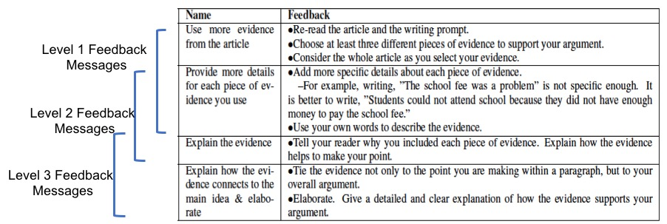
We ended up with four messages/three levels of feedback
Notes:
(Lindsay)
We ended up with four messages, which we grouped into three levels of feedback. So, based on students’ “scores” on various features that the system is looking at, the system select a set of feedback messages to display to students.

Slide 25
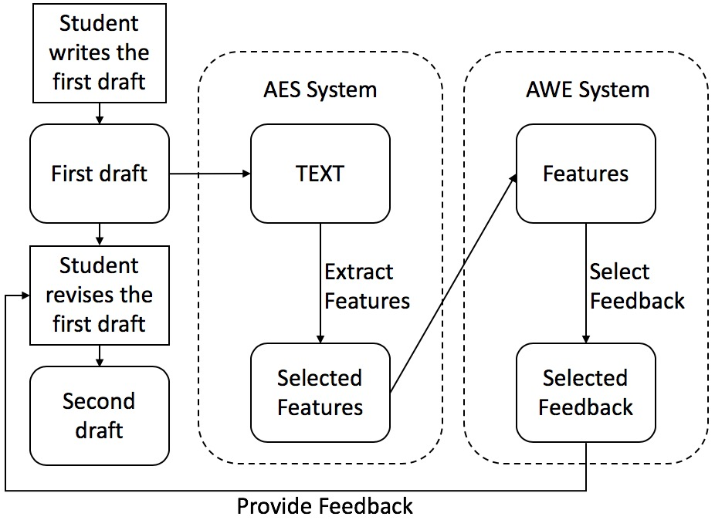
System Usage & Architecture
Zhang, H., Magooda, A., Litman, D, Correnti, R., Wang, E., Matsumura, L. C., Howe, E., & Quintana, R. (2019). eRevise: Using natural language processing to provide formative feedback on students' use of text evidence in writing. In Proceedings Thirty-First Annual Conference on Innovative Applications of Artificial Intelligence. Honolulu, HI.
Notes:
(Diane)
Here’s a diagram of the system architecture (talk about diagram)
--------------------
NPE indicates the breadth of unique topics
SPC (after further processing) indicates the number of unique pieces of evidence
A matrix of these two matches each essay to appropriate feedback

Slide 26
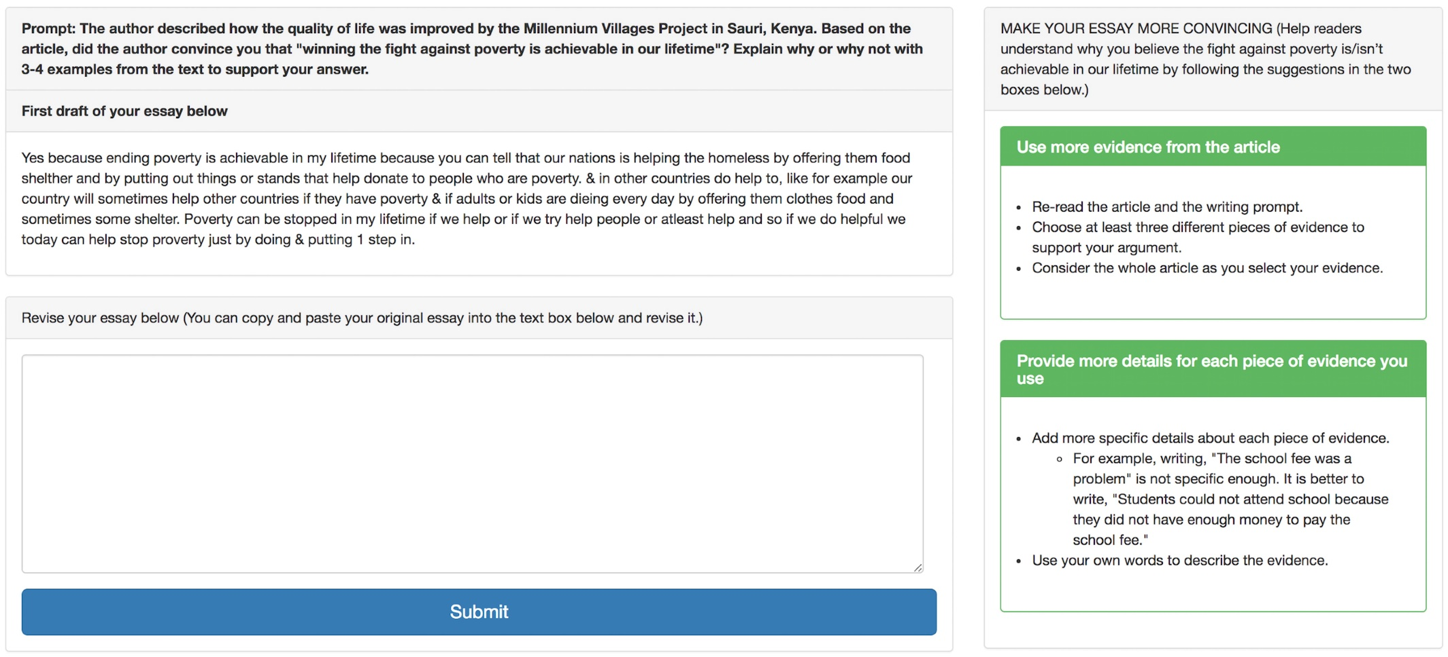
eRevise Student Interface Screenshot
Notes:
(Diane)
We named our system eRevise.
This is what the interface looks like for students
We should note that the students did not receive an AES score. They only received feedback.
The feedback messages themselves and this interface/system were piloted with a teacher and her classes prior to deployment in spring 2018

Slide 27
Spring 2018 Pilot Deployment of eRevise
143 students of seven 5th and 6th grade teachers in two public rural parishes in LA used eRevise
eRevise helped improve students’ text evidence use, as evaluated using RTA rubric (1-4)
  Mean scores improved from first to second draft, from 2.61 to 2.78 (p = 0.001)
eRevise increased the quantity and relevance/specificity of text evidence use, as evaluated using NLP features
  Feature values increased from first to second draft
    NPE: from 2.61 to 2.81 (p ≤ 0.003)
    SPC_TOTAL_MERGED: from 9.65-11.15 (p ≤ 0.001)
Notes:
(Diane – please add text if the bullets aren’t enough; just 1 min. for this slide)
Note there was not a comparison condition, this was not an RCT
Student writing did not improve on the other RTA dimensions (scored by a human)

Slide 28
Most recently, we are doing a deep qualitative analysis of students’ responses to understand their revision behavior and improve eRevise
Early results suggest a majority of students attempted to address the feedback, given via eRevise, but few essays substantively improved
  77% (110/143) of students attempted to address the feedback received
    More students receiving a higher level of feedback attempted to address the feedback they received
  Of the 110 essays that attempted to address feedback…
    42% did not show improvement from first to second draft, in line with the feedback (i.e., did not effectively execute revisions)
    36% showed slight improvement
    22% substantive improvement
Wang, E., Matsumura, L.C., & Correnti, R. (in preparation). eRevise: Automated formative feedback system to improve students’ use of text evidence in writing.
Notes:
(Elaine)
More students receiving a higher level of feedback attempted to address the feedback they received
62% (28/45) of those receiving Level 1 FB
78% (21/27) of those receiving Level 2 FB
86% (61/71) of those receiving Level 3 FB
Of the 110 essays that attempted to address feedback…
42% (46) did not improve (most essays receiving Level 1 or 2 feedback)
36% (40) slightly improved (about half of essays receiving Level 3 feedback)
22% (24) substantively improved (most of these received Level 3 feedback)

Slide 29
A number of factors may account for (lack of) attempt and improvement after revision
Students who attempted to address feedback and students whose essay showed greater improvement seem to…
  Be more motivated writers/have better attitudes toward writing than students who did not
  Understand the feedback they received better
We also explored associations with class-level characteristics
  We detect a potential positive relationship between students’ attempt to address feedback and revision improvement with classes where the teacher requires that students revise and resubmit some essays (in response to teacher’s written feedback)
Notes:
(Elaine)
Be more motivated writers/have better attitudes toward writing than students who did not (on an average of 4 survey items rated on a scale from 1-5)
Understand the feedback they received better (on an average of 2 survey items rated on a scale from 1-4)
We also explored associations with class-level characteristics: revision time, class achievement, teacher’s feedback and revision practices and routines

Slide 30
Students’ attempts to add evidence resulted in several missteps
Misstep | Example
Made small surface-level fixes | This is how the author of this passage convinced me on the question didif the author convinceconvinced me or not that "winning''winning the fight against poverty is achievable in our lifetime".lifetime''.
Added evidence that is not text based | Malaria is a very dangerous disease that can kill anyone who catches it. People who live in Africa are petrified that they are going to get Malaria that they can not even shut their eyes to get a good night's sleep.
Added details that repeat what is already in first draft | Another reason is that the story said that now water is connected to the hospital so now they can have water. Also they have a generator for power so thy can now have light.
Added evidence that does not add to argument (i.e., random details) | Also it says that "It is that "Its hard for me to see people sick with preventable diseases, people who are near death when they shouldn't have to be. “I just get scared and sad."Also, "Little kids were wrapped in cloth on their mothers backs, or running around in bare feet and tattered clothing.
Notes:
(Elaine)

Slide 31
Students’ attempts to explain their use of evidence were ineffective for several reasons
Misstep | Example
Added a 1-2 sentence conclusion that does not connect claim and evidence | In conclusion, it's good that other people want to care about other people and it is wrong to just let them die. The author showed me that the poverty is important in our life.
Added explanation that just repeats or paraphrases evidence | I chose these examples because they show how much progress we have made. These people have done so much against poverty I believe that "winning the fight" against poverty is achievable. All in all, I am convinced that "winning the fight" against poverty is achievable in life.
Added explanation that focuses on choice of evidence instead of content of evidence | “I put this evidence because it is proof from the text that backs up the answer.”
Notes:
(Elaine)
Type 1 – Added to a conclusion, but___
Type 2 – Repeated what was said earlier (evidence cited) – Earlier in first draft had noted that the village had made a lot of progress, this was repeated (and student repeated themselves again in their revision, stating twice that ‘winning the war against poverty is achievable.’
Type 3 – recall that we asked Ss in the feedback message to “explain why they chose the evidence they did.” Some students took this very literally.

Slide 32
Based on qualitative analysis, how can we improve eRevise to promote more effective revisions?
Improve feedback messages
Improve interface
Notes:
(Elaine)
Automated essay scoring systems have long been an object of interest as a way to reduce
the burden and cost of scoring summative assessments of students’ writing performance. eRevise
is attempting to explore the use of technologies for formative purposes to enhance students’
knowledge of a substantive writing construct – use of text evidence. While still in an early stage
of development, eRevise appears to provide formative feedback that students understood and
regarded as a generalizable ‘take-away’ that could be applied to future writing.
While students’ work improved overall, many students did not apply the feedback they
received. This is consonant with other research showing that students often ignore feedback,
even when they understand it, and require instruction around how to use feedback to revise
(Roscoe & McNamara, 2013). This is critical as AWE systems have come under criticism as an
attempt to supplant teachers, thus ignoring the instruction that is necessary during the revision
process as well as features of instructional practice that support students’ motivation to revise.
We emphasize that systems such as eRevise need to be integrated into a whole system for writing
instruction if they are to be useful for improving students’ writing skills.

Slide 33
Extra Slides

Slide 34
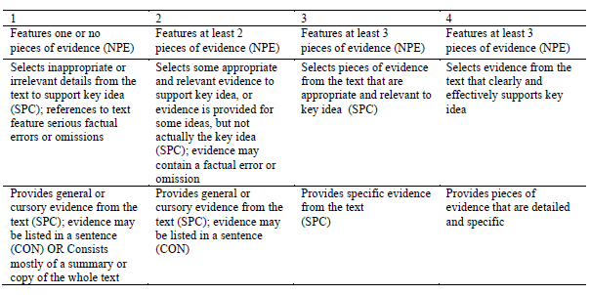
Rubric criteria and features in the AES system correspond
Notes:
(Diane)

Slide 35
Examples of two topics (and Associated Words) used to calculate NPE and SPC
Topic | Topic Words (Used to calculate NPE) | Specific Phrases (Used to calculate SPC)
Hospitals | care, health, hospital, treatment, doctor, electricity, disease, water, sick, medicine, generator, no, die, kid, bed, patient, clinical, officer, running | Yala sub district hospital, no running water electricity not medicine treatment could afford no doctor only clinical officer three kids bed two adults
Schools | school, supplies, fee, student, midday, meal, lunch, supply, book, paper, pencil, energy, free, children, kid, go, attend | kids not attend go school not afford school fees no midday meal lunch schools minimal supplies concentrate not energy
Notes:
(Diane)

Slide 36
Automating extraction of topics
Goal: Reduce the amount of expert effort and improve the scalability of an AES system for Evidence dimension
Results: Scoring performance using automatically extracted data-driven topical components is promising
Rahimi, Z., & Litman, D. (2016). Automatically extracting topical components for a response-to-text writing assessment. Proceedings 11th Workshop on Innovative Use of NLP for Building Educational Applications.

Slide 37
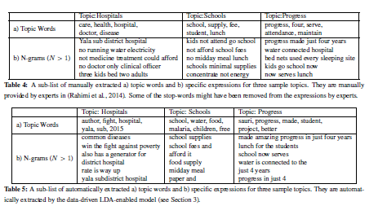

Slide 38
We also developed an alternative approach that is potentially more efficient and reliable
This year we developed a co-attention-based neural network for source-dependent AES
  Increases reliability (not sure about validity)
  Eliminates human source encoding and feature engineering
Zhang, H., & Litman, D. (2018). Co-attention based neural network for source-dependent essay scoring. In Proceedings of the Thirteenth Workshop on Innovative Use of NLP for Building Educational Applications (pp. 399-409).

Slide 39
The system selected feedback messages based on key features to specifications determined by our analysis of student responses
NPE indicates the breadth of unique topics
SPC (after further processing) indicates the number of unique pieces of evidence
A matrix of these two matches each essay to appropriate feedback
Notes:
(Diane)

Slide 40
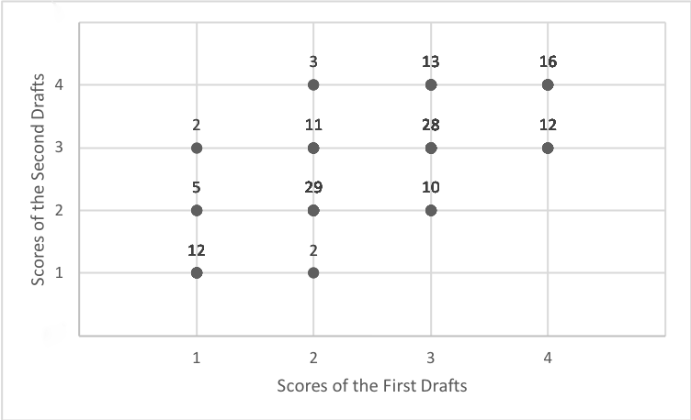
Plot of Evidence Score Change (n=143)
Notes:
(Diane/Rip?)
Note ceiling effects

Slide 41
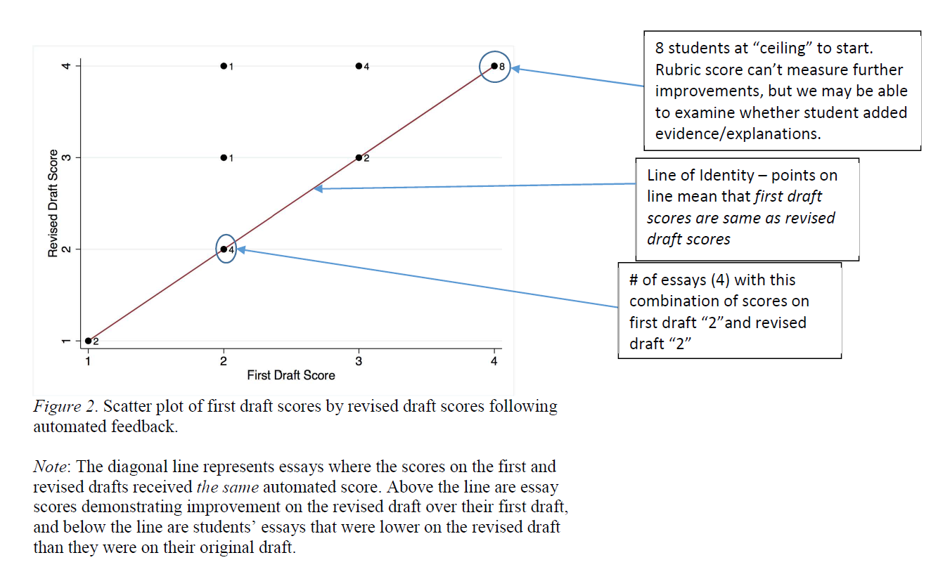
We provided class-level summary results to teachers
Notes:
(Rip)
AES results were not shown to students, but were included in summary reports to teachers

Slide 42
In 2018-2019 and beyond, we are expanding our study and deepening our inquiry along several lines
Studying 50 teachers in Louisiana, whose classes will use eRevise with two versions of RTA
Exploring impact of eRevise on teachers’ beliefs about response-to-text writing, criteria for evaluating student writing, feedback on student writing
    Teacher survey and interview pre- and post-eRevise experience, assigned tasks
Improving eRevise
    Personalizing feedback messages
    Improving interface to support revisions
    Developing materials to guide teachers
Notes:
(Elaine)

