Slide 1
Diane@Bloomberg

Slide 2
Events
Sunday
  Data for Good Exchange 2019
  Bloomberg.com/company/d4gx
Monday
  AI at Bloomberg
  https://www.techatbloomberg.com/?utm_medium=PostEventComm&utm_campaign=Tech&utm_source=Email&utm_content=D4GX&mpam=21377&bbgsum=DG-EM-09-19-M21377

Slide 3
Data for Good Exchange 2019 (6th edition)
  Data Science for the SDGs
    how data scientists, corporations, policy makers and researchers can collaborate on data science projects that will move us toward achieving the UN’s Sustainable Development Goals by 2030
  Participants
    academia, industry, government and NGOs, enabling them to share insights and progress on applying modern machine learning and data science methods to improve civic and social outcomes.
  Agenda
    https://www.bloomberg.com/lp/d4gx/?utm_medium=PostEventComm&utm_campaign=Tech&utm_source=Email&utm_content=D4GX&mpam=21377&bbgsum=DG-EM-09-19-M21377

Slide 4


Slide 5
Tracks
People
  https://www.techatbloomberg.com/blog/data-for-good-exchange-2019-preview-people-track/?utm_medium=EventInvite&utm_campaign=CTO&utm_source=Email&utm_content=201909-D4GX_EVENT&mpam=21377&bbgsum=DG-EM-09-19-M21377
Prosperity and Peace
Planet

Slide 6
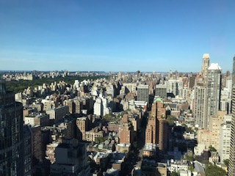
Bloomberg Global Headquarters NYC
High security!
Great views

Slide 7
AI at Bloomberg
Discussions on collaboration between academia and industry, network with professors from academic institutions across the US, and learn more about life at Bloomberg and our own research.
Participants
  Jinho Choi (Emory)
  Smaranda Muresan (Columbia)
  Sarah Ita Levitan (Columbia)
  Allan Ritter (OSU)
  Ani Nenkova (Penn)
  Jessy Li (U of Texas)
  William Wang (UCSB)
  Wei Xue (OSU)
  Yulia Tsvetkov (CMU)
  One or two other faculty, some students

Slide 8
Agenda (NDA)
CTO
Head of Data Science
Philanthropy
AI Overview
Intern Posters (Pitt alum Lingjia Deng)
Technical Talks on Twitter, Sentiment, Dialogue

